Slide 1
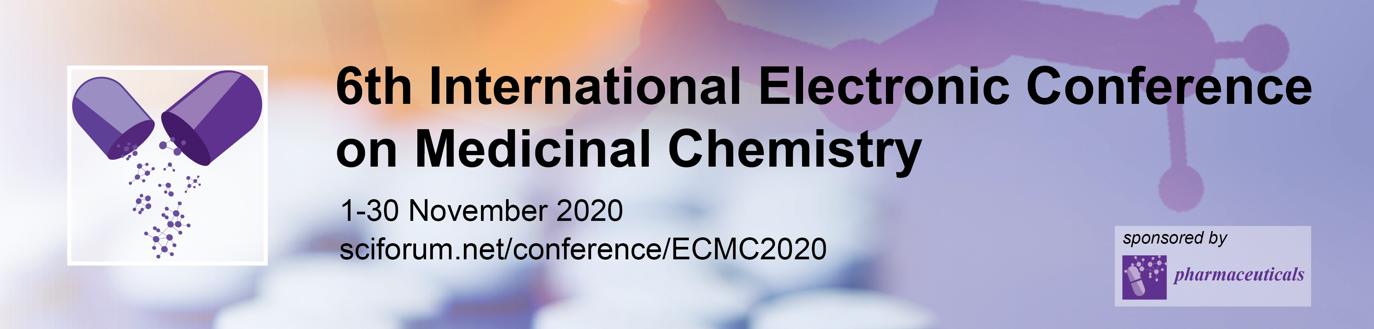
Skin permeability and analgesic activity effects of verbenone hydrazones
Mariia Nesterkina ^{1*}, Sergii Smola ², Iryna Kravchenko ¹
¹Department of Organic and Pharmaceutical Technologies, Odessa National Polytechnic University, Odessa, Ukraine
²A.V. Bogatsky Physico-Chemical Institute, National Academy of Sciences of Ukraine,
Odessa, Ukraine
* Corresponding author: mashaneutron@gmail.com

Slide 2
2
Skin permeability and analgesic activity effects of verbenone hydrazones
Graphical Abstract

Slide 3
3
Abstract: The present study aims to the development and synthesis of novel potential skin permeability enhancers based on derivatives of bicyclic terpenoid – verbenone. For this purpose, a series of hydrazones has been obtained via (‒)-verbenone condensation with hydrazides of para-substituted phenoxyacetic acids. The structure of synthesized compounds was characterized by ¹³C-NMR, ¹H-NMR, FT-IR and mass spectrometry.
The action mechanism of verbenone hydrazones on phospholipids of artificial membranes and lipids isolated from the rat stratum corneum was studied by fluorescence and FT-IR spectroscopy. When applying the fluorescent method, excimer/monomer emission intensity (I_{E}/I_{M}) ratio was calculated by measuring the relative intensities of pyrene excimer and monomer forms at 394 nm and 475 nm, respectively. According to our data, inclusion of verbenone hydrazones in phospholipid liposomes leads to growth of excimer to monomer ratio (I_{E}/I_{M}) indicating a decrease of membrane microviscosity. The disruption of hydrogen-bonded network formed by polar lipid groups was suggested as mechanism of action for verbenone derivatives confirmed by FT-IR analysis.
Given the above, (‒)-verbenone hydrazones was estimated after transdermal delivery as potential analgesic agents via chemical-induced pain models using capsaicin and allyl isothiocyanate (AITC) as algogens. All the tested compounds were found to suppress painful sensation produced by noxious stimuli which indicates TRP receptors as one of the pharmacological targets of verbenone hydrazones.
Keywords: analgesic affect; hydrazones; skin permeability; verbenone

Slide 4
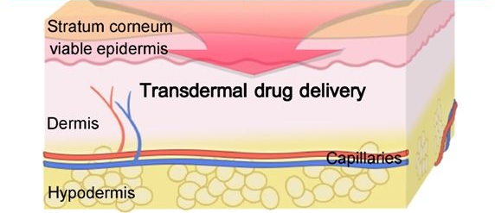
Mechanism and targets of topically applied compounds
4
Chemical enhancers
special attention is attracted to terpenes and their derivatives due to their high efficiency and low skin irritation
Borneol Safranal Thymol Limonene
Menthol Linalool Pinene
Stratum corneum
the outermost layer of the epidermis

Slide 5
Synthesis of verbenone hydrazones
5
Terpenoid
Hydrazide
Pharmacophore group
(-)-Verbenone
Anti-inflammatory
activity under topical application
(-)-Menthone

Slide 6
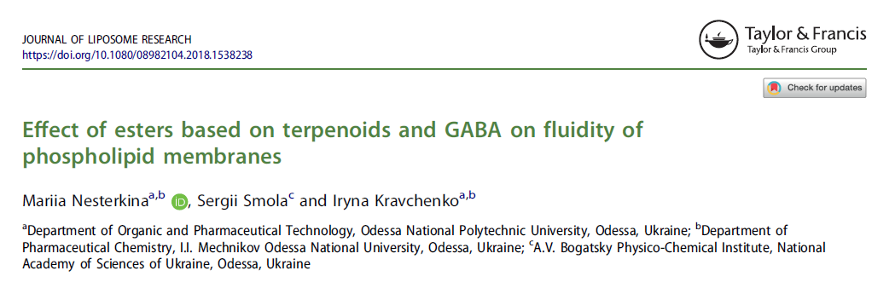
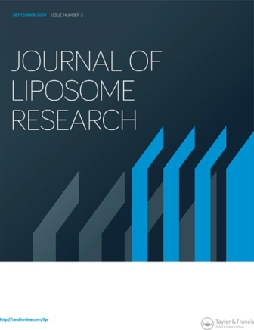
Mechanism and targets of topically applied compounds
6

Slide 7
Stages of the study
7
Synthesis
Fluorescence probe
FT-IR spectroscopy
Pharmacological investigation
R = H, Br, Cl, C(CH₃)₃, O‒C₆H₅
Investigation of analgesic activity
Isolation of lipids from rat stratum corneum
Liposome preparation containing verbenone hydrazones and pyrene

Slide 8
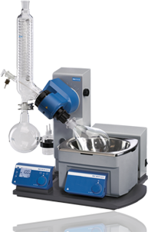
Investigation of hydrazones’ influence on membrane permeability using method of fluorescence probe
8
Chloroform solution of pyrene, verbenone hydrazones and lecithin were mixed in a molar ratio 1:10:100
The solvent was removed by slow evaporation under vacuum at 40 °C
The dried mixture was resuspended in 25 ml deionized water and vigorously stirred for 10 min
The resulting emulsion was then sonicated for 10 min at 22 kHz frequency
Steady-state fluorescence spectra of samples containing pyrene were recorded on a Horiba Jobin-Yvon Fluorog-FL 3-22 spectrophotometer equipped with a 450W Xe lamp
Pyrene
Water
Phospholipids
Verbenone hydrazones
Ultrasound

Slide 9
The influence of verbenone and its hydrazones on membrane
microviscosity and polarity
9
hν_{M} - monomer fluorescence (370-395 mn)
hν_{E} - excimer
fluorescence (470-480 nm)
Without enhancer
Verbenone
Compound 3
Pure phospholipids
with pyrene
(without enhancer)
Verbenone
Compound 3

Slide 10
Isolations of lipids from rat stratum corneum
10
The male Wistar rats (150–180 g) were used for skin preparation
The rats were anesthetized followed by shaving and surgically removing of abdominal and back regions.
SC was separated from the epidermis by incubating in trypsin solution (0.15% in PBS buffer, pH 7.4) during 24 h at 4°C and thereafter 4 h at 37°C. SC was then mechanically separated and carefully washed with a solution of trypsin inhibitor, deionized water and dried.
Stratum corneum

Slide 11
Investigation of hydrazones’ influence on lipids of stratum corneum
using FT-IR spectroscopy
11
Preparation of stratum corneum
The SC was dipped into chloroform: methanol (2:1) solution and kept in the dark for 72 h
Then the extract was washed twice with distilled water and the lower organic layer was evaporated under vacuum below 40 °C
The samples for FT-IR study have been prepared by dissolving the obtained lipids in carbon tetrachloride (CCl₄) with subsequent addition of hydrazones (10% relative to lipids’ mass)
FT-IR spectra were recorded for films
Compound 1
-H -Cl -Br
without enhancer verbenone compound 1
Decrease of influence on lipids

Slide 12
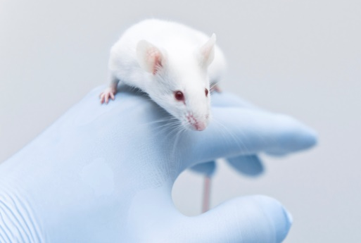
Pharmacological investigation of verbenone hydrazones
12
central nervous system peripheral nervous system
Pharmacological activity
Anticonvulsant
Pentylenetetrazole test
Analgesic
Chemical-induced pain
Thermal-induced pain
Maximal electroshock seizures

Slide 13
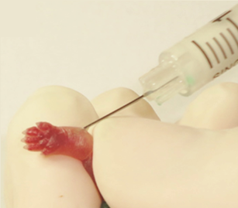
Experimental methods of pain induction
13
Dosage form: 2% ointment Base: PEG – PEO – 1,2-Propyleneglycol
Capsaicin
Allyl isothiocyanate (AITC)
Pain
The animal then was placed in an individual plexiglass cage. The time spent licking the injected paw was measured during 5/10 min after capsaicin/AITC administration and was considered as an indicator of pain response.

Slide 14
Analgesic activity of verbenone hydrazones
14
The most perspective structure
Capsaicin test
R = H, Cl or Br
Reference drug
Allyl isothiocyanate test
Benzocaine

Slide 15
Condensation of verbenone with 4-R-phenoxyacetic acid hydrazides in the presence of a catalytic amount of glacial acetic acid was successfully applied to synthesize the title compounds.
In this study, the interaction of verbenone hydrazones with artificial membranes and lipids isolated from rat SC was investigated with fluorescence and FT-IR spectroscopy.
Based on our experimental data, we may conclude that verbenone hydrazones demonstrate analgesic action by their topical application in models of chemically-induced pain.
Summary

Slide 16
THANK YOU FOR YOUR ATTENTION!
We are open for cooperation

