Slide 1
Effects of sertraline on Danio rerio embryos
Diana Gomes Moreira^{1,}*, Ana Aires¹, Maria de Lourdes Pereira ², and Miguel Oliveira³
¹Department of Chemistry, University of Aveiro, 38010-193 Aveiro;
² Department of Medical Sciences, University of Aveiro, Aveiro, Portugal;
³ Department of Biology & CESAM, University of Aveiro, 3810-193 Aveiro, Portugal.
* Corresponding author: diana.moreira10@ua.pt

Slide 2
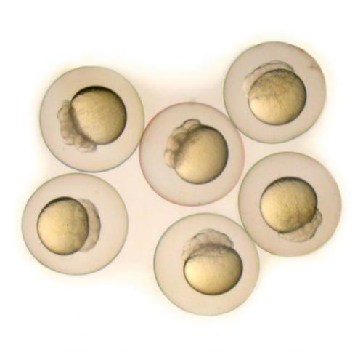
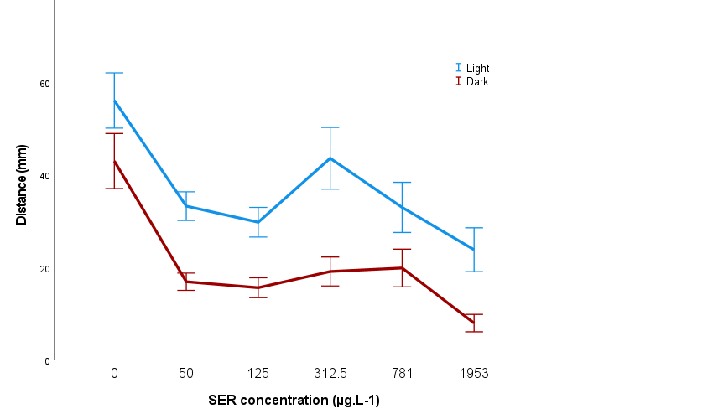
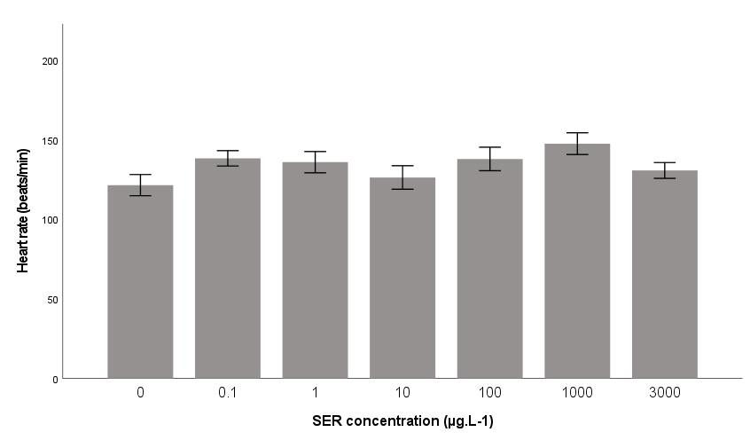
Effects of sertraline on zebrafish embryos
120h exposure to 0.1 - 3000 µg.L⁻¹
1 month exposure to 2 - 100 µg.L⁻¹
Development
Behaviour
Biochemical markers
*
*
*
*
Notes:
The aim of the study was to Evaluate the acute and chronic effects of SER on zebrafish (Danio rerio) embryos development, heartbeat rate, behaviour and biochemical markers

Slide 3
Abstract
The use of antidepressants has been increasing resulting in its presence in the aquatic environment. This environmental release raises concerns on potential effects to non-target organisms that have physiological systems regulated by these pharmaceuticals. Sertraline (SER) is an antidepressant belonging to the serotonin reuptake inhibitor class (SSRIs) that has a high consumption rate. However, there is little knowledge about the toxicological effects of SER in aquatic ecosystems. Thus, this study aimed to evaluate the acute (0.1 up to 3000 µg.L⁻¹) and chronic (2 up to 100 ng.L⁻¹.) effects of SER on zebrafish (Danio rerio) focusing on different endpoints, such as development (e.g. Fish Embryo Toxicity (FET) assay and heartbeat rate), behaviour (light/dark stimulus) and biochemical markers (e.g. associated with neurotransmission (AChE), antioxidant defenses (CAT and GST) and energy metabolism (LDH)). Overall, embryos demonstrated a high sensitivity to SER (e.g. promoting an increased heartbeat rate, increased sensitivity to light/dark stimulus at low concentrations and decreased sensitivity to higher SER concentrations. These findings support further research on the long-term effects of antidepressants such as sertraline to aquatic biota and new methodologies to efficiently remove them from the environment.
Keywords: Danio rerio; antidepressant; behaviour; biochemical endpoints

Slide 4
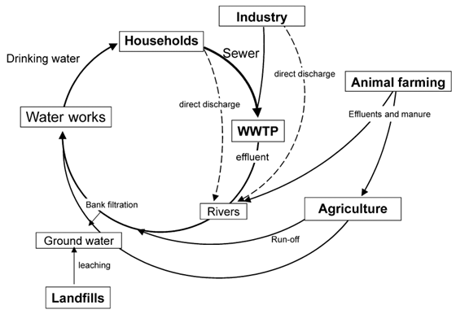
Introduction
Pharmaceuticals, nanoparticles, microplastics
Personal and domestic care products
Emerging contaminants (EC)
Result of inadequate management of the synthesised products and residues allied with inefficient wastewater treatment plants (WWTP)
Pesticides, pharmaceuticals, sewage sludge application to land
Petroviće t al., (2003) Analysis and removal of emerging contaminants in wastewater and drinking water. 2003 Nov;22(10):685–96
Notes:
The rapid population growth and technological advances have led to the occurrence of numerous emerging contaminants (EC) as a result of inadequate management of the synthesised products and residues allied with inefficient wastewater treatment plants (WWTP). The emerging contaminants can come from the households (e.g. personal and domestic care products), from the industry (e.g. pharmaceuticals, plastic), and from animal farming and agriculture (e.g. pesticides, pharmaceuticals used to treat animals, sewage sludge application to land). They can reach the groundwater through, for example, leaking sewers, discharge of WWT effluent (directly to ground or to surface water which then infiltrates) and landfill leachate

Slide 5
Introduction
Antidepressants
Presynaptic nerve terminal and synaptic cleft
Regulate the reuptake of neurotransmitters
Neurotransmitter Activity
Modulate mood and behaviour
Notes:
Overall the goal for antidepressant therapy is to influence neurotransmitter activity in the presynaptic nerve terminal and synaptic cleft and regulate the reuptake of neurotransmitters, modulating mood and behaviour

Slide 6
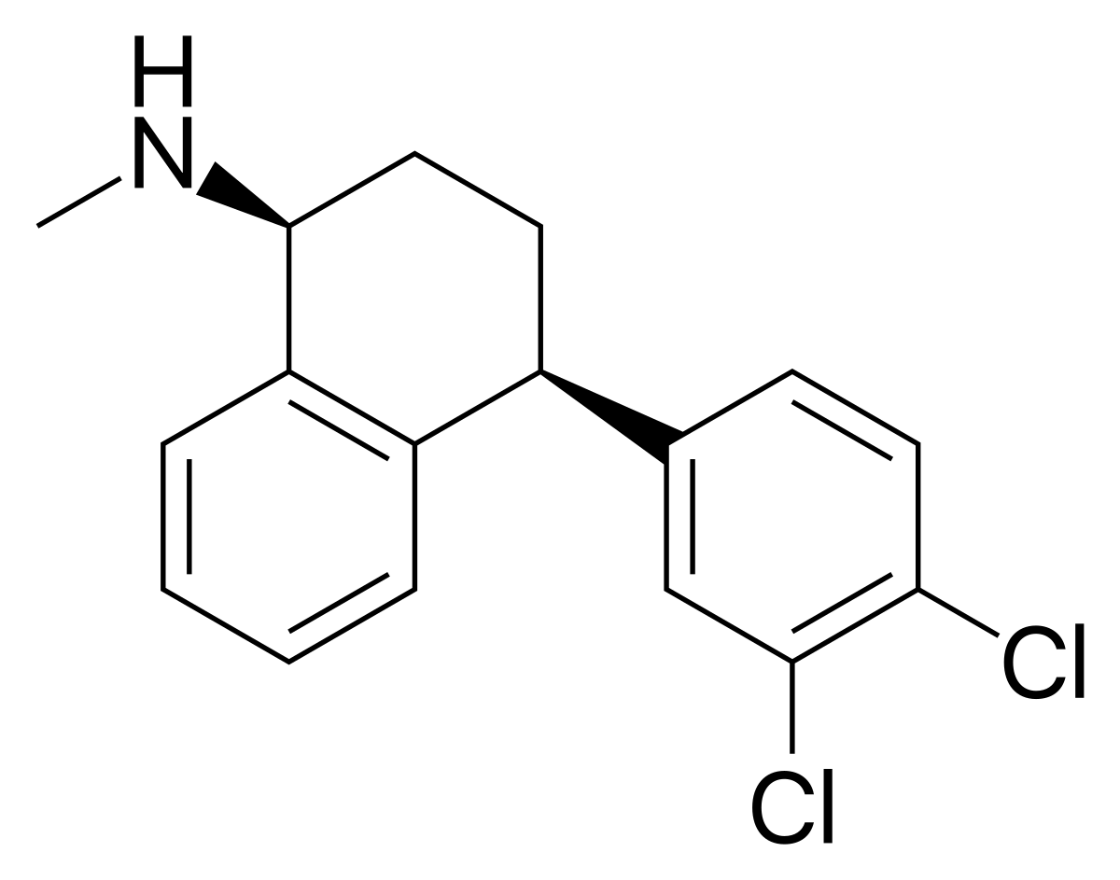
Introduction
Sertraline
IUPAC: (1S,4S)-4-(3,4-dichlorophenyl)-1,2,3,4-tetrahydro-1-naphtyl(methyl)amine
Antidepressant included in the Selective Serotonin Reuptake Inhibitor (SSRI) class
Applications:
Treatment of depression;
Anxiety disorders;
Obsessive-compulsive disorder;
Panic disorder
Side Effects:
Agitation;
Minimal sedation;
Moderately severe gastrointestinal effects;
Sexual dysfunction
Notes:
Sertraline is na antidepressant included in the serotonin selective reuptake inhibitor class
Sertraline acts by blocking the uptake of serotonin (5-HT) in the central nervous system (CNS) synaptic clefts resulting in increased serotonin levels in the brain
In addition to being used for depression treatment, it’s used for anxiety treatment, Obsessive-compulsive disorder and Panic disorder
Some of the side effects include Agitation, Minimal sedation, Moderately severe gastrointestinal effects and Sexual dysfunction

Slide 7
Material and Methods
Zebrafish (Danio rerio)
Embryo
Larva
Adult
Low cost and easy maintenance
High fecundity rate
Evident sexual dimorphism
Well characterised and conserved genome
Rapid development
Optically visible
External development
Genetic and embryological manipulation
Development of major organs systems at 36h
Optically visible
Model the health effects of environmental exposures to better understand the etiologies and mechanisms of environment-related disease in humans.
Notes:
The selection of the model organism to be used depends on the type of study, hypotesis, and of the desired screening procedure.
Currently, among the most used animal models, zebrafish stands out, since it has several attributes that make it appealing for the study of experimental manipulation, such as a rapid, genetic and embryological manipulation, are optically visible, easy maintanance and have high fecundity rates, evident sexual dimorphism, Well characterised and conserved genome
Model the health effects of environmental exposures to better understand the etiologies and mechanisms of environment-related disease in humans.

Slide 8
Material and Methods
Assessed endpoints
Fish Embryo Toxicity assay
Behaviour
Biochemical markers
Mortality
Edema
Malformations
Heartbeat rate
Total time
Total distance
% Time out
% Distance out
Slow, medium and rapid movements
Neurotansmission
Antioxidant defences
Energy metabolism
Notes:
In this study, we avaluated 3 parameters:
Through the Fish Embryo Toxicity assay, some of the endpoints recorded as indicators of acute lethality in fish were: mortality, edema, malformations and heartbeat rate
Through a behavioural analysis we assessed some parameters related to the movements performed by zebrafish, and the time and distance they spent during the recording
Some of the biochemical markers evaluated were neurotransmission, antioxidant defences and energy metabolism.

Slide 9
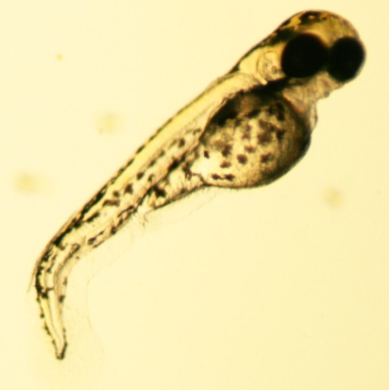
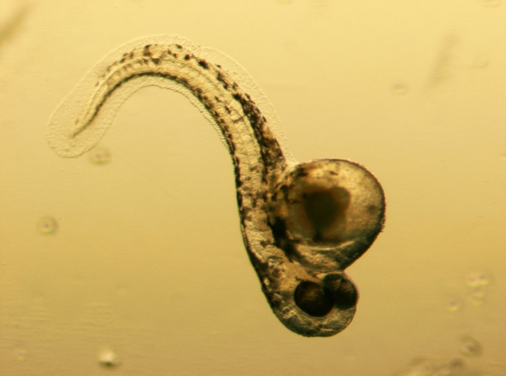
Results and discussion
Fish Embryo Toxicity assay
*
*
*
*
24h exposure to 10 µg.L⁻¹
48h exposure to 10 µg.L⁻¹
Zebrafish embryos heartbeat rate after 48h exposure to SER
72h exposure to 1000 µg.L⁻¹
72h exposure to 1 µg.L⁻¹
Notes:
Even though it was not possible to determine the LC50, clearly visible morphological abnormalities were observed, such as curvature of the tail (black arrow) , pericardial and yolk edema (thick black arrow), blood accumulation in the heart and yolk extension (red arrow).
Sertraline also was able to significantly increase the heartbeat rate in all tested concentrations except at 10 µgL⁻¹ and 3000 µgL⁻¹ when compared to the control group.

Slide 10
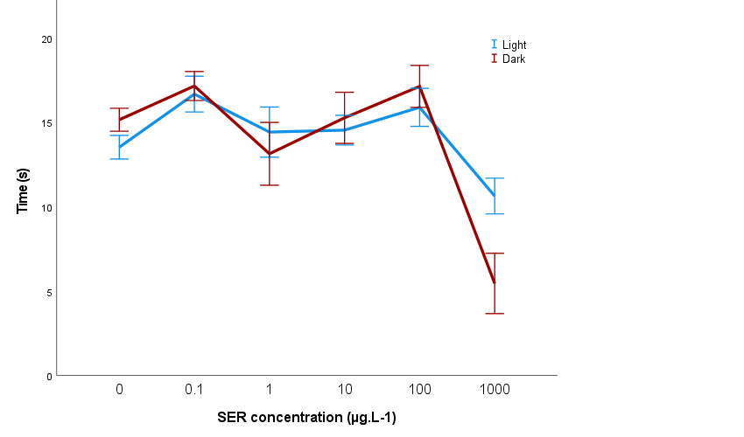
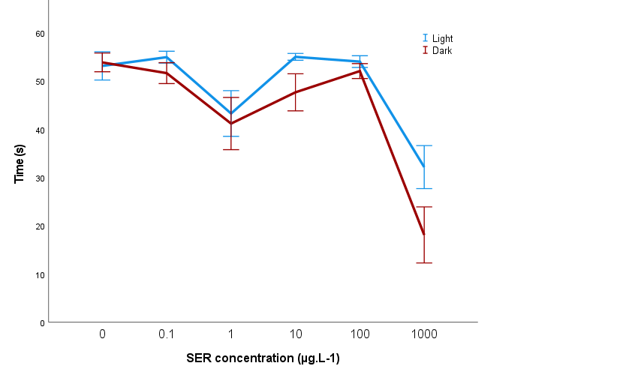
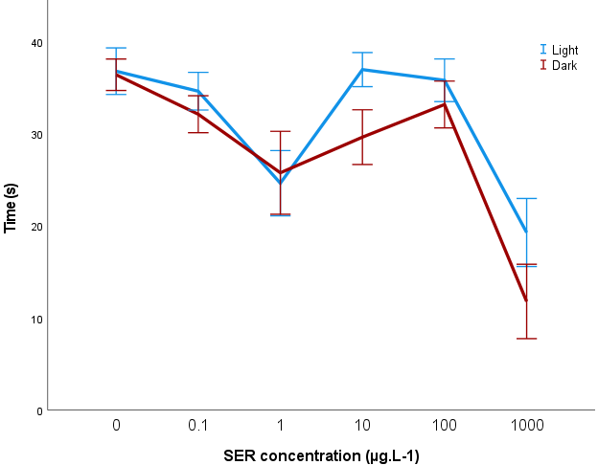
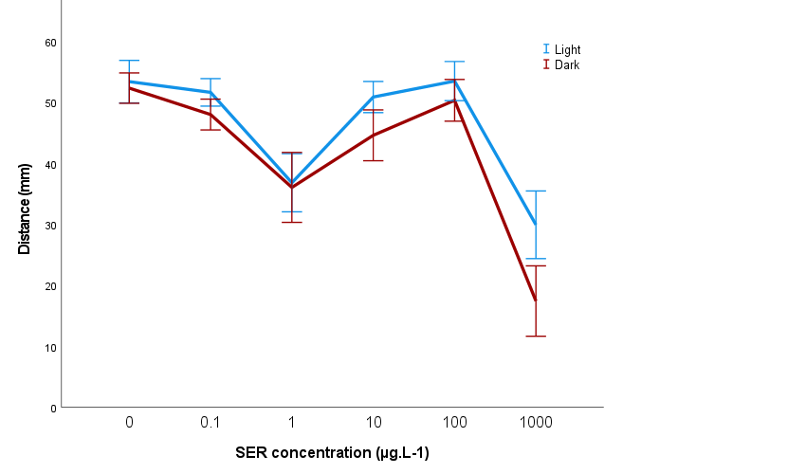
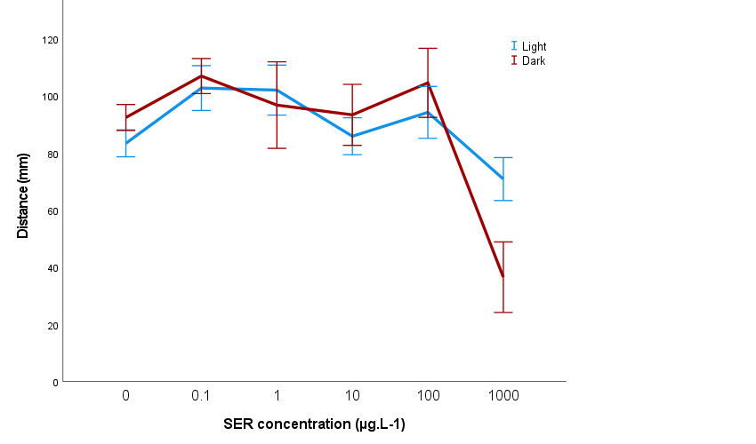
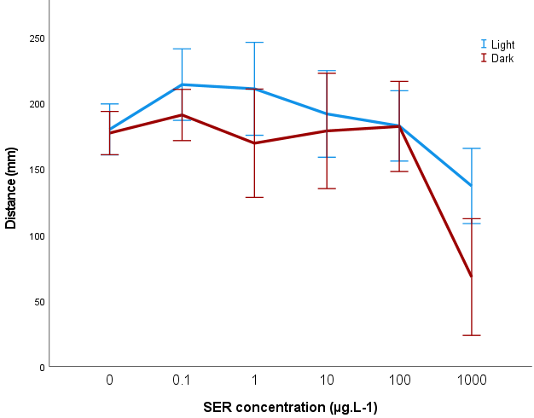
Results and discussion
Behaviour – Acute exposure
Slow/Inactivity movements - Time
Medium movements - Time
Total time
*
*
*
*
*
*
Slow/Inactivity movements -Distance
Medium movements - Distance
Total distance
*
*
*
*
*
*
Notes:
Behaviour analysis of the acute exposure indicated that sertraline induced changes in the swimming activity of zebrafish embryos. Sertraline exposure caused a significant decrease in the total distance and time moved (1000 µgL⁻¹ ), in the distance and time moved in slow movements (1 and 1000 µgL⁻¹) and in the distance and time in medium movements (100 and 1000 µgL⁻¹).

Slide 11
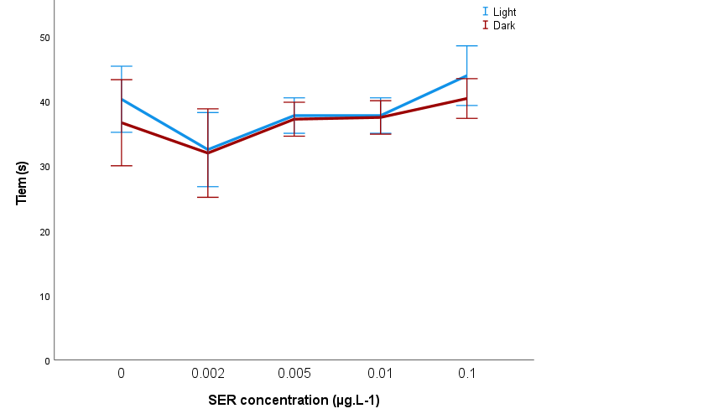
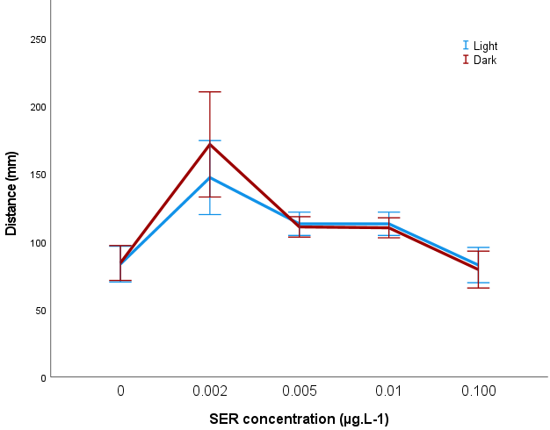
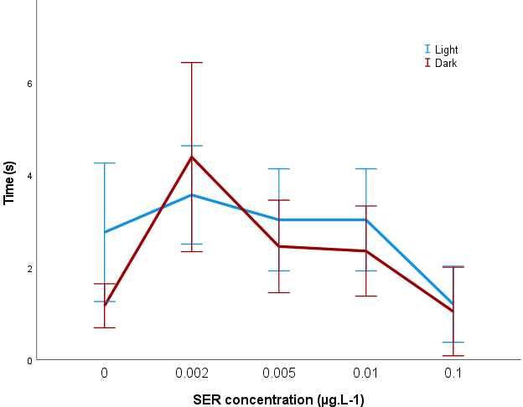
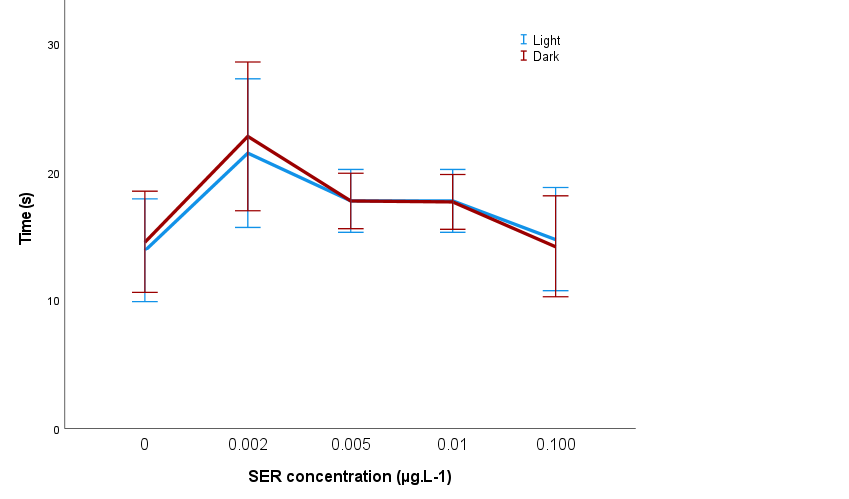
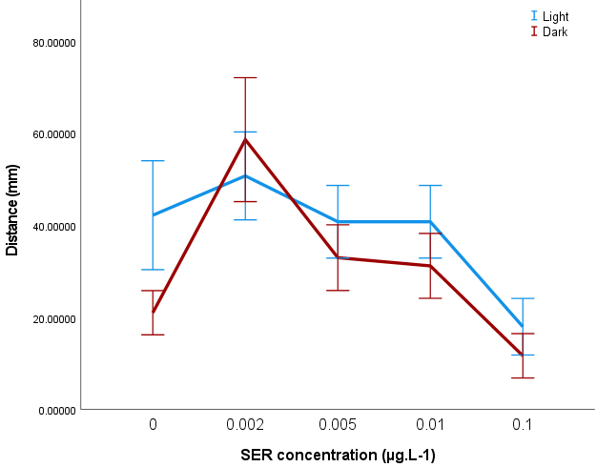
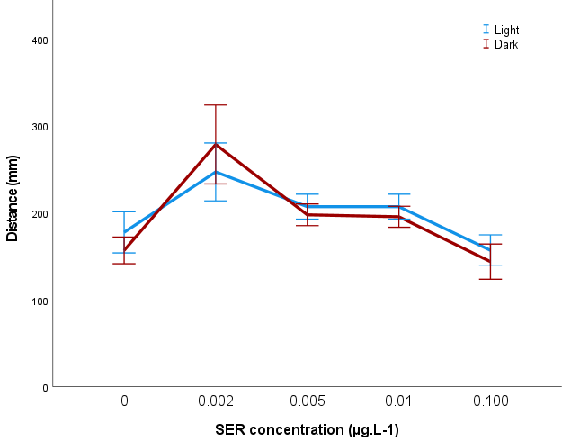
Results and discussion
Behaviour – Chronic exposure
Slow/Inactivity movements - Time
Medium movements - Distance
Rapid movements - Time
*
*
*
*
Medium movements - Time
Rapid movements - Distance
Total distance
*
*
*
*
Notes:
Behaviour analysis of the chronic exposure indicated sertraline exposure caused a significant decrease time moved in slow, and a significant increase in the distance and time moved in medium and rapid movements movements and na increase in the total distance

Slide 12
Conclusions
Notes:
Overall, our results are in agreement with previous literature investigating the effects of fluoxetine and citalopram, other SSRIs, on locomotor behaviour, heartbeat, development and biochemical markers of zebrafish early life stages. Addicionally, increased heartbeat rate is also in agreement with symptoms observed in overdose patients.
In the chronic exposure it could be observed that the lowest environmental tested concentration was able to induce significant alterations on zebrafish behaviour.
Impairment of locomotor behaviour might be related to neurological alterations in neurotransmission mediated by xenobiotics. There might be a link between the decrease of locomotor activity of hatched embryos and AChE activity, or a decrease in in two serotonin receptor transcripts (SERT – serotonin transporter protein and 5-HT1A – serotonin 1A receptor transcript) therefore further studies should be performed to corroborate this hypothesis.

Slide 13
Conclusions
Impairment of locomotor behaviour might be related to neurological alterations in neurotransmission mediated by xenobiotics. There might be a link between the decrease of locomotor activity of hatched embryos and AChE activity, or a decrease in in two serotonin receptor transcripts (SERT – serotonin transporter protein and 5-HT1A – serotonin 1A receptor transcript) therefore further studies should be performed to corroborate this hypothesis.
The data demonstrates non monotonic responses as effects of low concentrations were not observed in higher concentrations. Data supports the need for more studies and improvements in wastewater treatment plants.
Notes:
Overall, our results are in agreement with previous literature investigating the effects of fluoxetine and citalopram, other SSRIs, on locomotor behaviour, heartbeat, development and biochemical markers of zebrafish early life stages. Addicionally, increased heartbeat rate is also in agreement with symptoms observed in overdose patients.
In the chronic exposure it could be observed that the lowest environmental tested concentration was able to induce significant alterations on zebrafish behaviour.
Impairment of locomotor behaviour might be related to neurological alterations in neurotransmission mediated by xenobiotics. There might be a link between the decrease of locomotor activity of hatched embryos and AChE activity, or a decrease in in two serotonin receptor transcripts (SERT – serotonin transporter protein and 5-HT1A – serotonin 1A receptor transcript) therefore further studies should be performed to corroborate this hypothesis.

Slide 14
Acknowledgments
Thank you for your attention!
Thanks are due to FCT/MCTES for the financial support to CESAM (UID/AMB/50017/2019), through national funds.
MO had financial support of the program Investigador FCT, co-funded by the Human Potential Operational Programme and European Social Fund (IF/00335-2015).

