Slide 1

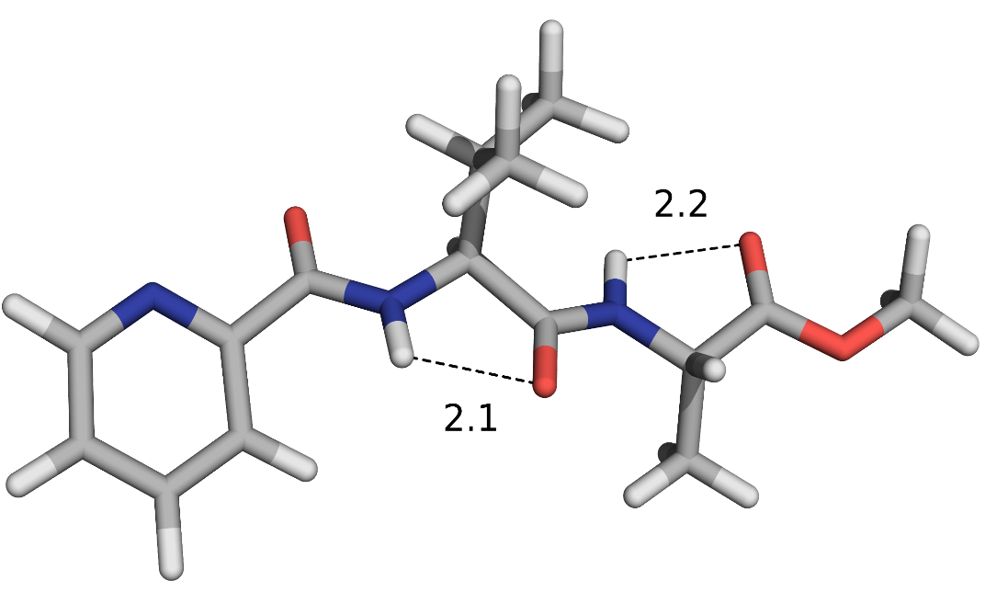
Synthesis, pharmacological, and biological evaluation of pyridine-based MIF‑1 peptidomimetics as positive allosteric modulators of D₂R
Beatriz L. Pires de Lima ^{a,*}, Sara C. Silva-Reis ª, Ivo E. Sampaio-Dias ª, Xerardo García-Mera ^{b}, José E. Rodríguez-Borges ª
LAQV/REQUIMTE, Department of Chemistry and Biochemistry, Faculty of Sciences, University of Porto, Porto, Portugal;
Department of Organic Chemistry, Faculty of Pharmacy, University of Santiago de Compostela, Santiago de Compostela, Spain.
*Email: up201603704@fc.up.pt
INTRODUCTION
In the last few decades, investigators deal with synthesizing structurally modified peptides in order to improve the stability and biological activity of these compounds, with the aim of obtaining new potential pharmaceuticals. This project describes the synthesis, pharmacological and biological evaluation of new class of mimetic compounds for neuropeptide MIF-1 (L-prolyl-L-leucylglycinamide) which perform important roles in central nervous system. The main objective was to explore the replacement of L-proline by heteroaromatic system such as picolinic acid (1), which is naturally synthesized in the body from L-tryptophan (TRP). Picolinic acid plays an important neuroprotective role since it protects against quinolinic acid, and kainic acid, inductors of neurotoxicity in the brain, which may contribute for the design of potent peptidomimetics with intrinsic neuroprotection.
ORGANIC SYNTHESIS
PHARMACOLOGY
The synthesis of pyridine-based peptidomimetics were prepared based on DIPEA/TBTU peptide coupling strategy in solution-phase (as depicted in Scheme 1), following a diversity-oriented synthesis (DOS) to create a set of structural-related amino acid combinations at the central and C-terminal positions. In some peptidomimetics, L-leucine was replaced by L-valine whereas glycine was substituted by L-alanine.
Dopamine D₂ receptor Functional Assay
A functional study was performed for peptidomimetic 6b at human D₂R expressed in CHO cells by analysis of cyclic adenosine monophosphate (cAMP) mobilization using homogeneous time resolved fluorescence measurements in presence of dopamine. The results are shown in Figure 1A. Compound 6b produced a typical bell-shaped dose-response curve and demonstrated a better performance than the parent neuropeptide (18.3 ± 7.1% for 6b vs. 15.4 ± 5.5% for MIF-1, both at 0.1 nM), without intrinsic agonism effect (Figure 1B).
A
B
Figure 1. A: Dopamine effect exerted by peptidomimetic 6b and MIF-1 (positive control) at different concentrations; B: Concentration-response curves of the compounds and dopamine (DA) at human D₂R
ENERGY MINIMIZATION
Scheme 1. Synthesis of picolinoyl-based peptidomimetics 5-8(a,b). Reagents and conditions: (i) DIPEA, TBTU, CH₂Cl₂; (ii) LiOH, MeOH/H₂O followed by H₂SO₄ 1 M; (iii) NH₃ (g), MeOH; (iv) DMF, TBTU, glycinamide hydrochloride, CH₂Cl₂; (v) DMF, TBTU, L-alaninamide hydrochloride, CH₂Cl₂.
In silico studies by energy minimization in gas-phase for compound 6b shows that this peptidomimetics exhibits an extended conformation placing the ester moiety outwards (Figure 2). The bioactive peptidomimetic 6b cannot adopt a type-II β-turn conformation since the postulated C-terminal carboxamide pharmacophore is absent, supporting existence of a secondary bioactive conformation (extended) for MIF-1.
PHARMACOLOGY
Dopamine D₂ receptor Binding Assay
Peptidomimetics 5-8(a,b) were tested to their ability to modulate dopamine D_{2S} receptors by enhancing the binding of radiolabeled [³H]-NPA ligand. A statistically significant enhancement (P < 0.05) of the [³H]-NPA response was observed for the peptidomimetic 6b, as depicted in Scheme 2.
Figure 2. Optimized geometry, at the M06-2X/6-31G(d,p) level of theory, for peptidomimetic 6b.
18.3 ± 9.1%
at 0.01 nM
22.5 ± 8.8%
at 0.1 nM
(maximum effect)
CYTOTOXICITY
Peptidomimetic 6b was evaluated on HEK 293T cells for 8 days up to 120 μM and cell viability was estimated based on MTT reduction (Figure 3). The results show that absence of cytotoxicity under the conditions tested.
MIF-1
11.9 ± 3.7%
at 0.01 nM (maximum effect)
Figure 3. Cell viability of HEK 293T cells tested by the MTT assay. HEK 293T cells were treated with peptidomimetic 6b at different concentrations (0, 3, 6, 12, 24, 60 and 120 μM) for 8 days. Following treatment with MTT reagent, viable cells were quantified by measuring the OD₄₉₀ of sample wells. *Level of significance P < 0.05.
[³H]-NPA
Compound 6b
Scheme 2. Modulation of [³H]-NPA binding exerted by MIF-1 and 6b at three different concentrations.
CONCLUSION
The pharmacological data obtained from binding and functional assays on human D₂R shows that peptidomimetic 6b acts as a positive allosteric modulator of D₂R. The absence of the postulated C-terminal carboxamide pharmacophore and the minimization energy performed for 6b indicates that it cannot adopt the postulated type-II β-turn bioconformation. This finding suggests that heteroaromatic scaffolds at prolyl position of MIF-1 may have a significant impact in the folding of the these tripeptidomimetics, inducing an extended conformation rather than type-II β-turn.
Overall, the pharmacological and toxicological profile of peptidomimetic 6b and its structural simplicity makes it a potential lead compound for further development and optimization of novel potent MIF-1 analogues.
Acknowledgements
This research was funded by Fundação para a Ciência e Tecnologia (FCT, Portugal), through grant UIDB/50006/2020 (to LAQV-REQUIMTE Research Unit). IESD thanks FCT for the doctoral grant SFRH/BD/93632/2013.

