Slide 1
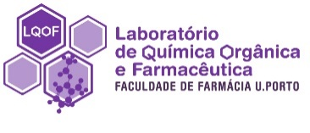
Design and synthesis of novel xanthene derivatives
Miguel Maia ¹, Andreia Palmeira ², Diana Resende ^{1,2}, Luís Gales ^{3,4}, Madalena Pinto ^{1,2}, Emília Sousa ^{1,2*}
¹ Medicinal Chemistry: Drug Discovery and Drug Design, CIIMAR – Interdisciplinary Centre of Marine and Environmental Research, Faculty of Porto, Porto, Portugal.
² Laboratory of Organic and Pharmaceutical Chemistry, FFUP – Faculty of Pharmacy, University of Porto, Porto, Portugal
³ Department of Molecular Biology, ICBAS - Instituto de Ciências Biomédicas Abel Salazar, University of Porto, Porto, Portugal
⁴ Bioengineering & Synthetic Microbiology, I3S – Instituto de Investigação e Inovação em Saúde, University of Porto, Porto, Portugal
* Corresponding author: esousa@ff.up.pt

Slide 2
Design and synthesis of novel xanthene derivatives
Graphical Abstract
Prediction
Pharmacokinetic/ druglike nature
Synthesis
Novel xanthene derivatives
Design
Molecular hybridization
Drug likeness
BBB permeation
P-gp efflux
CYP enzymes inhibition
Lipinski’s rules violation
PAINS
Design of suitable synthetic pathways
Application of green chemistry principles

Slide 3
Abstract:
Xanthenes are a special class of oxygen-incorporating tricyclic compounds. Structurally related to xanthones, the presence of different substituents in position 9 presents a large impact on their physical and chemical properties, as well as their biological applications. Xanthene-9-carboxylic acid, 9-hydroxyxanthene (xanthydrol) and their respective derivatives have been reported to exhibit remarkable biological activities, namely neuroprotection, antidiabetic, cytotoxic, and antibacterial.
Herein, we report the design of a virtual library of 300 compounds whose pharmacokinetic properties were assessed through computational tools. Synthesis strategies to obtain such drug-like xanthene derivatives - amide coupling, reductive amination, aromatic halogenation and Suzuki coupling - are described. Azaxanthenes and thioxanthenes, important xanthene bioisosters, are also considered for their capacity to establish different biologic interactions for their influence pharmacokinetic properties. Future studies will include the investigation of their potential as bioactive compounds.
Keywords: drug design, synthesis, xanthene derivatives

Slide 4
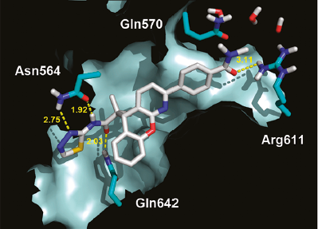
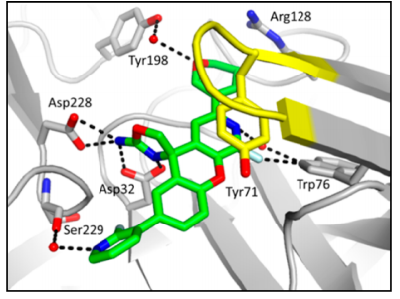
Antidiabetic³
Introduction
Xanthenes as privileged structures
Anti-inflammatory¹
Alzheimers disease²
Interaction with glucocorticoid receptor the ligand binding domain¹
Interaction with the catalytic pocket of BACE1²
Antimalarial⁴
¹ Y. Cheng, J. Brown, T.C. Judd, P. Lopez, W. Qian, T.S. Powers, J.J. Chen, M.D. Bartberger, K. Chen, R.T. Dunn, O. Epstein, R.T. Fremeau, S. Harried, D. Hickman, S.A. Hitchcock, Y. Luo, A.E. Minatti, V.F. Patel, H.M. Vargas, R.C. Wahl, M.M. Weiss, P.H. Wen, R.D. White, D.A. Whittington, X.M. Zheng, S. Wood, An Orally Available BACE1 Inhibitor That Affords Robust CNS Aβ Reduction without Cardiovascular Liabilities, ACS Medicinal Chemistry Letters, 6 (2015) 210-215.
² D.S. Weinstein, H. Gong, A.M. Doweyko, M. Cunningham, S. Habte, J.H. Wang, D.A. Holloway, C. Burke, L. Gao, V. Guarino, J. Carman, J.E. Somerville, D. Shuster, L. Salter-Cid, J.H. Dodd, S.G. Nadler, J.C. Barrish, Azaxanthene Based Selective Glucocorticoid Receptor Modulators: Design, Synthesis, and Pharmacological Evaluation of (S)-4-(5-(1-((1,3,4-Thiadiazol-2-yl)amino)-2-methyl-1-oxopropan-2-yl)-5H-chromeno[2,3-b]pyridin-2-yl)-2-fluoro-N,N-dimethylbenzamide (BMS-776532) and Its Methylene Homologue (BMS-791826), Journal of Medicinal Chemistry, 54 (2011) 7318-7333.
³ Y. Kwon, P. Song, J.H. Yoon, J. Ghim, D. Kim, B. Kang, T.G. Lee, J.-A. Kim, J.-K. Choi, I.K. Youn, H.-K. Lee, S.H. Ryu, Xanthene Derivatives Increase Glucose Utilization through Activation of LKB1-Dependent AMP-Activated Protein Kinase, PLOS ONE, 9 (2014) e108771.
⁴ A. Jarrahpour, E. Ebrahimi, E. De Clercq, V. Sinou, C. Latour, L. Djouhri Bouktab, J.M. Brunel, Synthesis of mono-, bis-spiro- and dispiro-β-lactams and evaluation of their antimalarial activities, Tetrahedron, 67 (2011) 8699-8704.

Slide 5
Results and discussion
Design
Computational prediction
Synthesis
Molecular hybridization
Pharmacokinetic/ druglike nature
Assessment of suitable synthetic pathways
Ongoing work

Slide 6
Results and discussion
Computational prediction
Design of a virtual library of ≈ 300 molecular hybrids
Calculation of drug likeness properties
c
Lipinski’s rule of five
BBB permeation
P-gp efflux
CYP inhibition
PAINS alerts
Central Nervous System (CNS) drug rules ⁷
Molecular weight < 450
logP < 5
< 3 H-bond donors
< 7 H-bond acceptors (sum of N and O)
<8 rotatable bonds
TPSA < 70 Å²
⁵. Pajouhesh H, Lenz GR. Medicinal Chemical Properties of Successful Central Nervous System Drugs. Neurotherapeutics. 2005;2:541-553. doi:https://doi.org/10.1602/neurorx.2.4.541
6

Slide 7
Results and discussion
Synthesis
Synthesis of novel xanthene derivatives through distinctive synthetic pathways
Biological applications
Synthesis of derivatives
Amide coupling
Buchwald-Hartwig cross coupling reaction
Reductive amination
In vitro / in vivo activities
Suzuki-Miyaura coupling
Aromatic halogenation
7

Slide 8
Results and discussion
Synthesis
Synthesis of novel xanthene derivatives through distinctive synthetic pathways
8

Slide 9
Conclusions
Computational prediction revealed promising druglike compounds with adequate pharmacokinetic properties;
Preliminary results for the N-alkylation of tricyclic moieties and aromatic halogenation showed that suitable synthetic pathways were found to synthesize the desire ligands;
Future work will focus on in vitro studies and further structure modifications for hit to lead optimization.

Slide 10
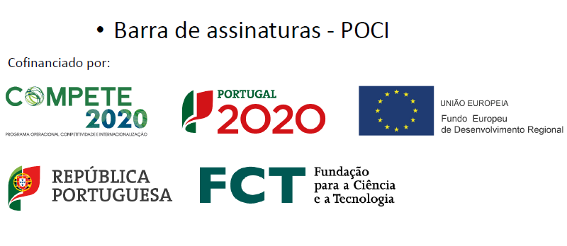
Acknowledgments
This research was supported by national funds through FCT - Foundation for Science and Technology within the scope of UIDB/04423/2020, UIDP/04423/2020, and under the project PTDC/SAU-PUB/28736/2017 (reference POCI-01-0145-FEDER-028736), co-financed by COMPETE 2020, Portugal 2020 and the European Union through the ERDF and by FCT through national funds, as well as CHIRALBIOACTIVE-PI-3RL-IINFACTS-2019. M.M. also acknowledge FCT for their PhD grant (SFRH/BD/146211/2019).

