Slide 1


Synthesis and anticancer activity of hybrid molecules based on lithocholic and (5Z,9Z)-tetradeca-5.9-dienedioic acids
Vladimir A. D'yakonov,* Regina A. Tuktarova, Lilya U. Dzhemileva,* Svetlana R. Ishmukhametova, Milyausha M. Yunusbaeva, and Usein M. Dzhemilev
¹Institute of Petrochemistry and Catalysis,Russian Academy of Sciences
pr. Oktyabrya 141, 450075 Ufa, Russian Federation.
* Corresponding author: DyakonovVA@rambler.ru

Slide 2
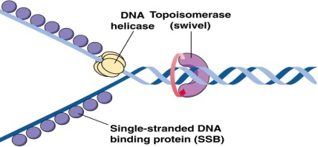
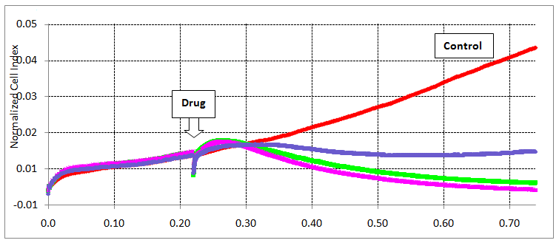
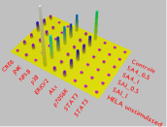
Synthesis and anticancer activity of hybrid molecules based on lithocholic and (5Z,9Z)-tetradeca-5.9-dienedioic acids
Graphical Abstract
Induction of apoptosis &
Cell cycle analysis
Topoisomerase I Inhibition
Real time analysis
Docking studies
Cell signalling (CREB, JNK, NFkB, p38,
ERK1/2, Akt, p70S6K, STAT3, STAT5)
Structure-activity studies
Cytotoxicity to Jurkat, K562, U937,
HL-60 cancer cells and HEK293
IC₅₀ 0.09-4.71 µM
R =

Slide 3
Abstract: Lithocholic acid (LA) as the main component of bile and its derivatives are biologically active compounds - they are proteasome regulators [Dang et al., 2011; 2012], activate the vitamin D receptor and enhance the interaction of cholecalciferols with the receptor [Ishizawa et al., 2008; Cheng et al., 2014], exhibit inhibitory activity against DNA polymerases β (pol β) [Mizushina et al., 2004], and appear antibacterial [Nascimento et al., 2015] and antitumor effects [Samadi et al. , 2017]. We have previously shown that the synthesized hybrid molecules based on steroids and cis-unsaturated acids are apoptosis inducers in cell cultures Jurkat, K562, U937, HeLa, HEK293 and inhibit in vitro the relaxation of supercoiled DNA induced by topoisomerase I [Dyakonov VA et al., 2013]. In the continuation of these studies, we synthesized the conjugates LA and (5Z, 9Z)-tetradeca-5,9-dienedioic acid, which are linked through ethylene glycol and diaminoalkane spacers of different lengths, and also studied the antitumor activity of the synthesized compounds. The synthesis of the target hybrid molecules based on LA and (5Z,9Z)-tetradeca-5,9-dienedioic acid, was carried out in two approaches: via 3-О-acetation of LA using a dicarboxylic acid, and then modified the LA carboxyl group at the С-24 position. For all synthesized compounds, the in vitro antitumor activity was evaluated for the first time on Jurkat, K562, HEK293, HELA, and U937 cell lines, using the Guava Nexin Reagent, Guava Cell Cycle and Guava ViaCount (Millipore) reagent kits, including the determination of IC50, the study of viability cells and influence on the cell cycle using flow cytometry.
Keywords: lithocholic acid, cross-cyclomagnesiation, anticancer activity, 5Z,9Z-dienoic acids.

Slide 4
Introduction
Lithocholic acid (LA) as the main component of bile and its derivatives are biologically active compounds - they are proteasome regulators [Dang et al., 2011; 2012], activate the vitamin D receptor and enhance the interaction of cholecalciferols with the receptor [Ishizawa et al., 2008; Cheng et al., 2014], exhibit inhibitory activity against DNA polymerases β (pol β) [Mizushina et al., 2004], and appear antibacterial [Nascimento et al., 2015] and antitumor effects [Samadi et al. , 2017]. We have previously shown that the synthesized hybrid molecules based on steroids and cis-unsaturated acids are apoptosis inducers in cell cultures Jurkat, K562, U937, HeLa, HEK293 and inhibit in vitro the relaxation of supercoiled DNA induced by topoisomerase I [Dyakonov VA et al., 2013]. In the continuation of these studies, we synthesized the conjugates LA and (5Z,9Z)-tetradeca-5,9-dienedioic acid, which are linked through ethylene glycol and diaminoalkane spacers of different lengths, and also studied the antitumor activity of the synthesized compounds. The synthesis of the target hybrid molecules based on LA and (5Z,9Z)-tetradeca-5,9-dienedioic acid, was carried out in two approaches: via 3-О-acetation of LA using a dicarboxylic acid, and then modified the LA carboxyl group at the С-24 position. For all synthesized compounds, the in vitro antitumor activity was evaluated for the first time on Jurkat, K562, HEK293, HELA, and U937 cell lines, using the Guava Nexin Reagent, Guava Cell Cycle and Guava ViaCount (Millipore) reagent kits, including the determination of IC50, the study of viability cells and influence on the cell cycle using flow cytometry.

Slide 5
Results and discussion
Scheme 1. Synthesis of (5Z,9Z)-tetradeca-5,9-diene-1,14-diol and (5Z,9Z)-tetradeca-5,9-dienedioic acid. (a): EtMgBr, Mg, Cp2TiCl2 (5 mol%), diethyl ether; (b): H3O+; (c): n-TsOH, CHCl3, MeOH; (d): H2CrO4/H2SO4, acetone, CH2Cl2
Scheme 2. Synthesis of LA derivative 8. (a): MeOH, AcCl, rt, 3 h; (b): (5Z,9Z)-tetradeca-5,9-dienedioic acid 5, EDCl·HCl, DMAP, CH2Cl2

Slide 6
Results and discussion
Scheme 3. Synthesis of LA derivative 11. (a): AcCl, pyridine, CH2Cl2, DMAP, rt, 16 h; (b): (5Z,9Z)-Тetradeca-5,9-diene-1,14-diol 4, EDCl·HCl, DMAP, CH2Cl2; (c): Jones reagent, acetone, CH2Cl2.
Scheme 4. Synthesis of LA-fatty acid conjugates linked via ethylene glycol units (a): ethylene glycols of different lengths, EDCl·HCl, DMAP, CH2Cl2; (b): (5Z,9Z)-tetradeca-5,9-dienedioic acid 5, EDCl·HCl, DMAP, CH2Cl2.

Slide 7
Results and discussion
Scheme 5. Synthesis of LA-fatty acid conjugates linked via diaminoalkane units (a): oxalyl chloride, dichloromethane; (b): Boc-protected diaminoalkanes, diisopropyl ethyl amine, dichloromethane; (c): trifluoroacetic acid, chloroform; (d): (5Z,9Z)-tetradeca-5,9-dienedioic acid, EDCl·HCl, DMAP, CH2Cl2

Slide 8
Cytotoxic activity of compounds 21a-d и 22a-d
 | Jurkat | K562 | U937 | HEK293 | HeLa
IC₅₀ (21а) | 3.5±0.56 | 2.3±0.21 | 3.4±0.35 | 5.3±0.23 | 4.0±0.17
IC50 (21b) | 4.7±0.18 | 1.9±0.67 | 2.6±0.85 | 3.4±0.23 | 2.1±0.54
IC50 (21c) | 2.0±0.45 | 2.1±0.12 | 2.5±0.08 | 0.80±0.07 | 1.8±0.36
IC50 (21d) | 0.14±0.01 | 0.09±0.03 | 0.21±0.03 | 0.18±0.007 | 0.98±0.06
IC50 (22a) | 0.14±0.02 | 0.18±0.03 | 0.24±0.01 | 0.67±0.03 | 0.55±0.04
IC50 (22b) | 0.07±0.01 | 0.09±0.00 | 0.09±0.00 | 0.44±0.08 | 0.39±0.07
IC50 (22c) | 0.11±0.02 | 0.09±0.01 | 0.13±0.00 | 0.31±0.06 | 0.22±0.04
IC50 (22d) | 0.08±0.03 | 0.18±0.06 | 0.28±0.04 | 0.38±0.07 | 0.58±0.34
IC₅₀ (campt) | 1.12±0.012 | 2.10±0.013 | 1.32±0.01 | 5.21±0.07 | 4.18±0.06

Slide 9
Analysis of Apoptosis and Cell Cycle of Compounds
Compound 22b
- The test compounds-leaders exhibit pronounced apoptosis-inducing activity
- When studying the cell cycle, an increase in the cell population in the pre-G0 phase was observed
Compound 22c
Compound 22b

Slide 10
Conclusions
For the synthesized compounds (21a-d and 22a-d) at this work the study of the antitumor activity in vitro on the Jurkat, K562, HEK293, HELA, and U937 cell lines using the Guava Nexin Reagent, Guava Cell Cycle and Guava reagent kits. ViaCount (Millipore), including IC50 determination, study of cell viability and effects on the cell cycle using flow cytometry were carried out. Individual hybrid molecules, which are leaders in antitumor activity, have been identified. The study of the cell cycle showed an increase in the cell population in the preG0 phase, which reliably indicates the presence of apoptosis-inducing properties in compound 22b.

Slide 11
Acknowledgments
This work was supported by the Russian Science Foundation, Russia (Grants No. 18-73-10030, 20-64-47019), Russian foundation of basic research (19-03-00603_a, 18-29-09068_mk). The structural studies of the synthesized compounds were performed with the use of Collective Usage Centre “Agidel” at the Institute of Petrochemistry and Catalysis of RAS. The biological studies of 5Z,9Z-dienoic acids and their derivatives were done in the Laboratory of Molecular Design and Biological Screening of Substances for Pharmaceutics at the Institute of Petrochemistry and Catalysis of RAS.

