Slide 1
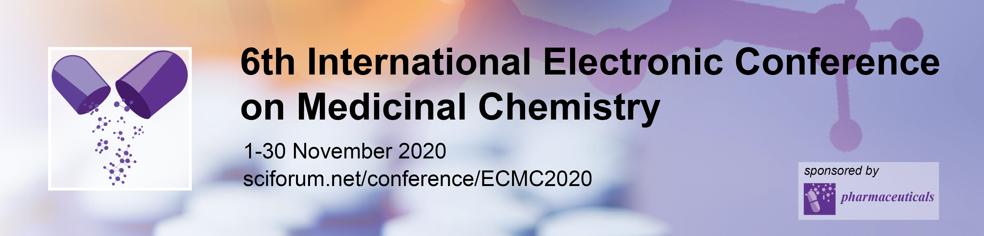


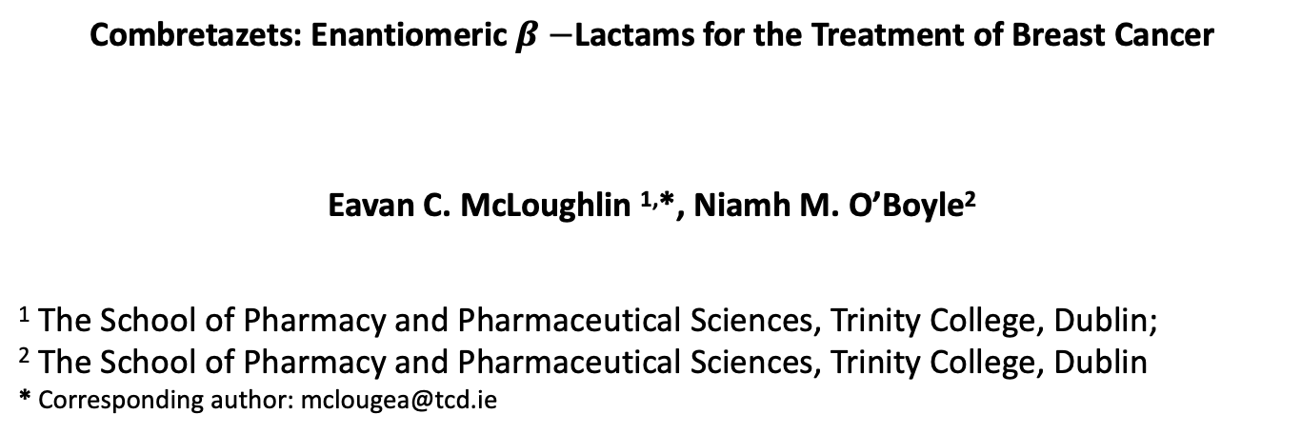
Combretazets: Enantiomeric $β−$Lactams for the Treatment of Breast Cancer
Eavan C. McLoughlin ^{1,}*, Niamh M. O’Boyle²
¹ The School of Pharmacy and Pharmaceutical Sciences, Trinity College, Dublin;
² The School of Pharmacy and Pharmaceutical Sciences, Trinity College, Dublin
* Corresponding author: mclougea@tcd.ie

Slide 2
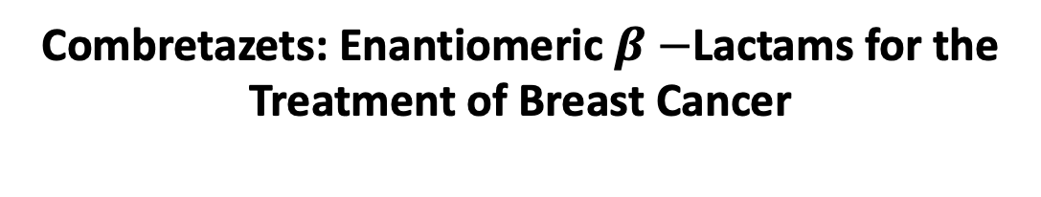
Combretazets: Enantiomeric $β−$Lactams for the Treatment of Breast Cancer

Slide 3
Abstract:
The combretastatins are diaryl stilbenoid natural products isolated from the bark of the South African willow tree Combretum caffrum. CA-4 (Figure 1) is a potent anticancer agent, which inhibits cancer cell proliferation and microtubule polymerisation by binding at the colchicine-binding site of tubulin. Only the cis configuration of CA-4 possesses anticancer bioactivity. It readily isomerizes in vivo during metabolism and upon storage into the more thermodynamically stable but significantly less active trans isomer. Our group has reported extensive series of antiproliferative, tubulin-binding β-lactam compounds – the ‘Combretazets’ – over the last decade with aim of overcoming this undesirable in vivo conversion to the inactive trans form. Substituting the ethylene bridge with a 1,4-diaryl-2-azetidinone ring (01, Figure 1) allows similar structural arrangement between CA-4’s two aromatic rings and overcomescis/trans isomerization. The racemic azetidinone 01 has an IC₅₀ value of 4 nM in MCF-7 cells. It is essential to distinguish the eutomer from the distomers. Here, we describe the synthesis, resolution, and biochemical activity of the enantiomers of 01.
Keywords: tubulin, anti-tubulin, tubulin poylmerisation inhibitors, colchicine, CA-4

Slide 4
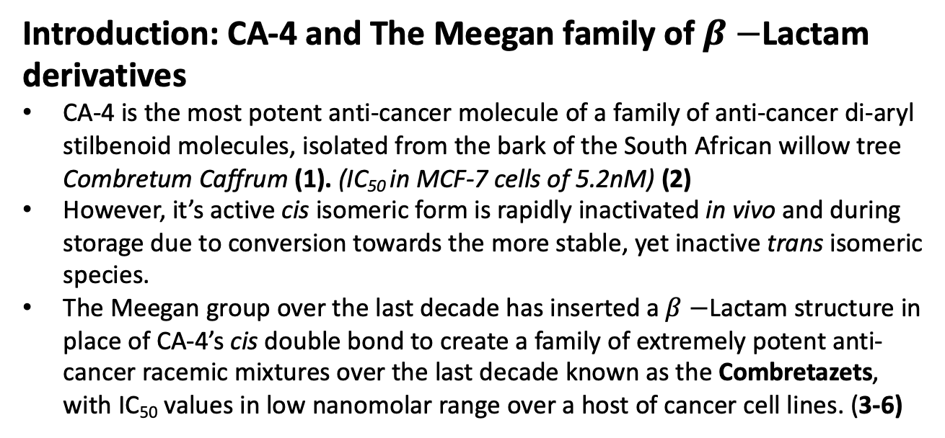
Introduction: CA-4 and The Meegan family of $β−$Lactam derivatives
CA-4 is the most potent anti-cancer molecule of a family of anti-cancer di-aryl stilbenoid molecules, isolated from the bark of the South African willow tree Combretum Caffrum (1). (IC₅₀ in MCF-7 cells of 5.2nM) (2)
However, it’s active cis isomeric form is rapidly inactivated in vivo and during storage due to conversion towards the more stable, yet inactive trans isomeric species.
The Meegan group over the last decade has inserted a $β−$Lactam structure in place of CA-4’s cis double bond to create a family of extremely potent anti-cancer racemic mixtures over the last decade known as the Combretazets, with IC₅₀ values in low nanomolar range over a host of cancer cell lines. (3-6)

Slide 5
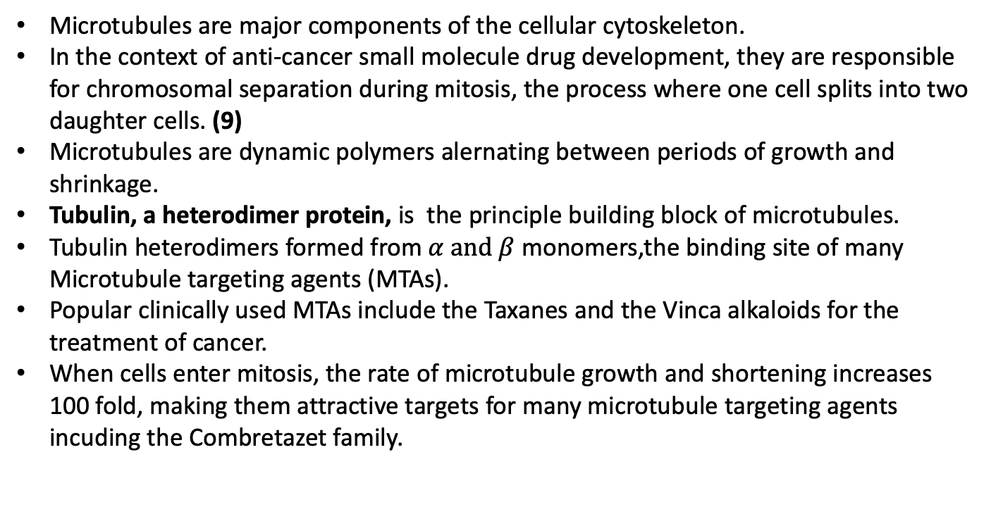
Microtubules and the Colchicine Binding site as the target of anti-tubulin agents: CA-4, Colchicine and the Combretazets.
Microtubules are major components of the cellular cytoskeleton.
In the context of anti-cancer small molecule drug development, they are responsible for chromosomal separation during mitosis, the process where one cell splits into two daughter cells. (9)
Microtubules are dynamic polymers alernating between periods of growth and shrinkage.
Tubulin, a heterodimer protein, is the principle building block of microtubules.
Tubulin heterodimers formed from $α and β$ monomers,the binding site of many Microtubule targeting agents (MTAs).
Popular clinically used MTAs include the Taxanes and the Vinca alkaloids for the treatment of cancer.
When cells enter mitosis, the rate of microtubule growth and shortening increases 100 fold, making them attractive targets for many microtubule targeting agents incuding the Combretazet family.

Slide 6
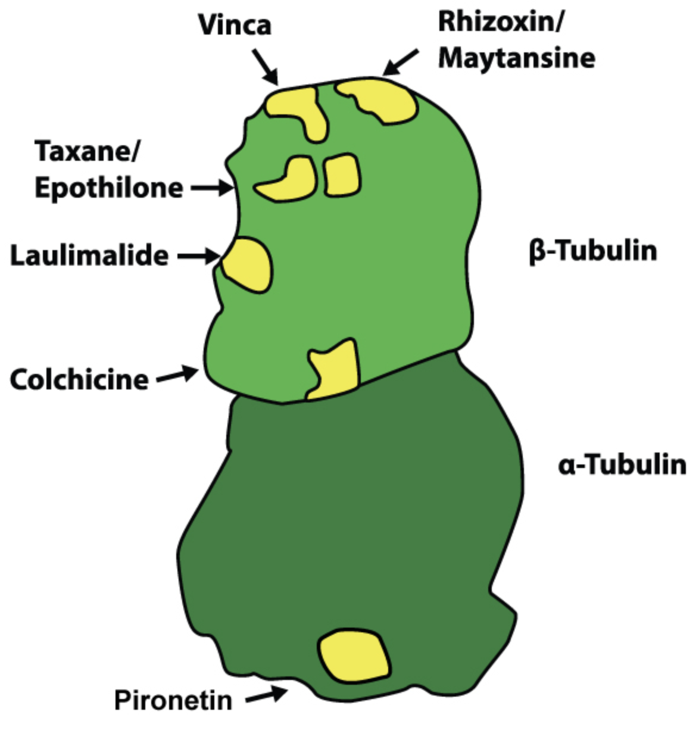
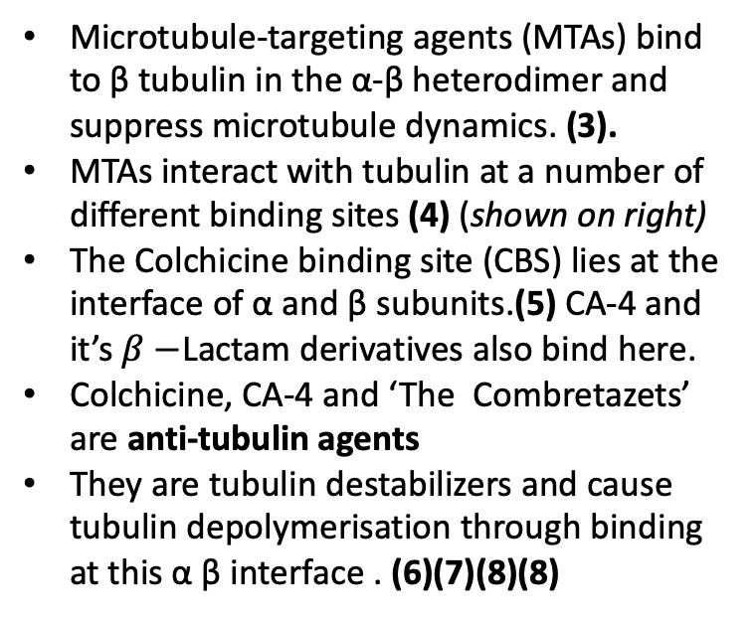
Introduction: CA-4 as a Colchicine Binding Site inhibitor
Microtubule-targeting agents (MTAs) bind to β tubulin in the α-β heterodimer and suppress microtubule dynamics. (3).
MTAs interact with tubulin at a number of different binding sites (4) (shown on right)
The Colchicine binding site (CBS) lies at the interface of α and β subunits.(5) CA-4 and it’s $β−$Lactam derivatives also bind here.
Colchicine, CA-4 and ‘The Combretazets’ are anti-tubulin agents
They are tubulin destabilizers and cause tubulin depolymerisation through binding at this α β interface . (6)(7)(8)(8)

Slide 7
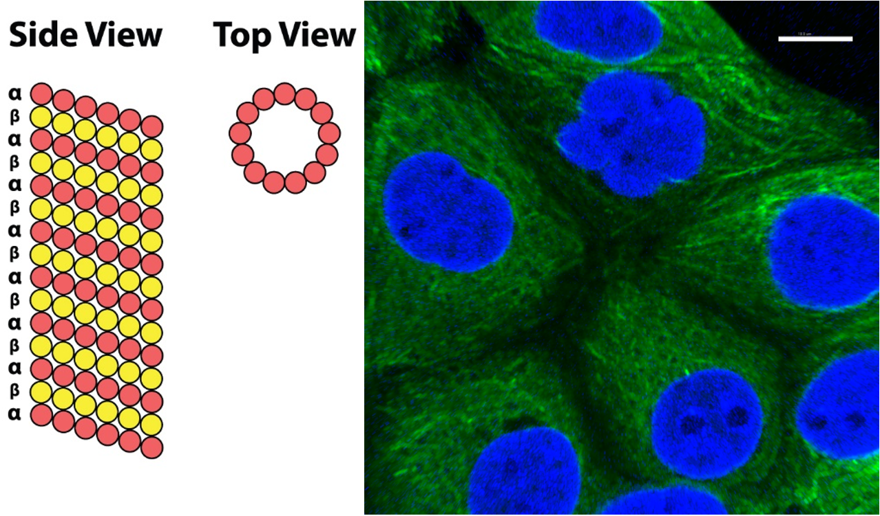
Anti-tubulin agents: Mode of Action of CA-4, Colchicine and The Meegan Group’s Combretazet Family
Colchicine derivatives will bind at the CBS and induce GTPase activity at the GTP cap on microtubules.
GTPase activity will promote loss of the microtubules GTP cap and cause tubulin dissasebly and de-polymerisation.
Colchicines toxicity limits it’s clinical use at higher doses for the treatment of cancer. Currently it is used in low doses for acute treatment of gout only. It’s toxicity also limits its use for the prevention of gout. (9,10)
The phosphate prodrug of CA-4, Fosbretabulin is currently undergoing clinical trials. (11-14)
To date no MTA targeting the Colchicine binding site is in routine clinical use.
Microtubule structure from side (left) and top perspectives (right). Side: Long, linear protofilaments consisting of αβ-tubulin heterodimers associate laterally. Top: Association of 13 protofilaments forms the microtubule, a long hollow cylinder. Right: Microtubule network in MCF-7 breast cancer cell in interphase ; cells were stained with mouse monoclonal anti-α-tubulin−FITC antibody (clone DM1A) (tubulin, green) Alexa Fluor 488 dye and counterstained with DAPI (nuclei, blue). Scale bar: 10 μM

Slide 8
Modifications to prevent cis → trans isomerization by the Meegan Group
Compound | IC₅₀ in MCF7 Cells
CA-4 | 5.2 nM
01R | 4 nM
02R | 22 nM
03R | 3 nM
04R | 4 nM
05R | 12 nM
06R | 5 nM
Replace double bond of Cis CA-4 with β-Lactam ring
Enables cis restriction of A and B rings
β-Lactam Cis Restricted Analogues of CA-4 – ‘the combretazets’,
  Promising analogues – greater OR comparable tubulin depolymerization potency with respect to CA-4
Rigid β-Lactam ring scaffold permits similar spatial arrangement between the two aromatic rings of cis CA-4
  overcoming issue of isomerization to inactive trans derivative.
Potency enhanced for analogues shown with respect to CA-4 in human breast cancer cell lines.
Potential treatment for triple negative breast cancer.
All analogues illustrated to date are racemic mixtures.
Isolation of individual enantiomers from respective racemic mixtures with potential to provide analogues of CA-4 with sub nanomolar IC₅₀ values for the treatment of breast cancer.
Most potent analogues selected for isolation as single enantiomer derivatives via chiral resolution (one enantiomer shown)

Slide 9
Lessons on Stereochemistry of organic compounds: Significance of chirality in Biochemical Environments
Stereoisomers are identical molecular species in both atomic constitution and bonding, differing only in three- dimensional spatial arrangement of atoms.
Stereoisomers with similar asymmetric centres which are mirror images of each other are termed enantiomers (seen for 01R below)
Enantiomers are physically identical (same melting point, boiling point, ¹ H NMR etc.) with the exception of their optical rotation of plane polarized light.
Chemical properties of chiral compounds are identical in achiral environments only.
However, properties of enantiomers can be vastly different in chiral environments including biological systems.
  Drug receptors are 3D proteins which are made up of chiral amino acids.
  Enantiomeric pairs may have greater or less affinity for receptors OR may be metabolised to a greater or lesser extent.

Slide 10
Chemistry: Synthesis of Racemic mixtures of ‘The Combretezet Family’ followed by Isolation of Enantiomers using Chiral Resolving agent

Slide 11
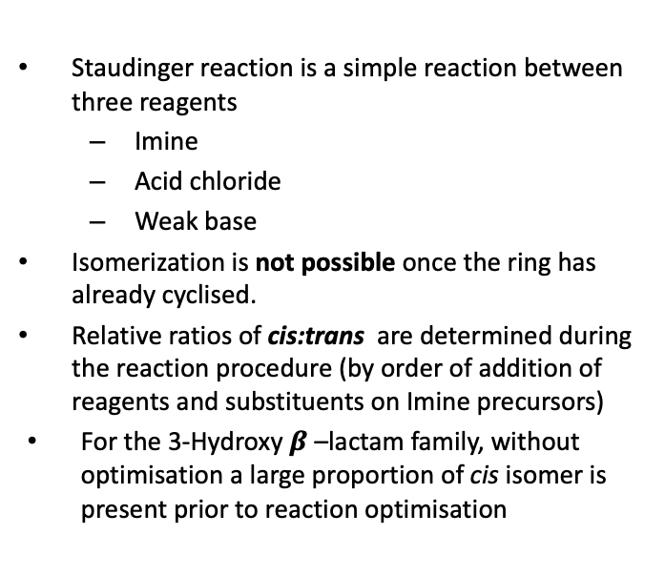
Synthesis of Racemic Mixtures: Staudinger Reaction
Staudinger reaction is a simple reaction between three reagents
  Imine
  Acid chloride
  Weak base
Isomerization is not possible once the ring has already cyclised.
Relative ratios of cis:trans are determined during the reaction procedure (by order of addition of reagents and substituents on Imine precursors)
For the 3-Hydroxy $β$ –lactam family, without optimisation a large proportion of cis isomer is present prior to reaction optimisation

Slide 12
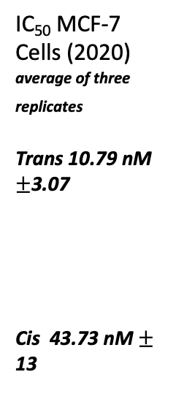
Synthesis of Racemic Mixtures: Staudinger Reaction
Important to isolate only the trans isomer. Cis isomer is significantly less active.
IC₅₀ MCF-7 Cells (2020) average of three replicates
Trans 10.79 nM $±$3.07
Cis 43.73 nM $±$ 13

Slide 13
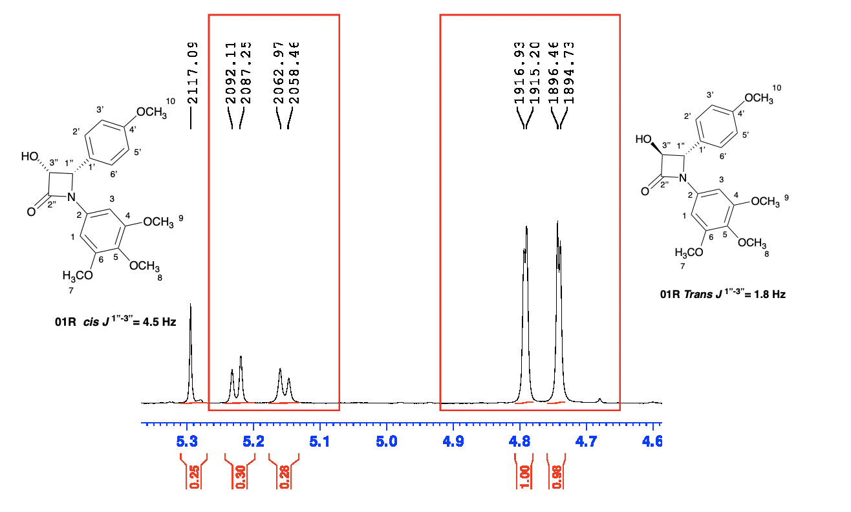
Preliminary Synthesis of 3-Hydroxy-β-Lactams
Mixed isomers present
Evidence:
  Duplication of peaks
  β-Lactam hydrogen doublets on ¹ H NMR duplicated. (H_{1&3})
Ratio of cis:trans can be seen as 1:4 with an integration of 0.3 cis :1.01 trans. (H_{1’’} and H_{3’’} doublets for cis and trans of 01R)

Slide 14
Optimised Synthesis of 3-Hydroxy-β-Lactams yielding > 95% Trans isomer
Reaction | Reaction Conditions | Ratio of Trans: Cis as per crude ¹ H NMR of Staudinger
1 | Imine and acid chloride (acetoxyacetyl chloride) allowed to stir for 20 mins at reflux prior to dropwise addition of base TEA. | 95:5
2 | Imine, TEA and acetoxyacetyl chloride added to solvent at 0 degrees and heated to reflux immediately | 20:80

Slide 15
Optimised Synthesis of 3-Hydroxy-β-Lactams yielding > 95% Trans isomer
Clipping of ¹ H NMR for Optimised Staudinger showing Trans 01a as major product
Conclusions:
Heating to reflux conditions prior to addition of tertiary base - appears to allow isomerization (k₂) by allowing reaction of imine with acid chloride

Slide 16
Chemistry: Synthesis of Racemic mixtures of ‘The Combretezet Family’ followed by Isolation of Enantiomers using Chiral Resolving agent

Slide 17
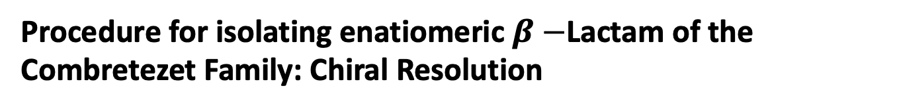
Procedure for isolating enatiomeric $β−$Lactam of the Combretezet Family: Chiral Resolution
Chiral resolution using N-(tert-butoxycarbonyl)-L-Proline is used to obtain enantiomerically pure β-lactams (illustrated on top left) obtained by esterification of the 3-OH.
This is followed by diastereomer separation using gravity column chromatography and a slow gradient elution (n-hexane: MTBE 80:20 – 33:66).
The eluent was optimised by visualising diastereomer separation on TLC.
Gradual separation is essential and thus the decision to separate using elution under gravity versus elution under flash pressure.
Removal of the amino acid affords free and optically pure enantiomers for biological testing.

Slide 18
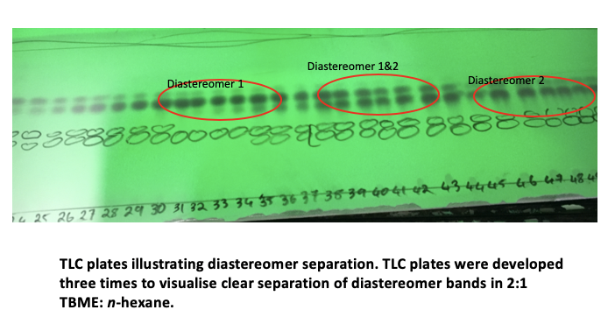
TLC plates showing separation of 01DS1&2
Choice of Chiral Resolving agent appears to be significant
N-(Tert-butoxycarbonyl)-L-Proline is the only amino acid which functions as a chiral resolving agent resulting in separation on TLC and subsequently on polar silica during column chromatography.
The eluent was optimized for the Resolution Procedure using TLC.
N-(Tert-butoxycarbonyl)-D-Proline trialled with no success.
N-(Tert-butoxycarbonyl)-L-Valine trialled with no success.
N-(Tert-butoxycarbonyl)-L-Phenylalanine – trialled tried with no success.
(Racemic as impurity sitting on top of diasteromer 1 (highest Rf) on this TLC)

Slide 19
Confirmation of Chiral Purity of Enantiomers
X-ray Crystallography providing absolute configuration
Chiral HPLC to determine % enantiomeric excess

Slide 20
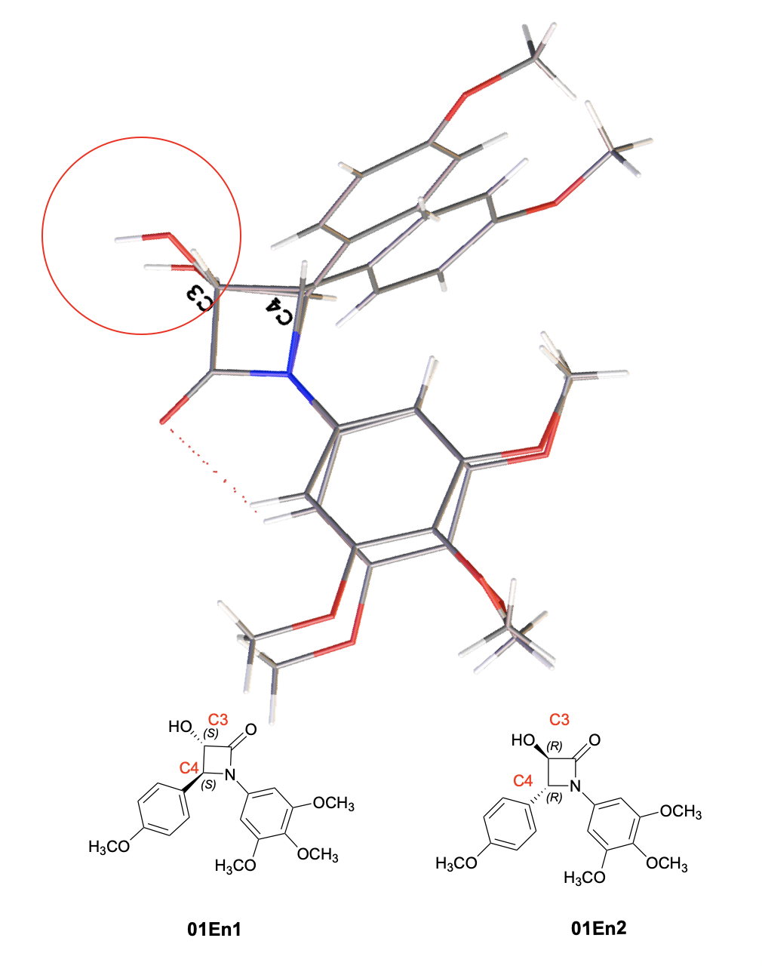
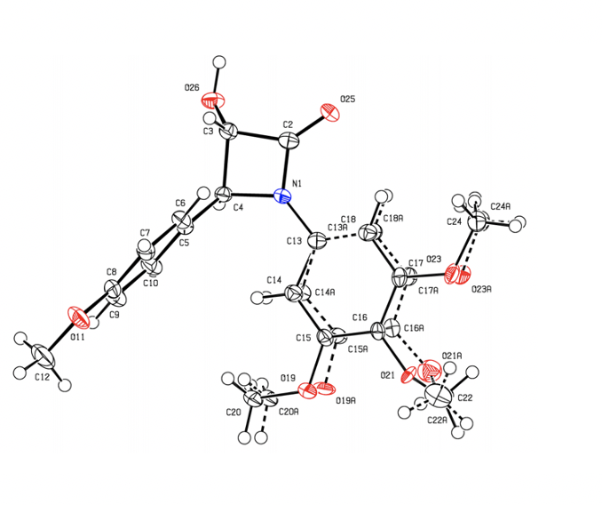
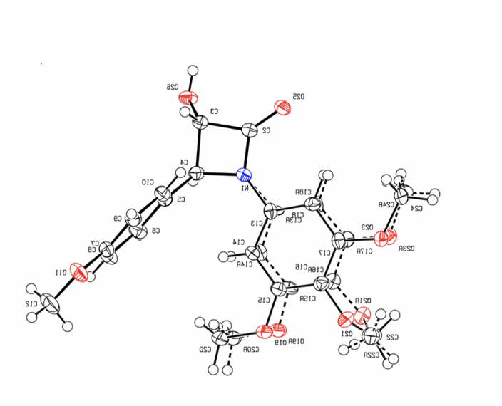
X-ray Crystallography for 01En1 & 01En2 confirming Absolute Stereochemistry and Chiral Purity
Chiral resolution has been achieved as seen on the superimposed X-ray crystal structures for 01 3-S,4-S and 01 3-R,4-R at the C3 and C4 positions. X ray crystallography confirms the absolute configuration for 01En1 as S and 01En2 As R at the C3 position. (highlighted by the red circle)
[α]²⁰_{D} : +25.14
[α]²⁰_{D} : -25.38

Slide 21
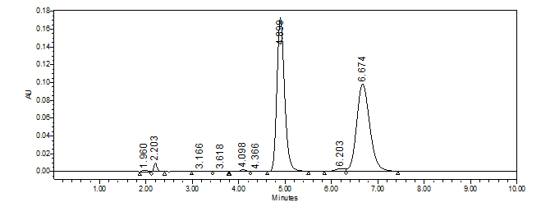
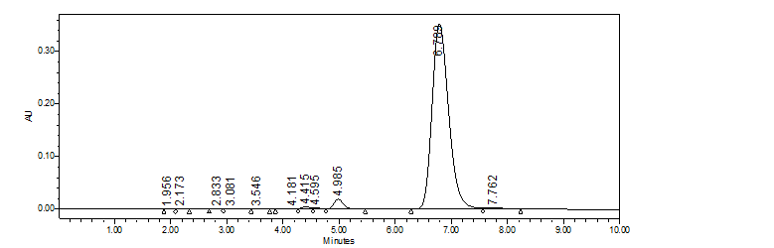
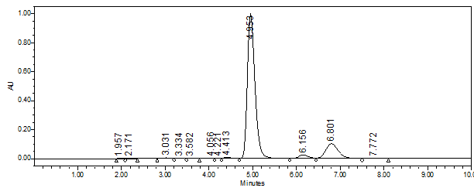
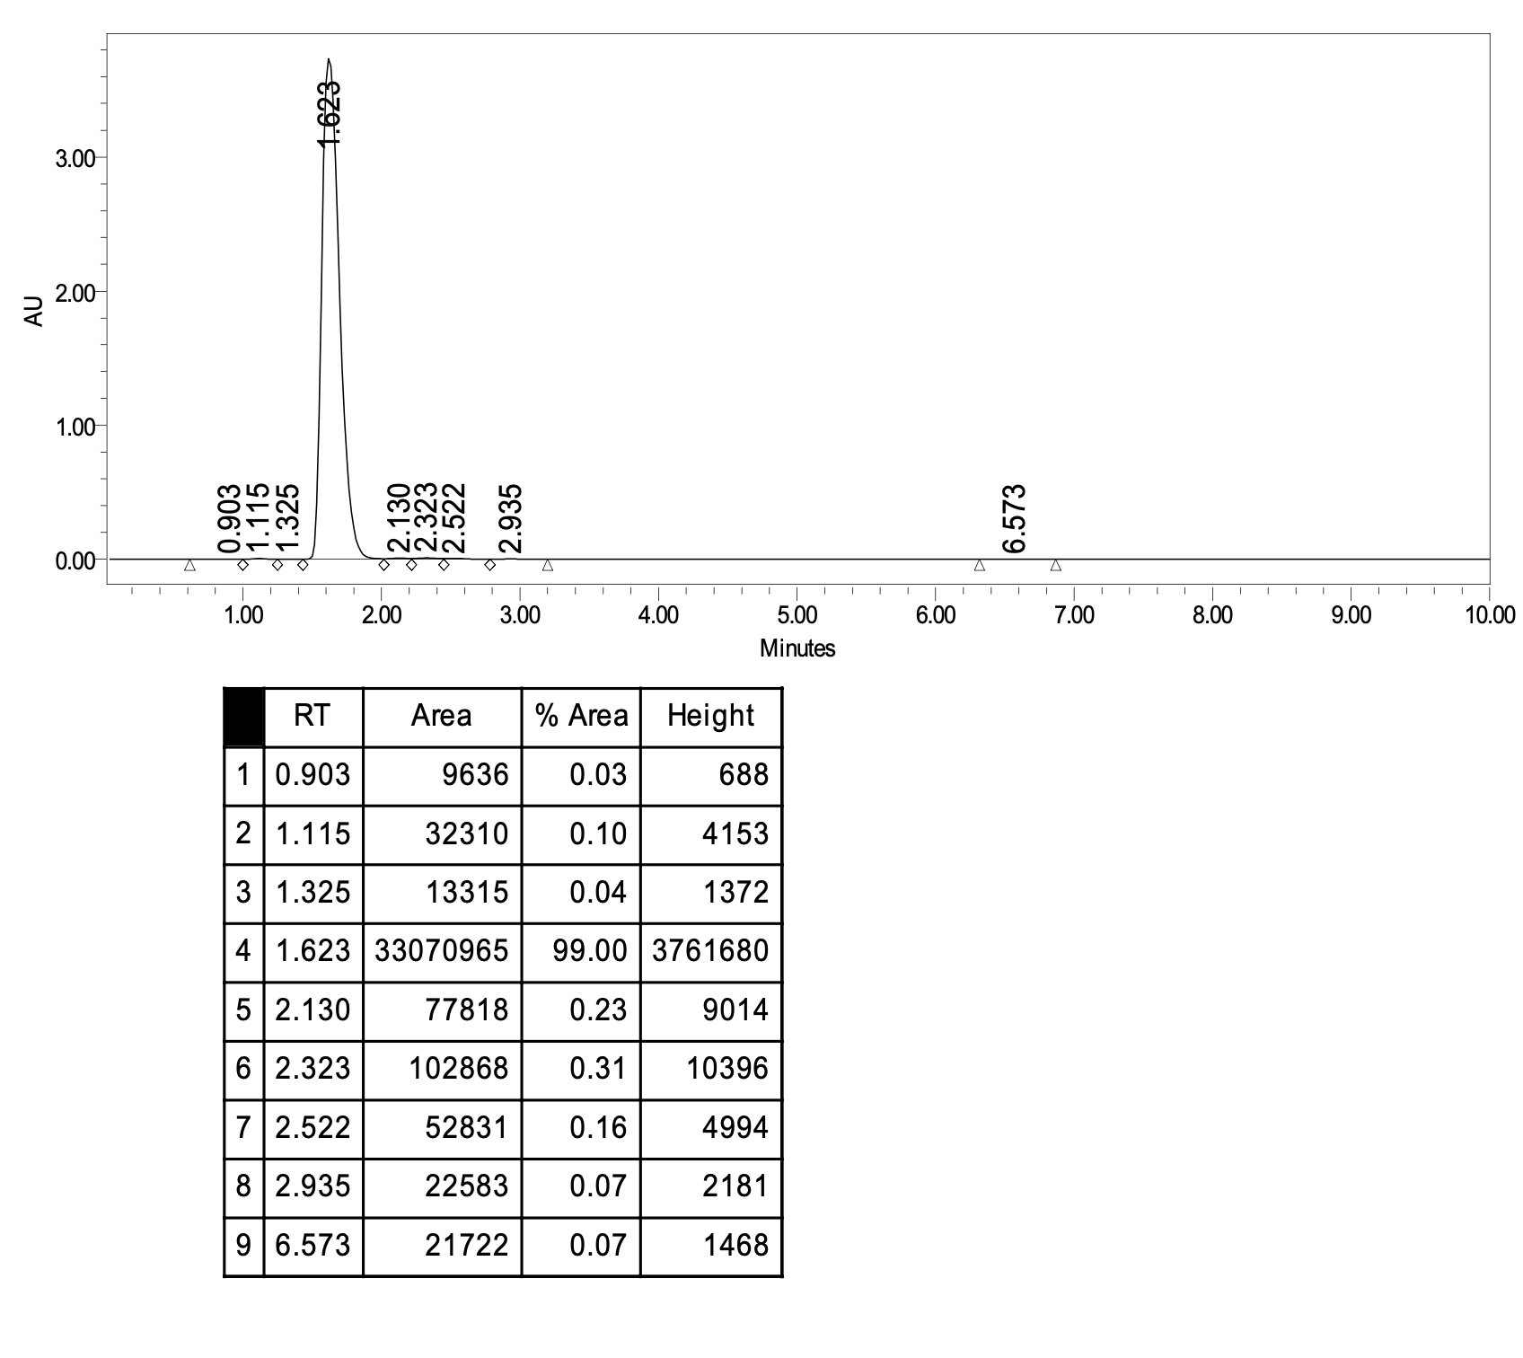
Chiral HPLC for 01 Combretazet Family
Chiral HPLC data for 01R
Chiral HPLC data for 01En1
Chiral HPLC data for 01En2
 | Major Peak % | Minor Peak % | Major-Minor | Total % Enantiomeric Excess(ee%)
01 En1 (S,S) | 96.96 | 3.04 | 96.96-3.04 | 93.93%
01 En2(R,R) | 85.39 | 14.61 | 85.39-14.61 | 70.78%
General method
Chrompak-IH-3 150 x 4.6 mm supplied by Chiral Technologies Europe with a Chiral- IH-3 guard column was used. This column utilised an immobilized chiral polysaccharide stationary phase, tris(S)-a-methylbenzylcarbamate
injection of 5 μL of sample
1 mg/mL
10 minute Run time
using n-hexane:propan-2-ol, 50:50 as mobile phase.
Achiral HPLC for 01R 70:30 ACN/H₂O

Slide 22
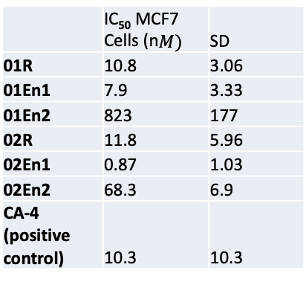
Biochemical Data in MCF-7 Breast Cancer Cells for 01 and 02 Combretazets
3-S, 4-S enantiomer appears superior in both cases (01En1 and 02En1)
02En1 appears extremely potent with an IC₅₀ in sub nanomolar range in MCF-7 cells
Compounds with greater activity than CA-4 in MCF-7 cells.
 | IC₅₀ MCF7 Cells (n$M)$ | SD
01R | 10.8 | 3.06
01En1 | 7.9 | 3.33
01En2 | 823 | 177
02R | 11.8 | 5.96
02En1 | 0.87 | 1.03
02En2 | 68.3 | 6.9
CA-4 (positive control) | 10.3 | 10.3

Slide 23
Cell Viability Data for 02R, 02En1 and 02En2 in MCF-7 Breast Cancer Cells
IC₅₀
11.87 nM
IC₅₀
0.871 nM
IC₅₀
68 nM

Slide 24
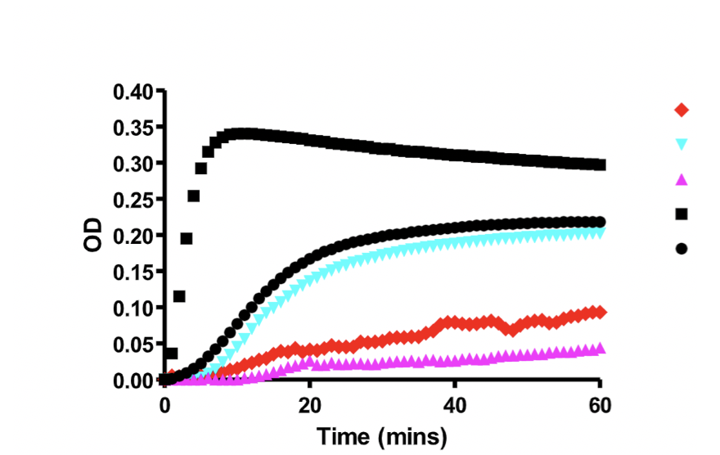
Preliminary Tubulin Polymerisation Assay for 02R, 02En2 and 02En2
02R (red diamond)
02En2 (light blue triangle)
02En1 (pink triangle)
Paclitaxel (positive control – black square)
Vehicle DMSO (black circle)
Preliminary Tubulin Polymerisation Assay illustrating 02R in red as an anti-tubulin agent, 02En1 in pink as a superior anti-tubulin agent.
02En2 although a potent Anti-proliferative analogue, does not appear to have anti-tubulin effects.

Slide 25
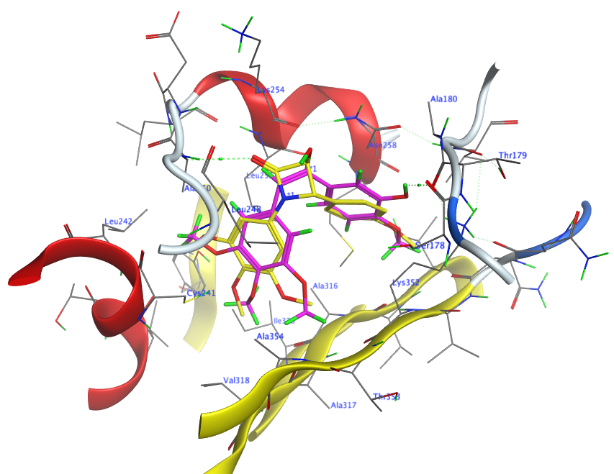
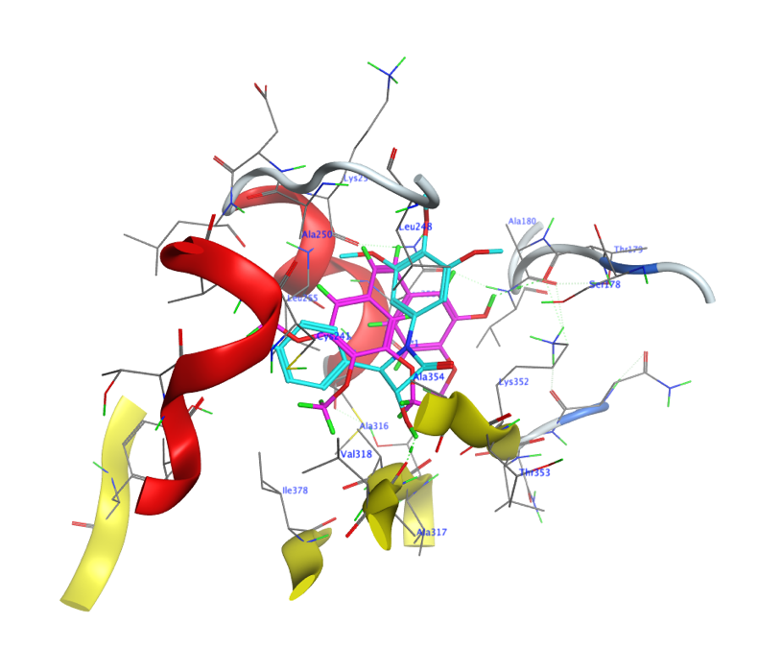
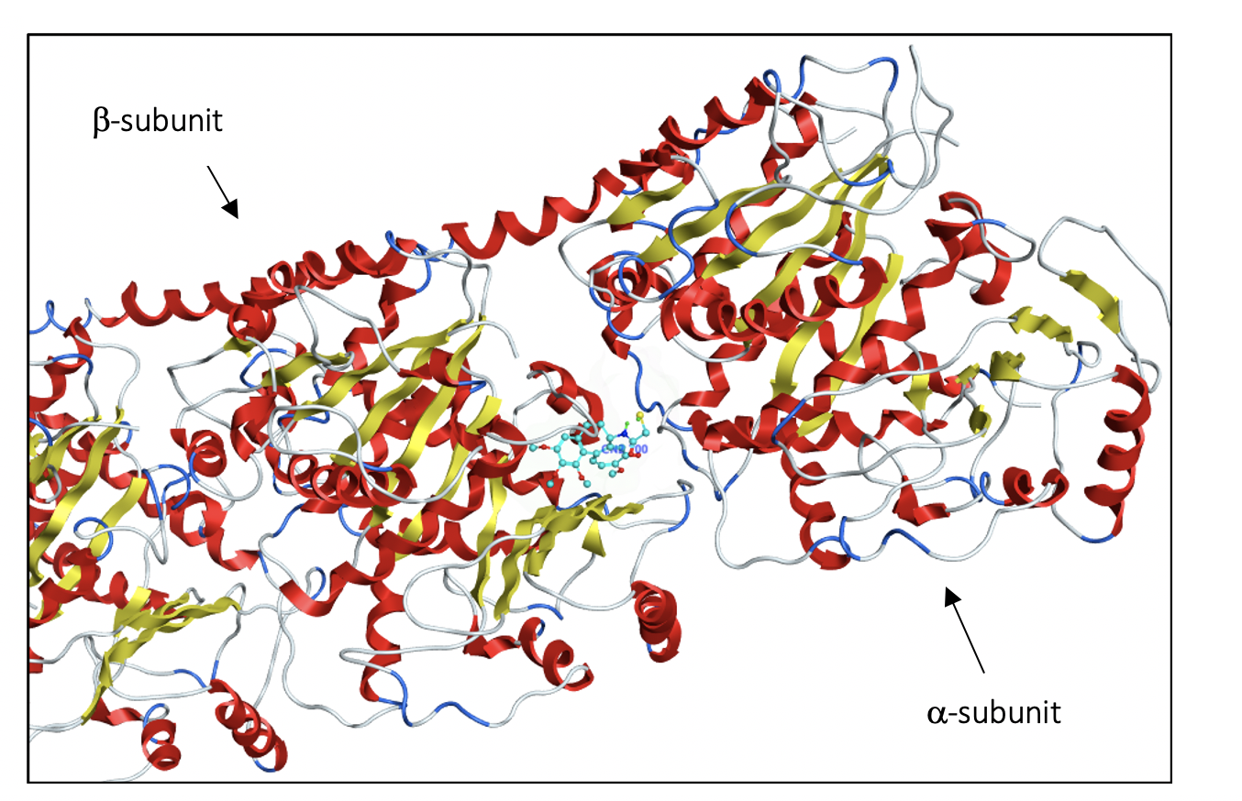
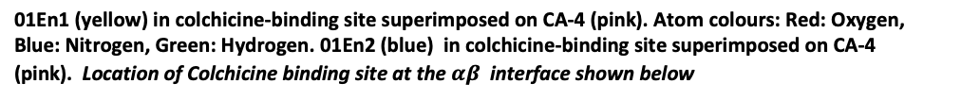
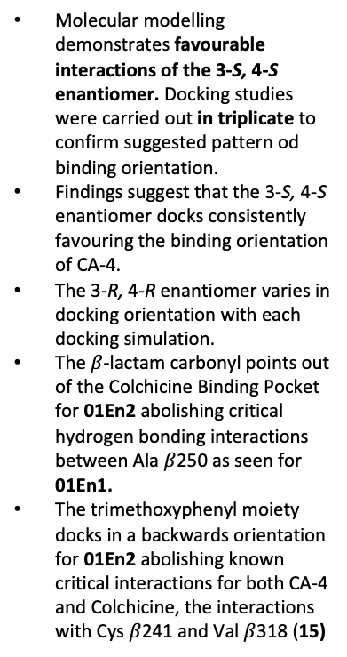
Molecular Modelling Data for 01 Combretazet Family
Molecular modelling demonstrates favourable interactions of the 3-S, 4-S enantiomer. Docking studies were carried out in triplicate to confirm suggested pattern od binding orientation.
Findings suggest that the 3-S, 4-S enantiomer docks consistently favouring the binding orientation of CA-4.
The 3-R, 4-R enantiomer varies in docking orientation with each docking simulation.
The $β$-lactam carbonyl points out of the Colchicine Binding Pocket for 01En2 abolishing critical hydrogen bonding interactions between Ala $β$250 as seen for 01En1.
The trimethoxyphenyl moiety docks in a backwards orientation for 01En2 abolishing known critical interactions for both CA-4 and Colchicine, the interactions with Cys $β$241 and Val $β$318 (15)
01En1 (yellow) in colchicine-binding site superimposed on CA-4 (pink). Atom colours: Red: Oxygen, Blue: Nitrogen, Green: Hydrogen. 01En2 (blue) in colchicine-binding site superimposed on CA-4 (pink). Location of Colchicine binding site at the $αβ$interface shown below

Slide 26
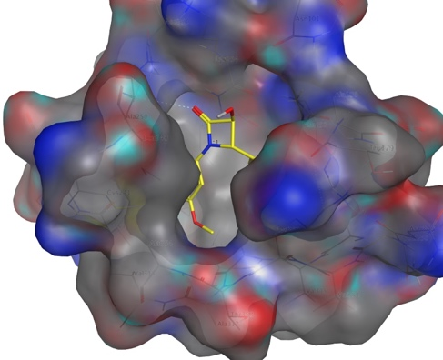
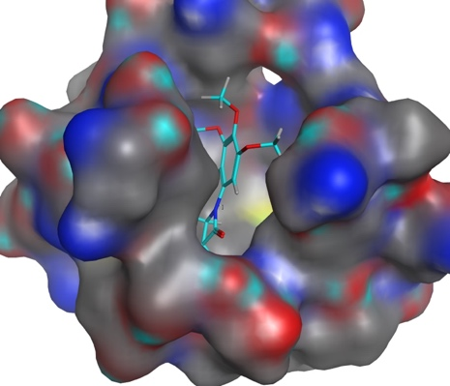
Molecular Modelling Data for 01 Combretazet Family
01En1 (yellow), 01En2 (cyan) in the Colchicine binding pocket. Red: Hydrophilic pocket interactions. Blue: hydrophobic pocket interactions. Black: neutral pocket interactions.
01En1 (yellow) can be visualised with carbonyl hydrogen bonding to Alaβ250 and 3-OH pointing out of Colchicine binding pocket.
01En2 (cyan) in contrast is seen with trimethoxyphenyl ring and carbonyl pointing out of pocket without the critical Alaβ250 interaction.

Slide 27
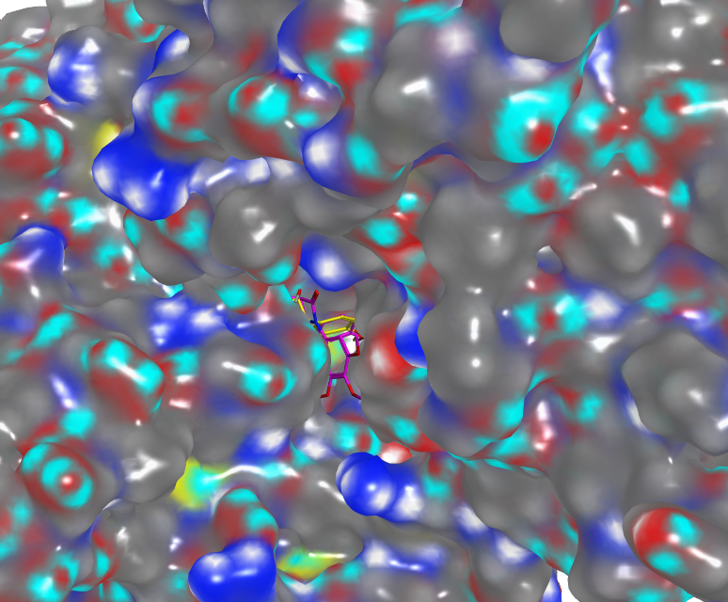
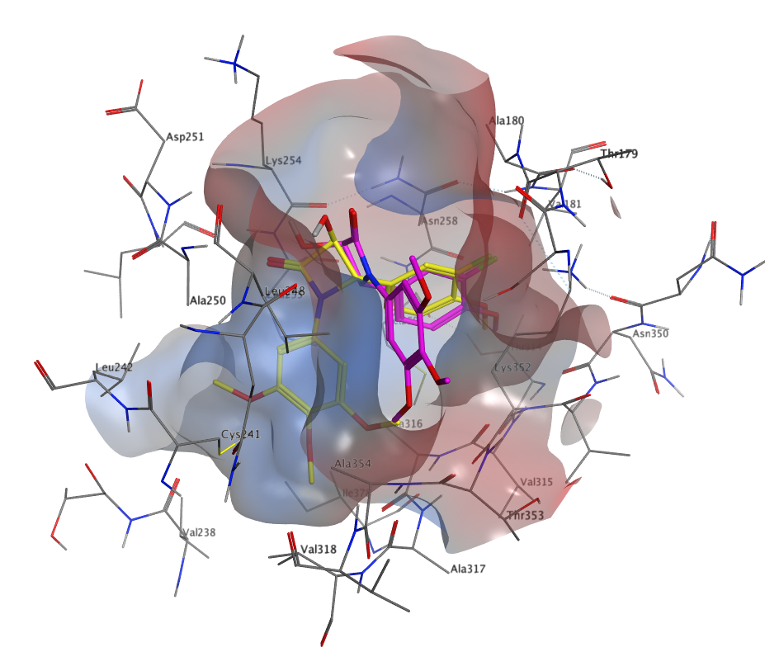
Molecular Modelling Data for 02 Combretazet Family
Colchicine binding site opening in 1SA0 receptor illustrating trimethoxyphenyl ring of 02En2 (pink) emerging and β-lactam carbonyl pointing out of pocket for 02En2 (pink).
02En1 in yellow seen buried deep within the binding pocket (Blue: hydrophobic pocket interactions. Black: neutral pocket interactions)
02En1 (yellow) and 02En2 (pink) docked at the colchicine-binding site. B rings display similar interactions while the β-lactam ring points to opposite sides of the pocket.
The trimethoxyphenyl rings are at a 180° angle to one another with 02En2 failing to interact with the key residues Cysβ241, Valβ238 and Valβ318

Slide 28
Conclusions & Future Work
The 3-S, 4-S enantiomer holds more biological activity relative to the 3-R,4-R. Relative contribution of each enantiomer towards the racemic IC₅₀ value must be further investigated.
Full panel of Combretezets to be screened in both MCF-7 cells (estrogen receptor positive breast cancer cells) and MDA-MB-231 cells (triple negative cells)
Tubulin Polymerisation Assays for each enantiomer.
Prodrug synthesis for most promising lead analogue.
Co-crystallisaton of analogues in Tubulin as a follow up to molecular modelling.

Slide 29
Acknowledgments
Professor Mary J. Meegan for expertise and advice on the synthesis of the Combretezet family.
Dr. Daniela Zisterer for guidance and advice on biochemistry, and use of cell culture facilities.
Dr. Manuel Ruether and Dr. John O’Brien for invaluable contribution towards spectroscopic characterisation of both diastereisomers and enantiomers.
Dr. Brendan Twamley for X-ray crystallography of enantiomers.
Dr. Azizah Malebari for providing the data on preliminary tubulin polymerisation assays.
Dr. Darren Fayne for advice on construction up of molecular procedures.
Mr. Conn Power (MSc. Student) for the Chiral HPLC data.
Miss Sophie Knox for her work on the Phenylalanine Prodrug synthesis.
Mr Mark Lyons for his work on the Valine Prodrug synthesis.

Slide 30



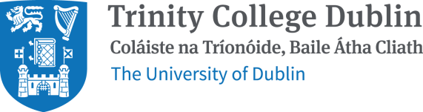
Acknowledgements – Thank You to Our Funders
Trinity College Dublin Provost’s PhD Project Awards
Royal Society of Chemistry Research Fund
TCD Wellcome Trust ISSF

Slide 31
References
Pettit, G. R.; Singh, S. B.; Hamel, E.; Lin, C. M.; Alberts, D. S.; Garcia-Kendall, D., Isolation and structure of the strong cell growth and tubulin inhibitor combretastatin A-4. Experientia 1989, 45 (2), 209-11.
O’Boyle, N. M.; Carr, M.; Greene, L. M.; Bergin, O.; Nathwani, S. M.; McCabe, T.; Lloyd, D. G.; Zisterer, D. M.; Meegan, M. J., Synthesis and Evaluation of Azetidinone Analogues of Combretastatin a-4 as Tubulin Targeting Agents. Journal of Medicinal Chemistry 2010, 53 (24), 8569-8584.
Malebari, A. M.; Fayne, D.; Nathwani, S. M.; O’Connell, F.; Noorani, S.; Twamley, B.; O’Boyle, N. M.; O’Sullivan, J.; Zisterer, D. M.; Meegan, M. J., Β-Lactams with Antiproliferative and Antiapoptotic Activity in Breast and Chemoresistant Colon Cancer Cells. European Journal of Medicinal Chemistry 2020, 189, 112050.
Prota, A. E.; Bargsten, K.; Diaz, J. F.; Marsh, M.; Cuevas, C.; Liniger, M.; Neuhaus, C.; Andreu, J. M.; Altmann, K.-H.; Steinmetz, M. O., A New Tubulin-Binding Site and Pharmacophore for Microtubule-Destabilizing Anticancer Drugs. Proceedings of the National Academy of Sciences of the United States of America 2014, 111 (38), 13817-13821.
Malebari, A. M.; Greene, L. M.; Nathwani, S. M.; Fayne, D.; O'Boyle, N. M.; Wang, S.; Twamley, B.; Zisterer, D. M.; Meegan, M. J., Β-Lactam Analogues of Combretastatin a-4 Prevent Metabolic Inactivation by Glucuronidation in Chemoresistant Ht-29 Colon Cancer Cells. European Journal of Medicinal Chemistry 2017, 130, 261-285.
O’Boyle, N. M.; Carr, M.; Greene, L. M.; Keely, N. O.; Knox, A. J. S.; McCabe, T.; Lloyd, D. G.; Zisterer, D. M.; Meegan, M. J., Synthesis, Biochemical and Molecular Modelling Studies of Antiproliferative Azetidinones Causing Microtubule Disruption and Mitotic Catastrophe. European Journal of Medicinal Chemistry 2011, 46 (9), 4595-4607.
Greene, T. F.; Wang, S.; Greene, L. M.; Nathwani, S. M.; Pollock, J. K.; Malebari, A. M.; McCabe, T.; Twamley, B.; O’Boyle, N. M.; Zisterer, D. M.; Meegan, M. J., Synthesis and Biochemical Evaluation of 3-Phenoxy-1,4-Diarylazetidin-2-Ones as Tubulin-Targeting Antitumor Agents. Journal of Medicinal Chemistry 2016, 59 (1), 90-113.
Wilson, L.; Jordan, M. A., Microtubule Dynamics:Taking Aim at a Moving Target CrossTalk Chemistry & Biology 1995, 2, 569-573.
Ahern, M. J.; Reid, C.; Gordon, T. P.; McCredlE, M.; Brooks, P. M.; Jones, M., Does Colchicine Work? The Results of the First Controlled Study in Acute Gout. Australian and New Zealand Journal of Medicine 1987, 17 (3), 301-304.
Lange, U.; Schumann, C.; Schmidt, K. L., Current Aspects of Colchicine Therapy - Classical Indications and New Therapeutic Uses. European journal of medical research 2001, 6 (5), 150-160
Mooney, C. J.; Nagaiah, G.; Fu, P.; Wasman, J. K.; Cooney, M. M.; Savvides, P. S.; Bokar, J. A.; Dowlati, A.; Wang, D.; Agarwala, S. S.; Flick, S. M.; Hartman, P. H.; Ortiz, J. D.; Lavertu, P. N.; Remick, S. C., A Phase Ii Trial of Fosbretabulin in Advanced Anaplastic Thyroid Carcinoma and Correlation of Baseline Serum-Soluble Intracellular Adhesion Molecule-1 with Outcome. Thyroid : official journal of the American Thyroid Association 2009, 19 (3), 233-240.
Griggs, M. J., Hesketh R., Targeting Tumour Vasculature: The Development of Combretastatin A4.. Lancet: Oncology 2 (2), 82-87.
EMA, Public Summary of Opinion on Orphan Designation Fosbretabulin Tromethamine for the Treatment of Gastro-Entero-Pancreatic Neuroendocrine Tumours EMA, Ed. EMA: London, 2016; pp 1-5.
EMA, Public Summary of Opinion on Orphan Designation Fosbretabulin Tromethamine for the Treatment of Ovarian Cancer. EMA, Ed. EMA: London, 2013; pp 1-4.
Ravelli RB, G. B., Curmi PA, Jourdain I, Lachkar S, Sobel A, Knossow M., Insight into Tubulin Regulation from a Complex with Colchicine and a Stathmin-Like Domain. Nature 2004, 428 (6979), 198-202.

