Slide 1
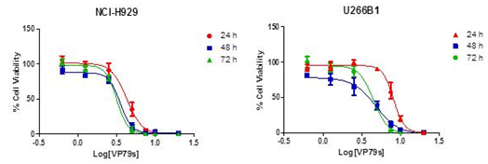
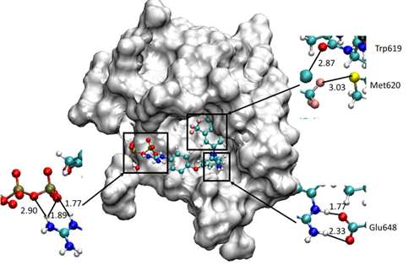
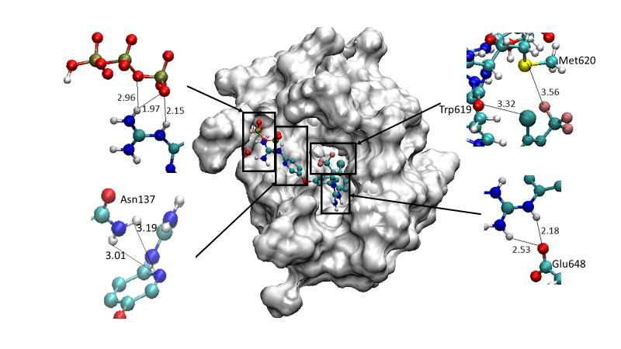
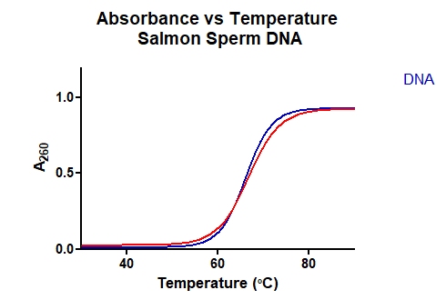
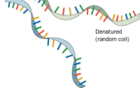
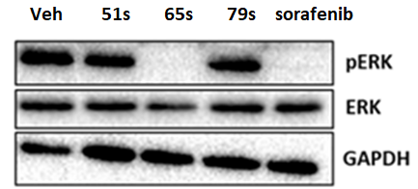
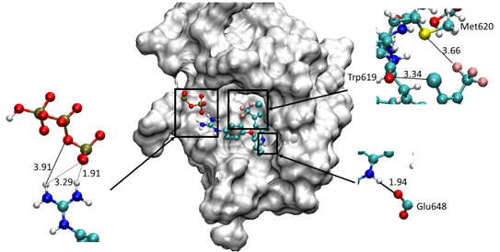
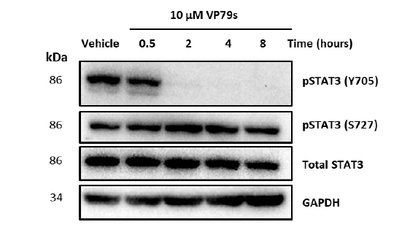
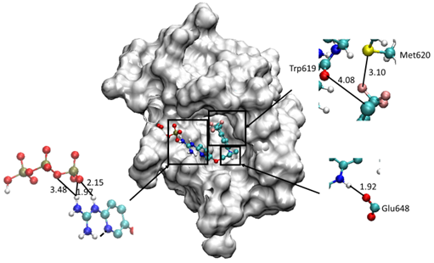
Guanidinium-like protein kinase inhibitors as anticancer agents
Helene B. Mihigo¹, Isabel Rozas¹
¹School of Chemistry, TBSI, Trinity College Dublin, 152-160 Pearse Street, Dublin 2.
mihigoh@tcd.ie; rozasi@tcd.ie
1. Introduction
Protein kinases (PKs), which are the second most important group of drug targets,¹ are currently being rigorously researched in medicinal chemistry. PKs can be inhibited by 3 types of inhibitors: type I (ATP competitive), type II (bind to the inactive conformation of the kinase) and type III (bind only to an allosteric site). Thus, type III inhibitors are highly selective as they do not bind to the conserved ATP binding site.² Previous work in the group found that compound 1 is a BRAF allosteric inhibitor, but its derivative, VP-79S, even though biologically active, does not inhibit BRAF, rather it was found to inhibit the JAK2/STAT3 pathway.⁴
2. Objectives
Synthesis of derivative of VP-79S
Docking studies of lead 1 and its derivatives in BRAF ‘in-house’ model
Biological evaluation of VP-79S
3. Synthesis
5. Biological evaluation of VP-79S
6. Conclusions
VP-79S kills MM cells at low µm concentration
. VP-79S targets the JAK2/STAT3 signalling pathway
New derivatives of compound VP-79S have been synthesised
4. Docking
Multiple Myeloma cell lines, U266 and H929, were treated with VP-79S. It was found that VP-79S killed the cells with low micromolar range concentrations.
Docking of lead compound 1 in the TP-containing BRAF model. Strong hydrogen bonding and electrostatic interactions observed.
Docking of VP-65S in the TP-containing BRAF model. Similar to 1 strong hydrogen bonding and ionic interactions are seen. The biding of the ligand is further reinforced by the new hydrogen interactions introduced by the pyridine.
DNA
VP-79S
VP-79S and VP-51S were found not to interfere with the Ras/ERK pathway but VP-65S and sorafenib(a known ERK inhibitor) were found to act similarly to lead compound 1in HL-60 cell line.
VP-79S does not bind/stabilise DNA based on thermal meting studies
VP79s was found to inhibit STAT3 phosphorylation on tyrosine 705 in a time dependent manner in U266.
VP-79S and ruxolitinib(known JAK2 inhibitor) were shown to inhibit phospho-JAK2 in the U266 cell line.
Docking of VP-51S in the TP-containing BRAF model. Replacement of the di-substituted guanidine by a secondary amine leads to a significantly
shorter molecule, leading to key hydrogen bond interaction being lost as well as electrostatic interaction
Docking of VP-79S in the TP-containing BRAF model. This derivative behaves similarly to VP-51S.
7. References
(1) Cohen, P. Nat. Rev. Drug Discov. 2002, 1, 309.
Zhang, J.; Yang, P. L.; Gray, N. S. Nat. Rev. Cancer 2009, 9, 28.
(3) Diez-Cecilia, E. et al. Bioorg. Med. Chem. Lett. 2015. 25, 4287-4292
(4) Rebecca Amet et al., in preparation.
8. Acknowledgements
The authors thank the Irish Research Council for postgraduate funding (HBM) and to Dr Cristina Trujillo, Prof. Daniela Z. Zisterer, Dr Rebecca Amet, Dr. Viola Previtali and Dr. Elena Diez-Cecilia for their contribution.

