Slide 1


In silico design, synthesis and evaluation of MurD and MurE ligase inhibitors as antibacterial agents
Niladri Saha ^{1,}*, Dr. Md. Afzal Azam²
¹ Research Scholar, Department of Pharmaceutical Chemistry,
JSS College of Pharmacy, Ooty ;
² Head and Professor, Department of Pharmaceutical Chemistry,
JSS College of Pharmacy, Ooty .
* Corresponding author: niladri9007@gmail.com

Slide 2
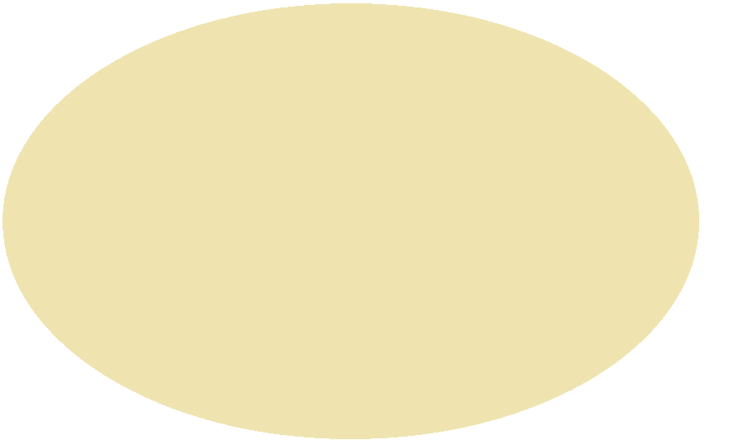

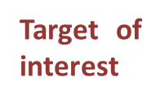
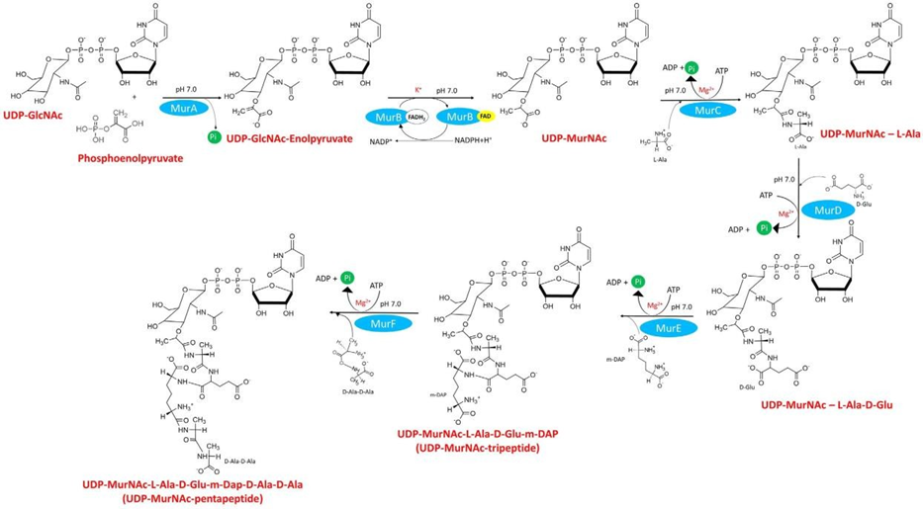
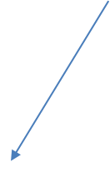
Dual Inhibition of MurD and MurE: A strategy for Anti-resistant Antibiotics Development
Graphical Abstract

Slide 3
Abstract:
Bacterial resistance is one of the biggest threat to health community, especially hospital acquired MRSA. There are various mechanisms are involved in bacterial resistance out of which, the penetration of cell wall and the mutation of target receptor are the most important. From the beginning, the later stage of Peptidoglycan synthesis has been targeted which occurs outside the cytoplasm. The early stage of peptidoglycan synthesis has never been exploited. Inside the cytoplasm a group of enzyme known as Mur enzymes having similar mechanism of action using ATP, act consecutively and the active residues for all the enzymes are conserved. These make them ideal for multi-target. The MurD involve in adding the D-glu amino acid whereas MurE involve for L-Lys/m-DAP amino acid addition. The MurE act as a gatekeeper for gram-positive and gram-negative bacteria. The product of the previous enzyme act as a substrate for the next one. By designing similar chemical nature to the MurD product, will be having the dual affinity. But the major drawback of these inhibitors are penetration. The IC₅₀ values and the MIC values have not correlated for most of the inhibitors. The current work is focused on this problem and we have designed some novel scaffold using various drug designing tools to get the desired hits. The MIC values and time kill studies of the synthesized compound has been carried out against MRSA (ATCC-43300). All the MICs were within µg/ml and better time–kill studies shown against the standard drug ciprofloxacin. These hits can optimized further to get the desired lead.
Keywords: MRSA; MurD; MurE.

Slide 4
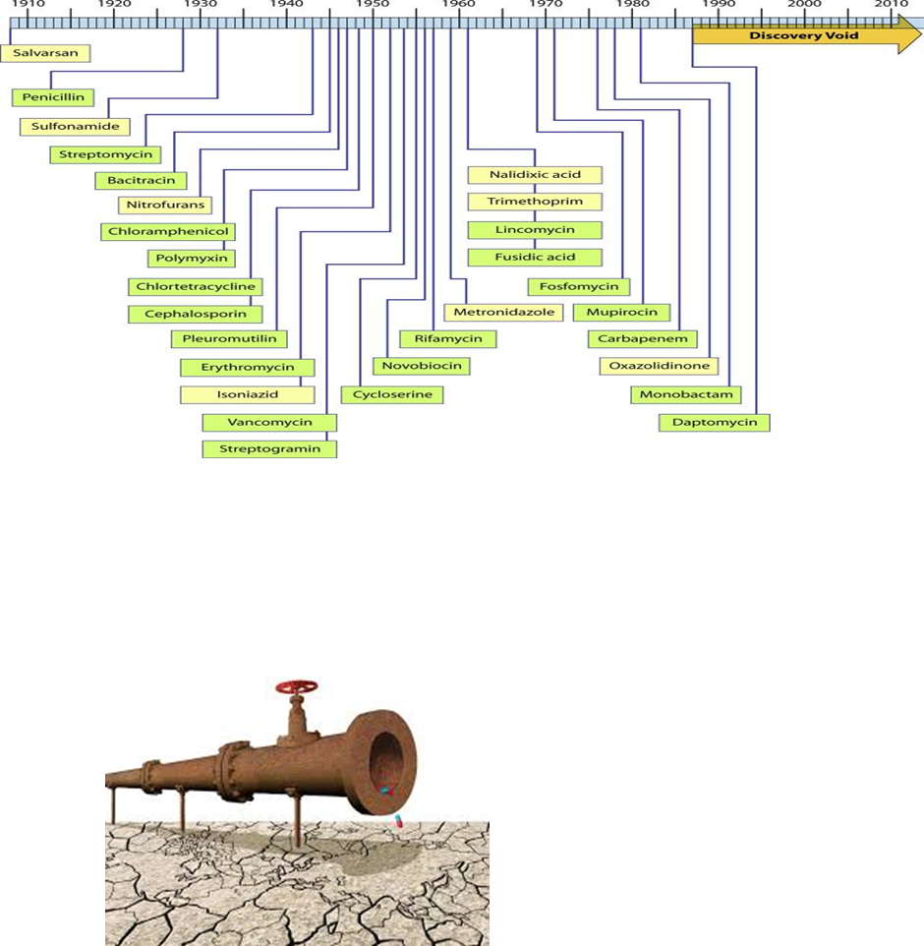

Introduction
Last resort antibiotics:
Vancomycin
Linezolid
Colistin
Daptomycin
3rd and 4th generation cephalosporins
Antibiotics approved by the U.S. Food and Drug Administration (FDA) Jan- 2010 to Dec 2017 were
Ceftaroline
Fidaxomicin
Bedaquiline
Dalbavancin
Tedizolid
Ceftolozane–tazobactam
Ceftazidime–avibactam
Meropenam
Delafloxacin

Slide 5
Literature survey (MurD)
E.coli MurD IC₅₀ 280 μM
E.coli MurD IC₅₀ 280 μM
E. coli MurD 56% residual activity at 500 μM
E. coli MurD IC₅₀ 270 µM; E. coli MurE IC₅₀ 32 µM
E.coli MurD IC₅₀ 230
μM MIC-128 μg/ml
E. coli MurD IC₅₀ 2 µM; S.aureus MurE IC₅₀ 6 µM
MIC- >128 µg/ml for E.coli and S.aureus
S.aureus MurD IC₅₀ 13 µM; S.aureus MurE IC₅₀ 13 µM; MIC- S.aureus 1-2 µg/ml
S. aureus MurD (IC₅₀ 6.4 µM)and MurE (IC₅₀ 17 µM) and E. coli MurD (IC₅₀ 8.2µM) and MurE (IC₅₀ 180 µM) MIC- S.aureus (MRSA) 8 µg/ml

Slide 6
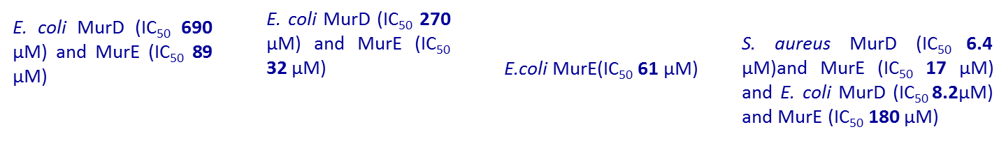
Literature survey (MurE)
E. coli MurD (IC₅₀ 206 µM) and MurE (IC₅₀ 494 µM)
E.coli MurE(IC₅₀ 330 µM)
E.coli MurE(IC₅₀ 330 µM)
E. coli MurD (IC₅₀ 148 µM) and MurE (IC₅₀ 16 µM)

Slide 7
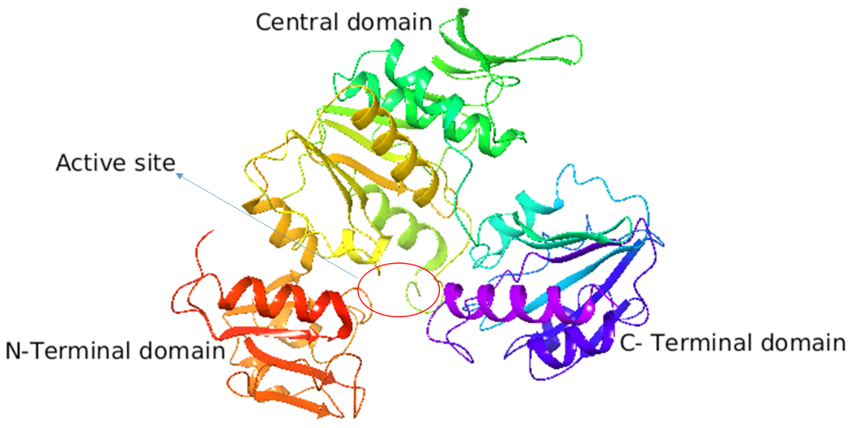
Domain representation in the 3D-crystal structure of MurD and MurE Ligase enzyme
N-Terminal Domain: 1-99
UMA
Central Domain: 100-304
ATP
C-Terminal Domain: 305-449
Incoming amino-acid

Slide 8
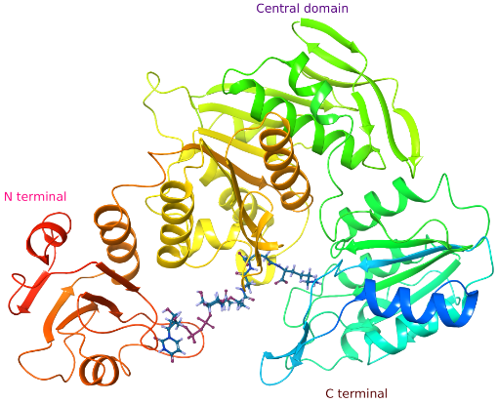



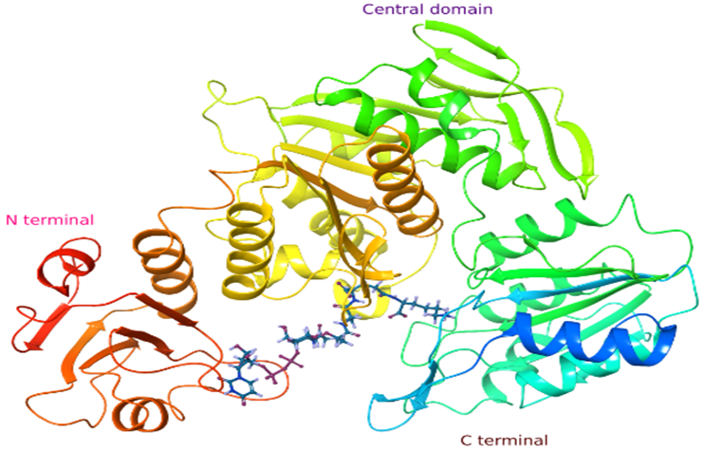
+ ATP + Mg²⁺ +
Product of MurD
MurD
Substrate
ADP +
MurE

Slide 9
Why MurD and MurE ?
Both MurD & MurE enzymes are present only in bacteria with high specificity towards their amino acid and also no structural homology with mammalian enzymes.
All Mur ligases presumably act through an analogous sequential enzymatic mechanism, as corroborated by structural, biochemical and computational studies.
The binding site residues of both the enzymes are conserved for different bacterial species.
As both MurD & MurE are consecutive enzymes with similar catalytic mechanism and binds to the substrate having same structural features.
This leads our attention to design a ligand which will act as analog of MurD product and MurE substrate.
As MurE plays a decisive role in cell wall synthesis which differentiate gram positive and gram negative bacteria. So, inhibitors of this enzyme will inhibit cell wall synthesis for both gram positive and gram negative bacteria .

Slide 10
Aim
To design molecules having similar nature to the product of the MurD enzyme which then act as a substrate for MurE, which posses the dual affinity.
The closed form of the enzyme structure, which is bound with the product has been used for the HTVS and designing.

Slide 11
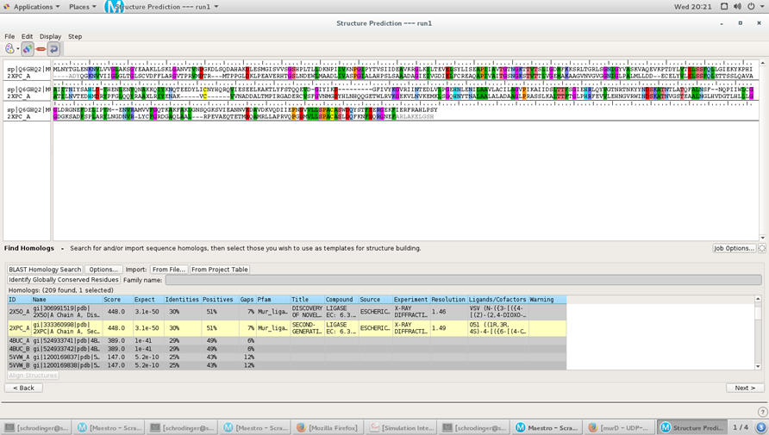
Homology modeling of S. aureus MurD enzyme using uniprot Fasta sequence (accession code: Q6GHQ2)
Fig 1: Alignment of template and query sequence and the alignment score of 2XPC.

Slide 12
Homology modeling (MurD from S.aureus)
Fig 2: Protein reliability report of the homology modeled S. aureus MurD enzyme.

Slide 13
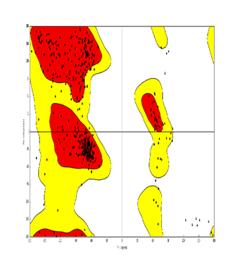
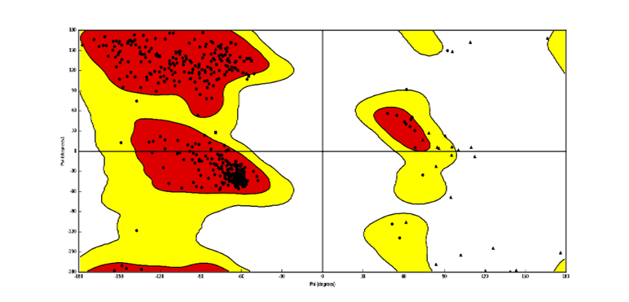
Protein Backbone
Ramachandran plot of MurD enzyme (Uniprot accession code: Q6GHQ2) homology model from S.aureus
Ramachandran plot of MurE enzyme X-ray crystal structure (PDB ID- 4C13) from S.aureus.

Slide 14
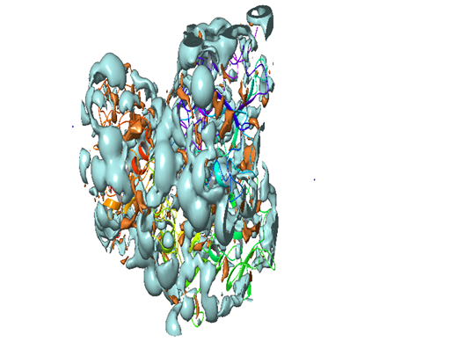
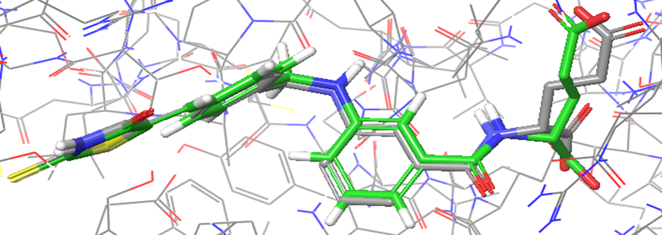
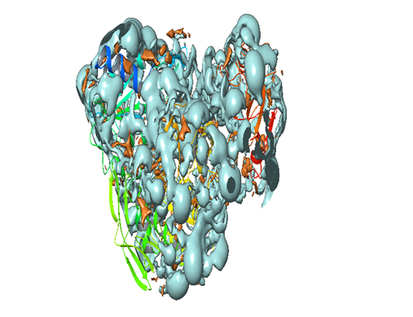
a
b
a
b
c
Fig 4: Hydrophillic (Blue) and Hdrophobic (Brown) surface mapping of the protien a) homology model of MurD and b) crystalographic structure of MurE (Pdb Id-4C13) S. aureus.
Fig 3: Pictorial representation of docking pose of co-crystal molecule in the active site of a) MurD enzyme model b) MurE enzyme (4C13) c) Overlay of the docking conformation with the co-crystal of ligand (RMSD 0.790).

Slide 15




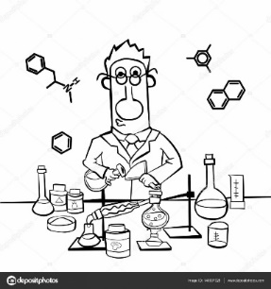

S. aureus MurD ligase active site
(Modeled protein)
Molecular Docking (HTVS, SP and XP) and Binding free energy calculation studies
Molecular Docking (XP) and Binding free energy calculation studies
Optimization of ligands
ADMET prediction
HTVS
4.8 million
Virtual hits
3820
SP-docking
350
XP-docking MM/GBSA
70
Top 10
virtual hits

Slide 16

Selected Top 10 HTVS

Slide 17
Docking result of in silico HTVS hits (DE1-DE10)
Table 1: Docking result of the virtual hits in MurD homology (Uniprot accession code: Q6GHQ2) model active site of S .aureus.
Comp. | Library | docking score | ªglide ecoul | ^{b}glide evdw | ^{c}glide emodel | ^{d}glide energy | ^{e}XP LipophilicEvdW
DE1 | Life chemicals F223-0271 | -6.2 | -9.2 | -47.2 | -65.2 | -48.3 | -3.2
DE2 | Timtec ST003236 | -5.4 | -7.2 | -38.6 | -62.4 | -50.6 | -3.8
DE3 | Chem Div G756-0425 | -5.1 | -12.6 | -36.5 | -61.2 | -50.3 | -3.5
DE4 | Chemdiv K279-1370 | -5.0 | -10.5 | -32.0 | -60.3 | -48.4 | -4.8
DE5 | Enamine T6806127 | -5.5 | -11.8 | -40.1 | -55.6 | -55.3 | -4.2
DE6 | Enamine T5346963 | -9.7 | -14.6 | -42.8 | -85.1 | -59.2 | -3.3
DE7 | Enamine T6299159 | -9.9 | -19.4 | -50.2 | -102.5 | -68.2 | -4.9
DE8 | Enamine T6067464 | -9.5 | -17.7 | -58.3 | -93.7 | -65.6 | -4.3
DE9 | Enamine T6520315 | -9.5 | -17.5 | -45.6 | -88.3 | -68.5 | -3.8
DE10 | Enamine T6004991 | -9.4 | -16.8 | -42.3 | -93.5 | -65.8 | -4.1
ªglide Coulomb energy; ^{b}glide van der Waals energy; ^{c}glide model energy; ^{d}glide energy; ^{e}glide lipophilic contact plus phobic attractive term in the glide score.

Slide 18
Table 2: Docking result of the virtual hits in the catalytic pocket of S. aureus MurE (PDB ID- 4C13) enzyme.
Comp. | Libery | docking score | ªglide ecoul | ^{b}glide evdw | ^{c}glide emodel | ^{d}glide energy | ^{e}XP LipophilicEvdW
DE1 | Life chemicals F223-0271 | -6.3 | -16.20 | -36.2 | -49.2 | -50.0 | -3.4
DE2 | Timtec ST003236 | -6.2 | -15.10 | -48.5 | -43.2 | -49.3 | -3.1
DE3 | Chem Div G756-0425 | -7.0 | -12.60 | -60.0 | -81.2 | -63.7 | -4.1
DE4 | Chemdiv K279-1370 | -7.2 | -9.30 | -59.3 | -83.2 | -62.5 | -4.7
DE5 | Enamine T6806127 | -7.3 | -9.80 | -65.6 | -89.0 | -60.5 | -4.5
DE6 | Enamine T5346963 | -5.9 | -14.20 | -39.2 | -40.1 | -54.3 | -3.3
DE7 | Enamine T6299159 | -4.1 | -11.40 | -55.8 | -46.3 | -38.6 | -2.5
DE8 | Enamine T6067464 | -4.8 | -7.70 | -42.8 | -36.5 | -37.2 | -2.6
DE9 | Enamine T6520315 | -5.9 | -17.20 | -51.8 | -53.8 | -46.7 | -2.7
DE10 | Enamine T6004991 | -5.7 | -10.30 | -53.5 | -52.1 | -48.4 | -3.2

Slide 19
Binding free energy calculation of in silico HTVS hits (DE1-DE10)
Table 3: Binding free energy calculation of HTVS hits by MM-GBSA approach against S. aureus MurD modeled protein.
Comp. | Library | ªΔG Coul | ^{b}ΔGLipo | ^{c}ΔG Solv GB | ^{d}ΔG vdW | ^{e}ΔG
DE1 | Life chemicals F223-0271 | 48.2 | -19.2 | -3.8 | -50.0 | -50.0
DE2 | Timtec ST003236 | 35.3 | -9.1 | -2.8 | -52.1 | -58.6
DE3 | Chem Div G756-0425 | 12.1 | -11.8 | -2.3 | -49.5 | -55.7
DE4 | Chemdiv K279-1370 | -5.2 | -105 | 9.2 | -53.2 | -59.3
DE5 | Enamine T6806127 | -9.1 | -17.1 | -11.3 | -63.8 | -67.3
DE6 | Enamine T5346963 | -3.8 | -13.1 | -15.7 | -66.6 | -60.4
DE7 | Enamine T6299159 | 61.1 | -6.7 | 21.0 | -69.1 | -55.5
DE8 | Enamine T6067464 | 23.6 | -5.6 | 16.8 | -68.3 | -50.6
DE9 | Enamine T6520315 | -5.8 | -5.5 | -12.6 | -55.2 | -60.6
DE10 | Enamine T6004991 | -5.2 | -7.1 | -12.4 | -60.3 | -61.8
ªCoulomb energy, ^{b}Lipophilic energy, ^{c}electrostatic solvation energy, ^{d}van der Waal energy, ^{e}Free energy binding.

Slide 20
Table 4: Free energy calculation by MMGBSA method for MurE (PDB ID-4C13) of S.aureus in the active site (kcal/mol)
Comp. | Libery | ªΔG Coul | ^{b}ΔG Lipo | ^{c}ΔG Solv GB | ^{d}ΔG vdW | ^{e}ΔG
DE1 | Life chemicals F223-0271 | -15.5 | -25.3 | -8.5 | -70.8 | -73.3
DE2 | Timtec ST003236 | -7.6 | -14.6 | -12.4 | -73.5 | -67.8
DE3 | Chem Div G756-0425 | -5.4 | -13.5 | -16.5 | -63.5 | -64.3
DE4 | Chemdiv K279-1370 | -4.4 | -21.2 | -16.2 | -73.8 | -70.0
DE5 | Enamine T6806127 | -14.5 | -18.7 | -18.9 | -83.3 | -75.7
DE6 | Enamine T5346963 | -5.2 | -11.6 | -14.3 | -53.8 | -60.6
DE7 | Enamine T6299159 | 10.5 | -13.6 | -12.1 | -63.2 | -59.4
DE8 | Enamine T6067464 | -3.6 | -7.3 | -17.1 | -64.6 | -56.8
DE9 | Enamine T6520315 | 21.8 | -9.3 | -13.6 | -42.4 | -43.7
DE10 | Enamine T6004991 | 19.7 | -10.4 | -14.1 | -47.4 | -49.3
ªCoulomb energy, ^{b}Lipophilic energy, ^{c}electrostatic solvation energy, ^{d}van der Waal energy, ^{e}Free energy binding.

Slide 21
Structure of designed molecules which has been synthesized

Slide 22
Docking result of designed molecules
Table 5: Docking result of synthesized molecules in the catalytic pocket of S. aureus MurD (kcal/mol)
Table 6: Docking result of synthesized molecules in the catalytic pocket of S. aureus MurE (PDB ID-4C13) (kcal/mol)
Title | docking score | ªglide ecoul | ^{b}glide evdw | ^{c}glide emodel | ^{d}XP HBond | ^{e}XP LipophilicEvdW | ^{f}glide energy
A1 | -4.5 | -7.0 | -49.4 | -75.4 | -0.4 | -3.5 | -56.4
A2 | -6.3 | -7.9 | -45.0 | -75.1 | -1.2 | -4.4 | -52.9
A3 | -5.4 | -7.9 | -54.6 | -92.6 | -0.7 | -4.4 | -62.5
A4 | -4.6 | -8.5 | -55.8 | -87.0 | -1.0 | -3.3 | -64.3
A5 | -5.0 | -8.2 | -53.0 | -81.5 | -0.3 | -4.3 | -61.2
A6 | -5.4 | -10.8 | -51.9 | -86.9 | -0.3 | -4.4 | -62.7
A7 | -4.8 | -5.0 | -49.5 | -75.4 | -0.1 | -4.6 | -54.6
A8 | -6.1 | -5.8 | -46.9 | -71.5 | -0.9 | -4.7 | -52.6
B1 | -5.5 | -11.1 | -38.2 | -63.9 | -1.9 | -2.6 | -49.4
B2 | -4.7 | -14.8 | -32.2 | -60.1 | -1.9 | -1.8 | -47.0
B3 | -6.3 | -12.4 | -39.0 | -68.6 | -1.9 | -3.1 | -51.4
B4 | -5.8 | -11.0 | -40.7 | -65.8 | -2.1 | -2.9 | -51.7
B5 | -6.3 | -14.9 | -39.3 | -68.3 | -2.2 | -2.9 | -54.3
B6 | -5.4 | -10.1 | -35.2 | -59.2 | -1.9 | -2.4 | -45.3
B7 | -5.3 | -10.8 | -39.8 | -69.6 | -1.9 | -2.4 | -50.6
B8 | -5.2 | -6.5 | -48.7 | -77.5 | -0.9 | -4.0 | -55.2
B9 | -5.2 | -12.1 | -40.9 | -70.1 | -1.2 | -3.0 | -53.0
B10 | -5.7 | -15.5 | -35.6 | -75.8 | -1.8 | -2.7 | -51.1
B11 | -5.2 | -10.3 | -43.7 | -68.4 | -1.2 | -3.3 | -54.1
C1 | -4.6 | -7.6 | -35.8 | -55.5 | -0.6 | -3.3 | -43.4
C2 | -4.7 | -9.7 | -40.0 | -59.4 | -0.5 | -3.5 | -49.7
C3 | -4.1 | -5.9 | -43.2 | -65.6 | -0.7 | -3.4 | -49.1
C4 | -4.8 | -5.4 | -38.8 | -58.9 | -1.1 | -3.5 | -44.2
C5 | -4.7 | -2.6 | -38.5 | -54.3 | -0.8 | -3.4 | -41.1
Title | docking score | ªglide ecoul | ^{b}glide evdw | ^{c}glide emodel | ^{d}XP HBond | ^{e}XP Lipophilic EvdW | ^{f}glide energy
A1 | -4.5 | -4.2 | -45.2 | -67.5 | -0.4 | -4.0 | -49.4
A2 | -3.7 | -5.1 | -36.1 | -57.2 | -0.6 | -2.9 | -41.2
A3 | -3.6 | -5.5 | -44.6 | -70.3 | 0 | -3.5 | -50.1
A4 | -4.1 | -4.1 | -47.2 | -66.7 | -0.5 | -3.6 | -51.4
A5 | -4.7 | -5.0 | -44.4 | -65.6 | -0.5 | -4.1 | -49.4
A6 | -4.0 | -5.2 | -41.3 | -65.6 | -0.5 | -3.3 | -46.5
A7 | -3.4 | -4.0 | -41.8 | -66.2 | -0.7 | -3.7 | -45.8
A8 | -4.1 | -3.2 | -49.2 | -71.3 | -0.7 | -4.1 | -52.4
B1 | -6.5 | -9.7 | -40.6 | -63.3 | -2.0 | -3.6 | -50.4
B2 | -7.7 | -14.3 | -41.5 | -75.7 | -1.7 | -3.5 | -55.9
B3 | -7.4 | -16.5 | -34.6 | -70.6 | -2.9 | -1.8 | -51.1
B4 | -8.0 | -13.3 | -39.1 | -81.9 | -1.9 | -3.5 | -52.4
B5 | -6.1 | -13.4 | -42.1 | -70.9 | -1.8 | -3.2 | -55.6
B6 | -4.1 | -6.8 | -31.8 | -49.0 | -0.7 | -2.4 | -38.6
B7 | -5.1 | -5.6 | -47.8 | -59.1 | -0.1 | -4.3 | -53.4
B8 | -5.0 | -9.4 | -38.7 | -61.7 | -2.1 | -3.1 | -48.1
B9 | -5.0 | -6.5 | -39.4 | -61.1 | -1.3 | -2.8 | -45.9
B10 | -5.3 | -7.6 | -32.8 | -64.4 | -2.0 | -2.5 | -40.5
B11 | -6.0 | -9.2 | -42.3 | -65.5 | -2.6 | -3.5 | -51.5
C1 | -3.3 | -5.7 | -30.7 | -49.0 | -0.7 | -2.1 | -36.4
C2 | -4.0 | -4.5 | -35.4 | -56.0 | -0.3 | -2.4 | -40.0
C3 | -4.2 | -8.1 | -39.7 | -61.8 | -0.4 | -2.4 | -47.8
C4 | -3.8 | -4.9 | -38.8 | -59.3 | -0.9 | -3.4 | -43.7
C5 | -4.6 | -4.8 | -31.6 | -49.8 | -0.8 | -2.1 | -36.4
ªglide Coulomb energy; ^{b}glide van der Waals energy; ^{c}glide model energy; ^{d}extra-precision hydrogen bond ^{e}glide lipophilic contact plus phobic attractive term in the glide score; ^{f}glide energy.

Slide 23
Table 7: Binding free energy (MM-GBSA) calculation of designed molecules and S. aureus MurD complexes (kcal/mol)
Table 8: Binding free energy (MM-GBSA) calculation of designed molecules and S. aureus MurE (pdb.C13)
Title | ªΔG Bind Coulomb | ^{b}ΔG Bind Lipo | ^{c}ΔG Bind Solv GB | ^{d}ΔG Bind vdW | ^{e}ΔG Bind
A1 | -42.4 | -37.0 | 26.1 | -109.2 | -123.9
A2 | -36.4 | -40.0 | 38.3 | -88.0 | -90.7
A3 | -51.9 | -25.8 | 42.2 | -79.1 | -81.4
A4 | -26.5 | -36.6 | 12.9 | -100.5 | -108.5
A5 | -39.7 | -22.9 | 21.9 | -48.8 | -81.8
A6 | -35.3 | -33.1 | 19.6 | -85.2 | -111.5
A7 | -73.0 | -32.9 | 53.9 | -78.0 | -85.9
A8 | -126.2 | -45.1 | 106.7 | -88.6 | -115.6
B1 | -39.3 | -19.1 | 3.0 | -26.0 | -85.4
B2 | -16.4 | -29.9 | 19.7 | -87.3 | -87.1
B3 | 30.9 | -23.7 | -23.5 | -55.3 | -71.1
B4 | 33.2 | -23.6 | -28.5 | -49.4 | -63.1
B5 | -29.3 | -30.6 | 48.8 | -87.3 | -58.9
B6 | -4.0 | -23.2 | -5.2 | -39.9 | -59.6
B7 | -70.7 | -33.9 | 29.2 | -69.6 | -107.4
B8 | -21.2 | -25.7 | 32.0 | -61.9 | -70.6
B9 | -4.3 | -15.4 | 3.6 | -52.3 | -57.5
B10 | -44.6 | -11.8 | 24.0 | -41.7 | -65.8
B11 | -13.6 | -22.7 | 42.0 | -93.4 | -59.1
C1 | -69.1 | -28.0 | 57.2 | -59.3 | -86.1
C2 | -75.7 | -31.6 | 44.2 | -87.1 | -111.4
C3 | -8.4 | -21.7 | 6.2 | -68.6 | -85.0
C4 | -5.9 | -16.9 | -17.4 | -52.3 | -83.1
C5 | -60.7 | -30.1 | 51.2 | -71.5 | -85.2
Title | ªΔG Bind Coulomb | ^{b}ΔG Bind Lipo | ^{c}ΔG Bind Solv GB | ^{d}ΔG Bind vdW | ^{e}ΔG Bind
A1 | 88.7 | -9.6 | -54.1 | -55.6 | -52.1
A2 | -24.9 | -3.3 | 33.4 | -18.2 | -41.7
A3 | 21.2 | -14.8 | -9.4 | -49.6 | -62.7
A4 | 69.1 | -15.6 | -18.2 | -50.5 | -42.6
A5 | -24.3 | -20.5 | 15.6 | -42.3 | -73.3
A6 | 77.1 | -18.4 | -30.6 | -37.9 | -44.7
A7 | -29.9 | -19.8 | 31.8 | -66.3 | -69.4
A8 | -118.1 | -5.5 | 79.3 | 0.2 | -45.2
B1 | -14.6 | -1.0 | 13.5 | -10.8 | -46.2
B2 | 68.0 | 1.1 | -38.4 | -38.5 | -31.9
B3 | 26.7 | -2.1 | -2.0 | -25.5 | -25.3
B4 | 15.2 | 2.1 | -24.9 | -14.6 | -37.2
B5 | 7.9 | -0.1 | 18.6 | -13.9 | -8.2
B6 | -44.3 | -5.4 | 35.6 | -8.5 | -26.3
B7 | -40.9 | -4.7 | 59.9 | -17.7 | 11.4
B8 | -73.4 | -1.8 | 37.8 | -1.9 | -57.7
B9 | -45.7 | 0.2 | 45.3 | -17.7 | -42.7
B10 | -7.9 | 2.7 | -11.5 | -4.0 | -54.0
B11 | -45.0 | 2.6 | 29.7 | -4.5 | -50.5
C1 | -19.0 | -5.7 | 45.7 | -17.5 | -13.6
C2 | 7.5 | -5.3 | 36.0 | -43.3 | -23.2
C3 | -5.6 | -4.1 | 57.8 | -47.8 | 8.4
C4 | -47.9 | -5.5 | 37.9 | -13.2 | -38.9
C5 | -36.1 | 2.4 | 41.7 | -9.5 | -15.9

Slide 24
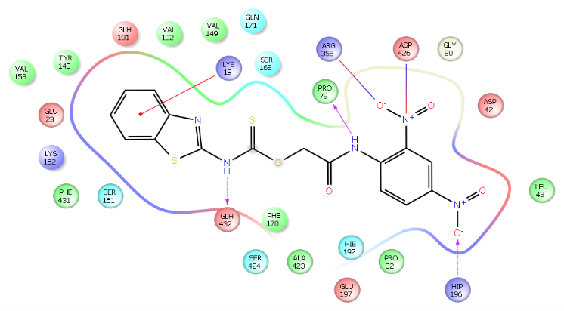
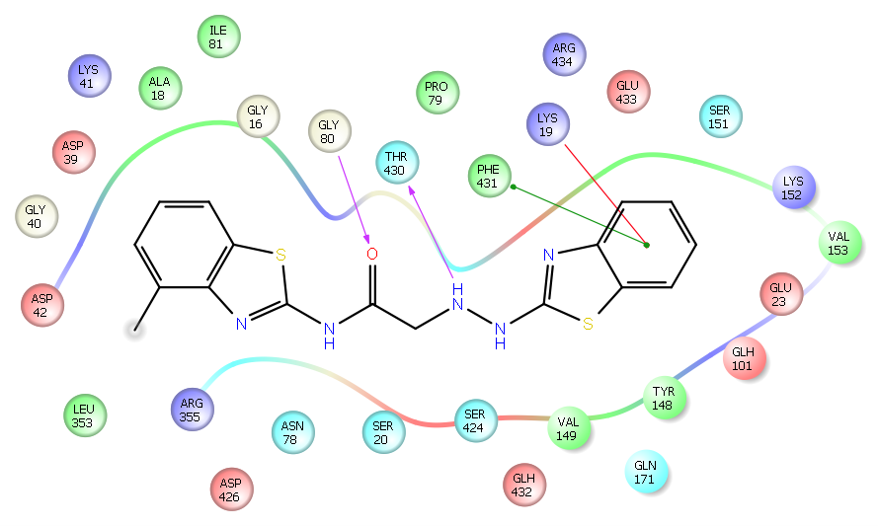
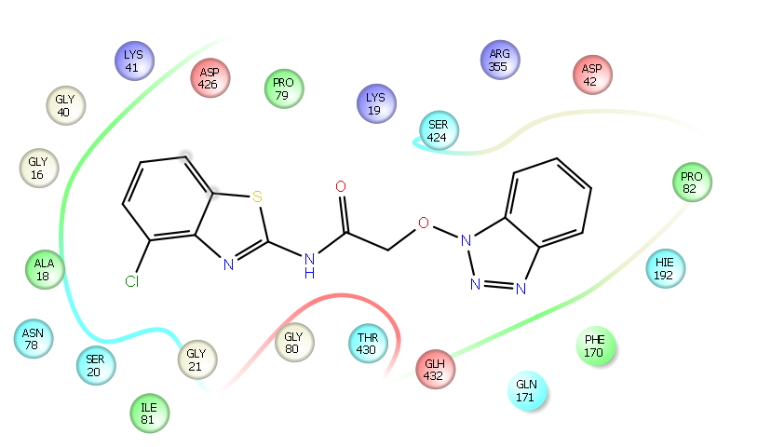
a
b
c
Figure 5: 2D-Pictorial representation of docking interaction in the binding pocket of MurD S. aureus homology model (2XPC) of compound (a) A1, (b) B11, (c) C2.

Slide 25
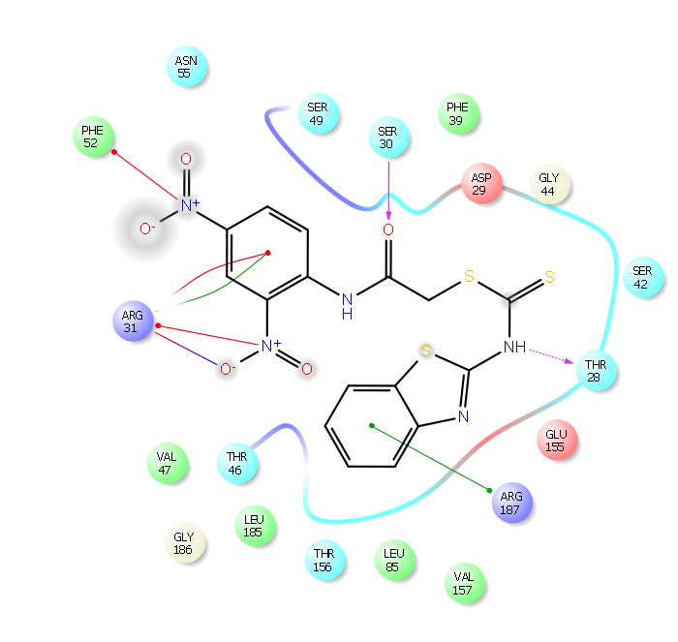
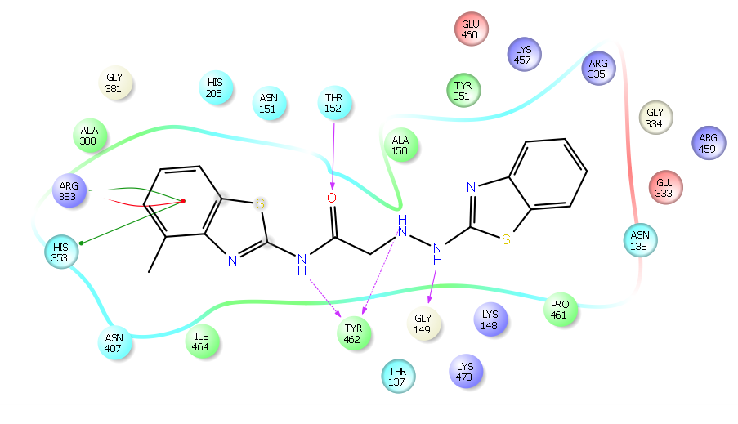
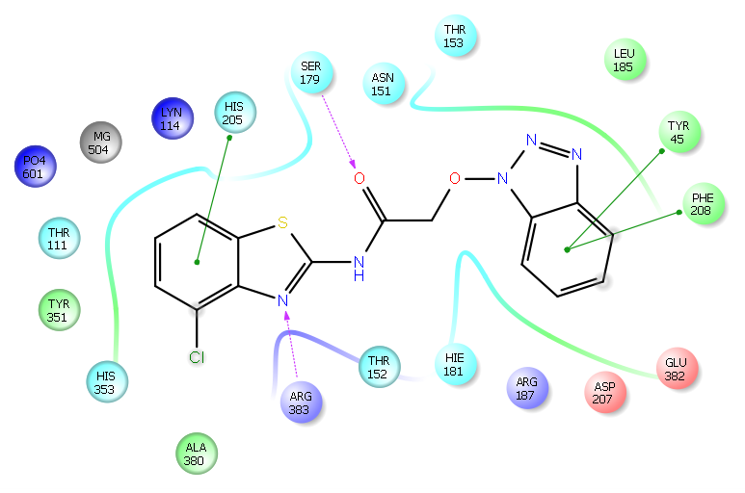
a
b
c
Figure 6: 2D-Pictorial representation of docking interaction in the binding pocket of S. aureus MurE (4C13) of compound A1 (a), (b) B11, (c) C2.

Slide 26
Table 9: Predicted ADMET profile of synthesized compounds.
Title | CNS | SASA | Donor HB | Acceptor HB | QP log Po/w | QP PCaco | PSA | Rule Of Three | Rule Of Five
A1 | -2 | 699.2 | 2 | 8 | 2.4 | 33.7 | 154.6 | 0 | 0
A2 | 2 | 684.4 | 2 | 5 | 5.5 | 3186.7 | 50.8 | 1 | 1
A3 | -2 | 728.6 | 2 | 9 | 1.5 | 4.2 | 196.8 | 1 | 1
A4 | -2 | 745.0 | 2 | 8.7 | 2.5 | 23.2 | 164.5 | 0 | 1
A5 | 0 | 767.9 | 2 | 6.7 | 5.3 | 1295.7 | 77.9 | 1 | 2
A6 | -2 | 692.4 | 2 | 7 | 3.9 | 145.9 | 116.1 | 1 | 1
A7 | -2 | 687.8 | 2 | 8 | 2.4 | 36.2 | 152.7 | 0 | 0
A8 | 2 | 709.1 | 2 | 5 | 5.7 | 3348.4 | 49.5 | 1 | 1
B1 | -2 | 606.5 | 2 | 6 | 1.4 | 17.9 | 126.2 | 1 | 0
B2 | -2 | 626.8 | 3 | 7 | -0.2 | 3.9 | 131.2 | 1 | 0
B3 | -2 | 656.5 | 3 | 6.7 | -0.1 | 2.5 | 149.8 | 1 | 0
B4 | -2 | 642.4 | 3 | 8 | -1.0 | 0.7 | 171.0 | 1 | 0
B5 | -2 | 637.6 | 2 | 6 | 0.9 | 7.2 | 125.4 | 1 | 0
B6 | 1 | 563.6 | 2 | 5 | 2.1 | 157.6 | 81.2 | 0 | 0
B7 | -2 | 651.0 | 2 | 6 | 2.0 | 28.4 | 120.3 | 0 | 0
B8 | 1 | 716.3 | 1 | 6.7 | 3.5 | 224.5 | 83.8 | 0 | 0
B9 | 1 | 627.5 | 2 | 6.5 | 2.3 | 145.0 | 89.3 | 0 | 0
B10 | -2 | 655.7 | 2 | 7.5 | 1.6 | 16.2 | 133.7 | 1 | 0
B11 | 1 | 624.3 | 2 | 6.5 | 2.5 | 157.8 | 86.3 | 0 | 0
C1 | 0 | 594.6 | 1 | 6 | 3.3 | 1051.2 | 75.4 | 0 | 0
C2 | -1 | 602.7 | 1 | 7.5 | 2.3 | 549.4 | 90.0 | 0 | 0
C3 | -2 | 620.2 | 1 | 8.5 | 1.1 | 56.1 | 136.3 | 0 | 0
C4 | -2 | 666.2 | 1 | 8.2 | 2.3 | 464.9 | 98.9 | 0 | 0
C5 | -2 | 581.4 | 1 | 7.5 | 1.8 | 483.0 | 90.8 | 0 | 0
Recommended limits | -2 to +2 | 300-1000 | 0.0-6.0 | 2.0-20.0 | -2 to 6.5 | <25 poor > 500 great nm/sec | 7-200 | Max 4 | Max 3

Slide 27
Synthesis Scheme (Scheme 1& 2)
Fig 7: Schematic representation of synthesis Scheme 1.
Fig 8: Schematic representation of synthesis Scheme 2.

Slide 28
Synthesis scheme 3
Fig 9: Schematic representation of synthesis Scheme 3.

Slide 29
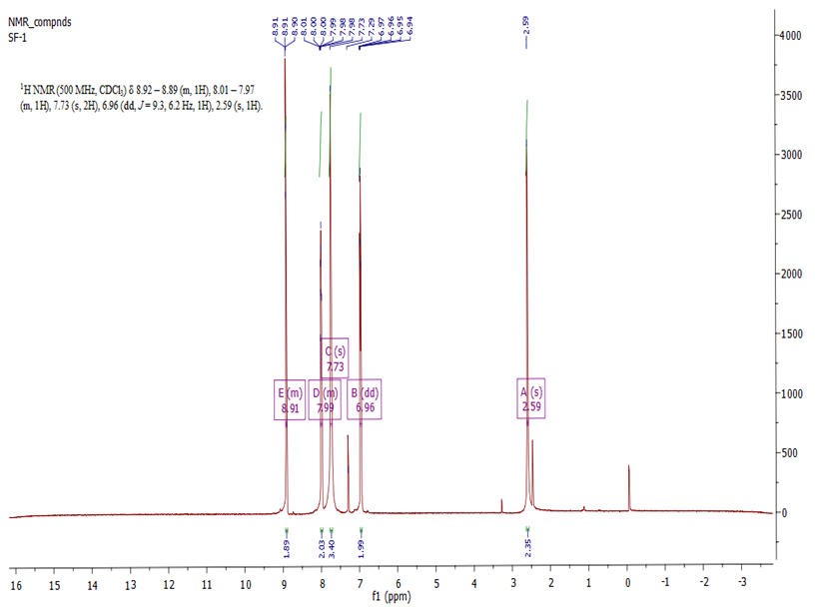
Spectral data of the synthesized compound A1
Fig 10: H¹ NMR spectrum of the synthesized compound A1.

Slide 30
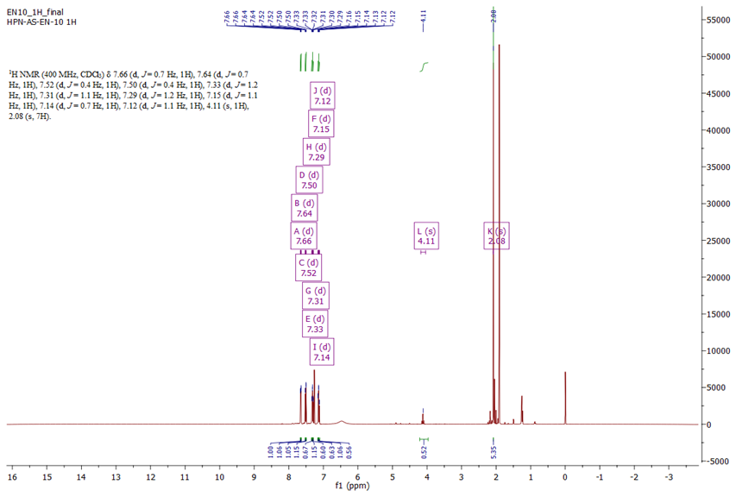
Spectral data of synthesized compound B11
Fig 11. H¹ NMR of synthesized compound B11.

Slide 31
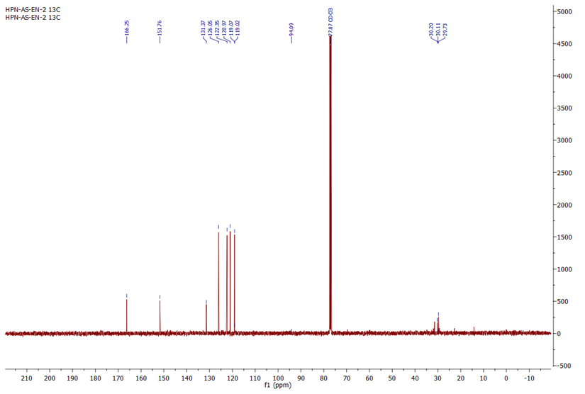
Spectral data of synthesized compound B11
Fig 12: C¹³ NMR of the synthesized compound B11.

Slide 32
Molecular dynamics study of literature molecule
Fig 13: The ligand-receptor complex during MD simulation different plots represent a) RMSD plot of C-α and backbone of the enzyme b) RMSF of all the MurE enzyme residues c) interaction of residues and types of interaction with time fraction for whole simulation time d) interaction profile of the ligand with different residues of MurE enzyme (PDB ID 4C13).

Slide 33
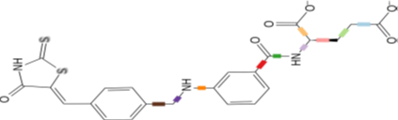
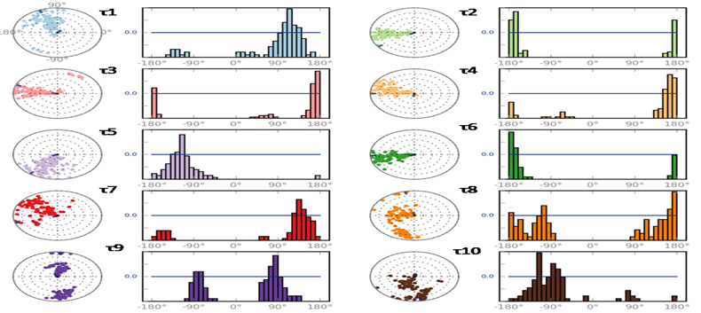
Molecular dynamics study of literature molecule
Fig 14: Representation of all the rotatable bonds torsion angle which represent the conformational change of the ligand during the whole MD simulation.

Slide 34
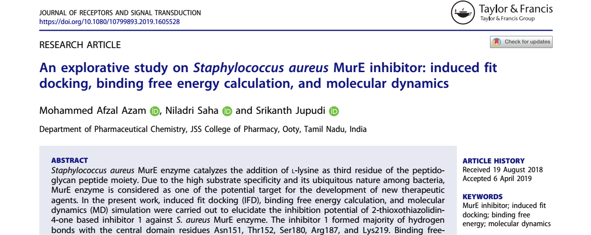
Publication

Slide 35
Table 10: MIC₅₀ values of all compound A1 and C2.
Title | ªSA-5021 | ^{b}SA-5022 | ^{c}SA-43300 | ^{d}KP-2706 | ^{e}PA-2036 | ^{f}EC-2567
A1 | 0.64 | 28.28 | 5.56 | 17.04 | 1.4 | 1.7
B11 | 72.37 | 2.07 | 12.98 | 36.41 | 1.41 | 1.72
C2 | 69.41 | 8.27 | 1.41 | >250 | 1.45 | 1.70
Ciprofloxacin | 10.34 | 6.37 | 16.49 | 1.39 | 6.87 | 1.55
(a) S. aureus (NCIM-5021) (b) S. aureus (NCIM-5022) (c) S. aureus (ATCC-43300) (d) K. Pneumonia (NCIM-2706) (e) P. aureginosa (NCIM-2036) (f) E. coli (NCIM-2567). **Concentration range has been used 250-1.95 µg/ml and as per CLSI guidelines.
Table 11. MBC values of compounds A1 and C2 3 strains of S. aureus (μg/ml)
Title | MRSA (ATCC 43300) |  |  | S. aureus (NCIM 5021) |  |  | S. aureus (NCIM 5022)
 | MIC | MBC | MBC/ MIC* | MIC | MBC | MBC/ MIC* | MIC | MBC | MBC/ MIC*
A1 | 5.56 | 62.5 | 11.24 | 0.64 | -do- | - | 28.28 | 72.5 | 2.56
C2 | 1.41 | 10 | 7.09 | 69.41 | 15 | 0.21 | 8.27 | 12.5 | 1.51
*Values ≤4 are bactericidal and ≥32 are having the chances of developing tolerance

Slide 36
Fig 15: Graphical representation of Time kill studies of synthesized compound A1 and C2 against MRSA strain (ATCC-43300) using ciprofloxacin as a standard.

Slide 37
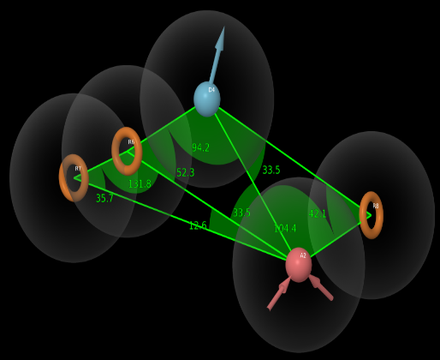
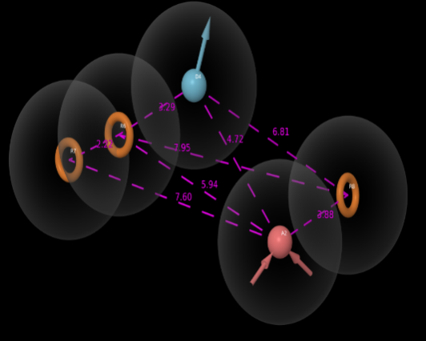
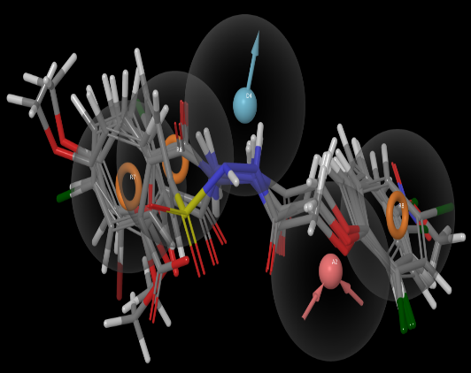
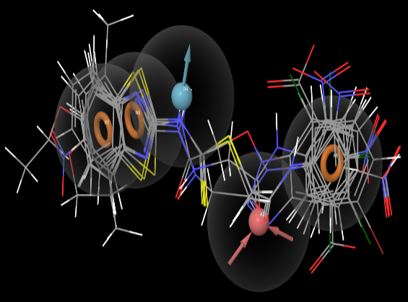
a
b
c
d
Fig 16: Represents pharmacophore model ADRRR_1 inter-site (a) distances in Å unit and (b) angles between the pharmacophoric points. Hydrogen bond acceptor (A): Pink sphere with arrow; Aromatic ring (R): yellow open circle; Hydrogen bond donor (D): blue sphere with arrow. (c) alignment of active compounds on the generated pharmacophore model (d) alignment of inactive compounds on the generated pharmacophore model.

Slide 38
Conclusion
MIC 1.41 and MBC 10 µg/ml (ATCC-43300) MRSA
MIC 5.56 and MBC 62.5 µg/ml (ATCC-43300)MRSA
Literature Molecule
The finding from our studies, the literature molecule MIC is higher than compound A1 and C2 which attributes the penetration through the cell membrane. The penetration problem may be the presence of ionized glutamic acid which is hindering the penetration for the literature molecule. Compound A1 showed MIC₅₀ 5 fold more than compound C2 and also the MBC is higher , which can be used for lead optimization . This two compound can further used for in-vitro studies for understanding the mechanism of action which will in turn help to develop the lead. All the previous attempt has failed because of the imbalance in the MIC and IC₅₀ , which we think our studies can be one of the best way to develop novel antibiotic by targeting novel enzymes.
S. aureus MurD (IC₅₀ 6.4 µM)and MurE (IC₅₀ 17 µM) and E. coli MurD (IC₅₀ 8.2µM) and MurE (IC₅₀ 180 µM) MIC- S.aureus (MRSA) 8 µg/ml

Slide 39
Acknowledgments
I would like to thank JSS College of Pharmacy, Ooty for providing the facilities and DST-SERB, Govt. of India, New Delhi for providing the funding (No.EMR/2016/002981).

