Slide 1
Towards quantitative analysis of the non-covalent interactions in a newly synthesized phenanthroline-based nickel(II) complex : A combined experimental and computational study
Brahim EL BALI ¹, Amani DIREM ^{2,}*, Mohammed LACHKAR ³, Esra ÇETİNER ⁴, Koray SAYIN ⁴, and Michal DUSEK ⁵
¹ Independent scientist, ORCID : 0000-0001-6926-6286 ;
² Laboratoire des Structures, Propriétés et Interactions Interatomiques LASPI²A. Faculté des Sciences et de la Technologie. University of ‘’Abbes Laghrour’’, Khenchela 40.000, Algeria;
³ Laboratory of Engineering of Organometallic and Molecular Materials, "LIMOM" URAC 19. Department of Chemistry. Faculty of Sciences, PO Box 1796, 30.000 Fès, Morocco ;
⁴ Department of Chemistry, Faculty of Science, Cumhuriyet University, Sivas 58140, Turkey;
⁵ Institute of Physics of the Czech Academy of Sciences, Na Slovance 2, 182 21 Praha 8, Czech Republic .
* Corresponding author: amani_direm@yahoo.fr
LASPI²A

Slide 2
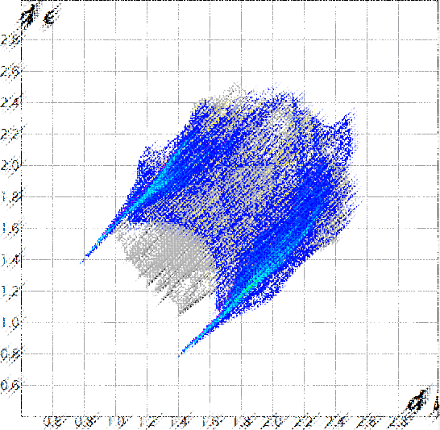
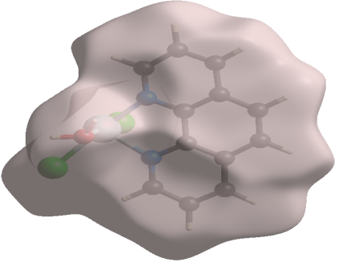
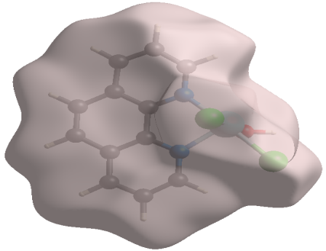
Towards quantitative analysis of the non-covalent interactions in a newly synthesized phenanthroline-based nickel(II) complex : A combined experimental and computational study
Graphical Abstract

Slide 3
Abstract:
A new phenanthroline-based nickel(ii) complex was synthesized and fully characterized by single-crystal X-ray diffraction. Its crystal structure revealed that it comprises Ni₂Cl₄(H₂O)₂(Phen)₂ dimmers linked via O─H...Cl hydrogen bonds. In order to get better insights into the hydrogen bonds and the intermolecular interactions holding the molecules together, a Hirshfeld surface analysis was carried out. Besides, the structure of the studied complex was optimized at M06-2X/6-31G(d)(LANL2DZ) level. Furthermore, the molecular orbital energy diagram, the contour plots of the molecular orbitals and the molecular electrostatic potential (MEP) map were calculated and discussed.
Keywords: Ni(II) complex, crystal Structure, hydrogen bonds, non-covalent interactions, Hirshfeld surface analysis, MEP map, quantum chemical calculations.

Slide 4
Introduction
Phenantroline derivaties are a very important class of organic and organometallic molecules due to their attractive coordinating features with transition metals [1]. Hence, photochemical properties of phenantroline-based metal complexes were recently reported [2]. Their biological applications were intensively studied [3] and their anticancer properties proved [4]. Additionaly, this class of coordination complexes are found to be interesting as potentiometric sensors [5] and are able to interact with DNA in an intercalative fashion inducing in some cases the DNA cleavage [6]. İn order to contribute to the better understanding of these materials, we report herein the structural and the electronic properties of a newly synthesized phenantroline-based Ni(II) complex [7]. İts non-covalent interactions will be fully analyzed by means of the Hirshfeld surface analysis [8,9], its molecular orbital energy diagram (MOED) and molecular electrostatic potential (MEP) map will be examined.

Slide 5
Results and discussion
Synthesis
C₁₂H₈N₂·HCl·H₂O
(NiCl₂.6H₂O + H₂O)
H₃PO₃ + H₂O)
1,10-Phenanthroline hydrochloride
monohydrate
Ni₂Cl₄(H₂O)₂(Phen)₂
Binuclear complex

Slide 6
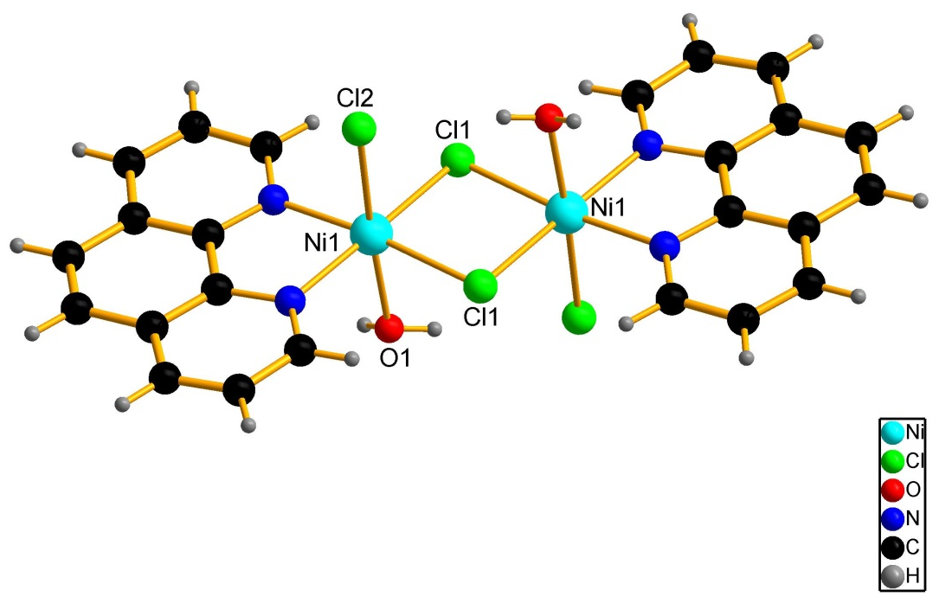
Results and discussion
Crystal structure
Space Group | P2₁/n
a (Å) | 12.6640 (5)
b (Å) | 6.8322 (3)
c (Å) | 14.2054 (5)
β (°) | 93.569 (9)
R[F² > 2σ(F²)] | 0.031
wR(F²) | 0.082

Slide 7
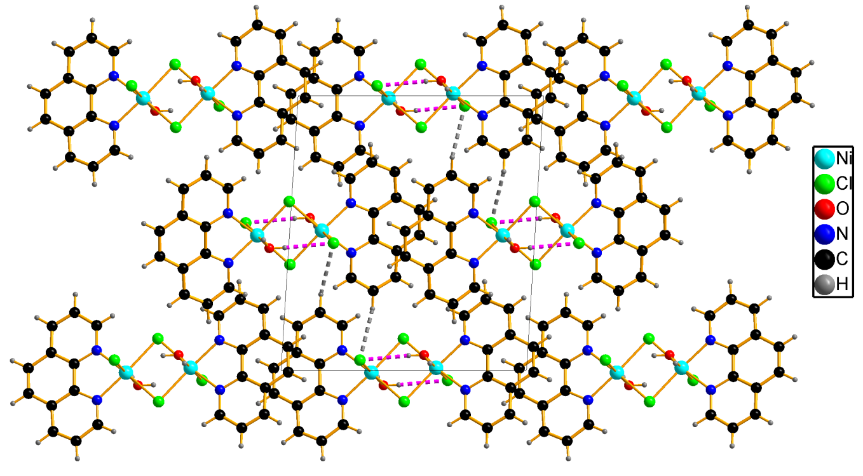
Results and discussion
Hydrogen bonding
D—H···A | D—H | H···A | D···A | D—H···A
O1—H1o1···Cl2^{i} | 0.78 (3) | 2.41 (3) | 3.1821 (17) | 168 (3)
Symmetry code: (i) x, y−1, z.

Slide 8
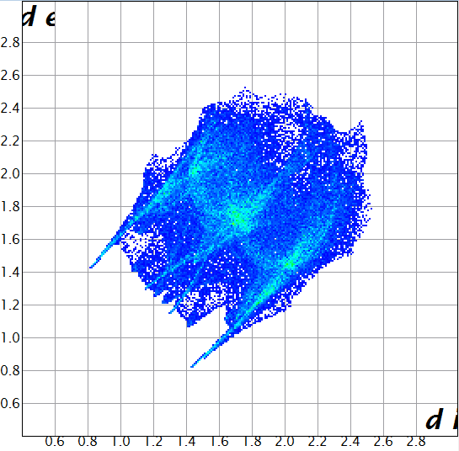
Results and discussion
Hirshfeld surface analysis
All contacts :
Asymmetric unit Binuclear complex

Slide 9
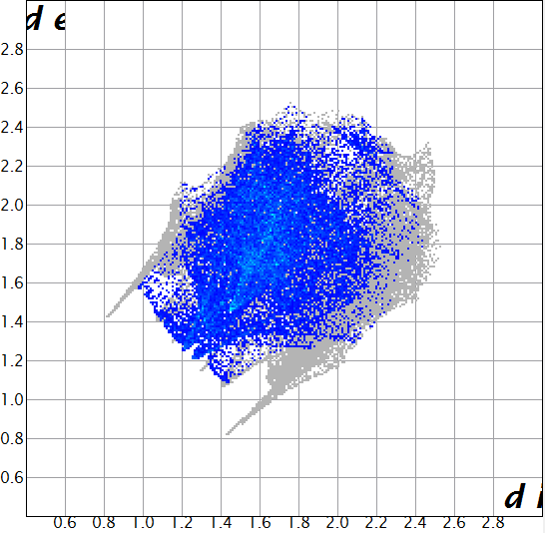
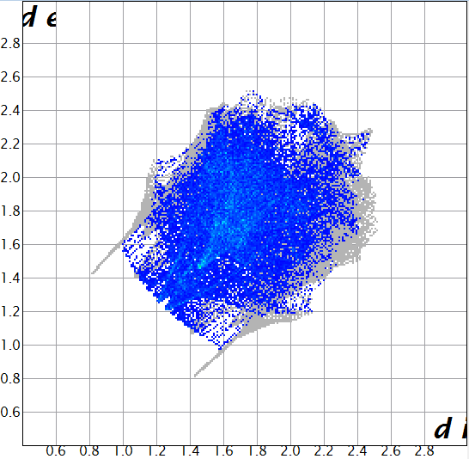
Results and discussion
Hirshfeld surface analysis
H…H contacts :
Asymmetric unit Binuclear complex
(30.1%) (35.6%)

Slide 10
Results and discussion
Hirshfeld surface analysis
H…H contacts :
d_{i} Representation

Slide 11
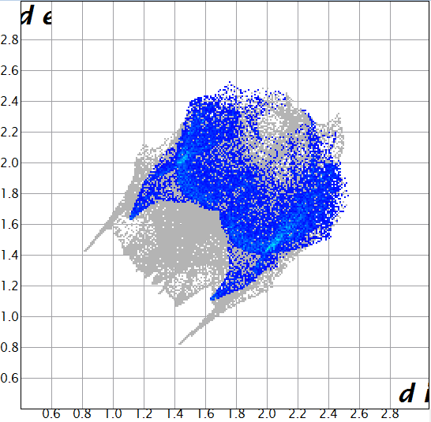
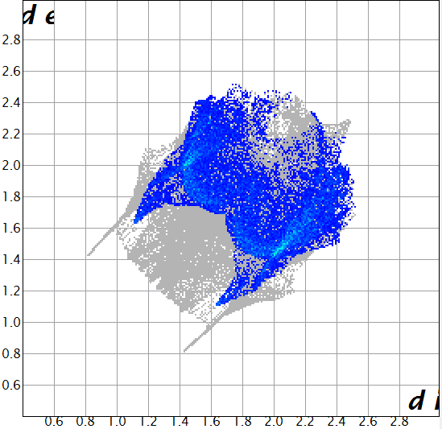
Results and discussion
Hirshfeld surface analysis
C…H/H…C contacts :
Asymmetric unit Binuclear complex
(23.0%) (26.3%)

Slide 12
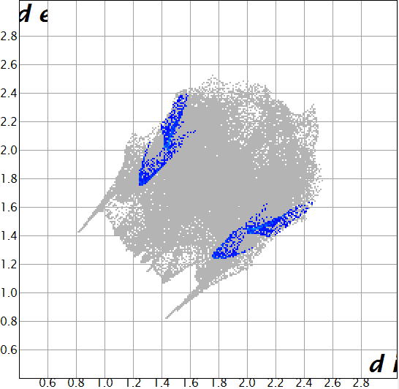
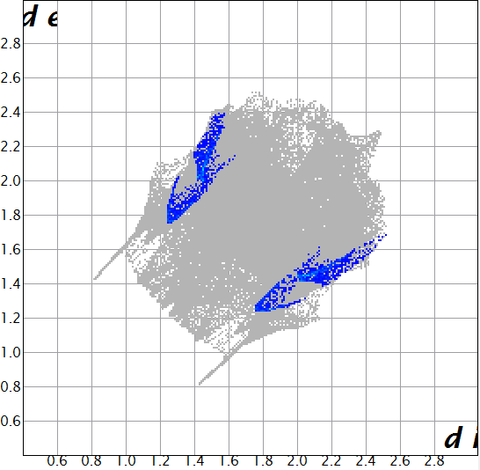
Results and discussion
Hirshfeld surface analysis
N…H/H…N contacts :
Asymmetric unit Binuclear complex
(2.4%) (2.7%)

Slide 13
Results and discussion
Hirshfeld surface analysis
N…H/H…N and C…H/H…C contacts :
Shape index Representation

Slide 14
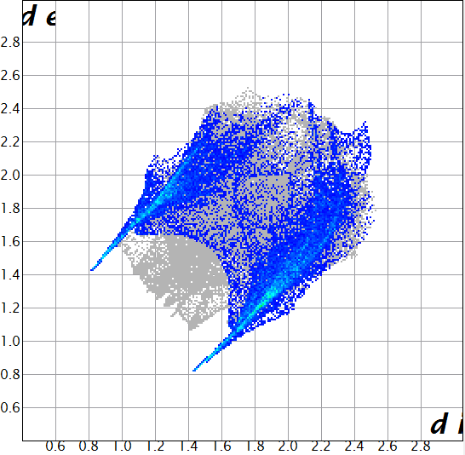
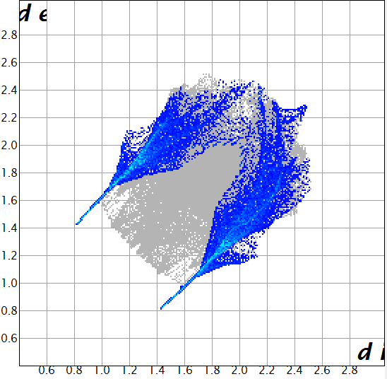
Results and discussion
Hirshfeld surface analysis
Cl…H/H…Cl contacts :
Asymmetric unit Binuclear complex
(30.4%) (23.4%)

Slide 15
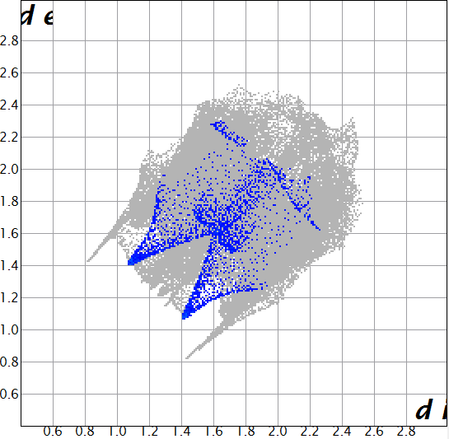
Results and discussion
Hirshfeld surface analysis
O…H/H…O contacts :
Asymmetric unit Binuclear complex
(3.0%) (3.5%)

Slide 16
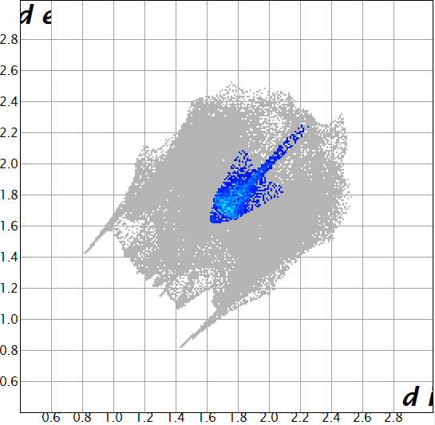
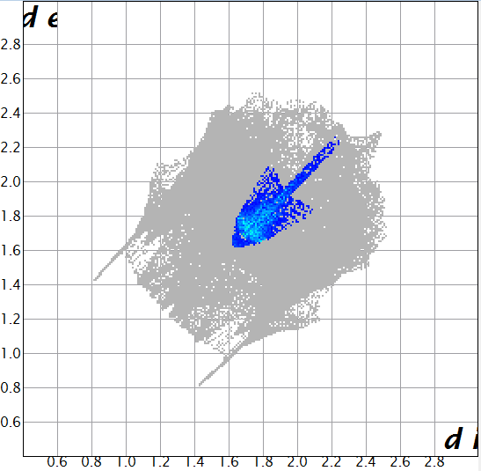
Results and discussion
Hirshfeld surface analysis
C…C contacts :
Asymmetric unit Binuclear complex
(5.8%) (6.6%)

Slide 17
Results and discussion
Hirshfeld surface analysis
Cl…H/H…Cl , O…H/H…O and C…C contacts :
d_{norm} Representation
Asymmetric unit Binuclear complex

Slide 18
Results and discussion
Hirshfeld surface analysis
Cl…H/H…Cl , O…H/H…O and C…C contacts :
d_{norm} Representation
The consideration of the asymmetric unit in the HSA allowed visualizing the intramolecular non-covalent interactions in the Ni(II) complex, namely an extra C-H..Cl interaction, two extra O-H..Cl interactions and an intramolecular Ni..Cl interaction with a contribution to the total surface of 3.2%.

Slide 19
Results and discussion
Hirshfeld surface analysis

Slide 20
Results and discussion
Quantum calculations
Optimized structure
The structure was optimized by using one of the DFT function hybrids M06-2X method, with a mix basis set ; LANL2DZ was used for Ni²⁺ centers and 6-31G(d) for the other atoms in the complex

Slide 21
Results and discussion
Quantum calculations
MOED and contour diagram :

Slide 22
Results and discussion
Quantum calculations
MEP :

Slide 23
Conclusions
A binuclear phenanthroline-based nickel(II) complex was synthesized and characterized by single-crystal x-ray diffraction. Its crystal structure is made of Ni₂Cl₄(H₂O)₂(Phen)₂ dimmers linked to each other via intermolecular O-H…Cl hydrogen bonds. The non-covalent interactions in the binuclear framework were analyzed usingHirshfeld surface analysis which indicated a rich variety of non-covalent contacts namely : Cl…H/H…Cl, H…H, C…H/H…C, C…C, Ni…Cl/Cl…Ni, O…H/H…O, N…H/H…N and Cl…C/C…Cl. The quantum calculations were carried out and the optimized structural properties were examined in detail. Additionally, the active sites were determined by the calculation of contour plots of the molecular orbitals and the MEP map.

Slide 24
References
[1] A. Abebe, M. Atlabachew, M. Liyew, E. Ferede, Synthesis of organic salts from 1,10-phenanthroline for biological applications, Cogent Chemistry. 4:1 (2018) 1476077. (https://doi.org/10.1080/23312009.2018.1476077).
[2] C. Bazzicalupi, A. Bencini, V. Fusi, C. Giorgi, P. Paoletti, B. Valtancoli, Lead complexation by novel phenanthroline-containing macrocycles, J. Chem. Soc., Dalton Trans. (1999) 393-400.
[3] D.B. Eni, D.M. Yufanyi, J.H. Nono, C.D. Tabong, M.O. Agwara, Synthesis, characterization and thermal properties of 1,10-phenanthroline mixed-ligand complexes of cobalt(II) and copper(II): metal-mediated transformations of the dicyanamide ion, Chem. Pap. 74 (2020) 3003–3016.
[4] P. Heffeter, M.A. Jakupec, W. Körner, S. Wild, N.G. von Keyserlingk, L. Elbling, H. Zorbas, A. Korynevska, S. Knasmüller, H. Sutterlüty, M. Micksche, B.K. Keppler, W. Berger, Anticancer activity of the lanthanum compound [tris(1,10-phenanthroline) lanthanum(III)]trithiocyanate (KP772; FFC24), Biochem Pharmacol. 71(4) (2006) 426-40.
[5] L.G. Bachas, L. Cullen, R.S. Hutchins, D.L. Scott, Synthesis, characterization and electrochemical polymerization of eight transition-metal complexes of 5-amino-1,10-phenanthroline, J. Chem. Soc., Dalton Trans. (1997) 1571-1578.
[6] A. Bencini, V. Lippolis, 1,10-Phenanthroline: A versatile building block for the construction of ligands for various purposes, Coordination Chemistry Reviews, 254(17) (2010) 2096-2180.

Slide 25
References
[7] B. El Bali, M. Lachkar, A. Direm, E. Çetiner, K. Sayin, M. Dusek, Experimental and computational studies of Di-μ-chlorido-bis[chlorido(1,10-phenanthroline-κ2N,N’)nickel(II)] NiCl2(H2O)(C12N2H8): Crystal structure, quantitative analysis of the intermolecular interactions and electronic properties, J. Mol. Struc. (2020) DOI: 10.1016/j.molstruc.2020.129576.
[8] S.K. Wolff, D.J. Grimwood, J.J. McKinnon, M.J. Turner, D. Jayatilaka, M.A. Spackman, CrystalExplorer 3.1, University of Western Australia: Perth, Australia.
[9] M.A. Spackman, D. Jayatilaka, Hirshfeld Surface Analysis, Cryst. Eng. Comm. 11 (2009) 19–32.
[10] a) GaussView, Version 5, R. Dennington, T. Keith & J. Millam, Semichem Inc., Shawnee Mission, KS, (2009). b) Gaussian 09, Revision A.02, M. J. Frisch, G. W. Trucks, H. B. Schlegel, G. E. Scuseria, M. A. Robb, J. R. Cheeseman, G. Scalmani, V. Barone, B. Mennucci, G. A. Petersson, H. Nakatsuji, M. Caricato, X. Li, H. P. Hratchian, A. F. Izmaylov, J. Bloino, G. Zheng, J. L. Sonnenberg, M. Hada, M. Ehara, K. Toyota, R. Fukuda, J. Hasegawa, M. Ishida, T. Nakajima, Y. Honda, O. Kitao, H. Nakai, T. Vreven, J. A. Montgomery, Jr., J. E. Peralta, F. Ogliaro, M. Bearpark, J. J. Heyd, E. Brothers, K. N. Kudin, V. N. Staroverov, R. Kobayashi, J. Normand, K. Raghavachari, A. Rendell, J. C. Burant, S. S. Iyengar, J. Tomasi, M. Cossi, N. Rega, J. M. Millam, M. Klene, J. E. Knox, J. B. Cross, V. Bakken, C. Adamo, J. Jaramillo, R. Gomperts, R. E. Stratmann, O. Yazyev, A. J. Austin, R. Cammi, C. Pomelli, J. W. Ochterski, R. L. Martin, K. Morokuma, V. G. Zakrzewski, G. A. Voth, P. Salvador, J. J. Dannenberg, S. Dapprich, A. D. Daniels, Ö. Farkas, J. B. Foresman, J. V. Ortiz, J. Cioslowski & D. J. Fox, Gaussian, Inc., Wallingford CT, (2009).

Slide 26
Acknowledgments
This research work is made possible thanks to the TUBITAK ULAKBIM, High Performance and Grid Computing Center (TR-Grid e-Infrastructure).
The crystallographic part was supported by the project 18-10438S of the Czech Science Foundation using instruments of the ASTRA laboratory established within the Operation program Prague Competitiveness - project CZ.2.16/3.1.00/24510.

