Slide 1






MICROWAVE-ASSISTED CONTINUOUS FLOW FOR THE SELECTIVE OLIGOMERIZATION OF GLYCEROL
Remi Nguyen, Nicolas Galy, Christophe Len
christophe.len@chimieparistech.psl.eu
lenresearch.com
@len_research
1st Int. Elect. Conf. Catal. Sci., November 2020,

Slide 2


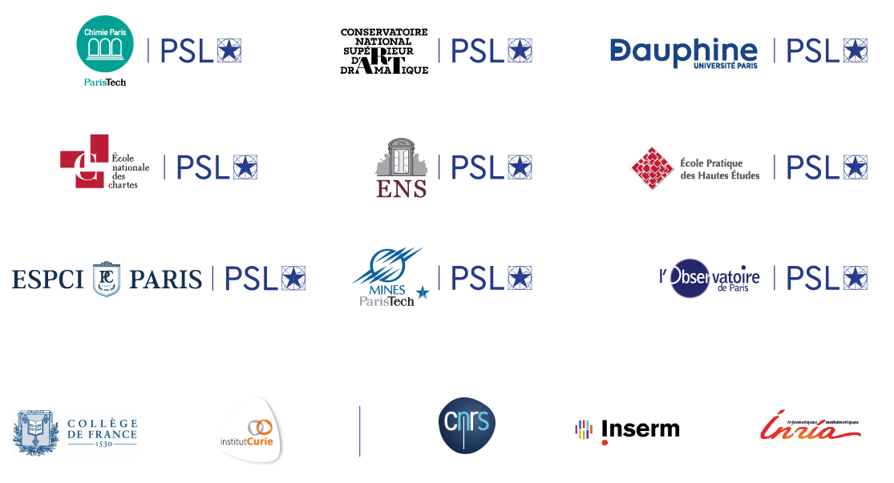
1st Int. Elect. Conf. Catal. Sci., November 2020,
Notes:
@

Slide 3
BENIGN BY DESIGN PROCESSES & TECHNOLOGIES
WHAT ARE THE TOOLS & LEVERS ?
In term of the processes & technologies
CATALYSIS
Homogeneous catalysis & Heterogeneous catalysis from bio-based derivatives or not
Nanocatalysis
Micellar catalysis
ALTERNATIVE ENERGY SOURCES
Continuous flow
Microwave irradiation in batch & in continuous flow
Ultrasound activation in batch & in continuous flow
Sunlight / UV in batch & in continuous flow
Electrochemistry in batch & in continuous flow
Ball Milling in batch & in continuous flow
Low amount of catalyst
Bio-inspired catalyst
Room temp reaction
Eco-friendly solvents
ALTERNATIVE REACTION MEDIA
Supercritical fluid (CO₂, MeOH, CH₃CN, H₂O…)
Ionic Liquids
Water
Polyethyleneglycol (PEG)
Solvent free « Best solvent is no solvent »

Slide 4
CONT. CHEMICAL PRODUCTION – A PARADIGM SHIFT
Current methods of synthesis for pharmaceuticals (APIs) and fine chemicals are entirely based on traditional batch manufacturing protocols.
Batch protocols have severe limitations compared to continuous flow processing.
Slow temperature control
Inefficient mass and heat transfer
Dangerous temperature gradients
Safety issues for many transformation
Instantaneous heating/cooling
Very fast mixing (<1s)
No concentration/temperature gradients
Inherently safe
Segmented individual steps
Processing a specific quantity
Multi purpose equipment
Quality managed by repetition and testing
Integrated synchronized operations
Continuous flow of product
Equipment dedicated for purpose
Quality managed by design and processes control of steady state
Lower cost level (operational, invest)
Increased productivity (small plant, low hold-up)
Shorter throughput time (less inventory)
Consistent quality (less off-spec, less by-products)

Slide 5
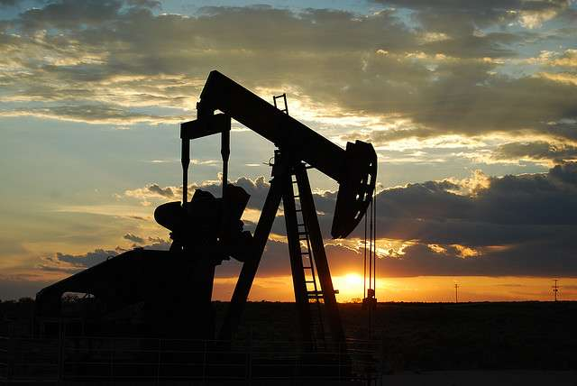
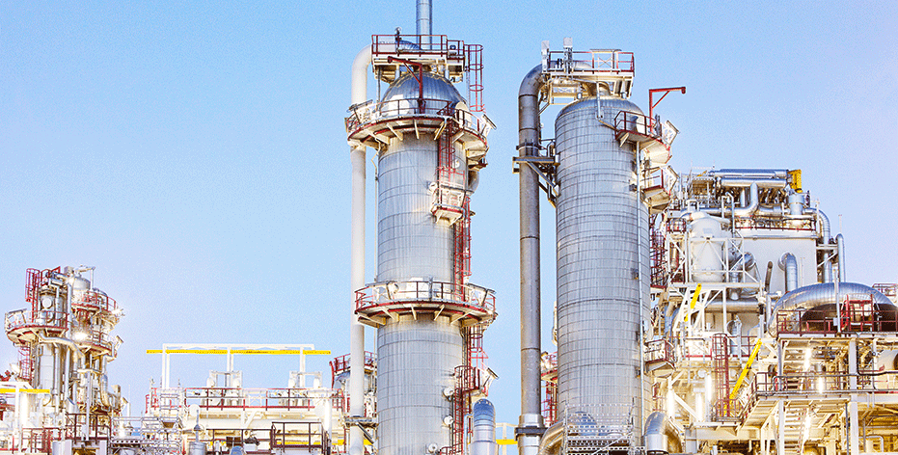
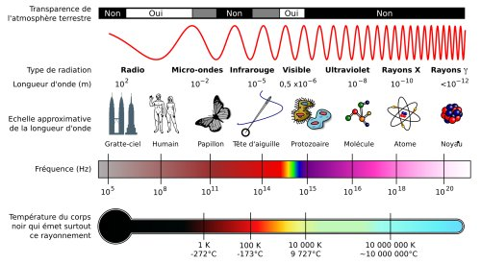
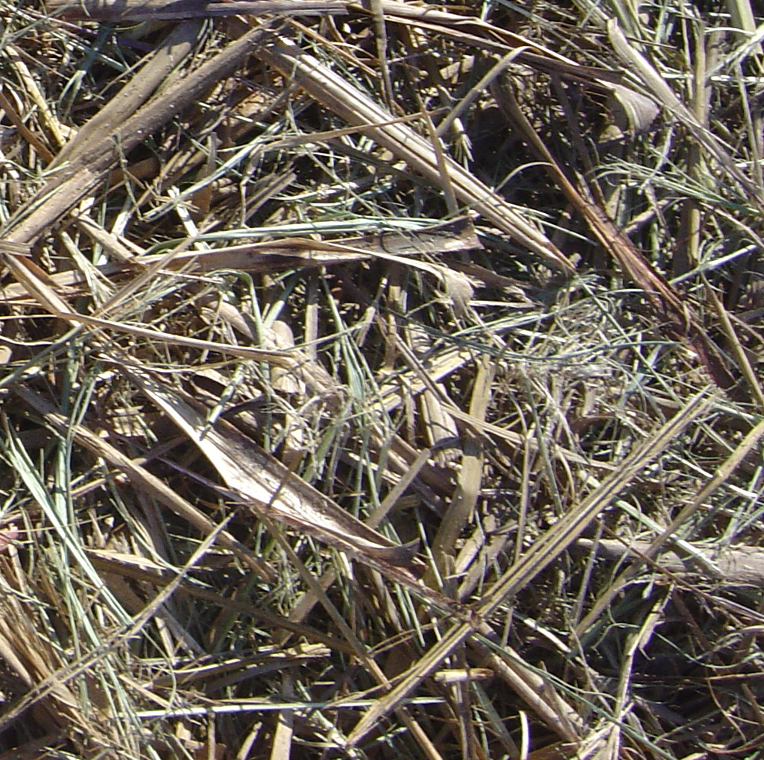
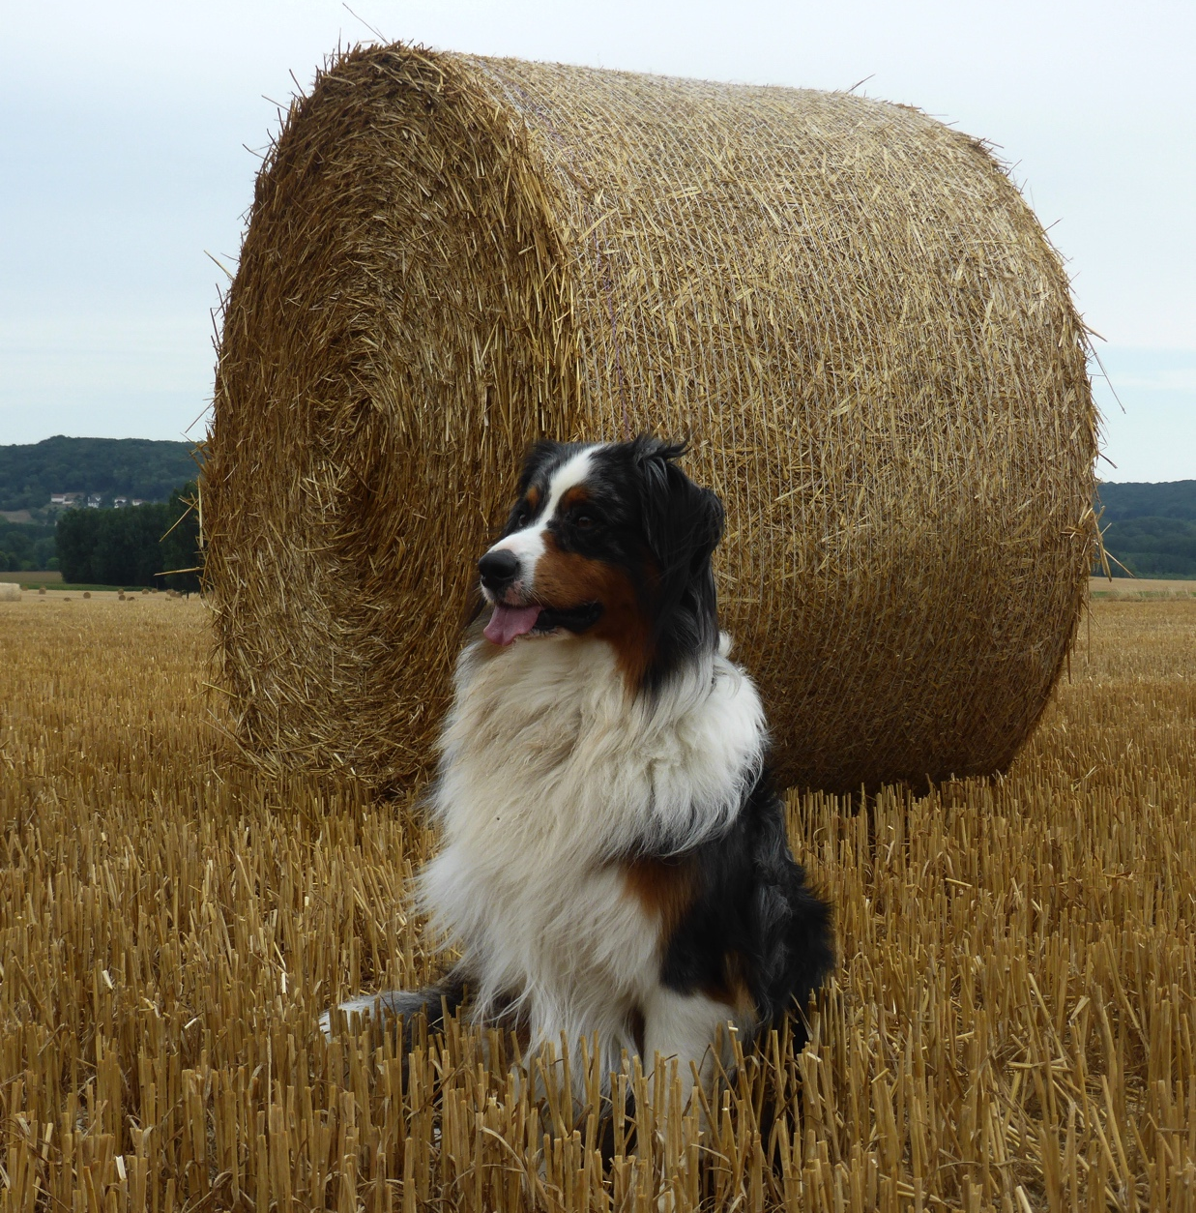

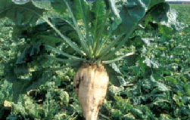
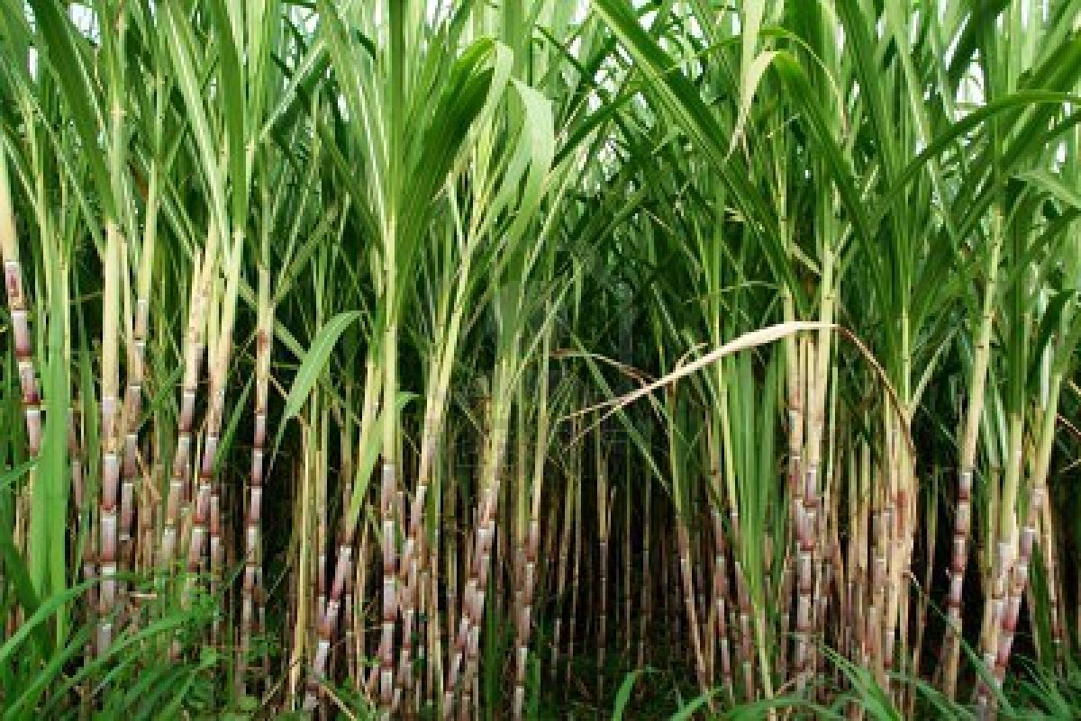
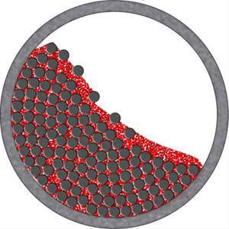
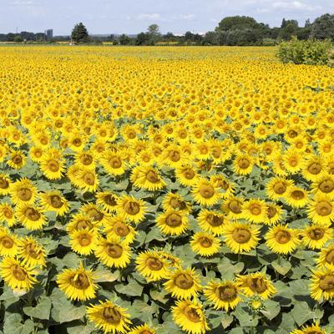

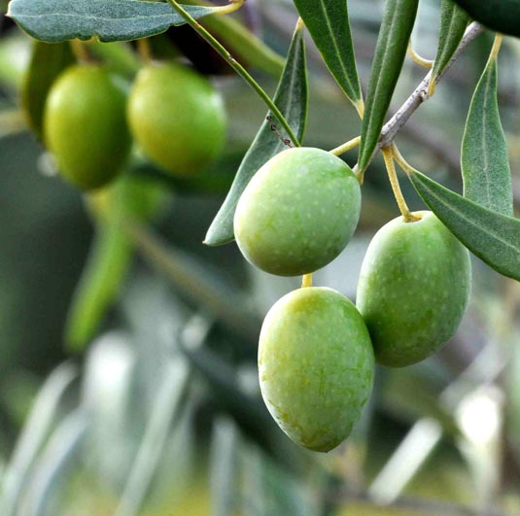
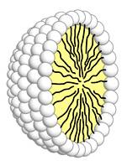
OUR EXPERTISES
STARTING MATERIALS
ALTER. TECHNOL.
VALUE ADDED CHEMICALS
Petrol
vs
vs
Microwave / Ultrasound
Lignocellulose
Microwave / Ultrasound
Vis
Vis
Carbohydrate
Green Solvent
Green Solvent
Oil
Ball milling
Ball milling
enzyme
enzyme
critical fluids
critical fluids
1st Int. Elect. Conf. Catal. Sci., November 2020,

Slide 6
HIKE AROUND GLYCEROL
« Glycerol »
in article title, abstract, keywords
from 2000 to present, 74,116 publications
1st Int. Elect. Conf. Catal. Sci., November 2020,

Slide 7
HIKE AROUND GLYCEROL
« Glycerol »
in article title, abstract, keywords
from 2000 to present, 74,116 publications
« Glycerol »
in patent
from 2000 to present, 3,661 patents
1st Int. Elect. Conf. Catal. Sci., November 2020,

Slide 8
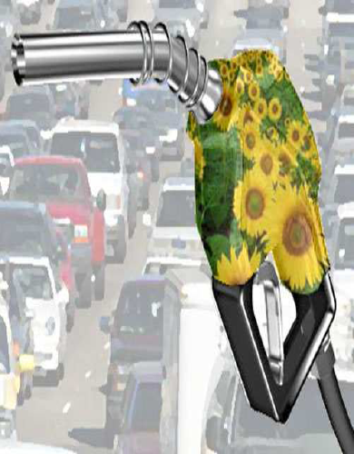
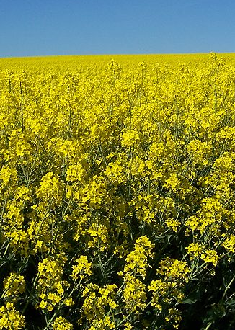

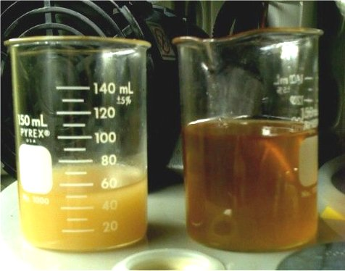
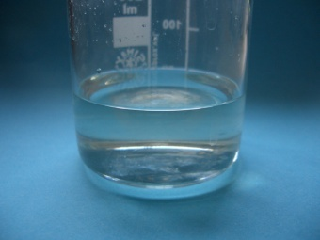
HIKE AROUND GLYCEROL
VEGETABLE OIL
BIODIESEL
CH₃OH
(1 Tons)
(10 Tons)
BLEND WITH DIESEL
RAPESEED
SUNFLOWER
(10 Tons)
GLYCERIN
GLYCEROL
Energy
consuming
process !
(1.2 Ton)
Price: 270 €/Ton
(1 Ton)
Price: 550 €/Ton
Sustainable Chem. Process. 2014, 2,1; J. Chem. Technol. Biotechnol. 2017, 92, 14; Energy Convers. Manage. 2017, 149, 355; Synthesis, 2018, 50, 723; Curr. Opin. Green Sustain. Chem. 2019, 15, 83.

Slide 9

HIKE AROUND GLYCEROL
✓
Sustainable Chem. Process. 2014, 2,1; J. Chem. Technol. Biotechnol. 2017, 92, 14; Energy Convers. Manage. 2017, 149, 355; Synthesis, 2018, 50, 723; Curr. Opin. Green Sustain. Chem. 2019, 15, 83.

Slide 10


POLYGLYCEROL
INDUSTRIAL APPLICATIONS OF POLYGLYCEROLS
Glycerol
Diglycerol
Triglycerol
Tetraglycerol
Polyglycerols for incorporation
in polymers as plasticizer
as ink ingredients
in polyurethane production.
Esters of polyglycerol for incorporation
in food as an emulsifier
in polymers as antifogging and antistatic agents, or lubricants
in inks and agrochemical formulations as emulsifiers, stabilizers, dispersants or humectants
in the paper and wastewater industries as antifoaming agents …
Molecules 2016, 21, 1038; J. Ind. Eng. Chem. 2017, 51, 312; Catalysts 2017, 7, 123; J. Ind. Eng. Chem. 2017, 51, 312; Catalysts. 2017, 7, 123.

Slide 11
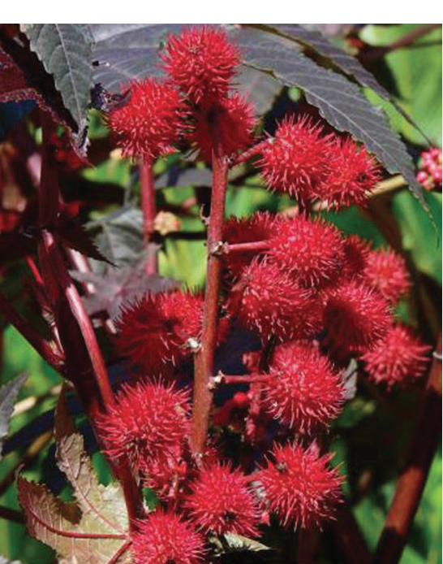
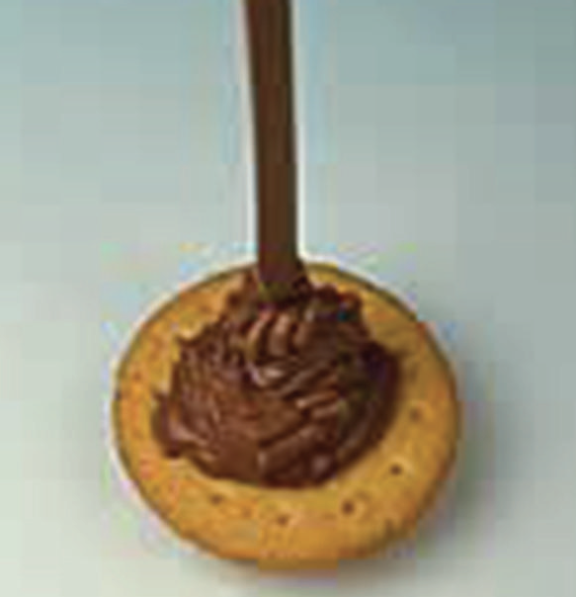
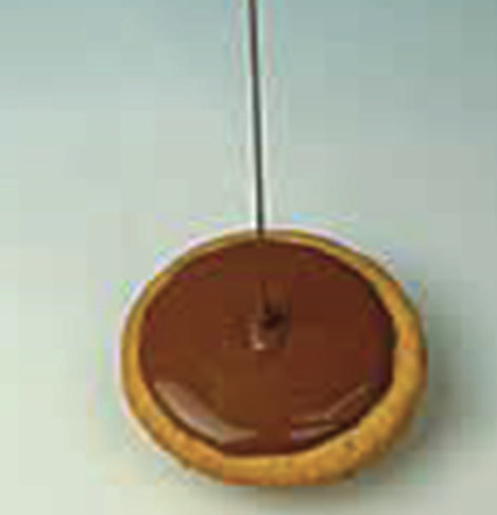
POLYGLYCEROL
INDUSTRIAL APPLICATIONS OF POLYGLYCEROLS
Glycerol
Diglycerol
Triglycerol
Tetraglycerol
Polyglycerol esters of fatty acids (PGEs) are used in food as an emulsifier, allowing water and flour to mix.
Castor bean plant
Ricinus communis
Influence of PGPR addition (0.2%) to a molten chocolate (27% cocoa butter)
PGPR (E476)
Molecules 2016, 21, 1038; J. Ind. Eng. Chem. 2017, 51, 312; Catalysts 2017, 7, 123; J. Ind. Eng. Chem. 2017, 51, 312; Catalysts. 2017, 7, 123.

Slide 12
POLYGLYCEROL
ISOMERS PG2 AND PG3 AND CYCLIC ISOMERS cPG2

Slide 13

POLYGLYCEROL
LINEAR/BRANCHED ISOMERS PG2 AND PG3
Dehydration
Dehydration
Molecules 2016, 21, 1038; J. Ind. Eng. Chem. 2017, 51, 312; Catalysts 2017, 7, 123; J. Ind. Eng. Chem. 2017, 51, 312; Catalysts. 2017, 7, 123.

Slide 14
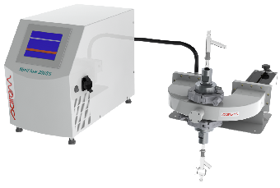
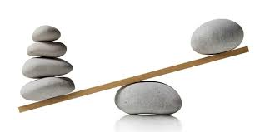
MW-ASSISTED CONT. GLYCEROL OLIGOMERIZATION
Water-free reaction
GLYCEROL 240 g
Company’s specifications
Cheapest possible catalyst that gives
the best possible result.
Not working on 1 mg of glycerol but on more than 200 g of glycerol.
Molecules 2016, 21, 1038; J. Ind. Eng. Chem. 2017, 51, 312; Catalysts 2017, 7, 123; J. Ind. Eng. Chem. 2017, 51, 312; Catalysts. 2017, 7, 123.

Slide 15
MW-ASSISTED CONT. GLYCEROL OLIGOMERIZATION
Water-free reaction
Entry | Flow | Res. Time | Composition (wt%) of the product by GC
 | (mL min⁻¹) | (min) | PG1 | PG2 | PG3 | PG4 | other
1 | 1.0 | 20 | 84.0 | 12.1 | 2.4 | 0.2 | O.4
2 | 0.5 | 40 | 70.3 | 19.5 | 6.3 | 1.0 | 2.0
3 | 0.25 | 80 | 59.1 | 22.1 | 9.3 | 4.4 | 5.0
Reaction conditions: glycerol (240 g, 2.61 mol), K₂CO₃ (10.0 g, 72.4 mmol), 238 °C.

Slide 16
MW-ASSISTED CONT. GLYCEROL OLIGOMERIZATION
Water-free reaction
To achieve higher conversion, our system has been transformed to work in cycle by continuously reinjecting the output in the reactor
Entry | Time | Composition (wt%) of the product by GC
 | (min) | PG1 | PG2 | PG3 | PG4 | other
1 | 50 | 85.9 | 12.3 | 1.5 | 0.2 | 0.1
2 | 100 | 71.8 | 20.6 | 5.2 | 1.2 | 1.2
3 | 150 | 62.1 | 25.5 | 7.9 | 2.3 | 2.2
4 | 250 | 55.1 | 26.4 | 10.0 | 3.7 | 4.8
5 | 250 | 55.2 | 24.2 | 9.2 | 3.4 | 7.4
Reaction conditions: glycerol (240 g, 2.61 mol), K₂CO₃ (10.0 g, 72.4 mmol), 238 °C,
0.5 mL min⁻¹.

Slide 17
MW-ASSISTED CONT. GLYCEROL OLIGOMERIZATION
α,α-diglycerol selectivity 72-74%
α,β-diglycerol selectivity 25-27%
β,β-diglycerol selectivity 1%
α,α-α,α-triglycerol selectivity 45%
α,α-α,β-triglycerol selectivity
α,α-β,α-triglycerol selectivity
Others less than 6%
45%
Reaction conditions: glycerol (240 g, 2.61 mol), K₂CO₃ (10.0 g, 72.4 mmol), 238 °C, 250 min,
0.5 mL min⁻¹.

Slide 18
MW-ASSISTED CONT. GLYCEROL OLIGOMERIZATION
In order to obtain a sample of oligomers with no glycerol or less amount of glycerol, short path evaporation has been explored.
Entry | Fraction | Composition (wt%) of the product by GC
 |  | PG1 | cPG2 | PG2 | cPG3 | PG3 | PG4 | PG5 | PG6 | other
1 | Crude | 55.2 | 1.6 | 24.2 | 0.7 | 9.2 | 3.4 | 1.5 | 0.6 | 3.0
2 ª | Distillat | 90 | 2.2 | 6.3 | 0.2 | 0.5 | - | - | - | 0.8
3 ª | Residue | - | - | 50.2 | 2.0 | 22.1 | 9.5 | 4.3 | 2.0 | 7.4
ª Short path evaporation: 0.1 mbar and 150°C.
Reaction conditions: glycerol (240 g, 2.61 mol), K₂CO₃ (10.0 g, 72.4 mmol), 238 °C, 250 min,
0.5 mL min⁻¹.
Furthermore the purification removed PG1, cPG2, a more lipophylic byproduct and PG2
and a 50% enriched dimer mixture is obtained.

Slide 19
CONCLUSION AND PERSPECTIVES
Energy
consuming
process !
GLYCERIN
GLYCEROL
(1.2 Ton)
Price: 270 €/Ton (2017)
(1 Ton)
Price: 550 €/Ton (2017)
Price: 1324 €/Ton (<2000)
Due to a substantial decrease in the price of purified glycerol between 2000 and today, the purification of glycerin is getting less attractive.
Therefore, direct use of crude glycerol (or glycerin) is becoming promising as well as the transformation of Used Cooking Oil
Starting from Used Cooking Oil and Glycerin, chemical production can be manufactured with low price and sustainable supply.
Mol. Catal. 2020, 494, 111128.

Slide 20

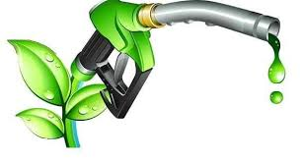

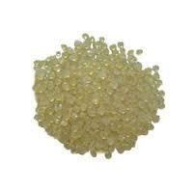
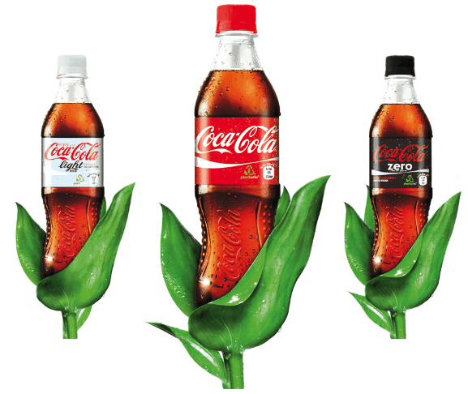

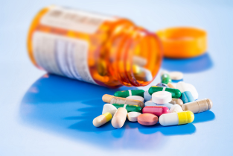

CONCLUSION AND PERSPECTIVES
Petrol
Lignocellulose
Carbohydrate
Continuous Flow and Catalysis
Continuous Flow + MW
Continuous Flow + US
Continuous Flow + hν
Continuous Flow + Ball Milling
Oil

Slide 21
MICROWAVE-ASSISTED CONTINUOUS FLOW FOR THE SELECTIVE OLIGOMERIZATION OF GLYCEROL
Remi Nguyen, Christophe Len
christophe.len@chimieparistech.psl.eu
lenresearch.com
@len_research
1st Int. Elect. Conf. Catal. Sci., November 2020,

