Slide 1
Fenton degradation of ofloxacin using a montmorillonite-Fe₃O₄ composite
A
presentation
by
Rahmah Alamri
School of Chemical Science, Universiti Sains Malaysia.

Slide 2
Introduction
Ofloxacin is a second generation fluoroquinolone antibiotic with the chemical formula C₁₈H₂₀FN₃O₄ and the chemical name 9-fluoro-2,3-dihydro-3-methyl-10-(4-methyl-1-piperazynyl)-7-oxo-7H-pyrido-[1,2,3-de]-1,4-benzoxazine-6-carboxylic acid.
It was patented in 1980 and subsequently approved for medical use in 1985.
Ofloxacin is frequently prescribed for the treatment of various bacterial infections that cause digestive, respiratory, bronchitis, gastrointestinal, gonorrhoea, pneumonia, chlamydia and urinary tract infections.
Studies have reported the detection of ofloxacin with different concentrations in hospital wastewater (25,000 – 35,000 ng/L), municipal wastewater treatment plants (53 – 1800 ng/L) and surface water (10 – 535 ng/L), and is still being detected in wastewater even after the conventional treatment.
Presence of ofloxacin in water results in high colour with unpleasant odours and may also leads to microbial resistance among pathogens or dead of microorganisms that are effective in wastewater remediation.
Thus, the development of an effective method for the thorough elimination of OFL from wastewater is imperative.

Slide 3
Advanced Oxidation Processes (AOPs)
These are highly efficient methods that accelerate the oxidation and degradation of a wide range of organic and inorganic substances that might be resistant to conventional methods.
The process involves the production of in situ transitory species (e.g hydroxyl radicals).
The oxidants such as hydroxyl radicals reacts with all aqueous pollutants.
These transitory species aid in the degradation process until the targeted pollutant is completely converted to CO₂, H₂O and mineral acids (if the pollutant contains halogens).
Some heavy metals could also be removed.
No other hazardous substances are formed.

Slide 4
Figure 1: Classification of advanced oxidation processes (AOPs).

Slide 5
Fenton Process
Fenton process is a process of oxidizing organic pollutants in a medium made-up of H₂O₂ and iron catalyst (ie. Fe²⁺ and H₂O₂).
The iron ions act as catalysts.
The H₂O₂ is an oxidant.
No energy input is necessary to activate H₂O₂.
The hydroxyl radicals produced are responsible for degrading organic pollutants.
Fenton’s reagent is relatively inexpensive.
The process is easy to operate and maintain.
There’s no form of energy involved as catalyst.

Slide 6
However the challenges faced during the homogenous Fenton process, leads to the development of heterogeneous catalysts.
Some of the heterogeneous catalysts include Fe₃O₄ nanoparticle, Cu-Fe, Fe-Mn etc.
Among the catalysts, Fe₃O₄ nanoparticles have received significant attention due to their low toxicity and biocompatibility properties.
Moreover, another type of potential heterogeneous catalyst that has gained attention involved immobilization of Fe₃O₄ on inorganic or organic solid supports.
Although such immobilization prevents the agglomeration and enhances the dispersibility of Fe₃O₄, the choice of appropriate support is critical.
Montmorillonite is among the most abundant clay minerals on earth, which is cheap, has a large surface area, non-toxic, abundant with many other excellent properties. All these imply that montmorillonite is a good candidate that could be used as a support for Fe₃O₄

Slide 7
Figure 2: Some features of hydroxyl radical.

Slide 8
Chemical Equations of a Fenton Process
Fe²⁺ + H₂O₂ Fe³⁺ + OH¯ + ·OH
Fe³⁺ + H₂O₂ Fe²⁺ + HO₂· + H⁺
Fe³⁺ + HO₂· Fe²⁺ + O₂ + H⁺
H₂O₂ + ·OH H₂O + HO₂·
Fe²⁺ + ·OH Fe³⁺ + OH¯
HO₂· + HO₂· H₂O₂ + O₂
Fe²⁺ + H₂O₂ [Fe(OH)₂]²⁺ Fe³⁺ + OH¯ + ·OH

Slide 9
Objectives of the Present Study
To synthesize various Fe₃O₄-montmorillonite composites using facile production processes.
To characterize structural and physicochemical properties of Fe₃O₄-montmorillonite composites using various methods.
To apply various Fe₃O₄-montmorillonite composites as catalysts for the degradation of ofloxacin antibiotic in aqueous media via hetero-Fenton process.
To correlate the hetero-Fenton efficiency of Fe₃O₄-montmorillonite composites with their physicochemical properties.

Slide 10
Fe₃O₄-Montmorillonite (FeM) composites
Figure 1: XPS spectra of montmorillonite (a), FeM-3 (b), FeM-5 (c), FeM-8 (d), FeM-10 (e) and FeM-15 (f).

Slide 11
Fe₃O₄-Montmorillonite (FeM) composites
Figure 2: FTIR spectra of bare montmorillonite and FeM composites

Slide 12
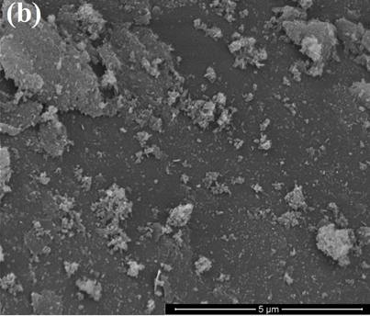
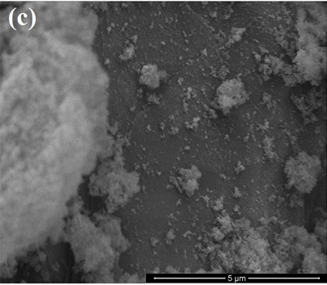
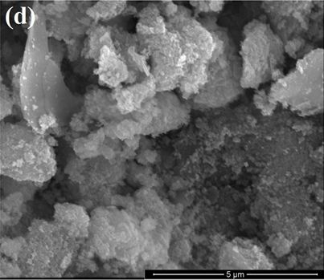
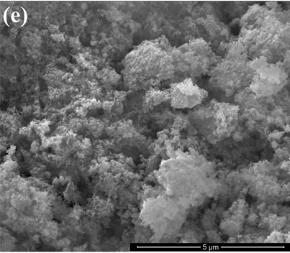
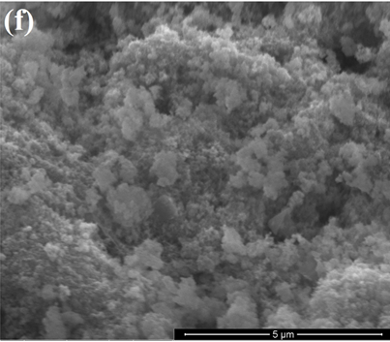
Figure 3: FESEM images of bare montmorillonite (a), FeM-3 (b), FeM-5 (c), FeM-8 (d), FeM-10 (e) and FeM-15 (f) composites.

Slide 13
Figure 4. TEM images of montmorillonite (a), FeM-3 (b), FeM-5 (c), FeM-8 (d), FeM-10 (e) and FeM-15 (f).

Slide 14
Table 1. Composition of bare montmorillonite and FeM composites as determined by EDX
Table 2. Surface area and pore volume of bare montmorillonite and FeM composites
Sample | Al % | Si % | K % | Mg% | O % | Fe %
Montmorillonite | 9.21 | 33.06 | 4.10 | 1.11 | 52.52 | -
FeM-3 | 1.61 | 17.75 | - | - | 37.36 | 43.19
FeM-5 | 1.31 | 10.17 | - | - | 36.92 | 51.60
FeM-8 | 0.83 | 6.58 | - | - | 33.93 | 58.66
FeM-10 | 0.47 | 5.24 | - | - | 33.75 | 60.54
FeM-15 | 0.18 | 2.71 | - | - | 32.96 | 64.15
Samples | BET surface area (m²/g) | Pore volume (cm³/g)
Montmorillonite | 258.108 | 0.423
FeM-3 | 247.944 | 0.634
FeM-5 | 192.118 | 0.602
FeM-8 | 163.552 | 0.384
FeM-10 | 161.800 | 0.363
FeM-15 | 113.186 | 0.312

Slide 15
Influence of Process Variables
Figure 5. OFL removal in different processes
Reaction conditions are based on: [OFL] = 50 mg/L, pH = 9, (FeM-10) = 0.75 g/L, (H₂O₂) = 5 ml/L.

Slide 16
Effect of operational parameters
Effect of Fe₃O₄ loading on montmorillonite
Effect of catalyst dosage
Effect of initial solution pH
Effect of initial OFL concentration

Slide 17
Effect of different oxidants
Effect of H₂O₂ dosage
Effect of reaction temperature
Effect of inorganic ions
Figure 6. Effects of (a) Fe₃O₄ loading on montmorillonite, (b) catalyst dosage, (c) initial solution pH, (d) initial OFL concentration, (e) different oxidants, (f) H₂O₂ dosage, (g) reaction temperature, and (h) inorganic salts.

Slide 18
Degradation of OFL under different conditions.
Figure 7. Degradation of OFL under different conditions.
Reaction conditions are based on: [OFL] = 50 mg/L, pH = 9, (FeM-10) = 0.75 g/L, (H₂O₂) = 5 ml/L.

Slide 19
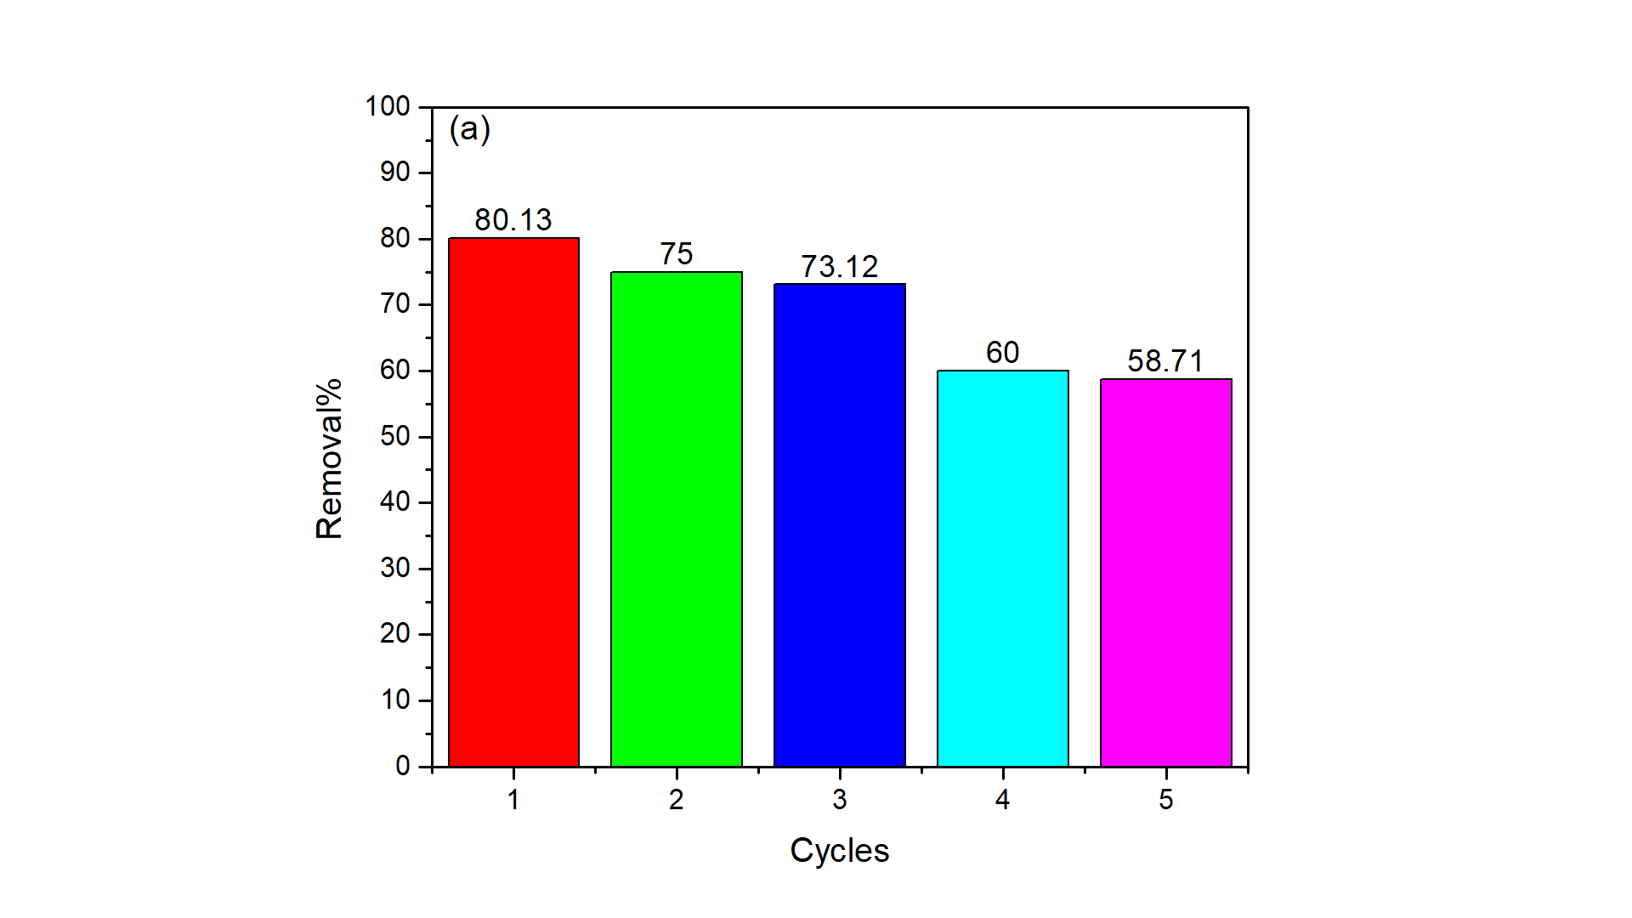
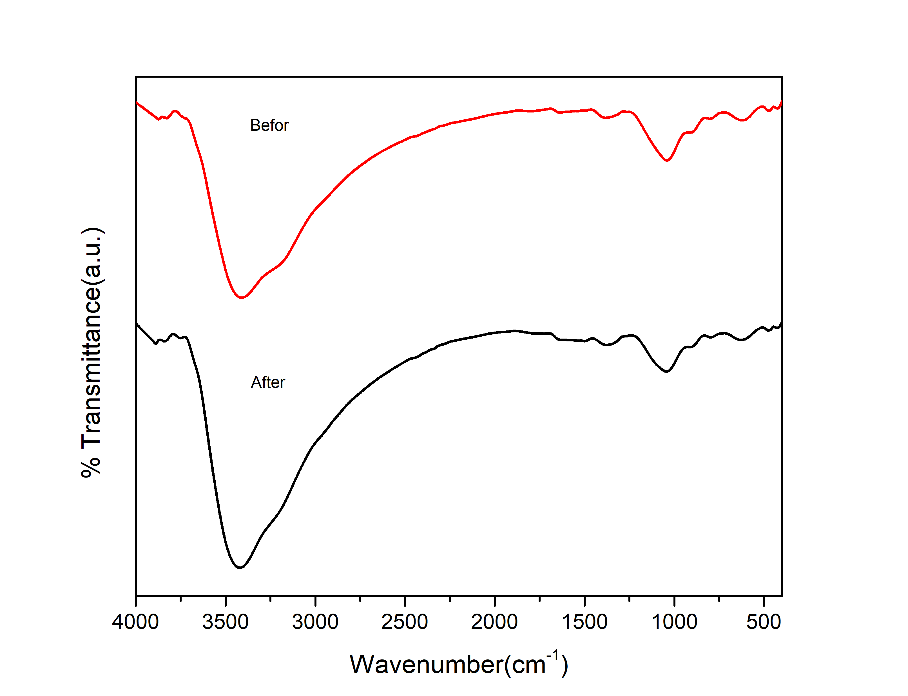
Reusability and Stability Studies
Figure 8. Recycling performance of FeM-10 composite in the degradation of OFL (a) FTIR spectra of FeM-10 composite before and after five cycles (b)

Slide 20
Conclusions
FeM (Fe₃O₄-montmorillonite) composites have been successfully synthesized using a facile co-precipitation process.
Characterization of the composites confirmed the immobilization of Fe₃O₄ onto montmorillonite.
FeM composites were able to successfully activate green oxidant (H₂O₂) for the subsequent degradation of aqueous ofloxacin (OFL) solution.
The performance by the optimized composite (FeM-10) within the pH range of wastewater (5 – 9) was appreciable.
Under the conditions of 0.75 g/L FeM-10, 5 mL/L H₂O₂, and natural pH, almost 81% of 50 mg/L of OFL was degraded within 120 min in the dark. However, the removal increased to about 92% during photo-Fenton process.
The FeM-10 composite maintained reasonable efficiency even after five cycles, therefore could be a promising heterogeneous catalyst for the activation of H₂O₂ to degrade pollutants, including OFL antibiotic.

