Slide 1

Highly Active Pandanus Nanocellulose-supported Poly(amidoxime) Copper (II) Complex for Ullmann Cross-coupling Reaction by:
Choong Jian Fui
Supervised by:
MAIN SUPERVISOR | PROF. DR. MD LUTFOR RAHMAN
CO-SUPERVISOR | DR. MOHD SANI BIN SARJADI

Slide 2
Background

Slide 3
Synthesis process is necessary due to the molecular complexity and various type of bond formation through the organic transformations is being grown in parallel fashion.
C‐C or C-N bonds formation (cross-coupling) reactions are important for the synthesis of essential chemicals such as:
1. Fine chemicals,
2. Drug and intermediate products,
3. Natural products etc.
Transition metal catalysts (Pd, Cu, Ni) are normally used for cross-coupling reactions (suzuki, heck, sonogashira, click etc.).

Slide 4
Catalyst
Homogeneous
Heterogeneous
Homogeneous catalyst | Heterogeneous catalyst
Expensive | Less expensive
Purification of product is difficult | Easy to purify the product
Can not be reused | Reusable
Environmental pollution | Environmental-friendly
Not stable in the reaction media | Stable under harsh conditions

Slide 5
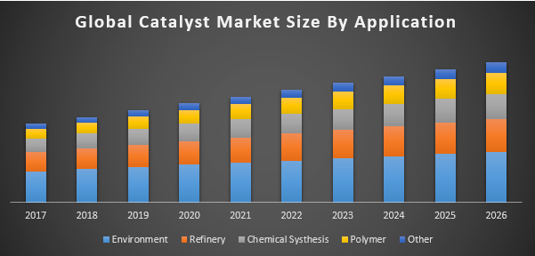
Price of the catalyst and catalyst market are growth year by year.
Therefore, the low cost, high activity, high stability, safe reusability, non-toxic, sustainable chemistry, and characteristic of green organic synthesis are well interest by most of the researcher in the development of heterogeneous metal catalyst

Slide 6
objectives

Slide 7
To extract the cellulose from the agro-waste (pandanus fruit fibre) and utilize to synthesize a poly(amidoxime) ligand,
To prepare heterogeneous copper catalysts from the cellulose-supported amidoxime ligands,
To evaluate the catalytic ability and reusability of synthesize catalyst in Ullmann cross-coupling reaction.

Slide 8
Methodology

Slide 9
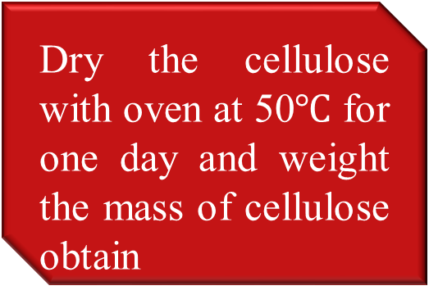
Cellulose Extraction
Filter the wood sawdust and weight 100g of fiber.
Dry the cellulose with oven at 50$℃$ for one day and weight the mass of cellulose obtain
(Sources: Rahman et al., 2016)

Slide 10
Synthesize nanocellulose
Procedure:
Boil the cellulose with 40% of H₂SO₄ for 1 hours.
Pour the mixture into the cool water after reaction done.
Neutralize the solution using NaOH .
Wash and dry.

Slide 11
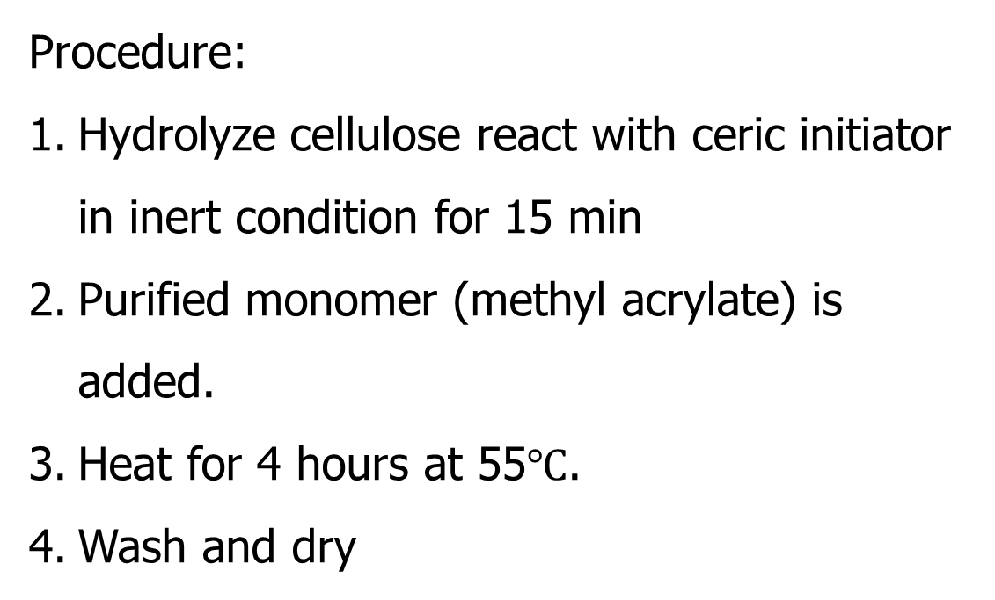
Graft Copolymerization (Poly(acrylonitrile))
Procedure:
Hydrolyze cellulose react with ceric initiator in inert condition for 15 min
Purified monomer (methyl acrylate) is added.
Heat for 4 hours at 55$℃$.
Wash and dry
(Sources: Mandal et al., 2016)

Slide 12
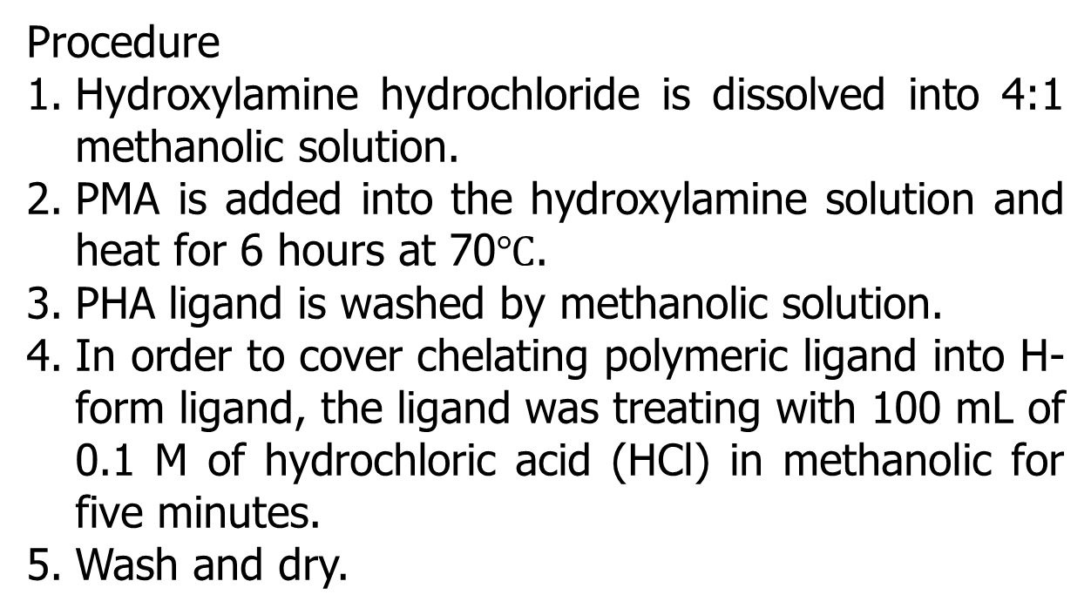
Synthesis of Poly(amidoxime) Ligand
Procedure
Hydroxylamine hydrochloride is dissolved into 4:1 methanolic solution.
PMA is added into the hydroxylamine solution and heat for 6 hours at 70$℃$.
PHA ligand is washed by methanolic solution.
In order to cover chelating polymeric ligand into H-form ligand, the ligand was treating with 100 mL of 0.1 M of hydrochloric acid (HCl) in methanolic for five minutes.
Wash and dry.
(Sources: Shaheen et al., 2016)

Slide 13
Preparation Of Metal Catalyst (Cu²⁺)
Shake for 2 hours with 180 rpm Agitation speed
Wash the ligand and dry it. The ICP-OES analysis should be used to estimate the copper adsorbed
(Sources: Rahman et al., 2016)

Slide 14
Reaction Mechanism

Slide 15
Ullmann Reactions
Cu(II)@PAM
base, heat, solvent

Slide 16
result

Slide 17
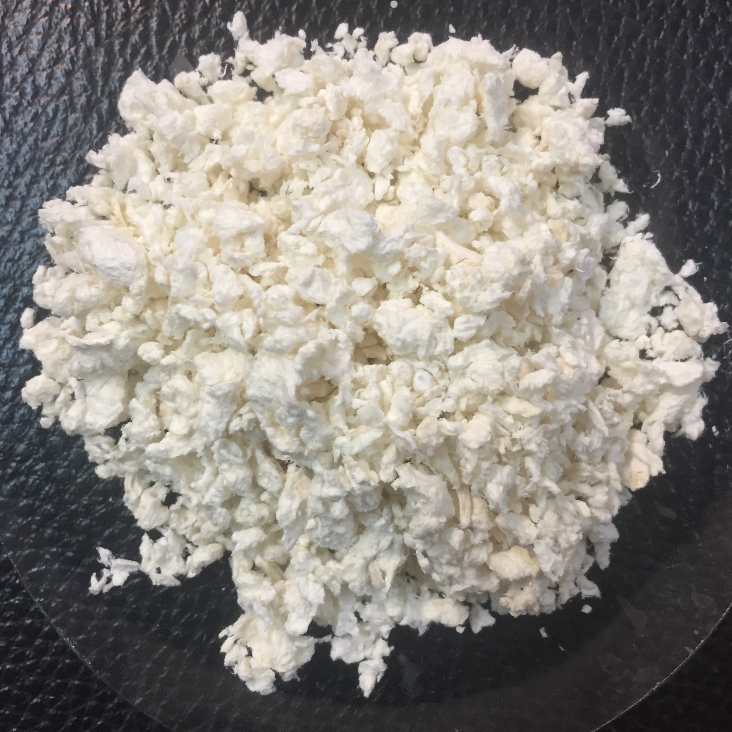
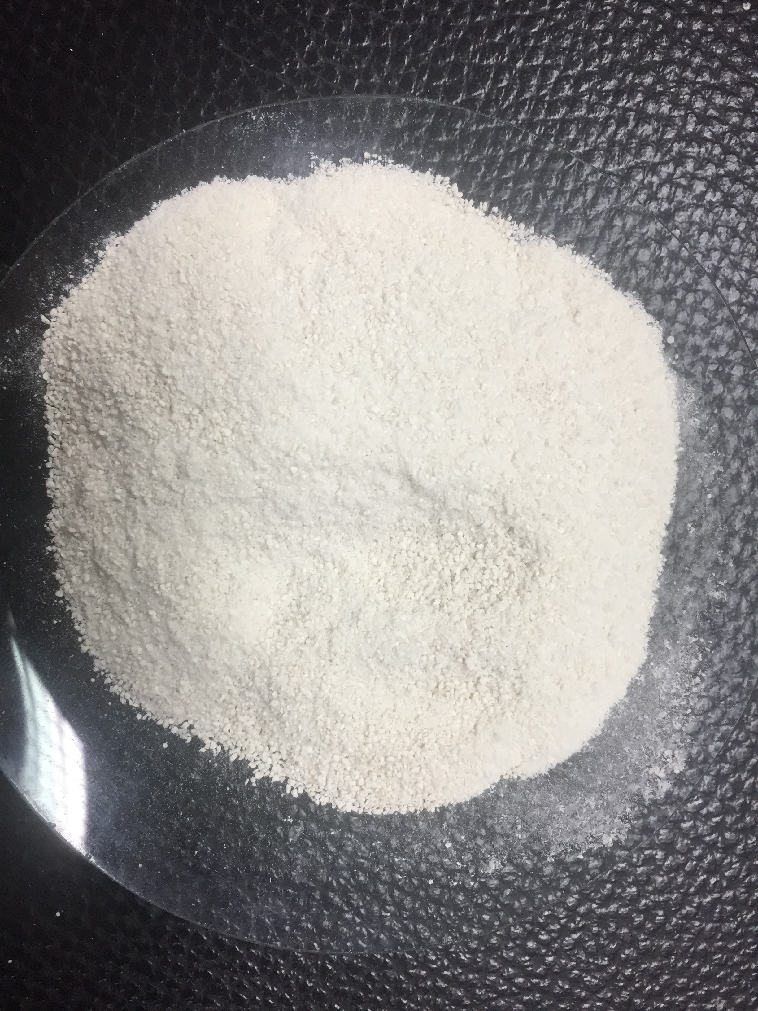
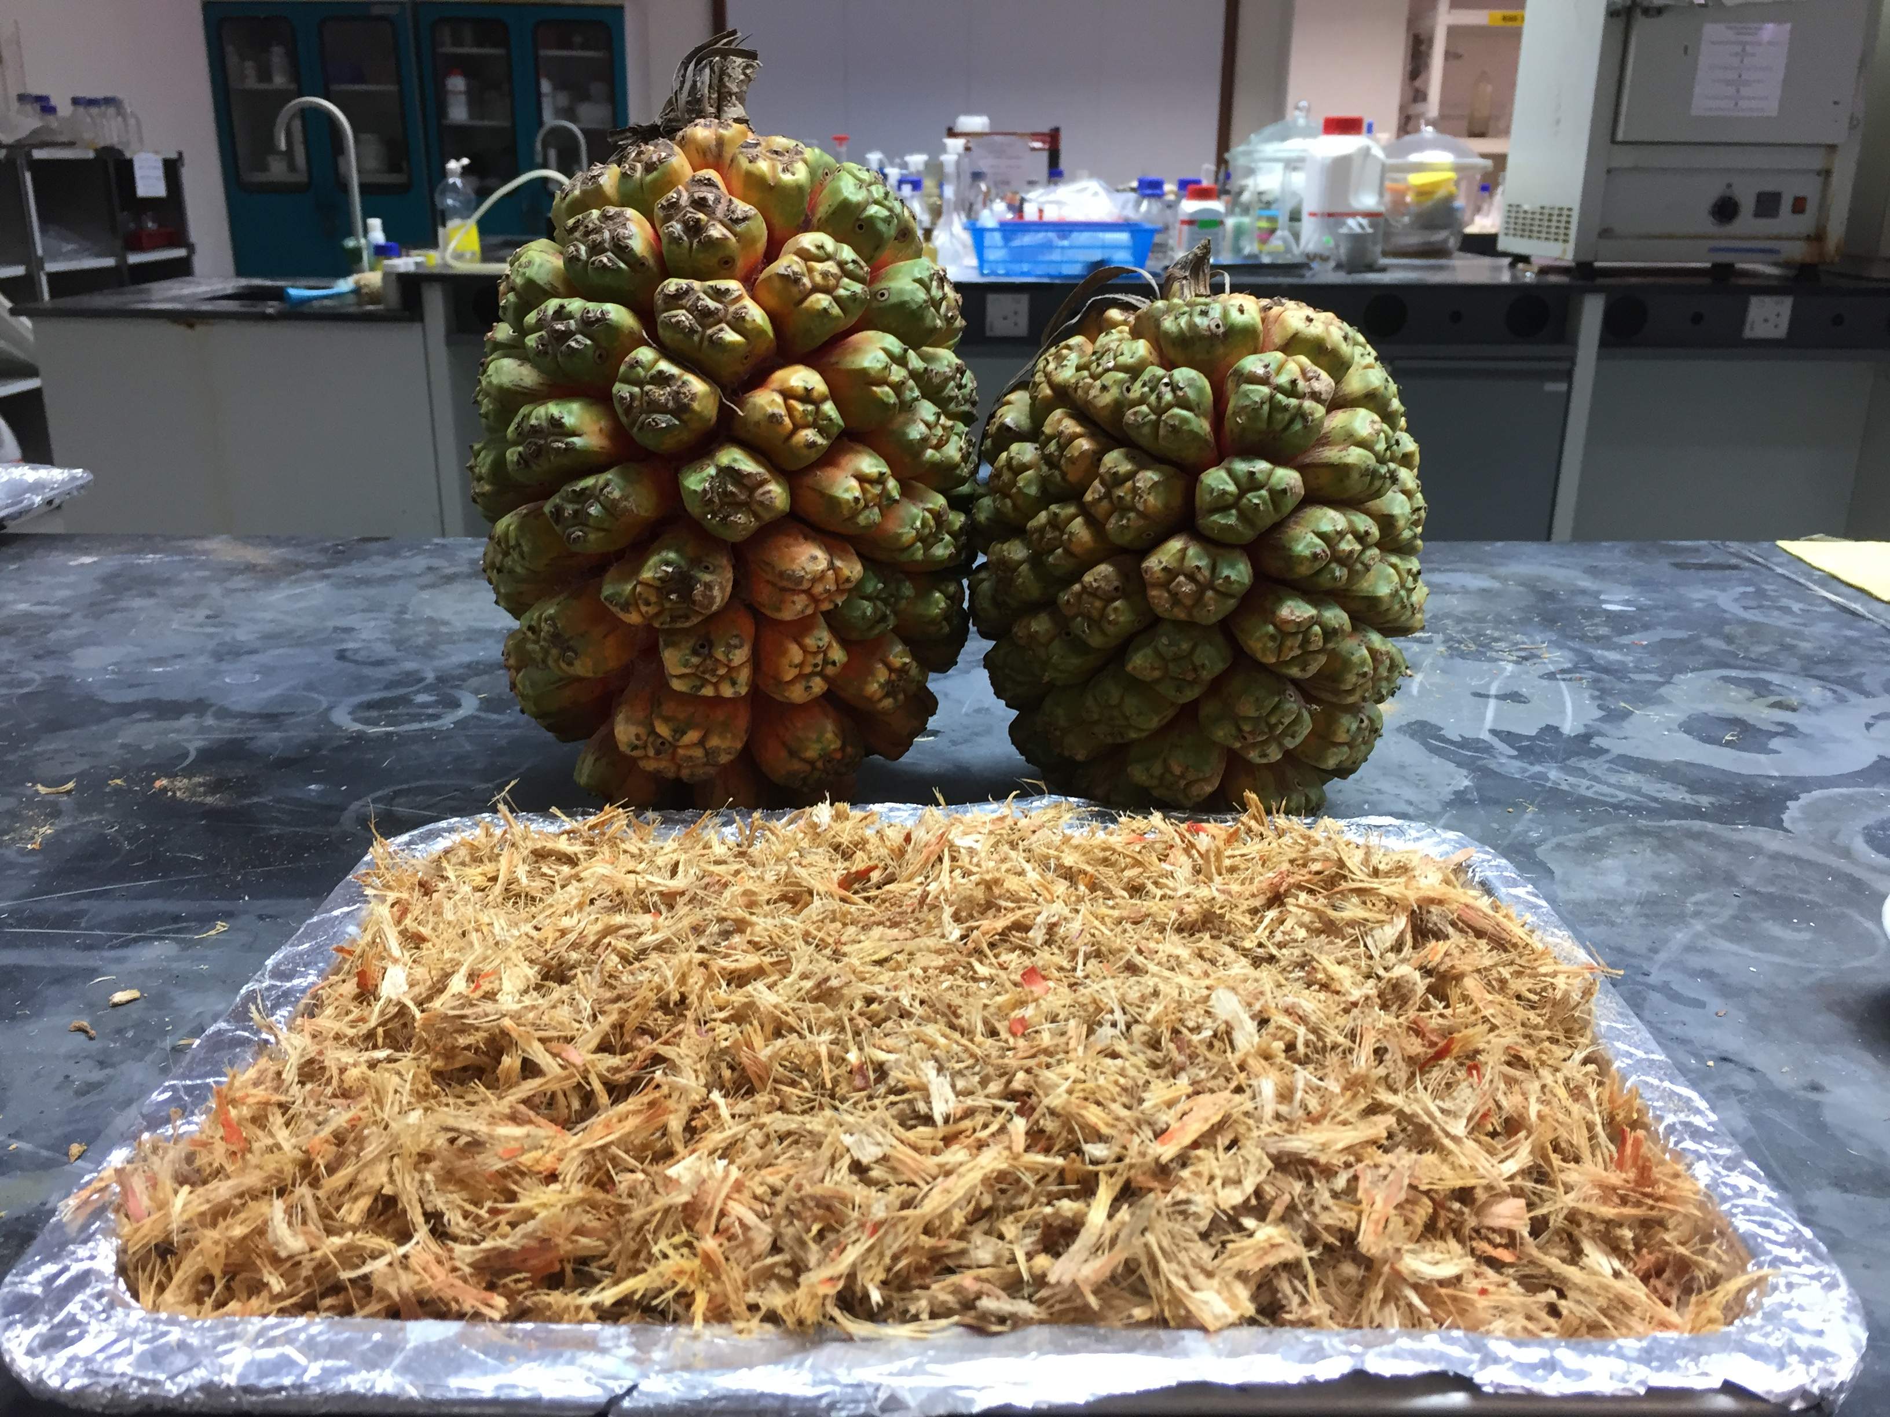
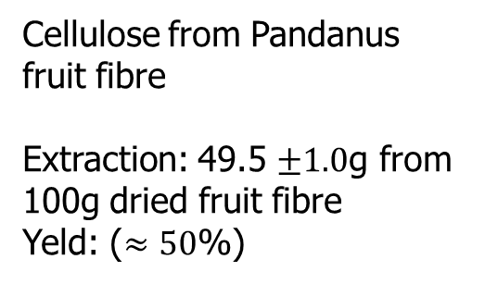
Product
Pandanus fruit and its fibre
Cellulose from Pandanus fruit fibre
Extraction: 49.5 $±1.0$g from 100g dried fruit fibre
Yeld: ($≈50$%)
(nanocellulose)

Slide 18
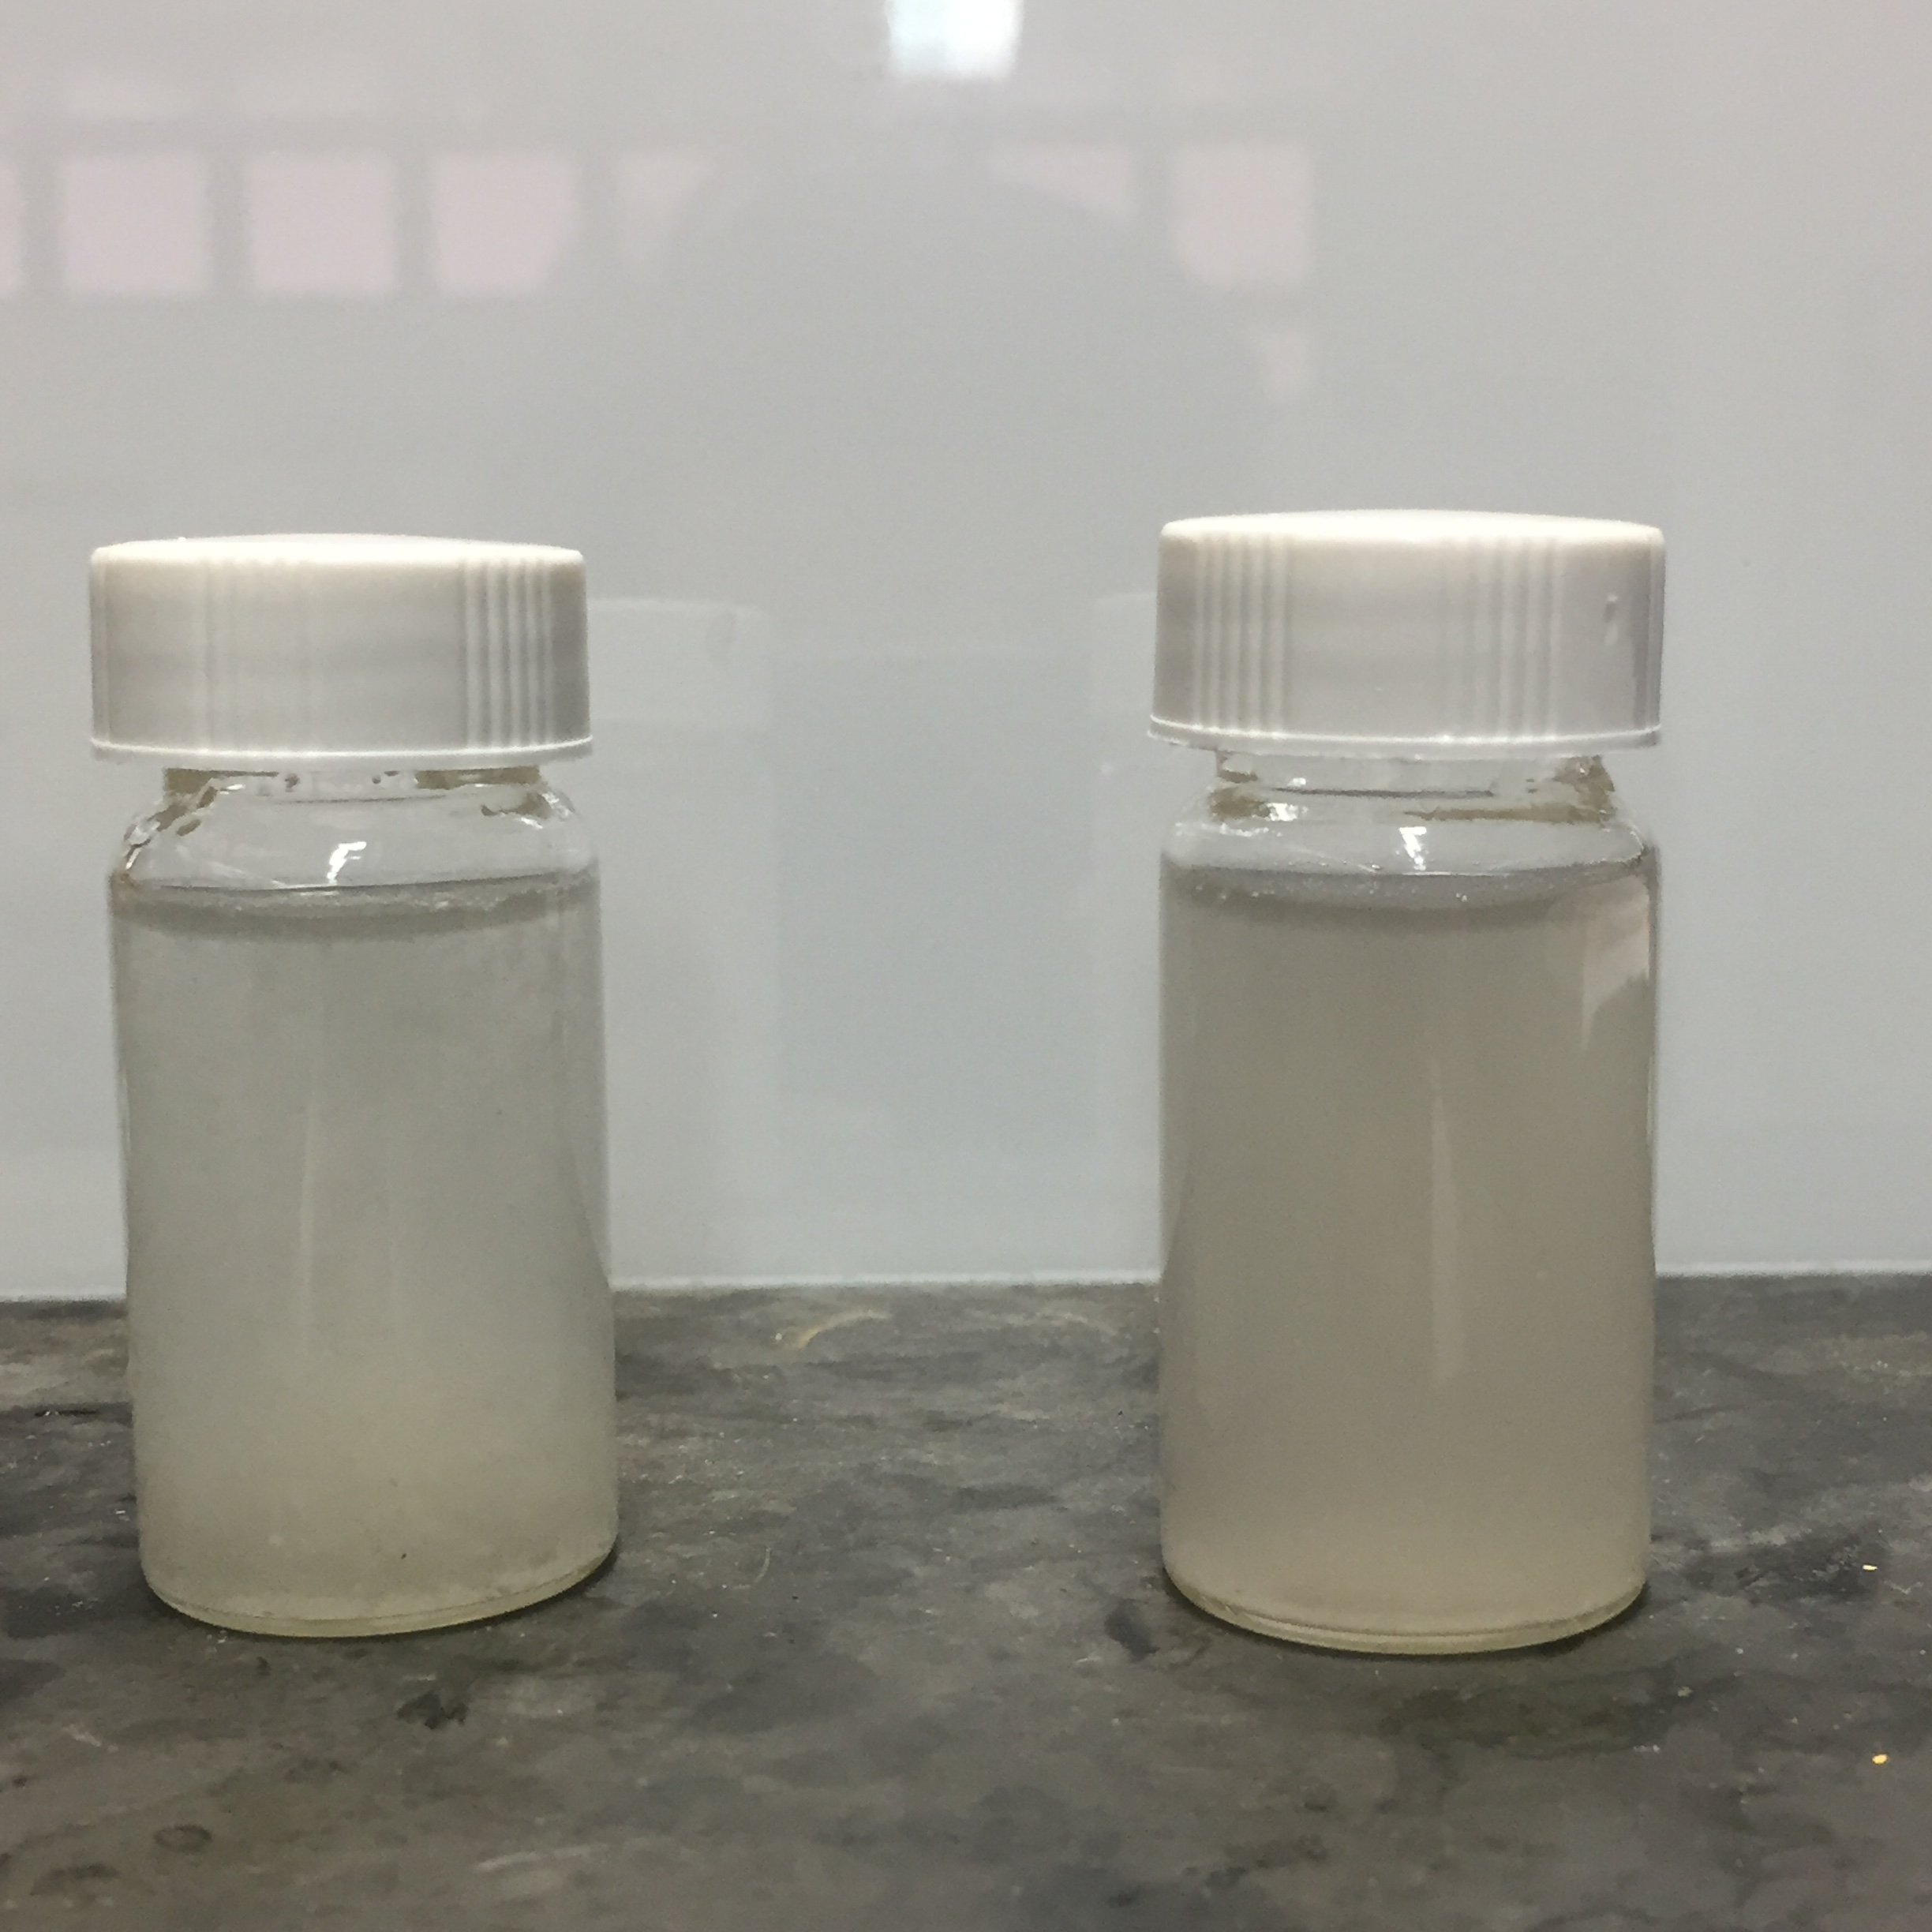
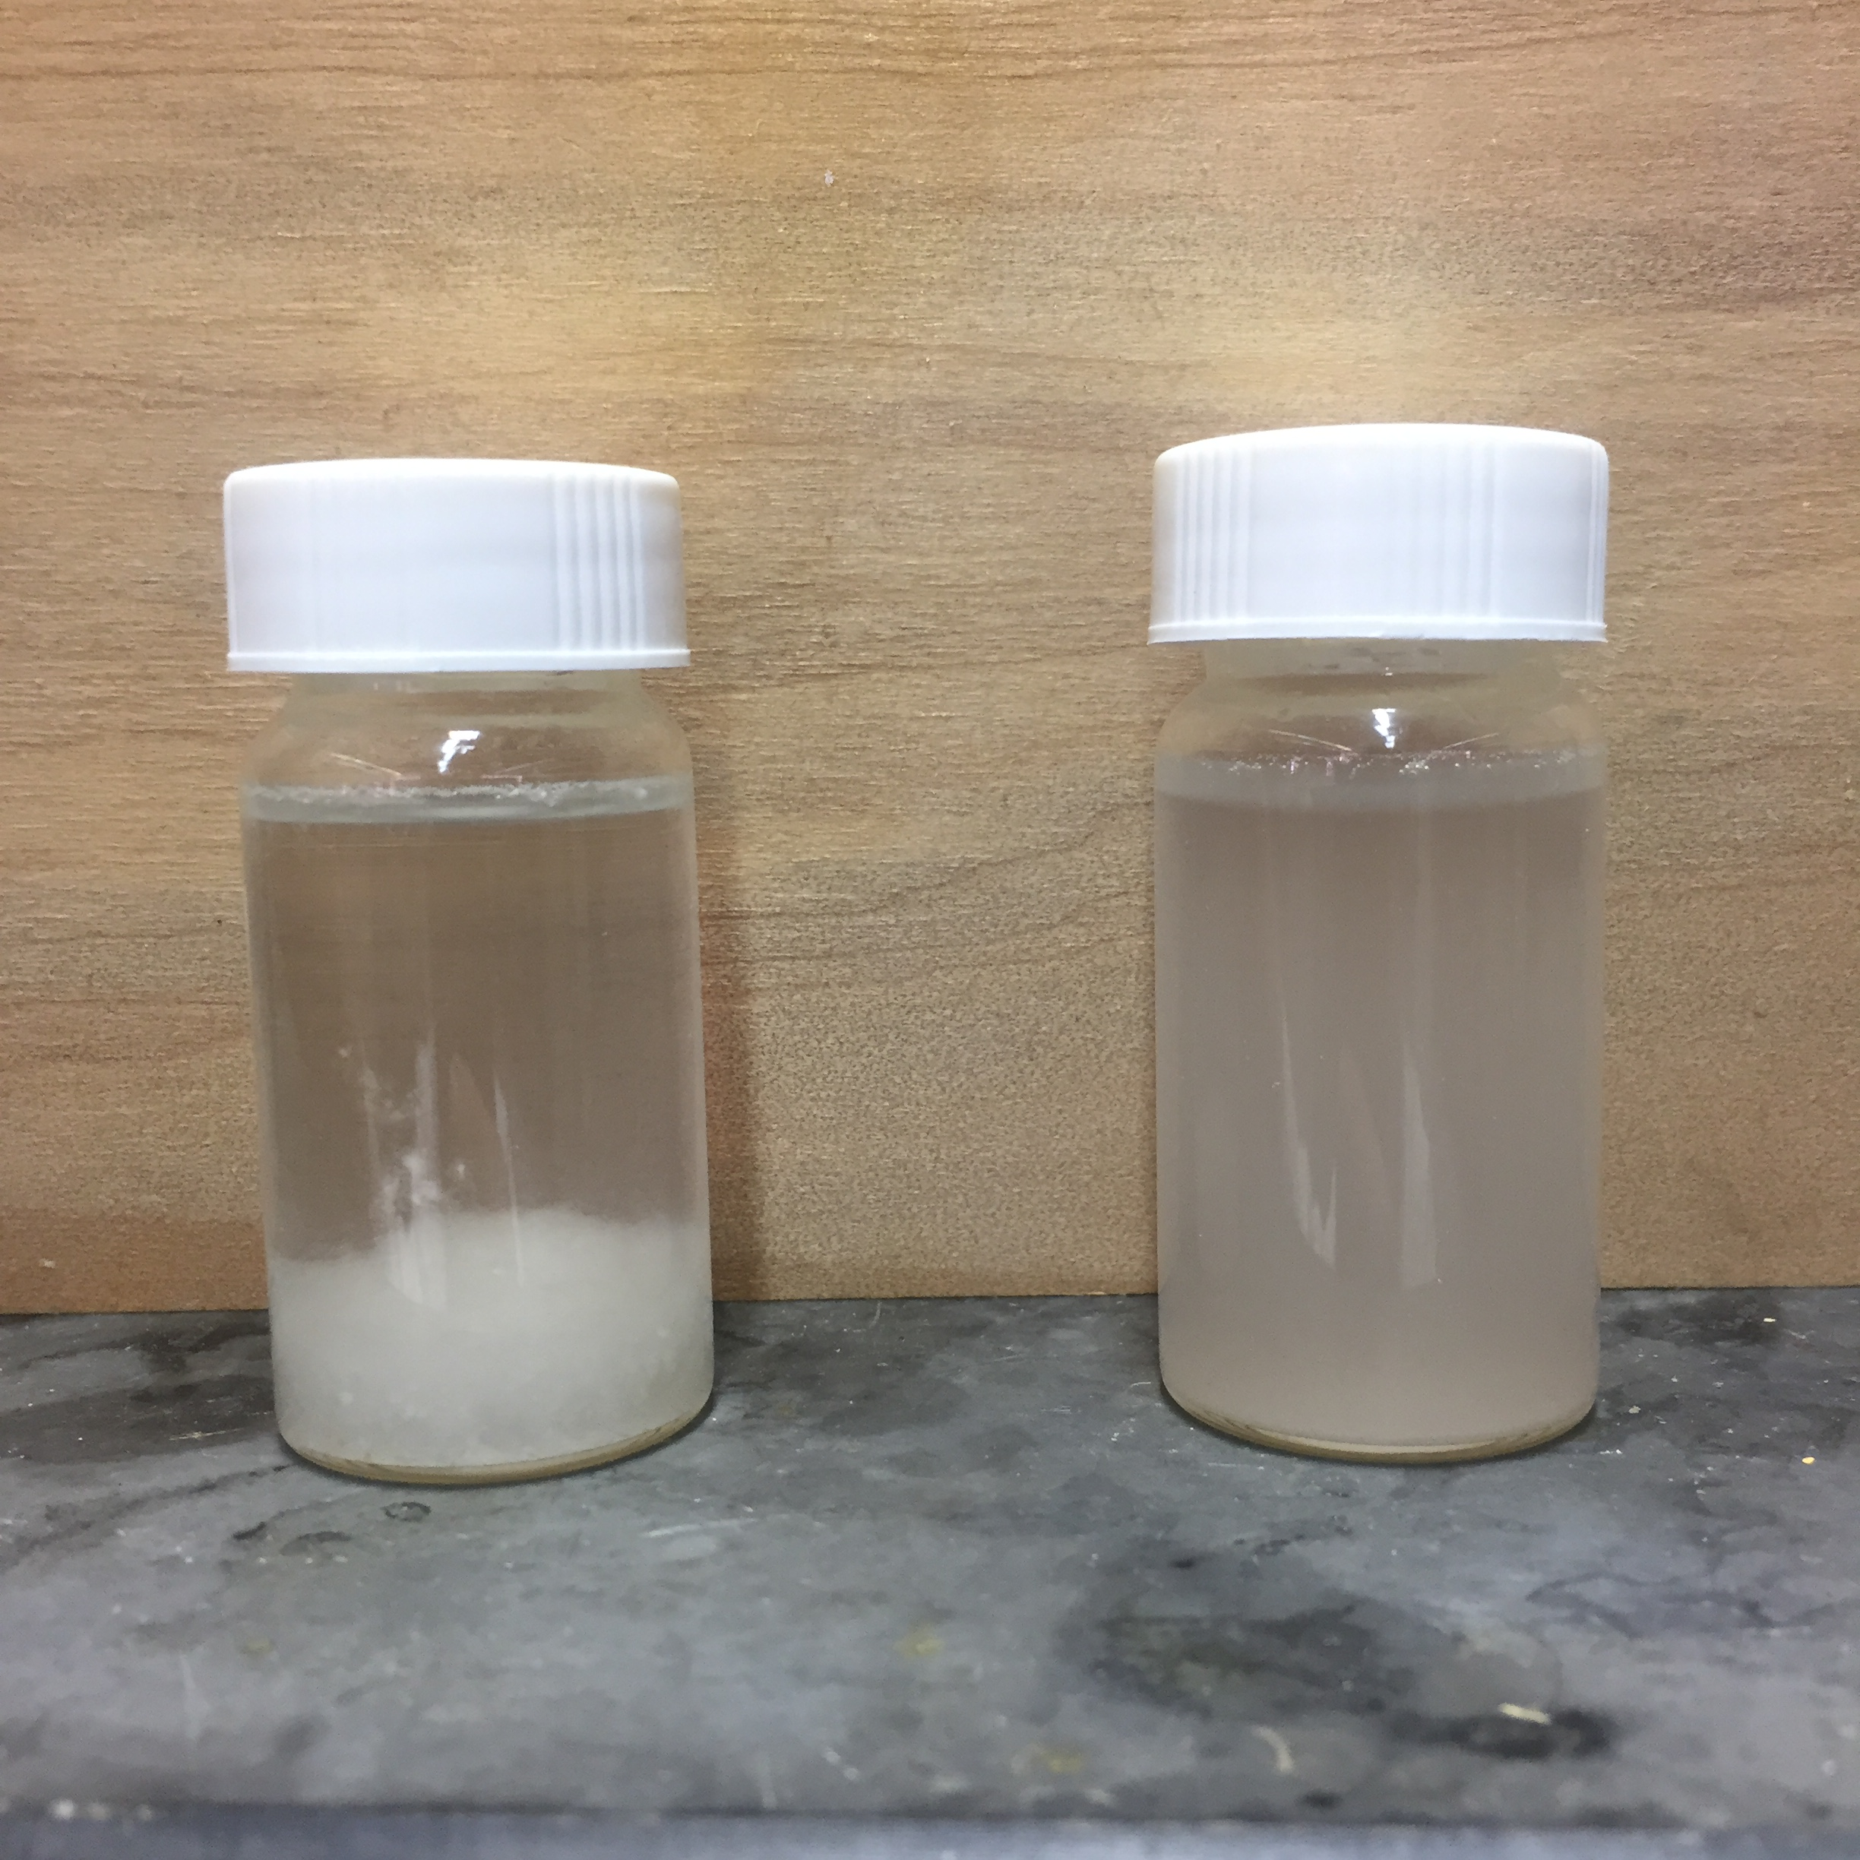
Physical stability of cellulose and nanocellulose
Cellulose
nanocellulose
Cellulose
nanocellulose
15 min String
Leave For 3 hour

Slide 19
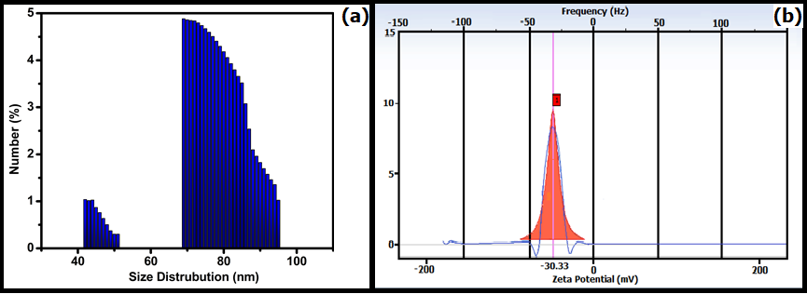
Particle size and zeta potential analysis

Slide 20
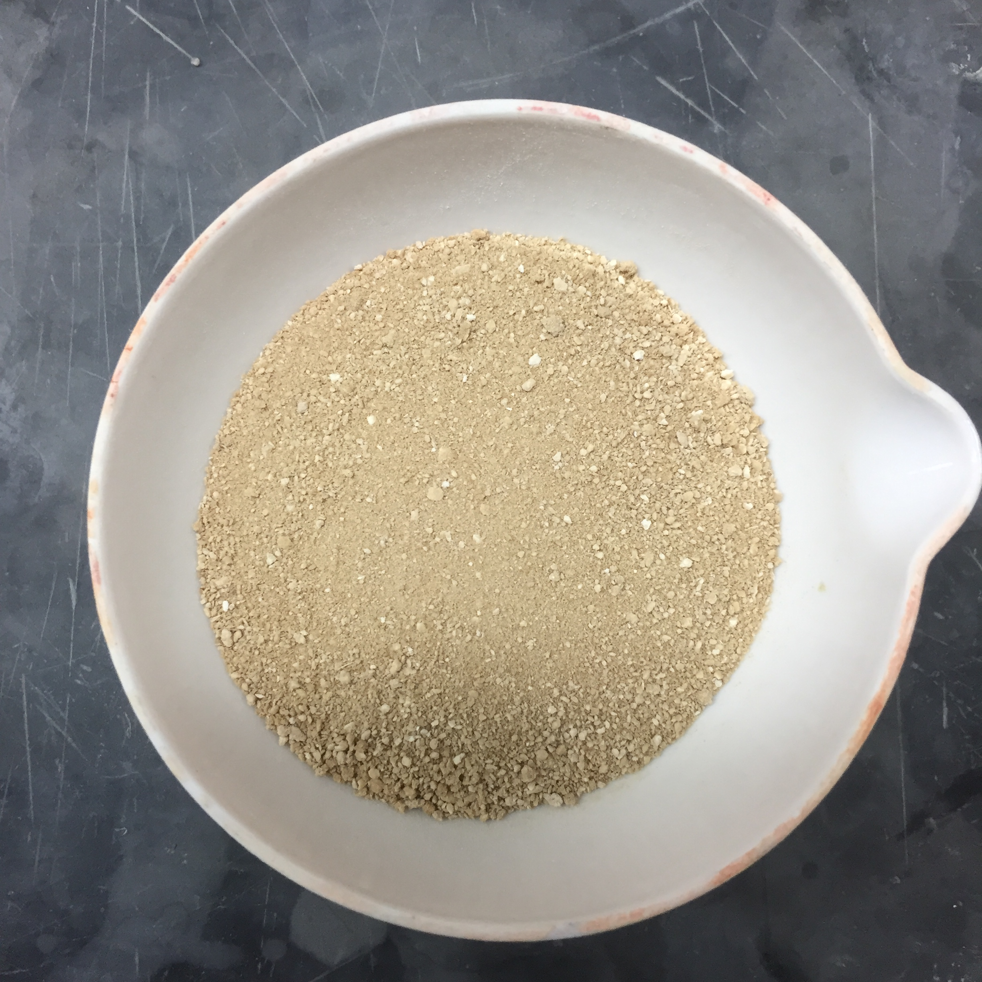
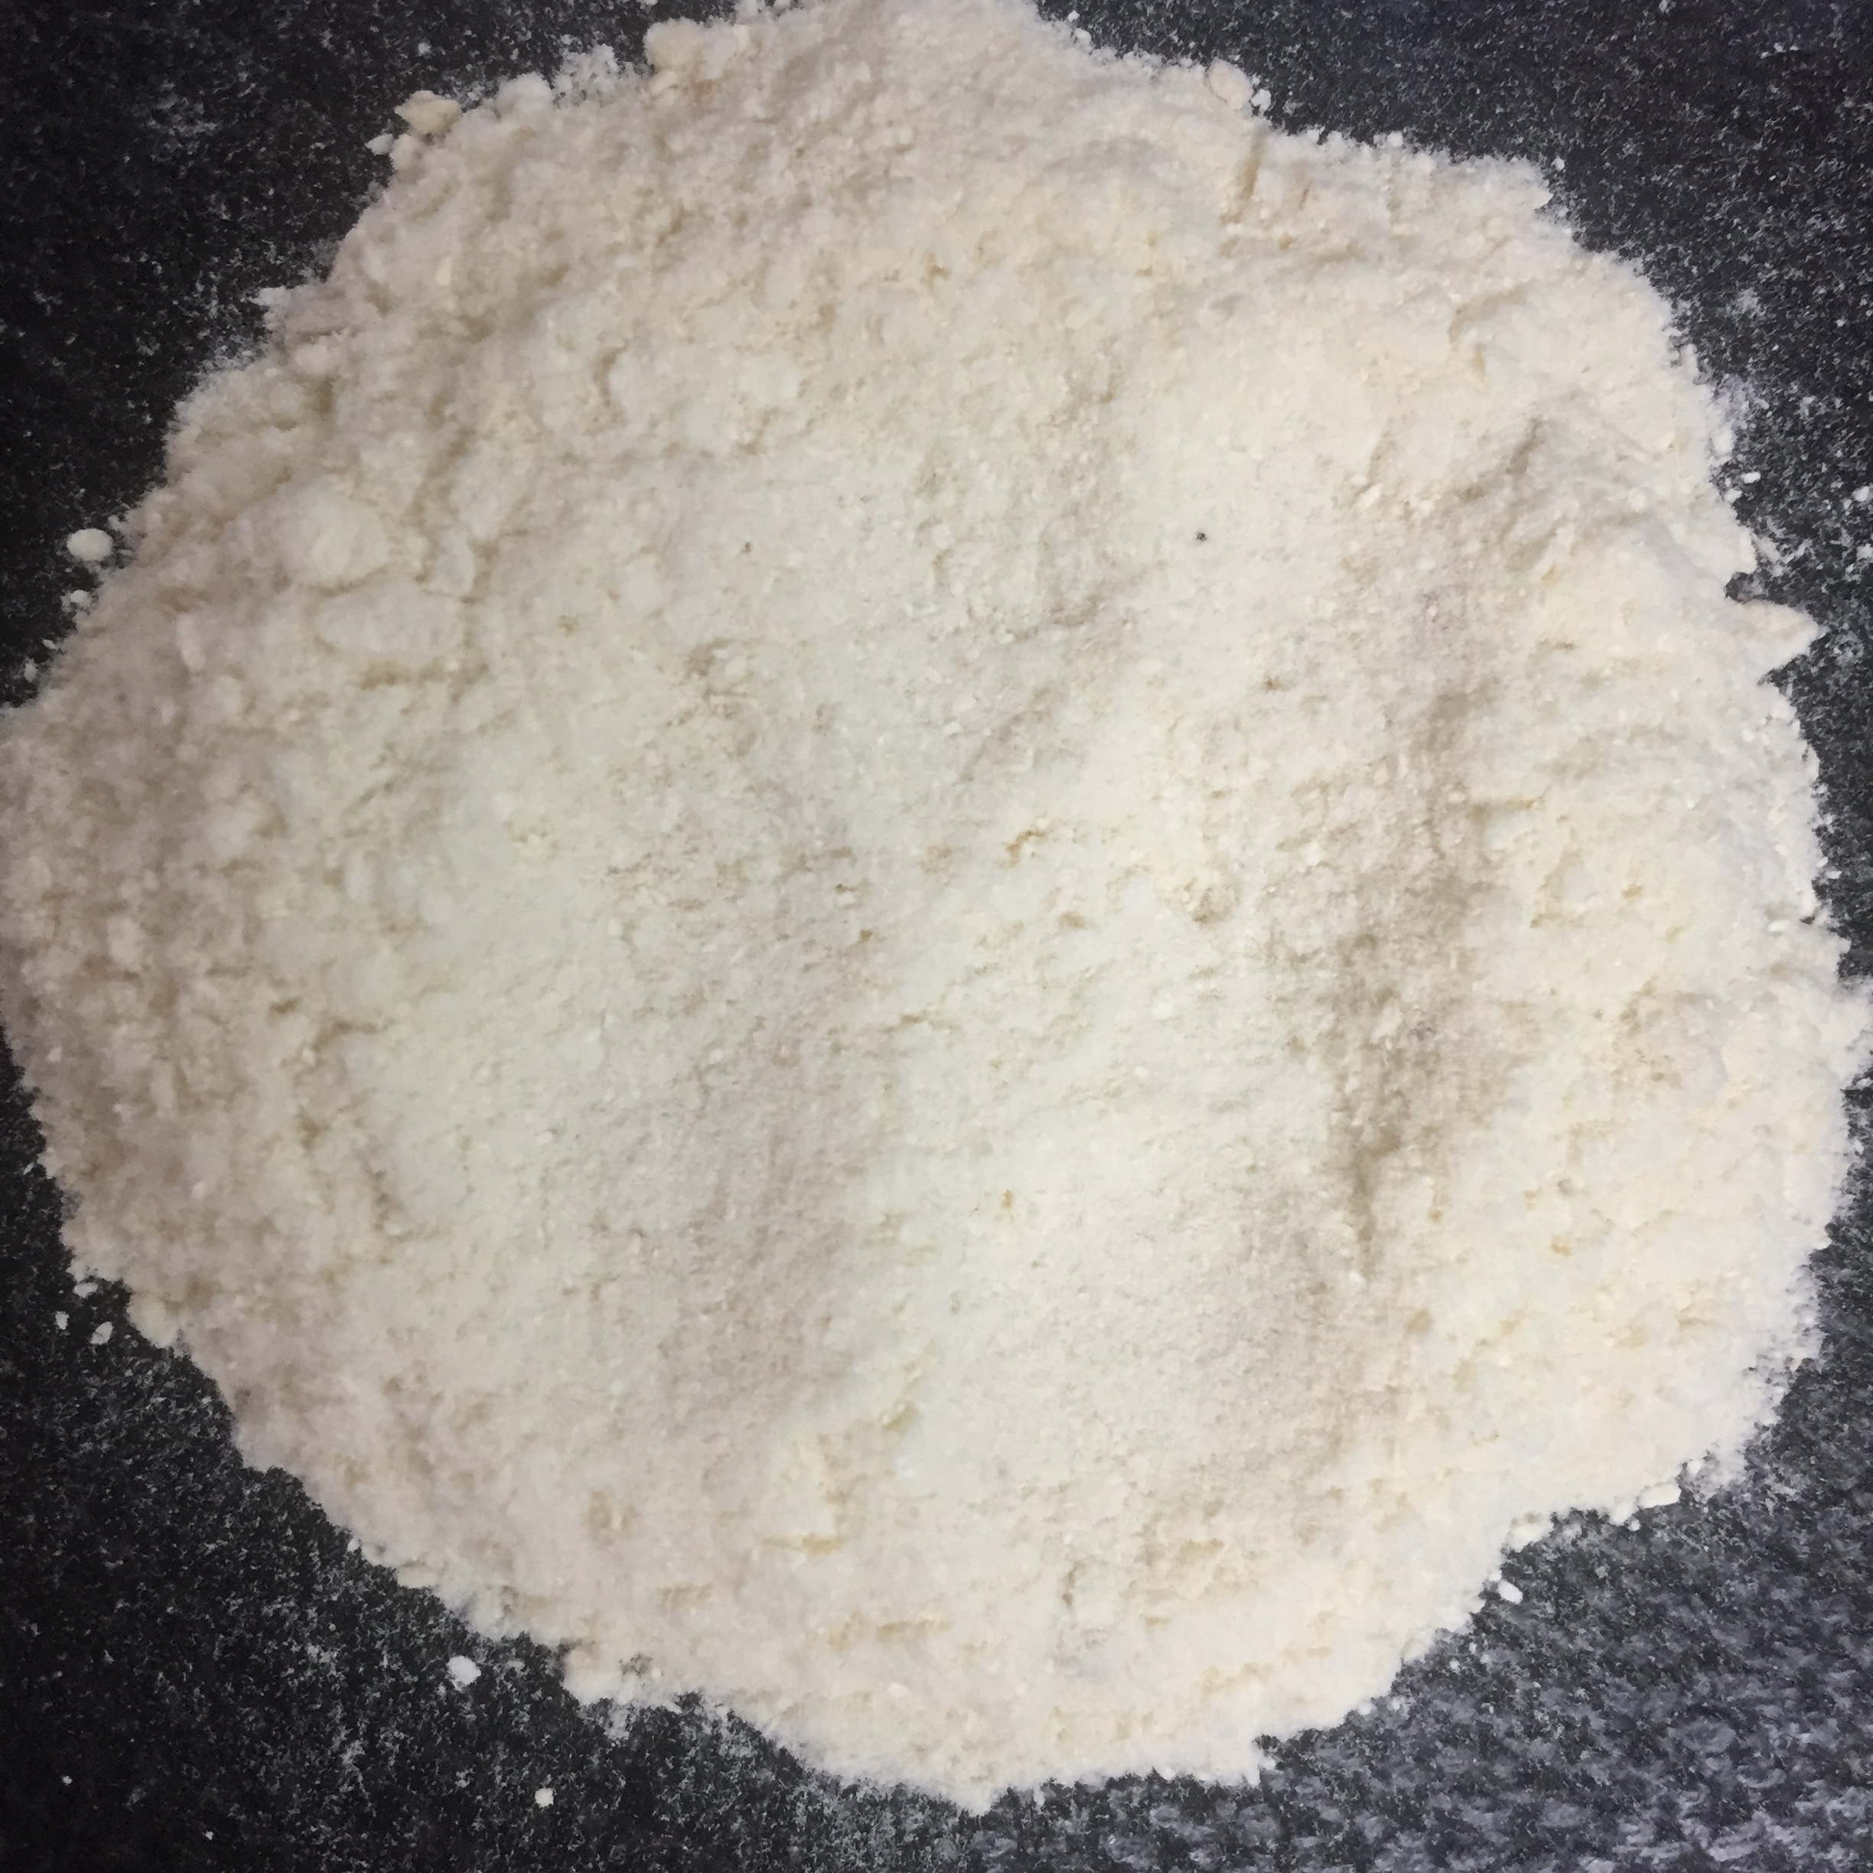
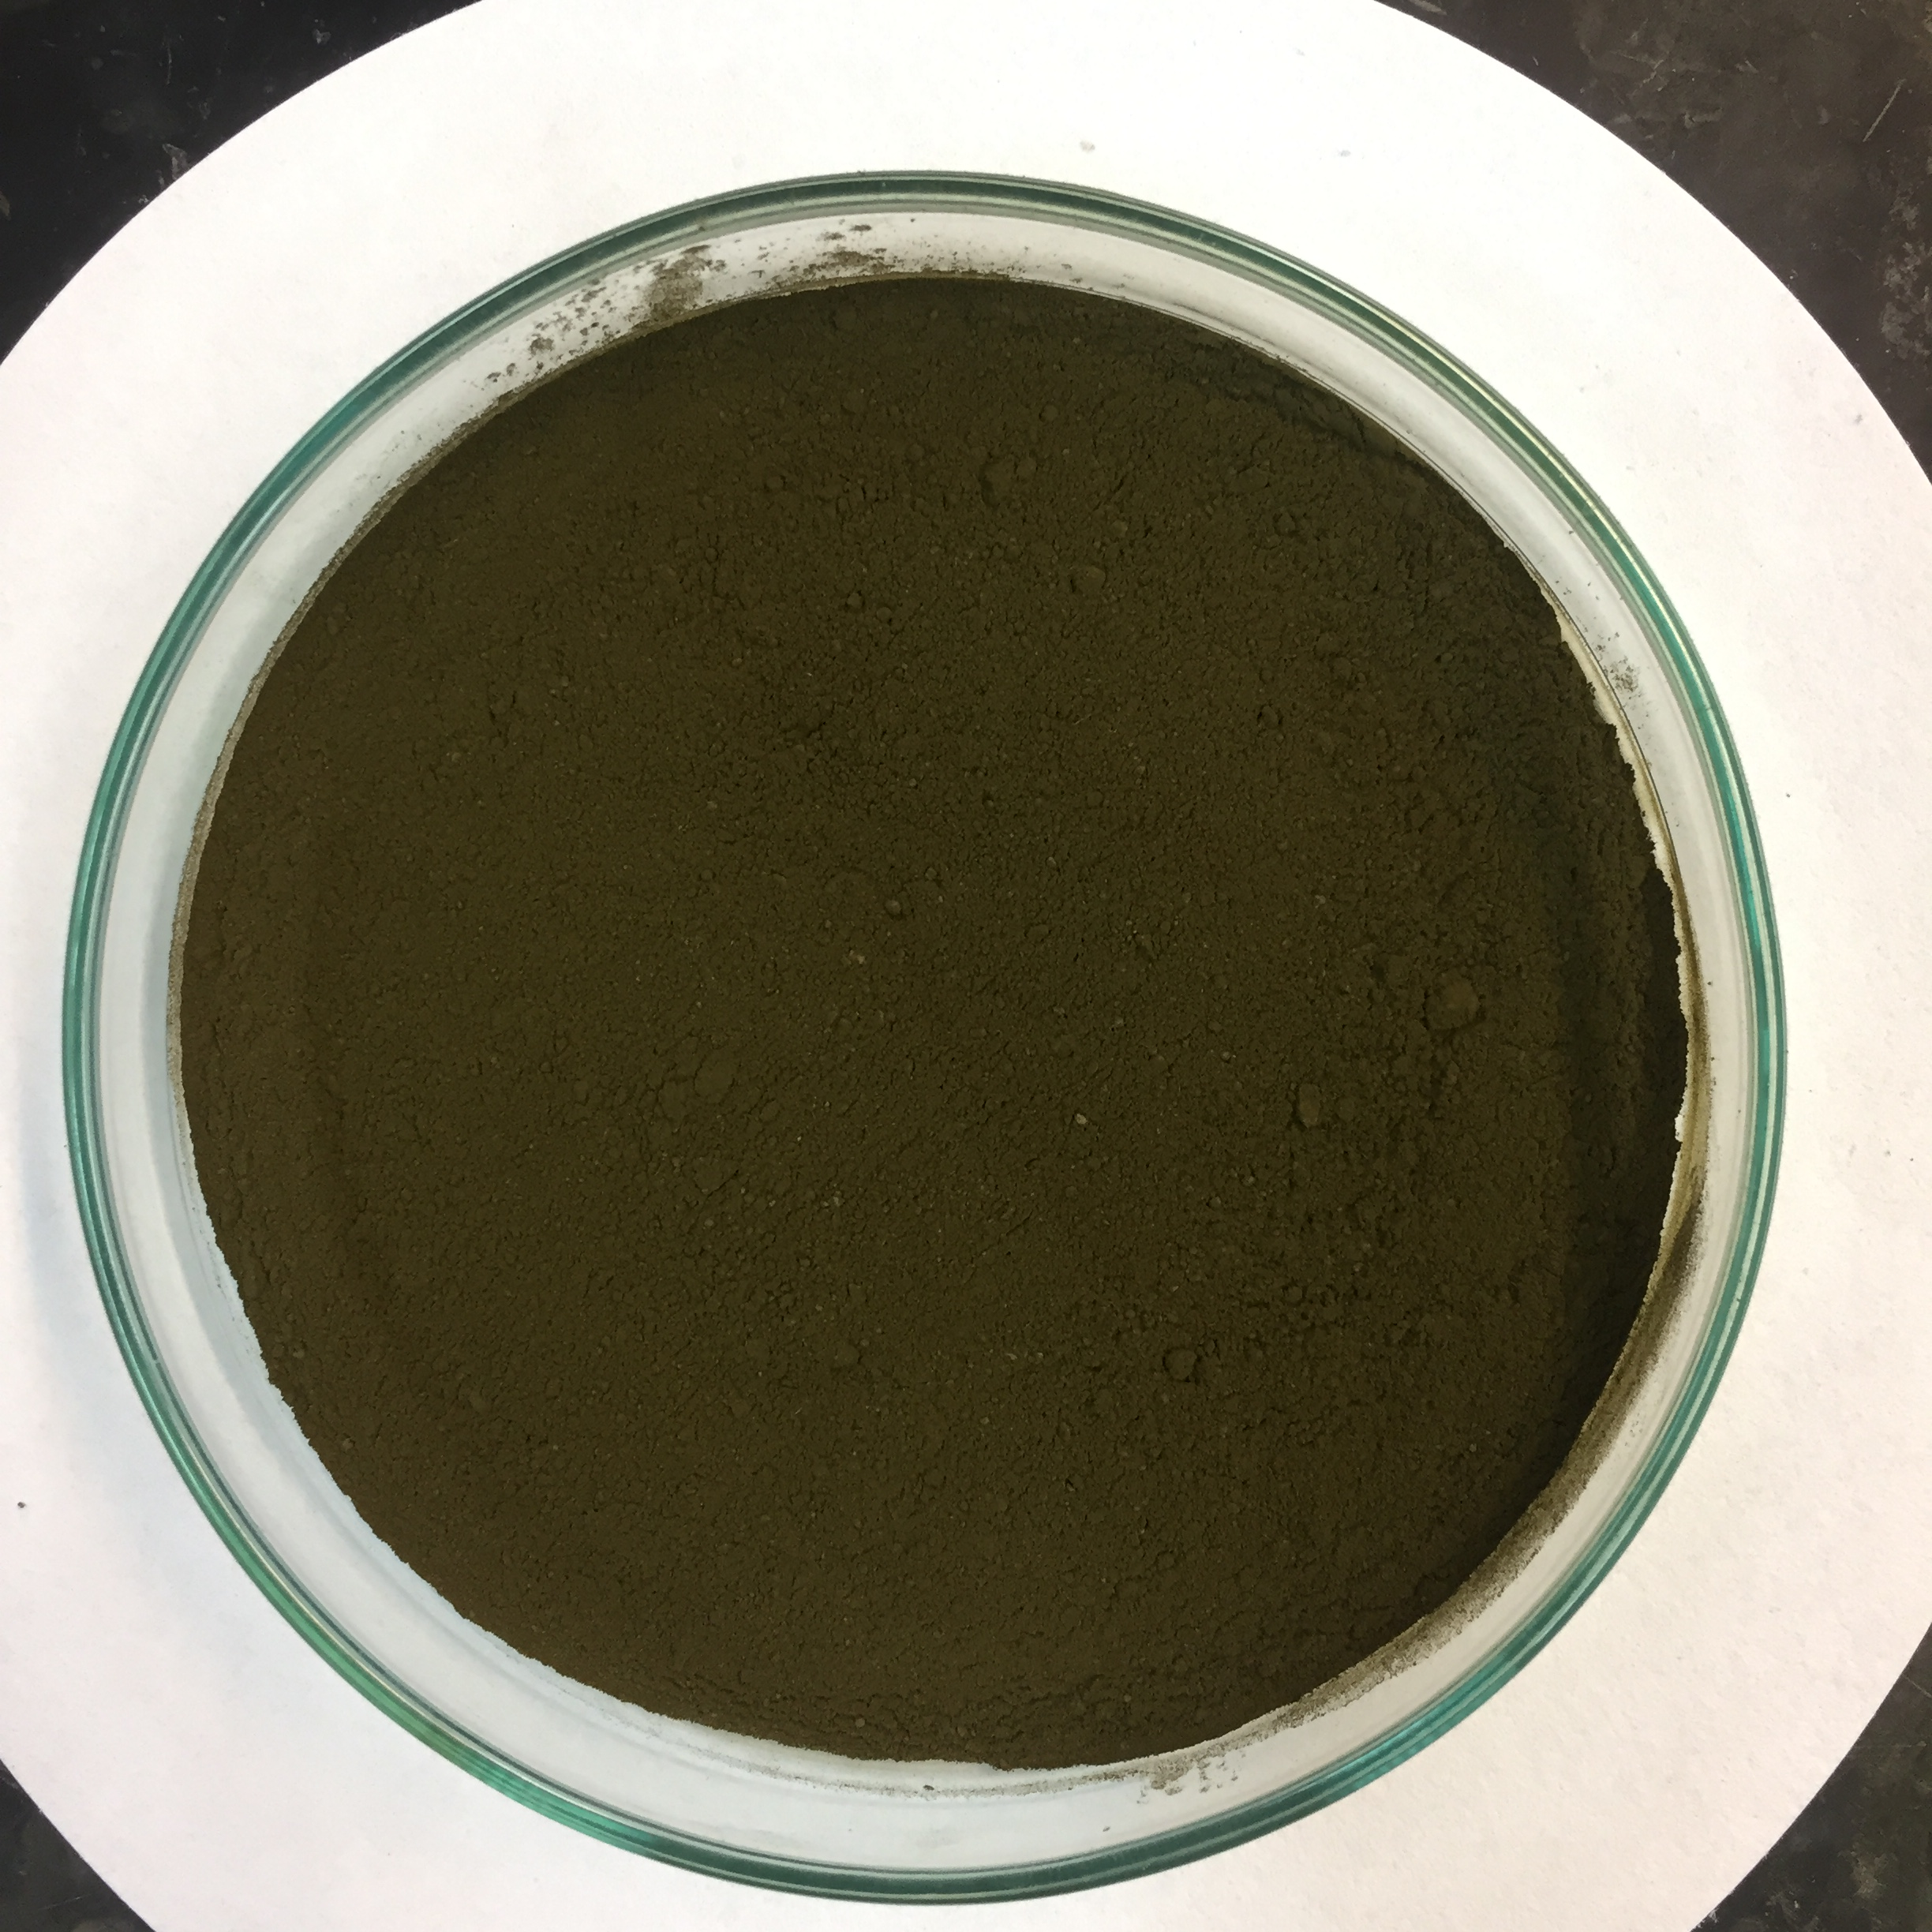
Product
Poly(acrylonitrile)
Yield: 18.15 g from 10g dried nanocellulose
Poly(amidoxime) Ligand
Yield: 28.50g from 10g dried poly(acrylonitrile)
Cu(II)@PAM
ICP-OES= 0.50mmol/g of copper

Slide 21
FT-IR Analysis

Slide 22
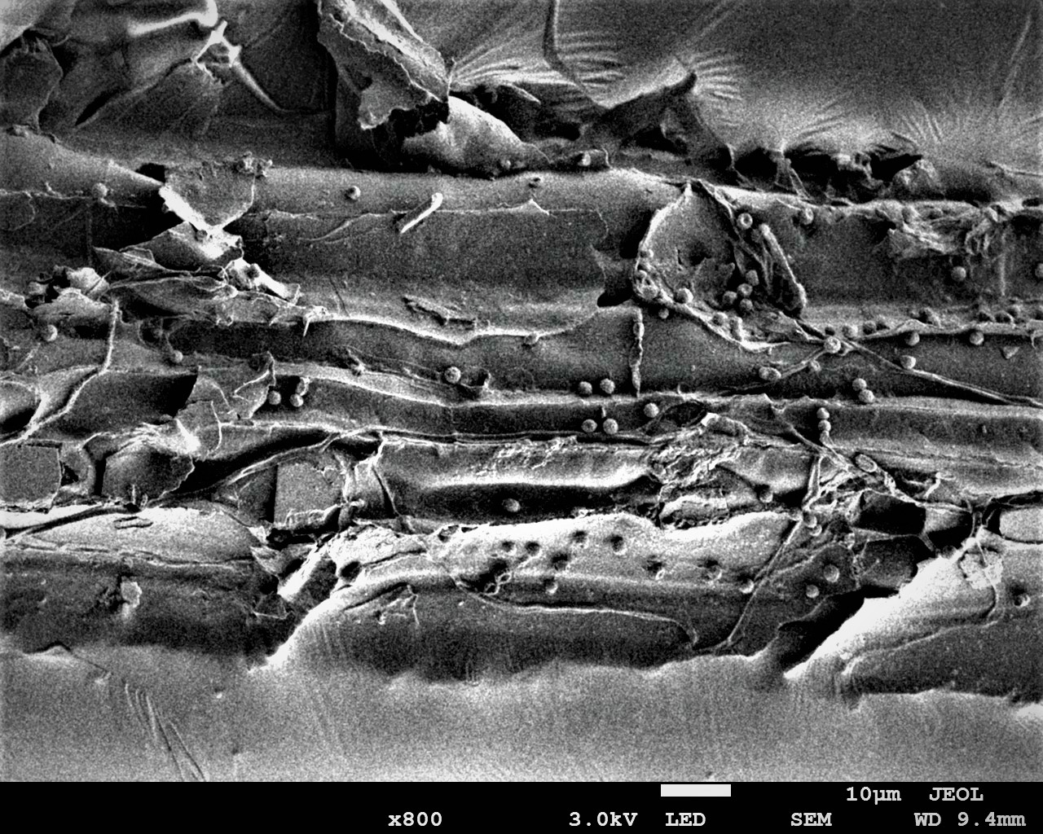
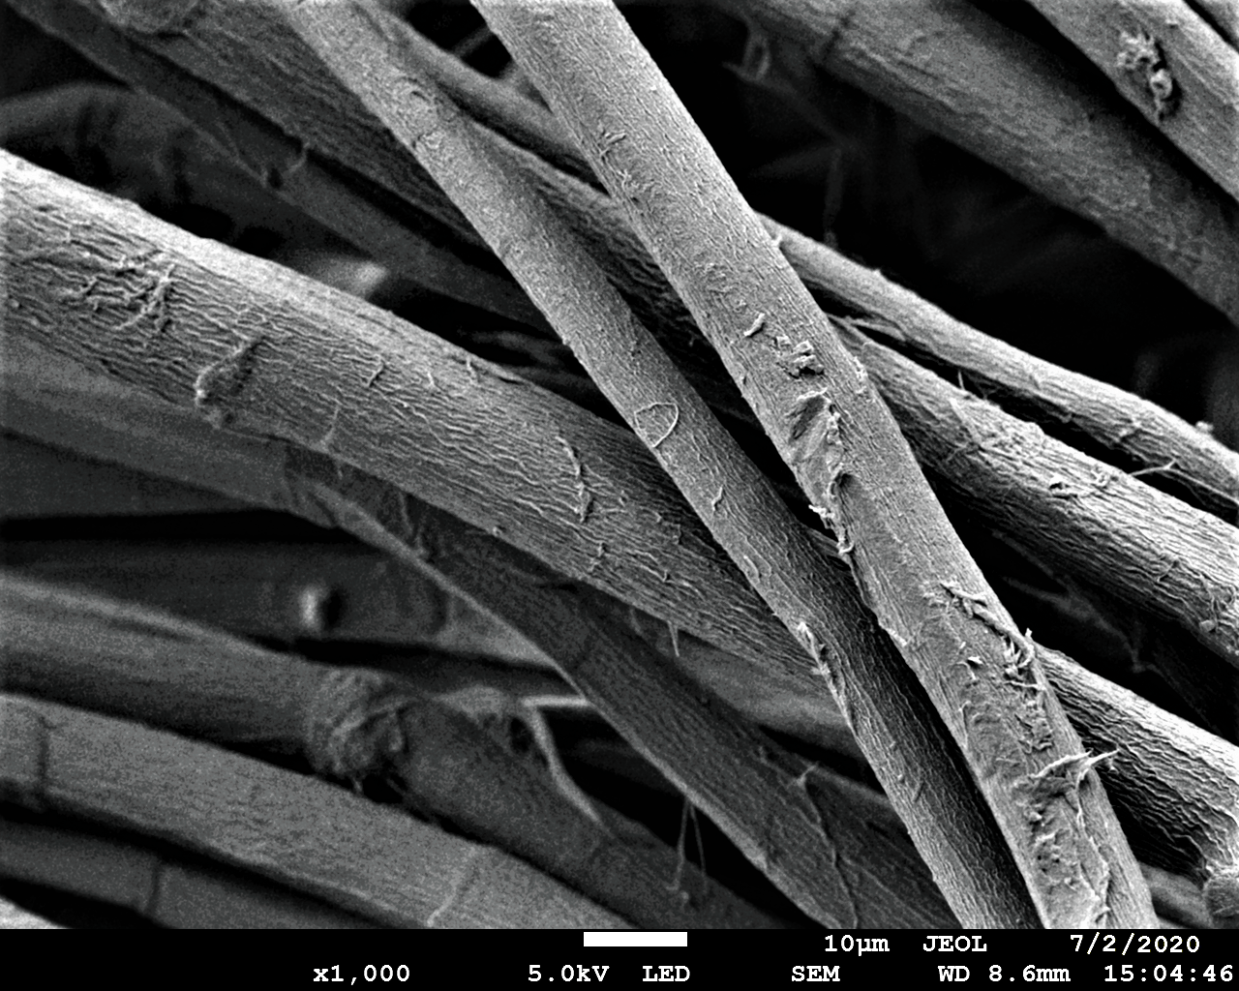
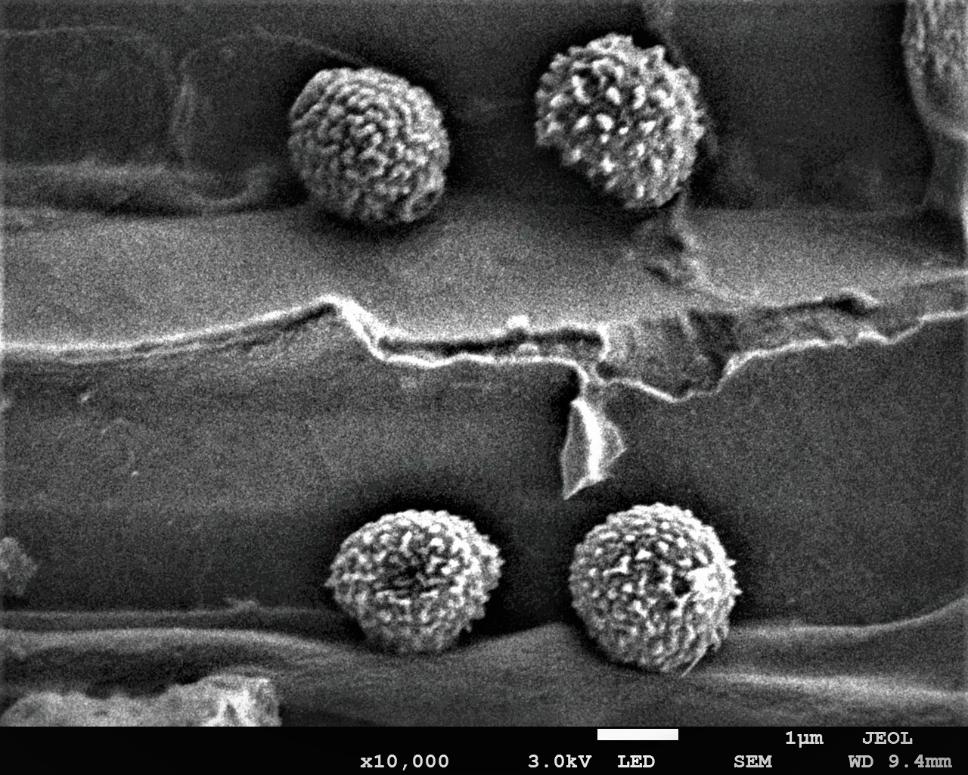
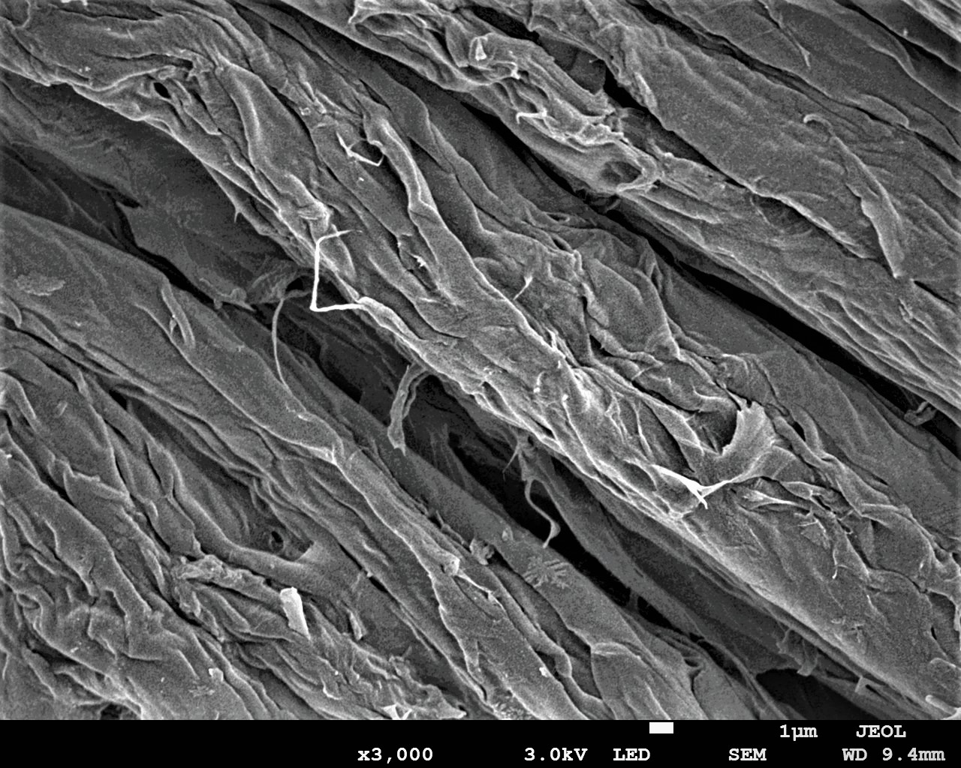
FE-SEM Analysis
Pandanus fruit fiber
Pandanus-cellulose
Magnification: 1000X

Slide 23
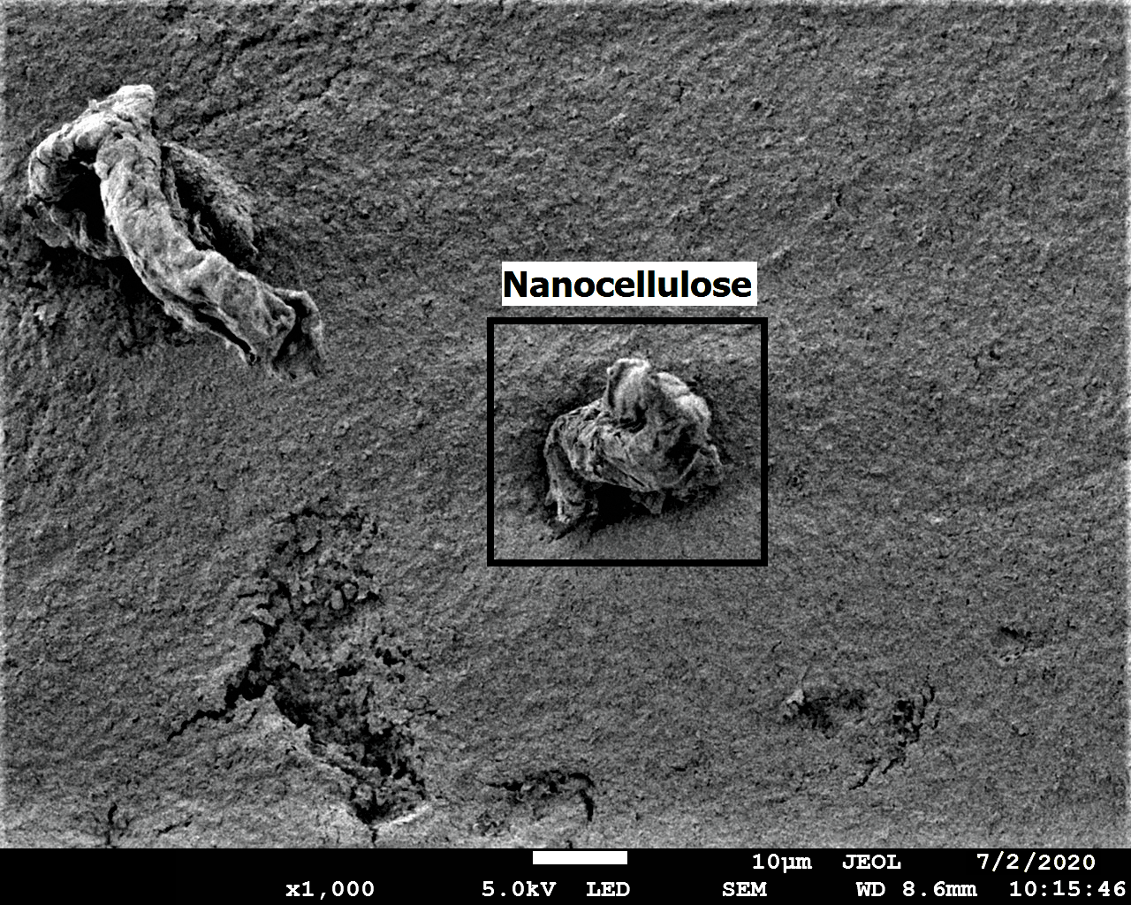
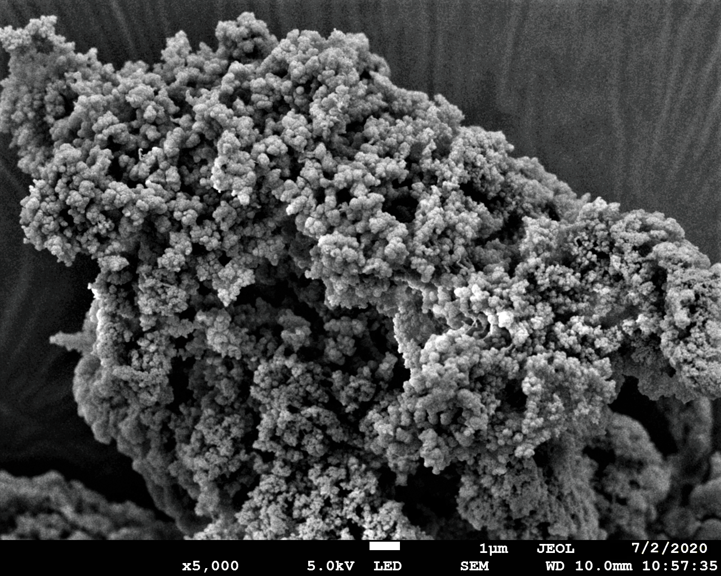
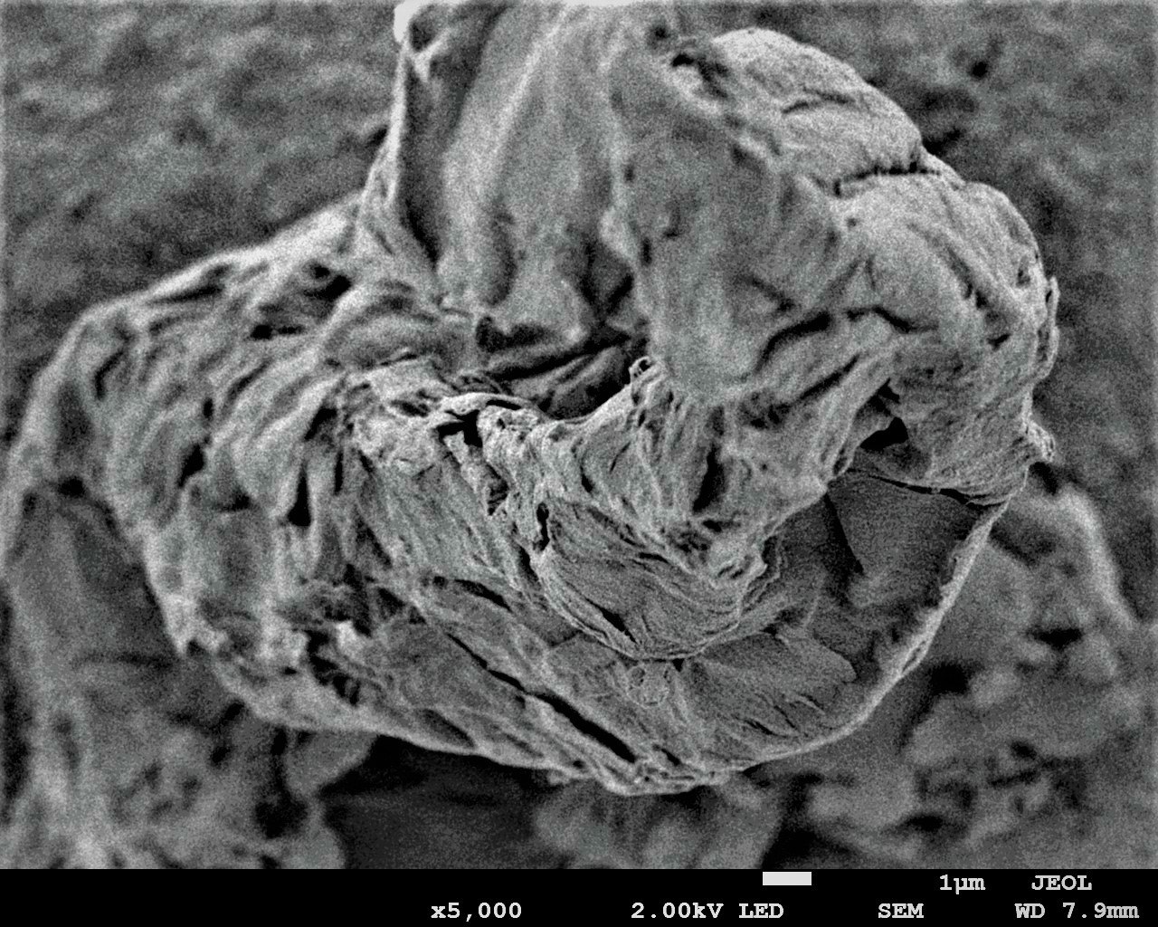
FE-SEM analysis
nanocellulose
Poly(acrylonitrile)
Magnification: 1000X
Magnification: 5000X

Slide 24
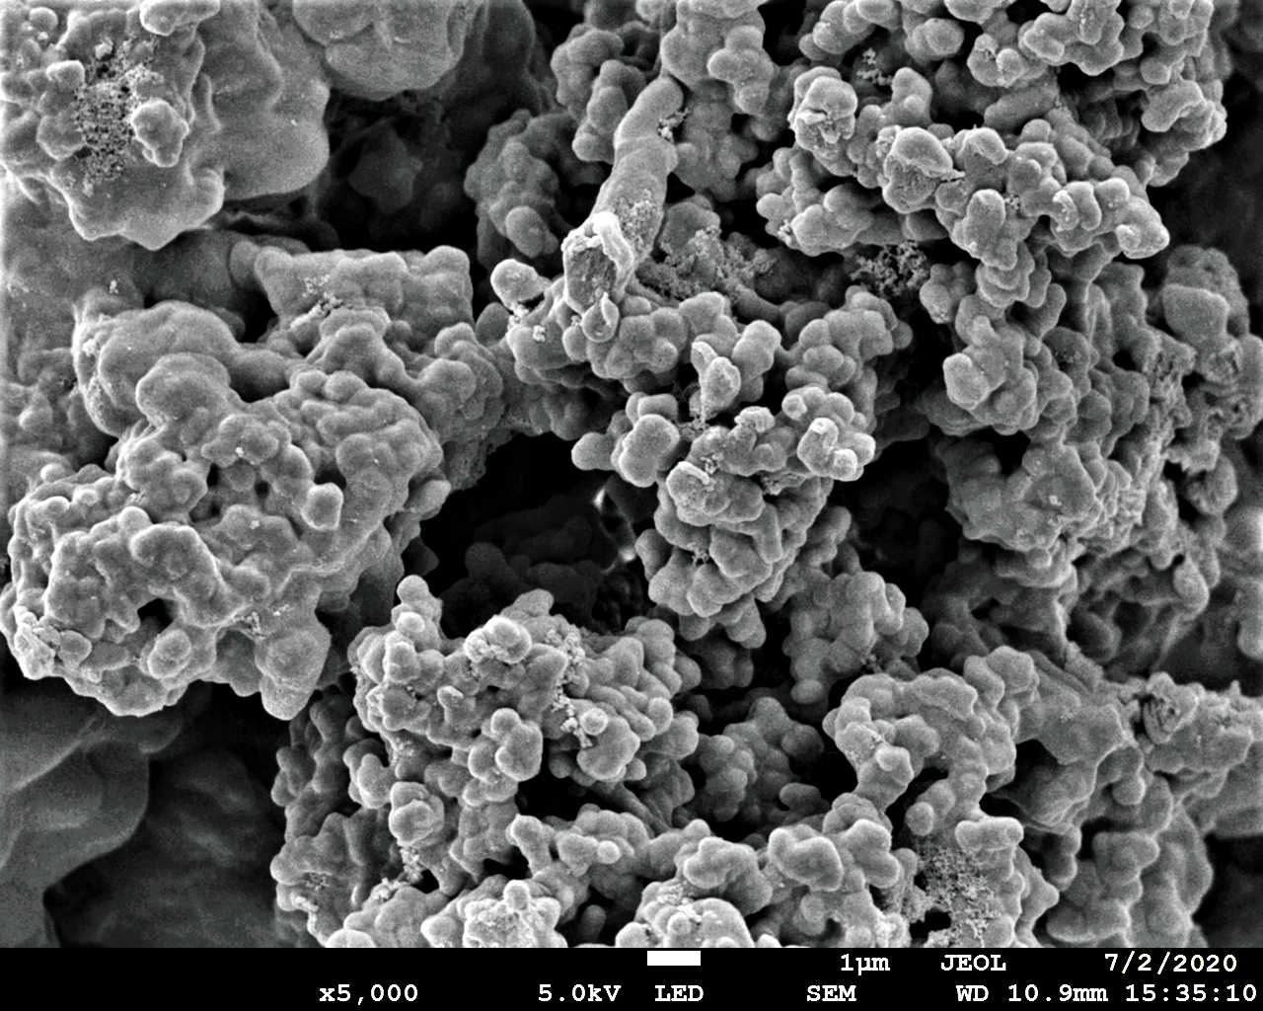
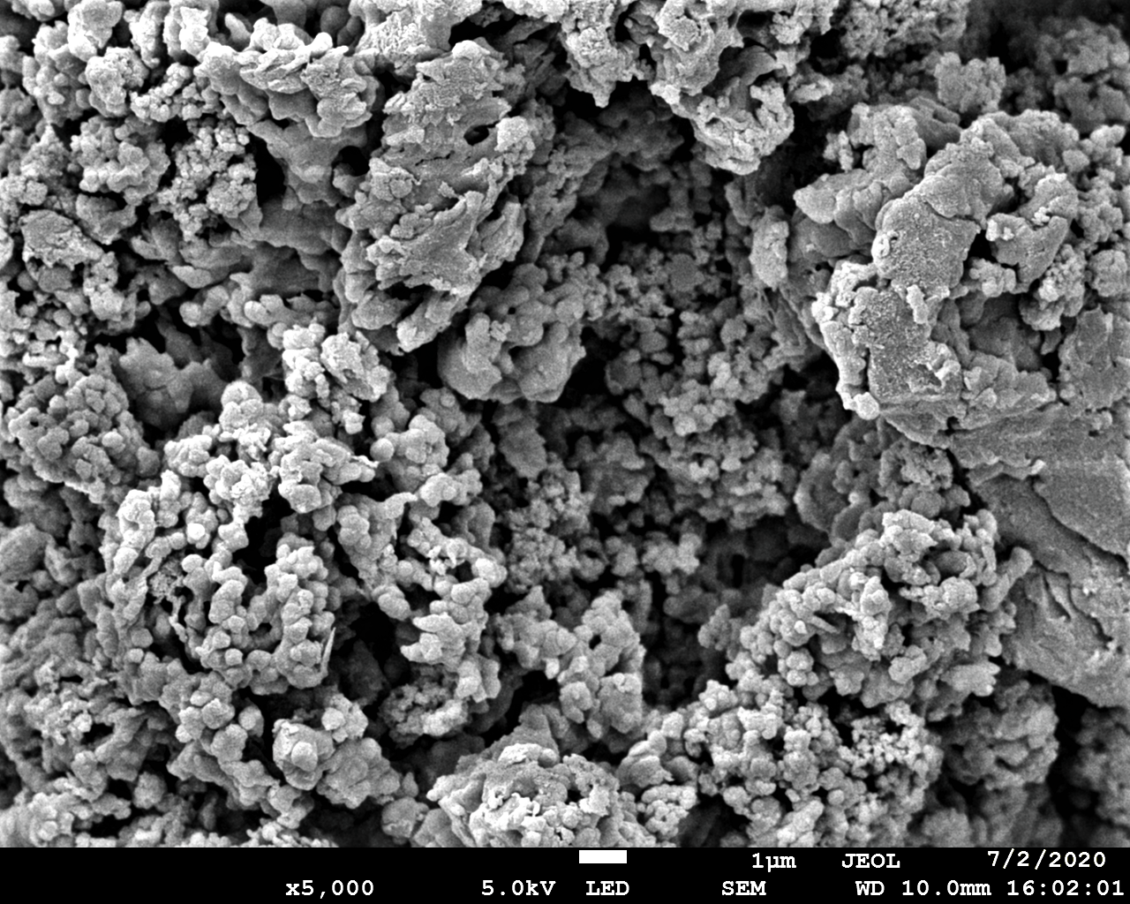
FE-SEM Analysis
Poly(amidoxime)
Cu(II)@PAM
Magnification: 5000X

Slide 25
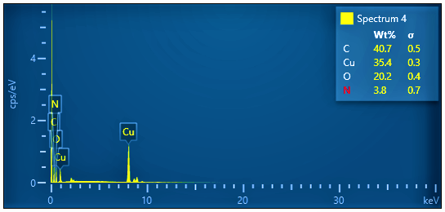
Energy Dispersive X-ray Diffraction (EDX Analysis)
Copper = 35.4%
Carbon = 40.7%
Oxygen = 20.2%
Nitrogen= 3.8%
Cu(II)@PAM

Slide 26
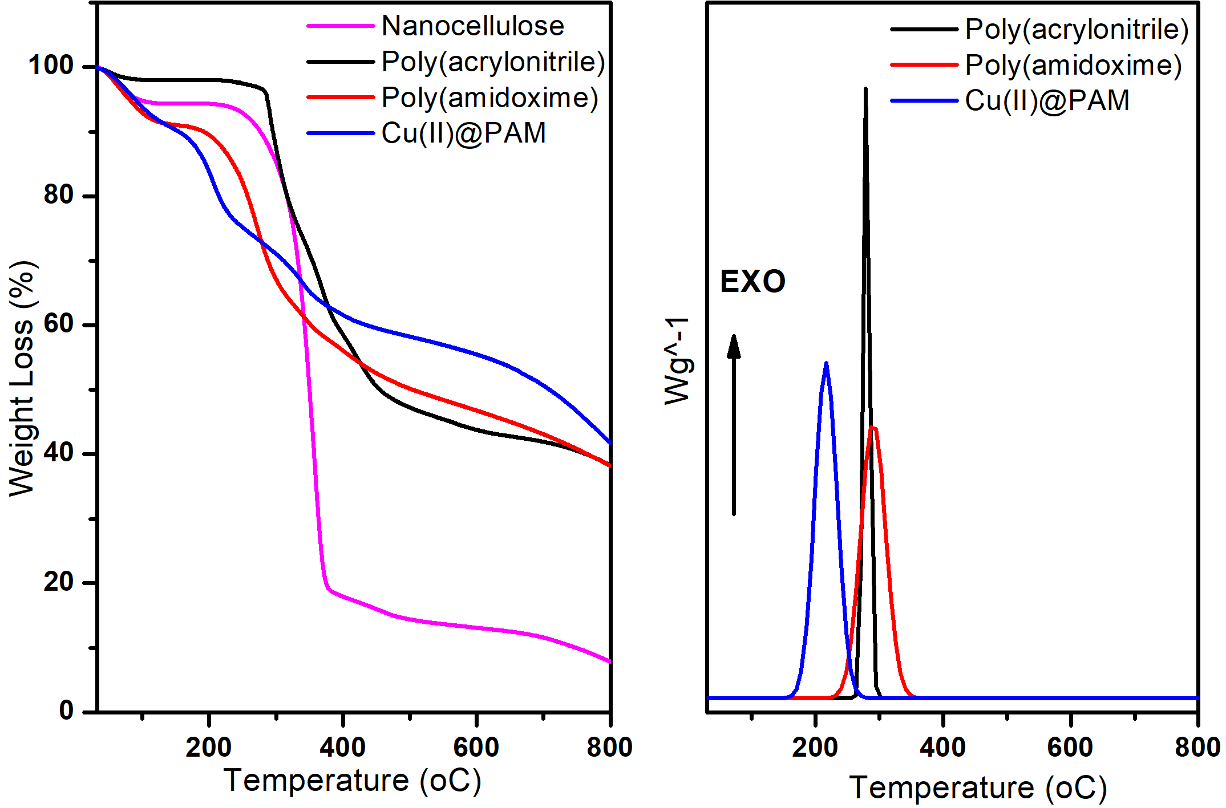
Tga & DSC

Slide 27
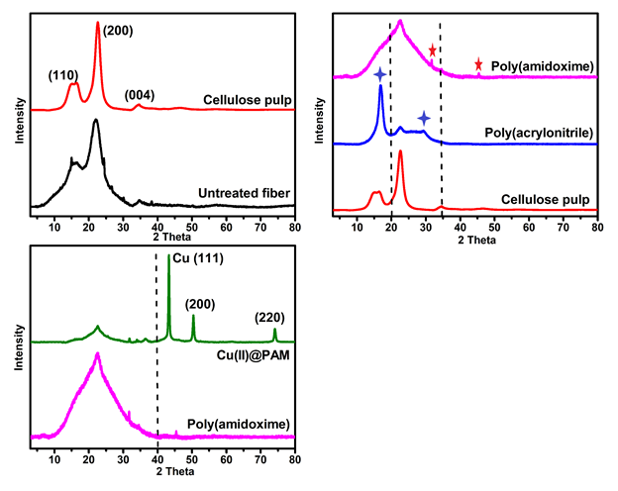
Xrd RESULT

Slide 28
XPs Analysis

Slide 29
Optimization Of Ullmann Reaction

Slide 30
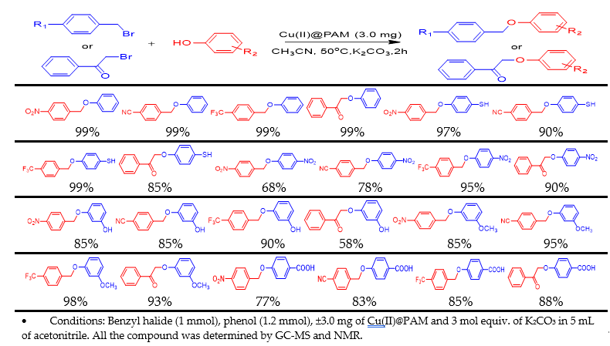
Reaction

Slide 32
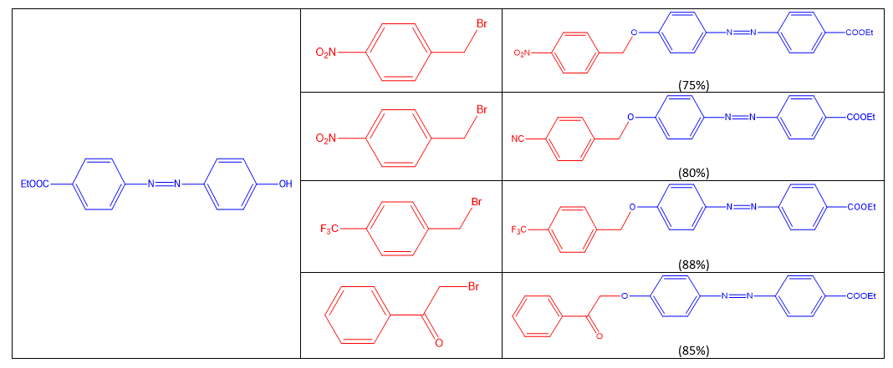

Slide 33
Mechanism for Ullmann Reaction

Slide 34
Reusability

Slide 35
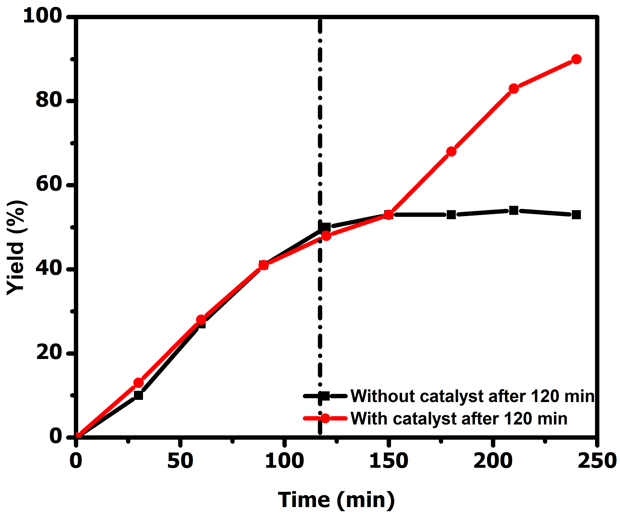
Leaching Study

Slide 36
Conclusion

Slide 37
Successful synthesis high active, stable and safe copper catalyst for Ullmann etherification reaction.
The synthesized copper catalyst can afford the Ullmann etherification in good to high yield of product.

Slide 38
Future work

Slide 39
Test the synthesize catalyst in other cross-coupling reaction (C-C, C-N, C-S, etc.)
Utilize the Cu(II)NPs@PAM in total synthesis of natural product, medicine compound.

Slide 40
References

Slide 41
D. Meijere A, Diederich F, editors. In Metal-Catalyzed Cross-Coupling Reactions, Second Completely Revised and Enlarged Edition.,
2004, Vol. 2.
Diederich F, Stang PJ, editors. Metal-catalyzed Cross-Coupling Reactions. 1998, Vol.1.
Knochel P, Leuser H, Gong LZ, Perrone S, Kneisel FF. Chem Organozinc Compd. 2006, 287.
Knochel P, Leuser H, Gong L-Z, Perrone S, Kneisel FF. Polyfunctional zinc organometallics for organic synthesis. 2005, 1
Fouquet E, Herve A. Polyfunctional tin organometallics for organic synthesis. 2005, 1
Shimizu M, Hiyama T. Polyfunctional silicon organometallics for organic synthesis. 2005, 1
Knochel P, Krasovskiy A, Sapountzis I. Polyfunctional magnesium organometallics for organic synthesis. 2005, 1
Knochel P, Ila H, Korn TJ, Baron O. Functionalized organoborane derivatives in organic synthesis. 2005, 1
Knochel P, Kopp F. Handbook of functionalized organometallics. 2005, 1
Stephenson GR. Polyfunctional electrophilic multihapto-organometallics for organic synthesis. 2005, 2
Rilatt I, Jackson RFW. J Org Chem. 2008; 73:8694.
Netherton MR, Fu GC. Angew Chem, Int Ed. 2002; 41:3910.
Anderson TJ, Jones GD, Vicic DA. J Am Chem Soc. 2004; 126:8100.
Jones GD, McFarland C, Anderson TJ, Vicic DA. Chem Commun., 2005, 4211.
Fürstner A, Martin R, Krause H, Seidel G, Goddard R, Lehmann CW. J. Am Chem Soc., 2008, 130:8773.
Kleimark J, Hedström A, Larsson P-F, Johansson C, Norrby P O. ChemCatChem. 2009, 1:152.
Md. S. Islama, B. H. Mandalab, T.K. Biswasac, Md. L. Rahman, S. S. Rashida, S.H. Tana and S. M. Sarkar. J. Name., 2012, 3, 1-3
S. L. Xie, Y. H. Hui, X. J. Long, C. C. Wang, Z. F. Xie, Chin. Chem. Lett., 2013, 24, 28.
O. Vassylyev, J.Chen, A.P. Panarello, J.G. Khinast, Tetrahedron Lett., 2005, 46, 6865.
C. Descorme, P. Gallezot,C. Geantet, and C. George. Chem. Cat. Chem., 2004, 1, 1 – 11.
K.K.R. Datta, M. Eswaramoorthy, C.N.R. Rao, J. Mater. Chem. 2007, 17, 613.
J. Zhu, J. Zhou, T. Zhao, X. Zhou, D. Chen, W. Yuan, Appli. Catal. A: Gen., 2009, 352,

Slide 42
S.J. Guo, J. Bai, H.O. Liang, C.P. Li, Chin. Chem. Lett. 2016, 27, 459–463.
M.J.G. Escalonilla, P. Atienzar, J.L.G. Fierro, H. Garcıa, F.J. Langa, Mater. Chem., 2008, 18, 1592–1600.
J.G. de Vries, Can. J. Chem., 2001, 79, 1086–1092.
S.S. Shendage, U.B. Patil, J.M. Nagarkar, Tetrahedron Lett., 2013, 54, 3457.
L.F. García, M. Blanco, C. Blanco, P. Álvarez, M. Granda, R. Santamaría, R.J. Menéndez, Mol. Catal. A: Chem., 2016, 416, 140–146.
C. Shen, H. Shen, M. Yang, C. Xia, P. Zhang, Green Chem., 2015, 17, 225–230.
P. Cotugno, M. Casiello, A. Nacci, P. Mastrorilli, M.M. Dell’Anna, A. Monopoli, J.
Organomet. Chem., 2014, 752, 1–5.
J. Li, X.Y. Shi, Y.Y. Bi, J.F. Wei, Z.G. Chen, ACS Catal., 2011, 1, 657.
P. Nehra, B. Khungar, K. Pericherla, S.C. Sivasubramanian, A. Kumar, Green Chem., 2014, 16, 4266–4271.
M.S. Sarkar, H. Qiu, M.J. Jin, J. Nanosci. Nanotechnol., 2007, 7, 3880–3883.
L. Jin, J. Liebscher, Chem. Rev., 2007, 107, 133
M. L. Rahman, S. M. Sarkar, M. M. Yusoff, M. H. Abdullah. RSC Adv., 2016, 6, 745-757.
M. L. Rahman, S. M. Sarkar, M. M. Yusoff. Front. Environ.l Sci. Eng., 2016, 10, 352-361.
S. M. Sarkar, T. Sultana, T. K. Biswas, M. R. Lutfor, M. M. Yusoff, New J. Chem. 2016, 40, 497.
O. A. Anunziata, M. L. Martínez and A. R. Beltramone. Materials, 2009, 2(4), 1508-1519.
Y. Han, G. Hwanga, H. Kima, B.Z. Haznedaroglu, B. Lee, Chem. Eng. J. 2015, 259, 653.
M. S. Sarkar, M. R. Lutfor, M. M. Yusoff, RSC Adv. 2015, 5, 1295.
D. Zhao, J. Feng, G. D. Stucky, Science, 1998, 279, 548.
T. F. Parangi, R. M. Patel and U. V. Chudasama. Bull. Mater. Sci., 2014, Vol. 37, No. 3, 609–615.
B. H. Mandal, M. R. Lutfor, M. M. Yusoff, K. F. Chong, S. M. Sarkar, Carbohydrate Polym. 2017, 56, 175.
S. M. Sarkar, Md. L. Rahman, and M. M. Yusoff. RSC Adv., 2014, 00, 1-3.
B. Yuan, Y. Pan, Y. W. Li,* B. Yin, and H. F. Jiang. Angew. Chem. Int. Ed., 2010, 49, 4054 –4058

Slide 43


