Slide 1



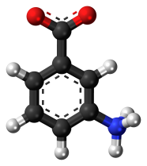

1 st International Electronic Conference on Catalysis Sciences
One-Pot Green Catalytic Preparation of 3-Aminobenzoic Acid in the Presence of Carbonaceous Bio-Based Materials in Subcritical Water
Sarra Tadrent, Christophe Len
10-30 November 2020

Slide 2
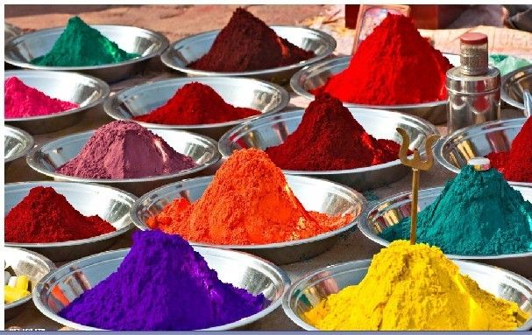
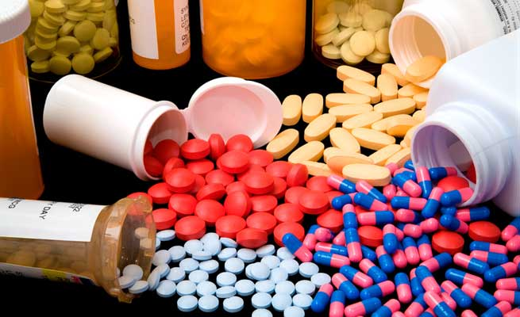
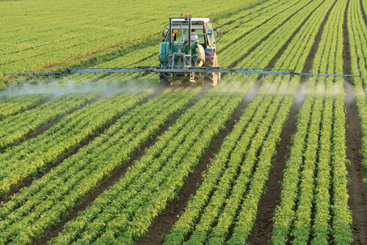
1 st International Electronic Conference on Catalysis Sciences
Introduction
3-aminobenzoic acid is widely considered as promising platform chemicals for the production of dyes, antioxidants, pharmaceuticals and agricultural chemicals.
Dyes
Pharmaceuticals
Agricultural chemicals
10-30 November 2020

Slide 3



1 st International Electronic Conference on Catalysis Sciences
Preparation of 3-aminobenzoic acid from 3-nitrobenzaldehyde
Retrosynthetic scheme:
Three steps
Metal catalysts
- Organic solvent …
Synthesis diagram:
Vilsmeier-Haak reaction (VH):
One-pot
Charcoal
Water
Norit Gac 12-40
H₂O (55 mL)
300 ℃, 90 bar
6 h
New process :
10-30 November 2020

Slide 4
1 st International Electronic Conference on Catalysis Sciences
Process optimization
Activated
carbon
H₂O (mL)
T (℃), P (bar)
6 h
1) Carbonaceous materials loading
2) Nature of the carbonaceous materials
NORIT GAC 12-40 (g) | Yield (%)
3 | 30
6 | 33
8 | 15
10 | 20
Type of activated carbon | Yield (%)
NORIT GAC 12-40 | 33
DACARB PC 1000 | 1
NORIT A supra | 23
NORIT SA2 | 20
3-nitrobenzaldehyde (10 mmol), NORIT GAC 12-40 (3-10 g), water (55 mL),
310 °C, 90 bar, 6 hours.
3-nitrobenzaldehyde (10 mmol), charcoal (6 g), water (55 mL), 310 °C, 90 bar,
6 hours.
10-30 November 2020

Slide 5
1 st International Electronic Conference on Catalysis Sciences
Process optimization
Activated
carbon
H₂O (mL)
T (℃), P (bar)
6 h
3) Water volumes loading
4) Reaction temperature
Water volume | Yield (%)
35 | 15
45 | 16
55 | 33
65 | 26
T (°C) | Yield (%)
250 | 12
270 | 36
300 | 59
310 | 33
320 | 21
3-nitrobenzaldehyde (10 mmol), NORIT GAC 12-40 (6 g), water (35-65 mL), 310 °C, 90 bar, 6 hours.
3-nitrobenzaldehyde (10 mmol), NORIT GAC 12-40 (6 g), water (55 mL),
250-320 °C, 90 bar, 6 hours.
10-30 November 2020

Slide 6
1 st International Electronic Conference on Catalysis Sciences
Process optimization
Activated
carbon
H₂O (mL)
T (℃), P (bar)
6 h
5) Substrate loading
6) Reaction time
n (mmol) | Yield (%)
5 | 20
10 | 59
20 | 22
30 | 30
Time (h) | Yield (%)
2 | 30
4 | 30
6 | 30
8 | 25
3-nitrobenzaldehyde (5-30 mmol), NORIT GAC 12-40 (6 g), water (55 mL),
300 °C, 90 bar, 6 hours.
3-nitrobenzaldehyde (10 mmol), NORIT GAC 12-40 (6 g), water (55 mL),
300 °C, 90 bar, 2-8 hours.
10-30 November 2020

Slide 7
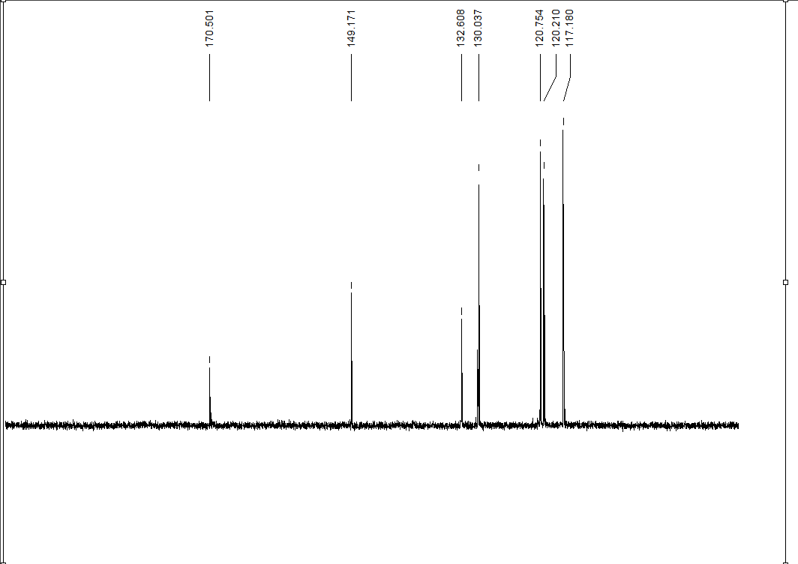
1 st International Electronic Conference on Catalysis Sciences
NMR analyzes of the finished product
a
g
d
f
b
e c
d
b
a
c
¹H NMR experimental spectrum
3-aminobenzoic acid
¹³C NMR experimental spectrum
3-aminobenzoic acid
10-30 November 2020

Slide 8
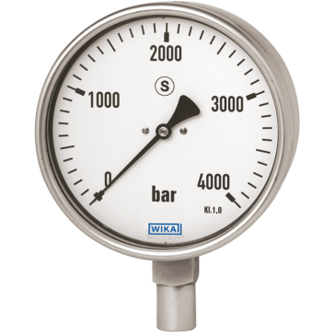


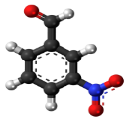

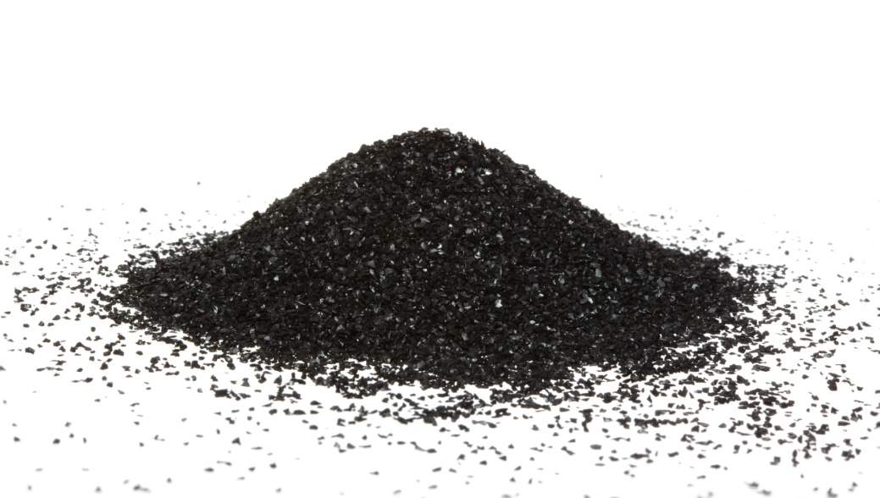
1 st International Electronic Conference on Catalysis Sciences
Proposed mechanism for the preparation of 3-aminobenzoic acid
Mechanism A
Mechanism B
300°C
100 bar
Activated
carbon
10-30 November 2020

Slide 9
1 st International Electronic Conference
on Catalysis Sciences
Conclusion
A simple and ecological process of preparation of 3-aminobenzoic acid (3-ABA) based on the redox of 3-nitrobenzaldehyde in a single step called “one pot” has been optimized.
Activated
carbon
H₂O (mL)
T (℃), P (bar)
t (h)
The best yield obtained is: 59%
Reaction conditions:
substrate loading (10 mmol)
Temperature (300°C)
pressure (90 bar)
water (55 mL),
Norit Gac 12-40 (6 g )
Reaction time (6 h)
10-30 November 2020
9

Slide 10
1 st International Electronic Conference on Catalysis Sciences
One-Pot Green Catalytic Preparation of 3-Aminobenzoic Acid in the Presence of Carbonaceous Bio-Based Materials in Subcritical Water
Sarra Tadrent, Christophe Len
10-30 November 2020

