Slide 1

Renewable polyether polyols via the hydrogenation of polyesters
Bernhard M. Stadler Sandra Hinze, Sergey Tin and Johannes G. de Vries

Slide 2
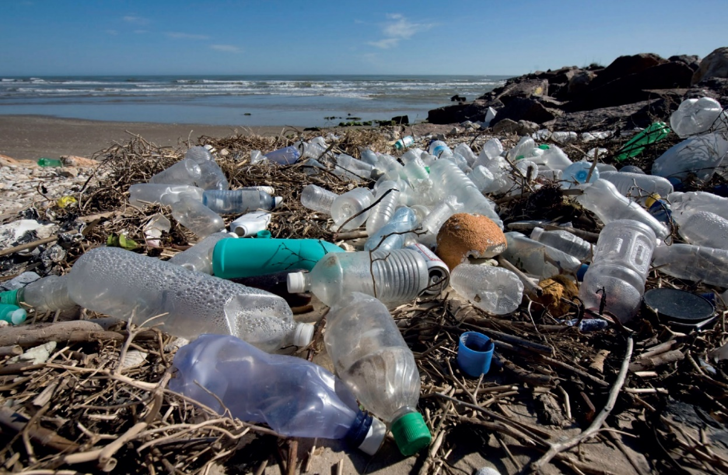
Plastic soup
Picture: D. Cressy, The Plastic Ocean, Nature, 2016, 536, 263-265.

Slide 3
What to do with all the plastic
Thus far 8.3 billion metric tons of plastic have been produced since the 1950’s.
Only about 9% of all plastic is recycled.
About 12% is incinerated
The remaining 80% went into landfills or is floating around.
It is clear that recycling plastic could be a great solution.
How can we do that?

Slide 4
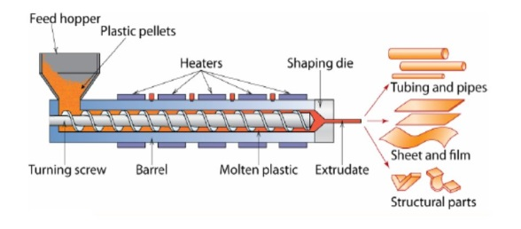


Polymer recycling - Overview
Mechanical recycling
Cracking
Depolymerization
Relative easy to implement
Applicable to a wide range of thermoplastic polymers
Reduced mechanical properties
Usage of the products in food contact applications is prohibited
Resulting product can be directly used in existing processes
PE, PS, PP preferred
Energy input for the monomer synthesis + polymerization needs to be spent again
Typically very pure products
Complementary to cracking, as polyesters, polycarbonates and polyamides can be used
Polymers need to be soluble or melt below catalyst decomposition T; Hydrolysis ➔ Lots of salt
Obtained products may not be cost competitive to virgin monomers
Review: B. Vander Beke, ChemSusChem 2014, 7, 1579-1593

Slide 5
Polyesterhydrogenation – Recent examples
Robertson, Chem. Commun. 2014, 50, 4884-4887.
M. L. Clarke, Chem. Eur. J. 2015, 21, 10851-10860.
Klankermayer, Sci. Adv. 2018, 4, eaat9669.
T=120°C, p(H₂)=54 bar, t=48 h
Substrat/Cat: 20-50
Additive: KO^{t}Bu
Substrates: Polylactide, Polycarbonate
T=120°C, p(H₂)=54 bar, t=48 h
Substrat/Cat: 50
Additive: KO^{t}Bu
Substrates: PET
T=140°C, p(H₂)=90 bar, t=16 h
Substrat/Cat: 100-200
Additive: HN(Tf)₂
Substrates: PET, Polylactide, Polycarbonates, Aliphatic Polyesters

Slide 6
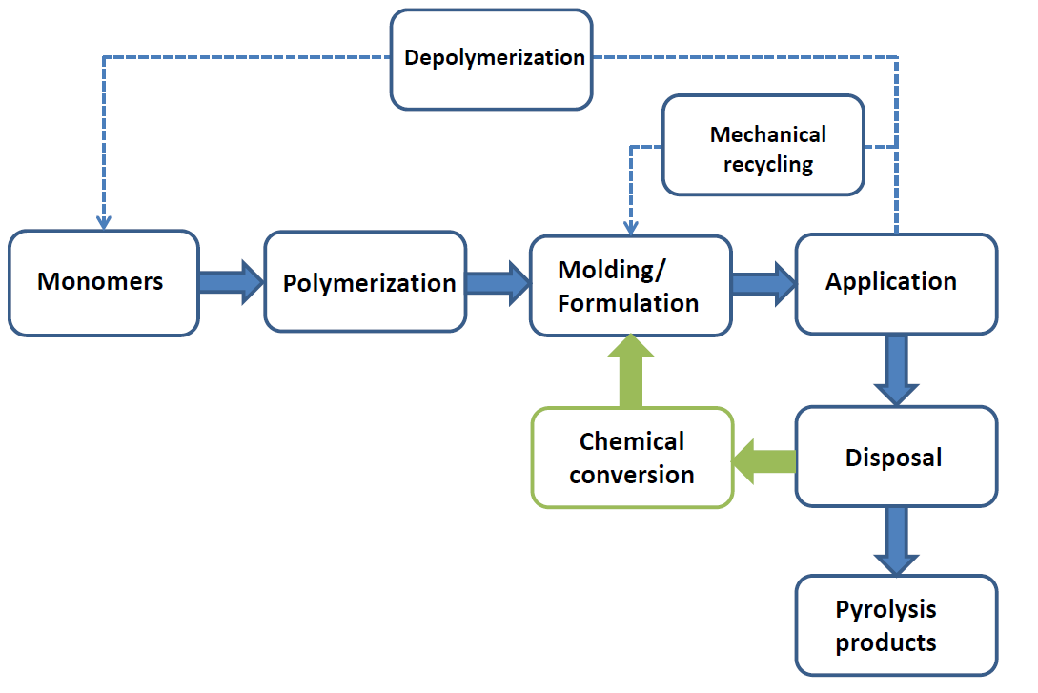
The Dilemma
Depolymerisation to monomers by hydrogenation or hydrolysis needs to compete with low feed-stock prices
Chemical conversion of polymers could turn plastic waste into a source for new materials

Slide 7
Reductive etherification
B. M. Stadler, S. Hinze, S. Tin, J. G. de Vries, ChemSusChem 2019, 12, 4082-4087.

Slide 8
Hydrogenation of polyesters to polyethers
Selectivity for ether formation increases with charge density of LA
Hafnium triflate interestingly increase selectivity over 120% which is due to catalytic THF ring- opening. Conversion of THF to n-dibutyl ether at high T and p(H2) has been observed in the presence of Hf (T. J. Marks, J. Am. Chem. Soc. 2014, 136, 104-107.)
B. M. Stadler, S. Hinze, S. Tin, J. G. de Vries, ChemSusChem 2019, 12, 4082-4087.

Slide 9
How does this reaction work?
Two mechanistic proposals
Mechanistic proposals: M. Beller, Angew. Chem. Int. Ed. 2015, 54, 5196-5200 Gooßen, ChemSusChem 2016, 9, 1442-1448
B. M. Stadler, S. Hinze, S. Tin, J. G. de Vries, ChemSusChem 2019, 12, 4082-4087.

Slide 10
Monitoring of the Mw over time
In the first mechanism the chain is broken and MW should drop.
In the second mechanism the M_{W} of the polymer should remain the same.
➔ A tandem sequence of hydrogenation to diols and etherification is observed
B. M. Stadler, S. Hinze, S. Tin, J. G. de Vries, ChemSusChem 2019, 12, 4082-4087.

Slide 11
Scope and limitations of industrial samples
B. M. Stadler, S. Hinze, S. Tin, J. G. de Vries, ChemSusChem 2019, 12, 4082-4087.

Slide 12
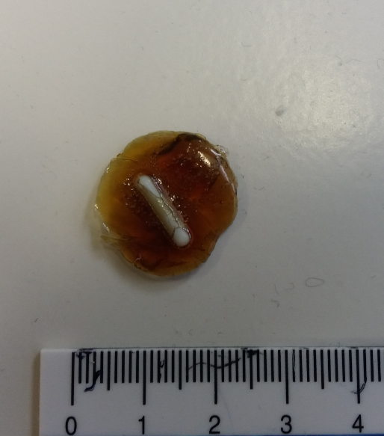
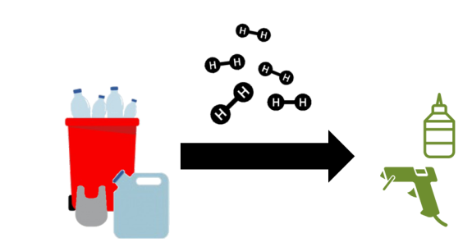
Are the polyethers useful? Yes they are.
The formed polyether polyols have exactly the right size for use in adhesives.
Preliminary experiments in which one of the polyether polyols was reacted with 2,4-toluenediisocyanate showed formation of a transparent film with a leather like haptic.
B. M. Stadler, S. Hinze, S. Tin, J. G. de Vries, ChemSusChem 2019, 12, 4082-4087.

Slide 13






Acknowledgement
For the gift of polyester samples (Henkel)
Adrian Brandt, Andreas Taden and Horst Beck
Prof. Dr. Johannes G. de. Vries
Partners of GreenSolRes
Henkel, Hybrid Catalysis RWTH Aachen University, Syncom, BASF, Lenzing, VITO
And you for your kind attention!
This project has received funding from the Bio Based Industries Joint Undertaking under the European Union’s Horizon 2020 research and innovation programme under grant agreement No720695. This project also received funding from the state of Mecklenburg-Vorpommern

