Slide 1
Production of biofuels by 5-hydroxymethylfurfural etherification using ion-exchange resins as solid acid catalysts
￼
￼
Please carefully check the accuracy of names and affiliations. Changes will not be possible after proofreading.
Names and affiliations have been revsied.
￼
￼
Please carefully check the accuracy of names and affiliations. Changes will not be possible after proofreading.
Names and affiliations have been revsied.
￼
￼
Please carefully check the accuracy of names and affiliations. Changes will not be possible after proofreading.
Names and affiliations have been revsied.
1st International Electronic Conference on Catalysis Sciences
Benjamín Torres Olea, Inmaculada Fúñez Nuñez, Cristina García Sancho, Juan Antonio Cecilia, Ramón Moreno Tost, Pedro Jesús Maireles Torres
Departamento de Química Inorgánica, Cristalografía y Mineralogía (Unidad Asociada al ICP-CSIC) Facultad de Ciencias, Universidad de Málaga, Campus de Teatinos, 29071 Málaga, Spain
Benjamín Torres Olea, Sandra Mérida Morales, Cristina García Sancho *, Juan Antonio Cecilia, y Pedro Jesús Maireles Torres
Departamento de Química Inorgánica, Cristalografía y Mineralogía (Unidad Asociada al ICP-CSIC) Facultad de Ciencias, Universidad de Málaga, Campus de Teatinos, 29071 Málaga, Spain; benjamin@uma.es (B.T.O.); sandra_merida@uma.es (S.M.M.); jacecilia@uma.es (J.A.C.) and maireles@uma.es (P.M.T.)
Correspondence: cristinags@uma.es; Tel.: +34-951-953-298
￼
Benjamín Torres Olea, Sandra Mérida Morales, Cristina García Sancho *, Juan Antonio Cecilia, y Pedro Jesús Maireles Torres
Departamento de Química Inorgánica, Cristalografía y Mineralogía (Unidad Asociada al ICP-CSIC) Facultad de Ciencias, Universidad de Málaga, Campus de Teatinos, 29071 Málaga, Spain; benjamin@uma.es (B.T.O.); sandra_merida@uma.es (S.M.M.); jacecilia@uma.es (J.A.C.) and maireles@uma.es (P.M.T.)
Correspondence: cristinags@uma.es; Tel.: +34-951-953-298
￼
Benjamín Torres Olea, Sandra Mérida Morales, Cristina García Sancho *, Juan Antonio Cecilia, y Pedro Jesús Maireles Torres
Departamento de Química Inorgánica, Cristalografía y Mineralogía (Unidad Asociada al ICP-CSIC) Facultad de Ciencias, Universidad de Málaga, Campus de Teatinos, 29071 Málaga, Spain; benjamin@uma.es (B.T.O.); sandra_merida@uma.es (S.M.M.); jacecilia@uma.es (J.A.C.) and maireles@uma.es (P.M.T.)
Correspondence: cristinags@uma.es; Tel.: +34-951-953-298
￼

Slide 2
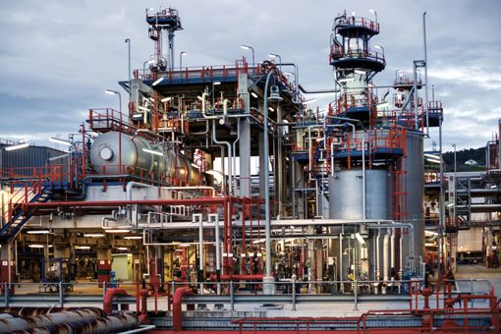
Fossil fuels are the most important source of fuels, energy and chemicals
Oil refinery in Spain
Corn Field in Liechtenstein. Corn plants are of great importance for the production of biofuels

Slide 3
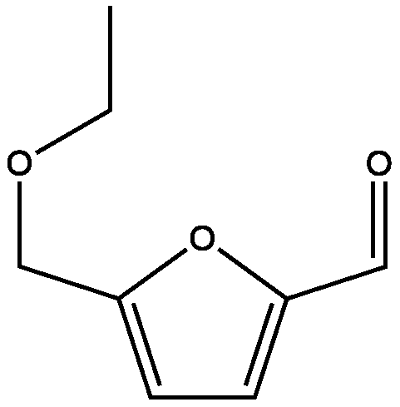
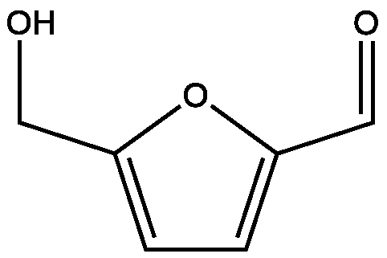
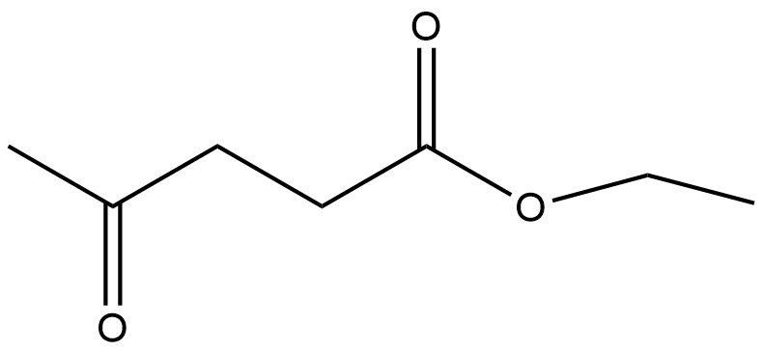
5-ethoxymehylfurfural (EMF) production from hexoses
-3 H₂O
Ethanol
Hexoses
Glucose, Fructose, Galactose, etc.
5-hydroxymehylfurfural (HMF)
5-ethoxymethylfurfural
Platform chemical
Biofuel
Ethyl levulinate (EL) ,byproduct in this process, is also an interesting biofuel additive.

Slide 4
Objectives
Application of different resins in the production of EMF from HMF to identify the most active and selective one
Application of resins to the direct dehydration and etherification of hexoses to EMF
Hexoses

Slide 5
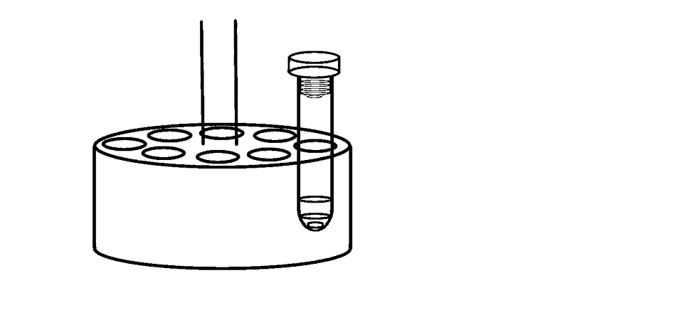
CatalYtic Tests And sample analysis
5 ml ethanol
0.05 g catalyst
0.1 g HMF / 0.15 g Hexose
Reactor are degassed with nitrogen before the reaction to avoid secondary unwanted reactions
Resulting samples were analized through High Pressure Liquid Chromatography (HPLC)
Products were detected and quantified employing a multiwavelength detector (MD-2015) and a refractive index detector (RI-2031-PLUS)

Slide 6
Catalysts Characterization
Catalyst Name | Resin type | Dry ionic exchange capacity (eq·kg⁻¹) | Mesh size (µm) | BET Surface área (m²·g⁻¹)
Purolite CT275DR | Macroreticular | 5,2 | 425-1200 | 20-40
Purolite CT269DR | Macroreticular | 5,2 | 425-1200 | 35-50
Purolite PD206 | Gel | 4,9 | 300-1200 | -
Amberlyst 15 | Macroreticular | >4,7 | 300-425 | 53

Slide 7
HMF etherification at 100ºC
HMF conversion under 100ºC by using 0.1g HMF and 0.05g of catalyst
Logarithm representation of conversion. Result is akin to a first order reaction.
7

Slide 8
HMF etherification at 100ºC
EMF selectivity at 100ºC by using 0.1g HMF and 0.05g of catalyst
EL selectivity at 100ºC by using 0.1g HMF and 0.05g of catalyst.
8

Slide 9
HMF etherification varying HMF loading
Employing different amounts of EMF does not affect conversion rate.
At the same time, different HMF loadings does not seem alter EMF or EMF results notably.
9

Slide 10
HMF results varying temperature
Altering temperature directly affects conversion rate.
Higher temperature favors EMF degradation causing EMF selectivity decrease. Therefore, EL selectivity increases due to furans dehydration.
10

Slide 11
Hexoses conversion at 100ºC
Hexose conversion and selectivities towards HMF, EMF and EL after 5 hours of reaction time at 100ºC.
Fructose was converted readily to HMF and its derivatives. However, glucose and galactose followed a different reaction path.
11

Slide 12
Conclusions
Several resins were assesed in ethanol for the production of EMF from HMF.
Purolite CT275DR showed the best catalytic results.
Although HMF loading had no effect in EMF in overall kinetics, temperature plays a major role conversion and selectivity.
Purolite was able to convert fructose into EMF successfully, however, it was unable to dehydrate aldoses without Lewis acid sites.

Slide 13
Acknowledgments
Thanks for your attention!
We thank the financial support provided by the Spanish Ministry of economy and competitiveness (RTI2018-94918-B-C44), FEDER funds for a postdoctoral contract (UMA18-FEDERJA-171), and the University of Malaga.

