Slide 1
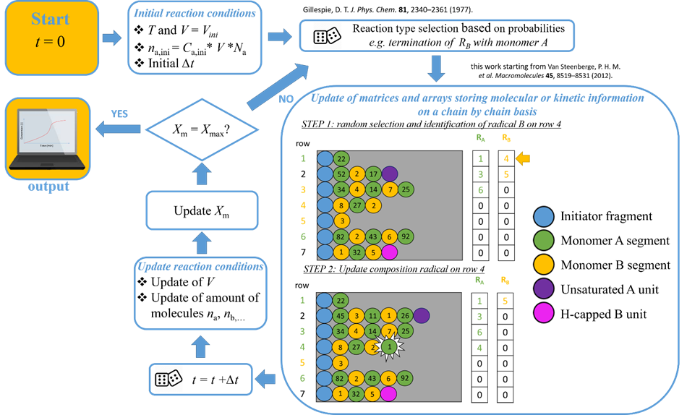
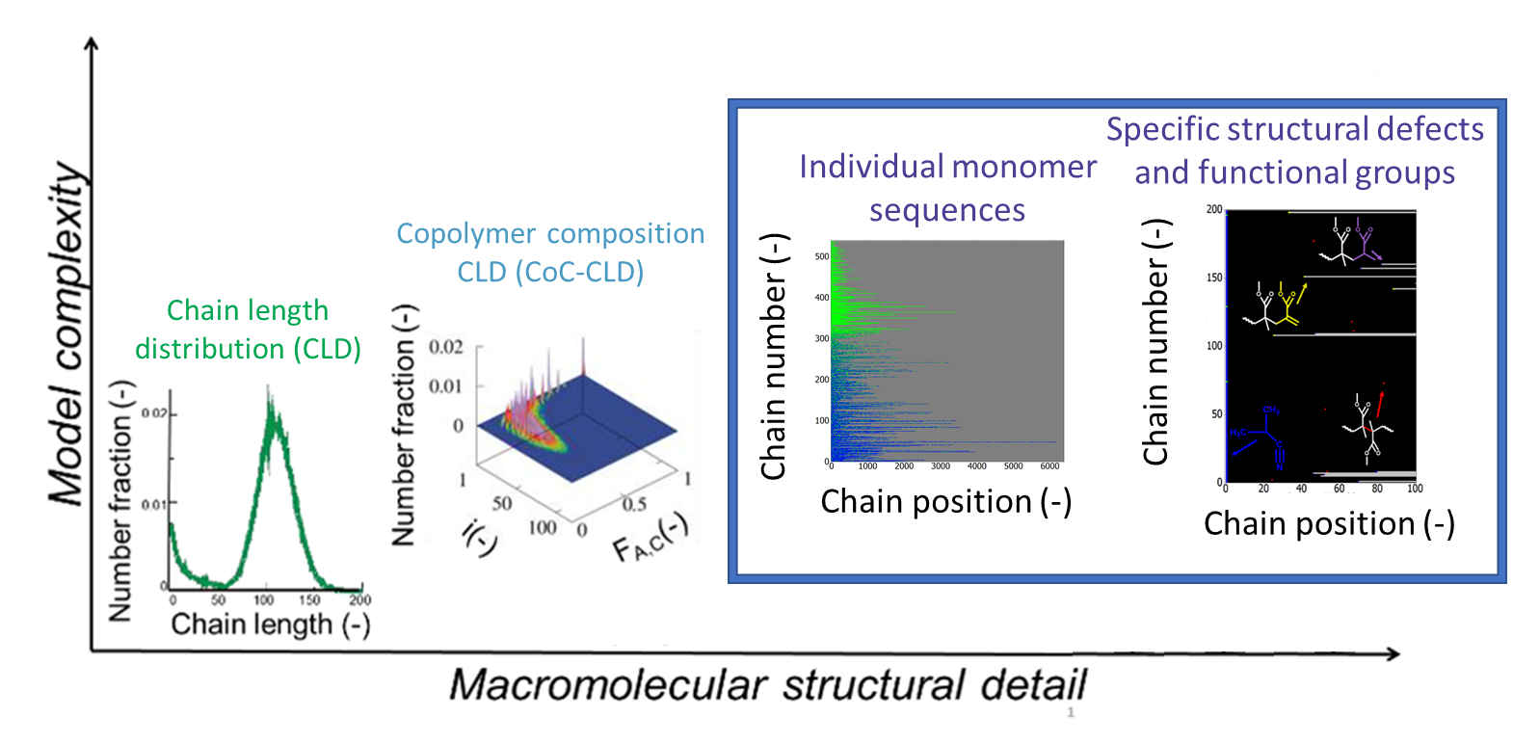
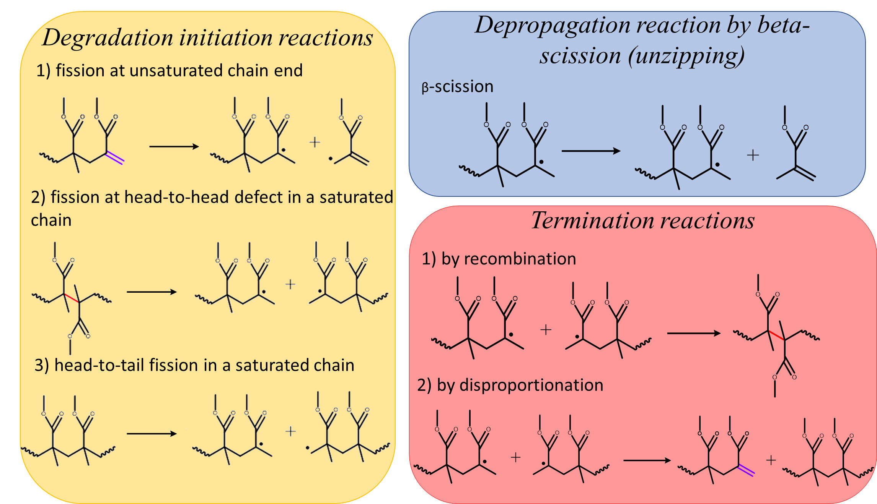
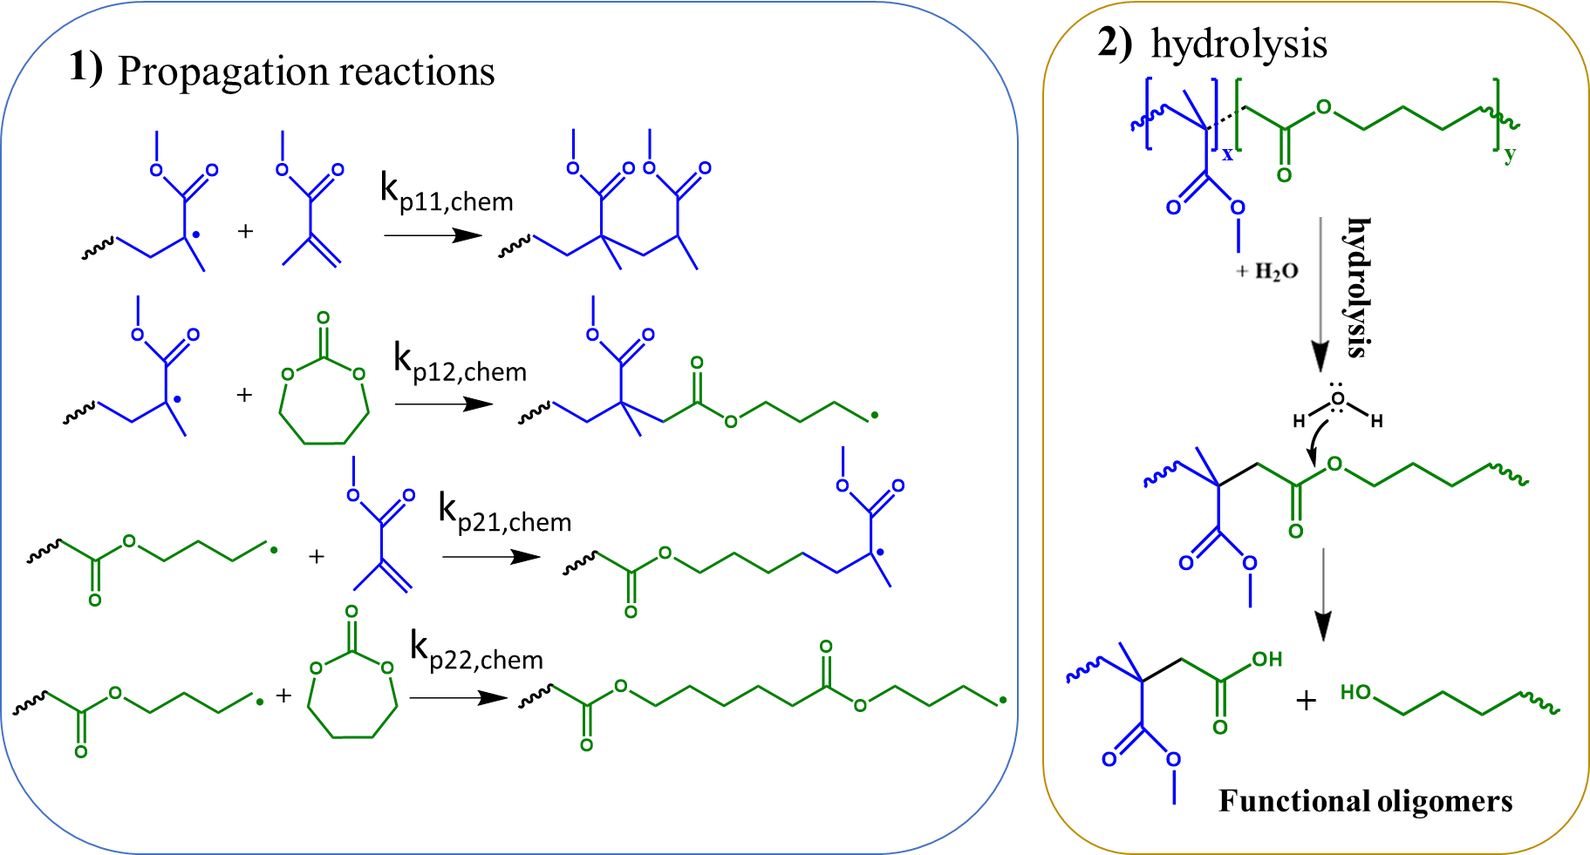
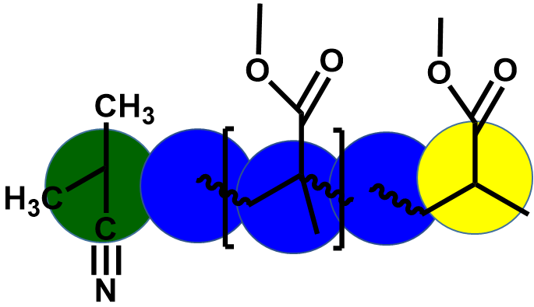
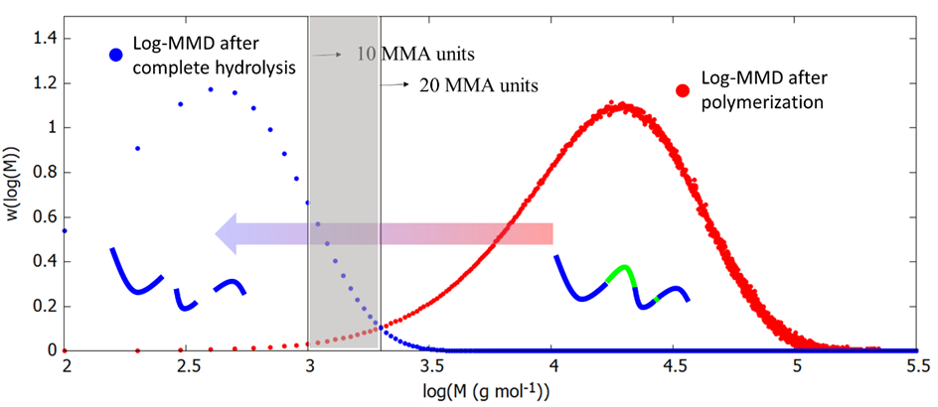
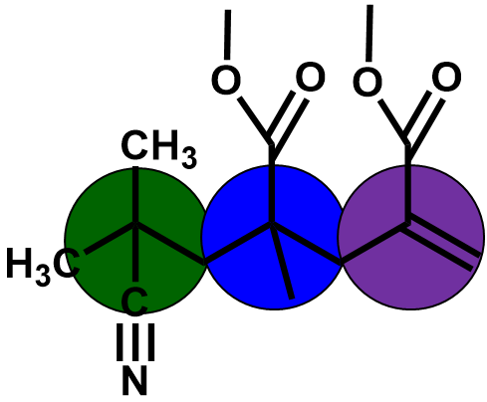
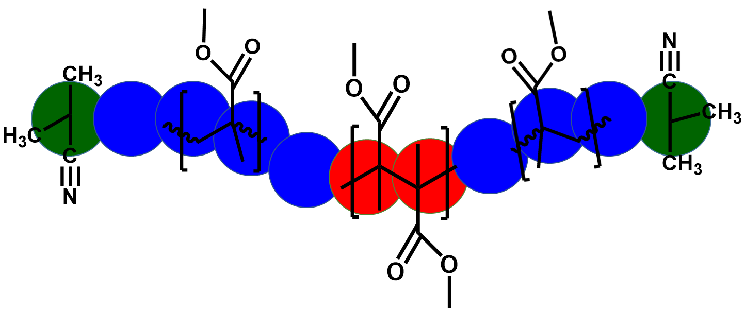
Green degradable (co)polyacrylics: a kinetic Monte Carlo study
Kyann De Smit,¹ Yoshi W. Marien,¹ Kevin M. Van Geem,¹ Paul H.M. Van Steenberge,¹ Dagmar R. D’hooge^{1,2}
¹Laboratory for Chemical Technology
²Centre for Textile Science and Engineering
Technologiepark 125, 9052 Ghent, Belgium
Technologiepark 70A, 9052 Ghent, Belgium
https://www.lct.ugent.be
https://www.ugent.be/ea/match/textiles
AIM
STRATEGY
One of the major challenges for todays society is the management and handling of plastic waste. Two main solutions have been put forward towards solving this issue: (i) recycling of the currently existing bulk polymers either through mechanical, thermal or chemical treatments or (ii) the development of degradable substitutes with the same properties as the conventional bulk polymers. A bottleneck is understanding the degradation of polymer materials on a molecular level. As polymer chains tend to break first at certain functional groups or structural defects of which the location and prevalence is highly important.
A matrix-based elementary step driven kinetic Monte Carlo model
obtain more knowledge over:
Thermal degradation mechanisms of conventional polymers through localization of structural defects and certain functional groups
Hydrolysis of biodegradable polymer substitutes, through localization of degradable units
Thermal degradation PMMA
Hydrolysis poly(MMA-MDO)
Degradation mechanism PMMA homopolymer
Reaction mechanism for radical ring-opening polymerization and hydrolysis
Linear
Model output
Model output
Degradation at 623K
Network
Head-to-head defects are most prone to fission and these bonds will degrade first, followed by fission at unsaturated chain ends and fission at head-to-tail bonds in saturated PMMA chains.
Shift in log-MMD in the first 35% of degradation is mainly due to fission at head-to-head bonds, which are generally larger due to their formation mechanism.
The shift to lower molecular weight from 35% to 70% is less significant due to the degradation of mainly unsaturated and saturated chains.
The shift in log-MMD is very dependent on the polymerisation conditions and thus the initial chain length, concentration of defects, etc.
The red log-MMD is the one after the copolymerization of MMA and 2-methylene-1,3-dioxepane (MDO) (f_{MMA,0}=f_{MDO,0}=0.5 and 343K). The blue log-MMD is the one at complete hydrolysis of the copolymer, meaning that every ester bond introduced by incorporation of an MDO unit has been hydrolysed.
The grey zone between log(M) = 3 and log(M) = 3.3 gives an indication for the maximal chain length of MMA segments that can be biodegraded.
Due to the huge difference in reactivity ratios of the system (MMA/MDO), the incorporation of MDO units is limited, even at a monomer feed fraction of 0.5. This results in longer MMA segments that are not biodegradable.
CONCLUSIONS
ACKNOWLEDGMENTS
A matrix-based, elementary step driven kMC model has been developed which is a powerful tool to study both radical polymerization and degradation as it allows to store kinetic and molecular information on a chain-by-chain-basis so that specific reactions can be explicitly executed. The developed kMC strategy can be seen as an important tool to support the understanding of both polymerization, depolymerization and degradation kinetics and is applicable in the long run to design and connect both polymer synthesis and degradation at the level of the individual molecule. Future work will be aimed at widening the portfolio of polymer compositions addressed and the consideration of different operation modes, taking into account possible constraints due to scale-up and impurities.
K.D.S. acknowledges support by the Fund for Scientific Research Flanders (FWO Flanders) through a SBO-project (1SB0619N, 2019-2020). This work has also received funding from the European Union’s Horizon 2020 research and innovation program under grant agreement No 820687. The Second Generation MethylMethAcrylate (MMAtwo) project related results presented reflect only the author's view. The Commission is not responsible for any use that may be made of the information it contains. P.H.M.V.S. acknowledges FWO Flanders for a postdoctoral fellowship. K.M.V.G. and D.R.D also acknowledge VLAIO/Catalisti regarding the WaTCH project.
E-mail: dagmar.dhooge@ugent.be

