Slide 1

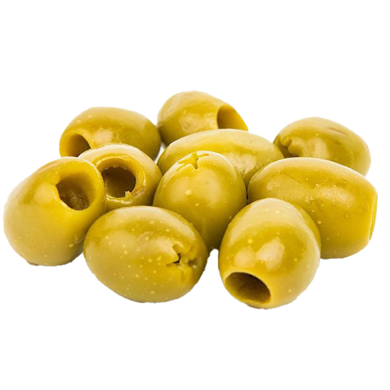

Effect of Packaging on Microbial Survival and Physicochemical Characteristics of Non-Thermally Preserved Green Spanish-Style Olives
Aikaterini Tzamourani¹, Georgios Oikonomou-Petrovits², Stavros Panagiotidis², George-John Nychas¹, Efstathios Ζ. Panagou¹
¹ Agricultural University of Athens, School of Food and Nutritional Sciences
Dept. of Food Science and Human Nutrition, Lab. of Microbiology and Biotechnology of Foods
Iera Odos 75, Athens, Greece, E-mail: stathispanagou@aua.gr
² PELOPAC S.A. Block 38, NB1A Street, Thessaloniki Industrial Area, Sindos 57022, Greece

Slide 2


Trade Preparations
(Trade Standards Applying to Table Olives, COI/OT/NC no. 1, December 2004)
Treated olives in brine (Spanish-style)
Natural olives in brine (Greek-style)
Olives darkened by oxidation (Californian style)
Dehydrated and/or shriveled olives

Slide 3

Spanish-style green table olive processing
Harvest
Debittering
(NaOH, 1.8-2.7%v/v,
12-24h)
Washing with water
(2 or 3 times)
Fermentation in brine
(6-10%)
Packaging
-
Storage

Slide 4
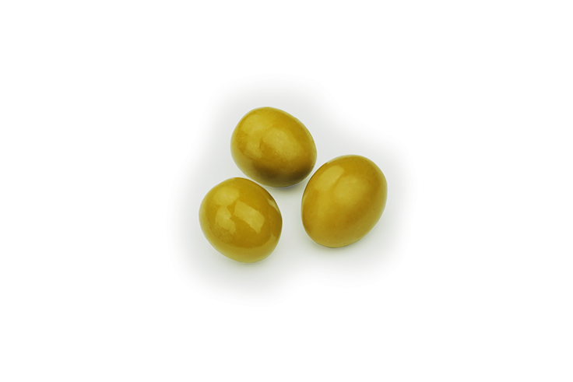
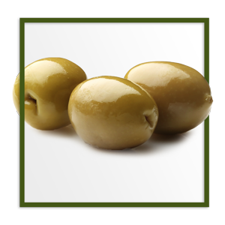
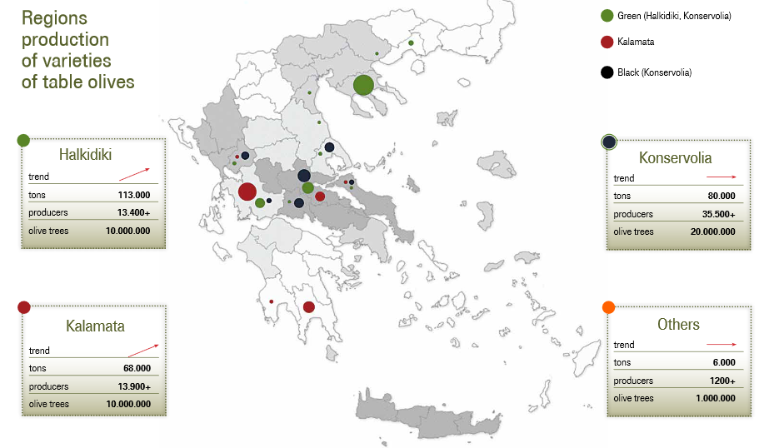
Greek varieties for Spanish-style processing
cv. Conservolea
cv. Halkidiki
https://olivetreeroute.gr/wp-content/uploads/Studies_Publications_017a.pdf

Slide 5
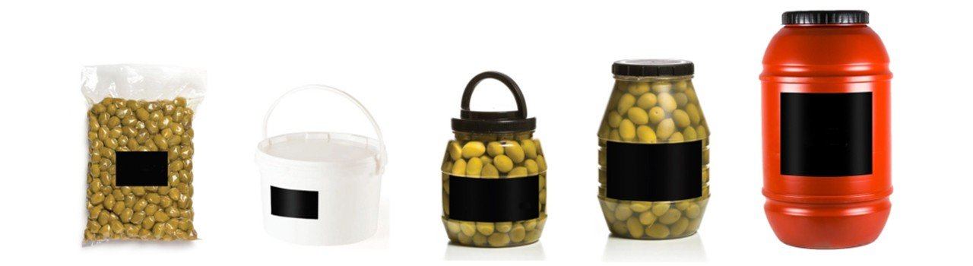
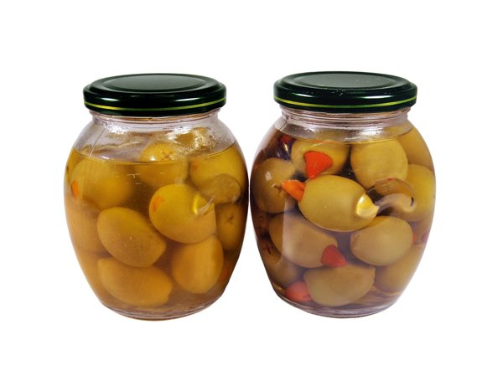
Packaging of table olives
  Glass containers
Plastic containers
Cans
Multi-laminated pouches
  Reduced size and weight
  Flexible
  Low permeability in O2 and water

Slide 6
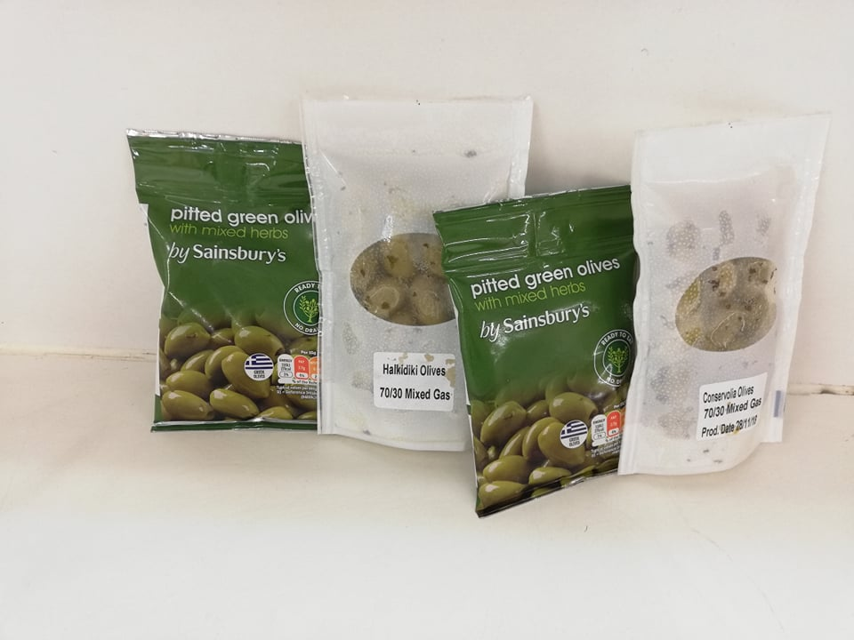
Aim of this study
  Investigate the effect of modified atmosphere packaging of Spanish-style green olives (cvs. Halkidiki and Conservolea) in multi-laminated pouches on:
  microbiological,
  physicochemical and
  sensory characteristics

Slide 7

Materials and methods
Samples of cvs. Halkidiki and Conservolea pitted green olives processed by the Spanish-method were packaged in high barrier multi-laminated pouches under modified atmospheres (30% CO₂ / 70% N₂) and stored at room temperature for 12 months.
Microbiological analysis (TVC, LAB, yeasts, Enterobacteriaceae)
Physicochemical analyses (pH, titratable acidity, salinity, color, texture)
Sensory evaluation (IOC. COI/OT/MO No.1/Rev.2 (International Olive Council), 2020

Slide 8
Microbiological results
(a)
(b)
Figure 1. Changes in the population of total viable counts (TVC), lactic acid bacteria (LAB) and yeasts on olive drupes of cvs. Halkidiki (a) and Conservolea (b) during modified atmosphere packaging in multi-laminated pouches. Data represent average values of duplicate samples ± standard deviation.

Slide 9

Microbiological results
Enterobacteriaceae could not be enumerated during storage in all samples.
LAB were the dominant microbiota and ranged between 5.4-6.4 log CFU/g and 4.5-6.2 log CFU/g for cvs. Halkidiki and Conservolea, respectively.
Yeasts were detected within the first 60 days (maximum counts of 4.9 log CFU/g and 5.4 log CFU/g in cvs. Halkidiki and Conservolea, respectively)
No yeasts could be detected on olives after 90 days of storage in both varieties.

Slide 10
Physicochemical results
(a)
(b)
Figure 2. Changes in pH, salt content and titratable acidity during storage of packaged pitted green olives of cvs. Halkidiki (a) and Conservolea (b). Data represent average values of duplicate samples ± standard deviation

Slide 11
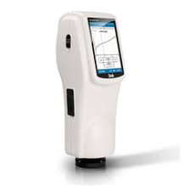
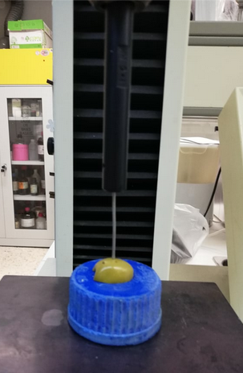
Physicochemical results
Color parameters L*, a* and b* did not change during storage in both varieties.
No statistically significant differences could be established for L* parameter.
The values of a* and b* parameters indicated the prevalence of green and yellow tonalities among samples regardless of table olive variety.
The force needed to penetrate the olive drupe was considered as a measure of the olive’s hardness and varied according to table olive variety and storage time.
The mean value of hardness was 15-20 N and after 360 days of storage it decreased to 8 N.

Slide 12
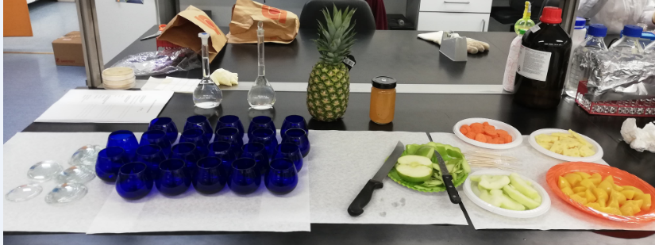
Sensory evaluation
The taste panel evaluated
  negative attributes (e.g., abnormal fermentation),
  gustatory attributes (salty, bitter and acid taste) and
  kinesthetic sensations (hardness, fibrousness, crunchiness).
No perception of abnormal fermentation (zapateria, putrid, butyric) was noticed throughout storage.

Slide 13
Sensory evaluation
cv. Halkidiki’s olives were bitter, acid, crisper and with increased fibrousness compared to cv. Conservolea.
The majority of the sensory characteristics did not vary throughout storage in both varieties. After 10 months of storage all olive samples received approximately the same score with no important differences.
The composition of the modified atmosphere is important since it affects the color and texture of olives.
Overall, all samples were characterized as “Extra”.

Slide 14
Conclusion
Modified atmosphere packaging of Spanish-style green pitted olives in multi-laminated pouches revealed stability with minor changes in the microbiological and physicochemical characteristics of cvs. Halkidiki and Conservolea olives during 12-month storage.
LAB dominated the olive surface from the beginning of storage whereas no yeasts could be detected after 3 months of storage.
The absence of Enterobacteriaceae and the changes in the physicochemical parameters (within the acceptable limits) throughout packaging ensures the microbiological safety and stability of the product during storage.

Slide 15

On-going work
Investigate and characterize the dominant microbial species using molecular techniques
Improve packaging conditions by testing different MAP composition and packaging materials

Slide 16


Thank you for your kind attention

