Slide 1

Cytotoxic effect of cholesterol metabolites on human colonic tumor (Caco-2) and non-tumor (CCD-18Co) cells and their potential implication in colorectal carcinogenesis
1st International Electronic Conference on Food Science and Functional Foods
Mussa Makran Ali, PhD Student
Gabriel López-García, Guadalupe Garcia-Llatas, Reyes Barberá, Amparo Alegría, Antonio Cilla
Nutrition and Food Science Area. Faculty of Pharmacy
University of Valencia, Spain
BIONUTEST research group

Slide 2
INDEX
INTRODUCTION
  Cholesterol metabolism by colonic microbiota
  Cholesterol metabolites and colorectal cancer
OBJECTIVE
MATERIAL AND METHODS
RESULTS
  Coprostanol
  Cholestanol
  Coprostanone
  Cholestenone
  5-Fluorouracil
DISCUSSION
  Cytotoxicity of cholesterol metabolites
  Compensatory response
  Cell line response
CONCLUSIONS
Notes:
2

Slide 3
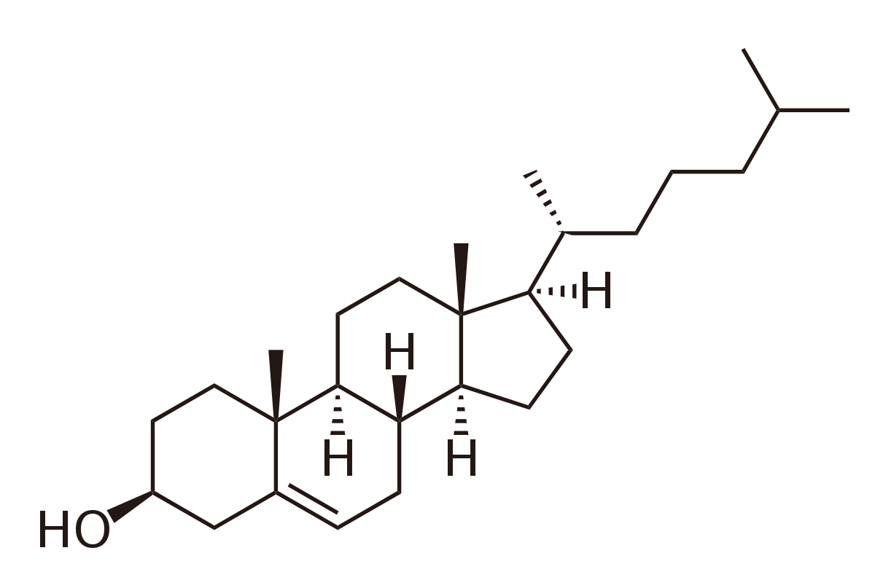
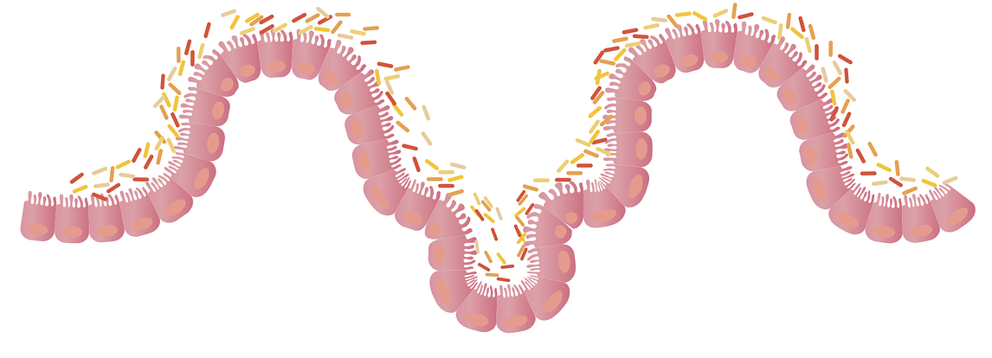
  CHOLESTEROL METABOLISM BY COLONIC MICROBIOTA
INTRODUCTION
OBJECTIVE
MATERIAL AND METHODS
RESULTS
DISCUSSION
CONCLUSIONS
Promoters of colorectal cancer
(CRC) [1-3]
Cholesterol
(1 g/day)
Metabolites
Colonic microbiota: Eubacterium and Bacteroides
[1] Hill et al., 1971. Lancet 1971. 297: 95-100; [2] Reddy & Wynder, 1977. Cancer. 39: 2533-39. [3] Korpela et al., 1988. Scand J Gastroenterol. 23: 277-83.
Notes:
3

Slide 4
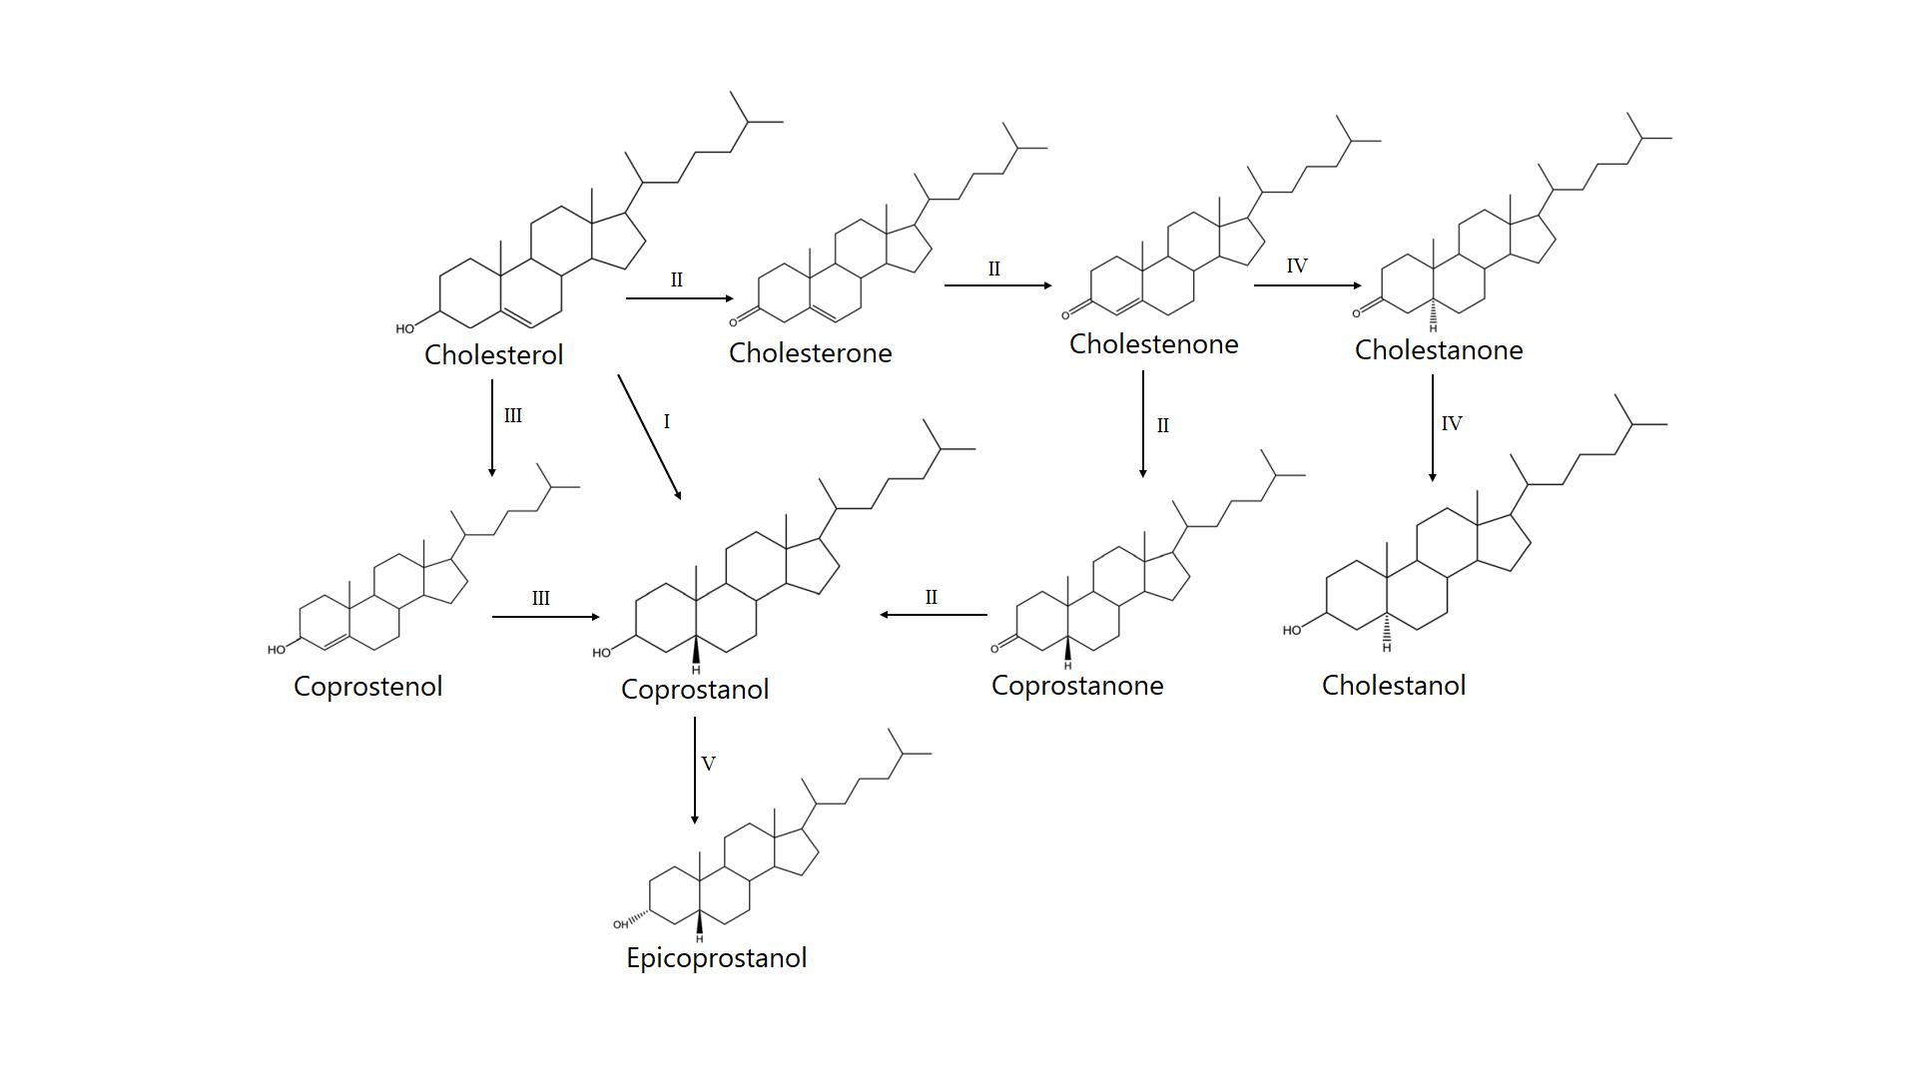
INTRODUCTION
OBJECTIVE
MATERIAL AND METHODS
RESULTS
DISCUSSION
CONCLUSIONS
  CHOLESTEROL METABOLISM BY COLONIC MICROBIOTA
Indirect
Indirect
Direct
Adapted from Cuevas-Tena et al., 2018. Eur J Lipid Sci Technol. 120: 1800054.
Notes:
4

Slide 5
  CHOLESTEROL METABOLITES AND COLORECTAL CANCER
INTRODUCTION
OBJECTIVE
MATERIAL AND METHODS
RESULTS
DISCUSSION
CONCLUSIONS
Metabolite | Conditions | Fecal vs. control (mg/g dry or wet* feces) | Referencia
Coprostanol | CRC | 14.2-26.4 vs. 6.8-14.7 | [1-4]
 | Ulcerative colitis | 19.9-26.6 vs. 6.7-12.9 | [5, 6]
 | Adenomatous polyps | 19.7 vs. 12.4 | [3]
 | Western diet vs. rich vegetables | 3.7-6.6 vs. 1.2-1.4* | [7, 8]
Coprostanone | CRC | 3.1-3.6 vs. 4.2-2.1 | [3, 4]
 | Ulcerative colitis | 3.4 vs. 2 | [6]
 | Adenomatous polyps | 4.2 vs. 2.1 | [6]
 | Western diet vs. rich vegetables | 2.1-3.4 vs. 0.2-2 / 0.65 vs. 0.12* | [3, 9]/[8]
Cholestanol | CRC | 0.6 vs. 0.4 | [10]
[1] Reddy et al., 1975. Cancer Res. 35: 3403-06; [2] Reddy et al., 1977. Cancer. 39: 1815-19; [3] Reddy & Wynder, 1977. Cancer. 39: 2533-39; [4] Peuchant et al., 1984. Clin Chim Acia. 141:151-68; [5] Reddy et al., 1977. Cancer Res. 37: 1697-701; [6] Reddy & Wynder, 1973. J Natl Cancer Inst. 50: 1437-42; [7] van Faassen et al., 1987. Am J Clin Nutr. 45: 962-7; [8] Hill et al., 1971. Lancet. 297: 95-10; [9] Reddy et al., 1978. Cancer Lett. 4: 217-22; [10] Kanazawa et al., 1996. Cancer. 77: 1701-06.

Slide 6
  CHOLESTEROL METABOLITES AND COLORECTAL CANCER
INTRODUCTION
OBJECTIVE
MATERIAL AND METHODS
RESULTS
DISCUSSION
CONCLUSIONS
Animal studies
[LDL-C], [metabolites] in feces and No. of chemoinduced large intestine tumors in rats with a diet rich in unsaturated fat vs. saturated fat [1]
Cholestanone and cholestenone nuclear aberrations in mice colonic epithelium [2]
Cholestenone sister chromatid exchange in mice colonic epithelium [3]
Incidence of chemoinduced large intestine tumors in rats with a diet rich in unsaturated fat + neomycin + cholesterol (vs. basal diet) [4]
Inhibitor of intestinal cholesterol absorption
[1] Broitman et al., 1977. Cancer. 40:2455-63; [2] Suzuki et al., 1986. Cancer Lett. 33: 307-16; [3] Kaul et al., 1987. Mutagenesis. 2: 441-4; [4] Panda et al., 1999. Br J Cancer. 80: 1132-36.
Notes:
6

Slide 7
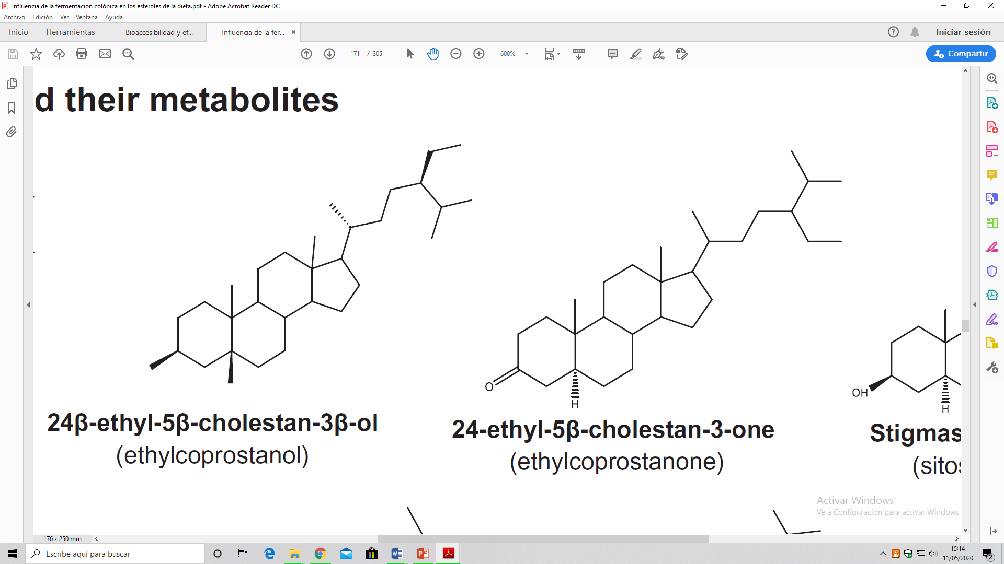
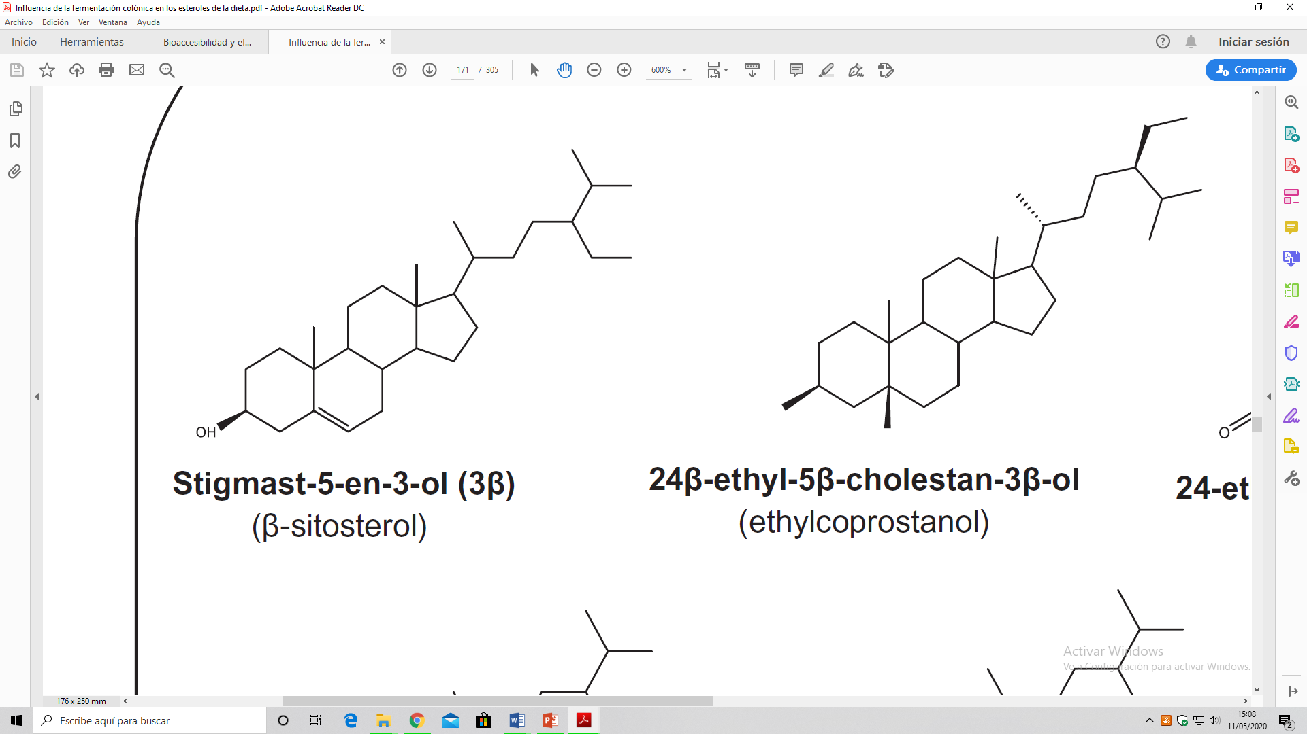
  CHOLESTEROL METABOLITES AND COLORECTAL CANCER
INTRODUCTION
OBJECTIVE
MATERIAL AND METHODS
RESULTS
DISCUSSION
CONCLUSIONS
Plant sterols lower the risk of CRC
By reducing the biotransformation of cholesterol by the colonic microbiota
β-Sitosterol
Sitostenone
Ethylcoprostanone
Ethylcoprostanol
Adapted from Cuevas-Tena et al., 2018. Eur J Lipid Sci Technol. 120: 1800054.
Notes:
7

Slide 8
INTRODUCTION
OBJECTIVE
MATERIAL AND METHODS
RESULTS
DISCUSSION
CONCLUSIONS
OBJECTIVE
To evaluate the cytotoxic activity of the main cholesterol-derived metabolites (coprostanol, cholestanol, coprostanone, and cholestenone) at physiologically relevant concentrations on tumoral (Caco-2) and non-tumoral (CCD-18Co) human colon cells.

Slide 9
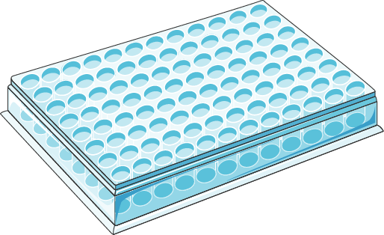

INTRODUCTION
OBJECTIVE
MATERIAL AND METHODS
RESULTS
DISCUSSION
CONCLUSIONS
CELL CULTURE AND TREATMENT
TREATMENT
Cholesterol metabolites
9.4-300 μM [1, 2]
24-72 h
D-MEM with ethanol 1.4% (v/v) (control)
5-Fluorouracil (25 µM): chemotherapeutic drug for CRC [3]
Seeded
24 h
(commercially available)
Caco-2 and CCD-18Co cells cultured in 75 cm² Falcon flasks
96-well plates at 25,000 cells/ well
[1] Cuevas-Tena et al., 2018. Eur J Lipid Sci Technol. 120: 1800054; [2] Pem et al., 2018, Water Research, 132, 222-240; [3] Álvarez-Sala et al., 2018. J Funct Foods. 49: 52-60.

Slide 10
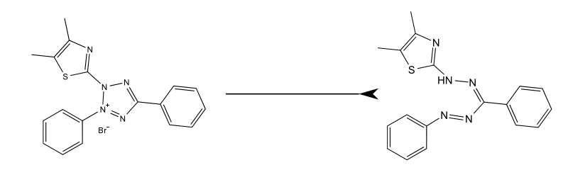
INTRODUCTION
OBJECTIVE
MATERIAL AND METHODS
RESULTS
DISCUSSION
CONCLUSIONS
CYTOTOXICITY ASSAY (MTT)
Mitochondrial reductases
-
[Toxic]
MTT
Formazan
(purple)
+
Viability (% vs. control)
50%
IC50
Concentration
Notes:
10

Slide 11
INTRODUCTION
OBJECTIVE
MATERIAL AND METHODS
RESULTS
DISCUSSION
CONCLUSIONS
COPROSTANOL IN CCD-18CO CELLS (NON-TUMORAL)
Control
A*
B*
9.4 18.75 37.5 75 150 300
The * indicates statistically significant differences (p <0.05) between the treatments and the control. Different uppercase letters (A-B) indicate statistically significant differences (p <0.05) at different times at the same concentration
Notes:
11

Slide 12
INTRODUCTION
OBJECTIVE
MATERIAL AND METHODS
RESULTS
DISCUSSION
CONCLUSIONS
COPROSTANOL IN CACO-2 CELLS (TUMORAL)
*
Control
9.4 18.75 37.5 75 150 300
The * indicates statistically significant differences (p <0.05) between the treatments and the control
Notes:
However, Caco-2 cells do not experience a reduction in viability after coprostanol treatments, observing, in turn, at 18.75 and 150 µM an increase in cell viability. This could indicate a possible gaiperrproliferative response to the toxic effect of coprostanol.
12

Slide 13
INTRODUCTION
OBJECTIVE
MATERIAL AND METHODS
RESULTS
DISCUSSION
CONCLUSIONS
CHOLESTANOL IN CCD-18CO CELLS (NON-TUMORAL)
Control
*
*
Compensation mechanisms?
*
*
*
ab*
ab*
ab*
*
b*
b*
9.4 18.75 37.5 75 150 300
Concentration (µM)
The * indicates statistically significant differences (p <0.05) between the treatments and the control. Different lowercase letters (a-b) indicate statistically significant differences (p <0.05) at different concentration at the same time
Notes:
13

Slide 14
INTRODUCTION
OBJECTIVE
MATERIAL AND METHODS
RESULTS
DISCUSSION
CONCLUSIONS
CHOLESTANOL IN CACO-2 CELLS (TUMORAL)
Control
*
*
*
*
*
9.4 18.75 37.5 75 150 300
Concentration (µM)
The * indicates statistically significant differences (p <0.05) between the treatments and the control
Notes:
14

Slide 15
INTRODUCTION
OBJECTIVE
MATERIAL AND METHODS
RESULTS
DISCUSSION
CONCLUSIONS
COPROSTANONE IN CCD-18CO CELLS (NON-TUMORAL)
Control
*
a
a*
aA*
aA*
bA*
*
*bB
bB
*
cB
9.4 18.75 37.5 75 150 300
The * indicates statistically significant differences (p <0.05) between the treatments and the control. Different lowercase letters (a-b) indicate statistically significant differences (p <0.05) at different concentration at same time. Different uppercase letters (A-B) indicate statistically significant differences (p <0.05) at different times at the same concentration
Notes:
15

Slide 16
INTRODUCTION
OBJECTIVE
MATERIAL AND METHODS
RESULTS
DISCUSSION
CONCLUSIONS
COPROSTANONE IN CACO-2 CELLS (TUMORAL)
*
*
Control
a*
b*
The * indicates statistically significant differences (p <0.05) between the treatments and the control. Different lowercase letters (a-b) indicate statistically significant differences (p <0.05) at different concentration at the same time
Notes:
16

Slide 17
INTRODUCTION
OBJECTIVE
MATERIAL AND METHODS
RESULTS
DISCUSSION
CONCLUSIONS
CHOLESTENONE IN CCD-18CO CELLS (NON-TUMORAL)
Control
aA*
aA*
bA*
a*
B*
*
c*
B*
d*
*
e*
e*
b*
*
*
b*
b*
9.4 18.75 37.5 75 150 300
The * indicates statistically significant differences (p <0.05) between the treatments and the control. Different lowercase letters (a-e) indicate statistically significant differences (p <0.05) at different concentrations at the same time. Different uppercase letters (A-B) indicate statistically significant differences (p <0.05) at different times at the same concentration
Notes:
17

Slide 18
INTRODUCTION
OBJECTIVE
MATERIAL AND METHODS
RESULTS
DISCUSSION
CONCLUSIONS
CHOLESTENONE IN CACO-2 CELLS (TUMORAL)
Control
a*
a*
b*
b*
*a
bA*
a*
bA*
cA*
bB*
cA*
cB*
cB*
bB*
bB*
The * indicates statistically significant differences (p <0.05) between the treatments and the control. Different lowercase letters (a-c) indicate statistically significant differences (p <0.05) at different concentrations at the same time. Different uppercase letters (A-B) indicate statistically significant differences (p <0.05) at different times at the same concentration
Notes:
18

Slide 19
INTRODUCTION
OBJECTIVE
MATERIAL AND METHODS
RESULTS
DISCUSSION
CONCLUSIONS
5-FU (25 µM)
Control
aA*
aA*
aA*
aB*
bA*
bA*
The asterisk indicates statistically significant differences (p <0.05) between the treatments and the control. Different lowercase letters (a-b) indicate statistically significant differences (p <0.05) between the different times for a cell line. Different uppercase letters (A-B) indicate statistically significant differences (p <0.05) between the two cell lines for the same time
Notes:
19

Slide 20
INTRODUCTION
OBJECTIVE
MATERIAL AND METHODS
RESULTS
DISCUSSION
CONCLUSIONS
CYTOTOXICITY OF CHOLESTEROL METABOLITES
 |  | IC₅₀ (μM)
 |  | CCD-18Co | Caco-2
Coprostanol | 24 h | >300^{aA} | >300^{aA}
 | 48 h | >300^{aA} | >300^{aA}
 | 72 h | 156 ± 17*^{cA} | >300^{aA}
Cholestanol | 24 h | >300^{aA} | >300^{aA}
 | 48 h | >300^{aA} | >300^{aA}
 | 72 h | >300^{aB} | >300^{aA}
Coprostanone | 24 h | 59 ± 7*^{aB} | >300^{aA}
 | 48 h | 136 ± 8*^{bB} | >300^{aA}
 | 72 h | 41 ± 4*^{cC} | 121 ± 7^{bB}
Cholestenone | 24 h | 27 ± 1*^{aC} | 37 ± 4^{aB}
 | 48 h | 46 ± 3^{bC} | 50 ± 3^{bB}
 | 72 h | 13 ± 3*^{cD} | 38 ± 3^{aC}
The * indicates statistically significant difference (p <0.05) vs. Caco-2 in the same time. Different lowercase letters (a-c) indicate statistically significant differences (p <0.05) at different times for the same metabolite and cell line. Different uppercase letters (A-D) indicate statistically significant differences (p <0.05) in different metabolites for the same time and cell line
Notes:
20

Slide 21
INTRODUCTION
OBJECTIVE
MATERIAL AND METHODS
RESULTS
DISCUSSION
CONCLUSIONS
CYTOTOXICITY OF CHOLESTEROL METABOLITES
 |  | IC₅₀ (μM)
 |  | CCD-18Co | Caco-2
Coprostanol | 24 h | >300^{aA} | >300^{aA}
 | 48 h | >300^{aA} | >300^{aA}
 | 72 h | 156 ± 17*^{cA} | >300^{aA}
Cholestanol | 24 h | >300^{aA} | >300^{aA}
 | 48 h | >300^{aA} | >300^{aA}
 | 72 h | >300^{aB} | >300^{aA}
Coprostanone | 24 h | 59 ± 7*^{aB} | >300^{aA}
 | 48 h | 136 ± 8*^{bB} | >300^{aA}
 | 72 h | 41 ± 4*^{cC} | 121 ± 7^{bB}
Cholestenone | 24 h | 27 ± 1*^{aC} | 37 ± 4^{aB}
 | 48 h | 46 ± 3^{bC} | 50 ± 3^{bB}
 | 72 h | 13 ± 3*^{cD} | 38 ± 3^{aC}
The most cytotoxic
The * indicates statistically significant difference (p <0.05) vs. Caco-2 in the same time. Different lowercase letters (a-c) indicate statistically significant differences (p <0.05) at different times for the same metabolite and cell line. Different uppercase letters (A-D) indicate statistically significant differences (p <0.05) in different metabolites for the same time and cell line
Notes:
21

Slide 22
INTRODUCTION
OBJECTIVE
MATERIAL AND METHODS
RESULTS
DISCUSSION
CONCLUSIONS
CYTOTOXICITY OF CHOLESTEROL METABOLITES
 |  | IC₅₀ (μM)
 |  | CCD-18Co | Caco-2
Coprostanol | 24 h | >300^{aA} | >300^{aA}
 | 48 h | >300^{aA} | >300^{aA}
 | 72 h | 156 ± 17*^{cA} | >300^{aA}
Cholestanol | 24 h | >300^{aA} | >300^{aA}
 | 48 h | >300^{aA} | >300^{aA}
 | 72 h | >300^{aB} | >300^{aA}
Coprostanone | 24 h | 59 ± 7*^{aB} | >300^{aA}
 | 48 h | 136 ± 8*^{bB} | >300^{aA}
 | 72 h | 41 ± 4*^{cC} | 121 ± 7^{bB}
Cholestenone | 24 h | 27 ± 1*^{aC} | 37 ± 4^{aB}
 | 48 h | 46 ± 3^{bC} | 50 ± 3^{bB}
 | 72 h | 13 ± 3*^{cD} | 38 ± 3^{aC}
The most vulnerable
The most cytotoxic
The * indicates statistically significant difference (p <0.05) vs. Caco-2 in the same time. Different lowercase letters (a-c) indicate statistically significant differences (p <0.05) at different times for the same metabolite and cell line. Different uppercase letters (A-D) indicate statistically significant differences (p <0.05) in different metabolites for the same time and cell line
Notes:
22

Slide 23
INTRODUCTION
OBJECTIVE
MATERIAL AND METHODS
RESULTS
DISCUSSION
CONCLUSIONS
CYTOTOXICITY OF CHOLESTEROL METABOLITES
Coprostanol and cholestanol: IC₅₀ >300 µM
Cholestenone and coprostanone Relationship between hydrophobicity and cytotoxicity
Low uptake by the colonocyte
HO
Equatorial
Position
Accepted cytotoxic values
IC₅₀ (48-72 h) < 4 μg / mL [1]
The most cytotoxic: IC₅₀ (CCD-18Co - 72 h): 5 ± 1 μg / mL
Nuclear aberrations [2] and sister chromatid exchange [3] in the colon of mice
The metabolite with the greatest capacity to promote CRC
[1] López-García et al., 2019. Nutraceuticals and Natural Product Derivatives: Disease Prevention & Drug Discovery. 1st ed. 145-165.; [2] Suzuki et al., 1986. Cancer Lett. 33: 307-16; [3] Kaul et al., 1987. Mutagenesis. 2: 441-4.
Notes:
23

Slide 24
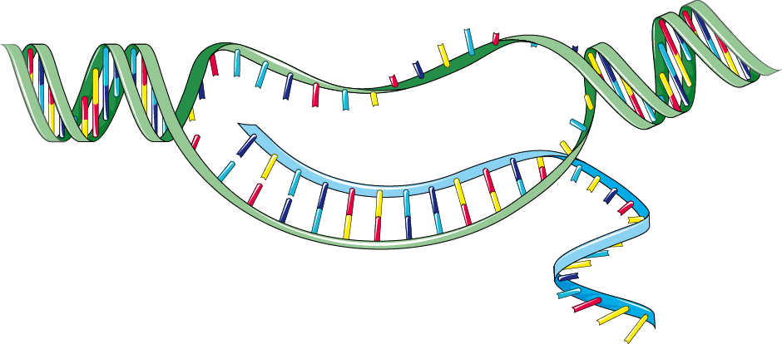
INTRODUCTION
OBJECTIVE
MATERIAL AND METHODS
RESULTS
DISCUSSION
CONCLUSIONS
COMPENSATORY RESPONSE
Secondary bile acid mimetic action?
Increase
ROS
NF-κB
Antioxidant enzymes
ABC transporters
Cell proliferation
Resistance to apoptosis
Inflammation
Apoptosis
Cholestanol
Ajouz et al., 2014. World J Surg. 12, 164; Payne et al., 2007. Carcinogenesis. 28: 215-222; Jarosz et al., 2017. Inflammopharmacology.25, 11-24; Lin et al., 2010. Expert Opin Ther Targets. 14: 45-55.
Notes:
24

Slide 25
INTRODUCTION
OBJECTIVE
MATERIAL AND METHODS
RESULTS
DISCUSSION
CONCLUSIONS
COMPENSATORY RESPONSE
Secondary bile acid mimetic action?
Increase
ROS
NF-κB
Antioxidant enzymes
Apoptosis
Cholestanol
Ajouz et al., 2014. World J Surg. 12, 164; Payne et al., 2007. Carcinogenesis. 28: 215-222; Jarosz et al., 2017. Inflammopharmacology.25, 11-24; Lin et al., 2010. Expert Opin Ther Targets. 14: 45-55.
Notes:
25

Slide 26

INTRODUCTION
OBJECTIVE
MATERIAL AND METHODS
RESULTS
DISCUSSION
CONCLUSIONS
COMPENSATORY RESPONSE
Secondary bile acid mimetic action?
Increase
ROS
NF-κB
ABC transporters
Apoptosis
Cholestanol
Cholestanol
Ajouz et al., 2014. World J Surg. 12, 164; Payne et al., 2007. Carcinogenesis. 28: 215-222; Jarosz et al., 2017. Inflammopharmacology.25, 11-24; Lin et al., 2010. Expert Opin Ther Targets. 14: 45-55.
Notes:
26

Slide 27
INTRODUCTION
OBJECTIVE
MATERIAL AND METHODS
RESULTS
DISCUSSION
CONCLUSIONS
COMPENSATORY RESPONSE
Secondary bile acid mimetic action?
Increase
ROS
NF-κB
Resistance to apoptosis
Apoptosis
Cholestanol
Ajouz et al., 2014. World J Surg. 12, 164; Payne et al., 2007. Carcinogenesis. 28: 215-222; Jarosz et al., 2017. Inflammopharmacology.25, 11-24; Lin et al., 2010. Expert Opin Ther Targets. 14: 45-55.
Notes:
27

Slide 28
INTRODUCTION
OBJECTIVE
MATERIAL AND METHODS
RESULTS
DISCUSSION
CONCLUSIONS
COMPENSATORY RESPONSE
Secondary bile acid mimetic action?
Increase
ROS
NF-κB
Cell proliferation
Resistance to apoptosis
Inflammation
Apoptosis
Cholestanol
Risk of CRC
Ajouz et al., 2014. World J Surg. 12, 164; Payne et al., 2007. Carcinogenesis. 28: 215-222; Jarosz et al., 2017. Inflammopharmacology.25, 11-24; Lin et al., 2010. Expert Opin Ther Targets. 14: 45-55.
Notes:
28

Slide 29


INTRODUCTION
OBJECTIVE
MATERIAL AND METHODS
RESULTS
DISCUSSION
CONCLUSIONS
CELL LINE RESPONSE
>
Proliferative activity
Antioxidant status [1]
Expression of ABC transporters [2]
<
Sensitivity
Compensatory response time
Caco-2
(tumoral)
CCD-18Co
(non-tumoral)
[1] Cermak et al., 1993. Cancer Res. 53, 5308-5313; [2] Lin et al., 2010. Expert Opin Ther Targets. 14, 45-55.
Notes:
29

Slide 30
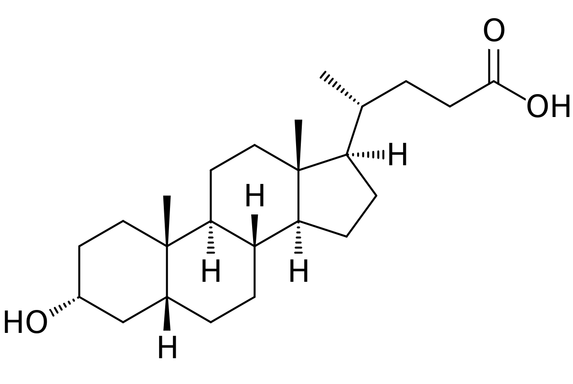
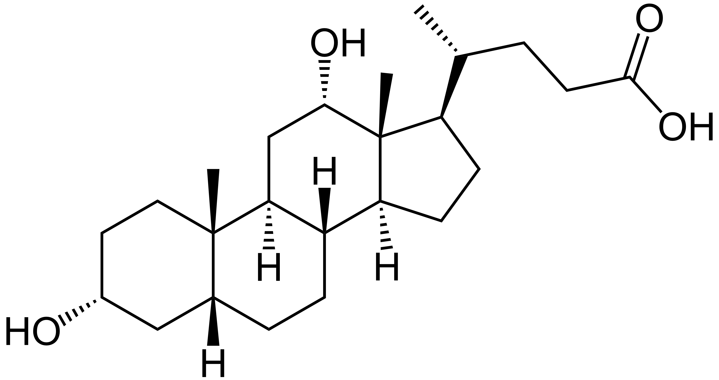
INTRODUCTION
OBJECTIVE
MATERIAL AND METHODS
RESULTS
DISCUSSION
CONCLUSIONS
Preliminary study A greater number of analytical repetitions is needed
Molecular mechanisms have not been studied Cell death and cell cycle progression
Hypothesis on compensatory response and cellular sensitivity without experimental support
Structural similarity to secondary bile acids (same activity?)
LIMITATIONS OF STUDY
Based
Deoxycholic acid
Lithocholic acid
Notes:
30

Slide 31
INTRODUCTION
OBJECTIVE
MATERIAL AND METHODS
RESULTS
DISCUSSION
CONCLUSIONS
Metabolites produced by intestinal bacteria from cholesterol, mainly those of a hydrophobic nature (cholestenone and coprostanone), could be involved in colorectal carcinogenesis through their cytotoxic activity.
Further studies are needed to determine the molecular mechanisms that mediate the cytotoxicity of cholesterol metabolites, and to define the selectivity of this effect.
The study of pathways involved in the compensatory response is needed, since this could contribute to the development of CRC.
Notes:
31

Slide 32
INTRODUCTION
OBJECTIVE
MATERIAL AND METHODS
RESULTS
DISCUSSION
CONCLUSIONS
Metabolites produced by intestinal bacteria from cholesterol, mainly those of a hydrophobic nature (cholestenone and coprostanone), could be involved in colorectal carcinogenesis through their cytotoxic activity.
Further studies are needed to determine the molecular mechanisms that mediate the cytotoxicity of cholesterol metabolites, and to define the selectivity of this effect.
The study of pathways involved in the compensatory response is needed, since this could contribute to the development of CRC.
Notes:
32

Slide 33
INTRODUCTION
OBJECTIVE
MATERIAL AND METHODS
RESULTS
DISCUSSION
CONCLUSIONS
Metabolites produced by intestinal bacteria from cholesterol, mainly those of a hydrophobic nature (cholestenone and coprostanone), could be involved in colorectal carcinogenesis through their cytotoxic activity.
Further studies are needed to determine the molecular mechanisms that mediate the cytotoxicity of cholesterol metabolites, and to define the selectivity of this effect.
The study of pathways involved in the compensatory response is needed, since this could contribute to the development of CRC.
Notes:
33

Slide 34
Cytotoxic effect of cholesterol metabolites on human colonic tumor (Caco-2) and non-tumor (CCD-18Co) cells and their potential implication in colorectal carcinogenesis
1st International Electronic Conference on Food Science and Functional Foods
THANKS FOR YOUR ATTENTION
Mussa Makran Ali (makran@alumni.uv.es)

