Slide 1
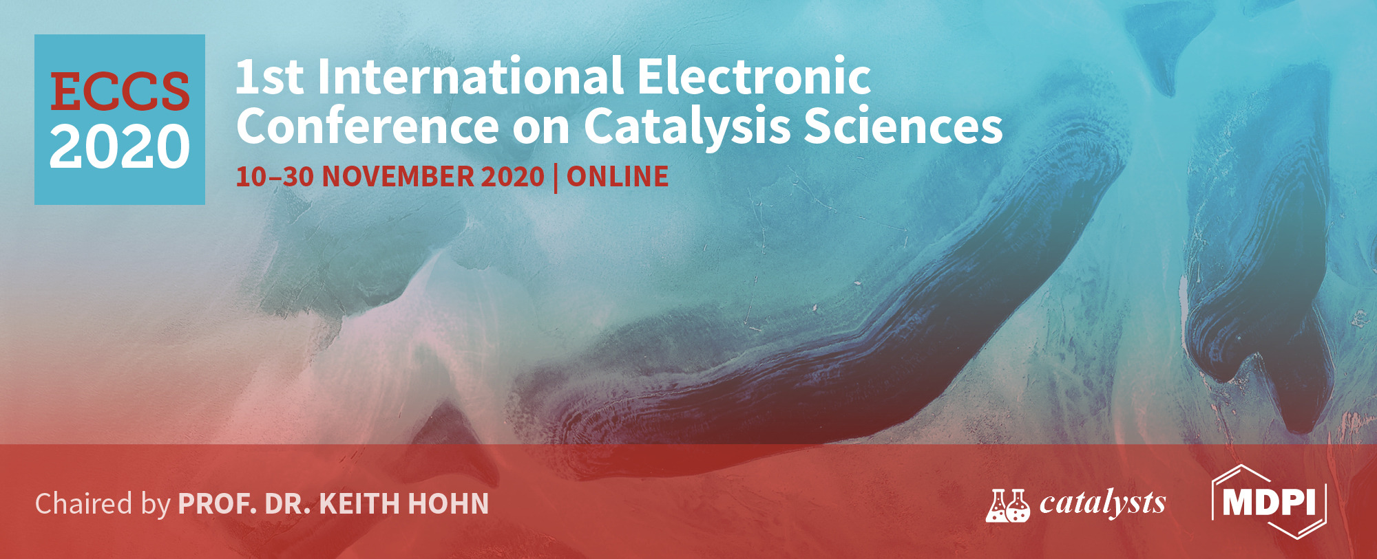
National Research and Development Institute for Cryogenics and Isotopic Technologies - ICSI Ramnicu Valcea
SBA-3-based nanocatalysts application in Nile Blue removal from wastewater
Violeta Niculescu, Marius Miricioiu, Amalia Soare, Adriana Marinoiu, Daniela Ebrasu-Ion,
Marius Constantinescu, Felicia Bucura
National Research and Development Institute for Cryogenics and Isotopic Technologies - ICSI Rm.Valcea
4th Uzinei Street, 240050, Ramnicu Valcea, Romania; E-mail: violeta.niculescu@icsi.ro
INTRODUCTION
Various mesoporous molecular sites, such as SBA, have been synthesized using self-assembly of surfactants, with low and / or high molecular weight copolymers. Mesoporous molecular sieves such as SBA-3 can be synthesized at room temperature under acidic conditions. The method is similar to that of SBA-15, except for the template, which may be a low molecular weight quaternary alkylammonium salt. For this reason, the development of this material is in-teresting for applications in catalysis and redox deposition of metals on a nano-metric scale. Also, various catalysts have been applied for the oxidation of organic compounds in water, includ-ing the organic dyes. Nile Blue is a fluorescent dye, used in various bio-applications and it is considered a contaminant in water.
MATERIALS AND METHODS
SBA-3 mesoporous silica was prepared using cetyltrimethyl-ammonium bromide (CTABr, Sigma Aldrich) and tetraethyl orthosilicate TEOS (Sigma Aldrich) as template and source of Si, respectively. An aqueous solution of HCl (37%) was added to control the pH of the system reaction. Thus, 2 g of CTMABr and 40 mL of HCl (37%) were dissolved in 100 mL of ultrapure water. TEOS (10 mL) was added dropwise to the acidic solution of CTABr with vigorous stirring at 30 °C. After 2 hours, the white precipitate (SBA-3 precursor) was aged at room temperature for 12 hours. The sample was then filtered and dried for 12 hours at 100 °C. SBA-3 was then immersed at reflux in ethanol for 6 hours to extract the surfactant; after that, the precipitate was filtered and washed with ultrapure water. After drying, SBA-3 mesoporous silica was calcined at 550 °C in air for 6 hours. The catalyst was obtained by post-synthesis method – wet impregnation. Oxidation was carried out with H₂O₂ as oxidant agent and ACN as solvent, (molar ratio 0.05:0.18:0.4 – dye: H₂O₂:ACN; 0.05 g catalyst) in a batch reactor at ambient temperature and pressure. The de-colourization experiments were monitored by UV-VIS spectrophotometry.
Recently, advanced oxidation processes have gained attention as efficient techniques for the organic dyes elimination. Nile Blue is a fluorescent dyes, used in various industries and they are considered pollutant chemicals in water. Catalytic oxidation reactions result in either the total oxidation of complex organic contaminants to carbon dioxide and water or in their partial oxidation into nontoxic components suitable for further bioprocessing. In this study, catalysts obtained by immobilisation of transitional metals on mesoporous silica were used to oxidize the dye in water to innocuous compounds.
RESULTS AND DISCUSSION
Table. Elemental analysis of the silica materials
Table. Structural parameters of the silica materials
Sample | C (%) | H (%) | O (%) | metal (%) | Si (%)
SBA-3 | 0,40 | 0,64 | 50,25 | - | 48,71
Ni-SBA-3 | 1,65 | 1,42 | 54,16 | 2,55 | 40,22
Sample | S_{BET} (m²/g) | d_{pBJH} (nm) | V_{p} (cm³/g)
SBA-3 | 549 | 2.20 | 0.991
Ni-SBA-3 | 268 | 2.20 | 0.161
Adsorption-desorption isotherm and pores distribution
It can be observed that at 3435 cm⁻¹ the SBA-3 support has bands specific to the presence of OH groups from the surface of silanol groups or from the water molecules adsorbed on the surface. After functionalization with metals, the intensity of these bands decreases, which proves the immobilization of the metal on the surface. The absorption band at 1650 cm⁻¹ of the SBA-3 sample can be attributed to the deformation vibrations of the adsorbed water molecules (δ_{H-O-H}). The band at about 960 cm⁻¹ in the spectra of the catalyst is assigned Si-ONi.
SEM image for SBA-3
FTIR spectra
SEM image for Ni-SBA-3
In the case of SBA-3, weight loss of about 9% occurs below 120 °C, most likely corresponding to the elimination of absorbed water. In the case of Ni-SBA-3, the weigh loss is about 15.6 %, due to adsorbed water elimination (up to 120 °C) and to metal oxides degradation (up to 400 °C).
TG analysis
Nile Blue conversion in the absence and presence of Ni-SBA-3 catalyst
CONCLUSION
From the results, it could be concluded that fluorescent dyes cations in wastewater could be oxidized by catalysts obtained by impregnation of transitional metals on mesoporous silica support, the final oxidation products being less harmful for the environment and also for the aquatic systems. The oxidation reactions followed the first order kinetics.
Funding
The work has been funded by the Romanian Ministry of Education an Research, NUCLEU Program-Financing Contract no. 9N/2019, under Project PN 19 11 03 01 “Studies on the obtaining and improvement of the acido-basic properties of the nanoporous catalytic materials for application in wastes valorization”
Acknowledgements
The authors would like to Chem. Eng. Claudia Sandru, from the National Research and Development Institute for Cryogenics and Isotopic Technologies – ICSI Rm. Valcea, Romania, for the support offered with SAA measurements.

