Slide 1
eWSeS
Blue-light-mediated selenealkoxilation and selenocyclofuncionalization
Moretti, M.,¹ Mangiavacchi, F.,¹ Liviabella, D.,¹ Penteado, F.,² Sancineto, L.,¹ Lenardao, E.² and Santi, C.^{1*}
Group of Catalysis, Synthesis and Organic Green Chemistry, Department of Pharmaceutical Sciences, University of Perugia, Perugia, Italy
Laboratory of Clean Organic Synthesis, Federal University of Pelotas, Pelotas, RS, Brazil
Sciforum 10-30 november 3020

Slide 2

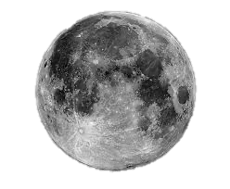
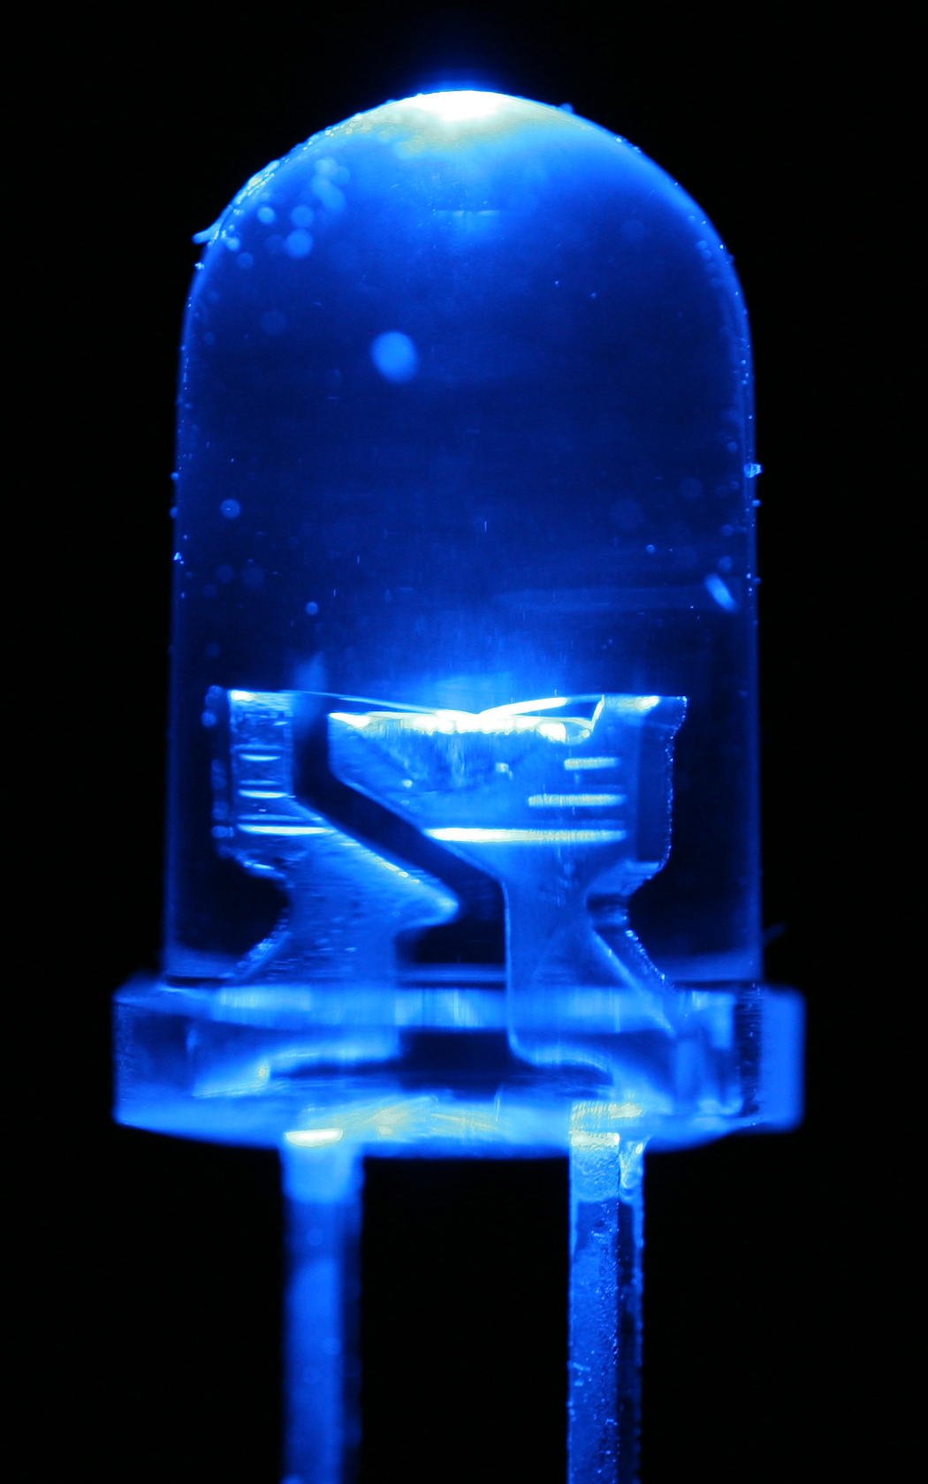
eWSeS
INTRODUCTION
In modern organic chemistry visible-light photocatalysis offers unique opportunities to achieve smooth and clean functionalization of complex molecules and molecular scaffolds by unlocking unexpected reactivities under mild reaction conditions [1].
In recent years selenium-containing compounds are gaining growing interest due to their synthetic versatility and important biological activities [2].
In this contribution, blueLEDs was used to promote a catalyst-free seleno alkoxylation as well as seleno cyclofuncionalization reactions leading to the preparation of Se-containing lactones and cyclic ethers
[1] C. Stephenson, T. Yoon and D. W. C. MacMillan, Visible, Light Photocatalysis in Organic Chemistry, Wiley-VCH, Verlag GmbH & Co. KGaA, Weinheim, Germany, 2018.
[2] E. Lenardao, C. Santi, L. Sancineto New Frontiers in Organoselenium Compounds, Springer Nature, Cham 2018
Sciforum 10-30 november 3020

Slide 3

eWSeS
Seleno hydroxylation
Entry | Solvent | Time (h) | NMR conversion % | A | B
1 | DCM | 9 | 20 | 27 | 73
2 | CH₃CN | 1.5 | 39 | 16 | 84
3* | CH₃CN | 4 | 6 | 25 | 75
4* | THF | 3 | <10 | Traces and undefined product
5* | DCM | 8 | 60 | 20 | 80
_{* Under Argon}
In an attempt to perform the selenoazidation reaction under photocatalytical conditions, the selenylation and concomitant oxygenation of C=C was instead achieved.
In entries 3-5 the reaction was performed under Ar atmosphere to rule out the effect of atmospheric oxigen.
Higher levels of substrate conversion were observed in DCM
Sciforum 10-30 november 3020

Slide 4
eWSeS
Seleno hydroxylation
Entry | Solvent | Time (h) | NMR conversion % | A | B | C
1 | CH₃OH (2mL) | 1.5 | 63 | 13 | 36 | 51
2 | CH₃CN (1.5mL) H₂O (0.5mL) | 1.5 | 61 | 46 | 54 | 0
3 | CH₃CN (1.5mL) H₂O (0.5mL) | 3 | 47 | 71 | 29 | 0
4 | CH₃CN (1.5mL) H₂O (0.5mL) | 3 | 35 | 54 | 46 | 0
In the presence of methanol, as expected, the main product is the one deriving from selenomethoxylation reaction
Sciforum 10-30 november 3020

Slide 5
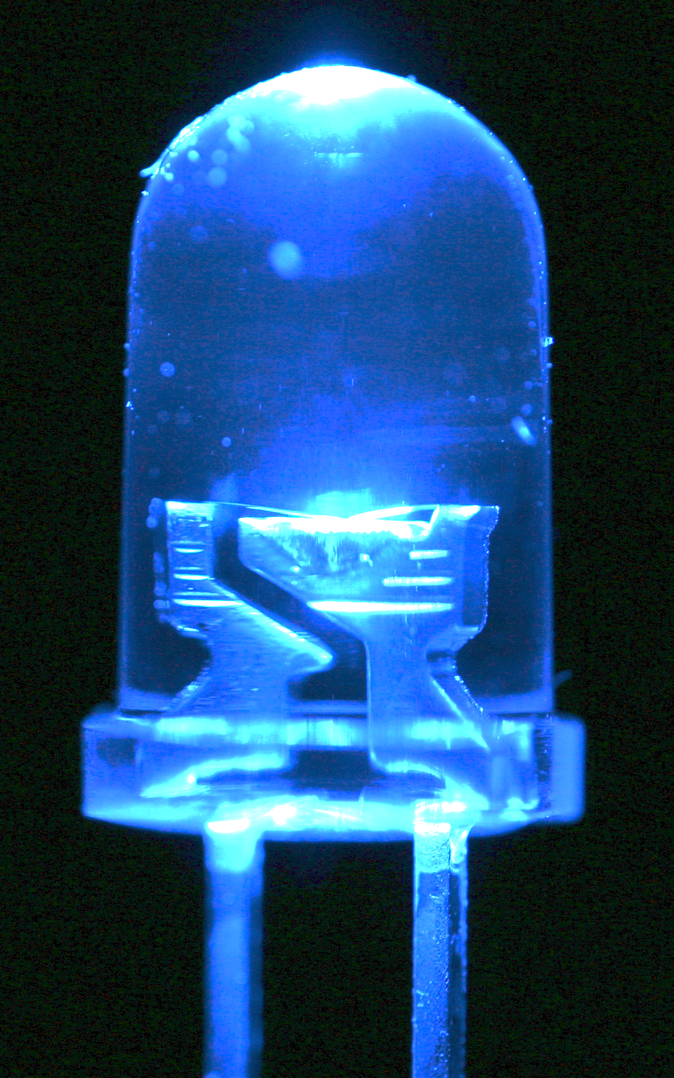
eWSeS
Seleno cyclization of trans-3-hexenoic acid
Entry | Time (h) | Light | NMR conversion % | Yeld %
1 | 5 | blue-light | 23 | 16
2 | 10 | blue-light | 44 | 43
3 | 5 | green-light | 5 | -
4 | 5 | -* | - | -
*the reaction was carried out in absence of light
The reaction works pretty well under BlueLEDs irradiation while the geen light is not powerful enough to activate the reaction
Sciforum 10-30 november 3020

Slide 6
eWSeS
Seleno cyclization of hex-5-en-1-ol
Entry | Time (h) | NMR Conversion (%) | Yeld (%)
1 | 5 | 37 | -
2 | 10 | 75 | 47
After 10 h of reaction time the cyclic compound was obtained with good conversion and moderate isolated yield.
Sciforum 10-30 november 3020

Slide 7
eWSeS
Scope of the Seleno cyclization reaction
The best reaction conditions were applied to a large series of alkenoic acids as well as alkenols. Most of the target compounds were obtaind in good to excellent yields after simple chromatographic purification
Entry | Substrate | Product | NMR conversion (%) | Yeld (%)
1 |  |  | 66 | 61
2 |  |  | 30 | 30
3 |  |  | 78 | 73
4 |  |  | 62 | 30
5 |  |  | 99 | 95
6 |  |  | < 50 | 32
7 |  |  | 81 | 50
CONCLUSIONS
A facile, catalyst-free, photocatalitically activated elechtrophilic selenylation process has been developed. This represents one among the few examples of photocatalysis applied to organoselenium chemistry
Sciforum 10-30 november 3020

