Slide 1
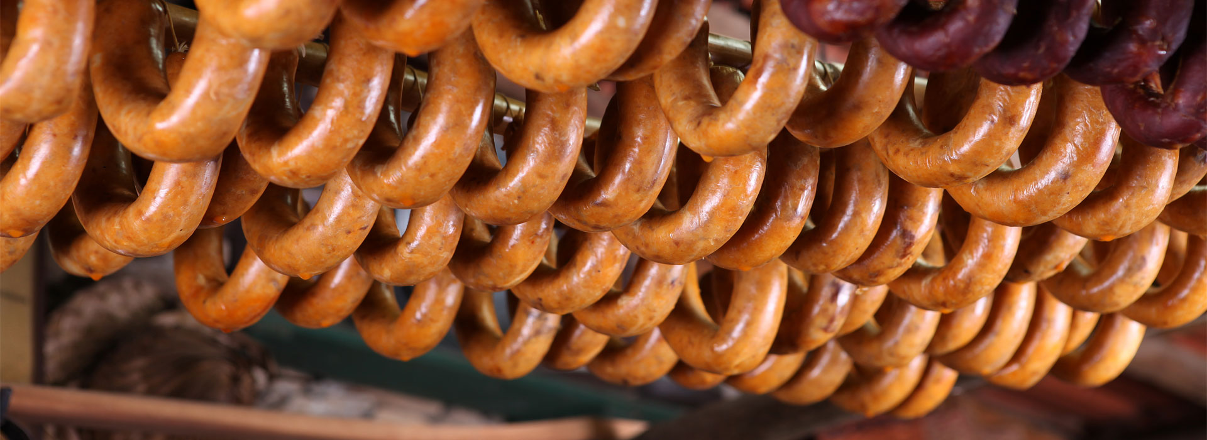
MICROBIOLOGICAL AND PHYSICOCHEMICAL ASSESSMENT OF ARTISANALLY PRODUCED “ALHEIRA” FERMENTED SAUSAGES IN NORTHERN PORTUGAL Sara Coelho-Fernandes, Odete Zefanias, Gisela Rodrigues, Ana Sofia Faria, Ângela Fernandes, Lillian Barros, Vasco Cadavez, Ursula Gonzales-Barron
1st International Electronic Conference on Food Science and Functional Food

Slide 2
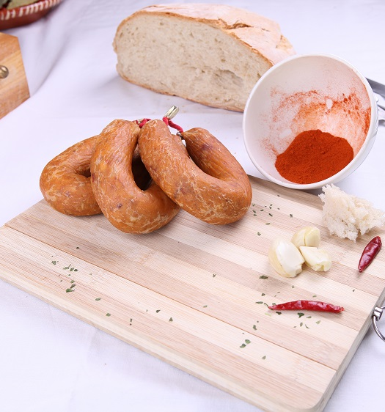
Introduction
Alheira is a traditional non-ready-to-eat sausage produced mainly in Northern Portugal
Traditionally made of a mix of poultry and pork, bread and seasonings
New formulations using game meat, codfish, mushrooms or even vegetarian/vegan options are also available in the market
Figure 1. Ingredients used in alheira formulation

Slide 3
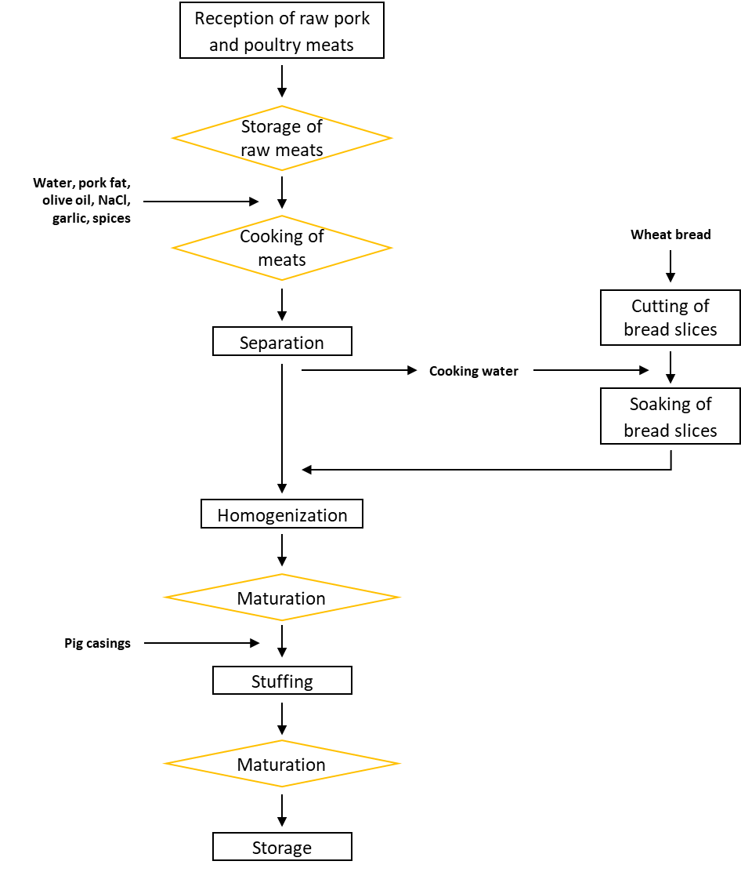
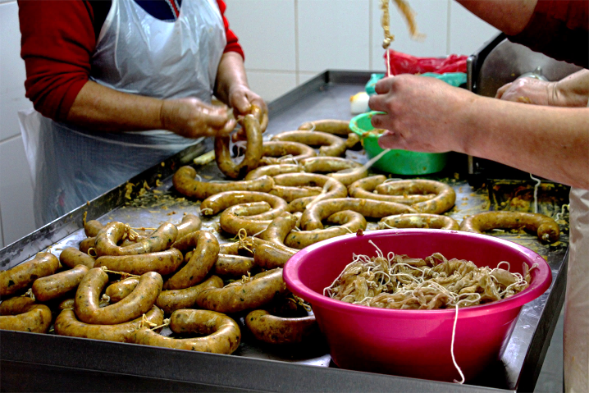
Alheira production
Cooked meats are shredded and mixed with salt, garlic, spices and sliced bread soaked in hot broth to form a non-uniform paste
This paste is stuffed into natural casings, and left to dry and mature at cold temperatures for 7-14 days
Figure 2. Alheira production fluxogram
Figure 3. Alheira stuffing process

Slide 4
Quality of artisanal alheira
Quality characteristics of alheira (physicochemical, nutritional, microbiological and sensorial attributes) are highly variable between regional producers, but also between batches of production of the same enterprise
Different ingredients and their quality
Different or not-sufficiently controlled processing variables and hygiene in the elaboration
Different recipes

Slide 5
Objectives
To evaluate the variability in relevant physicochemical and microbiological attributes of alheira sausages elaborated by representative artisanal producers of Northern Portugal
To understand the associations between these attributes through the derivation of 3D quality maps based on principal component analysis

Slide 6
Materials and methods
40 alheiras
5 alheira sausages from the same production batch
8 different artisanal establishments
Vila Real
Bragança
Chaves
Mirandela
Mogadouro
Miranda do Douro
Valpaços
Trás-os-Montes
Lisbon •
Figure 4. Districts of Portugal. The region of Trás-os-Montes appears in yellow.
Purchased 1-2 days after production and subjected to physicochemical and microbiological analysis within 24 hours after purchase
Casings were carefully removed from the sausages under aseptic conditions, and the contents were divided for physicochemical and microbiological analyses

Slide 7
Materials and methods
Physicochemical analysis
pH
Water activity (a_{w})
Moisture content
Ashes content
Protein content
Microbiological analysis
Total mesophiles
Lactic acid bacteria (LAB in MRS and M17)
Staphylococcus aureus
Presumptive Clostridium perfringens
Presence of Salmonella spp.

Slide 8
Materials and methods
Statistical analysis
Data from the 11 attributes were subjected to a principal component analysis (PCA) to summarize the information provided by the physicochemical and microbiological characteristics as well as their interrelationships
From the 3D-PCA, maps of physicochemical and microbiological quality were built from the projection of sample scores onto the span of the principal components
Scores were clustered by artisanal producer (i.e., location; not disclosed in the present study)

Slide 9
Results and discussion
The physicochemical and microbiological quality of alheira sausages presented considerable variability
Tables 1-2. Producer-specific mean values for physicochemical and microbiological analysis
Physicochemical analysis
pH | 4.034 – 4.606
a_{w} | 0.9758 – 0.9969
Moisture content | 45.39 – 58.36%
Protein content | 17.78 – 28.00% db
Ash content | 2.79 – 4.71% db
Microbiological analysis
Mesophilic counts | 7.161 – 9.679 log CFU/g
LAB counts | 7.704 – 11.00 log CFU/g
S. aureus counts | 1.699 – 6.021 log CFU/g
Presumptive C. perfringens | <0.699 – 1.699 log CFU/g
Salmonella spp. was detected in 4 of the 8 sampled artisanal producers at an incidence of 0.20 (one positive sample out of the five samples tested)

Slide 10
Results and discussion
Three meaningful components were extracted from the PCA, accounting for 63% of data variability
Variable | PC1 | PC2 | PC3 | Communalities
pH | -0.23 | 0.35 | 0.86 | 1.5
a_{w} | 0.24 | -0.84 | 0.17 | 1.2
Moisture | -0.05 | -0.73 | -0.04 | 1.0
Ashes | -0.48 | 0.47 | 0.05 | 2.0
Protein | 0.11 | -0.20 | 0.78 | 1.2
Total mesophiles | 0.85 | -0.14 | -0.26 | 1.2
Staphylococcus aureus | 0.58 | 0.47 | 0.37 | 2.7
Clostridium spp. | 0.25 | 0.70 | 0.11 | 1.3
LAB on MRS | 0.79 | -0.05 | 0.12 | 1.1
LAB on M17 | 0.81 | 0.14 | -0.34 | 1.4
Salmonella spp. | 0.35 | 0.04 | 0.10 | 1.2
Proportion Variance | 0.26 | 0.21 | 0.16 | -
Cumulative Variance | 0.26 | 0.48 | 0.63 | -
Table 3. Coefficients of correlation of the physicochemical and microbiological characteristics with the three Varimax-rotated factors (PC1, PC2, PC3) along with communalities and explained variances

Slide 11
Results and discussion
The first component (PC1) explained 26% of data variability
Highly correlated with LAB (on MRS agar (R=0.79); on M17 agar (R=0.81)) and mesophiles (R=0.85) and more weakly correlated with S. aureus (R=0.58)
PC1 was labelled longer processing duration, as longer fermentation times (or more efficient fermentations) tend to producer greater populations of mesophiles and LAB
If S. aureus contaminates the alheira mixture, its survival depends on an insufficient drop in pH during the first stage of fermentation. It would explain the weaker correlation of S. aureus with PC1, since in some cases this pathogen can either increase or decrease during processing.

Slide 12
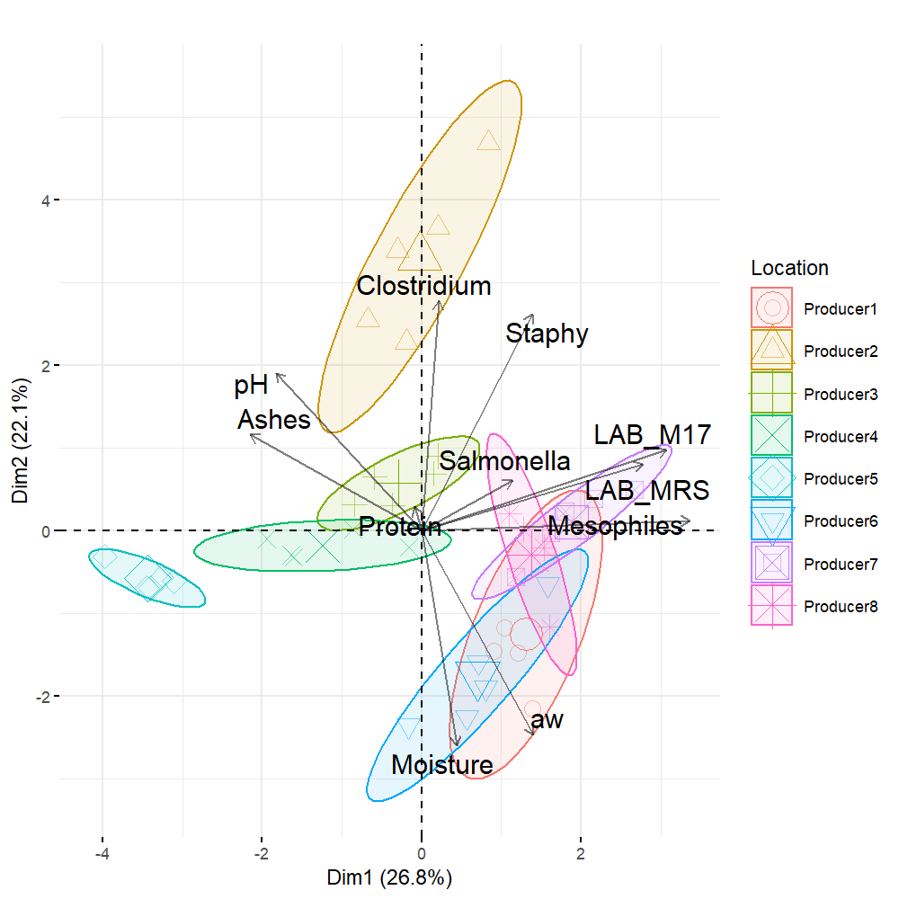
Results and discussion
Producers 1, 6, 7 and 8 seem to employ a longer processing time for the production of alheira sausages, or have a more efficient fermentation process
Producer 5 appears to have the shortest alheira production time, or has delayed fermentation
Figure 5. Map of the first and second principal component of the physicochemical and microbiological characteristics of alheira sausage with projections of samples from eight artisanal producers of Northern Portugal

Slide 13
Results and discussion
PC2 (21% of total variability) was highly and inversely correlated with moisture (R=-0.73) and a_{W} (R=-0.84), and directly correlated with presumptive C. perfringens counts (R=0.70)
The inverse correlations imply that drier alheiras tended to present higher counts of C. perfringens
PC2 was labelled as greater dehydration
Greater dehydration of alheira sausages can arise from longer drying times or higher drying temperatures

Slide 14
Results and discussion
Producers 1, 6 and 8 produced sausages with overall higher moisture content, yet, of variable moisture (i.e., larger ellipses along PC2 axis)
Producers 3, 4 and 5 elaborated drier sausages of more consistent moisture content (i.e., smaller ellipses along PC2)
Producer 2 elaborated the most dehydrated sausages, although their drying process may be not fully controlled (i.e., large ellipse along PC2 axis)
Figure 5. Map of the first and second principal component of the physicochemical and microbiological characteristics of alheira sausage with projections of samples from eight artisanal producers of Northern Portugal

Slide 15
Results and discussion
The third component (PC3) explained 16% of the data variability, and is highly correlated with only two variables, pH (R=0.86) and protein content (R=0.78)
Since in alheiras the main source of protein is the meat, PC3 can be labelled as higher meat proportion in the formulation
The probable tendency of artisanal producers to use pig meat of high pH (i.e., DFD meats) may explain why protein content and pH of alheiras seem so highly associated
Another explanation is that formulations with a lower proportion of meat are compensated with a higher proportion of regional bread, a foodstuff of lower pH. Thus, batters of higher proportion of meat will tend to have higher pH

Slide 16
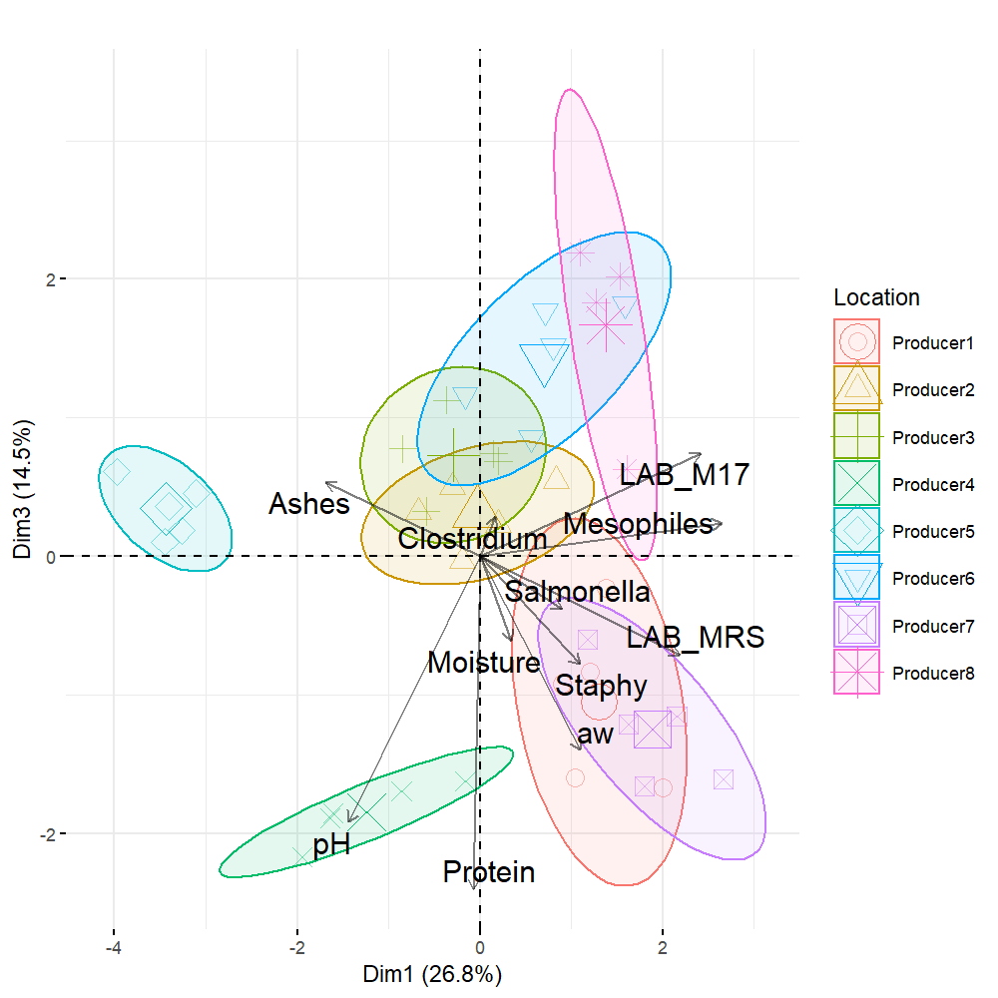
Results and discussion
Producers 1, 4 and 7 employed a higher concentration of meat in their formulations
Figure 6. Map of the first and third principal component of the physicochemical and microbiological characteristics of alheira sausage, with projections of samples from eight artisanal producers of Northern Portugal.

Slide 17
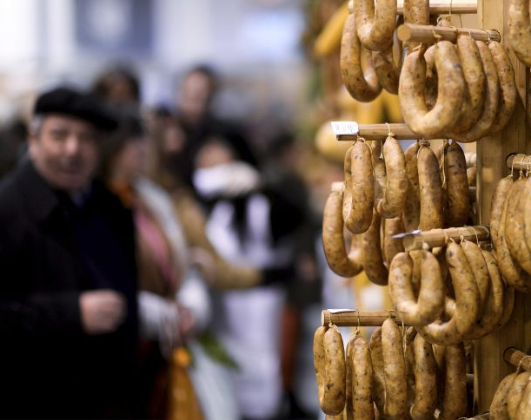
Conclusions
This work identified three quality axes underpinning the variability in artisanal alheiras:
duration of fermentation
extent of dehydration
proportion of meat in formulation
It has also highlighted the need to implement better microbiological control and process standardization during the production of artisanal alheiras

Slide 18
Acknowledgements
The authors are grateful to EU PRIMA programme and the Portuguese Foundation for Science and Technology (FCT) for funding the ArtiSaneFood project (PRIMA/0001/2018). The authors are grateful to FCT and FEDER under Programme PT2020 for financial support to CIMO (UIDB/ 00690/2020). Dr. Gonzales-Barron acknowledges the national funding by FCT, P.I., through the Institutional Scientific Employment Programme contract

Slide 19
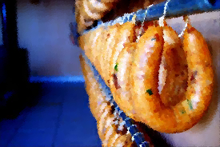
Thank you for your attention!

