Slide 1
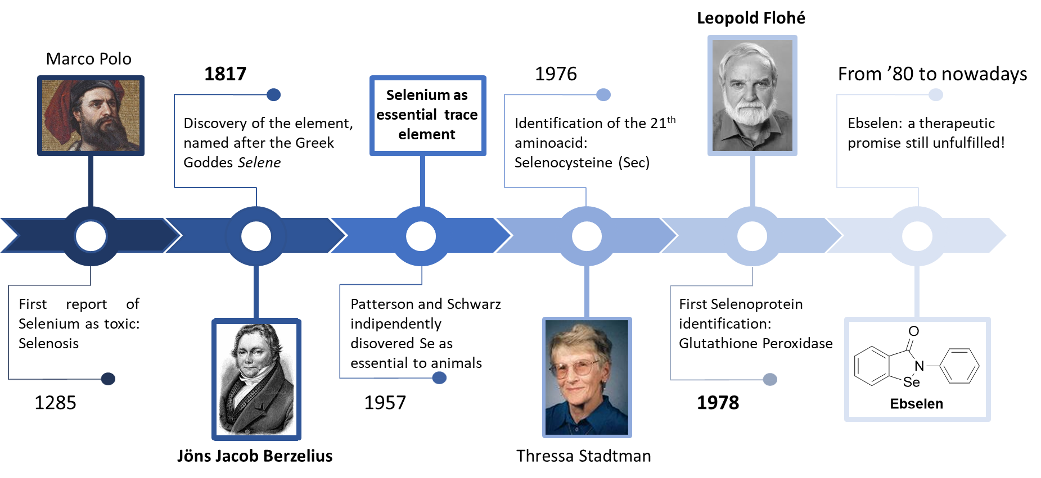
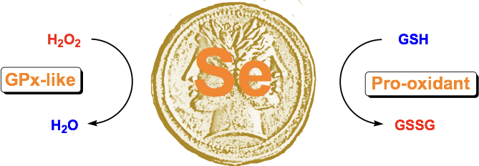
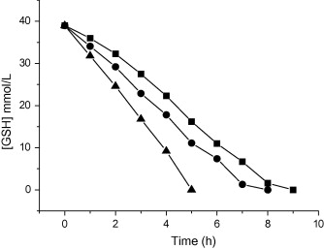
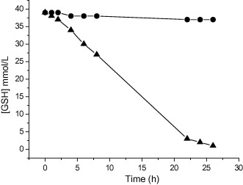
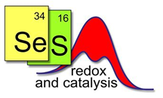
GpX-like catalysis: real opportunity or a chimera?
Claudio Santi *, Francesca Mangiavacchi, Cecilia Scimmi, Lisa Della Rina, Gilda Troci, letizia Crociani, Luca Sancineto
Group of Catalysis Synthesis and Organic Green Chemistry
Dpt Pharmaceutical Sciences University of Perugia Italy – claudio.santi@unipg.it
introduction
the Janus properties of PhSeZnCl
First introduced in 1985 by H. Sies the term “oxidative stress” is nowadays referring to an imbalance between pro-oxidant and anti-oxidant species in favor of the former which lead to the activation of cellular redox signal of defense (eustress) and/or molecular damage (distress). Glutathione Peroxidase (GPx) plays an important role in the cellular defense arsenal against oxidative stress. This enzyme has a key residue of Sec (selenocysteine) in the catalytic active site, containing a selenol group in which the selenium atom acts as a redox center for the cellular redox reactions.
Despite a huge number of paper claimed the GPx mimetic properties of several different small organoselenium derivatives a real therapeutic application was never been reported, and, in several cases, the toxicity was the main issue that determine the fail.
Some years ago we demonstrated that PhSeZnCl acts as catalyst in the reduction of peroxide demonstrating it with the most common texts. Also in this case the toxicity reduced our expectation to use it as an efficient GPx mimetic. We also proved that from a redox point of view it was due to an higher affinity for the reduced glutathione respect to the peroxide improving the prooxidant activity respect the antioxidant one.
● TBHP, H₂O₂,
▪
Free Radical Biol. Med. 2015, 88, 466; Free Radical Biol. Med. 2015, 78, 56; Tethraedron let. 2012, 53, 232.
H₂O₂ and 10% of PhSeZnCl
● without catalyst, stoichiometric amount of PhSeZnCl
a common mistake
77Se-NMR for monitoring the cycle
% of DMSO[O]
DSBA
In a similar study DSBA showed a lower toxicity and for his mild pro-oxidant activity was proposed and demonstrated to be an efficient hormetin. For this reason we started a deep investigation of the intermediated species involved in the reaction of DSBA with hydrogen peroxide and Dithiotreitol (DTTred) as cofactor. Considering the high insolubility of this diselenide in the most common organic solvent, the experiments were carried out in DMSO, commonly used also for many other compounds in biological tests. We discovered that DSBA in the described condition act as catalyst for the oxidation of DMSO affecting dramatically the oxidation rate of DTTred and, consequently the outcome of the test.
We checked also other selenium compounds as catalyst for the same reaction demonstrating that each of them have a different catalytic effect in the formation of the sulfone, This evidence introduce a clear and non predictable bias in all the biological tests involving simultaneously a selenium containing compound, hydrogen peroxide and use DMSO as solvent. These conditions are very common but we are convinced that all the results of antioxidant activity, especially GPx-like activity obtained in this way, have basically no sense and need to be repeated avoiding (if possible) this unpredictable perturbation. This open a renewed interest toward derivatives that are water soluble and can be tested and used avoiding DMSO. For example DSBA was transformed into the corresponding sodium salt and the catalytic cycle was studied by NMR ⁽⁷⁷Se) evidencing the formation of the species depicted in the next slide.
modulating the electron density on selenium
«in Tube» NMR test
10 mmol%
2 mmol%
1 mmol%
In order to improve the reactivity of diselenide toward hydrogen peroxide we synthetized the ortho methoxy derivative of DSBA. In this synthesis diselenide was obtained as minor product, respect to the selenide, and both this compounds were investigated (as sodium salts) by NMR in the conditions of a GPx-like catalytic cycle. Interestingly it was observed that diselenide affords a relatively stable Se-S intermediate that block the cycle reducing the catalytic activity. The oxygen of the methoxy group can form non bonding interaction increasing the electrophilicity of Selenium (in diselenide A) and sulfur (in Se-S adduct B). In this latter case It promote a useless ping-pong reaction interrupting the catalytic cycle.
The superiority of selenide respect diselenide in catalyze the reduction of a peroxide in the presence of a thiol as a cofactor was demonstrated also using the in Tube NMR test with DTT (see next slide). Oxidation of DTT is very fast with selenide and it is also concentration dependent, confirming the role as a catalyst.
Results reported in this poster indicate
10 mmol%
DSBA

