Slide 1


Bio Innovation of a Circular Economy for Plastics
AIMPLAS
H2020-NMBP- BIO-CN-2019
CE-BIOTEC-05-2016-870292 –BIOICEP

Slide 2

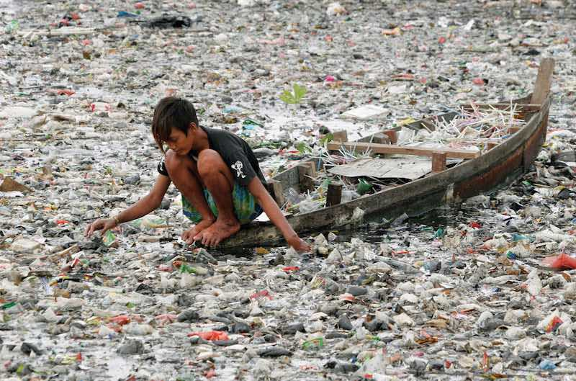
BioICEP Goals
Global production and consumption of plastic has grown exponentially in recent decades.
The accumulation of plastic is causing serious problems in the environment.
Using an innovative ‘triple action process’ the BioICEP team will attempt to accelerate the degradation of traditional plastic and turn it into biopolymers, which can be used as natural biodegradable replacement plastics

Slide 3
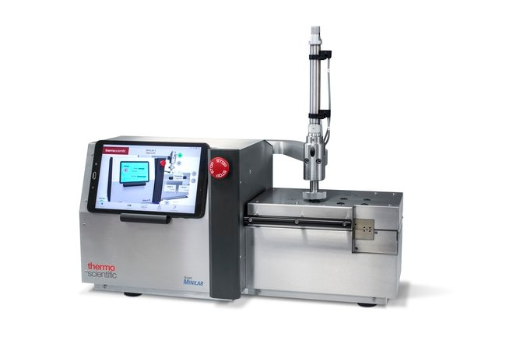
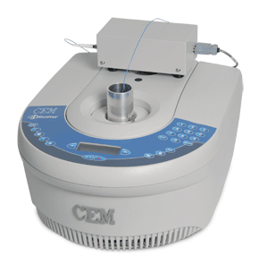
BioICEP Goals
The project’s approach is a triple-action depolymerisation system where the plastic waste will be broken down in three consecutive processes:
Mechano-biochemical disintegration processes, including a new proprietary sonic-green-chemical technology to reduce the polymer molecular weight of the base polymer to make it amenable to biodegradation.

Slide 4
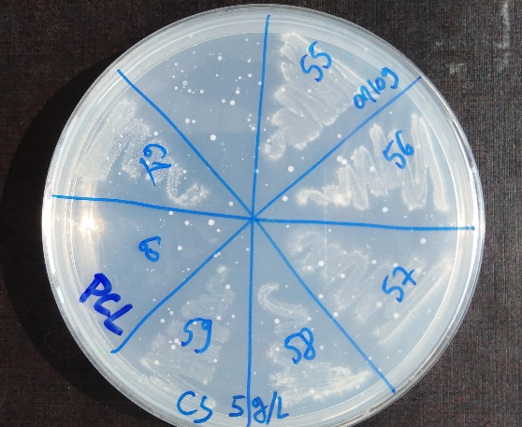
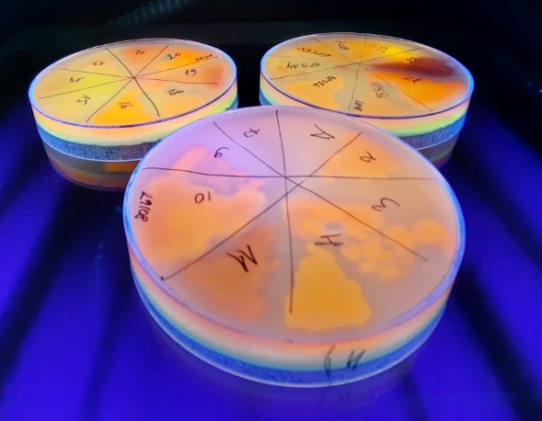
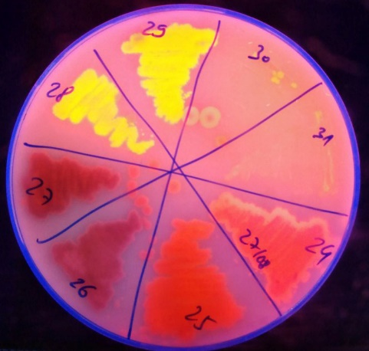
BioICEP Goals
The project’s approach is a triple-action depolymerisation system where the plastic waste will be broken down in three consecutive processes:
Biocatalytic digestion, with enzymes enhanced through a range of innovative techniques including accelerated screening through a novel fluorescent biosensor and directed evolution.

Slide 5
BioICEP Approach
Microbial consortia developed from the best in class single microbial strains, which combined leads to highly efficient degradation of mixed plastic waste streams. The outputs from this degradation process will be used as building blocks for new polymers or other bioproducts to enable a new plastic waste-based circular economy.

Slide 6
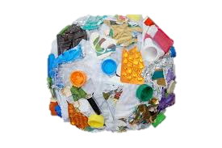
Bio-Motivation: Complete the life-circle for plastics
Accelerate the degradation of mixed waste plastic and valorise it as biopolymers and bioproducts which can be used as natural biodegradable replacement plastics – Plastics 2.0.
Biodegradation
Plastics 2.0
Bioprocessing

Slide 7
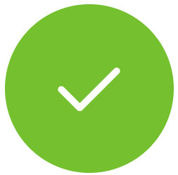
BioICEP Goals
Sustainable degradation of at least 20% of mixed plastics
Accelerate plastic biodegradation: via new microorganism communities expressing novel and improved enzymatic activities enabling the degradation of green pretreated mixtures of plastics
Bioprocessed biopolymers & bioproduct development
Degraded waste plastics molecules and monomers bioconversion into equivalent bioplastics valorising mixed plastic waste
Sustainable prototype system plan, paving the way to bring developed solutions to market, fulfilling current needs, future expectations, and delivering a seamless bio-innovative route for a circular economy for plastics

Slide 8
BioICEP Goals
The €5 million project, which will span four years, commencing in February 2020, is led by Athlone Institute of Technology, a third level institute in the heart of Ireland with a significant expert knowledge base and strong industry connections. AIT plus thirteen other partners from nine different European and Asian countries took part in the BioICEP project

Slide 9
The countries in BioICEP consortium have been selected to represent different mixed plastic pollution environments, with specific partners chosen which have the expertise and facilities to carry out the necessary technical innovations. A number of innovative booster technologies are at the core of this solution accentuating, expediting, and augmenting mixed plastics degradation to levels far in excess of those current achievable.

Slide 10
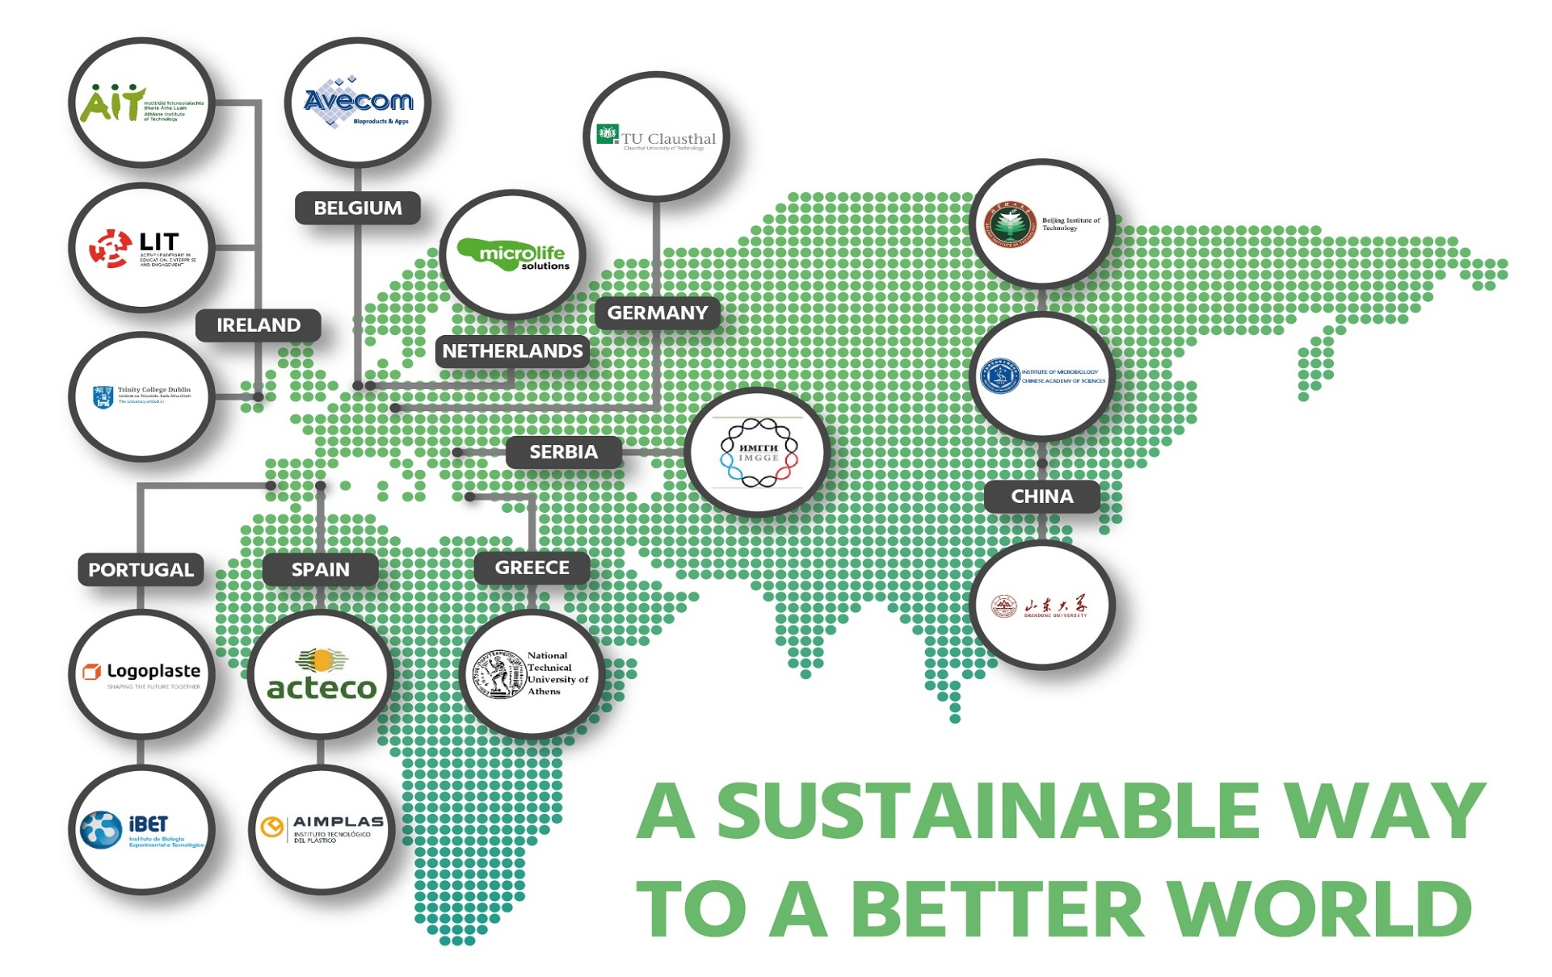

Slide 11
Our consortium brings together leading experts from industry and academia contributing a set of purpose-designed and ground-breaking technologies to achieve the BioICEP objectives:
Plastics Processing
Bioprocessing
Industry Client
Bioprocessing
Microbial Engineering
Pilot Plants
Biocatalysis
Bioplastics

Slide 12
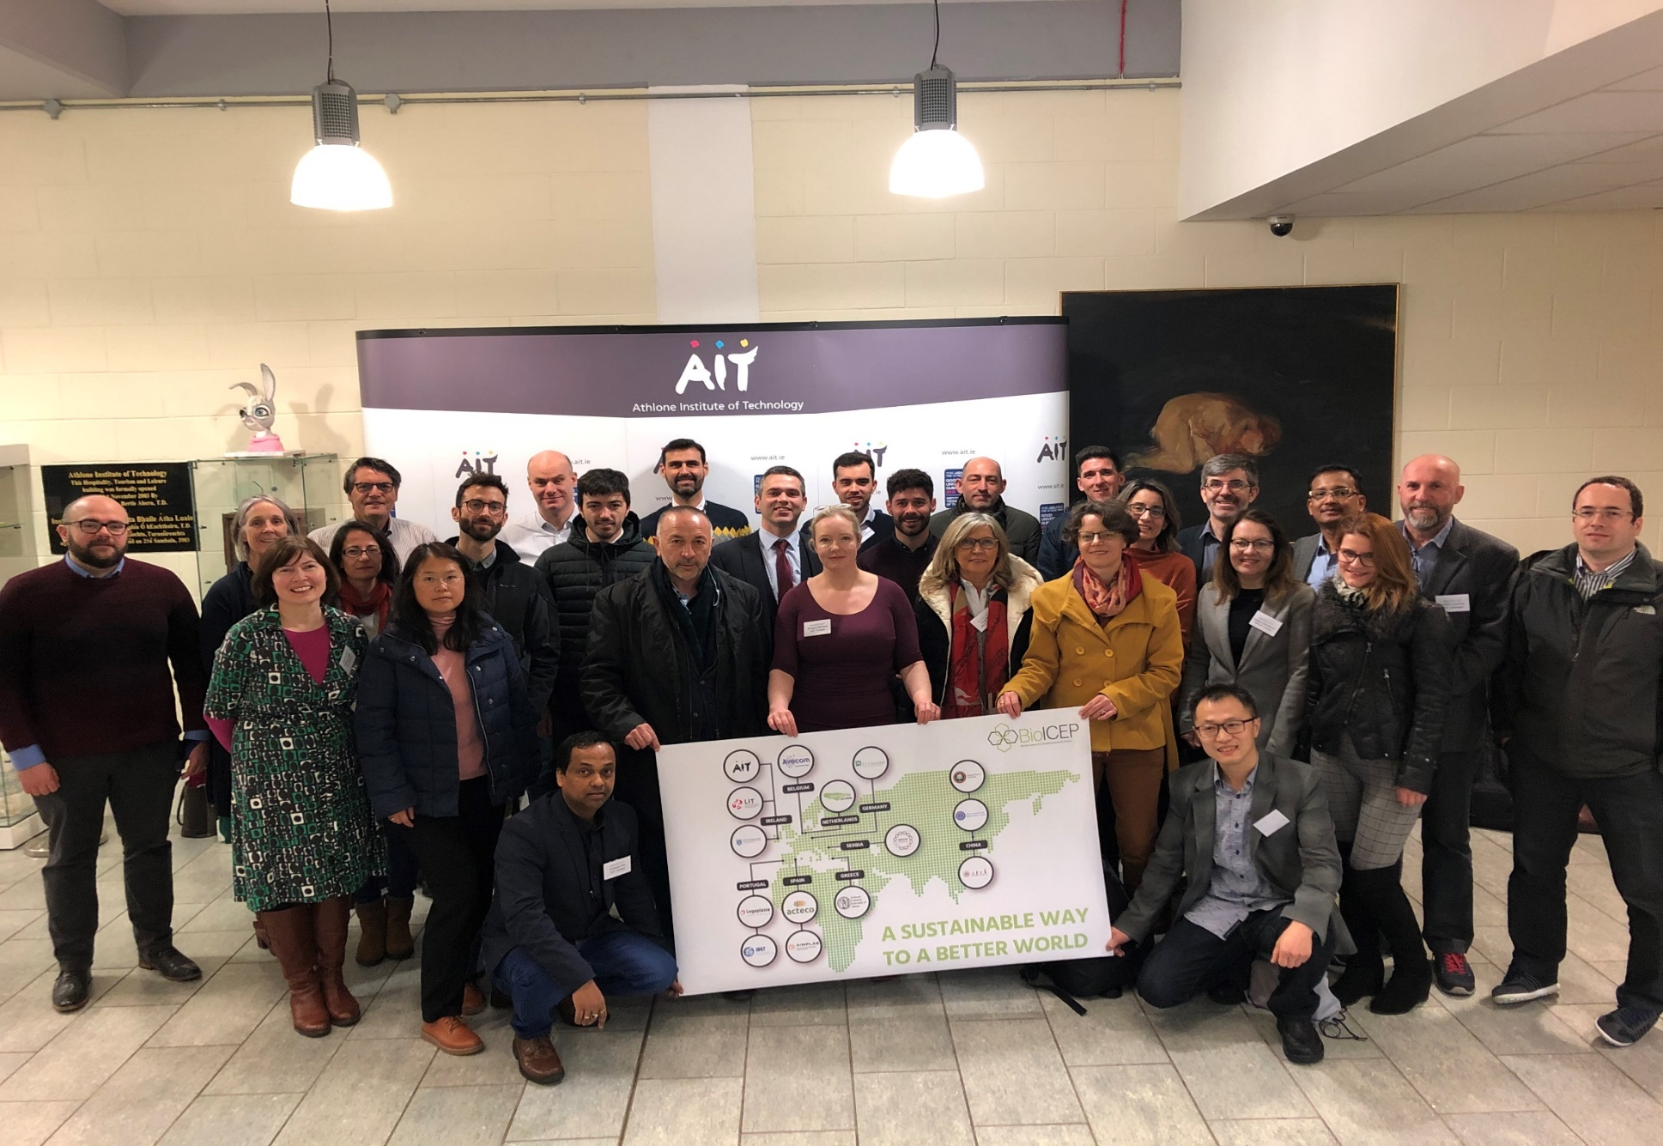

Slide 13
Thank you!
pferrero@aimplas.es
Pablo Ferrero

