Slide 1
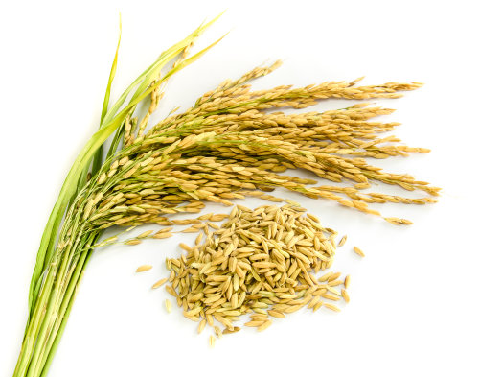
Evaluation of starch hydrolysis for glycemic index prediction of rice varieties
Cristiana Pereira, Regina Menezes, Vanda Lourenço, Teresa Serra, Carla Brites

Slide 2
INTRODUCTION
MATERIAL
METHODS
RESULTS AND DISCUSSION
CONCLUSION

Slide 3
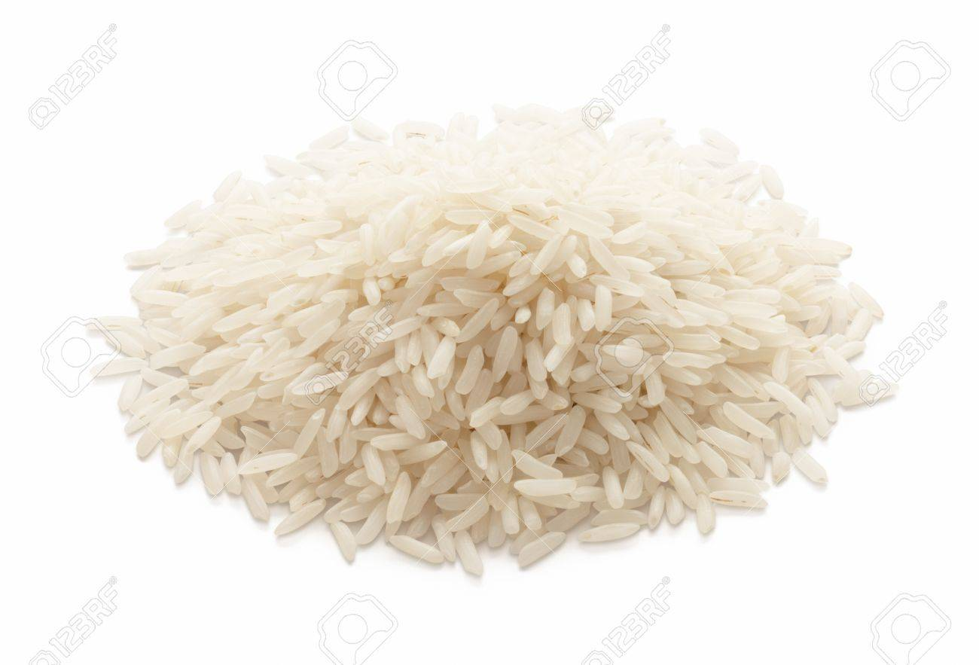
Introduction
Rice, one of the staple foods of the world’s population, is consumed as white cooked polished grain and has been considered a high glycemic index (GI) food.
Objective
Because is a fundamental food in our diet, it will be very important to evaluate its characteristics that can contribute to know the different glycemic responses of several rice types.

Slide 4
Introduction
Starch: amylose and amylopectin content
Gelatinization characteristics
Food processing
Factors that influence glycemic index of rice varieties wich can be precditors of starch digestion
High-amylose rice varieties
Lower viscosity profile
Lower
glycemic values?

Slide 5
Material
Rice Varieties | Type
Ceres | Japonica (Carolino)
Maçarico | Indica (Agulha)
Basmati | Basmati
Waxy | Glutinous
Standards: Corn starch (S 4126, Sigma)
HI-MAIZE resistant starch

Slide 6
Methods
Amylose content
Standard iodine colorimeric method (ISO 6647-2:2015).
Viscosity parameters
Gelatinization and pasting profiles were determined by rapid visco analyzer (RVA) and AACC method 76-21.

Slide 7
Methods
In vitro kinetics of starch digestion
The starch digestibility and estimated GI was measured by Goni et al., (1997) method. The rate of starch digestion was expressed as a % of the total starch hydrolyzed at different times (0, 5, 10, 30, and 60 min). The kinetics of starch digestion was estimated by follow equations:
C = C∞(1 − e ^{−kt})
(2) AUC= = C∞ (t_{f} − t₀) + (e ^{−kt}_{f} − e ^{−kt}₀)]
(3) HI= AUCsample/AUC reference sample
(4) GI= 39.6207 + (0.5498xHI)
C- starch hydrolyzed at time t (%); C∞- equilibrium starch hydrolyzed after 60 min (%);
k - kinetic constant;
HI- hydrolysis index ;
GI- glycemic index;
AUC- area under the hydrolysis curve

Slide 8
Results
In vitro starch hydrolysis rate compared with corn starches and estimated GI
There was a wide variation in the starch hydrolysis curves, with significant differences between the normal (higher hydrolysis rate, GI = 94.6) and the resistant starch corn starches (lower hydrolysis rate, GI = 54.8).

Slide 9
Results
In vitro starch hydrolysis rate compared with corn starches and estimated GI
Samples | Estimated GI (%)
Ceres | 88.49^{b}
Basmati | 86.65^{c}
Maçarico | 83.71^{d}
Waxy | 88.20^{b}
Corn Starch | 54.80e
Resistant starch | 94.60ª
It was possible to establish significantly differences between the different rice types
Ceres has the highest rate of and Maçarico has the lowest of starch hydrolysis
The results obtained show the effectiveness of the method for GI estimation

Slide 10
Results
Variation in GI of rice samples and its relation with amylose content
The 4 rice types differ in amylose content (exception for Basmati and Maçarico varieties).
Basmati (25.4%) and Maçarico (25.0%) with the highest amylose content, also have the lowest GI (86.6 and 83.7 respectively).

Slide 11
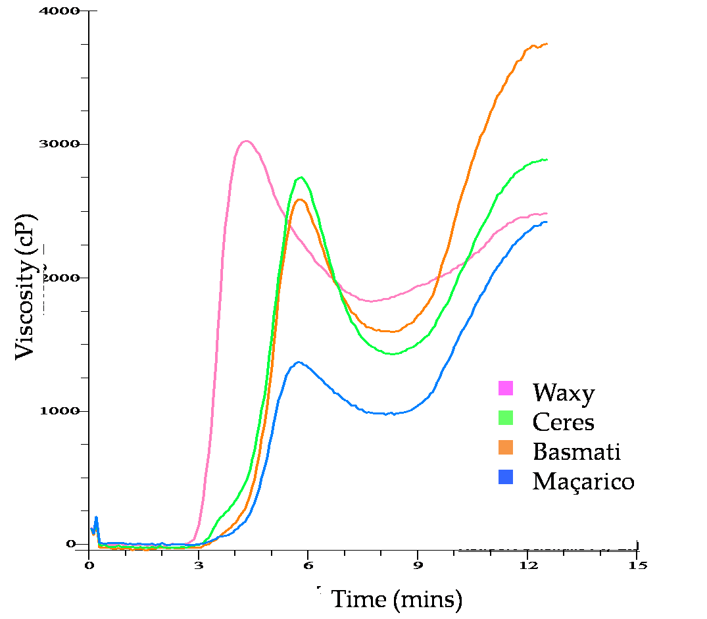
Results
Variation in GI of rice samples and its relation with viscosity profiles
Waxy rice has the maximum peak viscosity and also had a one of the highest GI=88.20
Maçarico shows the lowest viscosity profile and corresponds to the rice variety with the lowest GI=83.71

Slide 12
Results
Variation in GI of rice samples and its relation with viscosity profiles
Types | RVA parameters
 | Peak | Trough | Breakdown | Final Viscosity
Ceres | 2750^{b} | 1428^{c} | 1322ª |  | 2892^{b}
Basmati | 2589^{c} | 1592^{b} | 997^{c} |  | 3755ª
Maçarico | 1368^{d} | 977^{d} | 391^{d} |  | 2422^{d}
Waxy | 3025ª | 1819ª | 1206^{b} |  | 2488^{c}
RVA parameters peak, trough and breakdown have a positive correlation with the GI (0.96, 0.82 and 0.99).

Slide 13
Conclusions
The rice varieties with higher amylose contents and lower pasting profiles exhibit lower GIs compared with the Waxy and intermediate amylose varieties.
The results obtained support the use of the starch hydrolysis method for rice GI estimation.

Slide 14
This research received a financial support of TRACE-RICE -Tracing rice and valorizing side streams along mediterranean blockchain www.trace-rice.eu

