Slide 1




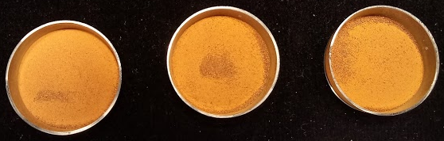
Can minerals be used as a tool to classify cinnamon samples?
1st International Electronic Conference on
Food Science and Functional Foods
Anna Flavia S. Silva^{1,2}; Luís Cláudio Martins^{1,3}; Liz M.B. Moraes¹; Isabela C. Gonçalves^{1,3};
Bianca B.R. de Godoy^{1,3}; Sara W. Erasmus²; Saskia van Ruth²; Fábio Rodrigo P. Rocha¹
¹Center for Nuclear Energy in Agriculture, University of Sao Paulo, Piracicaba, SP
²Food Quality and Design, Wageningen University and Research, Wageningen, The Netherlands
³“Luiz de Queiroz” College of Agriculture, University of Sao Paulo, Piracicaba, SP, Brazil
November, 2020

Slide 2
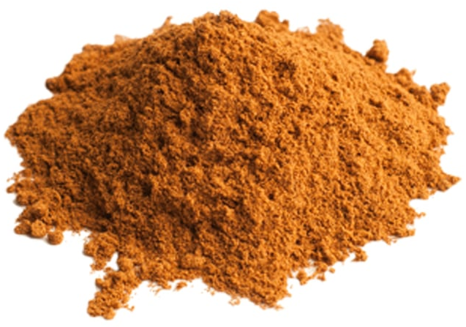
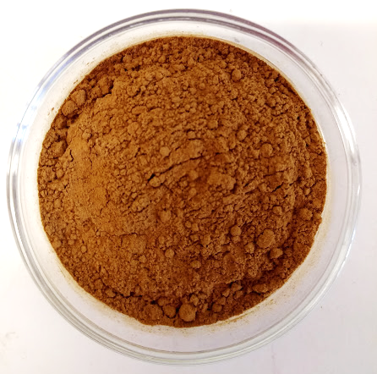
1. Introduction
2. Material and Methods
3. Results and Discussion
4. Conclusions
5. Acknowledgements
Presentation topics

Slide 3
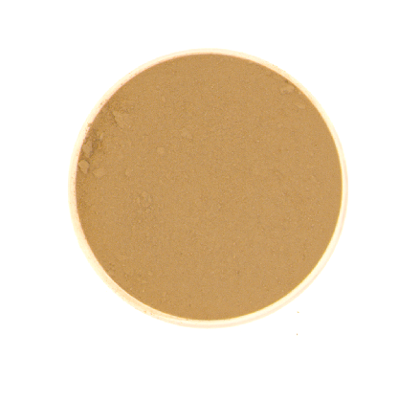
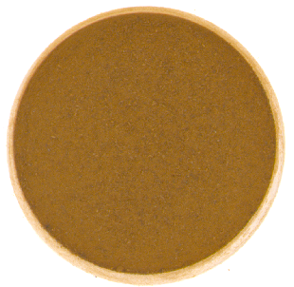
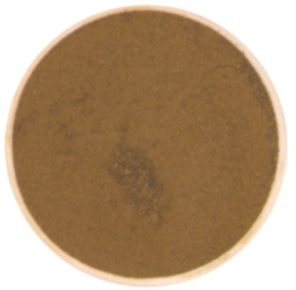
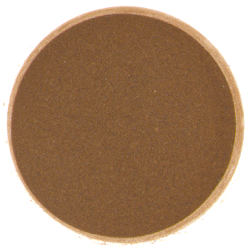
Introduction

Slide 4

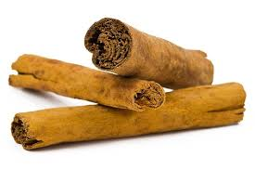
Cinnamomum zeylanicum
Rich in bioactive compounds
Benefits for human health
Uses: food and medicinal purposes
Pictures from Internet

Slide 5
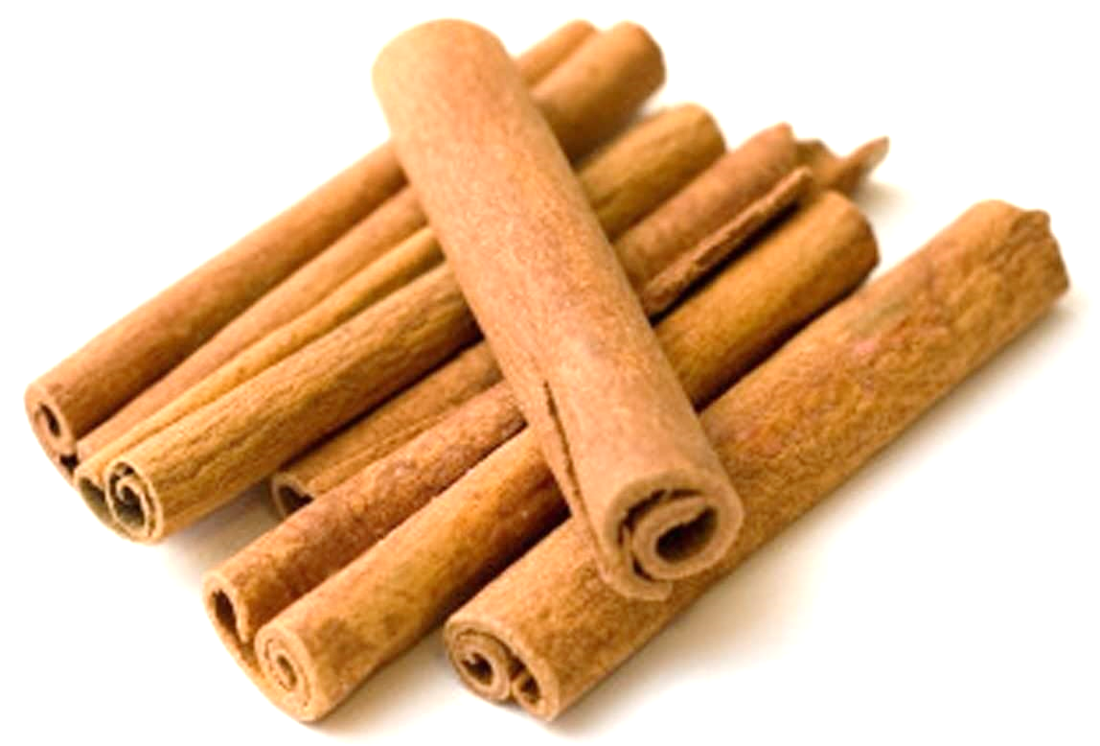
Cinnamomum cassia
Similar composition with
C. zeylanicum
Lower commercial value
Pictures from Internet

Slide 6
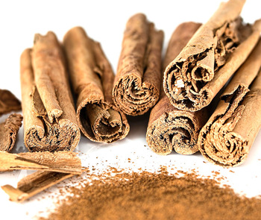

Spices’ vulnerability to food fraud
$ 13.8 billions (2019)
Market growing expectation: 6% (period 2020-2027)
30% of the Market concentrated in Asia
Healthiness, New Ingredients
GRV, 2020; Silvis et al Food Control 2017, 81, 80-87.
Pictures from Internet

Slide 7
Mineral composition as a target marker
Mineral profile can be exploited under terroir and traceability concepts. Some examples are: white tea, Spanish virgin olive oils, and yerba mate.
Other examples are strategies to discriminate authentic and non-authentic foods, considering mineral composition as a target marker. Some examples are: ethnical foods, honey, and organic sugarcane juice.
Kamiloglu. Food Chem. 2019, 277, 12-24; Oliveri; Downey. Trends Anal. Chem. 2012, 35, 74-86; Ye et al. Food Anal. Methods 2017, 10, 191-199; Beltrán et al. Food Chem. 2015, 169, 350-357; Marcelo et al. Microchem. J. 2014, 117, 164-171; Kokhar et al. Food Nutr. Res. 2012, 56(1), 1-8; Chudzinska; Baralkiewicz. Food Chem. Toxicol. 2010, 48, 284-290; Barbosa et al. Food Chem 2015, 184, 154-159.

Slide 8
Objectives
The aim of this work was to evaluate the feasibility of mineral composition as a possible authenticity marker for classifying cinnamon samples commercialized in Brazil. To this aim, 12 elements (P, S, Mg, Ca, K, Cu, Zn, B, Fe, Al, Mn, and Si) were investigated as targets, also considering their importance for human nutrition. The analytical procedure was based on microwave-assisted acid digestion and elemental determination by inductively coupled plasma optical emission spectroscopy (ICP OES). Principal component analysis was exploited for sample classification.

Slide 9
Material and Methods

Slide 10
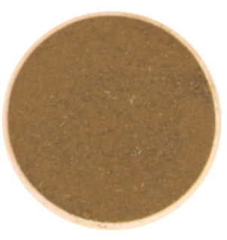
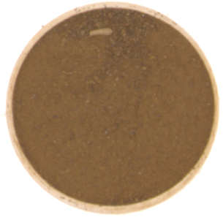
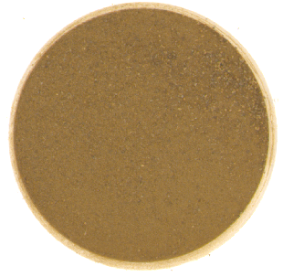
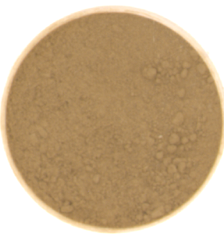
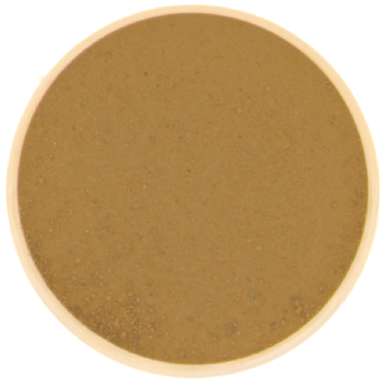
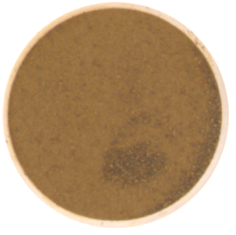
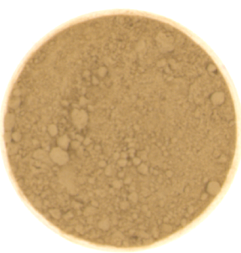
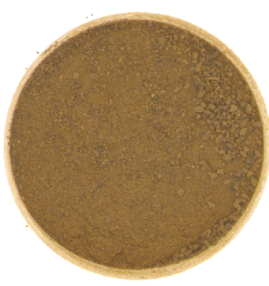
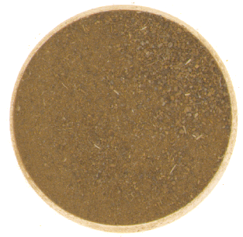
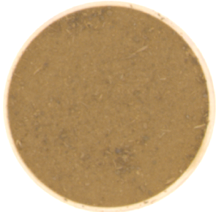

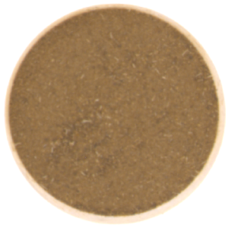
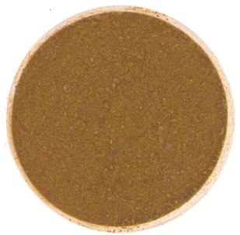
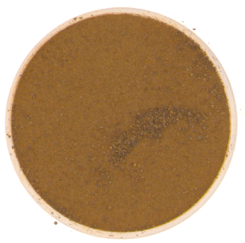
Samples overview
48 samples (conventional supermarket)
8 samples (bulk)
n = 56 of ground samples
4 cities in Sao Paulo region, Brazil
Notes:
Main difference are: in color, particle size, aroma,
distribution of the colors in the samples
Heterogeneity in powder and bark samples*
*Causes for variability:
Plant, geographic region, processing, oxidation, contamination, fraud

Slide 11
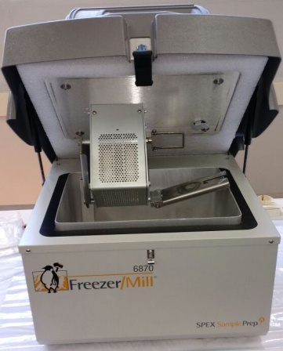
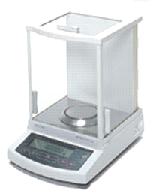
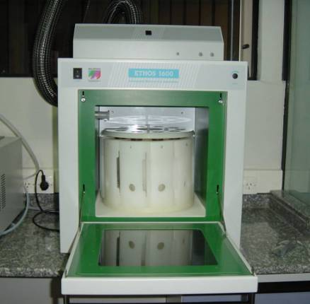
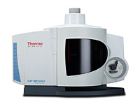
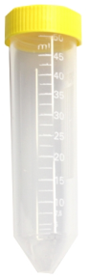
Procedure for mineral determination
Ethos 1600Milestone
Cinnamon sample
Cryogenic grinding
(10 min)
500 mg
(sample)
6,0 mL 2 mol L⁻¹ HNO₃
+
2,0 mL 30% v/v H₂O₂
Sample classification: PCA analysis at 95% of confidence level
(The Unscrambler X, version 10.4, CAMO Software, Norway, 2016)
Mineral
Profile
(Quantification)
Adjust volume
(with water H₂O) to 25 mL
ICAP 7400 Thermo
Digested Sample
Notes:
Main difference are: in color, particle size, aroma,
distribution of the colors in the samples
Heterogeneity in powder and bark samples*
*Causes for variability:
Plant, geographic region, processing, oxidation, contamination, fraud

Slide 12
Results and Discussion

Slide 13
General information about cinnamon samples
A = Contain gluten
B = C. zeylanicum
C = C. zeylanicum
(origin: Sri Lanka)
D = Samples bought in bulk
E = Chinese cinnamon (Cinnamomum cassia)
F = Contain traces of celery, mustard, and/or other spices
Prices varied from
US$ 0.02/g to US$ 0.14/g
Notes:
Main difference are: in color, particle size, aroma,
distribution of the colors in the samples
Heterogeneity in powder and bark samples*
*Causes for variability:
Plant, geographic region, processing, oxidation, contamination, fraud

Slide 14
Mass fractions (mg kg⁻¹) of cinnamon powder samples
Element (spectral line) | Minimum found | Maximum found | NIST 1515 found | NIST 1515 certified values | LOD | LOQ
P (213.618 nm) | 5.19 + 0.08 | 1223 + 22 | 1583 + 2 | 1610 + 20 | 0.03 | 0.08
S (182.034 nm) | 7.59 + 0.06 | 1681 + 16 | 1078 + 6 | N.A. | 0.05 | 0.14
Mg (280.270 nm) | 479 + 2 | 1352 + 17 | 2835 + 8 | 2710 + 80 | 0.06 | 0.18
Ca (422.673 nm) | 5300 + 30 | 13225 + 49 | 13720 + 93 | 15260 + 150 | 0.34 | 1.01
K (766.490 nm) | 3877 + 27 | 7183 + 74 | 14075 + 175 | 16100 + 100 | 0.32 | 0.95
Cu (324.754 nm) | 2.55 + 0.03 | 10.5 + 0.1 | 5.50 + 0.07 | 5.6 + 0.2 | 0.04 | 0.12
Zn (213.856 nm) | 5.4 + 0.1 | 24 + 1 | 12 + 1 | 12.5 + 0.3 | 0.04 | 0.11
B (249.773 nm) | 9.34 + 0.04 | 17 + 1 | 31.50 + 0.06 | 27 + 2 | 0.02 | 0.06
Fe (259.940 nm) | 18.0 + 0.5 | 1994 + 49 | 61.6 + 0.6 | 83 + 5 | 0.01 | 0.04
Al (396.152 nm) | 28.4 + 0.4 | 2142 + 13 | 295.87 + 16.91 | 286 + 9 | 0.10 | 0.30
Mn (257.610 nm) | 137.9 + 0.3 | 367 + 2 | 56.11 + 0.03 | 54 + 3 | 0.0002 | 0.0006
Si (251.611 nm) | 40.4 + 0.9 | 2743 + 52 | 551.24 + 3.48 | N.A. | 0.60 | 1.80
Notes:
Main difference are: in color, particle size, aroma,
distribution of the colors in the samples
Heterogeneity in powder and bark samples*
*Causes for variability:
Plant, geographic region, processing, oxidation, contamination, fraud

Slide 15
PCA analysis: perceptual maps
PC1, PC2, and PC3 are responsible for explaining 93% of the observed variance.
PC1 explains 63% of the observed variance, PC2 21%, and PC3 9% (95% confidence level).
Notes:
Main difference are: in color, particle size, aroma,
distribution of the colors in the samples
Heterogeneity in powder and bark samples*
*Causes for variability:
Plant, geographic region, processing, oxidation, contamination, fraud

Slide 16
PCA analysis: perceptual maps
Groups C. zeylanicum and 100% cinnamon powder highly clustered.
100% cinnamon powder
Cinnamomum zeylanicum
Chinese cinnamon
Cinnamon powder
Ground cinnamon
Not informed
Highly variability in other groups; 4 outliers (circled); only 4 samples of Chinese cinnamon
(C. cassia) were highly clustered.
Notes:
Main difference are: in color, particle size, aroma,
distribution of the colors in the samples
Heterogeneity in powder and bark samples*
*Causes for variability:
Plant, geographic region, processing, oxidation, contamination, fraud

Slide 17
Conclusion
The proposed strategy pioneering indicated the possibility to identify C. zeylanicum in commercial cinnamon powders, using microelements determined by ICP OES as authenticity markers. It also indicated the possibility to distinguish samples from C. cassia and others containing other grains, spices, and gluten, even though more studies are required to establish standard models for the classification of this product.
Notes:
Main difference are: in color, particle size, aroma,
distribution of the colors in the samples
Heterogeneity in powder and bark samples*
*Causes for variability:
Plant, geographic region, processing, oxidation, contamination, fraud

Slide 18
Acknowledgments

Slide 19
Funding
This research was funded by:
* Coordination for the Improvement of Higher Education Personnel (CAPES, financial code 001)
* University of Sao Paulo Program of Internationalization (USP/PrInt) supported by Capes (process number: 88887.371000/2019-00)
* National Council for Scientific and Technological Development (CNPq)
* São Paulo Research Foundation (FAPESP)
* National Institute of Advanced Analytical Sciences and Technologies (INCTAA).
Notes:
Main difference are: in color, particle size, aroma,
distribution of the colors in the samples
Heterogeneity in powder and bark samples*
*Causes for variability:
Plant, geographic region, processing, oxidation, contamination, fraud

Slide 20
Thanks for your attention!
E-mail: anna.flavia.silva@usp.br

