Slide 1
Effects of dietary chia polyphenols on fatty acid profile of eggs in heat-stressed Japanese quails
Agustín Lucini Mas^{1,2}, Rocío Inés Bonansea^{1,2}, Maria Emilia Fernandez^{3,4}, Jackelyn Melissa Kembro^{3,4}, Maria Carla Labaque^{3,4}, Daniel Alberto Wunderlin^{1,2} and María Verónica Baroni^{1,2}*
Córdoba, Argentina
Institute of Food Science and Techology Córdoba (ICYTAC-CONICET).
Organic Chemistry Department, Faculty of Chemical Sciences, National University of Córdoba.
Institute of Food Science and Techology (ICTA). Faculty of Exacts, Physical and Natural Sciences, National University of Córdoba.
Institute of Biological and Technological Investigations (IIByT-CONICET).

Slide 2
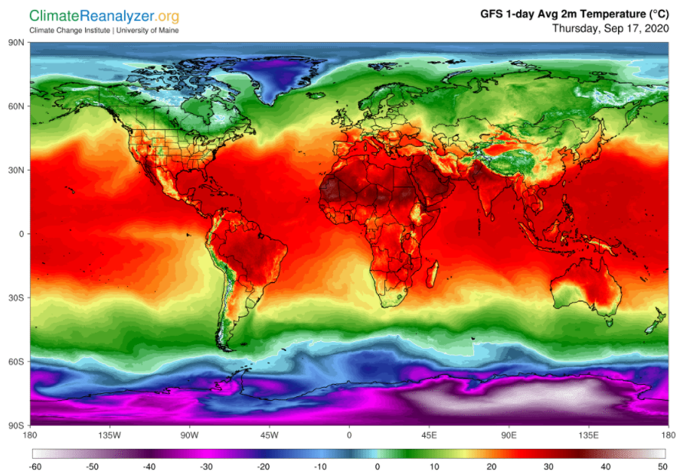
INTRODUCTION
Thermoneutrality
Objective
Study the effects of dietary supplementation with polyphenols from defatted chia seed cake on the fatty acids composition of eggs from Japanese quail exposed to heat stress
Notes:
CONSUMO ARGENTINA (SENASA serv nac sanid calid agroalim)
LUGAR DE PRODUCCIÓN
COND DE TEMP de confort 18-25
TEMP-ESTRÉS-MODIF METABOLISMO-ASIMILACIÓN
CALIDAD DE PRODUCTOS
NECESIDAD DE CONTRARESTAR - ESTRATEGIA

Slide 3
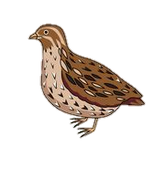
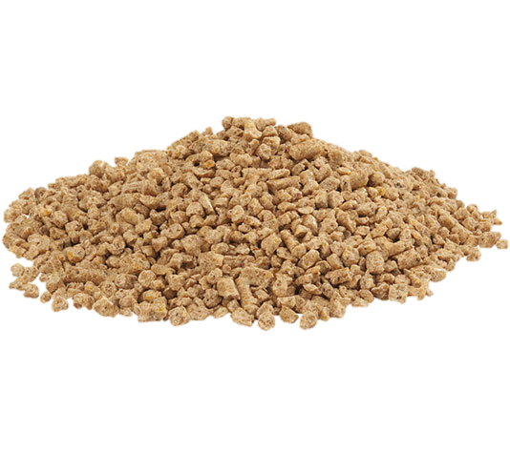
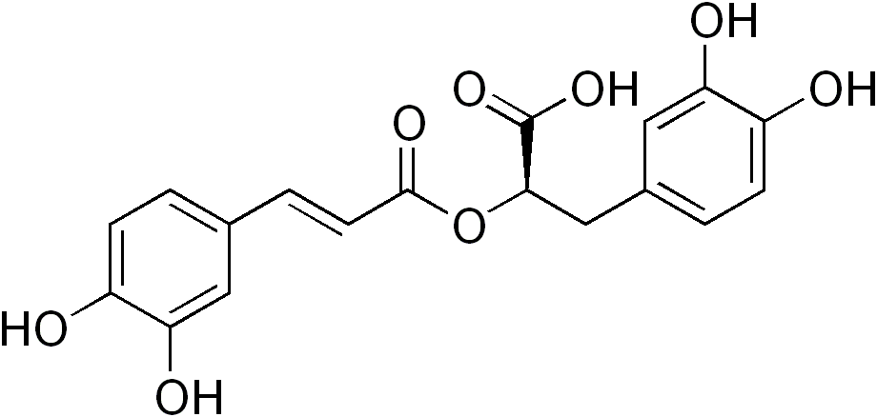
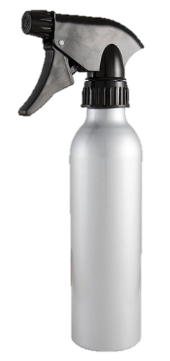
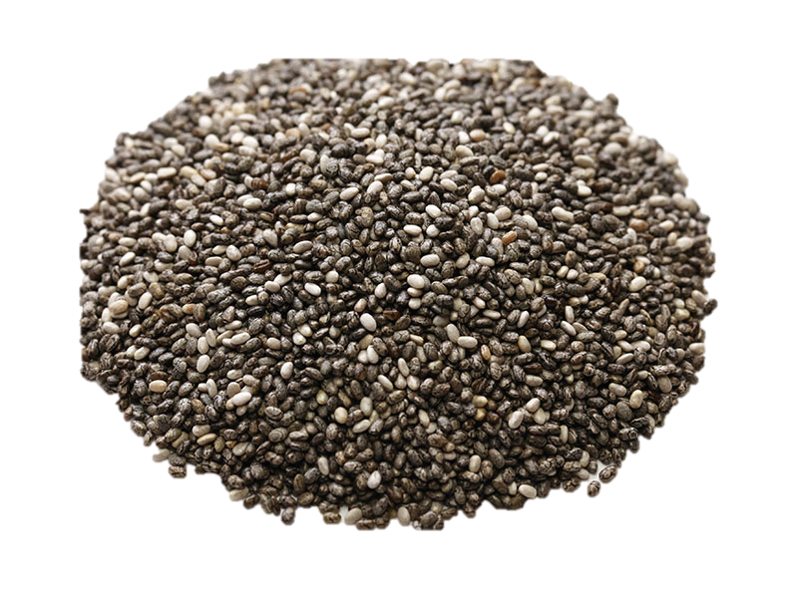
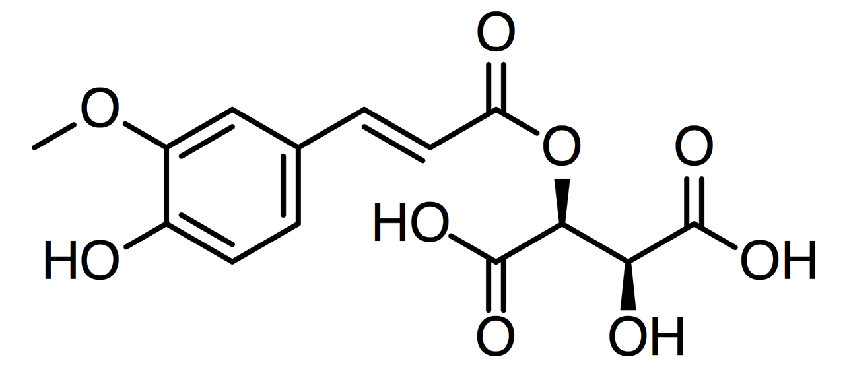
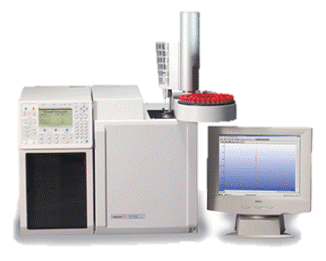
Methods
0 day
23 day
24 °C (NHS-BASAL)
34 °C (HS-BASAL)
standard commercial diet
24 °C
24 °C (NHS-CP500)
Coturnix Japonica
n = 24 females
standard
commercial diet
34 °C (HS-CP500)
500 mg chia polyphenols/Kg diet
Egg Sampling
Yolk lipids extraction with Choloform/Methanol
Fatty acids methyl esters (FAMES)
obtention
FAMES determination
by GC
SFA: Saturated Fatty Acids
MUFA: MonoUnsaturated Fatty Acids
PUFA: PolyUnsaturated Fatty Acids
CholoformMethanol
Methanol
Notes:
CONDICIONES (cant, edad, luz, temperatura, cambio de comida)
GRUPOS – CALOR
MODELO DESARROLLADO POR EL OTRO GRUPO

Slide 4
Results
 | NHS |  | HS
 | BASAL | CP500 | BASAL | CP500
C12:0 | 0.013^{ab} | 0.009^{b} | 0.023ª | 0.017^{ab}
C13:0 | 0.017^{ab} | 0.013^{b} | 0.021^{ab} | 0.014^{b}
C14:0 | 0.326 | 0.317 | 0.385 | 0.373
C15:0 | 0.029 | 0.018 | 0.034 | 0.028
C16:0 | 23.012ª | 20.747^{b} | 23.404ª | 22.207^{ab}
C17:0 | 0.143ª | 0.071^{b} | 0.152ª | 0.110^{ab}
C18:0 | 11.384 | 11.107 | 12.550 | 11.233
C20:0 | 0.013^{b} | 0.017^{b} | 0.035ª | 0.018^{b}
Σ SFA | 34.938ª | 32.297^{b} | 36.603ª | 34.000^{ab}
C14:1 | 0.044 | 0.050 | 0.068 | 0.029
C16:1 | 3.229ª | 3.030^{ab} | 3.009^{ab} | 2.353^{b}
C17:1 | 0.025 | 0.022 | 0.060 | 0.027
C18:1 | 40.898ª | 40.710ª | 37.055^{b} | 38.203^{b}
C20:1 | 0.088 | 0.073 | 0.125 | 0.084
Σ MUFA | 44.284ª | 43.887ª | 40.317^{b} | 40.700^{b}
C18:2 | 17.198^{b} | 18.877^{ab} | 19.062^{ab} | 19.633ª
C18:3 | 0.578^{b} | 0.783^{ab} | 0.826^{ab} | 1.193 ª
C20:4 | 2.685^{b} | 3.460ª | 2.387^{b} | 3.577ª
C20:5 | 0.044^{bc} | 0.067ª | 0.042^{c} | 0.057^{ab}
C22:4 | 0.075^{b} | 0.154^{ab} | 0.176^{ab} | 0.225ª
C22:6 | 0.197^{b} | 0.477ª | 0.588ª | 0.617ª
Σ PUFA | 20.778^{b} | 23.817^{ab} | 23.080^{b} | 25.300ª
a
a
b
b
a
a
ab
b
ab
b
a
b
Results are expressed as mean.
Values without letters did not show significant differences between any treatment.
Values with no letter in common are significantly different (p < 0.05) between different treatments.

Slide 5
Results
 | NHS |  | HS
 | BASAL | CP500 | BASAL | CP500
C12:0 | 0.013^{ab} | 0.009^{b} | 0.023ª | 0.017^{ab}
C13:0 | 0.017^{ab} | 0.013^{b} | 0.021^{ab} | 0.014^{b}
C14:0 | 0.326 | 0.317 | 0.385 | 0.373
C15:0 | 0.029 | 0.018 | 0.034 | 0.028
C16:0 | 23.012ª | 20.747^{b} | 23.404ª | 22.207^{ab}
C17:0 | 0.143ª | 0.071^{b} | 0.152ª | 0.110^{ab}
C18:0 | 11.384 | 11.107 | 12.550 | 11.233
C20:0 | 0.013^{b} | 0.017^{b} | 0.035ª | 0.018^{b}
Σ SFA | 34.938ª | 32.297^{b} | 36.603ª | 34.000^{ab}
C14:1 | 0.044 | 0.050 | 0.068 | 0.029
C16:1 | 3.229ª | 3.030^{ab} | 3.009^{ab} | 2.353^{b}
C17:1 | 0.025 | 0.022 | 0.060 | 0.027
C18:1 | 40.898ª | 40.710ª | 37.055^{b} | 38.203^{b}
C20:1 | 0.088 | 0.073 | 0.125 | 0.084
Σ MUFA | 44.284ª | 43.887ª | 40.317^{b} | 40.700^{b}
C18:2 | 17.198^{b} | 18.877^{ab} | 19.062^{ab} | 19.633ª
C18:3 | 0.578^{b} | 0.783^{ab} | 0.826^{ab} | 1.193 ª
C20:4 | 2.685^{b} | 3.460ª | 2.387^{b} | 3.577ª
C20:5 | 0.044^{bc} | 0.067ª | 0.042^{c} | 0.057^{ab}
C22:4 | 0.075^{b} | 0.154^{ab} | 0.176^{ab} | 0.225ª
C22:6 | 0.197^{b} | 0.477ª | 0.588ª | 0.617ª
Σ PUFA | 20.778^{b} | 23.817^{ab} | 23.080^{b} | 25.300ª
a
a
b
b
a
a
ab
b
ab
b
a
b
Results are expressed as mean.
Values without letters did not show significant differences between any treatment.
Values with no letter in common are significantly different (p < 0.05) between different treatments.

Slide 6
Results
 | NHS |  | HS
 | BASAL | CP500 | BASAL | CP500
C12:0 | 0.013^{ab} | 0.009^{b} | 0.023ª | 0.017^{ab}
C13:0 | 0.017^{ab} | 0.013^{b} | 0.021^{ab} | 0.014^{b}
C14:0 | 0.326 | 0.317 | 0.385 | 0.373
C15:0 | 0.029 | 0.018 | 0.034 | 0.028
C16:0 | 23.012ª | 20.747^{b} | 23.404ª | 22.207^{ab}
C17:0 | 0.143ª | 0.071^{b} | 0.152ª | 0.110^{ab}
C18:0 | 11.384 | 11.107 | 12.550 | 11.233
C20:0 | 0.013^{b} | 0.017^{b} | 0.035ª | 0.018^{b}
Σ SFA | 34.938ª | 32.297^{b} | 36.603ª | 34.000^{ab}
C14:1 | 0.044 | 0.050 | 0.068 | 0.029
C16:1 | 3.229ª | 3.030^{ab} | 3.009^{ab} | 2.353^{b}
C17:1 | 0.025 | 0.022 | 0.060 | 0.027
C18:1 | 40.898ª | 40.710ª | 37.055^{b} | 38.203^{b}
C20:1 | 0.088 | 0.073 | 0.125 | 0.084
Σ MUFA | 44.284ª | 43.887ª | 40.317^{b} | 40.700^{b}
C18:2 | 17.198^{b} | 18.877^{ab} | 19.062^{ab} | 19.633ª
C18:3 | 0.578^{b} | 0.783^{ab} | 0.826^{ab} | 1.193 ª
C20:4 | 2.685^{b} | 3.460ª | 2.387^{b} | 3.577ª
C20:5 | 0.044^{bc} | 0.067ª | 0.042^{c} | 0.057^{ab}
C22:4 | 0.075^{b} | 0.154^{ab} | 0.176^{ab} | 0.225ª
C22:6 | 0.197^{b} | 0.477ª | 0.588ª | 0.617ª
Σ PUFA | 20.778^{b} | 23.817^{ab} | 23.080^{b} | 25.300ª
a
a
b
b
a
a
ab
b
ab
b
a
b
Results are expressed as mean.
Values without letters did not show significant differences between any treatment.
Values with no letter in common are significantly different (p < 0.05) between different treatments.

Slide 7
Results
 | NHS |  | HS
 | BASAL | CP500 | BASAL | CP500
C12:0 | 0.013^{ab} | 0.009^{b} | 0.023ª | 0.017^{ab}
C13:0 | 0.017^{ab} | 0.013^{b} | 0.021^{ab} | 0.014^{b}
C14:0 | 0.326 | 0.317 | 0.385 | 0.373
C15:0 | 0.029 | 0.018 | 0.034 | 0.028
C16:0 | 23.012ª | 20.747^{b} | 23.404ª | 22.207^{ab}
C17:0 | 0.143ª | 0.071^{b} | 0.152ª | 0.110^{ab}
C18:0 | 11.384 | 11.107 | 12.550 | 11.233
C20:0 | 0.013^{b} | 0.017^{b} | 0.035ª | 0.018^{b}
Σ SFA | 34.938ª | 32.297^{b} | 36.603ª | 34.000^{ab}
C14:1 | 0.044 | 0.050 | 0.068 | 0.029
C16:1 | 3.229ª | 3.030^{ab} | 3.009^{ab} | 2.353^{b}
C17:1 | 0.025 | 0.022 | 0.060 | 0.027
C18:1 | 40.898ª | 40.710ª | 37.055^{b} | 38.203^{b}
C20:1 | 0.088 | 0.073 | 0.125 | 0.084
Σ MUFA | 44.284ª | 43.887ª | 40.317^{b} | 40.700^{b}
C18:2 | 17.198^{b} | 18.877^{ab} | 19.062^{ab} | 19.633ª
C18:3 | 0.578^{b} | 0.783^{ab} | 0.826^{ab} | 1.193 ª
C20:4 | 2.685^{b} | 3.460ª | 2.387^{b} | 3.577ª
C20:5 | 0.044^{bc} | 0.067ª | 0.042^{c} | 0.057^{ab}
C22:4 | 0.075^{b} | 0.154^{ab} | 0.176^{ab} | 0.225ª
C22:6 | 0.197^{b} | 0.477ª | 0.588ª | 0.617ª
Σ PUFA | 20.778^{b} | 23.817^{ab} | 23.080^{b} | 25.300ª
a
a
b
b
a
a
ab
b
ab
b
a
b
Results are expressed as mean.
Values without letters did not show significant differences between any treatment.
Values with no letter in common are significantly different (p < 0.05) between different treatments.

Slide 8
Results
 | NHS |  | HS
 | BASAL | CP500 | BASAL | CP500
C12:0 | 0.013^{ab} | 0.009^{b} | 0.023ª | 0.017^{ab}
C13:0 | 0.017^{ab} | 0.013^{b} | 0.021^{ab} | 0.014^{b}
C14:0 | 0.326 | 0.317 | 0.385 | 0.373
C15:0 | 0.029 | 0.018 | 0.034 | 0.028
C16:0 | 23.012ª | 20.747^{b} | 23.404ª | 22.207^{ab}
C17:0 | 0.143ª | 0.071^{b} | 0.152ª | 0.110^{ab}
C18:0 | 11.384 | 11.107 | 12.550 | 11.233
C20:0 | 0.013^{b} | 0.017^{b} | 0.035ª | 0.018^{b}
Σ SFA | 34.938ª | 32.297^{b} | 36.603ª | 34.000^{ab}
C14:1 | 0.044 | 0.050 | 0.068 | 0.029
C16:1 | 3.229ª | 3.030^{ab} | 3.009^{ab} | 2.353^{b}
C17:1 | 0.025 | 0.022 | 0.060 | 0.027
C18:1 | 40.898ª | 40.710ª | 37.055^{b} | 38.203^{b}
C20:1 | 0.088 | 0.073 | 0.125 | 0.084
Σ MUFA | 44.284ª | 43.887ª | 40.317^{b} | 40.700^{b}
C18:2 | 17.198^{b} | 18.877^{ab} | 19.062^{ab} | 19.633ª
C18:3 | 0.578^{b} | 0.783^{ab} | 0.826^{ab} | 1.193 ª
C20:4 | 2.685^{b} | 3.460ª | 2.387^{b} | 3.577ª
C20:5 | 0.044^{bc} | 0.067ª | 0.042^{c} | 0.057^{ab}
C22:4 | 0.075^{b} | 0.154^{ab} | 0.176^{ab} | 0.225ª
C22:6 | 0.197^{b} | 0.477ª | 0.588ª | 0.617ª
Σ PUFA | 20.778^{b} | 23.817^{ab} | 23.080^{b} | 25.300ª
a
a
b
b
a
a
ab
b
ab
b
a
b
Results are expressed as mean.
Values without letters did not show significant differences between any treatment.
Values with no letter in common are significantly different (p < 0.05) between different treatments.

Slide 9
Results
 | NHS |  | HS
 | BASAL | CP500 | BASAL | CP500
C12:0 | 0.013^{ab} | 0.009^{b} | 0.023ª | 0.017^{ab}
C13:0 | 0.017^{ab} | 0.013^{b} | 0.021^{ab} | 0.014^{b}
C14:0 | 0.326 | 0.317 | 0.385 | 0.373
C15:0 | 0.029 | 0.018 | 0.034 | 0.028
C16:0 | 23.012ª | 20.747^{b} | 23.404ª | 22.207^{ab}
C17:0 | 0.143ª | 0.071^{b} | 0.152ª | 0.110^{ab}
C18:0 | 11.384 | 11.107 | 12.550 | 11.233
C20:0 | 0.013^{b} | 0.017^{b} | 0.035ª | 0.018^{b}
Σ SFA | 34.938ª | 32.297^{b} | 36.603ª | 34.000^{ab}
C14:1 | 0.044 | 0.050 | 0.068 | 0.029
C16:1 | 3.229ª | 3.030^{ab} | 3.009^{ab} | 2.353^{b}
C17:1 | 0.025 | 0.022 | 0.060 | 0.027
C18:1 | 40.898ª | 40.710ª | 37.055^{b} | 38.203^{b}
C20:1 | 0.088 | 0.073 | 0.125 | 0.084
Σ MUFA | 44.284ª | 43.887ª | 40.317^{b} | 40.700^{b}
C18:2 | 17.198^{b} | 18.877^{ab} | 19.062^{ab} | 19.633ª
C18:3 | 0.578^{b} | 0.783^{ab} | 0.826^{ab} | 1.193 ª
C20:4 | 2.685^{b} | 3.460ª | 2.387^{b} | 3.577ª
C20:5 | 0.044^{bc} | 0.067ª | 0.042^{c} | 0.057^{ab}
C22:4 | 0.075^{b} | 0.154^{ab} | 0.176^{ab} | 0.225ª
C22:6 | 0.197^{b} | 0.477ª | 0.588ª | 0.617ª
Σ PUFA | 20.778^{b} | 23.817^{ab} | 23.080^{b} | 25.300ª
a
a
b
b
a
a
ab
b
ab
b
a
b
Results are expressed as mean.
Values without letters did not show significant differences between any treatment.
Values with no letter in common are significantly different (p < 0.05) between different treatments.

Slide 10
Conclusions
The use of defatted chia seed cake seems to be a promising sustainable strategy to improve the nutritional quality of eggs in heat-stress conditions, while decreases the amount of wastes from food industry.
SFA
PUFA
References
1. Abd El-Hack, M.E., Alagawany, M., Mahorese, K.M., Arif, M., Saeed, M., Arain, M.A., Soomro, R.N., Siyal, F.A., Fazlani, S.A., Fowler, J. Productive performance, egg quality, hematological parameters and serum chemistry of laying hens fed diets supplemented withh certain fat-soluble vitamins, individually or combined, during summer season. Anim. Nutr. 2019, 5, 49–55.
2. Marchiori, M.S., Oliveira, R.C., Souza, C.F., Baldissera, M.D., Ribeiro, Q.M., Wagner, R., Gündel, S.S., Ourique, A.F., Kirinus, J.K., Stefani, L.M., Boiago, M.M., da Silva, A.S. Curcumin in the diet of quail in cold stress improves performance and egg quality. Anim. Feed Sci. Technol. 2019, 254, 114192.
3. Nazar, F.N., Videla, E.A., Marin, R.H. Thymol supplementation effects on adrenocortical, immune and biochemical variables recovery in Japanese quail after exposure to chronic heat stress. Animal 2019, 13, 318–325.
4. Fernández, M.E., Marin, R.H., Luna, A., Zunino, M.P., Labaque, M.C. Thymol feed supplementation in quail alters the percentages of nutritionally relevant egg yolk fatty acids: effects throughout incubation. J. Sci. Food Agric. 2017, 97, 5233–5240.

