Slide 1



Preliminary discrimination of commercial extra virgin olive oils from Brazil by geographical origin and olives’ cultivar: A call for broader investigations
Aline Gabrielle Alves de Carvalho ¹, Lucía Olmo-García ², Bruna Rachel Antunes Gaspar ¹, Alegría Carrasco-Pancorbo ², Vanessa Naciuk Castelo-Branco ^{3,} and Alexandre Guedes Torres ¹
¹ Laboratory of Nutritional Biochemistry and Food Science, Lipid Biochemistry and Lipidomics Laboratory, Institute of Chemistry, Federal University of Rio de Janeiro, Rio de Janeiro 21941-902, Brazil;
² Department of Analytical Chemistry, Faculty of Sciences, University of Granada, Ave. Fuentenueva s/n, E-18071 Granada, Spain;
³ Laboratory of Food Biotechnology, Fluminense Federal University, Niteroi 24230-340, RJ, Brazil;
November 2020

Slide 2
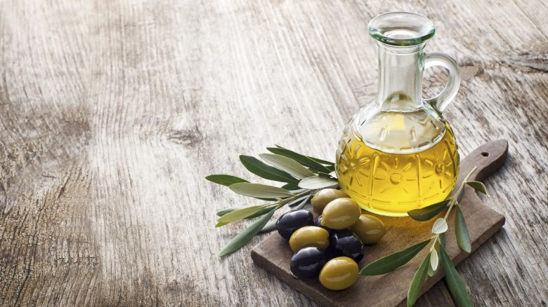
Introduction

Slide 3
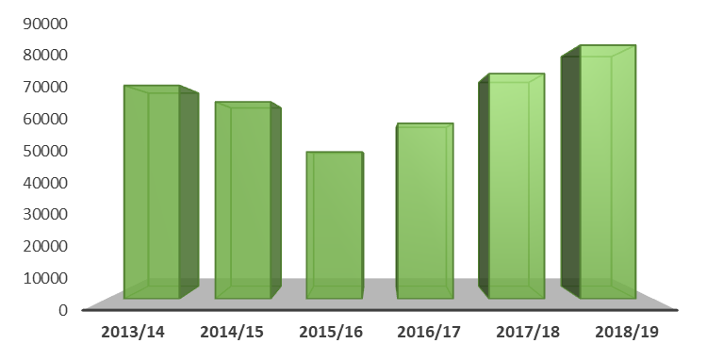
Brazilian EVOO Market, Occurrence, and Production
Olive oil imports by Brazil (t)
IOC, 2020

Slide 4
Brazilian EVOO Market, Occurrence, and Production
More than 86,000 tons of olive oil
Olive oil imports by Brazil (t)
IOC, 2020

Slide 5
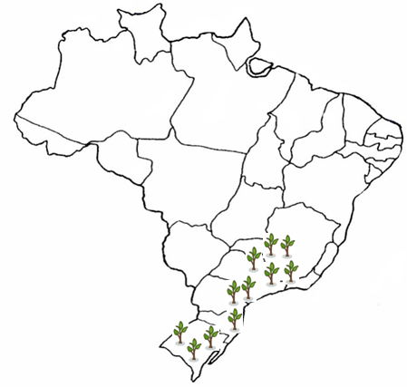
Brazilian EVOO Market, Occurrence, and Production

Slide 6

Brazilian EVOO Market, Occurrence, and Production
Mantiqueira mountain range (MG) Since 2008

Slide 7
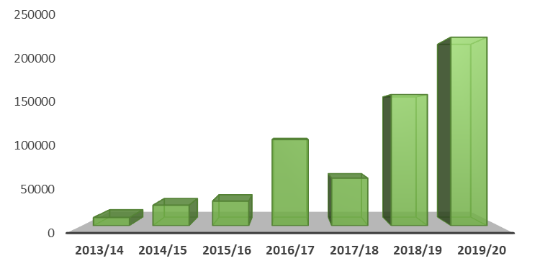
Brazilian EVOO Market, Occurrence, and Production
Olive oil production in Brazil (L)
Carvalho et al, 2020

Slide 8
Brazilian EVOO Market, Occurrence, and Production
Less than 1% of national consumption
Olive oil production in Brazil (L)
Carvalho et al, 2020

Slide 9
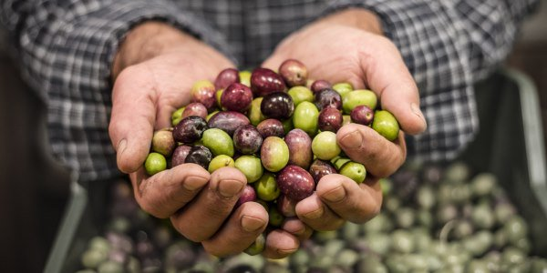

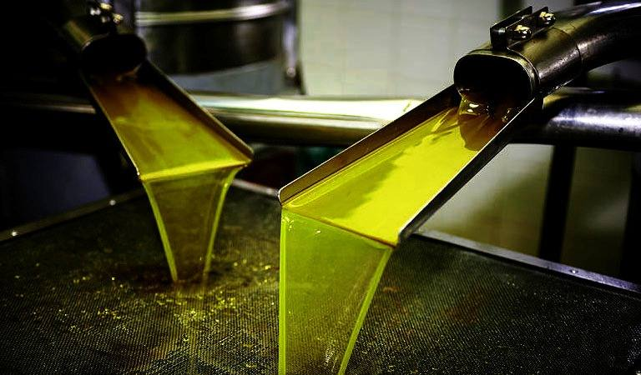
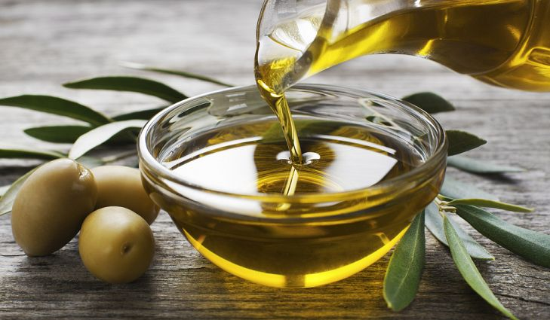
Factors that influence on olive oil composition
Cultivar and ripening degree
Edaphoclimatic conditions
Conditions of olive oil production

Slide 10
Factors that influence on olive oil composition
Cultivar and ripening degree
Edaphoclimatic conditions
Conditions of olive oil production
Multivariate analysis

Slide 11

Objective
To achieve a preliminary discrimination of commercial olive oils produced in Brazil according to olives’ cultivar and region of production by applying multivariate analysis to the oils’ compositional profiles.

Slide 12
Samples and Methods

Slide 13
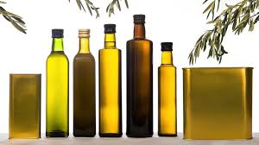
EVOO sampling
15 samples
Brazilian Arbequina
Spanish Arbequina
Brazilian Koroneiki
3 brands - South
2 brands - Southeast
5 brands - Catalunya
Carvalho et al, 2020

Slide 14
Multivariate analyses
7 excluded variables
Principal component analysis (PCA)
78 normalized selected variables
Cultivar
Geographical origin
Partial least squares discriminant analysis (PLS-DA)
85 evaluated variables
78 normalized selected variables
Altitude*
The Unscrambler®, software version 9.7
*Altitude quartiles (GraphPad Prism®)

Slide 15
Multivariate analyses variables
All data used to perform multivariate analysis are available in the previously mentioned publication, and ranged among samples as follows:
Peroxide value
3.89 to 19.10 mEq O₂/kg
k₂₃₂
1.47 to 2.88
Free acidity
k₂₇₀
0.12 to 0.22
0.04 to 0.58 % 18:1
Antioxidant capacity
2.27 to 3.29 mmol TE/kg
Oxidative stability index
12.52 to 64.72 h
p-Anisidine value
Total phenolic content
4.31 to 18.9 mg GAE/100 g
1.59 to 10.8
Quality parameters and other features
Carvalho et al, 2020

Slide 16
Multivariate analyses variables
All data used to perform multivariate analysis are available in the previously mentioned publication, and ranged among samples as follows:
16:1n-7
0.04 to 2.05
18:0
1.10 to 2.63
16:0
18:1n-9
66.6 to 86.0
8.54 to 17.1
18:3n-3
0.50 to 0.92
M:P_{ratio}
4.44 to 20.6
18:2n-6
3.52 to 14.3
Fatty acid profile (g/100g) and M:P _{ratio}
Carvalho et al, 2020

Slide 17
Multivariate analyses variables
All data used to perform multivariate analysis are available in the previously mentioned publication, and ranged among samples as follows:
3 Lignans
n.d. to 49.5
10 Simple phenols and derivatives
n.d. to 9.20
27 Secoiridoids and derivatives
n.d. to 249
3 Triterpenic compounds
2.25 to 92.3
3 Free fatty acids content
0.31 to 264
4 Flavonoids
n.d. to 3.00
Minor components by RP-LC-MS (mg/kg)
Carvalho et al, 2020

Slide 18
Multivariate analyses variables
All data used to perform multivariate analysis are available in the previously mentioned publication, and ranged among samples as follows:
Minor components by NP-LC-DAD/FLD (mg/kg)
8 Volatile and semi-volatile compounds (μg/g)
2 Free sterols
n.d. to 1739
6 Pigments
n.d. to 25.1
4 Tocopherols
n.d. to 267
n.d. to 18.5
Carvalho et al, 2020

Slide 19
Multivariate analyses variables
All data used to perform multivariate analysis are available in the previously mentioned publication, and ranged among samples as follows:
Geographical origin and cultivar
Origin
Brazil (South or Southeast) or Spain
Altitude
134 to 1155 m
Cultivar
Arbequina or Koroneiki
Carvalho et al, 2020

Slide 20
Representative figure to invite you to get to know our previous work
Multivariate analyses variables
Carvalho et al, 2020

Slide 21
Results

Slide 22
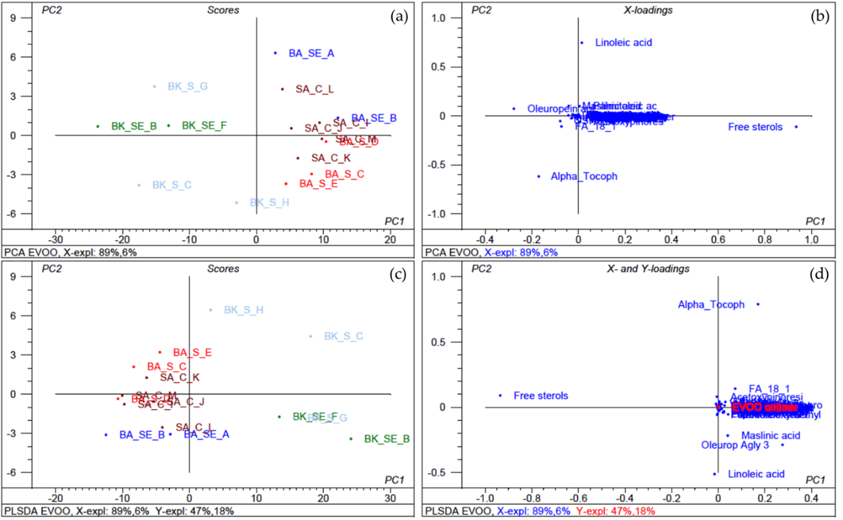
PCA
Figure 1. Clustering of EVOO samples: (a). Scores plot of the PCA model. (b). Loadings plot of the PCA model. (c) Scores plot of the PLS-DA model. (d). Loadings plot of the PLS-DA model. EVOO samples: BA SE A - Brazilian cv. Arbequina from Southeast, brand A. BA SE B - Brazilian cv. Arbequina from Southeast, brand B. BA S C - Brazilian cv. Arbequina from South, brand C. BA S D - Brazilian cv. Arbequina from South, brand D. BA S E - Brazilian cv. Arbequina from South, brand E. BK SE B - Brazilian cv. Koroneiki from Southeast, brand B. BK SE F - Brazilian cv. Koroneiki from Southeast, brand F. BK S C - Brazilian cv. Koroneiki from South, brand C. BK S G - Brazilian cv. Koroneiki from South, brand G. BK S H - Brazilian cv. Koroneiki from South, brand H. SA C I - Spanish cv. Arbequina from Catalonia, brand I. SA C J - Spanish cv. Arbequina from Catalonia, brand J. SA C K - Spanish cv. Arbequina from Catalonia, brand K. SA C L - Spanish cv. Arbequina from Catalonia, brand L. SA C M - Spanish cv. Arbequina from Catalonia, brand M.

Slide 23
PCA
Figure 1. Clustering of EVOO samples: (a). Scores plot of the PCA model. (b). Loadings plot of the PCA model. (c) Scores plot of the PLS-DA model. (d). Loadings plot of the PLS-DA model. EVOO samples: BA SE A - Brazilian cv. Arbequina from Southeast, brand A. BA SE B - Brazilian cv. Arbequina from Southeast, brand B. BA S C - Brazilian cv. Arbequina from South, brand C. BA S D - Brazilian cv. Arbequina from South, brand D. BA S E - Brazilian cv. Arbequina from South, brand E. BK SE B - Brazilian cv. Koroneiki from Southeast, brand B. BK SE F - Brazilian cv. Koroneiki from Southeast, brand F. BK S C - Brazilian cv. Koroneiki from South, brand C. BK S G - Brazilian cv. Koroneiki from South, brand G. BK S H - Brazilian cv. Koroneiki from South, brand H. SA C I - Spanish cv. Arbequina from Catalonia, brand I. SA C J - Spanish cv. Arbequina from Catalonia, brand J. SA C K - Spanish cv. Arbequina from Catalonia, brand K. SA C L - Spanish cv. Arbequina from Catalonia, brand L. SA C M - Spanish cv. Arbequina from Catalonia, brand M.

Slide 24
PCA
Figure 1. Clustering of EVOO samples: (a). Scores plot of the PCA model. (b). Loadings plot of the PCA model. (c) Scores plot of the PLS-DA model. (d). Loadings plot of the PLS-DA model. EVOO samples: BA SE A - Brazilian cv. Arbequina from Southeast, brand A. BA SE B - Brazilian cv. Arbequina from Southeast, brand B. BA S C - Brazilian cv. Arbequina from South, brand C. BA S D - Brazilian cv. Arbequina from South, brand D. BA S E - Brazilian cv. Arbequina from South, brand E. BK SE B - Brazilian cv. Koroneiki from Southeast, brand B. BK SE F - Brazilian cv. Koroneiki from Southeast, brand F. BK S C - Brazilian cv. Koroneiki from South, brand C. BK S G - Brazilian cv. Koroneiki from South, brand G. BK S H - Brazilian cv. Koroneiki from South, brand H. SA C I - Spanish cv. Arbequina from Catalonia, brand I. SA C J - Spanish cv. Arbequina from Catalonia, brand J. SA C K - Spanish cv. Arbequina from Catalonia, brand K. SA C L - Spanish cv. Arbequina from Catalonia, brand L. SA C M - Spanish cv. Arbequina from Catalonia, brand M.

Slide 25
PCA
Sterols and tocopherols have been previously reported as influencing factors when discriminating EVOO by geographical origin and cultivar [Kyçyk et al, 2016; Martakos et al, 2020].
Figure 1. Clustering of EVOO samples: (a). Scores plot of the PCA model. (b). Loadings plot of the PCA model. (c) Scores plot of the PLS-DA model. (d). Loadings plot of the PLS-DA model. EVOO samples: BA SE A - Brazilian cv. Arbequina from Southeast, brand A. BA SE B - Brazilian cv. Arbequina from Southeast, brand B. BA S C - Brazilian cv. Arbequina from South, brand C. BA S D - Brazilian cv. Arbequina from South, brand D. BA S E - Brazilian cv. Arbequina from South, brand E. BK SE B - Brazilian cv. Koroneiki from Southeast, brand B. BK SE F - Brazilian cv. Koroneiki from Southeast, brand F. BK S C - Brazilian cv. Koroneiki from South, brand C. BK S G - Brazilian cv. Koroneiki from South, brand G. BK S H - Brazilian cv. Koroneiki from South, brand H. SA C I - Spanish cv. Arbequina from Catalonia, brand I. SA C J - Spanish cv. Arbequina from Catalonia, brand J. SA C K - Spanish cv. Arbequina from Catalonia, brand K. SA C L - Spanish cv. Arbequina from Catalonia, brand L. SA C M - Spanish cv. Arbequina from Catalonia, brand M.

Slide 26
PLS-DA
Figure 1. Clustering of EVOO samples: (a). Scores plot of the PCA model. (b). Loadings plot of the PCA model. (c) Scores plot of the PLS-DA model. (d). Loadings plot of the PLS-DA model. EVOO samples: BA SE A - Brazilian cv. Arbequina from Southeast, brand A. BA SE B - Brazilian cv. Arbequina from Southeast, brand B. BA S C - Brazilian cv. Arbequina from South, brand C. BA S D - Brazilian cv. Arbequina from South, brand D. BA S E - Brazilian cv. Arbequina from South, brand E. BK SE B - Brazilian cv. Koroneiki from Southeast, brand B. BK SE F - Brazilian cv. Koroneiki from Southeast, brand F. BK S C - Brazilian cv. Koroneiki from South, brand C. BK S G - Brazilian cv. Koroneiki from South, brand G. BK S H - Brazilian cv. Koroneiki from South, brand H. SA C I - Spanish cv. Arbequina from Catalonia, brand I. SA C J - Spanish cv. Arbequina from Catalonia, brand J. SA C K - Spanish cv. Arbequina from Catalonia, brand K. SA C L - Spanish cv. Arbequina from Catalonia, brand L. SA C M - Spanish cv. Arbequina from Catalonia, brand M.

Slide 27
PLS-DA
Figure 1. Clustering of EVOO samples: (a). Scores plot of the PCA model. (b). Loadings plot of the PCA model. (c) Scores plot of the PLS-DA model. (d). Loadings plot of the PLS-DA model. EVOO samples: BA SE A - Brazilian cv. Arbequina from Southeast, brand A. BA SE B - Brazilian cv. Arbequina from Southeast, brand B. BA S C - Brazilian cv. Arbequina from South, brand C. BA S D - Brazilian cv. Arbequina from South, brand D. BA S E - Brazilian cv. Arbequina from South, brand E. BK SE B - Brazilian cv. Koroneiki from Southeast, brand B. BK SE F - Brazilian cv. Koroneiki from Southeast, brand F. BK S C - Brazilian cv. Koroneiki from South, brand C. BK S G - Brazilian cv. Koroneiki from South, brand G. BK S H - Brazilian cv. Koroneiki from South, brand H. SA C I - Spanish cv. Arbequina from Catalonia, brand I. SA C J - Spanish cv. Arbequina from Catalonia, brand J. SA C K - Spanish cv. Arbequina from Catalonia, brand K. SA C L - Spanish cv. Arbequina from Catalonia, brand L. SA C M - Spanish cv. Arbequina from Catalonia, brand M.

Slide 28
PLS-DA
Figure 1. Clustering of EVOO samples: (a). Scores plot of the PCA model. (b). Loadings plot of the PCA model. (c) Scores plot of the PLS-DA model. (d). Loadings plot of the PLS-DA model. EVOO samples: BA SE A - Brazilian cv. Arbequina from Southeast, brand A. BA SE B - Brazilian cv. Arbequina from Southeast, brand B. BA S C - Brazilian cv. Arbequina from South, brand C. BA S D - Brazilian cv. Arbequina from South, brand D. BA S E - Brazilian cv. Arbequina from South, brand E. BK SE B - Brazilian cv. Koroneiki from Southeast, brand B. BK SE F - Brazilian cv. Koroneiki from Southeast, brand F. BK S C - Brazilian cv. Koroneiki from South, brand C. BK S G - Brazilian cv. Koroneiki from South, brand G. BK S H - Brazilian cv. Koroneiki from South, brand H. SA C I - Spanish cv. Arbequina from Catalonia, brand I. SA C J - Spanish cv. Arbequina from Catalonia, brand J. SA C K - Spanish cv. Arbequina from Catalonia, brand K. SA C L - Spanish cv. Arbequina from Catalonia, brand L. SA C M - Spanish cv. Arbequina from Catalonia, brand M.

Slide 29
PLS-DA
Altitude might influence on olive oil composition, for instance, on fatty acids, tocopherols, and phenolic compounds profiles [Di Vaio et al, 2013; Aguilera et al, 2005; Mousa et al, 1996].
Figure 1. Clustering of EVOO samples: (a). Scores plot of the PCA model. (b). Loadings plot of the PCA model. (c) Scores plot of the PLS-DA model. (d). Loadings plot of the PLS-DA model. EVOO samples: BA SE A - Brazilian cv. Arbequina from Southeast, brand A. BA SE B - Brazilian cv. Arbequina from Southeast, brand B. BA S C - Brazilian cv. Arbequina from South, brand C. BA S D - Brazilian cv. Arbequina from South, brand D. BA S E - Brazilian cv. Arbequina from South, brand E. BK SE B - Brazilian cv. Koroneiki from Southeast, brand B. BK SE F - Brazilian cv. Koroneiki from Southeast, brand F. BK S C - Brazilian cv. Koroneiki from South, brand C. BK S G - Brazilian cv. Koroneiki from South, brand G. BK S H - Brazilian cv. Koroneiki from South, brand H. SA C I - Spanish cv. Arbequina from Catalonia, brand I. SA C J - Spanish cv. Arbequina from Catalonia, brand J. SA C K - Spanish cv. Arbequina from Catalonia, brand K. SA C L - Spanish cv. Arbequina from Catalonia, brand L. SA C M - Spanish cv. Arbequina from Catalonia, brand M.

Slide 30
Conclusion

Slide 31
Final considerations
EVOO discrimination
Cultivar
Partially by geographical origin
Call for more studies on Brazilian EVOO composition → biomarkers

Slide 32
Thank you!
Email: alinegac@gmail.com

Slide 33
References
International Olive Oil Council (IOC). Available online: https://www.internationaloliveoil.org/wp-content/uploads/2020/07/IOC-NEWSLETTER-151-July-2020-def.-.pdf (accessed on 7 October 2020).
Carvalho, A.G.A.; Olmo-García, L.; Gaspar, B.R.A.; Carrasco-Pancorbo, A.; Castelo-Branco, V.N.; Torres, A.G. Evaluating Quality Parameters, the Metabolic Profile, and Other Typical Features of Selected Commercial Extra Virgin Olive Oils from Brazil. Molecules 2020, 25(18), 4193.
Kyçyk, O.; Aguilera, M.P.; Gaforio, J.J.; Jiménez, A.; Beltrán, G. Sterol composition of virgin olive oil of forty‐three olive cultivars from the World Collection Olive Germplasm Bank of Cordoba. J Sci Food Agric. 2016, 96(12), 4143-4150.
Martakos, I.; Kostakis, M.; Dasenaki, M.; Pentogennis, M.; Thomaidis, N. Simultaneous Determination of Pigments, Tocopherols, and Squalene in Greek Olive Oils: A Study of the Influence of Cultivation and Oil-Production Parameters. Foods, 2020, 9(1), 31.
Di Vaio, C.; Nocerino, S.; Paduano, A.; Sacchi, R. Influence of some environmental factors on drupe maturation and olive oil composition. J Sci Food Agric. 2013, 93(5), 1134-1139.
Aguilera, M.P.; Beltrán, G.; Ortega, D.; Fernández, A.; Jiménez, A.; Uceda, M. Characterisation of virgin olive oil of Italian olive cultivars: Frantoio'and Leccino', grown in Andalusia. Food chem. 2005, 89(3), 387-391.
Mousa, Y.M.; Gerasopoulos, D.; Metzidakis, I.; Kiritsakis, A. Effect of altitude on fruit and oil quality characteristics of ‘Mastoides’ olives. J Sci Food Agric. 1996, 71(3), 345-350.

