Slide 1
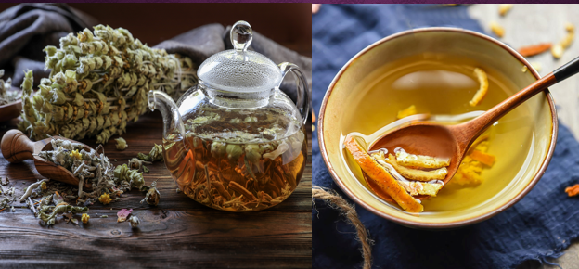
POSTPRANDIAL BIOACTIVITY OF SPREAD CHEESE, ENHANCED WITH MOUNTAIN TEA AND ORANGE PEEL EXTRACT, IN HEALTHY VOLUNTEERS. A PILOT STUDY.
Olga Papagianni, Thomas Loukas², Athanasios Magkoutis², Theodora Biagki¹, Charalampia Dimou¹, Charalampos Karantonis², Antonios Koutelidakis^{1*}
¹Human Nutrition Lab, Food Science and Nutrition Department, University of the Aegean, Myrina Limnos, ²Outpatιent Clinic, Myrina Limnos, ³Laboratory of Chemistry and Food Analysis, Food Science and Nutrition Department, University of the Aegean, Myrina Limnos
* correspondence: Dr Α. Koutelidakis, Assistant Professor in Human Nutrition, e-mail: akoutel@aegean.gr

Slide 2
Introduction
Postprandial lipemia, glycemia and oxidative stress may promote cell dysfunction and affect the outcome of cardiovascular disease(CVD).
Mountain tea (Sideritis sp.) and orange peel (fruit by-product), as natural functional foods, contain bioactive compounds with possible beneficial effects on serum lipids and glucose levels, as well as on plasma total antioxidant activity.
It has been investigated that the enhancement of a spread cheese with natural bio-functional foods, such as mountain tea (Sideritis sp.) and dried orange peel extract, may reduce postprandial metabolic biomarkers in healthy volunteers.
CVD
Outcome
Postprandial lipemia
Postprandial Oxidative Stress
Postprandial glycemia
1st International Electronic Conference on Food Science and Functional Foods 10/11/2020 - 25/11/2020

Slide 3
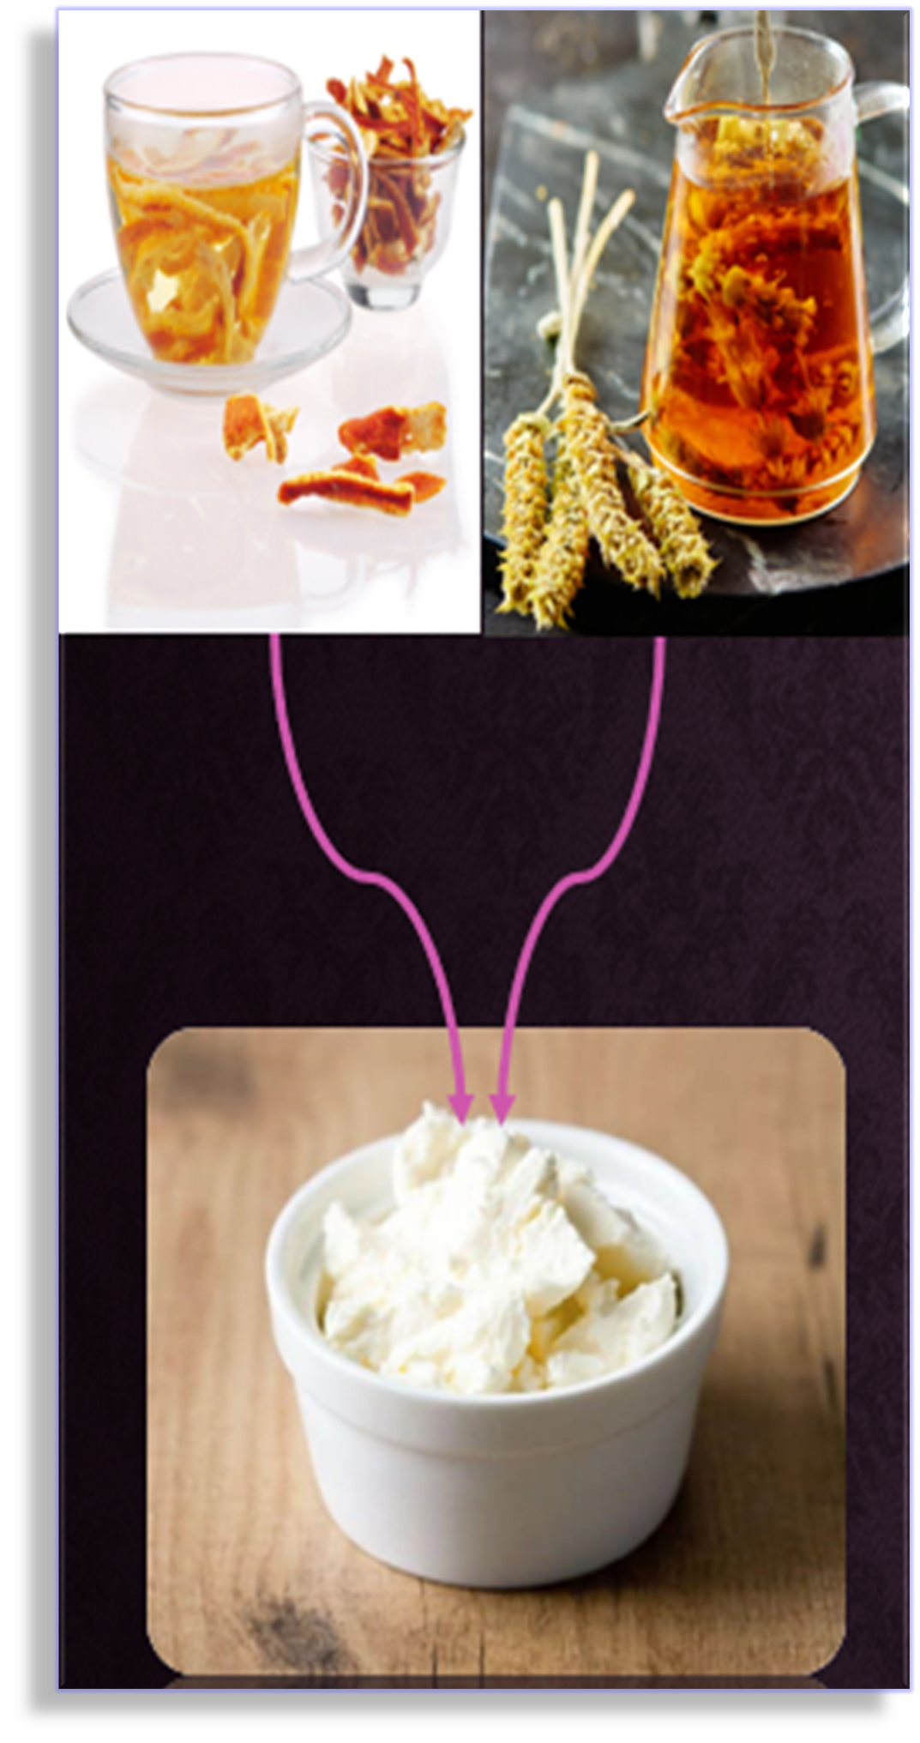
POSTPRANDIAL EFFECT
Total cholesterol
LDL-cholesterol
Glucose
Triglycerides
HDL-cholesterol
Antioxidants
?
1st International Electronic Conference on Food Science and Functional Foods 10/11/2020 - 25/11/2020

Slide 4
Methods
Study Design
Cross-over design, pilot study
9 healthy volunteers 20-30 years old, were randomized and participated to this nutritional intervention.
Filling in a short questionnaire on medical history and eating habits
Anthropometrics & blood tests (at a public hospital)
The 9 volunteers (4 men and 5 women) who participated in the 2 day randomized nutritional intervention-clinical study, arrived at the Nutrition Unit of Aegean University, in Lemnos.
The trial included the consumption of a meal, rich in fat and carbohydrates, [2 slices-80g of white bread, spread with 40g of butter and 30g of full fat spread cheese] (control meal). After a week washout period, the same volunteers consumed the same meal contained a novel spread cheese, enhanced with 6% mountain tea and dried orange peel extract [3g mountain tea, 3g orange peel, 100ml boiling water ]* (intervention meal).
*Antioxidant capacity of the extract- FRAP method : 34,67μmol Fe2SO4/ml
Total phenolics of the extract-Folin- Ciocalteu method: 49,9μg gallic acid/ml
Blood sampling was performed, before and 1.5, 3 and 5 h after meal consumption.
Ethics
The study protocol was approved by the Ethics committee of Aegean University and the study performed in accordance with the Declaration of Helsinki. All the participants signed an informed consent form and informed about the prime target of this study, the confidentiality of data and the voluntary nature of participation.
1st International Electronic Conference on Food Science and Functional Foods 10/11/2020 - 25/11/2020

Slide 5
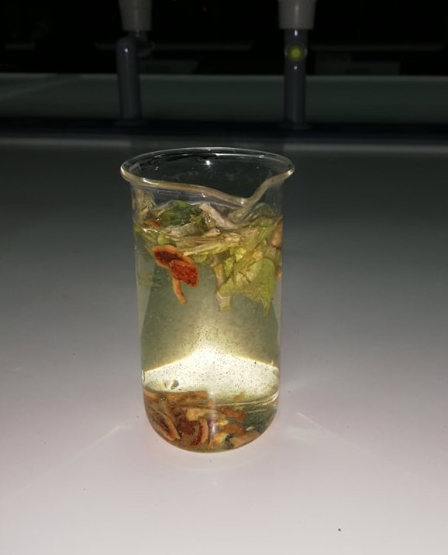
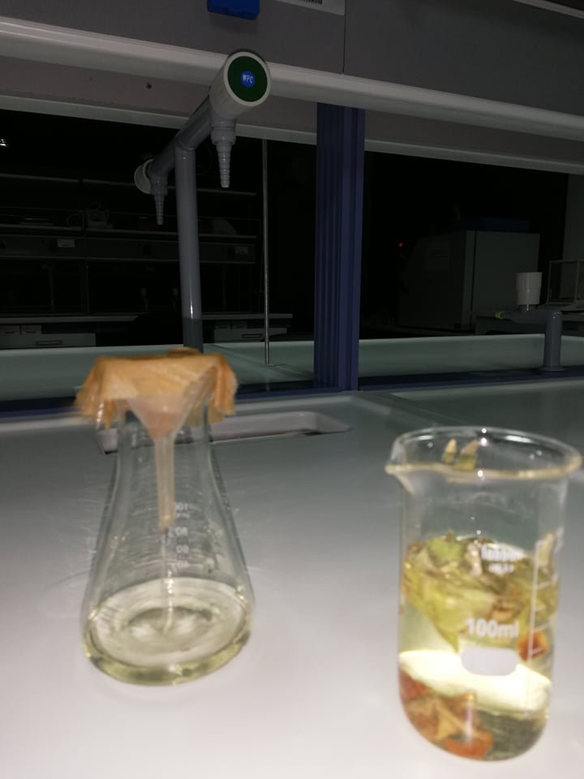
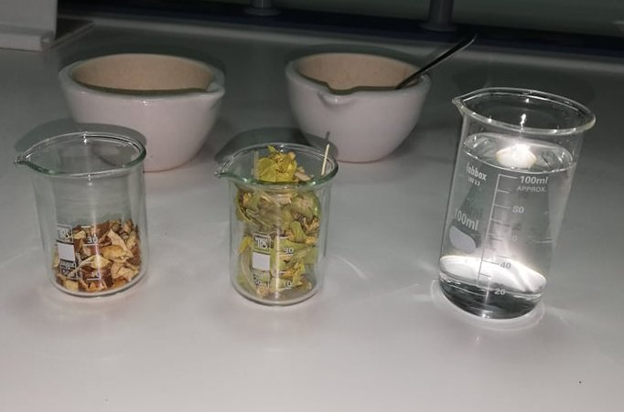
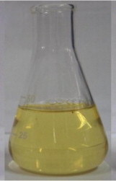
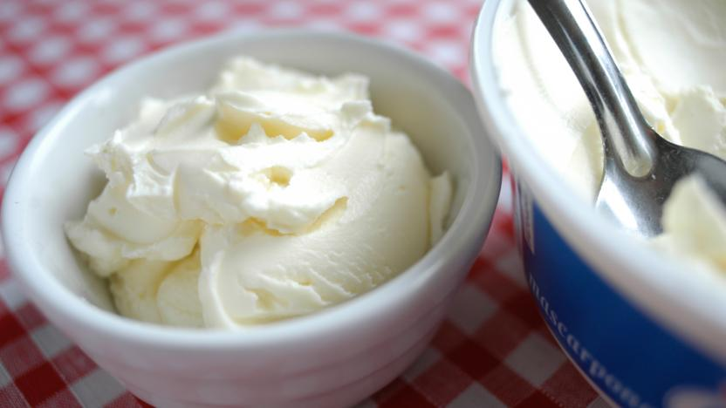
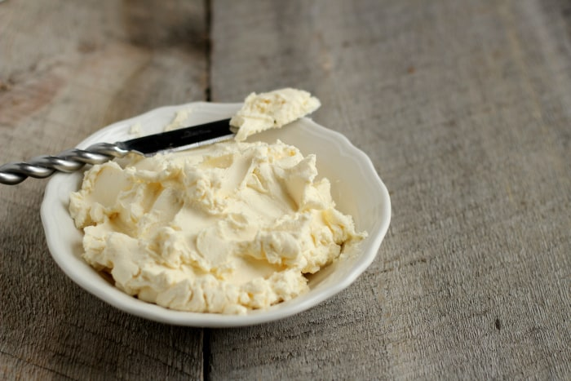
Preparation of the novel, spread cheese
In 100 ml of boiling water were added 3g of mountain tea and 3g of dried orange peel, and then remaining for 5min until the extraction of bioactive compounds.Filtration of the extract was followed by filter paper.
The functional spread cheese was prepared adding 6ml of mountain tea-orange peel extract to 94g cheese, followed by mixture homogenization.
Mountain tea-Orange peel extraction
Novel cheese preparation
1st International Electronic Conference on Food Science and Functional Foods 10/11/2020 - 25/11/2020

Slide 6
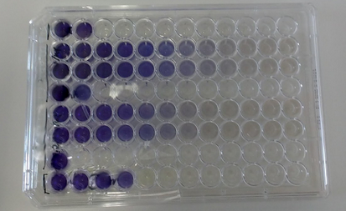
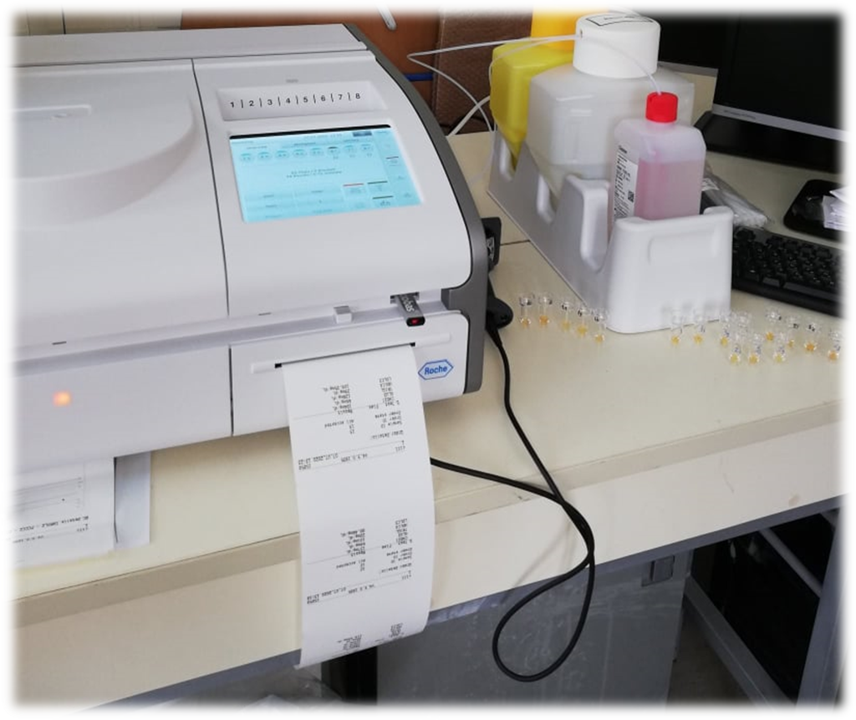
Analytical techniques
Measurement of antioxidant capacity and total phenolics of the extract(mountain tea-orange peel)
Antioxidant capacity determination- FRAP (Ferric Reducing Antioxidant Power) method
A spectrophotometric method for measuring the absorption of antioxidants, expressed
in terms of μmol Fe₂SO₄/ml, since they have the property of converting Fe⁺³ to Fe²⁺ (in complex with TPTZ),
giving a blue color.
Determination of total phenolics- Folin-Ciocalteu method
A spectrophotometric method for the absorption of total phenolics, expressed in μg gallic acid/ml, based on the ability of phenolic compounds to reduce phosphomolybdenum and phosphobolphoric acid compounds in an alkaline environment, giving a blue color.
The total antioxidant capacity (FRAP assay), serum lipids [Total, HDL-, LDL- cholesterol and triglycerides], glucose and uric acid were measured using a Roche Cobas c111 biochemical analyzer, while anticoagulant activity were also determined for each instant.
1st International Electronic Conference on Food Science and Functional Foods 10/11/2020 - 25/11/2020

Slide 7
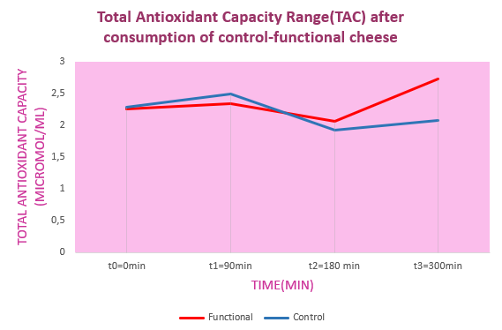
Results
A statistically significant increase in the antioxidant capacity of plasma 3h after meal consumption, and HDL-cholesterol 1.5h after meal, in the presence of the novel cheese [enhanced with mountain tea-orange peel extract],compared to the consumption of control cheese (p <0.05). There was a tendency to decrease the rate of increase of glucose and triglycerides 1.5h after interventional meal. The remaining biomarkers did not show statistically significant differences (p> 0.05).
Graph 1. Value range curves for total antioxidant capacity of volunteer plasma, after consuming control and functional(novel), spread cheese respectively.
1st International Electronic Conference on Food Science and Functional Foods 10/11/2020 - 25/11/2020

Slide 8
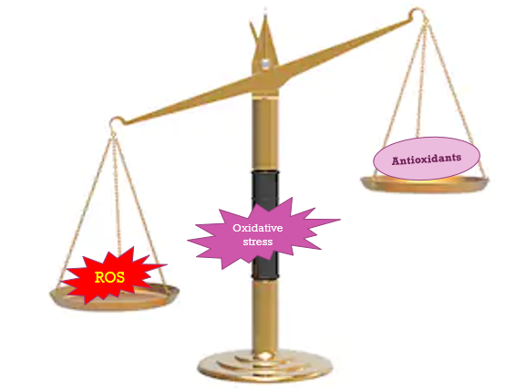
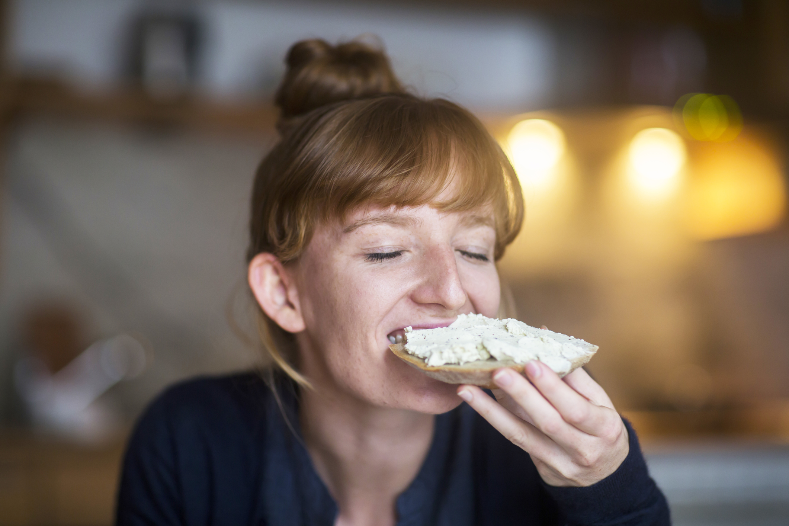
Conclusions
These findings suggest that the enhancement of a spread cheese with mountain tea and orange peel extract may be beneficial on plasma antioxidant capacity, attenuating possible postprandial oxidative stress. The phenolic compounds metabolites may also affect the postprandial levels of serum triglycerides and glucose levels.
Nevertheless, this was a pilot study; thus the extention of the study with more participants could lead to safer conclusions about the postprandial effect of the extracts to postprandial oxidative stress, lipemia and glycemia biomarkers, factors that significantly affect the risk of cardiovascular disease.
POTENTIAL
REDUCTION OF
CVD RISK
1st International Electronic Conference on Food Science and Functional Foods 10/11/2020 - 25/11/2020

Slide 9
References
Koutelidakis, Α.Ε., Rallidis, L, Koniari, K., Panagiotakos, D., Komaitis, M., Zampelas, A., Anastasiou-Nana, M., Kapsokefalou, M. (2013) Effect of green tea on postprandial antioxidant capacity, serum lipids, C Reactive Protein and glucose levels in patients with coronary artery disease. European Journal of Nutrition, 53(2):479-486.
Georgakopoulou V., Dimou C., Karantonis C. In Vitro Antioxidant, Antithrombotic, Antiatherogenic and Antidiabetic Activities of Urtica dioica, Sideritis euboea and Cistus creticus Water Extracts and Investigation of Pasta Fortification with the Most Bioactive One. Current Pharmaceutical Biotechnology, 2019, 20(10): 874-880
1st International Electronic Conference on Food Science and Functional Foods 10/11/2020 - 25/11/2020

