Slide 1
Development of a vegan Spanish sausage-type using coproducts from the pepper “Sol del Pilar“
José Ángel Pérez-Álvarez, Carmen María Botella-Martínez, Casilda Navarro-Rodríguez de Vera, Estrella Sayas-Barberá, Manuel Viuda-Martos, Juana Fernández-Lopez, Elena Sánchez-Zapata·
IPOA Research Group, Agro-Food Technology Department, Higher Polytechnic School of Orihuela, Miguel Hernández University, Orihuela, Alicante, Spain
· SURINVER, Laboratorio de productos de V Gama. Pilar de la Horadada. Alicante, Spain.
Corresponding author: ja.perez@goumh.umh.es

Slide 2
INTRODUCTION

Slide 3
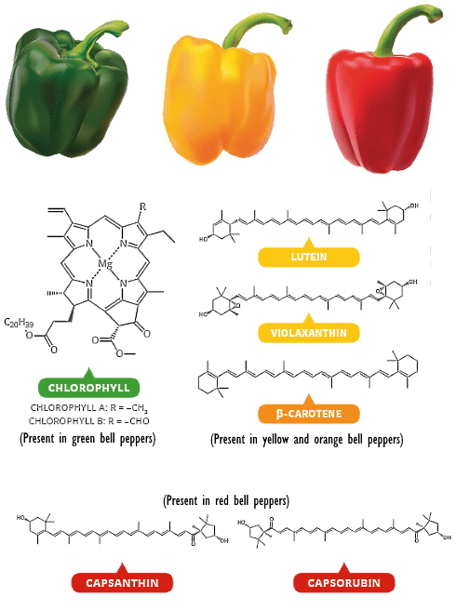
INTRODUCTION

Slide 4
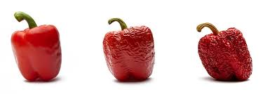
INTRODUCTION
Valorization
PEPPER PROCESSING
PEPPER COPRODUCTS
Spreadable vegan blood sausage-type

Slide 5
MATERIALS AND METHODS
Water activity
pH
Colour properties
Sensorial analysis
Texture
Firmness
Shear force

Slide 6
RESULTS
Table 1.- Table 1. Mean and standard deviation of pH, water activity (Aw), and CIELAB colour parameters (L*: lightness; a*: red/green co-ordinate (+/-); b*: yellow/blue co-ordinate (+/-); C*: Chroma and H*: hue), Firmness and shear force of a spreadable vegan blood sausage-type elaborated with organic red Sol del Pilar peppers.
Parameters | Spreadable vegan blood sausage-type
pH | 4.15±0.01
Aw | 0.948±0.006
L* | 32.25±1.62
a* | 11.86±0.97
b* | 13.90±1.22
C* | 25.71±0.99
H* | 49.62±1.19
Firmness (kg) | 1.50±0.68
Shear force (kg s) | 1.62±0.11

Slide 7
RESULTS
Table 2. Mean and standard deviation of sensorial analysis parameters (general aspect, acceptability, aroma, spreadability, fattiness, colour, saltiness, pepper taste and off-taste) of spreadable vegan blood sausage-type elaborated with organic red Sol del Pilar peppers.
Parameters | Spreadable vegan blood sausage-type
General aspect | 6.87±1.65
Acceptability | 6.65±1.07
Aroma | 6.17±1.53
Spreadability | 6.70 ±1.26
Fattiness | 6.13±1.34
Colour | 3.09±0.60
Saltiness | 2.96±0.68
Pepper taste | 3.04±0.24
Off-taste | 2.71±1.24

Slide 8
conclusions
This work is a practical application in an industrial scale for the use of “ready to measure” parameters to evaluate important practical parameters that can decide the reformulation or acceptation of the product to scale up to make a local consumer test.
The good acceptability obtained for this product indicates that the use of Sol del Pilar co-products is a very good source of raw material for vegan food formulations.

Slide 9
Funding and acknowledgments
This work was supported by SOL NEW FOOD. AGCOOP_D/2018/014. Ayudas para la cooperación en el marco del programa de Desarrollo Rural de la Comunidad Valenciana 2014-2020 CAMACCyDR (53 % UE- Feader, 8,86 % MAPA, and 38,14 % CAMACCyDR)

