Slide 1
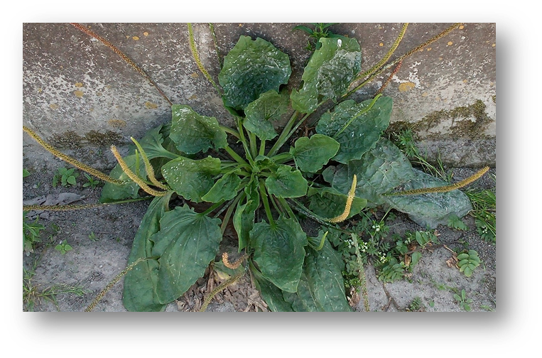
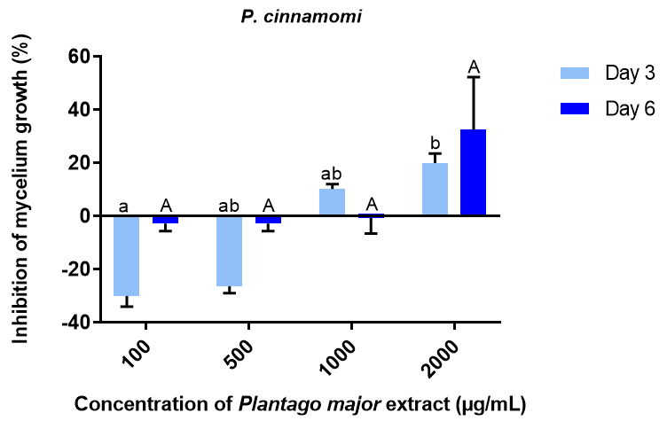
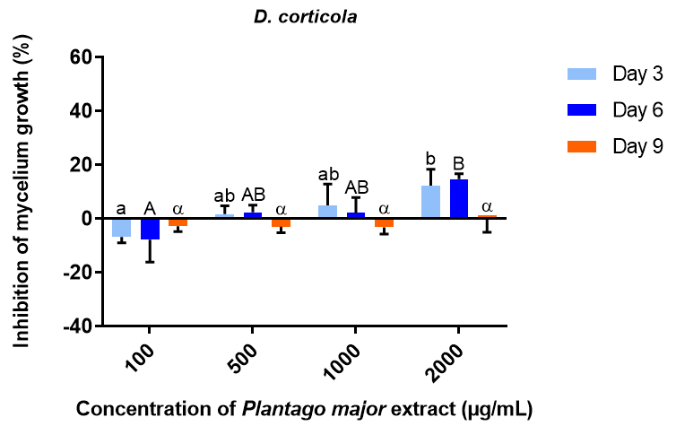
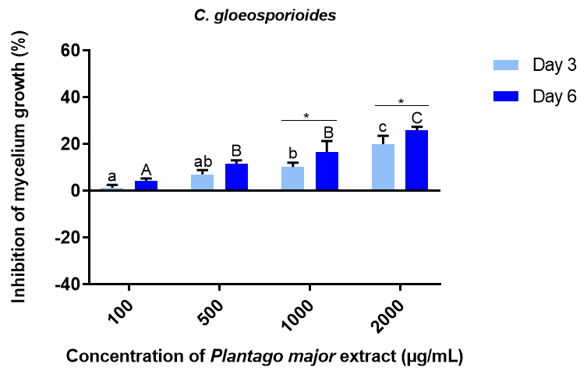
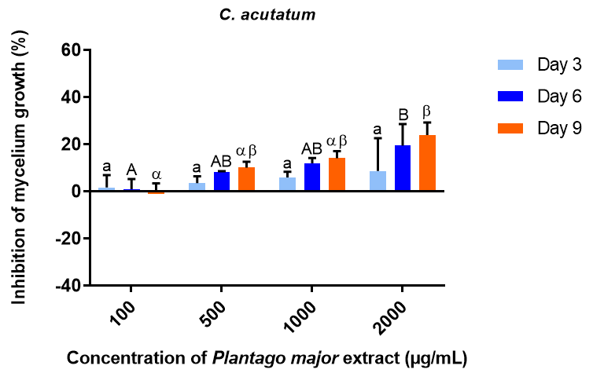
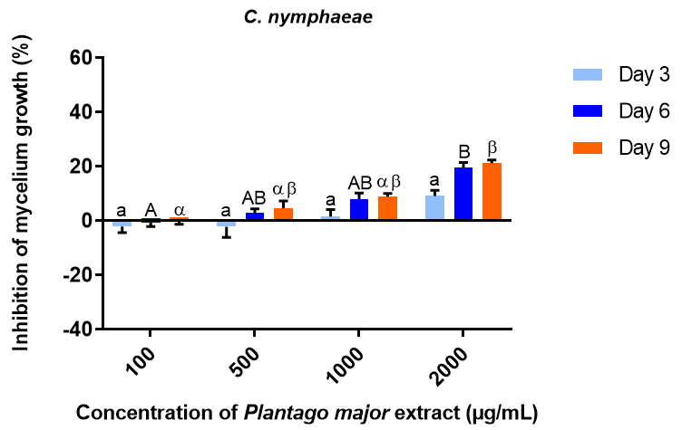
Protective antifungal activity of Plantago major extract against the phytopathogenic fungi Phytophthora cinnamomi, Diplodia corticola and Colletotrichum species
Cláudia Ferreira¹, Rui Oliveira^{1,2,3,*}
¹ Centre of Molecular and Environmental Biology (CBMA), Department of Biology, University of Minho, Campus de Gualtar, 4710-057 Braga, Portugal
² Centre for the Research and Technology of Agro-Environmental and Biological Sciences (CITAB), Department of Biology, University of Minho, Campus de Gualtar, 4710-057 Braga, Portugal
³ Centre of Biological Engineering (CEB), Department of Biology, University of Minho, Campus de Gualtar, 4710-057 Braga, Portugal
*Correspondence: ruipso@bio.uminho.pt
Introduction
Crop-protecting synthetic fungicides raise environmental and human concerns due to accumulation in edible vegetables¹, showing significant toxicity to humans², and in soil³, groundwater and rivers⁴, affecting ecological balance. Plantago major (Figure 1) extract is a rich source of biodegradable secondary metabolites, which have multiple modes of antifungal action and lower probability of development of resistant fungi strains, a very notorious problem with the use of synthetic fungicides⁵. The objective of this work is to evaluate the antifungal activity of P. major extract, as a potential replacement of synthetic fungicides, aiming to contribute to sustainable agriculture practices and food safety.
Results
A
B
C
D
E
Figure 1. Plantago major
Figure 2. Representative images of P. major antifungal activity at different concentrations, 100, 500, 1000 or 2000 µg/mL, against Phytophthora cinnamomi, on PDA solid medium, after 6 days of incubation (n=3). Negative control (A), 100 µg/mL (B), 500 µg/mL (C), 1000 µg/mL(D) and 2000 µg/mL (E).
A
B
C
D
Materials and Methods
To investigate P. major inhibition on the mycelial growth of the phytopathogenic fungi Colletotrichum acutatum, Colletotrichum gloeosporioides, Colletotrichum godetiae, Colletotrichum nymphaeae, Diplodia corticola and Phytophthora cinnamomi, the dried plant was extracted with 50% (v/v) ethanol, the solution dried by evaporation, and the residue dissolved in water. The aqueous extract was incorporated into PDA medium at different concentrations, 100, 500, 1000 and 2000 µg/mL and mycelial discs of each fungus were placed in the center of each Petri dish. Radial mycelial growth was measured at 3, 6 and 9 days after inoculation. For each treatment, three replicates were performed. The assay ended when the negative control reached full growth. The antifungal activity of the extract was calculated in terms of inhibition percentage of mycelia growth by using the following formula:
$$Inhbition \left(\%\right)=\frac{dc−dt}{dc}×100$$
, where 𝑑𝑐 is the average increase in mycelia growth in negative control and 𝑑𝑡 is the average increase in mycelia growth in treated sets.
E
E
F
Figure 3. Effect of P. major on mycelial growth of Phytophthora cinnamomi (A), Diplodia corticola (B), Colletotrichum gloeosporioides (C), Colletotrichum acutatum (D), Colletotrichum godetiae (E) and Colletotrichum nymphaeae (F) isolates on PDA medium with incorporation of P. major extract. Percentage of growth inhibition determined after 3,6 and 9 days of incubation at different concentrations of P. major extract, 100, 500, 1000 or 2000 µg/mL. Data are presented as mean of three independent experiments ± SD. One-way ANOVA and Kruskal Wallis test were used for multiple comparisons. Differences were considered statistically significant if P <0,05. Mean values followed by the same letters are not statistically different (lowercase letters for day 3, capital letters for day6 and Greek letters for day 9). Comparisons between different days of the same concentration are only represented if they are significant.
Conclusions
C. acutatum
C. godetiae
C. nymphaeae
P. cinnamomi
D. corticola
C. gloeosporioides
Significant diference between concentrations 100 and 2000 µg/mL on the third day.
Reestablishment of mycelial growth after nine days, suggesting adaptation of the fungus.
The extract has dose-dependent inhibition on fungal growth on the third and sixth days.
Significant differences from day 6 to day 9 between 100 and 2000 µg / mL.
References
1. Frank, R.; Braun, H.E.; Ripley, B.D. Residues of insecticides and fungicides on Ontario‐grown vegetables, 1986–1988. Food Addit. Contam. 1990, 7, 545–554, Resistance; Elsevier, 2015; Vol. 90; ISBN 9780128022757. doi:10.1080/02652039009373917.
2. Wang, P.; Yang, M.; Jiang, L.; Wu, Y.J. A fungicide miconazole ameliorates tri-o-cresyl phosphate-induced demyelination through inhibition of ErbB/Akt pathway. Neuropharmacology 2019, 148, 31–39, doi:10.1016/j.neuropharm.2018.12.015.
3. Sukul, P. Enzymatic activities and microbial biomass in soil as influenced by metalaxyl residues. Soil Biol. Biochem. 2006, 38, 320–326, doi:10.1016/j.soilbio.2005.05.009.
4. Wightwick, A.; Walters, R.; Allinson, G.; Reichman, S.; Menzies, N. Environmental Risks of Fungicides Used in Horticultural Production Systems. Fungicides 2010, doi:10.5772/13032.
5. Lucas, J.A.; Hawkins, N.J.; Fraaije, B.A. The Evolution of Fungicide
The extract from P. major has the potential to replace synthetic fungicides with convenient application programs in crops in order to control and prevent fungal growth. By inhibiting fungal growth by 20 – 32,2%, P. major extract would not be likely to promote fungal resistances and would not have impact on the environment.

