Slide 1
Effect of Resistant Maltodextrin on Bioactive Compounds of Orange Pasteurized Juice
Presented at the 1st International Electronic Conference on Food Science and Functional Foods, 10-25 November 2020.
Elías Arilla, Javier Martínez-Monzó, Purificación García-Segovia and Marta Igual*
Universitat Politècnica de València; Food Technology Department, Food Investigation and Innovation Group.

Slide 2
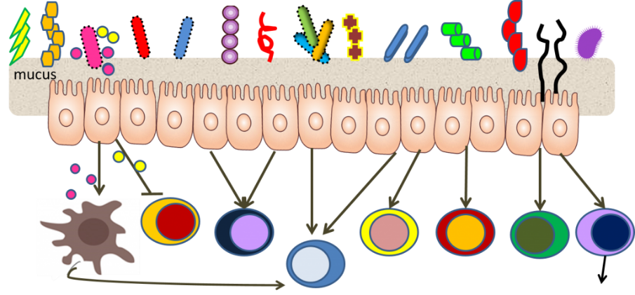
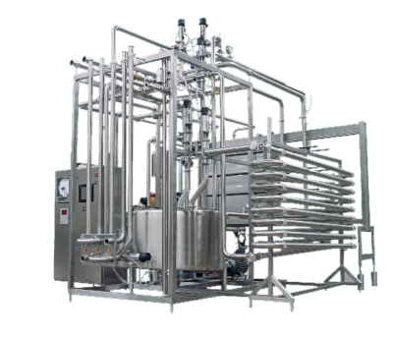
What is Resistant Maltodextrin (RMD)?
Water-soluble fiber
Could be fermented in the colon
Potential functional and prebiotic effects
Why do we use Orange Pasteurized Juice?
Orange Juice is the most demanded fruit juice
Pasteurization is the most common methond to prolong shelf-life
Heat treatments cause losses of bioactive compounds
Effect of Resistant Maltodextrin on Bioactive Compounds of Orange Pasteurized Juice

Slide 3
Scarce information is available on what effects RMD displays in food matrices. Therefore, we wanted…
To evaluate the effect of RMD addition on the Bioactive Compounds of Orange Pasteurized Juice.
Effect of Resistant Maltodextrin on Bioactive Compounds of Orange Pasteurized Juice

Slide 4
How we did it?
Sample preparation and pasteurization
Orange juice with pulp, OJP
Analytical determinations
ºBrix, acidity and pH
Statistical analysis
ANOVA
Orange juice without pulp, OJWP
Increasing RMD concentrations (2.5, 5 and 7.5%)
Pasteurization process (85ºC, 10 s)
Total phenols (Folin-Ciocalteu, spectrophotometry)
Total carotenoids (extraction with hexane/acetone/etanol, spectrophotometry)
Ascorbic acid and vitamin C (HPLC)
Antioxidant capacity (DPPH, spectrophotometry)
Correlation analysis (Pearson’s coefficient)
Effect of Resistant Maltodextrin on Bioactive Compounds of Orange Pasteurized Juice

Slide 5
How we did it?
Variations of each bioactive compound for all orange juice samples with increasing RMD concentrations (2.5, 5 and 7.5%) with respect the control samples were calculated according to the following equation:
$${∆M}_{i}^{RMD\%}=\frac{\left(M_{i}^{RMD\%}−M_{i}^{Control}\right)}{M_{i}^{Control}}×100$$
Effect of Resistant Maltodextrin on Bioactive Compounds of Orange Pasteurized Juice

Slide 6
What were our results?
ºBrix, acidity and pH
Control samples complied with AIJN orange juice guidelines.
No adulteration or deviation occurred during the orange juice extractions.
RMD addition led to an increase in total soluble solids and less citric acid content (because of orange juice replacement). Small changes in pH were found.
Sample | ºBrix | Acidity | pH
OJP0 | 11.38 (0.03)ª | 0.773 (0.04)^{h} | 3.683 (0.006)ª
OJP2.5 | 13.58 (0.02)^{c} | 0.747 (0.002)^{g} | 3.677 (0.006)ª
OJP5 | 15.75 (0.04)^{e} | 0.725 (0.002)^{f} | 3.69 (0.02)ª
OJP7.5 | 17.99 (0.04)^{g} | 0.711 (0.002)^{e} | 3.71 (0.02)ª
OJWP0 | 11.47 (0.08)^{b} | 0.691 (0.002)^{d} | 3.80 (0.03)^{b}
OJWP2.5 | 13.72 (0.03)^{d} | 0.670 (0.003)^{c} | 3.90 (0.04)^{b}
OJWP5 | 15.9 (0.05)^{f} | 0.6530 (0.0005)^{b} | 3.827 (0.006)^{b}
OJWP7.5 | 18.09 (0.02)^{h} | 0.636 (0.002)ª | 3.823 (0.006)^{c}
Effect of Resistant Maltodextrin on Bioactive Compounds of Orange Pasteurized Juice

Slide 7
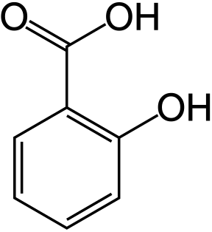
What were our results?
Total phenols and total carotenoids
OJP samples marked higher phenolic increase while OJWP samples presented higher carotenoids variations.
These variations were higher when higher RMD concentrations were applied.
f
d
e
d
c
c
c
b
b
a
a
a
Effect of Resistant Maltodextrin on Bioactive Compounds of Orange Pasteurized Juice

Slide 8
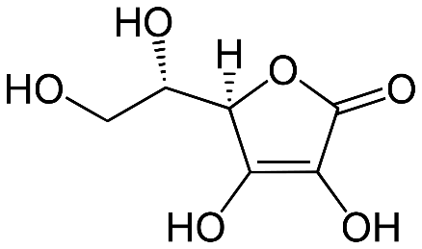
What were our results?
Ascorbic acid and vitamin C
Ascorbic acid variations were more noticeable in OJWP samples.
Orange pulp seems to interact with RMD to increase dehydroascorbic acid protection, as OJP samples obtained slightly higher variations of vitamin C.
The protective effect was more intense when higher RMD concentrations were applied.
c
c
abc
bc
abc
bc
b
ab
ab
ab
a
a
Effect of Resistant Maltodextrin on Bioactive Compounds of Orange Pasteurized Juice

Slide 9
What were our results?
Antioxidant capacity
Higher RMD concentrations before Orange Juice Pasteurization led to higher antioxidant capacity, especially in OJWP samples.
d
c
ab
bc
a
a
Effect of Resistant Maltodextrin on Bioactive Compounds of Orange Pasteurized Juice

Slide 10
What role did each of the bioactive compounds play in the antioxidant capacity?
Correlation statistical analyses (Pearson’s coefficient) were performed to answer this question
Vitamin C and total phenols played a major role in the antioxidant capacity.
There was a significant correlation between ascorbic acid and total carotenoids content, probably because of the stabilizing effect of ascorbic acid on carotenoids.
Effect of Resistant Maltodextrin on Bioactive Compounds of Orange Pasteurized Juice

Slide 11
In summary, our findings were that RMD addition before Orange Juice Pasteurization:
Led to a protective effect in both total phenols and total carotenoids content.
Led to a protective effect on the ascorbic acid and vitamin C content.
Led to higher antioxidant capacity.
All protective effects were higher when higher RMD concentration was applied.
Effect of Resistant Maltodextrin on Bioactive Compounds of Orange Pasteurized Juice

Slide 12
This research was supported by Agència Valenciana de la Innovació (Generalitat Valenciana).
Research grant reference: INNTAL31/19/002.
Effect of Resistant Maltodextrin on Bioactive Compounds of Orange Pasteurized Juice

Slide 13
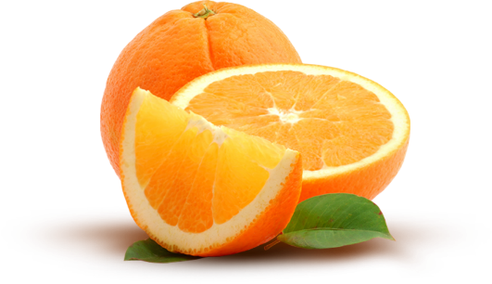
THANK YOU FOR YOUR ATTENTION
Effect of Resistant Maltodextrin on Bioactive Compounds of Orange Pasteurized Juice

