Slide 1


Assessment of chemical, physico-chemical and sensorial properties of frankfurters-type sausages added with roselle (Hibiscus sabdariffa L.), extracts
Anna Judith Pérez-Báez, Juan Pedro Camou, Martín Valenzuela-Melendres, Raquel Lucas-González and Manuel Viuda-Martos

Slide 2


Objective
The aim of this work was to determine the effect of roselle (Hibiscus sabdariffa L.) extracts addition on chemical, physico-chemical, and sensorial properties of frankfurters-type sausages.

Slide 3
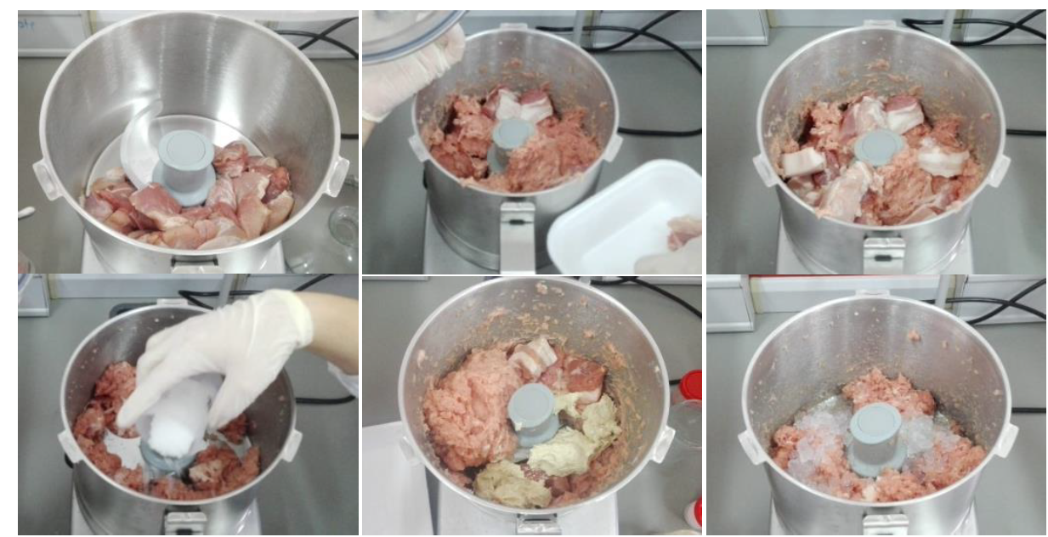
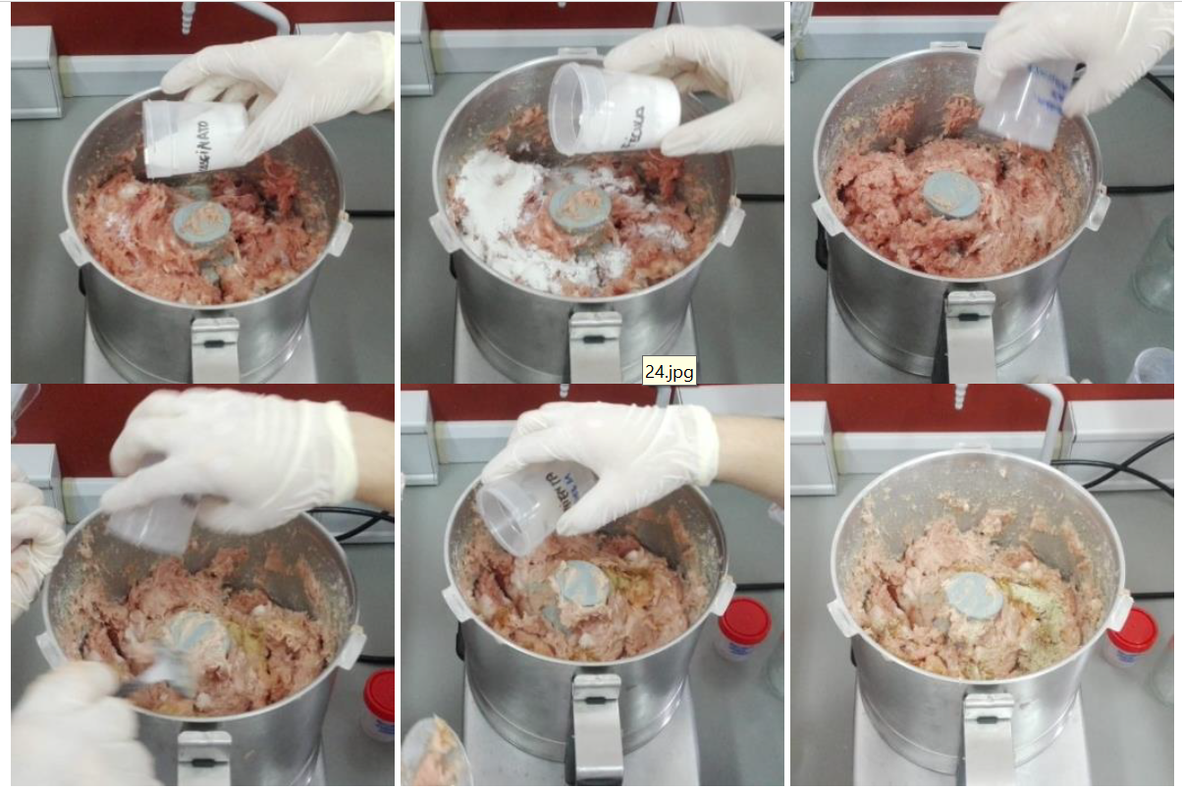
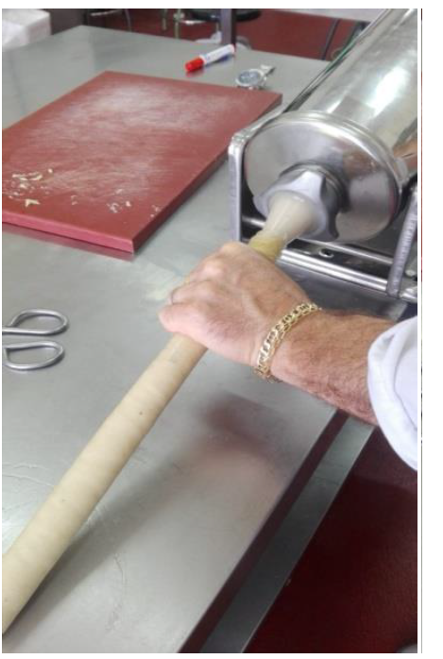
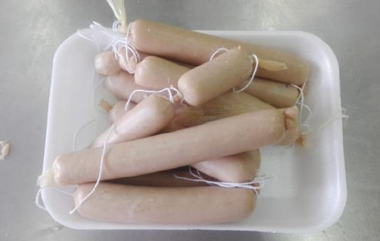
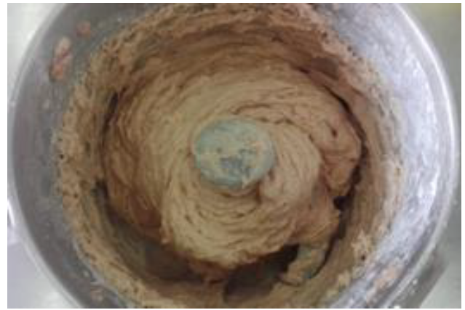
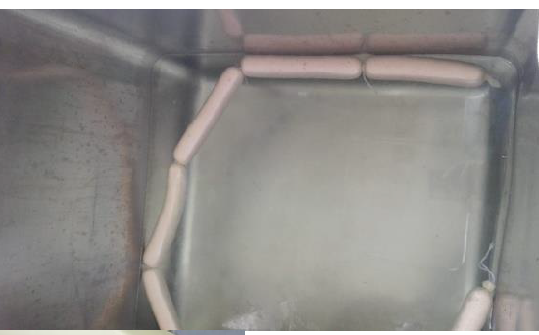
Material and Methods

Slide 4
Material and Methods
Ingredients (g/100g) | CS | FRE4 | FRE8
Lean Pork Trim | 57.17 | 57.17 | 57.17
Pork backfat | 24.50 | 24.50 | 24.50
Ice | 12.25 | 8.17 | 4.08
Roselle extract | --- | 4.08 | 8.17
Salt | 2.04 | 2.04 | 2.04
Corn starch | 1.23 | 1.23 | 1.23
Potato peel flour | 1.23 | 1.23 | 1.23
Caseinate | 1.23 | 1.23 | 1.23
Smoke | 0.080 | 0.080 | 0.080
Sodium ascorbate | 0.025 | 0.025 | 0.025
Sodium Tripolyphosphate | 0.020 | 0.020 | 0.020
Sodium nitrite | 0.015 | 0.015 | 0.015
White pepper | 0.16 | 0.16 | 0.16
Nutmeg powder | 0.04 | 0.04 | 0.04
Chemical composition
Physico-chemical properties
Sensorial analysis
CS: Control sample, FRE4: frankfurter +4% roselle extract; FRE8: frankfurter +8% roselle extract.

Slide 5
Results
Proximate composition
 | Moisture | Ash | Proteins | Fat
CS | 64.34±1.13ª | 2.39±0.01ª | 17.97±0.27 ^{ab} | 13.28±1.56ª
FRE4 | 61.70±0.83ª | 2.35±0.02ª | 18.07±0.27 ª | 14.29±0.75 ª
FRE8 | 63.01±0.96ª | 2.41±0.10ª | 17.08±0.02 ^{b} | 13.61±0.76ª
CS: Control sample, FRE4: frankfurter +4% roselle extract; FRE8: frankfurter +8% roselle extract.
Physico-chemical properties
 | Emulsion stability | pH | Aw
CS | 98.18 ± 0.45ª | 6.04 ± 0.01ª | 0.97 ± 0.00ª
FRE4 | 99.28 ± 0.34ª | 5.83 ± 0.03^{b} | 0.96 ± 0.00ª
FRE8 | 99.28 ± 0.44ª | 5.71 ± 0.02^{c} | 0.96 ± 0.00ª
CS: Control sample, FRE4: frankfurter +4% roselle extract; FRE8: frankfurter +8% roselle extract.

Slide 6
Results
Residual Nitrite content
Reduction 20%
CS: Control sample, FRE4: frankfurter +4% roselle extract; FRE8: frankfurter +8% roselle extract.

Slide 7
Results
Sensorial analysis
CS: Control sample, FRE4: frankfurter +4% roselle extract; FRE8: frankfurter +8% roselle extract.

Slide 8
Conclusions
This study suggests that the reformulation of Frankfurt-type sausages using roselle extracts is feasible and represents a viable alternative to improve the safety and the nutritional composition of the final product without adversely affecting the technological properties

