Slide 1


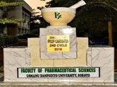

Identification of novel compounds from Neocarya macrophylla against toxins from Naja nigricollis using computational approach
Amina Jega Yusuf¹*, Musa Ismail Abdullahi², and Aliyu Muhammad Musa²
¹ Department of Pharmaceutical & Medicinal Chemistry, Usmanu Danfodiyo University, Sokoto, Nigeria
² Department of Pharmaceutical & Medicinal Chemistry, Ahmadu Bello University, Zaria, Nigeria
* Corresponding author: amina.yusuf@udusok.edu.ng

Slide 2
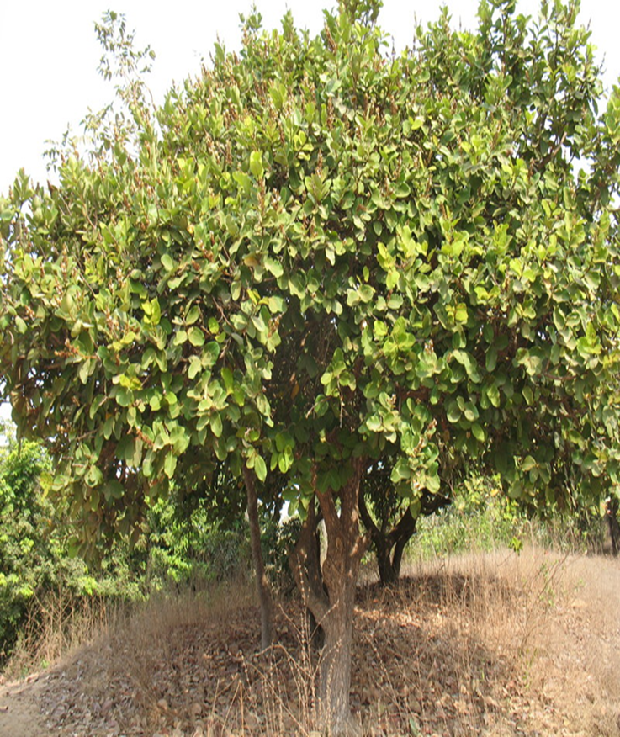
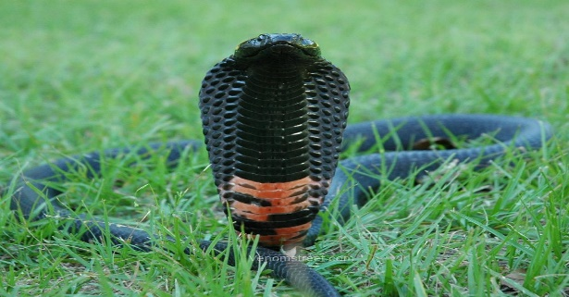
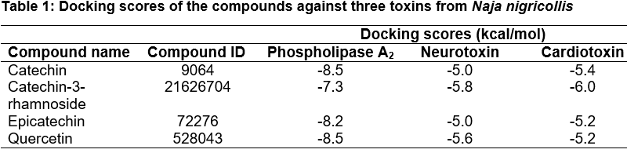
Graphical abstract: Identification of novel compounds from Neocarya macrophylla against toxins from Naja nigricollis using computational approach
Catechin
Epicatechin
Catechin-3-rhamnoside
quercetin
Molecular Docking
Isolation
PLA2
Neurotoxin
Cardiotoxin
N. macrophylla

Slide 3
Abstract: Envenomation resulting from snakebite especially N. nigricollis constitutes a frequent medical emergency in many tropical and sub-tropical countries. The unavailability and side effects associated with the only definitive treatment for snakebite victims necessitated the search for alternative available agents with lesser side effects. The aim of this study was to investigate the inhibitory action of compounds isolated from N. macrophylla against toxins (phospholipase A₂, neurotoxin and cardiotoxin) from N. nigricollis venom using computational approach.
Phytochemical constituents of N. macrophylla (catechin, epicatechin, catechin-3-rhamnoside and quercetin) were screened against three toxins from N. nigricollis using AutoDock tools in PyRx software and post docking analysis was conducted using the Chimera 1.14 and BIOVIA Discovery studio visualizer 2020.
The results have shown that, the compounds from N. macrophylla can bind with high affinity (ranging from -7.3 to -8.5 kcal/mol) to the active sites of phospholipase A₂ compared to the other toxins. The docking scores of the compounds against neurotoxin and cardiotoxin ranges from (-5.2 to -6. 6) and (-5.2 to -6.0), respectively.
The outcome of this study revealed that, phytoconstituents from N. macrophylla can effectively inhibit toxins from N. nigricollis venom and thus, could serve as lead compounds for further analysis.
Keywords: Neocarya macrophylla, flavonoids, in silico, antivenom

Slide 4
Introduction
Envenomation resulting from snakebite is a neglected public health issue in many tropical and subtropical countries especially in Africa, Asia and Latin America
with about with about 5.4 million snake bites occur each year, resulting in 1.8 to 2.7 million cases of envenomings (poisoning from snake bites) and in addition, there are 81 410 and 137 880 deaths and around three times as many amputations and other permanent disabilities each year (WHO, 2019).
The unavailability and side effects associated with the only definitive treatment (administration of ASVs) for snakebite victims necessitated the search for alternative available agents with lesser side effects.
Snake venom is a complex mixture of enzymatic and toxic proteins, which include phospholipase A₂ (PLA₂), myotoxins, hemorrhagic metallo-proteineases and other proteolytic enzymes, coagulant components, cardiotoxins, cytotoxins and neurotoxins (Kini, 1997; Aird, 2000; Ameen et al., 2015).
Pathology induced by envenomation is due to the collective effect of myotoxic phospholipases A₂, neurotoxins, hyaluronidases and cytotoxins among others.

Slide 5

Introduction con’t
Neocarya macrophylla (Family; Chrysobalanaceae) commonly known as gingerbread plum has been used in traditional medicine to treat snake bites, cancer, breathing disorders among other (Yusuf et al., 2015).
The antisnake venom of the plant have been validated against Naja nigricollis venom in animal models (Yusuf et al., 2019; Yusuf et al., 2020).
Catechin, catechin-3-rhamnoside, epicatechin and quercetin were previously isolated from the stem bark and leaves of N. macrophylla (Figure 1) (Yusuf et al., 2019; Yusuf et al., 2020).
The aim of the study was to investigate the inhibitory action of compounds isolated from N. macrophylla against toxins (phospholipase A₂, neurotoxin and cardiotoxin) from Naja nigricollis venom using computational approach.

Slide 6
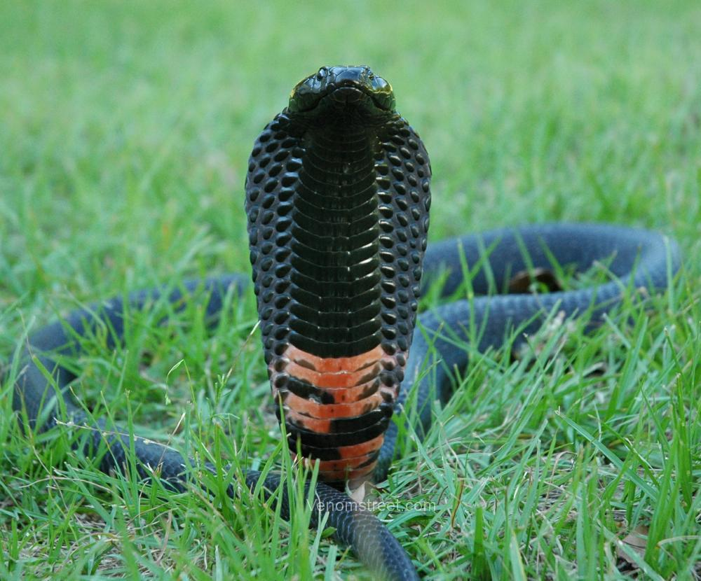
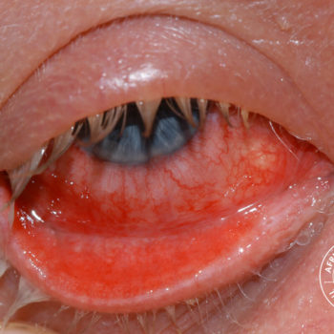
Naja nigricollis
Snake bite

Slide 7
Figure 1: 2D structures of compounds isolated from Neocarya macrophylla

Slide 8

Catechin
Epicatechin
Catechin-3-rhamnoside
quercetin
METHODOLOGY
Isolation
PLA2
Neurotoxin
Cardiotoxin
Ligand preparation
Protein preparation
Molecular Docking analysis
AutoDock tools in PyRx software
Post docking analysis
Chimera 1.14
BIOVIA Discovery studio visualizer 2020

Slide 9
Results and discussion
Table 1: Docking scores of the compounds against three toxins from Naja nigricollis
 |  | Docking scores (kcal/mol)
Compound name | Compound ID | Phospholipase A₂ | Neurotoxin | Cardiotoxin
Catechin | 9064 | -8.5 | -5.0 | -5.4
Catechin-3-rhamnoside | 21626704 | -7.3 | -5.8 | -6.0
Epicatechin | 72276 | -8.2 | -5.0 | -5.2
Quercetin | 528043 | -8.5 | -5.6 | -5.2

Slide 10
Figure 2: A) Docking pose of the compounds at the active site of N. nigricollis PLA₂. 2D animated poses between the compounds and N. nigricollis PLA₂ B) catechin, C) epicatechin, D) catechin-3-rhamnoside, E) Quercetin

Slide 11
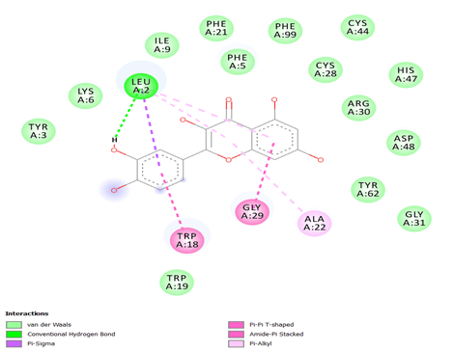
E) Quercetin

Slide 12
Figure 3: A) Docking pose of the compounds at the active site of N. nigricollis cardiotoxin. 2D animated poses between the compounds and N. nigricollis cardiotoxin B) catechin, C) epicatechin, D) catechin-3-rhamnoside, E) Quercetin

Slide 13
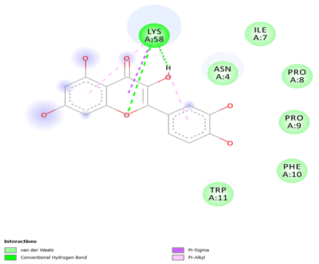


Slide 14
Figure 4: A) Docking pose of the compounds at the active site of N. nigricollis neurotoxin. 2D animated poses between the compounds and N. nigricollis neurotoxin B) catechin, C) epicatechin, D) catechin-3-rhamnoside, E) Quercetin

Slide 15
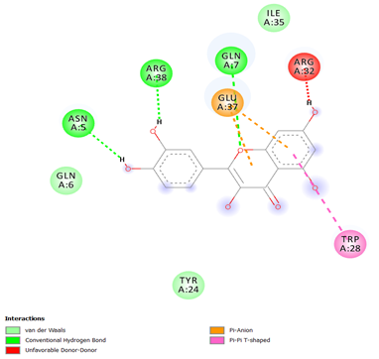
E) Quercetin

Slide 16
Table 2: Interactions of the compounds against the three toxins from Naja nigricollis
 | Interactions
Compound name | Phospholipase A₂ | Neurotoxin | Cardiotoxin
Catechin | H-Bond: PHE21, ASP48 Others: TYR3, PHE5, LYS6, ILE9, LEU9, TRP18, ALA22, CYS28, GLY29, ARG30, CYS44, HIS47, TYR51, PHE99 | H-Bond: ASN5, ARG32 Others: GLN7, TYR24, TRP28, ILE 35, GLU37, ARG38, GLY39 | H-Bond: LYS2 Others: CYS3, ASN4, ILE7, PRO8, PRO9, PHE10, TRP11, ASP57, LYS58
Catechin-3-rhamnoside | H-Bond: GLY29 Others: LEU2, TYR3, PHE5, LYS6, ILE9, TRP18, TRP19, PHE21, ALA22, ASP23, CYS28, ARG30, TYR62, PHE99 | H-Bond: LYS15, GLU37 Others: ASN5, GLN6, GLN7, TYR24, LYS26, TRP28, ILE36, RG38, GLY39, CYS40 | H-Bond: PRO8, LYS23, ASN60 Others: ASN4, LEU6, ILE7, PRO9, PHE10, TRP11, ARG36, LYS58
Epicatechin | H-Bond: HIS47, ASP48 Others: LEU2, TYR3, PHE5, LYS6, TRP18, PHE21, ALA22, CYS28, GLY29, CYS44, TYR51, TYR62, PHE99 | H-Bond: ARG32 Others: ASN5, GLN7, LYS15, TYR24, TRP28, ILE35, GLU37, ARG38, GLY39, CYS40 | H-Bond: ASN4 Others: LEU6, ILE7, PRO8, PRO9, PHE10, TRP11, ARG36, LYS58, ASN60
Quercetin | H-Bond: LEU2 Others: TYR3, PHE5, LYS6, ILE9, TRP18, TRP19, PHE21, ALA22, CYS28, GLY29, ARG30, GLY31, CYS44, HIS47, ASP48, TYR62, PHE99 | H-Bond: ASN5, GLN7, ARG38 Others: GLN6, TYR24, TRP28, ARG32, ILE35, GLU37 | H-Bond: LYS58 Others: ASN4, ILE7, PRO8, PRO9, PHE10, TRP11

Slide 17
Conclusion
We have screened four compounds (catechin, catechin-3-rhamnoside, epicatechin and quercetin) isolated from N. macrophylla using molecular docking.
The outcome of this study revealed that, phyto-constituents from N. macrophylla can effectively inhibit toxins from N. nigricollis venom and thus, could serve as lead compounds for further analysis

Slide 18
Some References
World Health Organization, WHO. 2019. Snake envenomings. WHO Fact sheets; [cited 2019 Aug 23]. Available from: https://www.who.int/news-room/fact-sheets/detail/snakebiteenvenoming.
Kini, R. M. (1997). Venom Phospholipase A2 Enzymes. Structure, Function and Mechanism,Chichester: John Wiley & Sons Ltd., Chichester, United Kingdom, 155–183.
Aird, S. D. (2002). Ophidian envenomation strategies and the role of purines, Toxicon 40 (59): 35-393.
Mackessy, S. P. (2002). "Biochemistry and pharmacology of colubrid snake venoms" Toxin Reviews. Journal of Toxicology: 21 (1-2): 43–83.
Robert, A. H., Adam, H., Simon, C. W., Brian, F., David Soares, A M., Fontes, M. R. M and Giglio, J. R (2004). Phospholipases A2 myotoxins from Bothrops snake review. Current Organic Chemistry, 8: 1677–1690.
Ameen, S. A., Salihu, T., Mbaoji, C. O., Anoruo-Dibia, C. A and Adedokun, R. A. M. (2015). Medicinal plants used to treat Snake bite by Fulani Herdsmen in Taraba State, Nigeria. International Journal of Applied Agricultural and Apicultural Research 11 (1&2): 10-21.
Kini, R., Chan, Y., 1999. Accelerated evolution and molecular surface of venom phospholipase A2 enzymes. J. Mol. Evol. 48, 125–132..
Warrell, D. A. (2003). Injuries, envenoming, poisoning, and allergic reactions caused by animal. In: Warrell DA, Cox TN, Firth JD, Benj J Jr, editors. Oxford Textbook of Medicine. Oxford: Oxford University Press; 2003. pp. 923–45

Slide 19
Acknowledgments
We acknowledged the efforts of Mr. Adeboyega Abayomi of the Department of Biochemistry University of Jos, Nigeria and Jaris Computational Biology Center for providing the necessary softwares for the research work

