Slide 1
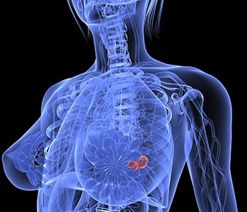
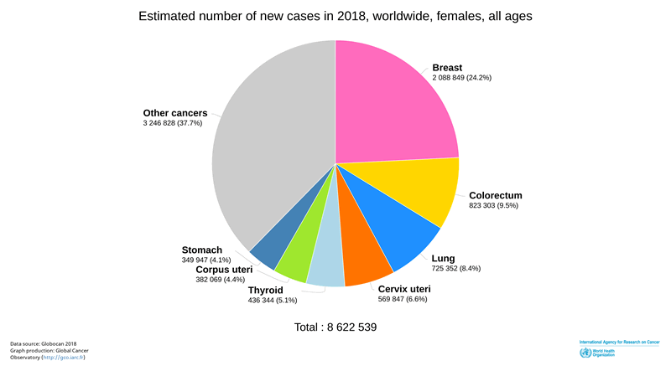
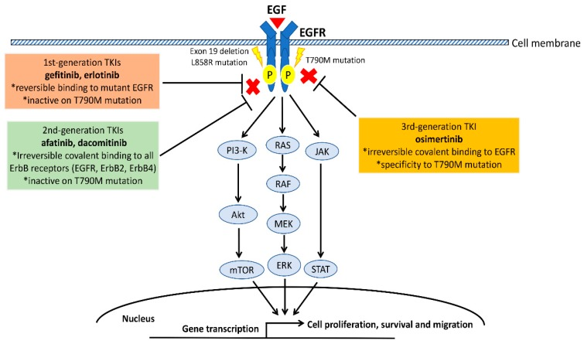
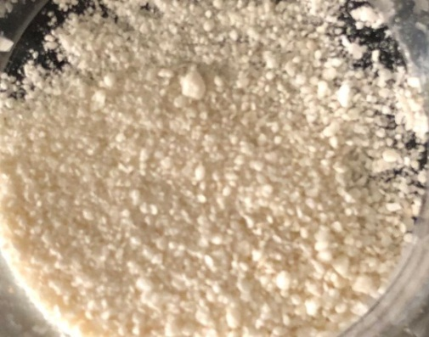
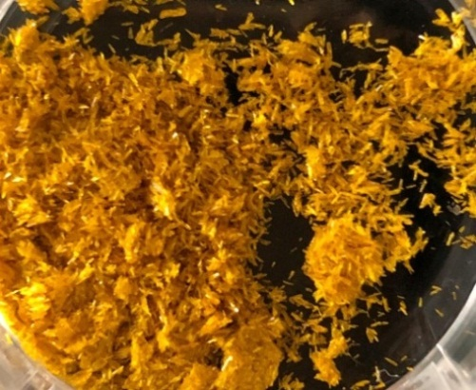
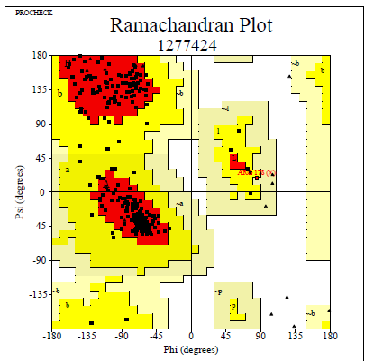
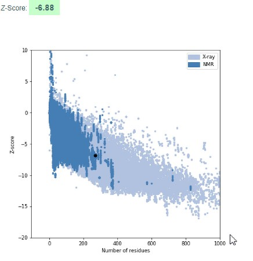
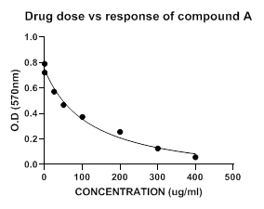
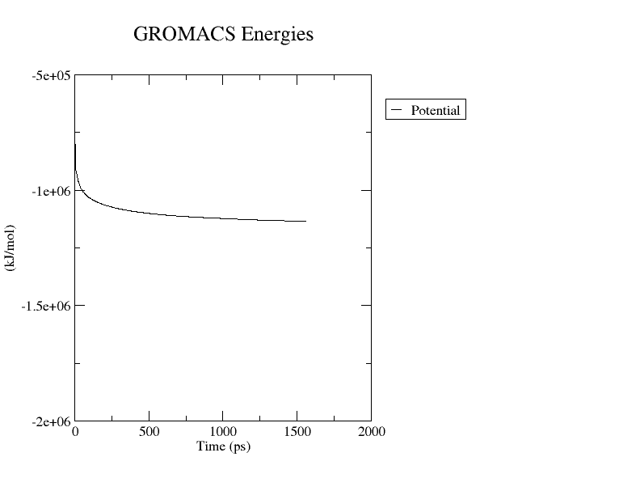
In-Silico and In-Vitro Study of Benzanilide Derivatives as a Potent Anti-Cancer Agent
¹Shruti Chandrashekar, ¹Shraddha Shetty, *¹Mala Parab, ²Santosh S Chhajed, ¹Debjani Dasgupta, *¹Pramodkumar P Gupta
¹School of Biotechnology and Bioinformatics, D Y Patil Deemed to be University, Navi Mumbai, Maharashtra, India
²Department of Pharmaceutical Chemistry, MET Institute of Pharmacy, Nashik, Maharashtra, India
Corresponding author: Mala Parab, (mala.parab@dypatil.edu ) ; Pramodkumar P Gupta, (pramodkumar785@gmail.com / pramod.gupta@dypatil.edu )
Abstract:
Cancer is one of the leading causes of death in the current world. Among numerous anticancer drug targets, EGFR is a potential and one of the highly studied drug target. Benzanilide scaffold and its derivatives are the promising groups of compounds with several biological activities including antifungal, antimycotic, antibacterial, spasmolytic, and anticancer. Here, we have tried to develop an improve anticancer compound with benzanilide scaffold. A list of in-silico based benzanilide derivatives was designed and evaluated using molecular docking energy and pharmacophoric interactions in comparison to known EGFR inhibitor. The two optimum compounds A and B were synthesized and tested for their in-vitro anticancer activity by MTT Assay against MCF-7 cell line. Blood lymphocytes were used for studying the effect of the compounds on non-cancerous cells within the human body. The IC₅₀ value of compound A and compound B against MCF-7 was calculated to be 122.3 µM and 101.9 µM respectively. Evaluation of cytotoxic studies of synthesized molecules reveals that both the compounds show cytotoxic activity. The results suggested that compounds A and B could be further explored and studied with more molecular assays to understand its detail activity as an anti-cancer agent.
Background
Methodology
In-Silico Modelling
Sketch and design compounds
ADME-T properties calculation
Modelling of EGFR protein kinase domain
Energy minimization
Structure validation
Molecular docking
Synthesis of Compounds
Fig 1: Breast Cancer
Fig 2: Breast Cancer statistical data
Melting point analysis
TLC
In-Vitro Analysis
MTT assay on MCF-7 and lymphocytes
IC50 value and statistical validation.
Fig 3: EGFR structure
Fig 4: EGFR Mechanism
Fig 5: Methodology
Results
Table: 1.0 – Molecular Docking result with Compound Standard , A and B
Table: 2.0 – Compound Synthesized A and B
Ligand | Protein | Binding Energy (Kcal/Mol) | Conventional Hydrogen bond | Pi-Pi stacked | Van der waals
Standard molecule | EGFR Tyrosine Kinase | -9.5 | MET A-793 | PHE A: 723 | THR A -790 THR A : 854 GLY A- 719 LEU A- 792
Compound A | EGFR Tyrosine Kinase | -7 | - | PHE A: 723 | ASN A:842 THR A: 854 ASP A : 855 LYS A :745
Compound B | EGFR Tyrosine Kinase | -7.8 | MET A- 793 | PHE A: 723 | ASP A : 855 LYS A :745 GLY A: 796 GLY A: 719
COMPOUND | WATER | ETHANOL | METHANOL | DMSO
COMPOUND A | Not soluble | Soluble | Soluble | Soluble
COMPOUND B | Partially soluble | Soluble | Soluble | Soluble
Fig 6: Designed and sketched compounds
Fig 7: Homology Modelling of EGFR kinase domain
Fig 12: Molecular docking standard compound
Fig 13: Molecular docking compound A
Fig 14: Molecular docking compound B
Fig 15: Synthesized compound A –
N-phenylbenzamide
Fig 16: Synthesized compound B –
N-(4-nitrophenyl)benzamide
The statistical analysis of compounds on MCF- 7 cell line shows, 95% confidence level or profile likelihood. IC50 value was calculated to be 122.3 for compound A and 101.9 for compound B. The R2 value for compounds A and B was 0.9853 and 0.9991 respectively
In lymphocytes, IC50 value in the range of 300-400 which indicates that much higher concentration of drug is required to inhibit non-cancerous cells making them less harmful. The R2 value for compound A and B was 0.2362 and 0.9356
The cells exhibited altered morphology and a change in adherence patterns was reported.
The MTT assay results for lymphcytes show no significant changes in cell density even with increase in concentration of the drug, indicating that it has no toxic effect on non-cancerous cells in human body.
Fig 8: Ramachandran Plot
Fig 9: ProSA Analysis
Fig 17: Cytotoxicity result of compound A with MCF-7
Fig 18: Cytotoxicity result of compound B with MCF-7
Fig 19: Cytotoxicity result of compound B with Lymphocytes
Fig 20: Cytotoxicity result of compound B with Lymphocytes
Fig 10: RMSD Template Vs Model = 0.197A
Fig 11: Energy minimization of model
Conclusion: Benzanilide scaffold is majorly used as drugs for various infectious diseases and very less information is available about their anti-cancer activity. The results suggested that compounds A and B could be further explored and studied with more molecular assays to understand its detail activity as an anti-cancer agent.

