Slide 1
Instrumental and sensory properties of cowpea and whey protein concentrate-fortified extruded rice snacks
H. N. N Dilrukshi
Department of Wine, Food and Molecular Biosciences,
Lincoln University,P.O. Box 84, Lincoln, Christchurch, 7647, New Zealand

Slide 2
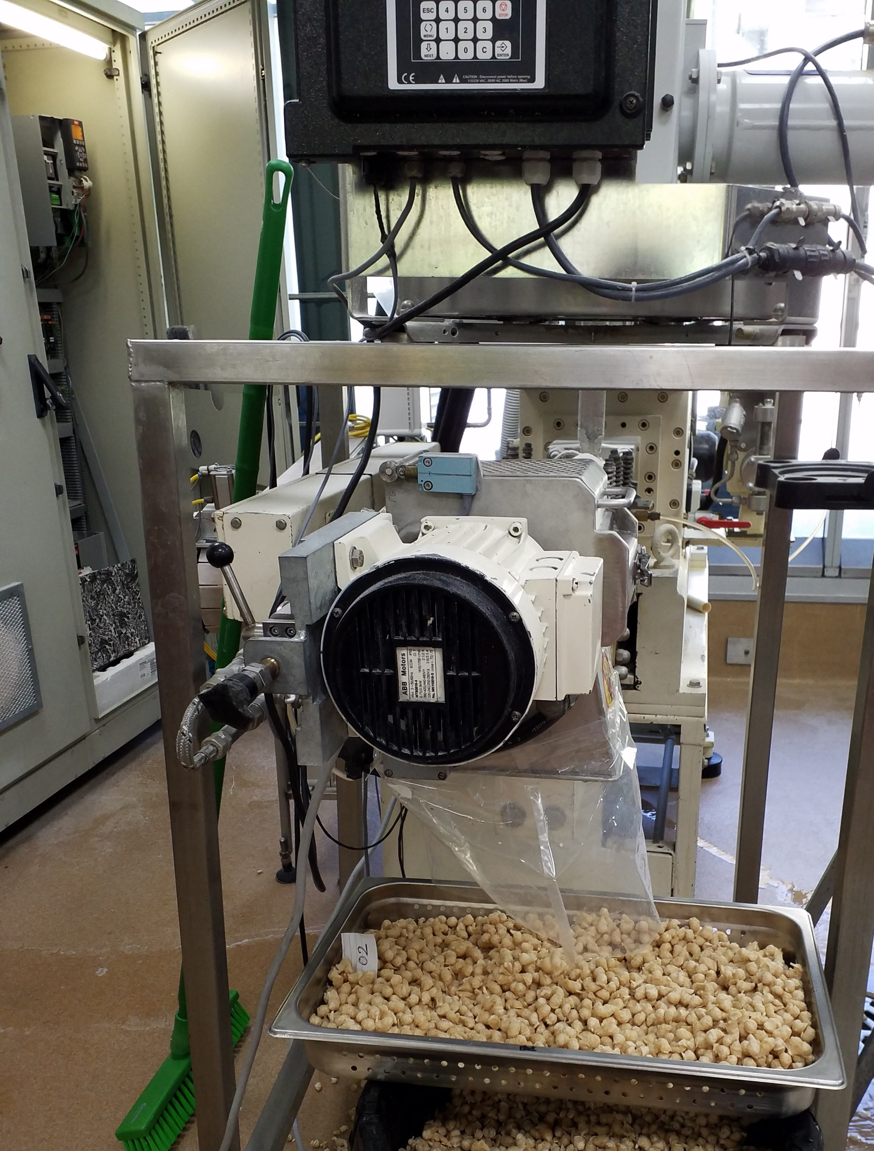
Outline
Introduction
Objective
Methodology
Results and Discussion
Conclusion
References
Acknowledgments

Slide 3
Introduction
Extrusion technology - offers an excellent avenue to combine different ingredients in ready-to-eat snacks with a wide variety of textures and mouth feelings
These additions - reduce carbohydrate-rich, high glycaemic products, and improve bioactive components in snacks
Source: masonfit.com/healthy-snacks-guide

Slide 4
Source:(Dalbhagat, Mahato et al. 2019))
Various researchers have strived to enhance the nutritional profiles of extruded products with protein, fibre and bioactive components, through the addition of legumes, fruits, vegetables and food industry by-products

Slide 5
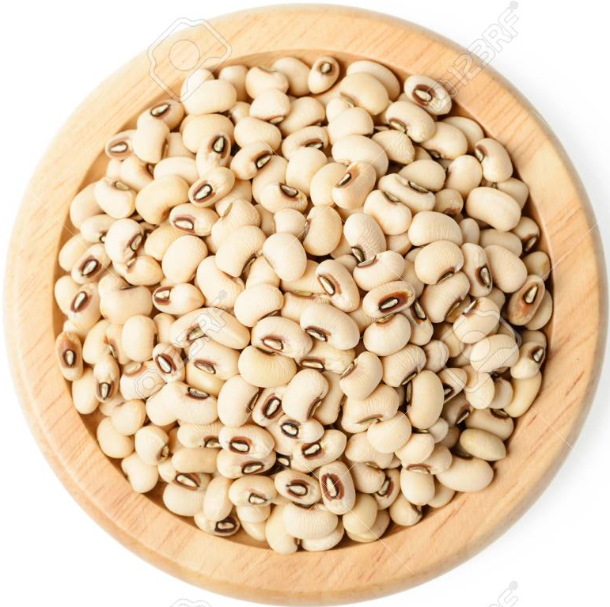
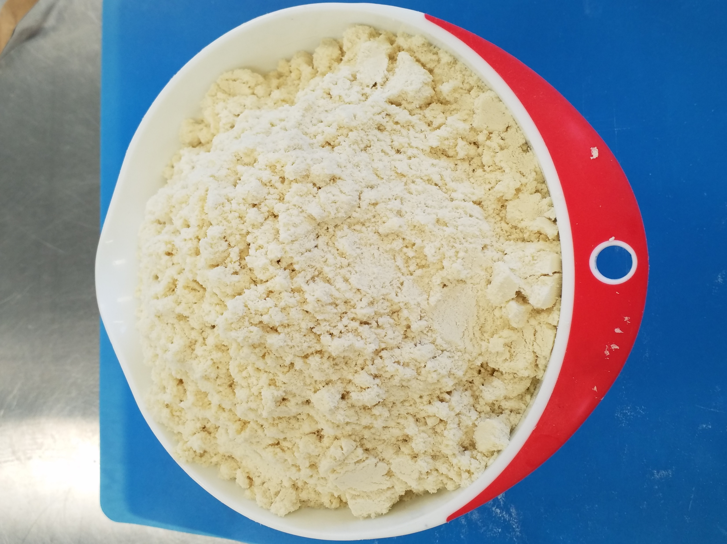
Objective Assess the instrumental and sensory properties of extruded ready-to-eat snacks rich in fibre and protein using a new combination of ingredients
+
+
Rice
Oryza sativa
Whey Protein
Cowpea Vigna unguiculata L. Walp.

Slide 6
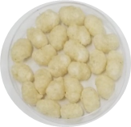
Methodology Raw material combinations and extrusion conditions
90% Rice + 10% Cowpea
80% Rice + 15% Cowpea + 5% WPC
100% Rice Flour
Extrusion Process Conditions
Screw speed | 252 rpm
Die temperature | 111.5°C
Feed rate | 7.98 kg h¯¹
Water rate | 90.67 kg h¯¹
Die diameter | 3 mm
70% Rice + 20% Cowpea + 10% WPC
60% Rice + 25% Cowpea + 15% WPC
50% Rice + 30% Cowpea + 20% WPC

Slide 7
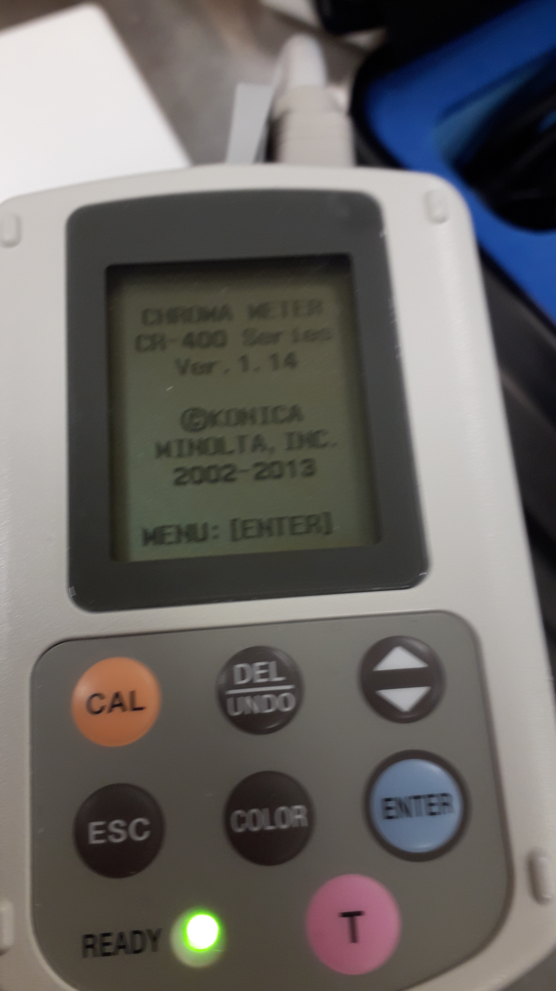
Colour Analysis
L* (brightness), a* (redness) and b* (yellowness) - by using a tristimulus colour analyser (Minolta Chroma Meter CR 210, Minolta Camera Co., Japan).
Total colour change (∆E) and the browning index (BI) were calculated according to the following equations
${∆E}^{∗}= \sqrt{{∆L}^{∗^{2}}+{∆a}^{∗^{2}}{+ ∆b}^{∗^{2 }}}$
$BI= \left(100 × \frac{\left(X−0.31\right)}{0.17}\right)$
$$Where X=(a^{∗ }+1.75 )/(5.645L∗+a^{∗ }−0.3012b^{∗})$$

Slide 8
Texture Analysis
Crispiness, and Hardness 5-bladed Kramer Shear Cell(HDP/KS5), Texture Analyser equipped with a 50 kg load cell (TA.XT2; Stable Micro Systems, Godalming, UK)

Slide 9
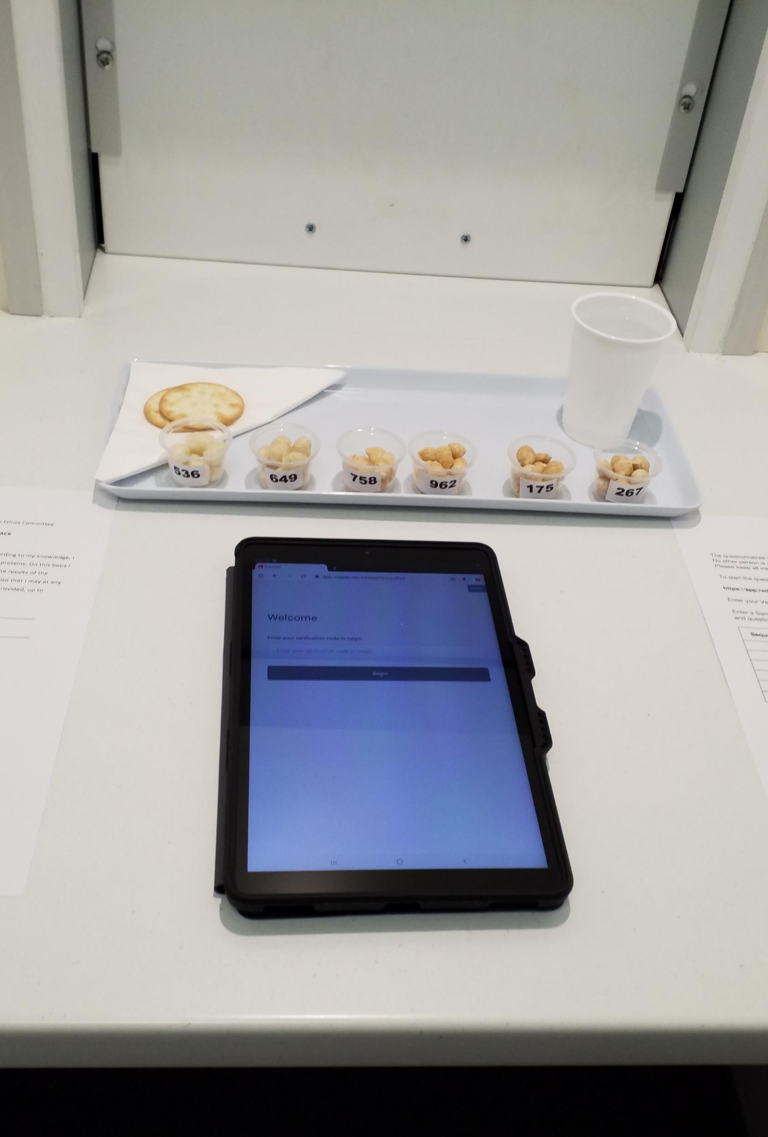
Sensory Analysis
Computerised questionnaires were administered (RedJade®Sensory Solutions, LLC, CA, USA)
Consumers (N = 70) were recruited from the staff and postgrads students
Each panellist was served five pieces of six extruded snack formulations, labelled with three-digit codes, following a counter-balanced presentation order
Unsalted crackers and water were provided for palate cleansing

Slide 10
Statistical Analysis
CATA (Check-All-That-Apply) data, Penalty analysis (JAR-Just above right), correspondence analysis was performed using XLSTAT statistical software (Addinsoft, NY, U.S.A.)
Analysis of variance (ANOVA), and Tukey’s tests(p<0.05) were carried out to determine whether differences existed among treatments in terms of colour, texture and sensory liking scores

Slide 11
Results and Discussion
Instrumental texture and colour Analysis
Table 1. Mean values (and standard deviations) of colour and texture parameters
Sample | Colour Properties |  |  |  |  | Texture
 | L* | a* | b* | ΔE | BI | Crispiness | Hardness
Control | 75.92 ± 0.93ª | -0.45 ± 0.02e | 12.24 ± 0.21^{d} | - | - | 45.40 ± 6.23ª | 223.35 ± 10.67^{c}
10% CPF | 68.30 ± 0.98^{b} | 0.32 ± 0.05^{d} | 12.77 ± 0.46^{d} | 7.69 | 20.56 | 39.80 ± 4.32ª | 243.32 ± 12.88^{c}
15% CPF + 5% WPC | 68.07 ± 0.65^{b} | 2.26 ± 0.08^{c} | 18.90 ± 0.79^{c} | 10.65 | 34.29 | 37.80 ± 2.17ª | 308.9 ± 32.3^{b}
20% CPF + 10% WPC | 67.14 ± 0.72^{bc} | 3.06 ± 0.13ª | 21.62 ± 0.06ª | 13.32 | 41.38 | 40.40 ± 1.14ª | 326.2 ± 22.6^{b}
25% CPF + 15% WPC | 65.93 ± 0.97^{c} | 2.34 ± 0.09^{c} | 20.07 ± 0.14^{b} | 13.00 | 38.13 | 38.80 ± 1.30ª | 339.11 ± 20.18^{b}
30% CPF + 20% WPC | 65.75 ± 0.33^{c} | 2.69 ± 0.12^{b} | 21.83 ± 0.47ª | 14.33 | 42.47 | 23.80 ± 6.83^{b} | 446.11 ± 15.46ª
*The same letter in superscript within column indicates homogeneous groups established by ANOVA (P < 0.05).

Slide 12
Table 2. Mean scores (and standard deviations) of consumer responses based on a 9-point hedonic scale for sensory attributes
*Mean values in the same row followed by different letters are significantly different (P < 0.05).
Sample | Appearance | Colour | Aroma | Overall flavour | Texture | After taste | Overall liking
Control | 5.70 ±1.77ª | 5.65± 1.77ª | 5.44±1.30ª | 5.17±1.50ª | 5.29±1.71^{b} | 5.04±1.77^{b} | 5.11±1.65^{b}
10% CPF | 5.69± 1.55ª | 5.79±1.74ª | 5.63±1.38ª | 5.80±1.55ª | 6.16±1.49ª | 5.67±1.56^{ab} | 5.77±1.44^{ab}
15% CPF + 5% WPC | 5.97 ±1.52ª | 6.19±1.31ª | 5.73±1.34ª | 5.89±1.85ª | 6.36±1.51ª | 5.99±1.80ª | 6.07±1.53ª
20% CPF + 10% WPC | 5.61± 1.48ª | 5.73±1.58ª | 5.56±1.40ª | 5.24±1.61ª | 6.04±1.50ª | 5.41±1.58^{ab} | 5.46±1.58^{ab}
25% CPF + 15% WPC | 5.53 ±1.50ª | 5.73±1.56ª | 5.46±1.44ª | 5.21±1.70ª | 6.04±1.65ª | 5.01±1.71^{b} | 5.31±1.7^{ab}
30% CPF + 20% WPC | 5.64±1.60ª | 5.69±1.48ª | 5.35±1.36ª | 5.2±1.63ª | 5.99±1.55^{ab} | 5.06±1.74^{b} | 5.20±1.64^{b}

Slide 13
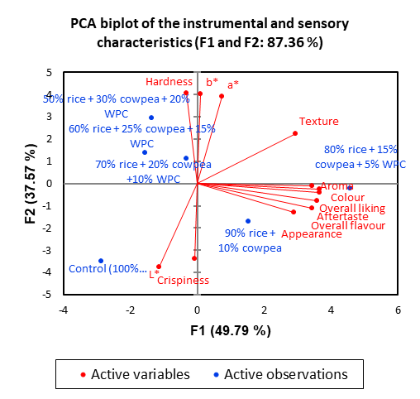
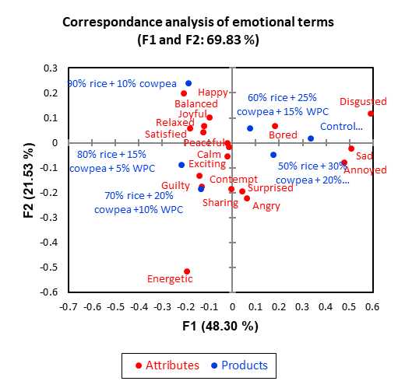
Based on the CATA emotional terms selected by panellists, extruded snacks samples could be classified into two groups, i.e., 1) 10-20% cowpea and 5-10% WPC, and 2) 25-30% cowpea and 15-20% WPC
10-15% cowpea and 5% WPC incorporated snacks were associated with “happy”, “balanced”, “joyful”, “relaxed”, “satisfied”, “peaceful”, “calm” and “exciting”

Slide 14
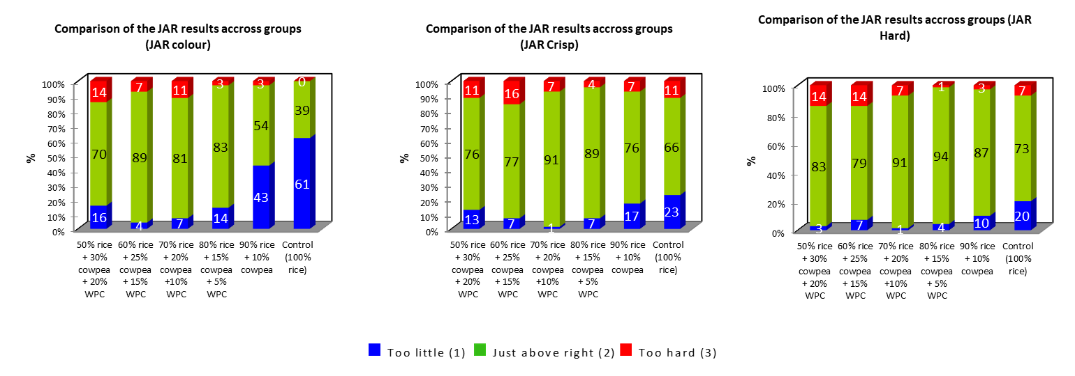
Figure 3 JAR results from consumer acceptance test for extrudates with (a) colour; (b) Crispiness; (c) Hardness
Overall, the percentage of consumers that rated the attributes as just about right increased in all categories with cowpea and WPC addition. Similarly, to hedonic scores, 15% cowpea flour and 5% WPC addition rated 83% for colour, 89% crispiness with 87% for hardness

Slide 15
Conclusion
A cowpea-WPC based gluten-free extruded snack containing 10-15% Cowpea flour and 5% WPC was found to exhibit the most desirable consumer acceptability properties
90% Rice + 10% Cowpea
80% Rice + 15% Cowpea + 5% WPC

Slide 16
References
A. M. Paula and A. C. Conti-Silva, “Texture profile and correlation between sensory and instrumental analyses on extruded snacks,” J. Food Eng., vol. 121, no. 1, pp. 9–14, 2014, doi: 10.1016/j.jfoodeng.2013.08.007
S. A. Wani and P. Kumar, “Influence of different mixtures of ingredients on the physicochemical, nutritional and pasting properties of extruded snacks,” J. Food Meas. Charact., vol. 10, no. 3, pp. 690–700, 2016, doi: 10.1007/s11694-016-9353-9.
M. Sha, S. Pathania, and A. Sharma, “LWT - Food Science and Technology Optimization of the extrusion process for development of high fi bre soybean-rice ready-to-eat snacks using carrot pomace and cauli fl ower trimmings,” vol. 74, 2016, doi: 10.1016/j.lwt.2016.07.031.
S. M. Beck, K. Knoerzer, M. Foerster, S. Mayo, C. Philipp, and J. Arcot, “Low moisture extrusion of pea protein and pea fibre fortified rice starch blends,” J. Food Eng., vol. 231, pp. 61–71, 2018, doi: 10.1016/j.jfoodeng.2018.03.004.
C. Brennan, M. Brennan, E. Derbyshire, and B. K. Tiwari, “Effects of extrusion on the polyphenols , vitamins and antioxidant activity of foods,” Trends Food Sci. Technol., vol. 22, no. 10, pp. 570–575, 2011, doi: 10.1016/j.tifs.2011.05.007.

Slide 17
Acknowledgements
I want to express my sincere gratitude to my supervisors Prof. Charles S. Brennan, Dr. Margaret A. Brennan and Dr. Damir D Torrico, for the continuous support and guidance throughout the experimental period
All the staff members of the department WFBM and Postgraduate students who participated as sensory panellists are highly appreciated
Also, my sincere thanks go to Letitia Stipkovits for her technical support during the study period

Slide 18
Thank You

