Slide 1
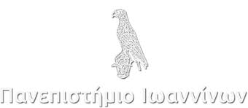
Acoustic emission monitoring of the fracture behavior of mortar specimens fabricated using recycled concrete aggregates
Anastasios Mpalaskas¹, Dimitrios G. Aggelis², Theodore E. Matikas¹
¹Department of Materials Science and Engineering, University of Ioannina, Greece
²Department Mechanics of Materials and Constructions, Vrije Universiteit Brussel (VUB), Pleinlaan 2, 1050 Brussels, Belgium

Slide 2
Introduction
The environmental impacts of the process and transfer of raw materials from the resource location to the construction site is enormous
Additionally, the natural resources become more limited and harder to obtain
Coarse (CRCA)
develop an alternative solution, like the process of Recycled Concrete Aggregate (RCA)
recycled concrete aggregate
Fine (FRCA)

Slide 3
Introduction
In the present study we wish to monitore the fracture behavior of recycled mortar specimens using the acoustic emission technique
To produce the recycled mortar beams, a portion of fine recycled concrete aggregates has been used, and the specimens were tested in three-point bending
Acoustic Emission has been used for the fracture investigation of mortars fabricated with different types and combinations of Fine recycled concrete aggregates (FRCA), limestone, natural, and standard sand as components of the specimens tested as well as the addition of fiber reinforcement
This work led to a comparison between the fracture behavior of recycled mortar specimens with steel fiber-reinforced and baseline mortars fabricated with 100% natural sand

Slide 4
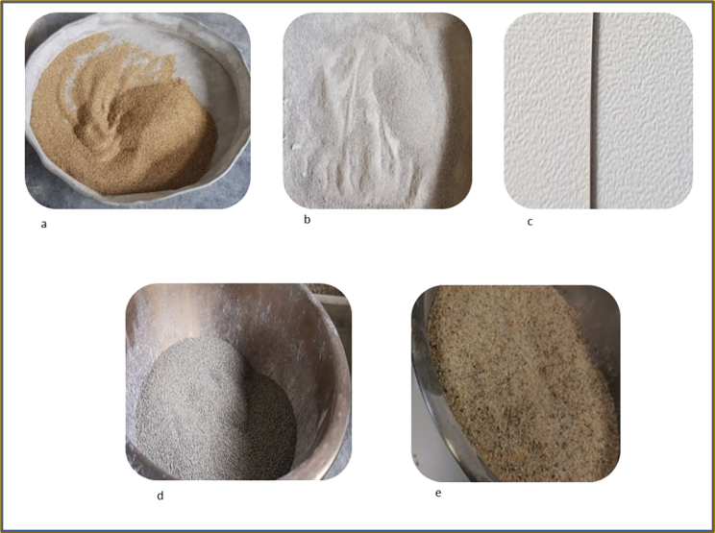
Experimental part
Limestone
Natural Sand
Straight Dhaped Steel Fiber
Recycled Concrete Aggregate
Standard Sand

Slide 5
Experimental part
Four groups of three specimens per 40x40x160mm
RCxS mortar from 20% per weight from fine recycled concrete aggregates see and 80% from standard sand
RCxL and consists of mortar from 20% per weight fine recycled concrete aggregates and 80% from limestone
PxT and consists of a mortar fabricated from 100% natural crushed sand
Sx, consists of steel fiber reinforced mortar also fabricated from 100% natural crushed sand

Slide 6
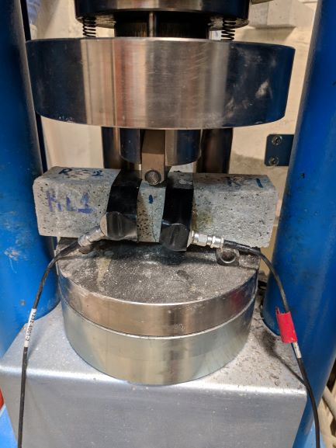
Experimental part (3-P bending)
BS EN EN 13892-2:2002
Displacement rate 50N/s until the fracture
Two piezoelectric sensors named (R15, Mistras)/ 150 kHz
Materials:
Ratio W:C:A, 0.5:1:3 by mass
Cement (type II 42.5N)
Same grain size in between 1.19 mm - 0.841 mm with16 – 20 Sieve Designation
Straight-Steel Fibers used for reinforcement with 39,3 kg/m3 with a diameter of 0.6 mm and length of 25 mm and density was 7.85 kg/dm3

Slide 7
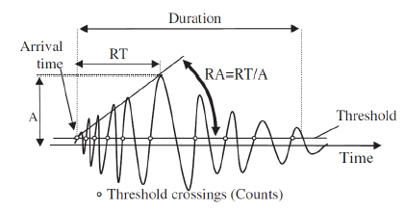
Experimental part (Acoustic Emission)
A schematic representation of a waveform
Main features
the maximum amplitude AMP (dB).
the "rise time" (RT) (which is the time between the first threshold crossing and the point of peak amplitude in µs). Rise Time is related to the fracture mode of the crack, and so is the inverse of the slope of the initial part of the signal (RA value, RT/A in µs/V).
AF (average frequency) can be measured by the total number of threshold crossings divided by the duration and can characterize the Frequency content
the duration DUR (the period between the first and the last threshold crossing),

Slide 8
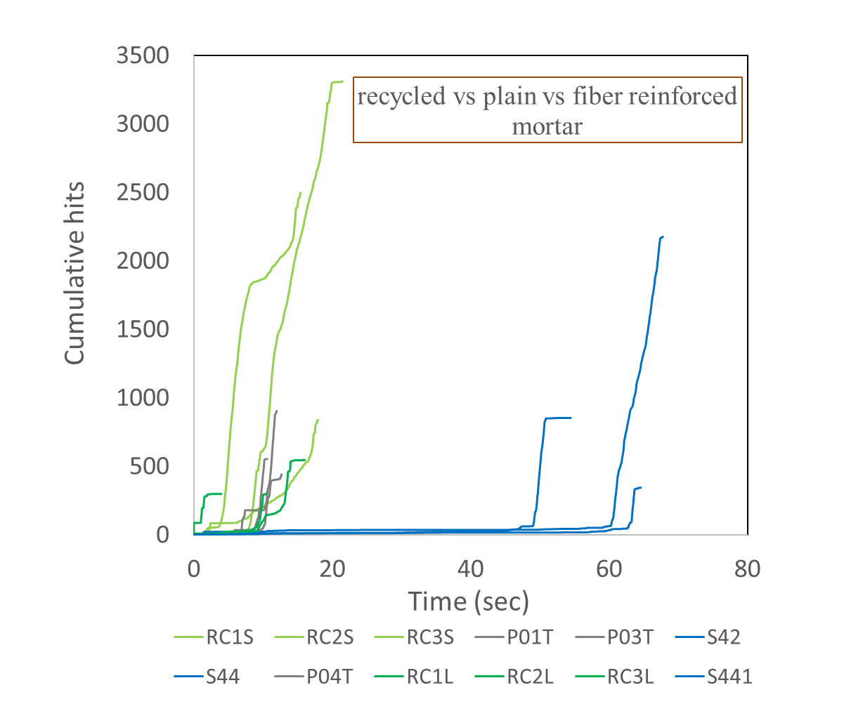
Results
RCxS and the Sx groups achieve the maximum acoustic activity
because of the fiber pull out at the cement-paste matrix that emits extra energy for the Sx specimens during the loading condition

Slide 9
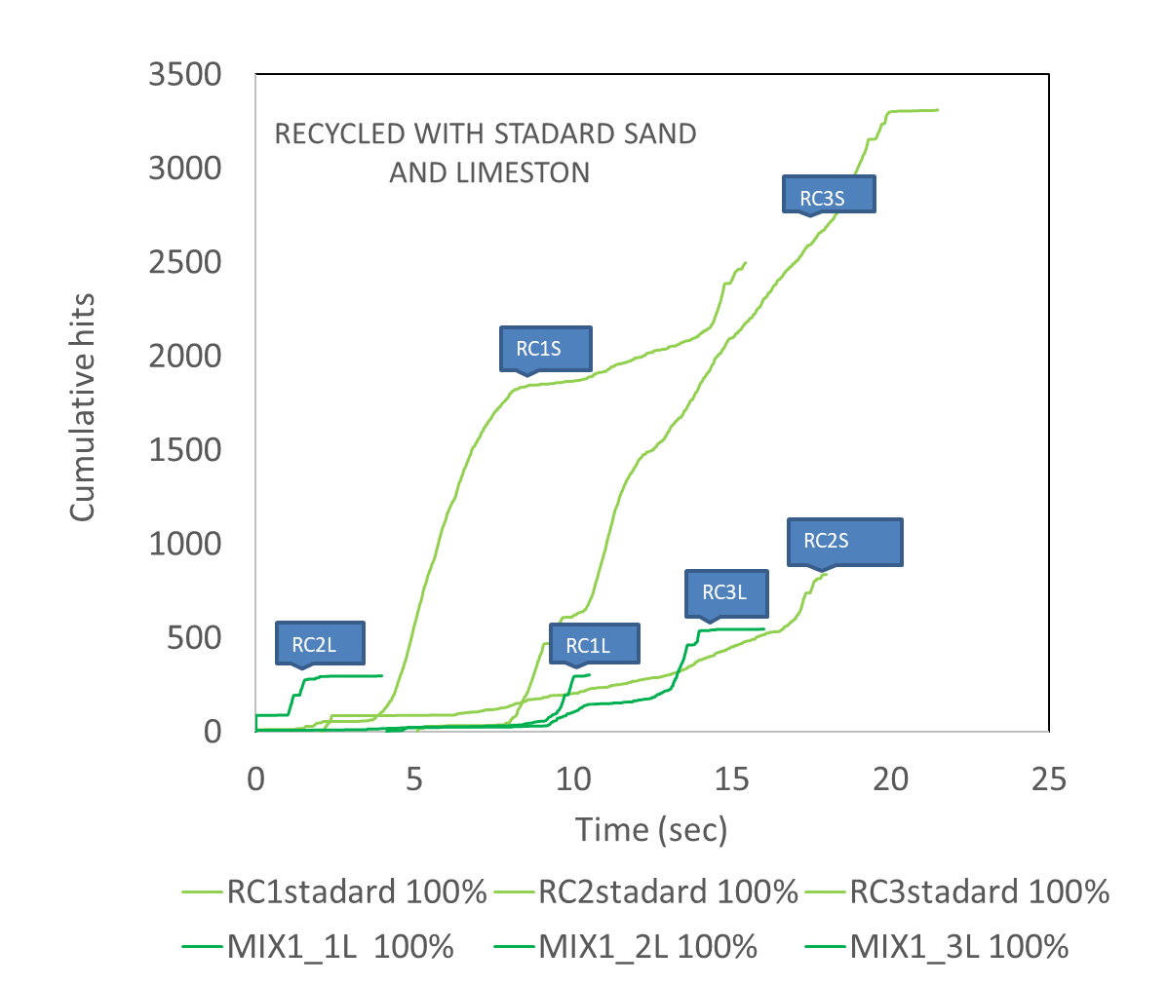
Results
The microcrack propagation path appears more extensive in the RCxS group compared with the RCxL justifying the higher acoustic emission activity
Harsh and stiffer grains of the standard sand group tend to release a more significant amount of energy, making the fracture more brittle

Slide 10
Results (3P bending)
mechanical testing and the essential acoustic emission parameters
The AE parameters are mean values from both sensors representing the total hits population of the signals emitted during the loading condition.
Mortar Type | Maximum Load (kN) | Sum COUNT | Sum ENERG | AMP (dB) | AF (kHz) | RA (μs/V)
RC1S | 2,74 3,14 2,97 | 86421 | 25518, | 52,02 | 54,36 | 4554,38
RC2S |  | 31823 | 12535 | 53,35 | 67,83 | 3244,55
RC3S |  | 193853 | 110784 | 54,29 | 47,02 | 3941,49
RC1L | 2,04 | 10063 | 3246 | 50,44 | 50,98 | 6354,95
RC2L | 1,55 | 12082 | 3396 | 51,21 | 49,08 | 7420,88
RC3L | 1,87 | 19570 | 5803 | 50,89 | 49,65 | 4846,11
P01T | 3,77 | 23227 | 6811 | 47,25 | 33,79 | 9515,60
P03T | 4,33 | 28021 | 8819 | 47,80 | 33,51 | 12625,61
P04T | 6,60 | 40225 | 14318 | 50,23 | 41,67 | 14205,75
S42 | 7,80 | 72414 | 31225 | 49,65 | 44,99 | 6343,10
S41 | 7,39 | 39107 | 17858 | 51,04 | 44,99 | 7962,24
S44 | 7,75 | 14472 | 4643 | 50,57 | 43,93 | 7196,15

Slide 11
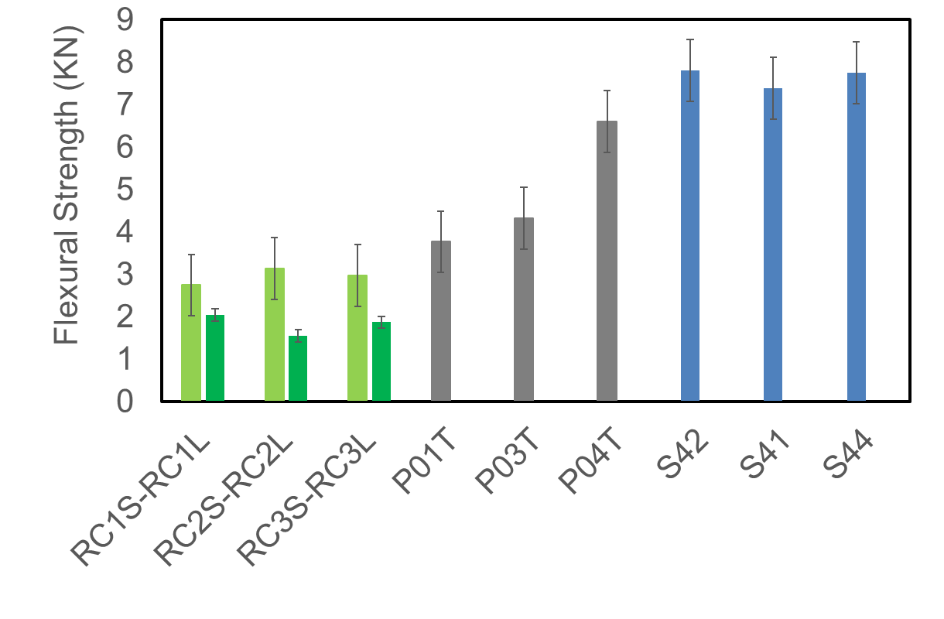
Results (3P bending)
The fiber-reinforced specimens (Sx group) exhibit higher flexural strength amongst all types, and they are followed by the plain mortar (PxT group) as expected.
The two groups of recycled concrete aggregates have minor Flexural strength

Slide 12
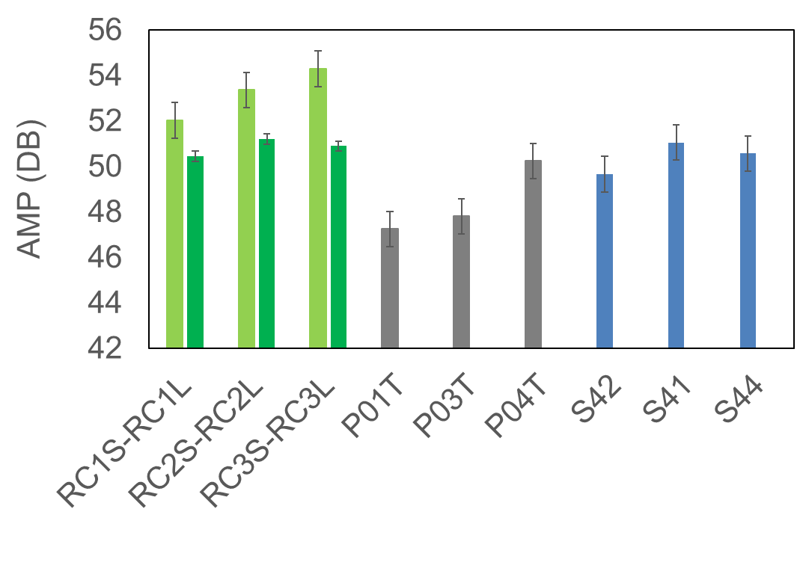
Results (3P bending)
The two recycled groups exhibit higher AMP values
The specimens from the RCxS group shows the highest AMP values with not overlap

Slide 13
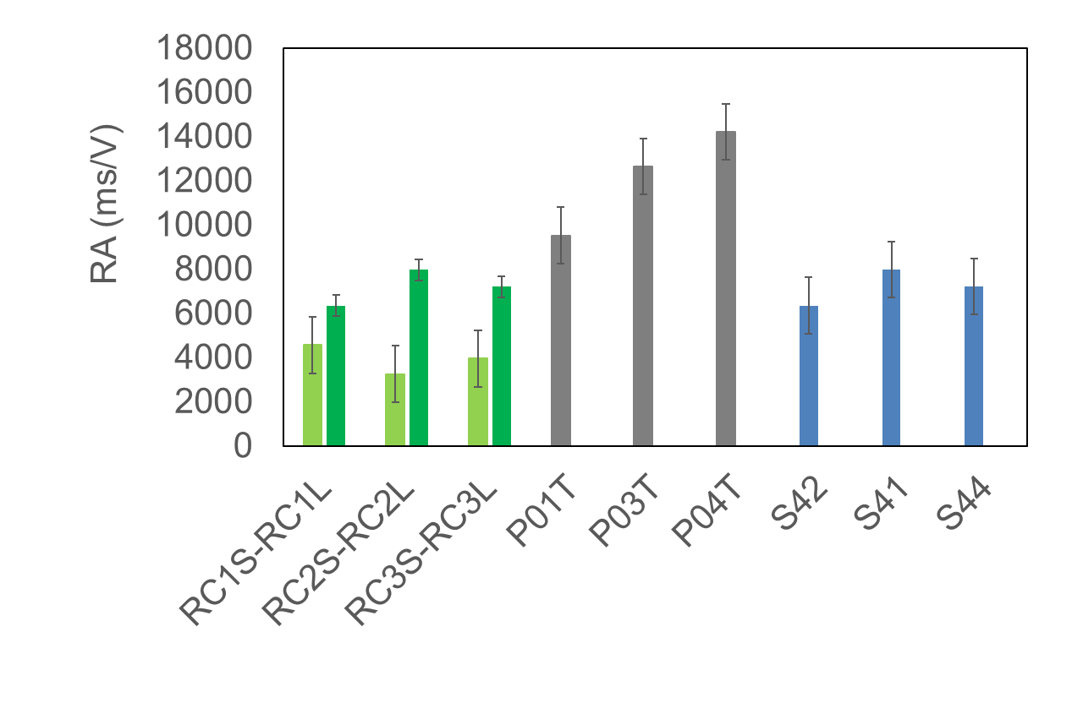
Results (3P bending)
The specific behavior of Mode I tensile microcracking of the two groups of the recycled concrete aggregate mortars, appear more evident
The lower values of the RA, together with the high AMP, can confirm the more tensile microcracking emitted by the two groups that represent the recycled concrete aggregates samples

Slide 14
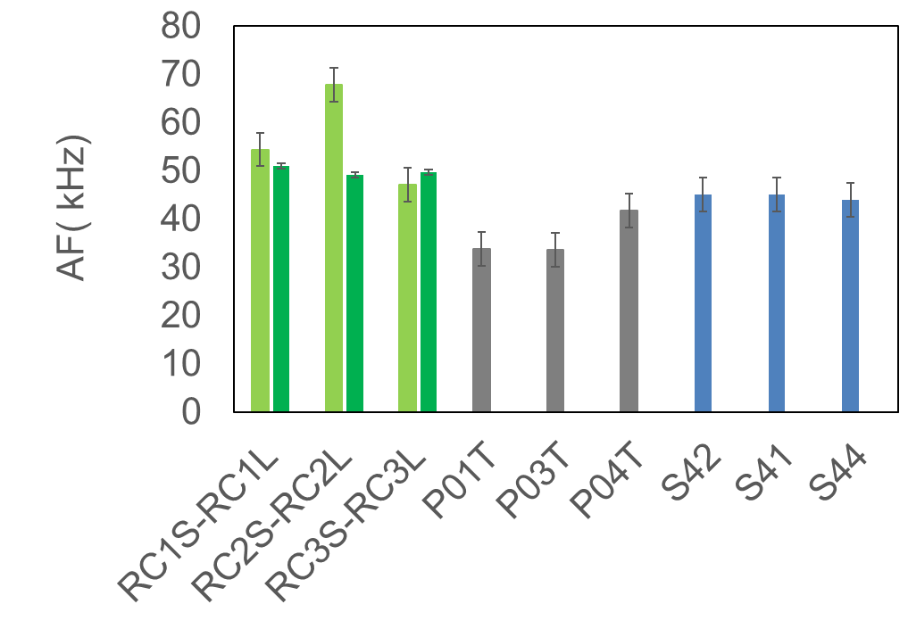
Results (3P bending)
The higher values of the AF, together with the high AMP, can confirm the more tensile microcracking emitted by the two groups that represent the recycled concrete aggregates samples
The trend is more obvious for the RCxS that also have the addition of the standard sand which also favors the more brittle fracture and the tensile microcracking

Slide 15
Conclusions
The maximum flexural strength of the four groups corresponds well with the literature. The fiber-reinforced mortars exhibit better performance followed by the mortars fabricated with 100% natural sand, and lastly, by the recycled concrete aggregates mortars.
The difference between the flexural strength of the standard and the limestone recycled mortars groups is being justified by the stiffer nature of the standard sand grains compared with the limestone ones.
The Fiber-reinforced mortar, except for the better mechanical properties, doesn't seem to follow a specific AE trend. Even though a Mode II shear cracking is expected because of the fibers pull out from the matrix, the AE monitoring hasn't proved a precise type of failure at the microstructure because of the fiber's straight shape.

Slide 16
Conclusions
The higher acoustic emission activity of the RCxS group compared with the RCxL, can be explained by the potentially extensive microcrack propagation path generated. More investigation should be made with a scanning electron microscope for proofing the crack network grow.
The higher water absorption of the recycled aggregates leads to increased porosity at the mortar specimens, respectively. The specific tensile microcracking behavior of the recycled mortars microstructure is being favored by the expanded porosity.
The more spherical grains of the limestone mortar tends to slip each other at the microcracks initiating the shear movement with results, the increase of the RA, and the decrease of the AF values if directly compared with the standard sand samples, which exhibits much more clear Mode I tensile microcracking.
More specifically, the volumetric change at the microstructure because of the pore's increment affects the microcrack initiation and propagation network that is responsible for the increase at longitudinal elastic waves emitted during loading.
Moreover, the remaining touched old cement paste at the surface of the recycled grains preventing the shear microcracking because of the friction resistance increment.

Slide 17
Thank you
Any questions?
tbalask@gmail.com
daggelis@vub.be

