Slide 1
Gelled Emulsions based on Amaranth Flour with Hemp and Sesame Oils
Carmen María Botella-Martínez, Juana Fernández-López, José Ángel Pérez-Álvarez and Manuel Viuda-Martos.

Slide 2
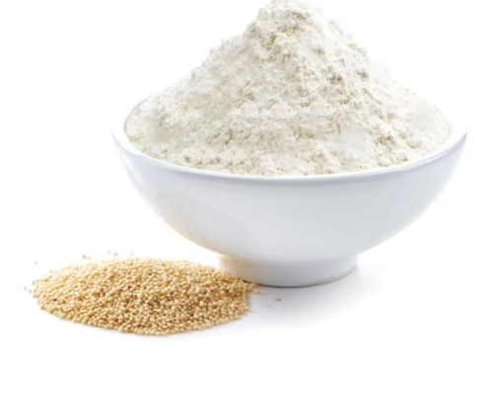
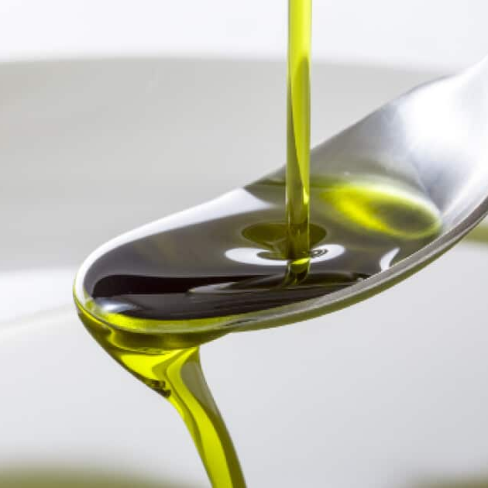
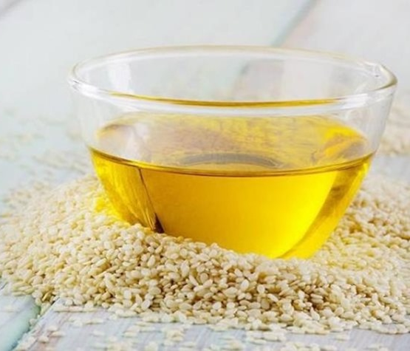
Objectives
The aim of this study was to develop oil-in-water (O/W) gelled emulsions formulated with hemp oil, sesame oil, amaranth flour and different gelling agents.

Slide 3
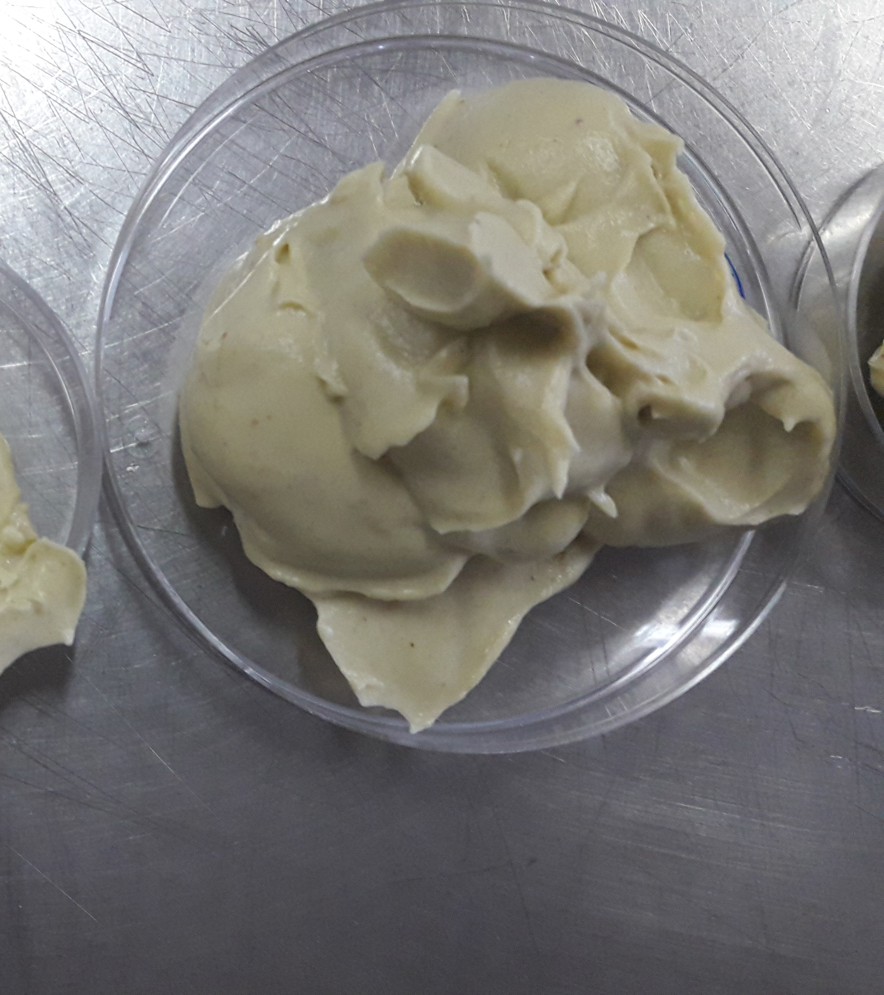
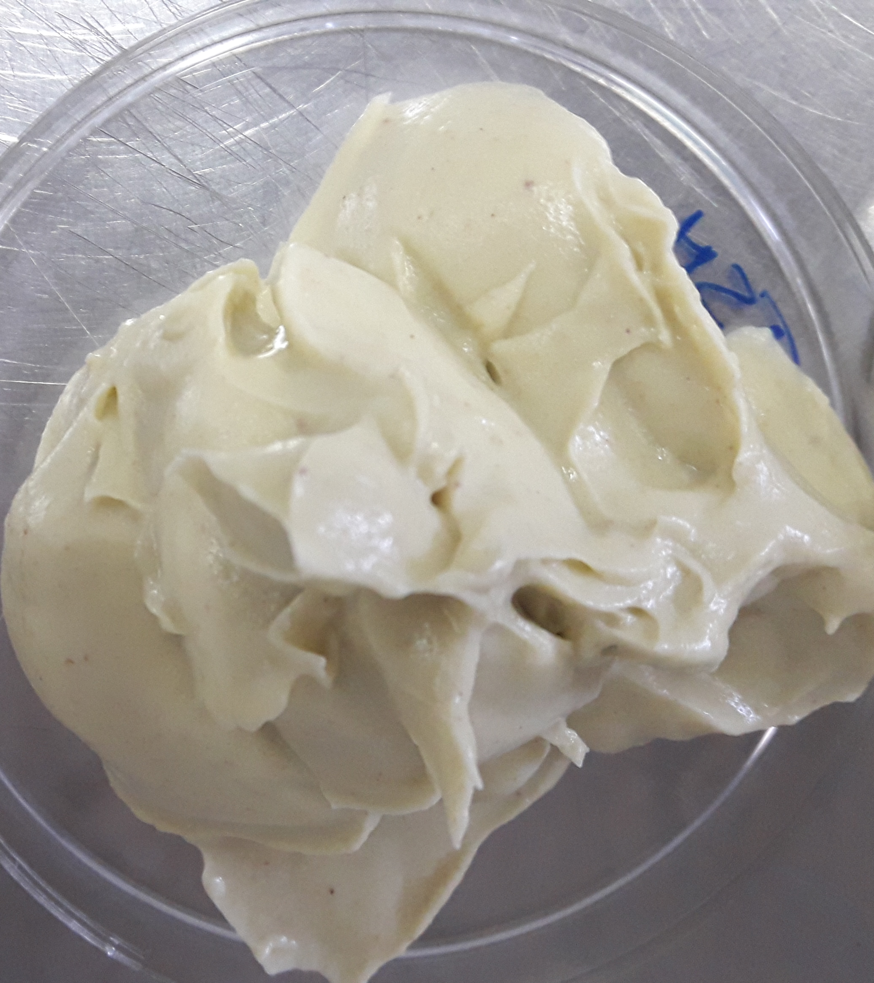
Materials and Methods

Slide 4
Materials and Methods
Formulation of hemp and sesame oils-in-water emulsion gels.
Samples¹ | Water | Flour | Gel instant | Gellan gum | Hemp oil | Sesame oil
GAH | 47 | 10 | 1.5 | 1.5 | 40 | -
GAS | 47 | 10 | 1.5 | 1.5 | - | 40
¹GAH: Gelled emulsion of amaranth flour and hemp oil. GAS: gelled emulsion of amaranth flour and sesame oil. The results are expressed in g/100g.

Slide 5
Materials and Methods
Water
GI
AF
Oil
GG
DETERMINATIONS:
Gel instant
Color space CIEL*a*b* on time 0 and 15.
Texture (spreadability)
Emulsion stability on time 0 and 15.
Oxidation by TBARs on time o and 15.
Amaranth flour
Gellan gum
Hemp or sesame

Slide 6
Results
Color parameters at t₀ and t₁₅ of the gelled emulsions.
Samples¹ | Day | L* | a* | b*
GAH | 0 | 69.45±1.91^{ab} | -1.03±0.21^{d} | 23.52±0.54ª
 | 15 | 61.83±2.30^{c} | -0.52±0.28^{c} | 23.22±1.62ª
GAS | 0 | 71.47±0.95ª | 0.71±0.08^{b} | 12.72±0.22^{b}
 | 15 | 67.37±0.65^{b} | 0.75±0.09ª | 13.04±0.44^{b}
GAH GAS
¹ GAH: gelled emulsion amaranth flour and hemp oil. GAS: gelled emulsion amaranth flour and sesame oil. L*: luminosity; a *: red / green coordinate; b *: yellow / blue coordinate. Values ​​followed by the same lowercase letter within the same column indicate that there are no statistically significant differences (p> 0.05) according to the Tukey multiple range test.

Slide 7
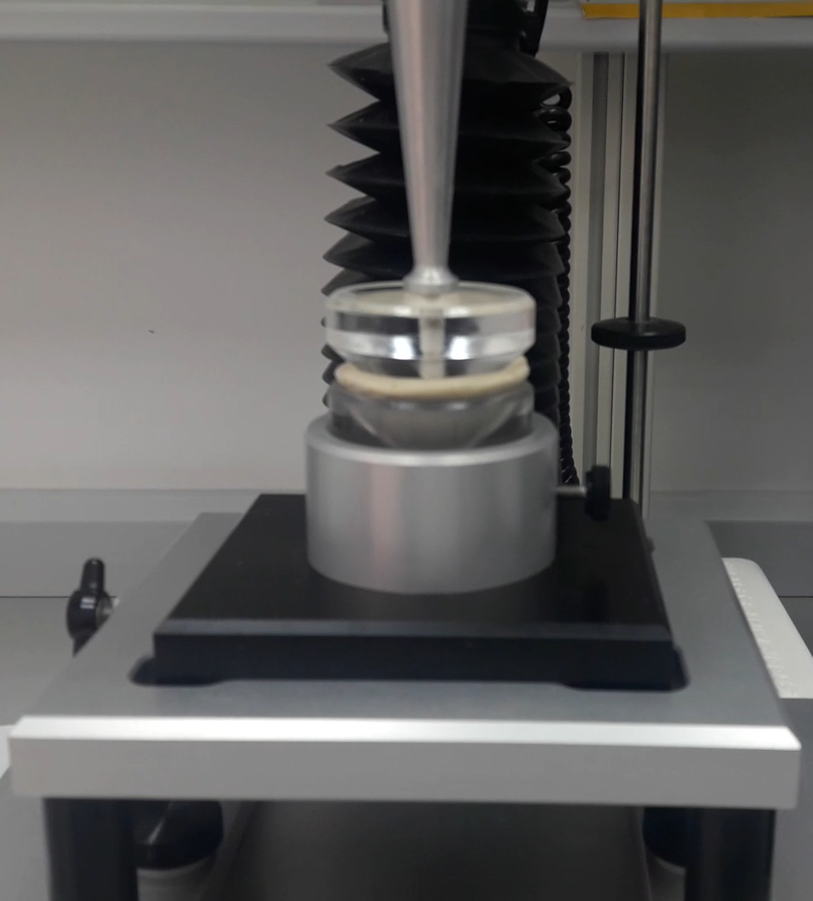
Results
Texture parameters at t₀ to mesure the spreadability of samples.
Samples¹ | Firmess (g) | Work of shear (g.s)
GAH | 536.67±21.28ª | 460.00±8.17ª
GAS | 466.67±11.45^{b} | 366.67±13.42^{b}
¹GAH: gelled emulsion amaranth flour and hemp oil. GAS: gelled emulsion amaranth flour and sesame oil. Values ​​followed by the same lowercase letter within the same column indicate that there are no statistically significant differences (p> 0.05) according to the Tukey multiple range test.

Slide 8
Results
Emulsion stability.
Measured as g of total liquid expelled/ 100g sample. Values ​​followed by the same lowercase letter there are no statistically significant differences (p> 0.05) according to the Tukey multiple range test.
Lipid oxidation by measuring change in TBARs.
Values ​​followed by the same lowercase letter there are no statistically significant differences (p> 0.05) according to the Tukey multiple range test.

Slide 9
Conclusions
In view of the results obtained, the GAH emulsion showed the highest stability, the best firmness values, although GAS has a higher initial lipid oxidation than GAS and a more greenish color. The color could be a small inconvenience when the gelled emulsion is introduced in meat products to replace the fat. The both emulsions are not viable after freezing because their stability is lost and their lipid oxidation values are triggered.

Slide 10
Conclusions
Despite this, gelled emulsions could be a potential alternative for their application in the development of functional foods. So, in future studies could investigate the use of oil in water gelled emulsion prepared with healthier combinations of pseudo-cereal flour with seed oils as possible future fat replacer.

Slide 11
Thank you for your attention

