Slide 1

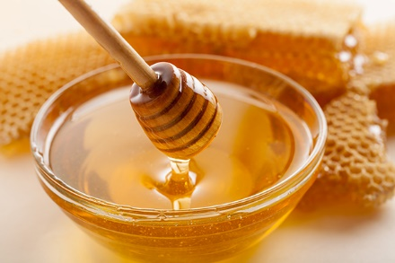


Comparing the antimicrobial actions of Greek honeys from the island of Lemnos and manuka honey from New Zealand against clinically important bacteria
https://foods_2020.sciforum.net/
Maria Gkoutzouvelidou¹, Georgios Panos¹, Maria Nefertiti Xanthou¹, Alexandros Papachristoforou^{1,2}, and Efstathios Giaouris^{1,*}
¹Department of Food Science and Nutrition (DFSN), School of the Environment, University of the Aegean, Lemnos, Greece
²Department of Agricultural Sciences, Biotechnology and Food Science, Cyprus University of Technology, Limassol, Cyprus

Slide 2
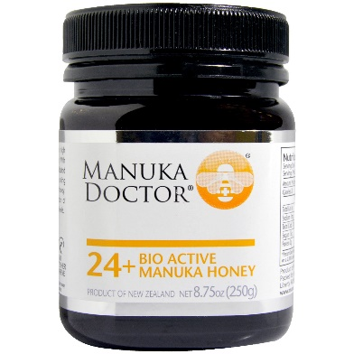
Honey & antimicrobial properties
Honey is a natural complex food that can be stored for long time at room temperature without the need to add any preservative.
This is due to a synergistic combination of its low water activity (a_{w} < 0.6), low pH (ca. 3.2-4.5) and its antimicrobial compounds, such as:
hydrogen peroxide (H₂O₂)
phenolic compounds (such as flavonoids)
methylglyoxal (MGO)
antimicrobial peptides (such as bee defensin-1).
Many studies have explored the antimicrobial action and therapeutic uses of manuka honey, which is native to New Zealand and parts of Australia.
Manuka honey is currently licensed in many countries as a topical medical preparation for the treatment of wounds infection.
2/14

Slide 3
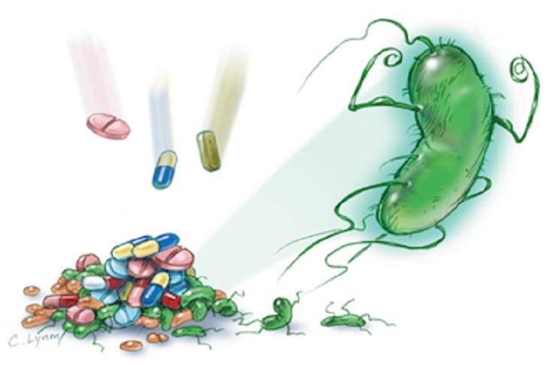

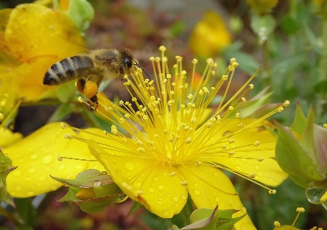
Increasing interest in antimicrobial properties of honey
In recent years, there has been increasing interest in the antibacterial properties of honeys produced throughout the word, mainly due to:
the rapid increase of antibiotic resistant bacteria (MDR)
the consumers demand for medicinal foods (nutraceuticals)
Honey properties and taste vary depending on:
the flora foraged by bees (such as pine, sage, thyme etc.)
the geographical foraging area and the local climatic environment (temperature, soil, rainfall, etc.)
processing and storage conditions
Studies have revealed that the strong antimicrobial actions of some of the tested honeys may be superior to that of manuka, known for its rich MGO content.
3/14

Slide 4

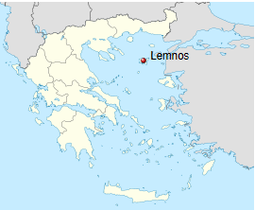
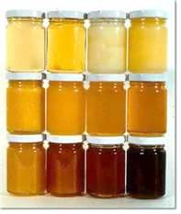
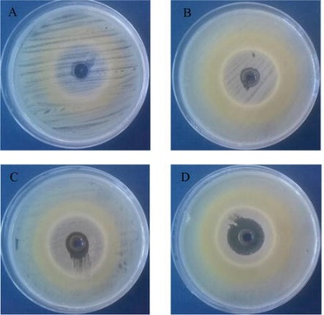
Aim of this work
In this study, the antimicrobial actions of eight honeys produced in various locations of the Lemnos island (north-eastern Greece) and that of manuka honey blend (from New Zealand, UMF 30+) were evaluated against ten clinically relevant bacteria, including five Gram-positive and five Gram-negative.
To do this, the agar-well diffusion assay was applied to measure the diameter of inhibition zones (mm) of two selected concentrations for each honey (25 and 12.5% v/v).
The minimum inhibitory and bactericidal concentrations (MIC and MBC) of each honey were also calculated against two representative of the bacterial species (S. Typhimurium and S. aureus), following the broth microdilution and agar spot methods, respectively.
The pH, water activity, and pollen content of each honey were also determined.
4/14

Slide 5

Bacterial strains used as targets
s/n | Bacterial species | Strain | Gram reaction
1 | Salmonella enterica ser. Enteritidis | P167807 | -
2 | Salmonella enterica ser. Typhimurium | DT193 | -
3 | Escherichia coli O157:H7 | ATCC 43888 | -
4 | Vibrio parahaemolyticus | ATCC 17802 | -
5 | Pseudomonas aeruginosa | ATCC 27853 | -
6 | Staphylococcus aureus | DFSN_B26 | +
7 | Staphylococcus epidermidis | FMCC B-202 | +
8 | Enterococcus faecalis | ATCC 29212 | +
9 | Listeria monocytogenes | AAL 20074 | +
10 | Bacillus cereus | ATCC 10876 | +
5/14

Slide 6


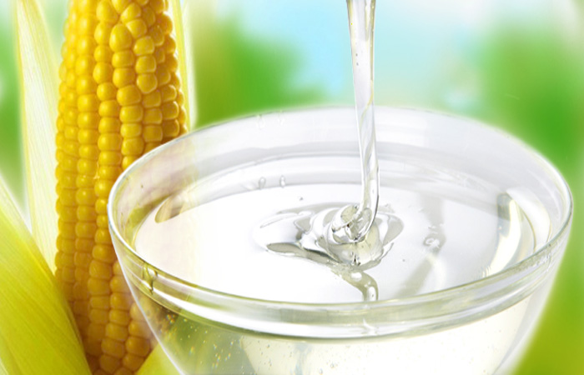
Agar-well diffusion assay
For each honey, two dilutions (25 and 12.5 % v/v) were prepared (using quarter-strength Ringer's solution as the diluent).
40 μL of each dilution were then placed in duplicate in wells (of 5 mm diameter) prepared in soft TSA (0.7% w/v agar) placed in a petri dish.
Each soft agar medium had also been inoculated with the target microorganism (ca. 10⁶ CFU/mL).
Following the addition of the diluted honey samples into the wells, dishes were placed at 37 °C for 24 h (except for B. cereus which was incubated at 30 ºC).
Soft TSA also contained 3% (w/v) NaCl in the case of halophile V. parahaemolyticus.
Following incubation, the growth inhibition zones around each well were measured (mm).
Ampicillin (50 μg/μL) and corn glucose syrup (82% v/v) were used as positive and negative antimicrobial controls, respectively.
6/14

Slide 7
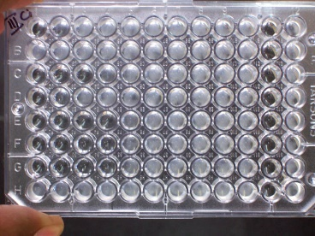
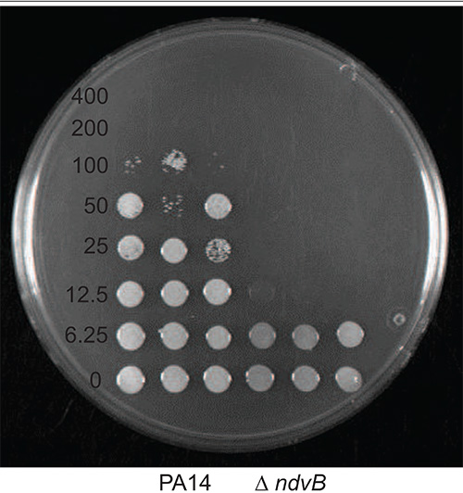
Determination of minimum inhibitory and bactericidal concentrations (MIC, MBC) of each honey
MIC: lowest honey’s concentration preventing visible bacterial growth.
MBC: lowest honey’s concentration reducing viability of the initial bacterial inoculum by ≥ 99.9%.
MIC → Broth microdilution method (in 96-well PS microtiter plates; 10 concentrations / honey → 25 – 0.1% v/v).
Two strains: S. Typhimurium & S. aureus (Gram- & Gram+).
Incubation for 24 h at 37 ºC in TSB (optimal growth conditions).
Absorbance measurements (at 600 nm).
MBC → agar spot method
Lemnos honey No 2
MIC
7/14

Slide 8
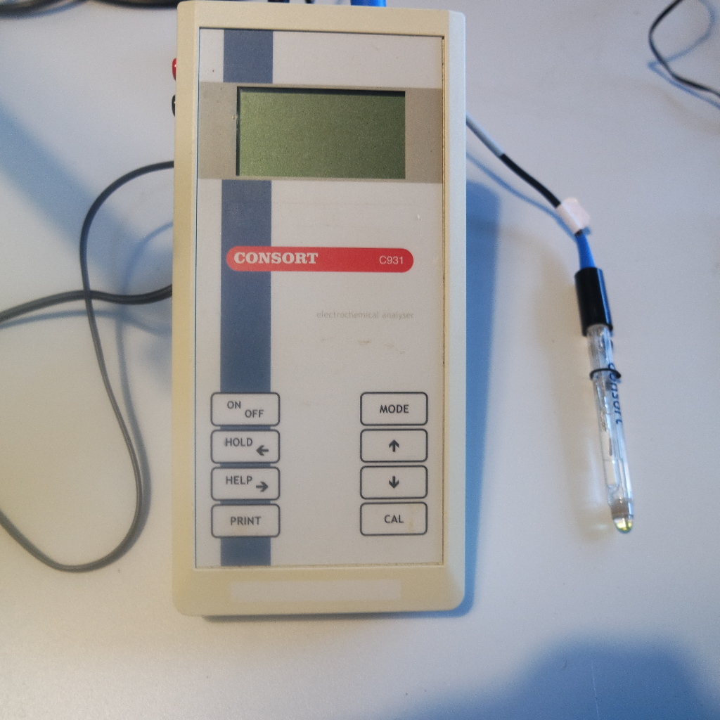

pH, a_{w} measurements and determination of the botanical origin of honeys
The pH of each honey was measured using the C931P Consort electrochemical analyzer following mixing 10 g of each honey with 75 mL of distilled water.
The a_{w} of each honey was determined using the LabTouch instrument of Novasina AG.
All honeys were also analyzed palynologically using a nonacetalytic technique and according to standard methods to determine their botanical origin.
For each honey, more than 800 pollen grains were counted and digitally photographed using Motic Compound Microscope B3-223 ASC equipped with a CCD color camera.
These were finally identified with reference to our database pollen grain collection of Lemnos plants, prepared according to standard methods, and results were expressed in percentages.
For the palynological analysis of the manuka honey blend, literature sources were used to identify the origin of its digitally photographed pollen grains
8/14

Slide 9

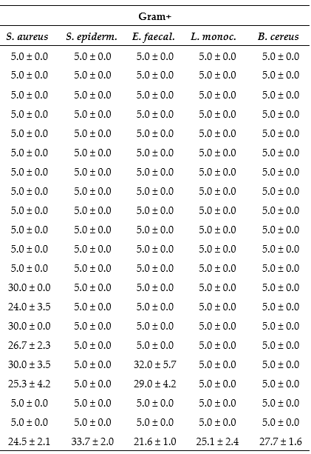
Diameters (mm) of inhibition zones of honeys, each applied at two concentrations (25 and 12.5% v/v) against the target bacteria as there were determined by the agar-well diffusion assay
Each value also comprises the diameter of the well (5 mm). The inhibition zones of glucose syrup and kanamycin, used as negative and positive antimicrobial controls, are also indicated.
9/14

Slide 10
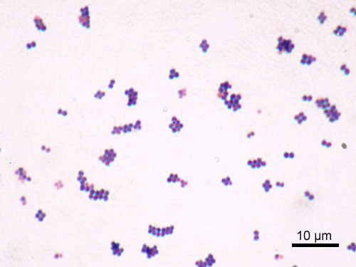
Results of the agar-well diffusion assay
In general, the Gram-positive bacteria were more resistant compared to the Gram-negative ones, apart from P. aeruginosa for which no inhibition was observed for any of the tested honeys.
Similarly, none of the honeys at either tested concentration (i.e., 25 and 12.5% v/v) could inhibit the growth of S. epidermidis, L. monocytogenes and B. cereus, while E. faecalis was found susceptible only to the action of manuka honey.
The two Salmonella serovars (i.e., Enteritidis and Typhimurium), E. coli O157:H7 and V. parahaemolyticus, were inhibited by all nine tested honeys at both concentrations (except for Lemnos honey No 6 applied at 12.5% against S. Enteritidis).
S. aureus was found susceptible to only two Lemnos honeys (samples 7 and 8) and to manuka.
These two local honey samples, and in particular sample 7, were found to present the strongest antibacterial actions, being able to inhibit five of the ten tested strains.
This inhibition against most of the susceptible strains was superior to that of manuka, which was still able to inhibit six of the ten strains.
10/14

Slide 11
MIC and MBC of each honey against S. Typhimurium and S. aureus as there were determined by the broth microdilution and agar spot methods
Lemnos honey No 2 was found to present the strongest antibacterial action displaying MIC and MBC against both bacterial species equal to 12.5% (v/v).
For all the other tested honeys, MIC and MBC were either 25% (v/v) or even higher.
Glucose syrup could not inhibit neither bacteria at the concentrations this was tested (i.e., 25 – 0.1% v/v).
No clear correlation between the antimicrobial results of the two tested methods, i.e., agar-well diffusion and broth microdilution, could be established.
The MIC and MBC of glucose syrup used as negative antimicrobial control are also indicated.
11/14

Slide 12
pH, a_{w} values and pollen composition (%) of each honey
As expected, the pH values varied between 3.6 (for almost all Lemnos honeys) to 4.3 (for manuka honey).
Water activity was found to vary from 0.551 (Lemnos honey No 6) to 0.627 (manuka honey).
The pH and aw of glucose syrup measured 4.85 and 0.731, respectively.
Pollen composition of the Lemnos honeys were multifloral, containing pollens from a variety of plant species including myrrh (Anthillis hermanniae) and thyme (Thymus capitatus) -dominant pollen grains-, burdock (Arctium lappa), thistle (Silybum marianum) etc., thus highlighting the rich plant biodiversity encountered in the island of Lemnos
The pH and a_{w} of glucose syrup are also indicated.
12/14

Slide 13
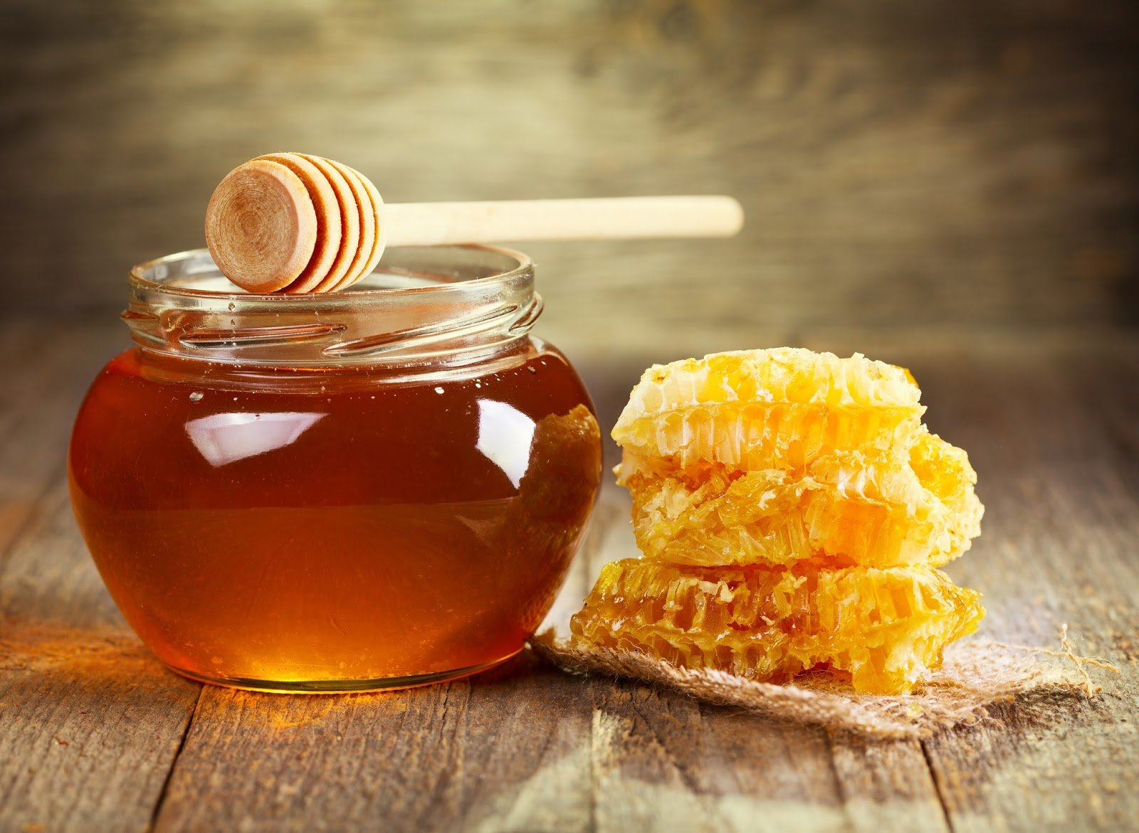
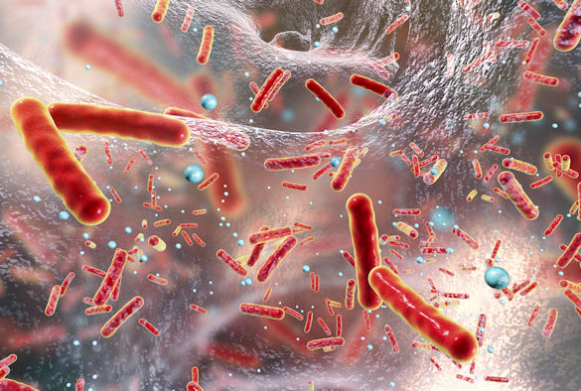
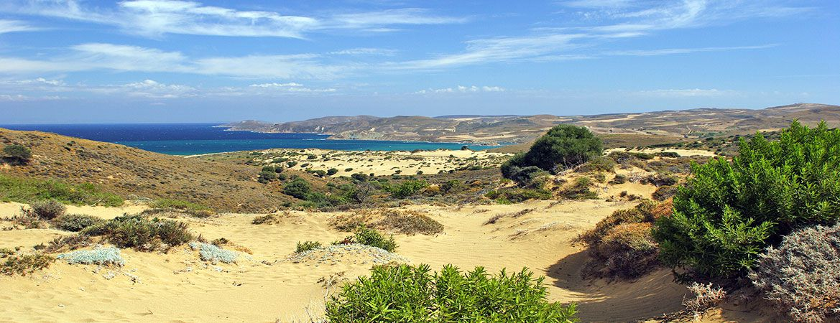

Summary (main outcomes)
In recent years, several studies have been published about the antimicrobial actions of honeys collected from various parts of the world.
These have revealed promising antimicrobial activity of some honeys even against multidrug-resistant bacterial pathogens, such as the methicillin resistant S. aureus (MRSA).
These have also emphasized the variability in the antimicrobial effect of honeys depending on the sample and target microorganism and pointed to the need for further research.
Our study, focusing on honeys produced in a Greek island of the north Aegean region (i.e., Lemnos), known for its biodiversity and containing wild plants of medicinal importance, such as thyme and myrrh, complements all these other studies.
In summary, our results revealed that all the Lemnos honeys presented antibacterial action which, for some samples, was superior to that of manuka.
Such honeys show great potential for the development of natural antimicrobial systems for use in foods and medicine.
13/14

Slide 14





stagiaouris@aegean.gr
14/14

