Slide 1
Mapping of novel binary copper oxides with
density functional theory modelling
S. Sampath¹, K. Tokar^{1,2}, M. Derzsi^{1,3}
¹Advanced Technologies Research Institute, Faculty of Materials Science and Technology in Trnava,
Slovak University of Technology in Bratislava, Jána Bottu 8857/25, 917 24 Trnava, Slovakia
²Institute of Physics, Slovak Academy of Sciences, Dúbravská cesta 9, 845 11 Bratislava, Slovakia
³Center of New Technologies, University of Warsaw, Żwirki i Wigury 93, 02089 Warsaw, Poland
sankari.sampath@stuba.sk
10-20 November

Slide 2
Introduction
Binary copper oxides [Cu-O] have remarkable electronic and optical properties.
Cu-O find numerous applications in photovoltaics and all-oxide electronics due to their abundance, low cost and non-toxic nature that makes Cu-O highly attractive for further exploration.
Our Goal - To predict new stable binary Cu-O phases using density functional theory (DFT) and Evolutionary Algorithm (EA) methods.

Slide 3
Known binary Cu-O
Cu^{I}₂O^{[1]}
Cuprite
Cu^{II}O^{[2]}
Tenorite
Cu^{I}₂Cu^{II}₂O₃^{[3]}
Paramelaconite
P n -3 m
a = 4.271Å
C2/c
a = 4.691Å, b = 3.417Å,
c = 5.13Å, β = 99°
I 4₁/ a m d
a = b = 5.818Å,
c = 9.894Å
[1] Benxian L et.al, J. Solid State Chem., 184, 2097 (2011)
[2] Chaudhary N et.al, Solid State Commun., 247, 36 (2016)
[3] Morgan P E D et.al, J. Solid State Chem., 121, 33 (1996)

Slide 4
Computational procedure
Evolutionary
algorithms
Databases
Input models (Lit.,)
DFT optimisation
Spin polarised calculation DFT+U
High- and low-spin solutions (HS/LS)
Lattice dynamics

Slide 5
Calculation details
DFT method for structure optimization (VASP program).
Details of the DFT calculations: PBEsol functional, planewave cut-off 520eV.
Electron correlations handled with Liechtenstein approach: U_{Cu}=9eV, J_{Cu}=1eV.
EA for the search of crystal structures (XtalOpt program^{[4]}).
Lattice dynamics calculations using program PHONOPY^{[5]}.
[4] Patrick A et.al, Comput. Phys. Commun., 222, 418 (2018)
[5] Togo A et.al, Scr. Mater., 108, 1 (2015)

Slide 6
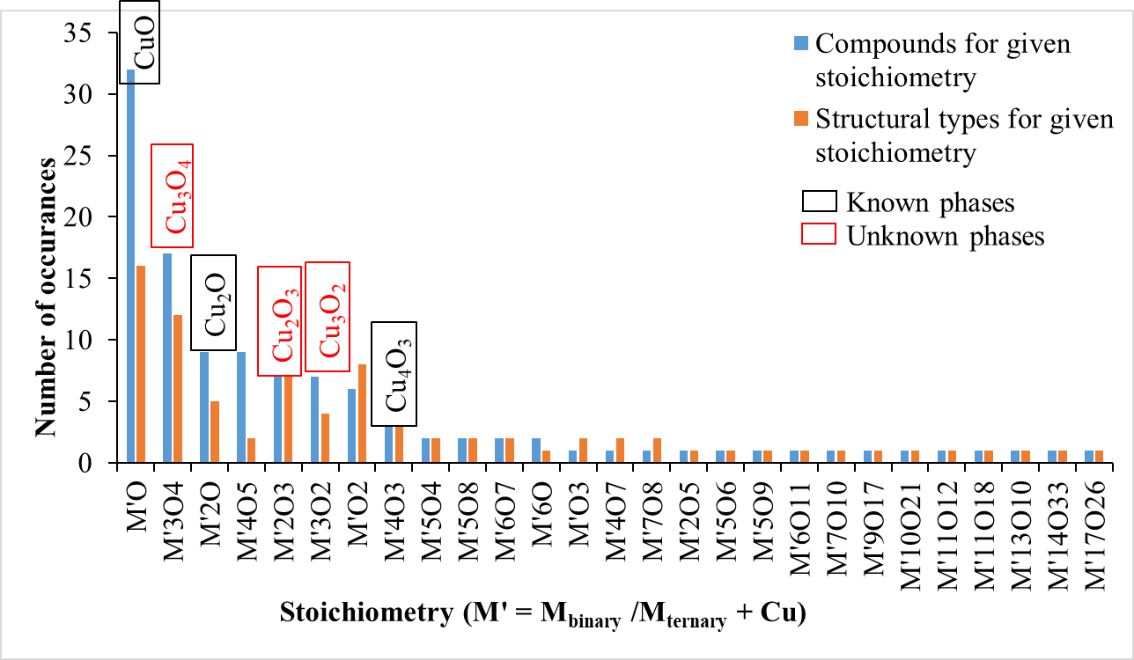
Strategy for the selection of input models

Slide 7
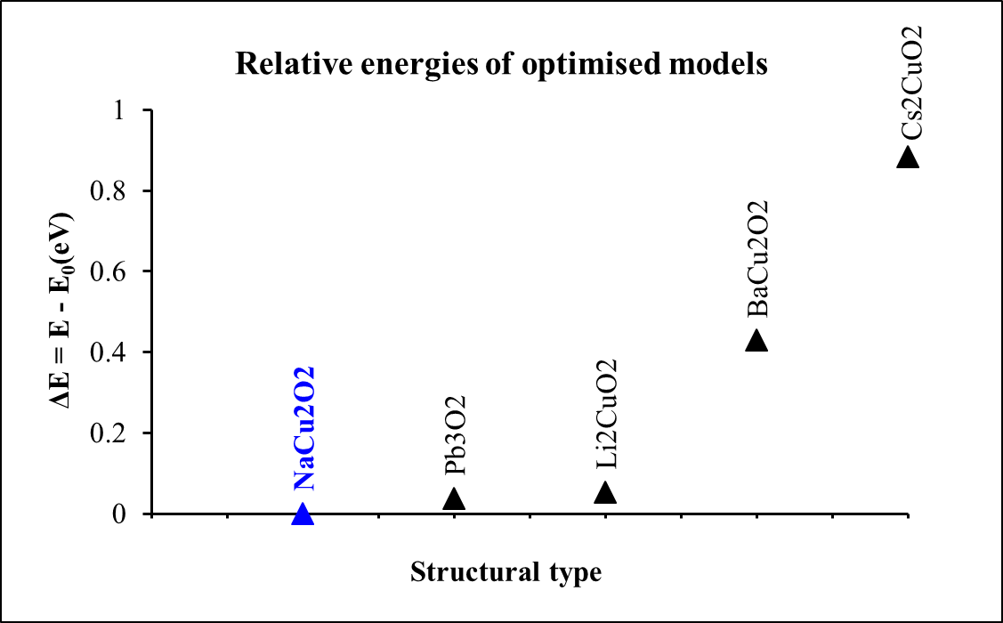
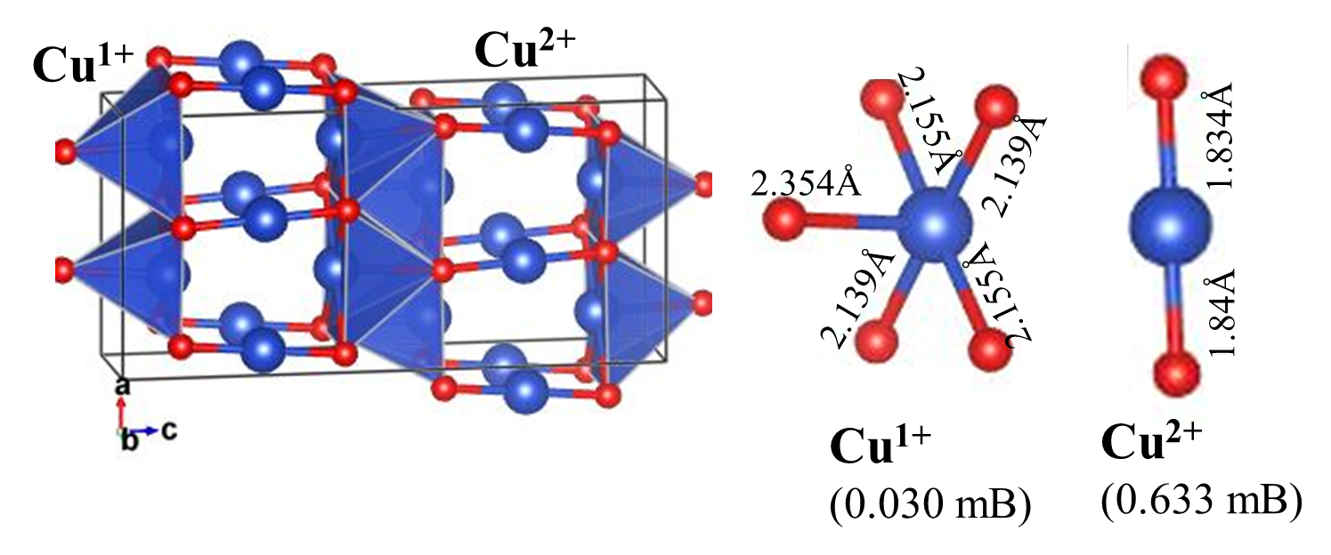
Cu₃O₂ Stoichiometry
NaCu₂O₂ Structural type
P n m a
a = 5.896Å, b = 2.827Å, c = 2.139Å

Slide 8
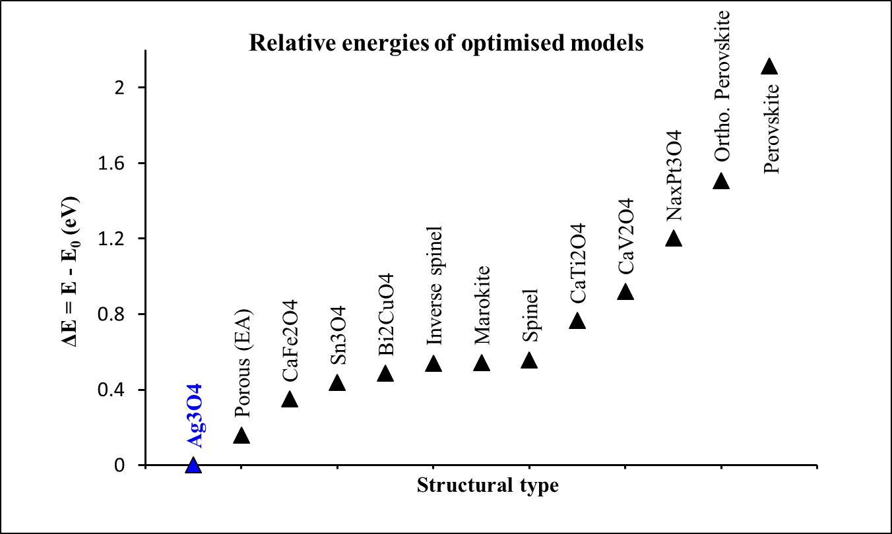
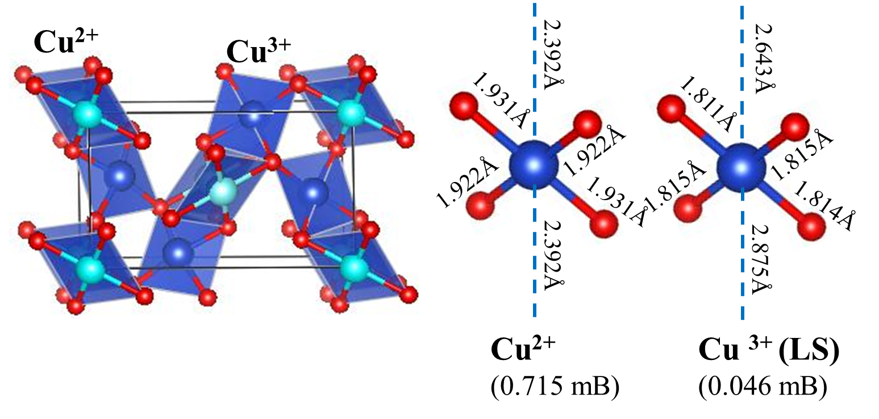
Cu₃O₄ Stoichiometry
Ag₃O₄ Structural type
P 1 2₁ / c 1
a = 3.298Å, b = 8.454Å,
c = 5.005Å, β = 102.9°
Calculated both HS and LS solutions. Only LS solution is stable.

Slide 9
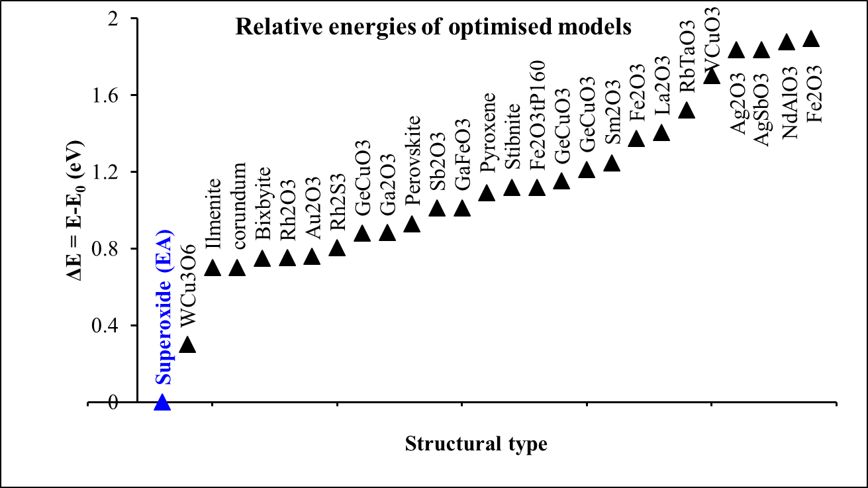
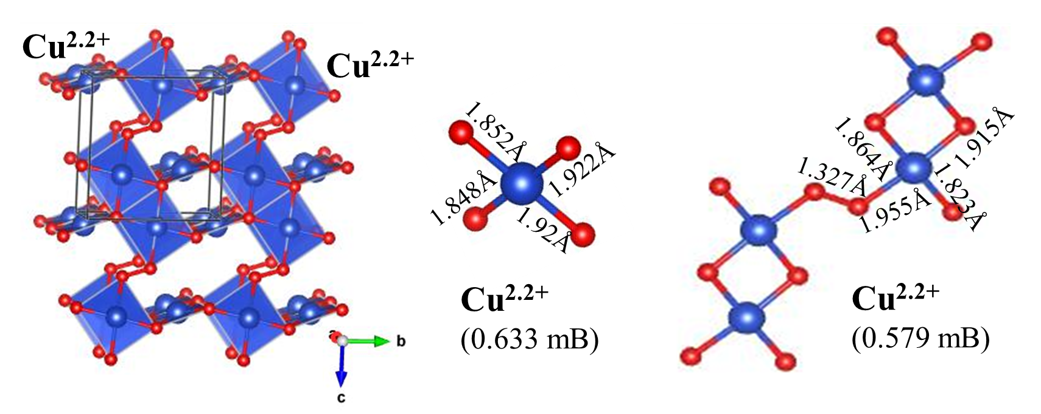
Cu₂O₃ Stoichiometry
Superoxide(EA) Structural type
O-O bridge
P 1
a = 2.789Å, b = 5.957Å,
c = 6.578Å, α = 93°; β = 102.9°; γ = 94°
Compound (spin) | a (Å) | b (Å) | c (Å) | V/Z (Å)³ | ΔE/Z (eV) | Mag. (m_{B})
Superoxide(EA) (FM) | 2.794 | 5.927 | 6.582 | 50.661 | 0.006 | 0.626
Superoxide(EA) (AFM) | 2.789 | 5.957 | 6.578 | 50.886 | 0.000 | +0.627 -0.581

Slide 10
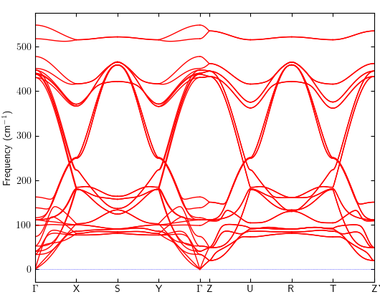
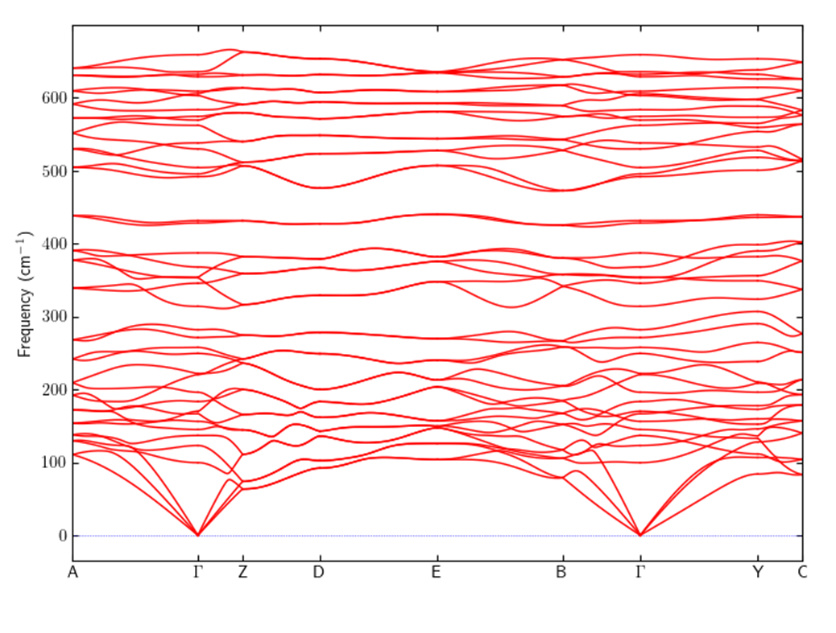
Impact of lattice dynamics on the stability of the models
Phonon dispersion curves
Cu₃O₂
Cu₃O₄
Na₂CuO₂ structure type
Ag₃O₄ structure type

Slide 11
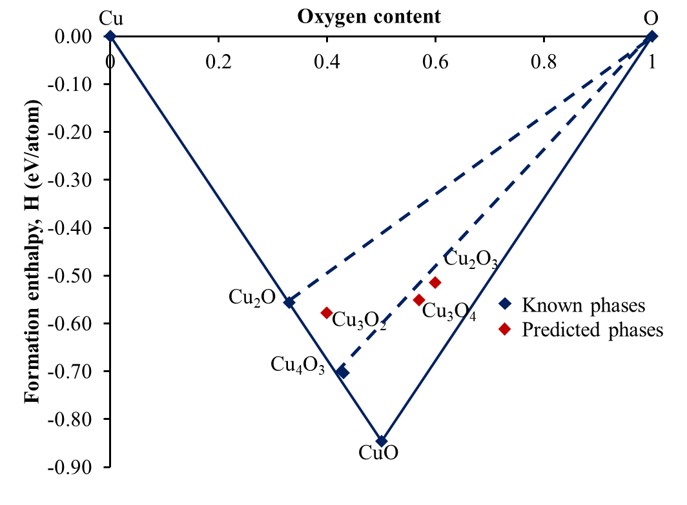
Convex Hull
Thermodynamically, Convex Hull represents the enthalpy.
Correctly predicted the stability of existing phases.
3 new Cu-O phases are stable with respect to elements Cu, O and Cu₂O phase.
Cu₃O₄ and Cu₂O₃ are stable with respect to Cu₄O₃.
3 new phases are metastable in respect to CuO phase.
Cu₃O₂ = -0.578eV/atom,
Cu₃O₂ = -0.551eV/atom
Cu₃O₂ = -0.515eV/atom.

Slide 12
Conclusions
Crystal structures of 3 new Cu-O compounds are predicted – Cu₃O₂, Cu₃O₄ and Cu₂O_{3.}
Cu₃O₂ was predicted for Na₂CuO₂ type structure.
Cu₃O₄ was predicted as a low spin Ag₃O₄ structural type.
Cu₂O₃ was predicted as a AFM superoxide (EA) type.
The new structure types found to be dynamically stable.
Correctly predicted the stability of existing binary Cu-O phases.
The newly predicted Cu-O phases are stable with respect to elements Cu, O and Cu₂O phase.
Cu₃O₄ and Cu₂O₃ are stable with respect to Cu₄O₃.

Slide 13
Acknowledgements
The European Regional Development Fund, Research and Innovation Operational Programme, for project No. ITMS2014+: 313011W085.
Scientific Grant Agency of the Slovak Republic, grant No. VG 1/0223/19.
The Slovak Research and Development Agency, grant No. APVV-18-0168.
Aurel supercomputing infrastructure in CC of Slovak Academy of Sciences acquired in projects ITMS 26230120002 and 26210120002 funded by ERDF.

Slide 14
Thank you for your attention!

