Slide 1
Persimmon flour co-products as novel ingredients in the reformulation of pork liver pâté
Raquel Lucas-González, José Ángel Pérez-Álvarez, Manuel Viuda-Martos and Juana Fernández-López*
IPOA Research group. Agro-Food Technology Department. Escuela Politécnica Superior de Orihuela,
Universidad Miguel Hernández de Elche, 03312 Orihuela, Alicante, Spain.

Slide 2
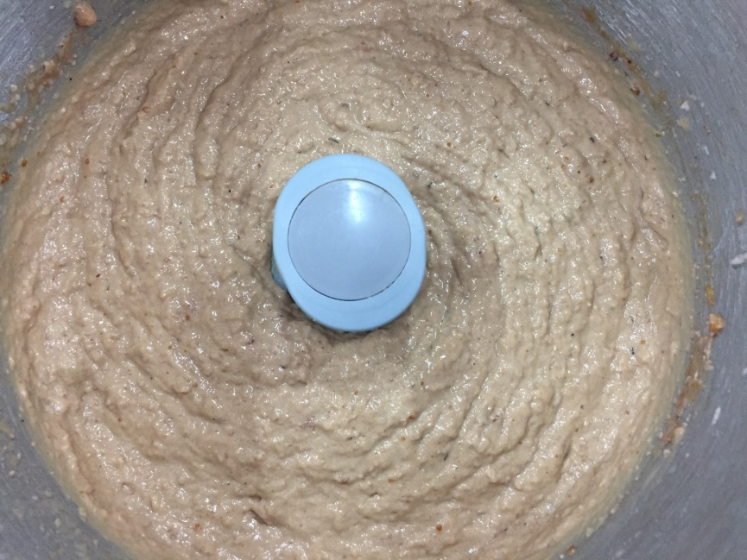
Objectives
The aim to the study was to enrich pork liver pâté with persimmon flour co-products at two concentrations, 3 and 6% and to compare their total cholesterol, fatty acid polyphenolic compounds profiles and lipid oxidation after in vitro digestion with the control pâté.

Slide 3
Material and Methods
Elaboration of three different batches of pate formulations:
Control pork liver pâté (CP) (without persimmon flour)
Pork liver pâté enrichment with 3% of persimmon flour cv “Rojo Brillante” (P-3RB)
Pork liver pâté enrichment with 6% of persimmon flour cv “Rojo Brillante”(P-6RB)

Slide 4
Material and Methods
Polyphenol profile (HPLC)
Fatty acid profile (GC)
Total cholesterol (HPLC)
In vitro gastrointestinal digestion (Cost-Infogest method)
Lipidic oxidation (TBARS assay) after in vitro digestion

Slide 5
Results
Monoinsaturated>saturated>poliinsaturated
Table 1. Total cholesterol in pork liver pâté samples.
 | Total cholesterol (mg/100g)
CP | 98±8^{bc}
P-3RB | 89±3^{b}
P-6RB | 68±11^{ab}
CP: control pâté; P-3RB: pork liver pâté enrichment with 3% of persimmon flour cv “Rojo Brillante”; P-6RB: pork liver pâté enrichment with 6% of persimmon flour cv “Rojo Brillante”. Different Lower letters (a-c) indicate significant differences.

Slide 6
Results
Figure 1. Polyphenol profile in pâté enriched with persimmon flours.
CP: control pâté; P-3RB: pork liver pâté enrichment with 3% of persimmon flour cv “Rojo Brillante”; P-6RB: pork liver pâté enrichment with 6% of persimmon flour cv “Rojo Brillante”. Total: Sum of four polyphenols quantified. Different case lower letters (a-b) for each individual phenolic compound and the total indicate significant differences between the two studied samples.

Slide 7
Results
Figure 2. Lipidic oxidation increase (%) of pork liver pâté samples after in vitro gastrointestinal digestion.
CP: control pâté; P-3RB: pork liver pâté enrichment with 3% of persimmon flour cv “Rojo Brillante”; P-6RB: pork liver pâté enrichment with 6% of persimmon flour cv “Rojo Brillante”. Different case lower letters (a-b) for each simulated digestion phase indicate significant differences between the three studied samples.

Slide 8
Conclusions
The enrichment of pâté with persimmon flours caused a reduction in their total cholesterol content and lipid oxidation after in vitro digestion, without modifications in their fatty acid profile to what the phenolic compounds contributed by persimmon flours could be contributing.

