Slide 1
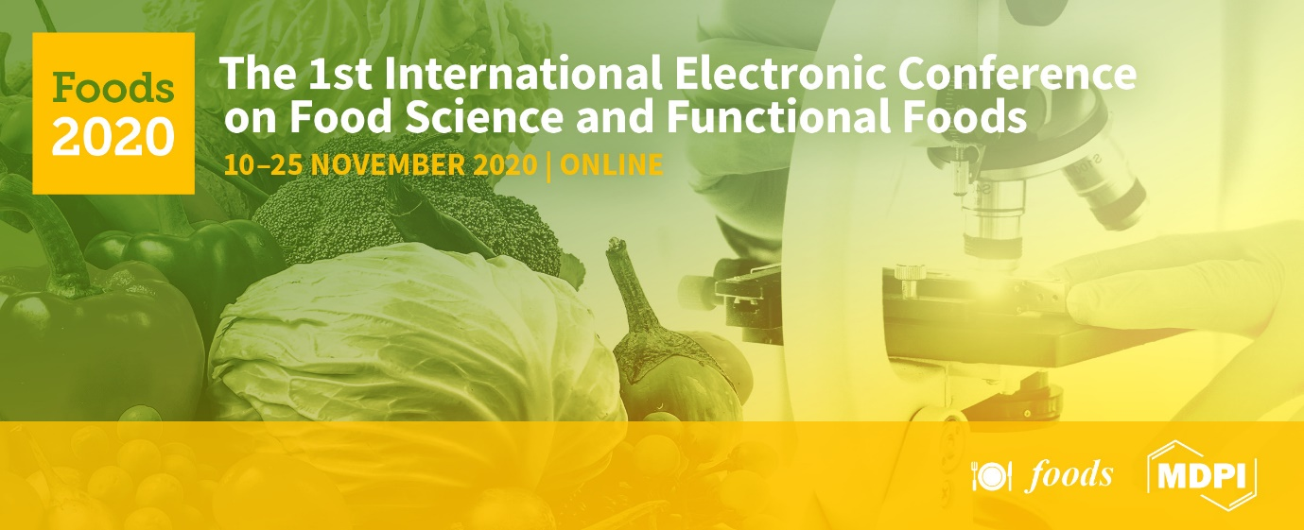







“Profiling of the oil of the Egyptian cultivar of sesame ‘Giza 32’ using LC-MS-based untargeted metabolomics”
Reham Hassan Mekky, Essam Abdel-Sattar, Antonio Segura-Carretero and María del Mar Contreras

Slide 2
Outline
Introduction
Aim of work
Materials and methods
  Recovery of the oil phenolic-rich fraction from SG32 seeds
  Untargeted Metabolic Profiling of the phenolic fraction SG32 oil by RP-HPLC-DAD-QTOF-MS and MS/MS
  Results
      RP-HPLC-DAD-QTOF-MS and MS/MS Characterization of SG32 oil
      Comparison between SG32 oil and cake
Conclusion
References

Slide 3
Outline
Introduction
Aim of work
Materials and methods
  Recovery of the oil phenolic-rich fraction from SG32 seeds
  Untargeted Metabolic Profiling of the phenolic fraction SG32 oil by RP-HPLC-DAD-QTOF-MS and MS/MS
  Results
      RP-HPLC-DAD-QTOF-MS and MS/MS Characterization of SG32 oil
      Comparison between SG32 Oil and Cake
Conclusion
References

Slide 4
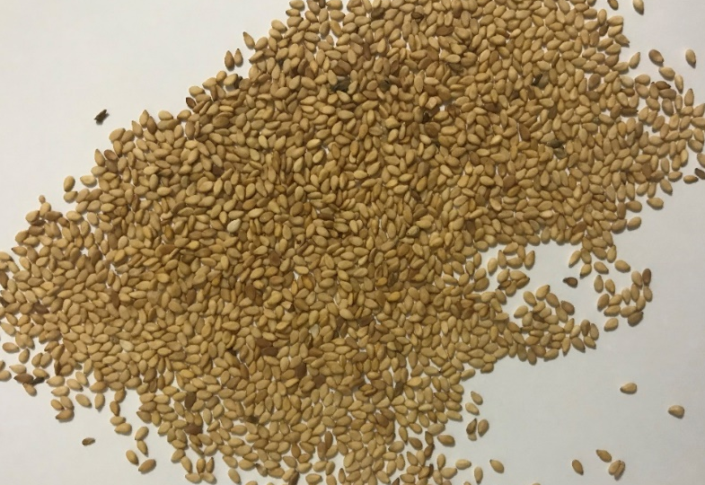
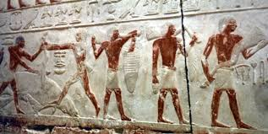
Introduction
Sesame (Sesamum indicum L.) is an oil crop whose cultivation is distributed all over the world. Its use dates since Ancient Egypt where it was used in soothing asthma [1-2].
Sesamum indicum L.
http://ancientomnivore.com/eat-like-an-ancient-egyptian/

Slide 5
Introduction
Reported Phytoconstituents in S. indicum (Selection)
p-hydroxybenzoic acid
Caffeic acid
Citric acid
Kaempferol
Quercetin
Pinoresinol diglucoside

Slide 6
Introduction
Reported biological activities in S. indicum (Selection)
Sesame biological activities
Hypo-lipidemic
Anti-diabetic
Anticancer
Antioxidant
Antihypert-ensive
Antileishm-anial
Cardio-protective
[3]

Slide 7
Outline
Introduction
Aim of work
Materials and methods
  Recovery of the oil phenolic-rich fraction from SG32 seeds
  Untargeted Metabolic Profiling of the phenolic fraction SG32 oil by RP-HPLC-DAD-QTOF-MS and MS/MS
  Results
      RP-HPLC-DAD-QTOF-MS and MS/MS Characterization of SG32 oil
      Comparison between SG32 Oil and Cake
Conclusion
References

Slide 8
Aim of Work
1
Performing untargeted profiling of SG 32 oil
2
Comparing the phenolic composition of the sesame oil was with the cake counterpart.

Slide 9
Outline
Introduction
Aim of work
Materials and methods
  Recovery of the oil phenolic-rich fraction from SG32 seeds
  Untargeted Metabolic Profiling of the phenolic fraction SG32 oil by RP-HPLC-DAD-QTOF-MS and MS/MS
  Results
      RP-HPLC-DAD-QTOF-MS and MS/MS Characterization of SG32 oil
      Comparison between SG32 Oil and Cake
Conclusion
References

Slide 10

Material and methods
Sesame Seeds
‘Giza 32’
SG32
Recovery of the oil phenolic-rich fraction from SG32 seeds
1) Homogenized in 10 mL n-hexane
2) Stirring 30 min
3) Centrifugation 5 min, 8000 rpm
Pellet
(Sesame Cake)
Supernatant
4) Evaporation
Sesame Oil
5) Reconstitution in hexane
6) Liquid-liquid extraction with (MeOH:H₂O, 80:20) × 3
RP-HPLC-DAD-QTOF-MS & MS/MS

Slide 11
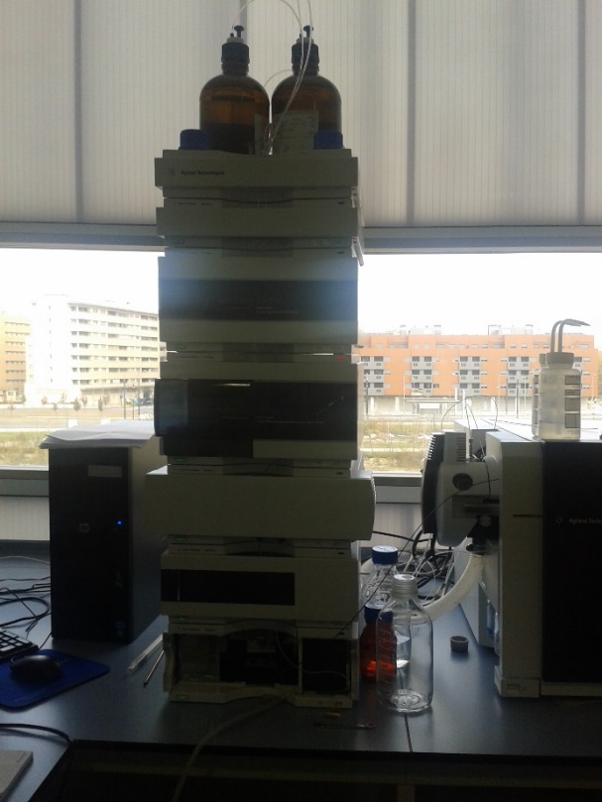
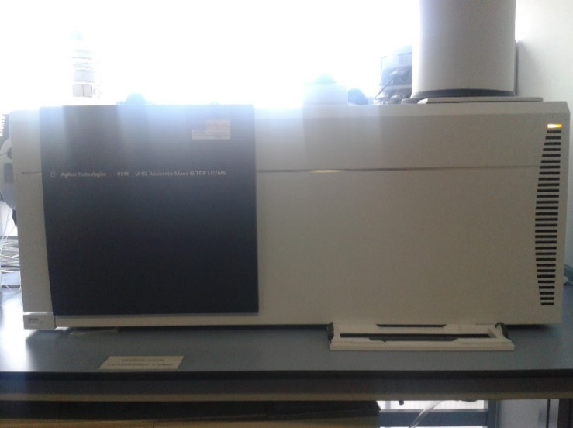
Material and methods
Untargeted Metabolic Profiling of the phenolic fraction SG32 oil by RP-HPLC-DAD-QTOF-MS and MS/MS
Agilent 1200 series rapid resolution equipped with a diode array detector and A 6540 Agilent Ultra-High-Definition Accurate-Mass Q-TOF LC/MS (equipped with an ESI interface).

Slide 12
Outline
Introduction
Aim of work
Materials and methods
  Recovery of the oil phenolic-rich fraction from SG32 seeds
  Untargeted Metabolic Profiling of the phenolic fraction SG32 oil by RP-HPLC-DAD-QTOF-MS and MS/MS
  Results
      RP-HPLC-DAD-QTOF-MS and MS/MS Characterization of SG32 oil
      Comparison between SG32 Oil and Cake
Conclusion
References

Slide 13
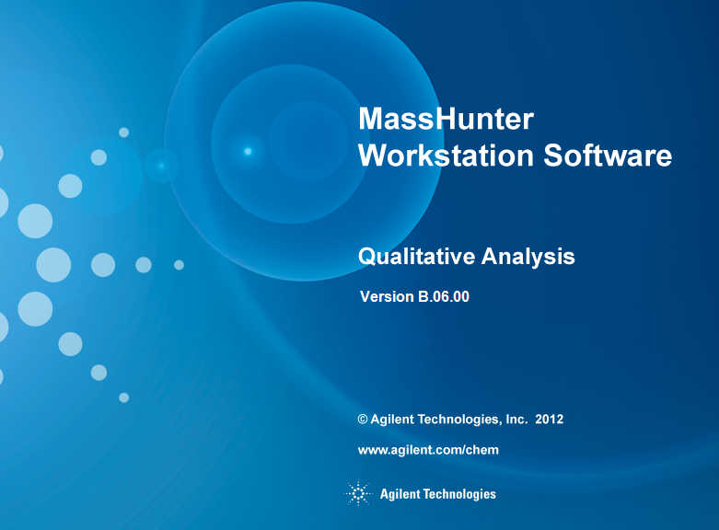
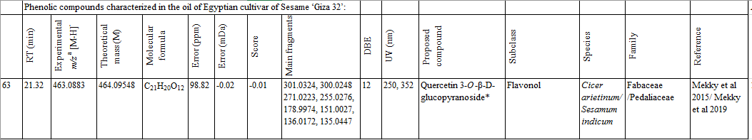



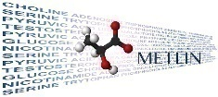




Results and discuusion
      RP-HPLC-DAD-QTOF-MS and MS/MS Characterization of SG32 oil

Slide 14
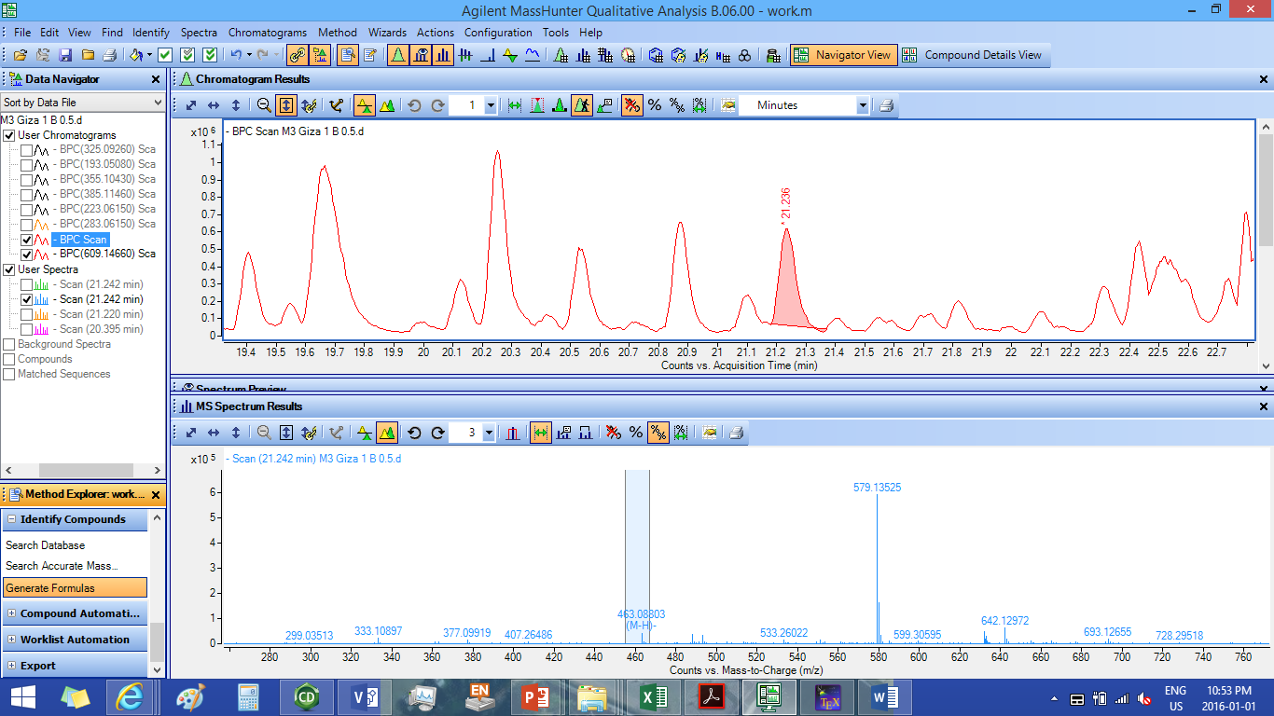
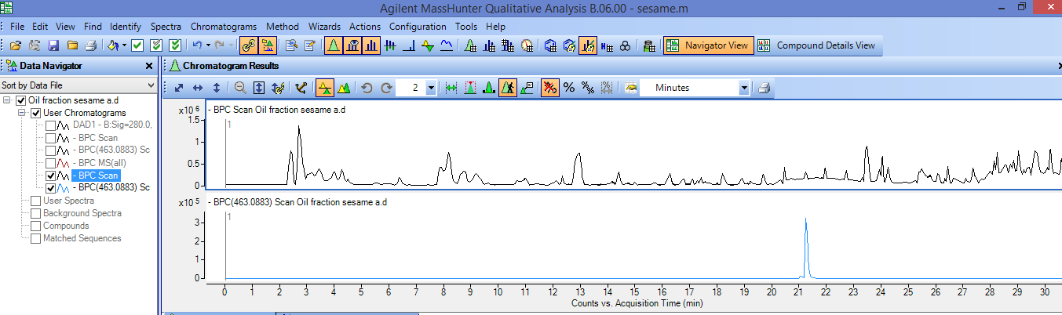
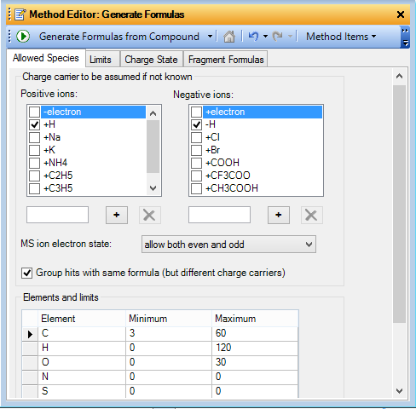
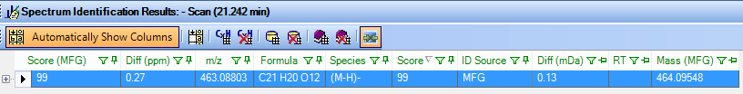
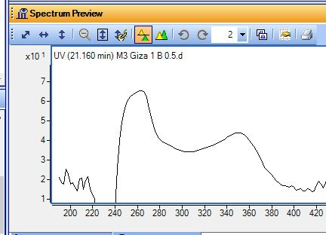
Peak 63
250
352
Flavonols
Quercetin 3-O-β-
D-glucopyranoside

Slide 15
The Global Number of Characterized Compounds from SG 32 Oil
Results and discussion
Total 86
Compounds
59 for the
1st time in
Sesame oil
3 new
proposed
structures
22 Non-phenolics
64
phenolics
24
Confirmed
with
standards

Slide 16
Results and discuusion
Classification, number of compounds found per class, and relative in sesame oil.
Lowest value Highest value

Slide 17
Results and discuusion
Comparison between Sesame Oil and Cake
A Venn diagram illustrating the common metabolites between SG32 oil and SG32 cake.

Slide 18
Outline
Introduction
Aim of work
Materials and methods
  Recovery of the oil phenolic-rich fraction from SG32 seeds
  Untargeted Metabolic Profiling of the phenolic fraction SG32 oil by RP-HPLC-DAD-QTOF-MS and MS/MS
  Results
      RP-HPLC-DAD-QTOF-MS and MS/MS Characterization of SG32 oil
      Comparison between SG32 Oil and Cake
Conclusion
References

Slide 19
Conclusion
The present study demonstrates the first report dealing with the metabolic profiling of sesame oil using RP-HPLC–DAD–ESI–QTOF-MS and -MS/MS.
86 metabolites, mainly belonging to the phenolic class were characterized.
64 metabolites were commonly present in both SG32 oil and cake.
Further studies are required to trace the presence of biologically important metabolites in commercial sesame oils

Slide 20
Outline
Introduction
Aim of work
Materials and methods
  Recovery of the oil phenolic-rich fraction from SG32 seeds
  Untargeted Metabolic Profiling of the phenolic fraction SG32 oil by RP-HPLC-DAD-QTOF-MS and MS/MS
  Results
      RP-HPLC-DAD-QTOF-MS and MS/MS Characterization of SG32 oil
      Comparison between SG32 Oil and Cake
Conclusion
References

Slide 21
References
FAO-Statistics (2018). Productions, crops.
Aboelsoud, N.H. Herbal medicine in ancient Egypt. Journal of Medicinal Plants Research 2010, 4, 082-086.
Lim, T. Sesamum indicum. In Edible Medicinal and Non-Medicinal Plants, Springer: 2012; Vol. 4, pp. 187-219.

Slide 22
Thank you!!!
Questions

