Slide 1
MEAT SNACKS CONSUMPTION: ASPECT THAT THE CONSUMER LOOKS FOR TO CONSIDER THEM A HEALTHY FOOD
Miguel Angel Alarcón-García^{3*,} Jose Angel Perez-Alvarez^{1*,} Jairo Humberto López-Vargas², Maria Jesús Pagán-Moreno³
¹ IPOA Research Group. Agri-Food Technology Department. Universidad Miguel Hernández (UMH), CYTED 119RT0568 Healthymeat Network, Orihuela, Spain; ja.perez@goumh.umh.es
² Instituto de Ciencia y Tecnología de Alimentos (ICTA) Universidad Nacional de Colombia, sede Bogotá, Santa Fe de Bogotá, Colombia; jhlopezv@unal.edu.co
³ CUINA Food Research and Innovation Group. Food Technology Department. Universitat Politecnica de Valencia, Valencia, Spain; mialgar7@upv.edu.es; jpagan@tal.upv.es

Slide 2
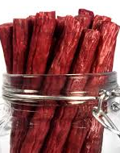
INTRODUCTION
Consumer’s preferences trends
Healthy lifestyles
Convenience food, small portions, indulgent food
Wide offer of food products
Growth continued of snack Industry
Market survey

Slide 3
OBJETIVE
The aim of this work was to study snack consumption and to analyse in snacks and meat snacks, which consumers' preferences are considered as healthy.

Slide 4
MATERIAL AND METHODS
Online survey.
Participants: 234
63,8% women
36,2% men
18 - 74 years old.

Slide 5
MATERIAL AND METHODS
Survey
Snack most frequently consumed
meat snack
snack

Slide 6
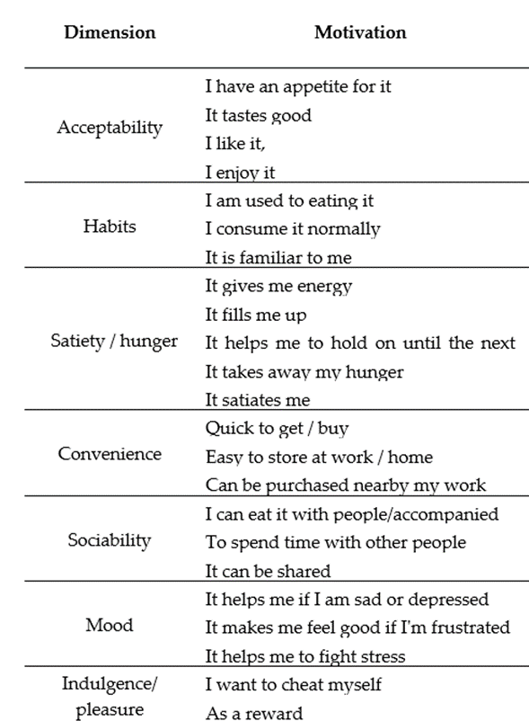
MATERIAL AND METHODS
Survey
Motivación of consumption
meat snack
LIKERT SCALE
1. Not important
7. Very important
6….
5….
4….
3….
2….
snack

Slide 7
MATERIAL AND METHODS
Survey
How frequency do you consume it?
Can the snacks be considered as healthy food?
Is this aspect decisive in the purchase and consumption of it?
What characteristics you look for in a healthy snack?

Slide 8
RESULTS AND DISCUSION
Most consumed snacks
fruits | 67,9 %
dairy | 53,8 %
Nuts or seeds | 53 %
coffee | 50,9 %
cookies | 31,2 %
Meat snacks | 28,6 %
dehydrated meat (ham, loin, jerky, etc.) | 53.8 %
cooked sausages | 39.7 %
products such as fuet, chorizo, salami, etc. | 31.2 %
nuggets | 25.2 %
meat sticks | 14.5 %
The meat snacks most consumed by those surveyed were type of ( ( ((and (

Slide 9
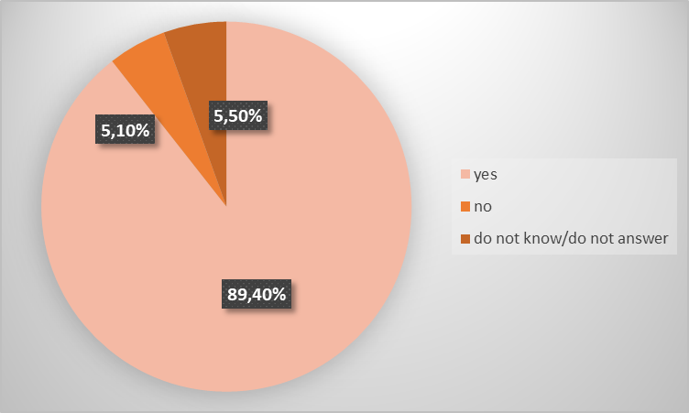
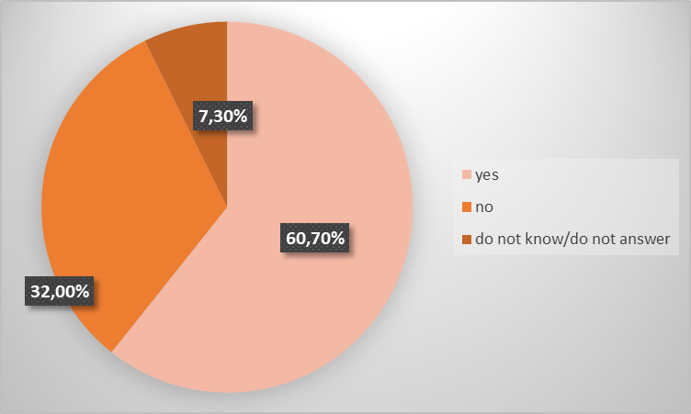
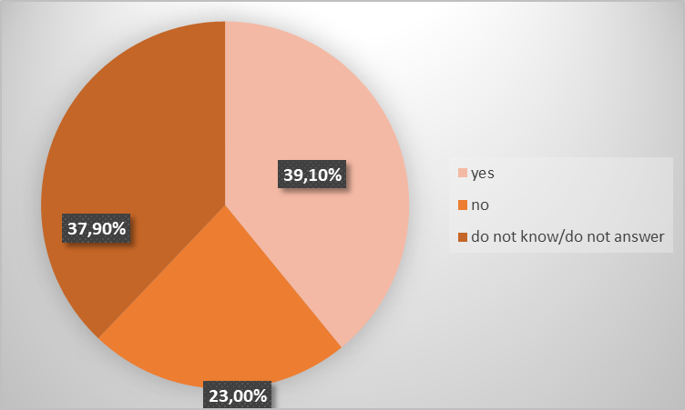
RESULTS AND DISCUSION
Can the snacks be considered as healthy food?
snack
meat snack
snack
Is the healthy nature of a snack the key in purchase and consumption choices?

Slide 10
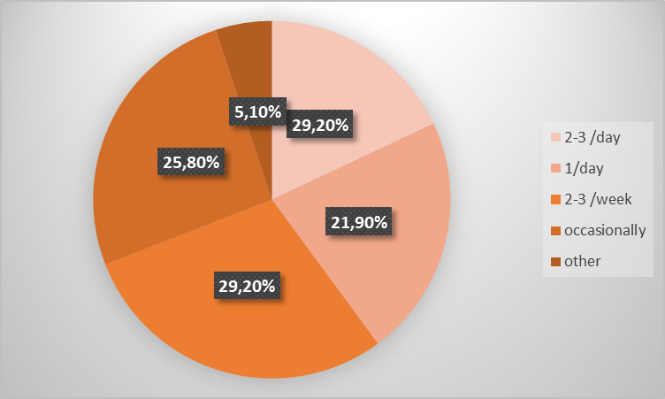
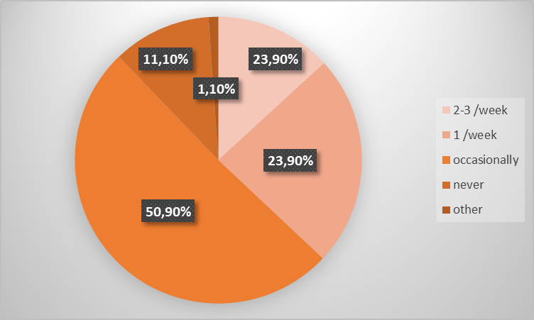
RESULTS AND DISCUSION
Frequency of consumption?
snack
meat snack

Slide 11
RESULTS AND DISCUSION
Motivations
snack

Slide 12
RESULTS AND DISCUSION
Characteristics that consumers mentioned to consider as a healthy snack
snack
that improve health (functional) | 30.3%
low in sugar | 27.7%
low in fat | 13%
high in vitamins and minerals | 7.8%
high in protein | 7.4%
high in fiber | 6.5%
low in salt | 3.5%
high in omega-3 fatty acids | 2.6%
high content in proteins of plant origin | 0.4%
low content of nutrients with high risk to health | 0.4%
high content of nutrients in general | 0.4%

Slide 13
RESULTS AND DISCUSION
Motivations
Meat snack

Slide 14
RESULTS AND DISCUSION
Characteristics that consumers mentioned to consider as a healthy snack
Meat snack

Slide 15
CONCLUSIONS
The most important motivations for the acquisition and consumption of snacks were those related to convenience. On the other hand, specifically for meat snacks the participants exposed the acceptability’s motivations as the most crucial (it tastes good, I like, I enjoy and I have an appetite for it), above convenience and sociability dimensions.
The most popular snacks were fruits, dairy, nuts/seeds and meat snacks. More than 50% of those surveyed consumed them from once a day to two or three times a week. As for meat snacks, the most consumed were dehydrated meats (ham, loin, jerky, etc.), but for the majority of respondents only occasionally eats. Moreover, in a healthy meat snack consumers were looking for high protein and low salt content.

