Slide 1
Extraction, chemical characterization, and antioxidant activity of bioactive plant extracts
Beatriz Nunes Silva, Vasco Cadavez, Pedro Ferreira-Santos, José António Teixeira, Ursula Gonzales-Barron
1st International Electronic Conference on Food Science and Functional Foods

Slide 2
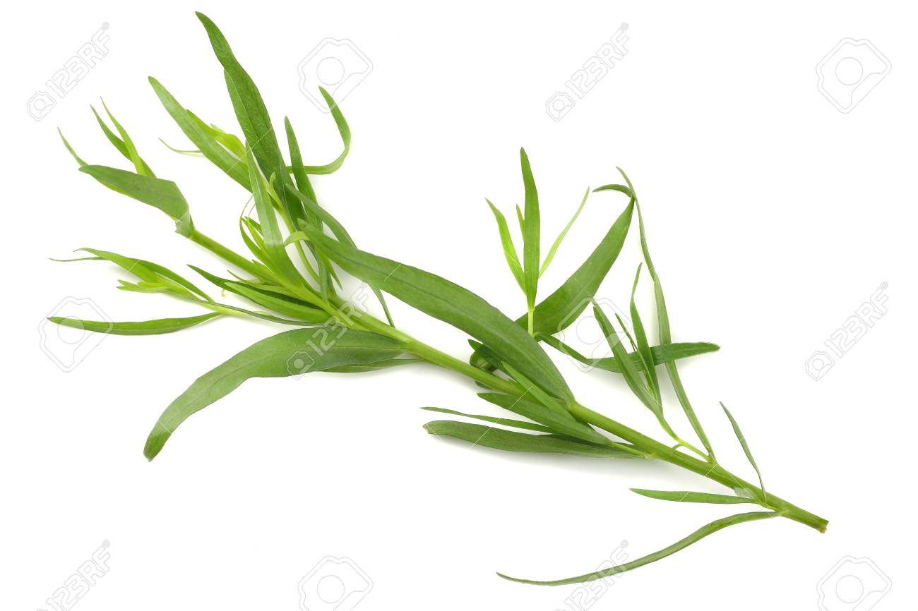
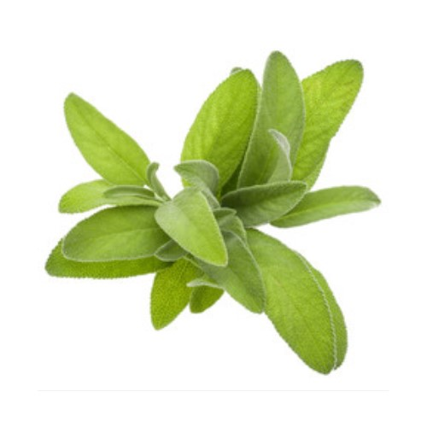
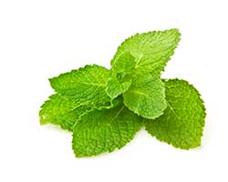
Motivation
Plant extracts have been proposed as alternative biocides and antioxidants to be included in food products
There is scientific evidence of the antimicrobial and antioxidant properties of several plants
Solid-liquid and Soxhlet extractions are often used in the food industry
Rosemary
Lemon balm
Basil
Tarragon
Sage
Spearmint

Slide 3
Objectives
To study the phytochemical and antioxidant profile of plant extracts
(as obtained by distinct extraction methods and solvents)
To assess the potential of plant extracts to be used as food preservatives

Slide 4
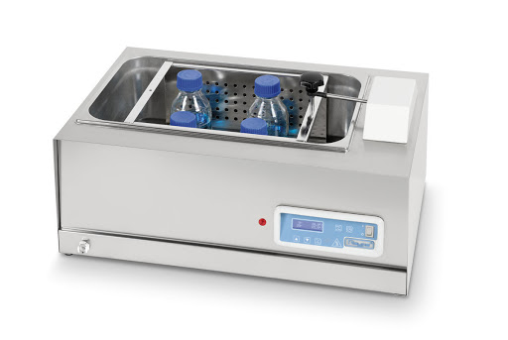
Methodology
Chemical characterization
Total Phenolic Content
Total Flavonoid Content
Antioxidant activity
DPPH
ABTS
FRAP
Identification and quantification of individual phenolic compounds
UPLC-DAD
Solid-liquid Extraction
Rosemary
Lemon balm
150 rpm, 60 ºC, 90min
dH₂O and Et70%
Basil
Tarragon
Soxhlet Extraction
7 recycles,
120 ºC dH₂O;
80 ºC Et70%
Sage
Spearmint
Notes:
The total phenolic content (TPC) was determined using the Folin−Ciocalteu assay
The total flavonoid content (TFC) was determined by aluminium chloride colorimetric method
All experiments were performed in triplicate and data is presented as mean ± standard deviation (SD) values. The significance of variables was evaluated by analysis of variance (α=0.05) and principal component analysis (PCA) was used on phenolic compounds to discriminate between extracts. Statistical analysis was conducted in R software.

Slide 5
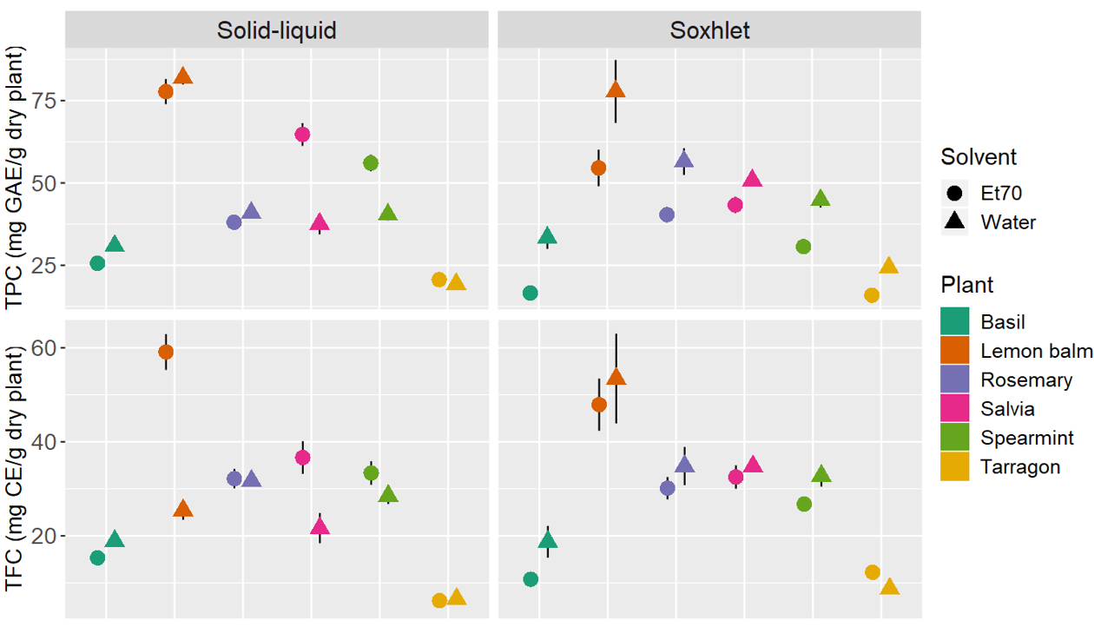
RESULTS
indicates p < 0.05 between solvents for each plant extract
TPC and TFC
Notes:
Yellow arrows: influence of extraction technique when the solvent is water
Alcoholic solvents are more effective in extracting phenolic compounds than water (improved solubility from the raw material to the solvent medium) and that lower temperatures are more adequate to extract such compounds as they avoid thermal degradation and oxidation.
Hence, it is expected that ethanol 70% + Soxhlet method leads to lower TPC and TFC, since phenolic compounds are likely extracted early in the process and then exposed to a higher temperature for a longer time.
Oppositely, higher TPC and TFC are obtained when ethanol 70% is used at more reduced temperatures, when using the solid-liquid extraction for example.
For Soxhlet extractions, water may be the most appropriate solvent, whereas for solid-liquid extractions, a mixture of water/ethanol is likely more adequate.

Slide 6
RESULTS
indicates p < 0.05 between extraction methods for each aqueous plant extract
TPC and TFC
Notes:
Yellow arrows: influence of extraction technique when the solvent is water
Alcoholic solvents are more effective in extracting phenolic compounds than water (improved solubility from the raw material to the solvent medium) and that lower temperatures are more adequate to extract such compounds as they avoid thermal degradation and oxidation.
Hence, it is expected that ethanol 70% + Soxhlet method leads to lower TPC and TFC, since phenolic compounds are likely extracted early in the process and then exposed to a higher temperature for a longer time.
Oppositely, higher TPC and TFC are obtained when ethanol 70% is used at more reduced temperatures, when using the solid-liquid extraction for example.
For Soxhlet extractions, water may be the most appropriate solvent, whereas for solid-liquid extractions, a mixture of water/ethanol is likely more adequate.

Slide 7
RESULTS
Higher TPC in aqueous extracts from
Soxhlet extraction
TPC and TFC
Notes:
Yellow arrows: influence of extraction technique when the solvent is water
Alcoholic solvents are more effective in extracting phenolic compounds than water (improved solubility from the raw material to the solvent medium) and that lower temperatures are more adequate to extract such compounds as they avoid thermal degradation and oxidation.
Hence, it is expected that ethanol 70% + Soxhlet method leads to lower TPC and TFC, since phenolic compounds are likely extracted early in the process and then exposed to a higher temperature for a longer time.
Oppositely, higher TPC and TFC are obtained when ethanol 70% is used at more reduced temperatures, when using the solid-liquid extraction for example.
For Soxhlet extractions, water may be the most appropriate solvent, whereas for solid-liquid extractions, a mixture of water/ethanol is likely more adequate.

Slide 8
RESULTS
indicates p < 0.05 between extraction methods for each hydroethanolic plant extract
TPC and TFC
Notes:
Blue arrows: influence of extraction technique when the solvent is Et70
Alcoholic solvents are more effective in extracting phenolic compounds than water (improved solubility from the raw material to the solvent medium) and that lower temperatures are more adequate to extract such compounds as they avoid thermal degradation and oxidation.
Hence, it is expected that ethanol 70% + Soxhlet method leads to lower TPC and TFC, since phenolic compounds are likely extracted early in the process and then exposed to a higher temperature for a longer time.
Oppositely, higher TPC and TFC are obtained when ethanol 70% is used at more reduced temperatures, when using the solid-liquid extraction for example.
For Soxhlet extractions, water may be the most appropriate solvent, whereas for solid-liquid extractions, a mixture of water/ethanol is likely more adequate.

Slide 9
RESULTS
Higher TPC in hydroethanolic extracts from
Solid-liquid extraction
TPC and TFC
Notes:
Yellow arrows: influence of extraction technique when the solvent is water
Alcoholic solvents are more effective in extracting phenolic compounds than water (improved solubility from the raw material to the solvent medium) and that lower temperatures are more adequate to extract such compounds as they avoid thermal degradation and oxidation.
Hence, it is expected that ethanol 70% + Soxhlet method leads to lower TPC and TFC, since phenolic compounds are likely extracted early in the process and then exposed to a higher temperature for a longer time.
Oppositely, higher TPC and TFC are obtained when ethanol 70% is used at more reduced temperatures, when using the solid-liquid extraction for example.
For Soxhlet extractions, water may be the most appropriate solvent, whereas for solid-liquid extractions, a mixture of water/ethanol is likely more adequate.

Slide 10
RESULTS
Overall:
Et70
(improved solubility)
+
solid-liquid extraction
(lower temperature, reduced degradation)
most effective combination to extract phenolic compounds
TPC and TFC
Notes:
Yellow arrows: influence of extraction technique when the solvent is water
Alcoholic solvents are more effective in extracting phenolic compounds than water (improved solubility from the raw material to the solvent medium) and that lower temperatures are more adequate to extract such compounds as they avoid thermal degradation and oxidation.
Hence, it is expected that ethanol 70% + Soxhlet method leads to lower TPC and TFC, since phenolic compounds are likely extracted early in the process and then exposed to a higher temperature for a longer time.
Oppositely, higher TPC and TFC are obtained when ethanol 70% is used at more reduced temperatures, when using the solid-liquid extraction for example.
For Soxhlet extractions, water may be the most appropriate solvent, whereas for solid-liquid extractions, a mixture of water/ethanol is likely more adequate.

Slide 11
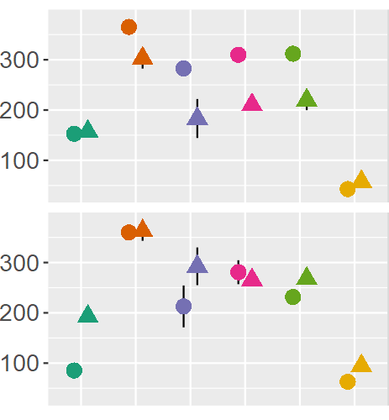
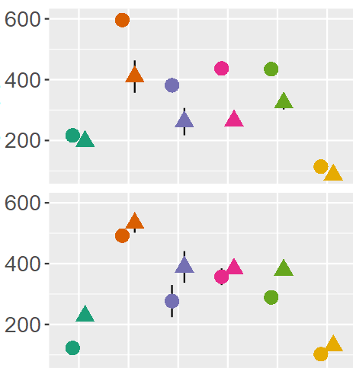
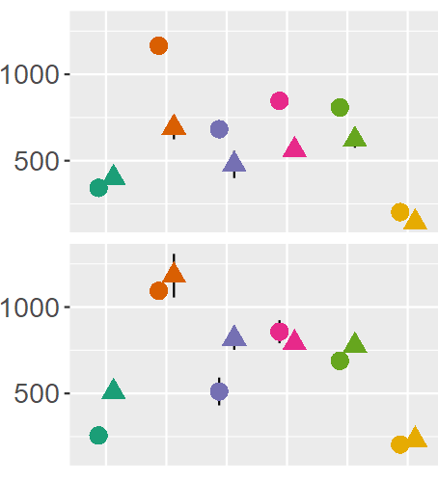
RESULTS
Regardless of the extraction method or solvent:
lemon balm extracts → highest antioxidant activities
tarragon extracts → lowest antioxidant activities
Antioxidant activity
DPPH
ABTS
FRAP
Solid-liquid
μmol TE/g dry plant
μmol Fe²⁺/g dry plant
Soxhlet
Notes:
Similar to TPC results, the antioxidant activity of extracts, except those of tarragon, are generally dependent on the extraction method and/or solvent applied.

Slide 12
RESULTS
Identification and Quantification of Individual Phenolic Compounds
15 compounds identified
Rosmarinic acid
Ferulic acid
Ellagic acid
Naringin
Hesperidin
Resveratrol
Quercetin
p-coumaric acid + epicatechin
o-coumaric acid
Chlorogenic acid
Cinnamic acid
Syringic acid
Vanillic acid
Kaempferol
3,4-HBA
PCA was conducted to visualize the influence of phenolic compounds on extracts differentiation
Present in all extracts

Slide 13
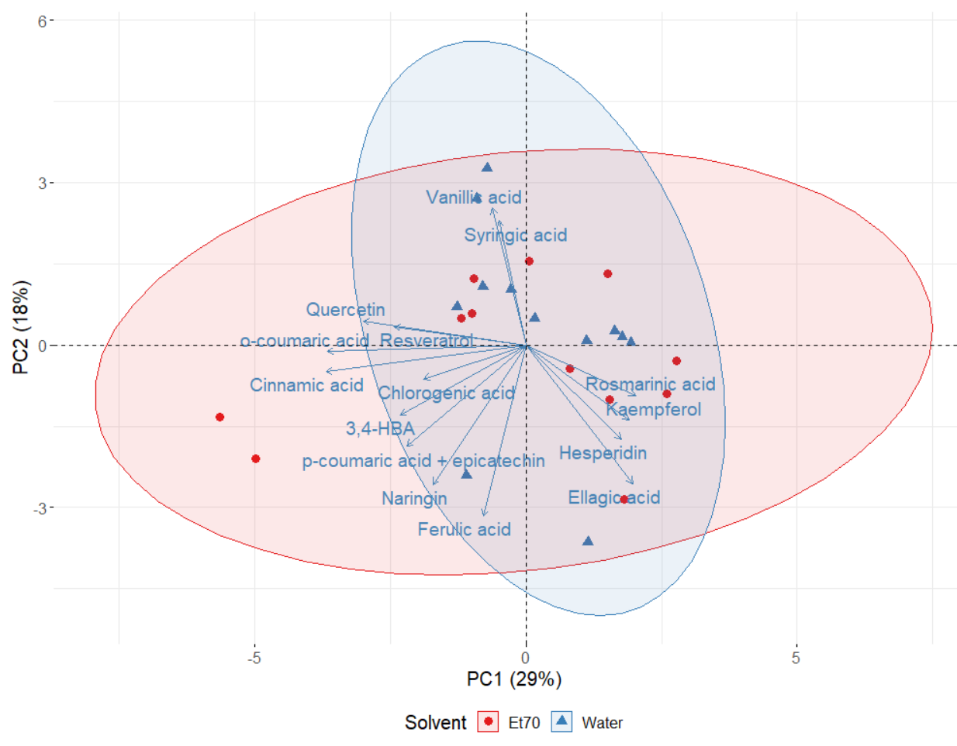
RESULTS
Identification and Quantification of Individual Phenolic Compounds
Hydroethanolic extracts: higher concentrations of rosmarinic acid, resveratrol, and hesperidin
Aqueous extracts: higher concentrations of vanillic and syringic acids
Unable to distinguish between solvents…
Notes:
Rosmarinic acid, resveratrol, and hesperidin: these phenols are poorly soluble in water

Slide 14
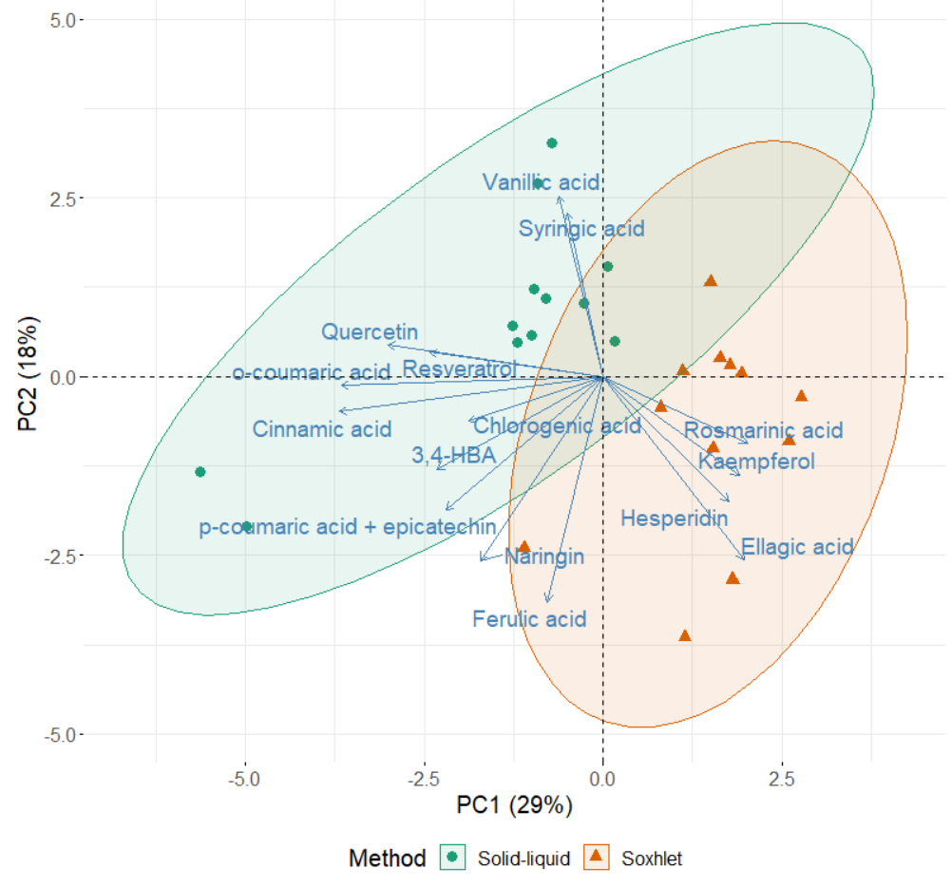
RESULTS
Identification and Quantification of Individual Phenolic Compounds
…but good discrimination between methods!
Unable to distinguish between solvents…
Notes:
Suggests greater difference in phenolic compounds for extracts obtained from different methods than different solvents

Slide 15
RESULTS
Identification and Quantification of Individual Phenolic Compounds
Soxhlet extracts: higher concentrations of rosmarinic acid, kaempferol, hesperidin and ellagic acid
Solid-liquid extracts: higher concentrations of vanillic and syringic acids, resveratrol, and quercetin
Notes:
Suggests greater difference in phenolic compounds for extracts obtained from different methods than different solvents

Slide 16
RESULTS
Identification and Quantification of Individual Phenolic Compounds
Valuable results to help selecting the best method/solvent combination to achieve a specific phenolic compound!
Notes:
Suggests greater difference in phenolic compounds for extracts obtained from different methods than different solvents

Slide 17
Conclusions
Insight on the phytochemical profile and antioxidant activity of plant extracts
Evaluation of the effect of extraction methods and solvents
Differences between aqueous and ethanolic extracts
Differences between solid-liquid and Soxhlet techniques
Overall higher phenolic content: solid-liquid hydroethanolic extracts
Lemon balm extracts: highest TPC, TFC and antioxidant activities
Tarragon: “worst” results in all assays

Slide 18
Acknowledgements
BNS wishes to acknowledge the financial support provided by the Portuguese Foundation for Science and Technology (FCT) through the PhD grant SFRH/BD/137801/2018.
The authors are grateful to EU PRIMA programme and the Portuguese Foundation for Science and Technology (FCT) for funding the ArtiSane Food project (PRIMA/0001/2018).

Slide 19
Thank you! Any questions: beatrizsilva@ceb.uminho.pt
1st International Electronic Conference on Food Science and Functional Foods

