Slide 1
UHT treatment on the stability of faba bean protein emulsion
Malik Adil Nawaz

Slide 2
Plant-based milk alternatives
Plant-based milk alternatives are more environmentally friendly than dairy
Nut-milks have a higher eco-impact than grain or legume-based milks
Most common plant-based milk is soy milk
Health risk associated to soybean e.g. soy allergy
Food Science Challenge:
Soy protein substitute
Off (beany, oxidation) flavour
Watery mouthfeel
Colloidal instability over shelf life
Nutritional benefits (eg phenols)
Mineral fortification
Presence of anti-nutritionals and allergens
Faba beans protein has a huge potential
due to higher protein contents and less anti-nutritional components

Slide 3
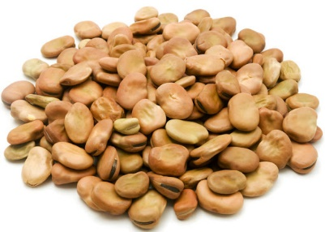
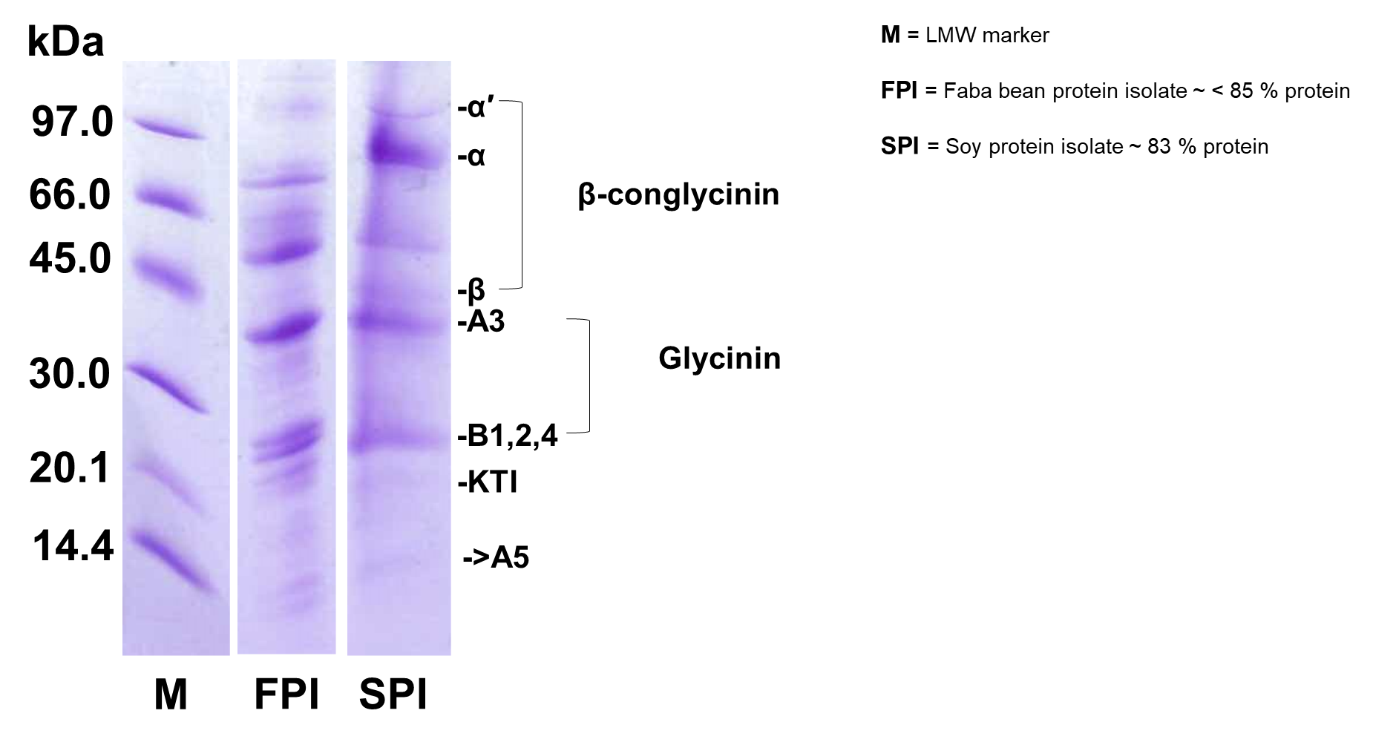
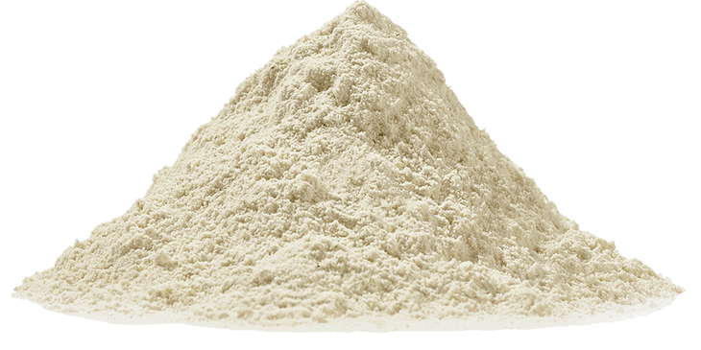
Faba bean protein
Faba bean protein bands are similar to soy, showing it’s potential to be used soy protein alternative in legume based beverages

Slide 4
Model faba protein-based beverage with high protein (5-8 %) and functional components
Lipid
3 %
Fibre
20 %
Protein
63 %
Starch
7 %
Ash
4 %
Faba bean concentrate used in this study

Slide 5
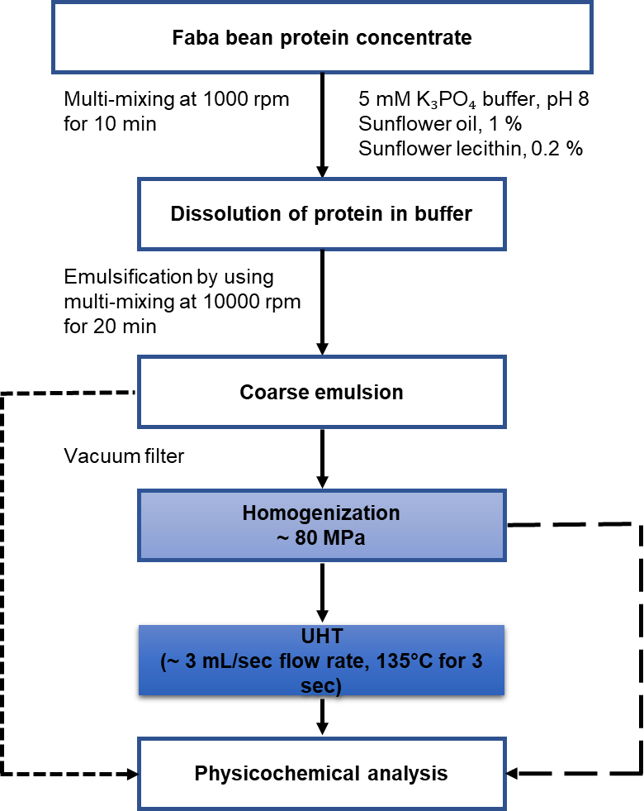
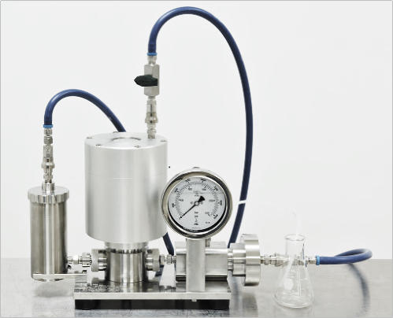
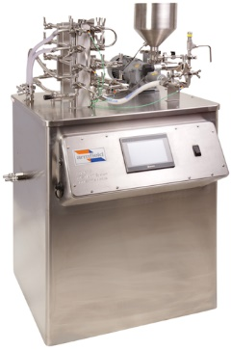
Experimental design

Slide 6
Particle size distribution
UHT resulted in bigger size particles possibly due flocculation and coalescence

Slide 7
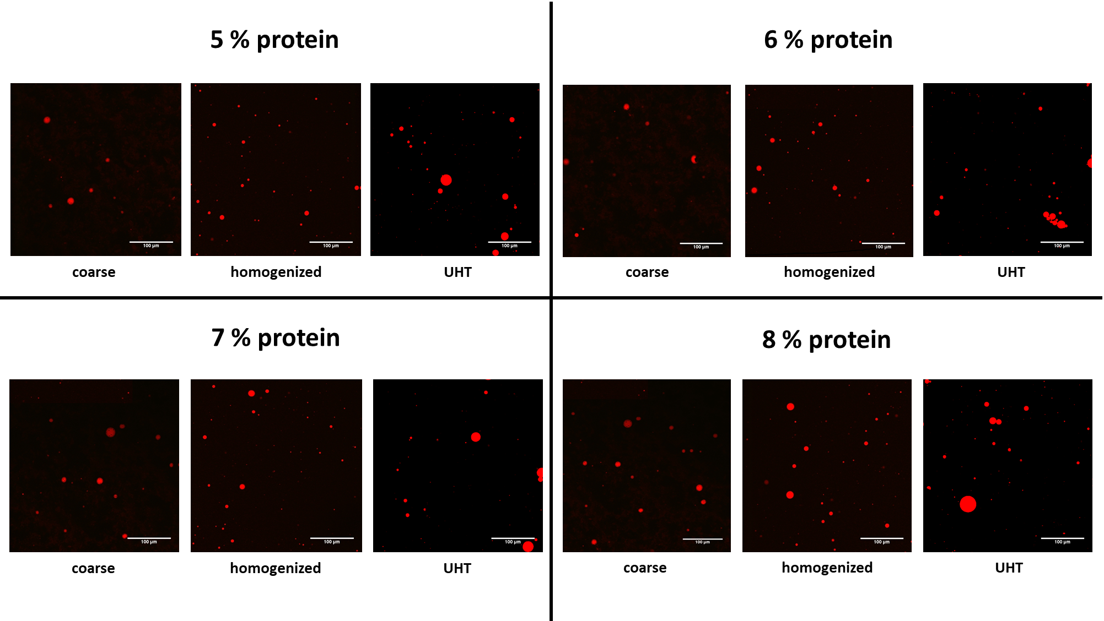
Confocal micrographs

Slide 8
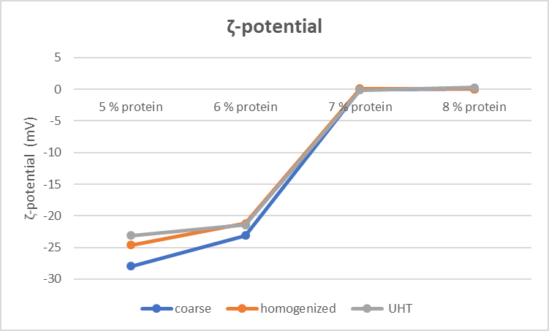
ʑ-potential
ʑ-potential is an indication of emulsion stability.
Emulsions 7 and 8 % protein easily flocculate or coagulate
due to ʑ-potential value near 0.

Slide 9
Thermal induced gelation
Fresh UHT
UHT (24 hour storage at 4°C
Thermal induced gelation occurred in shelf stable beverage samples
possibly due to protein denaturation and unfolding hydrophobic chains

Slide 10
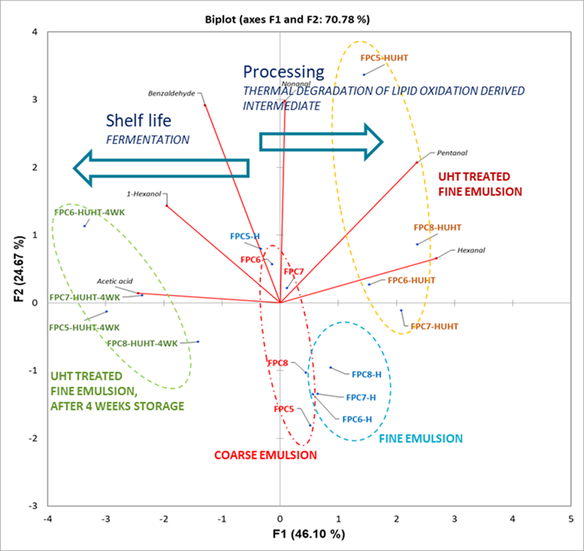
Off-flavours of model drink
In total 21 compounds were detected and quantified, representing different chemical classes such as alcohols, aldehydes, ketones, esters, furan and acids.

Slide 11
Thank you
Conclusions
Faba bean has similar protein like soybean and can be used as soy replica in plant-based milk alternatives.
Protein emulsions with 8 % protein showed induced gelation after UHT. Therefore, further research is planned to overcome this challenge.
Agriculture and Food
Adil Malik +61 3 9123 4567
Malik.nawaz@csiro.au
Roman Buckow +61 3 9731 3270
Roman.buckow@csiro.au

