Slide 1
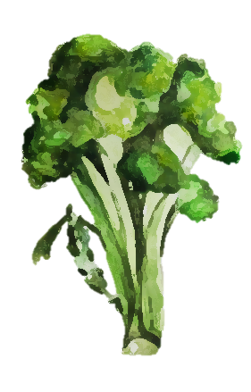
Increased stability of Bimi® glucosinolates by bioencapsulation
Paula Garcia-Ibañez , Diego A Moreno and Micaela Carvajal

Slide 2
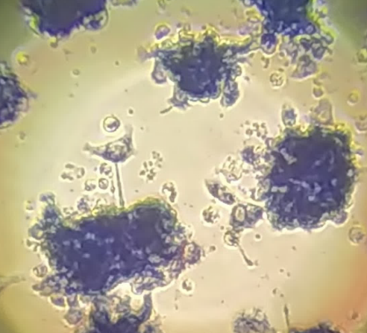
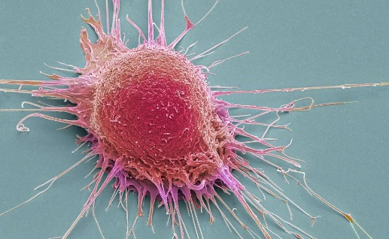
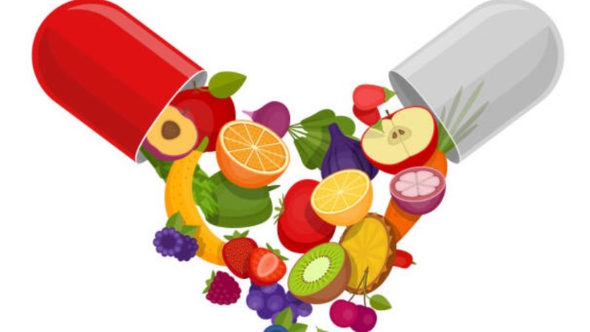

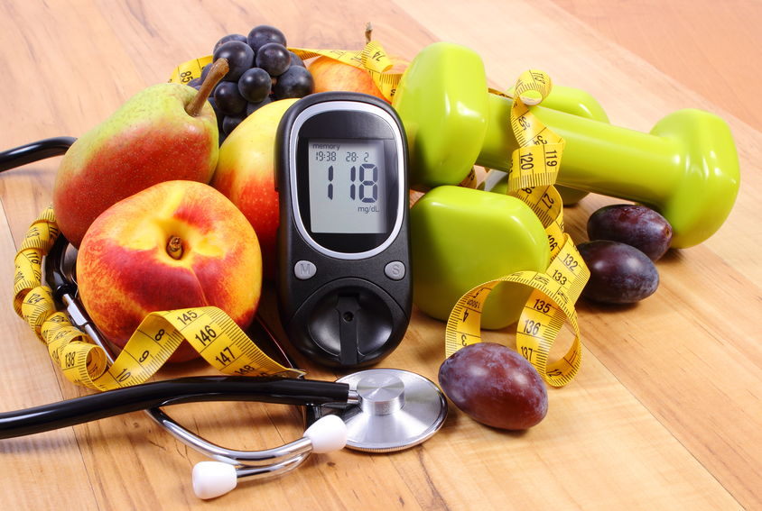

Introduction
Non-comunicable diseases
Cancer
Chronic inflammation
Obesity
Diabetes
Bioactive-enriched foods and functional ingredients emerge as coadjuvants in diets

Slide 3


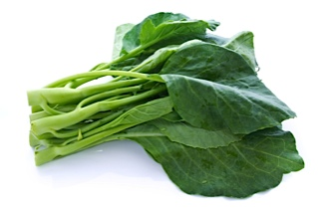
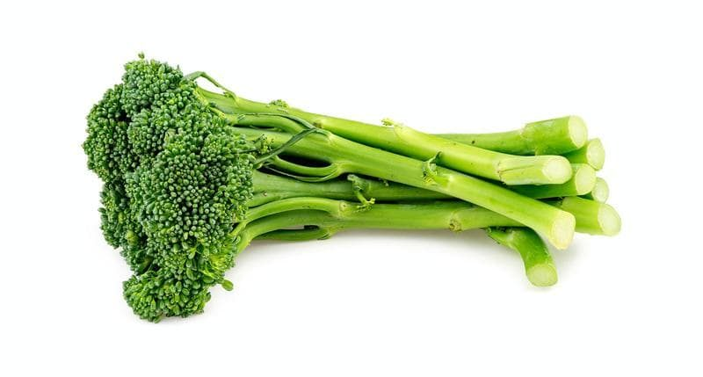
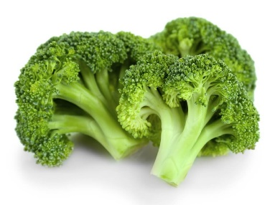

Introduction
Phase II detoxification enzymes inducers
Anti-tumorigenic activity
Nrf2 transcriptor factor inductor
Gut microbiome modulators
Glucosinolates and Isothiocyanates
Mitsiogianni et al. 2019, Antioxidants.
Kaczmarek et al. 2019, The Journal of nutritional biochemistry
Brassica oleracea L. var. italica
Brassica oleracea L. var. alboglabra
Bimi ®

Slide 4
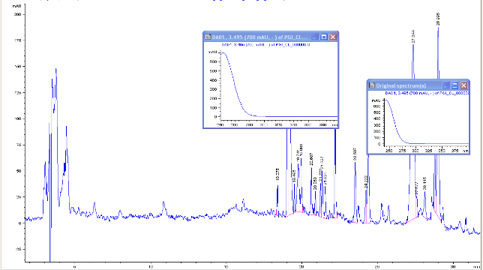

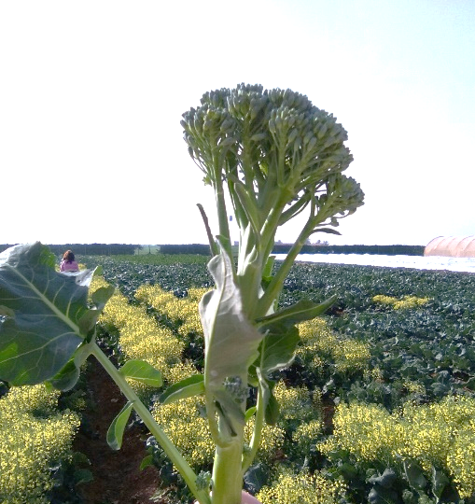
Material
-200 µM SA
-100 µM MeJA
-SA+MeJA
HPLC-DAD-ESI-Msn analysis

Slide 5
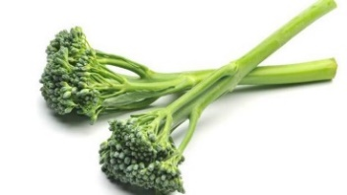
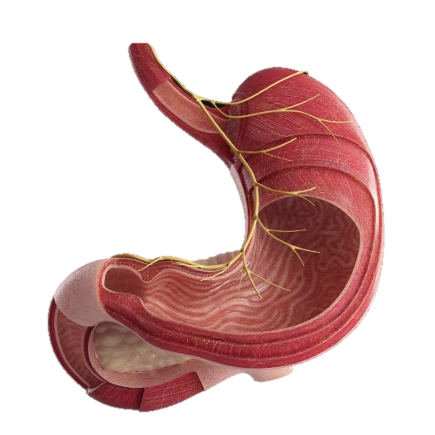

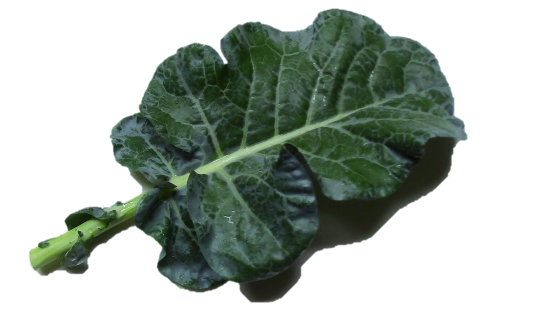
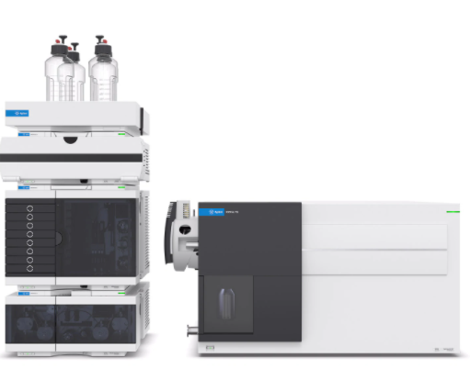
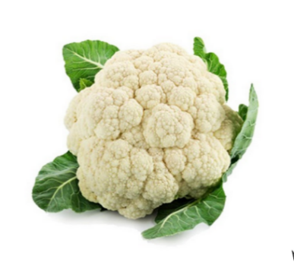
Material
Bimi® edible part elicitated with the combination treatment
SFN-rich extract elaboration
Gastric in vitro digestion (3h)
Bimi® leaves elicitated with 100 µM MeJA
Microencapsulation
UHPLC-QqQ- MS/MS Metabolite analysis
Cauliflower plasma membrane vesicles extraction

Slide 6
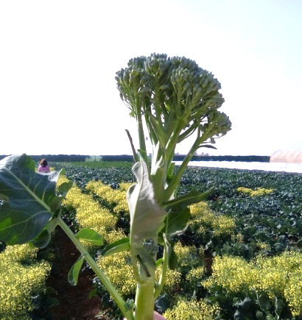
Results and Discussion
mg g D.W.⁻¹ | Edible part |  |  |  | Leaves
GLS | Control | 200 µM SA | 100 µM MeJA | SA+MeJA | Control | 200 µM SA | 100 µM MeJA | SA+MeJA
GRA | 4.06±0.12a | 3.95±0.06b | 4.13±0.08a | 3.98±0.04b | 1.4±0.04ab | 1.67±0.07a | 1.10±0.07b | 1.52±0.01ab
HGB | * | 1.76±0.19a | 1.56±0.21a | 1.27±0.05a | * | * | * | *
GB | 0.94±0.04d | 3.73±0.14c | 4.79±0.1b | 5.63±0.07a | 0.72±0.03c | 0.75±0.12c | 3.9±0.04a | 2.26±0.09b
MGB | 1.72±0.08b | 2.2±0.11a | 1.8±0.05b | 2.35±0.08a | * | * | 1±0.01a | 0.71±0.07b
NGB | 0.74±0.05c | 0.18±0.04d | 2.44±0.1b | 3.01±0.16a | * | 0.19±0.02c | 1.63±0.03a | 0.5±0.003b
*The presence of the GLSs was under limit of quantification by HPLC-DAD-ESI-MSn (< 0.02 mg/ g D.W.).
SA: salicylic acid, MeJA: methyl jasmonate, GLS: glucosinolate, GRA: glucoraphanin, HGB: 4-hydroxy-glucobrassicin, GB: glucobrassicin, MGB: 4-metoxy-glucobrassicin; NGB: neoglucobrassicin

Slide 7
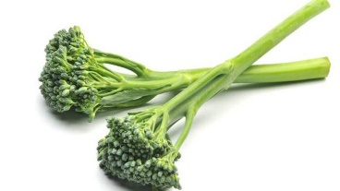
Results and discussion
Bimi® edible part
B
Bimi® leaves

Slide 8

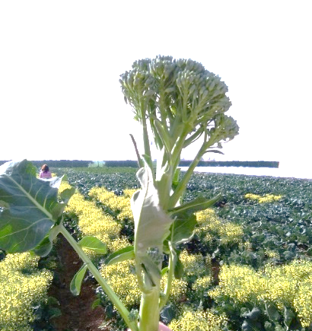
Conclusion
Elicitors (200 µM SA, 100 µM MeJA and their combination) favored an enrichments of glucosinolates in the edible part of Bimi® and their leaves.

Slide 9

Conclusion
When Bimi® plant material was used for a SFN-rich extract for an in vitro gastric digestion, higher concentrations of SFN were found in the microencapsulated samples, in both the edible part and leaves.

Slide 10


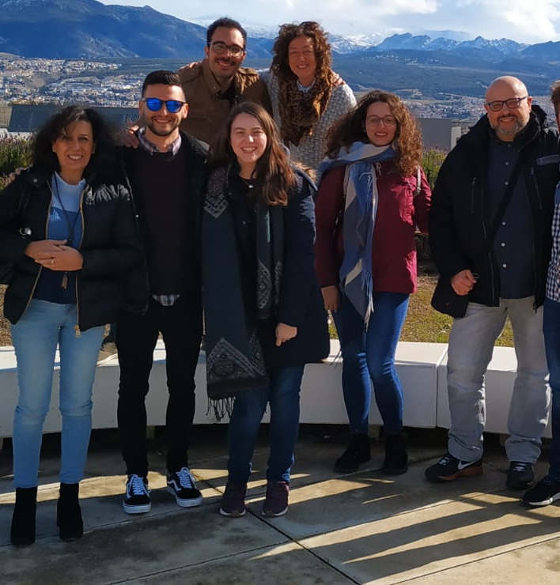



Acknowledgements
This work was funded by the CDTI, Spain (BIOTAGUT) and by the Spanish Ministerio de Ciencia, Innovación y Universidades (AGL2016-80247-C2-1-R).
P. García-Ibañez was funded by a grant from the Fundación Séneca-CARM, Spain (21273/FPI/19).
Aquaporins Group, Vegetal nutrition department, CEBAS-CSIC (IG @aqpteam)
Sakata seed iberica S.L.U. provided the seeds

