Slide 1
TECHNO-FUNCTIONAL PROPERTIES OF NEW ANDEAN INGREDIENTS: MACA (Lepidium meyenii) AND AMARANTH (Amaranthus caudatus).
Miguel Angel Alarcón-García^{3*,} Jose Angel Perez-Alvarez^{1*,} Jairo Humberto López-Vargas², Maria Jesús Pagán-Moreno³
¹ IPOA Research Group. Agri-Food Technology Department. Universidad Miguel Hernández (UMH), Orihuela, Spain; ja.perez@goumh.umh.es
² Instituto de Ciencia y Tecnología de Alimentos (ICTA) Universidad Nacional de Colombia, sede Bogotá, Santa Fe de Bogotá, Colombia; jhlopezv@unal.edu.co
³ CUINA Food Research and Innovation Group. Food Technology Department. Universitat Politecnica de Valencia, Valencia, Spain; mialgar7@upv.edu.es; jpagan@tal.upv.es

Slide 2
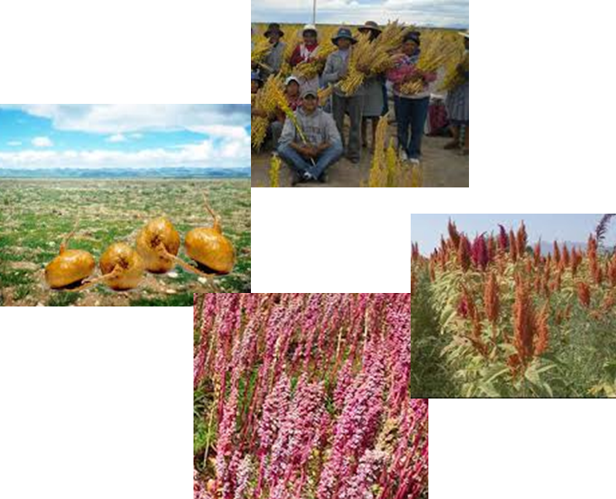
INTRODUCTION
Andean highlands are located in native areas over 4000 m altitude
Wisdom and extraordinary nutritional features
Soups, beverages, pasta, jams, puddings, and others
Contents of bioactive compounds

Slide 3
INTRODUCTION
Low level of fat, high level of protein, minerals (Ca, Mg, K), dietary fiber
Maca: glucosinolates, functional polysaccharides, alkamides, antioxidant ,anti-inflammatory
Minerals (P, Ca, K, Mg), vitamins (E, B2, C), antioxidants, dietary fiber, and protein
Cholesterol-lowering, anticancer precursors, squalene, unsaturated fatty acids with Ω6 .
Maca (Lepidium meyenii)
Amaranth (Amaranthus cuadatus)

Slide 4
OBJECTIVE
The aim of this work was to evaluate, and the main techno-functional properties of wholemeal (W) and non-wholemeal (NW) maca and amaranth flours in terms of their adding processed food aptitude.

Slide 5
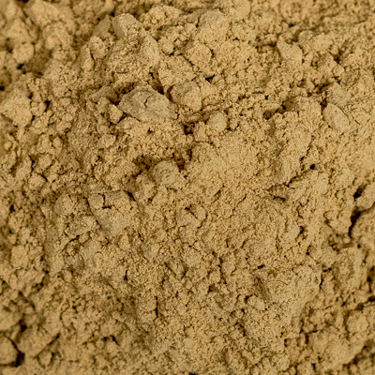
MATERIALS AND METHODS
Plant materials
Amaranth (Amaranthus cuadatus)
-Wholemeal
-Non-wholemeal
Maca (Lepidium meyenii)
-Wholemeal
-Non-wholemeal

Slide 6
MATERIALS AND METHODS
Techno-functional properties
WHC - Water Holding Capacity. Wu, L.; Zhang, M.; Xin, X.; Lai, F.; Wu, H. Food Funct. 2019, 10(5), 2894–905
SI - Solubility Index. Wu, L.; Zhang, M.; Xin, X.; Lai, F.; Wu, H. Food Funct. 2019, 10(5), 2894–905
SC - Swelling Capacity. Robertson, J.A.; Monredon, F.D.; Dysseler, P.; Guillon, F.; Amadó, R.; Thibault J.F. LWT. 2000, 33, 72-79
OHC - Oil Holding Capacity. Wu, L.; Zhang, M.; Xin, X.; Lai, F.; Wu, H. Food Funct. 2019, 10(5), 2894–905
EC - Emulsifying Capacity. Sathe, S.K.; Salunkhe, D.K. J. Food Sci. 1981, 46(1), 71–81
ES - Emulsifyng Stability. Sathe, S.K.; Salunkhe, D.K. J. Food Sci. 1981, 46(1), 71–81
FC - Foaming Capacity: Shevkani, K.; Singh, N.; Kaur, A.; Rana, J.C. Food Hydrocoll. 2015, 43, 679–689
FS – Foam Stability (30 min): Shevkani, K.; Singh, N.; Kaur, A.; Rana, J.C. Food Hydrocoll. 2015, 43, 679–689
PARTICLE SIZE. ISO 13320. 2020

Slide 7
RESULTS AND DISCUSSION
PARTICLE SIZE: Volume mean diameter - D(4,3)
D(4,3) | D(4,3)
Maca no integral | 128,08±0,90ª (µm)
Amaranto No integra | 128,53±1,45ª (µm)
Maca Integral | 157,25±3,57^{b} (µm)
Amaranto Integral | 327,17±17,18^{c} (µm)

Slide 8
RESULTS AND DISCUSSION
HYDRATION PROPERTIES
Water holding capacity (WHC)
Solubility index (SI)
Sweeling capacity (SC)

Slide 9
RESULTS AND DISCUSSION
OIL HOLDING CAPACITY, EMULSIFYING CAPACITY AND EMULSION STABILITY
Oil holding capacity (OHC)
Emulsifying capacity (EC)
emulsion stability at 24h (ES)

Slide 10
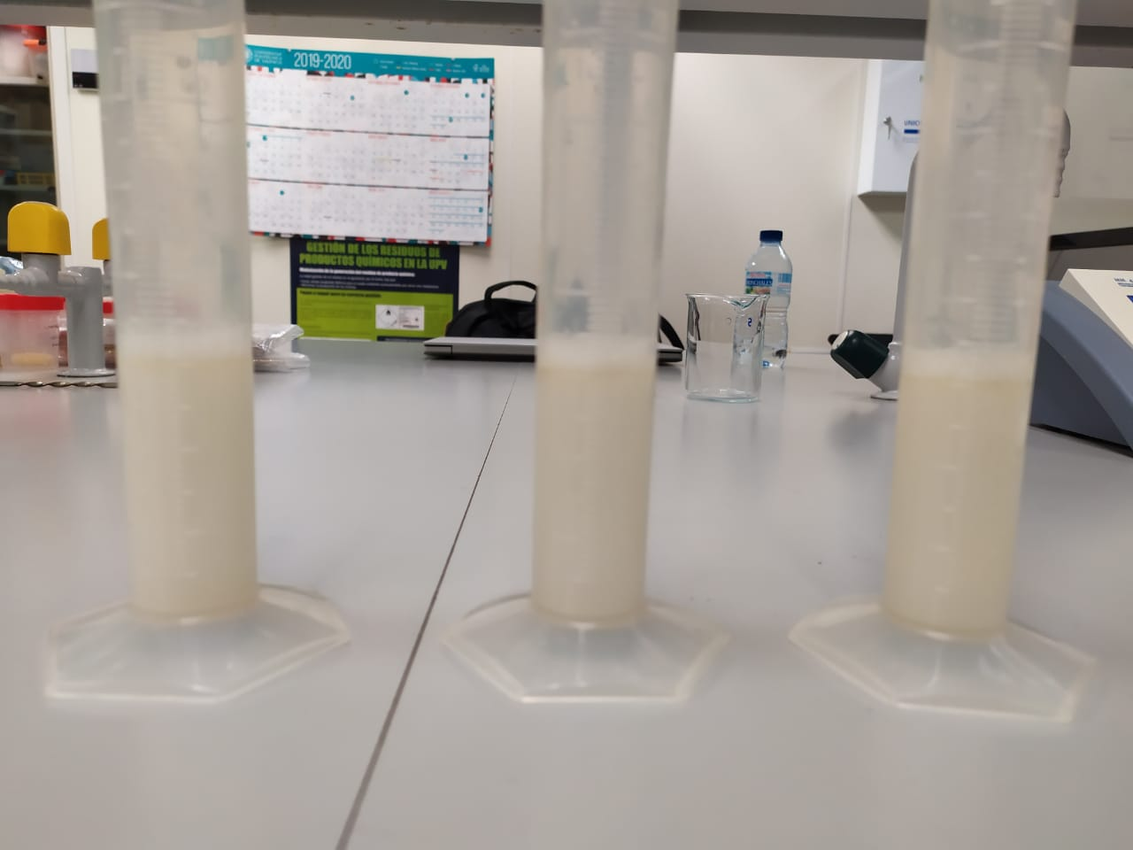
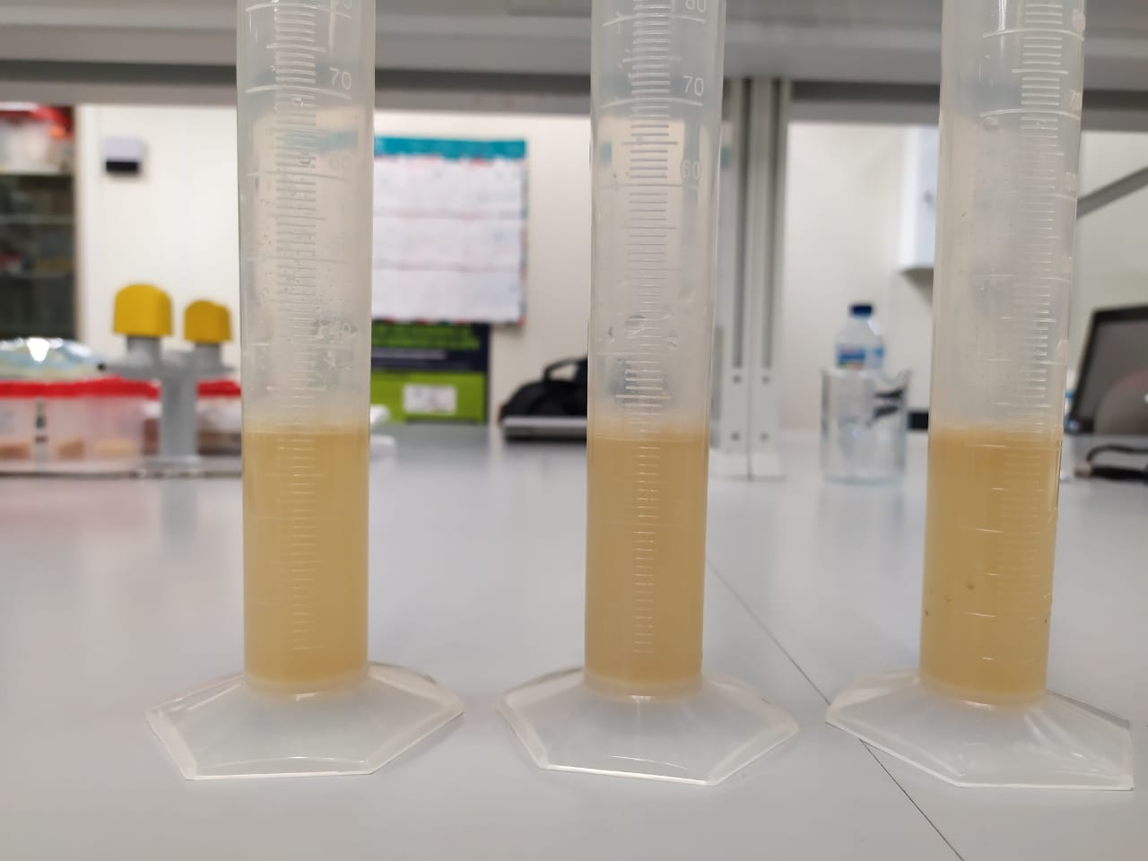
RESULTS AND DISCUSSION
Foaming capacity and foam stability
Foaming capacity (FC)
Foam stability at 30 min (FS)

Slide 11
CONCLUSIONS
The results obtained allow us to consider incorporating these types of flours to diﬀerent food products, knowing their eﬀect on Water Holding Capacity, Oil Holding Capacity, Emulsifying Capacity and therefore being able to modify the processes concerning the traditional ones. This is especially interesting in the case of the meat products elaboration process in which these parameters could be critical, with the addition of these types of flours.

