Slide 1






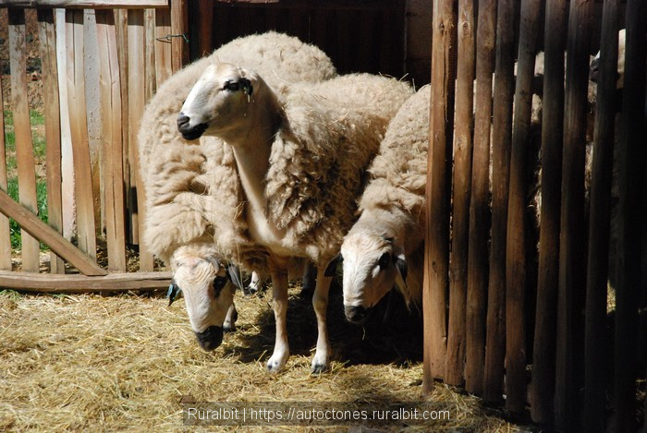
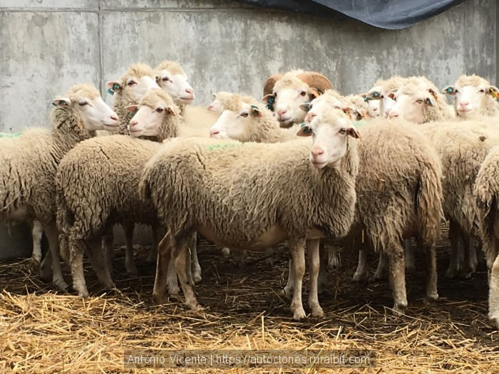

MICROBIAL DETERIORATION OF LAMB MEAT OF PORTUGUESE ORIGIN
AS AFFECTED BY ITS INTRINSIC PROPERTIES
Gisela Rodrigues¹, Sara Coelho-Fernandes¹, José M. Lorenzo², Ursula Gonzales-Barron¹,and Vasco Cadavez¹
¹Centro de Investigação de Montanha (CIMO), Instituto Politécnico de Bragança, Portugal
²Fundación Centro Tecnolóxico da Carne, Parque Tecnolóxico de Galicia, Spain
1st International Electronic Conference on Food Science and Functional Food
Notes:
Hello everyone, thank you for being here. My name is Gisela Rodrigues and I’d like to thank the opportunity for prisenting this study, titled MICROBIAL DETERIORATION OF LAMB MEAT OF PORTUGUESE ORIGIN AS AFFECTED BY ITS INTRINSIC PROPERTIES, with results stemming from the EcoLamb project.
I work at Centro de Investigação de Montanha in Bragança, Portugal.

Slide 2
Content
Introduction
Objectives
Materials and methods
Results and discussion
Conclusion

Slide 3

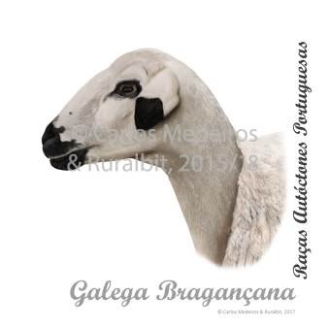
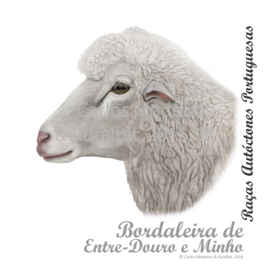
Introduction
In Portugal, there are 15 autochthonous sheep breeds
The main autochthonous sheep breeds exploited for meat production are Churra-Galega-Bragançana (CGB) and Bordaleira-de-Entre-Douro-e-Minho (BEDM)
Sheep and goat meat production constitutes 2.8% of Portugal’s meat production
Figure 1. Churra Galega Bragançana Mediterrânea (Bragança)
Figure 2. Bordaleira-entre-Douro-E-Minho Atlântica (Ponte de Lima)

Slide 4
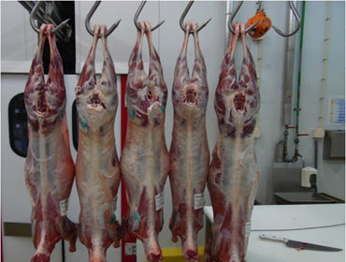
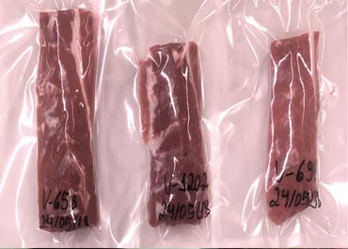
Introduction
Lamb meat achieves ~80% of its maximum tenderness potential after 7 days of cold maturation
During maturation, microbial deterioration takes place due to the proliferation of psychrotrophic bacteria, lactic acid bacteria, Pseudomonas spp., Clostridium spp., etc.
Vacuum packaging (VP) is well-known to prolong the life of the meat, by retarding microbial deterioration. It depends on:
  chilling system/profile
  initial microbial contamination
  physicochemical or intrinsic properties of the meat
Figure 3. Lamb carcasses
Figure 4. Vaccum-packed lamb meat
Notes:
Sheep and gout meat production constitutes 2.8% of Portugal’s meat production

Slide 5
Objectives
i) To evaluate the evolution of spoilage indicator microorganisms in refrigerated vacuum-packed (VP) lamb meat from two Portuguese breeds, Churra-Galega-Bragançana (CGB) and Bordaleira-de-Entre-Douro-e-Minho (BEDM)
ii) To elucidate any interrelationship between meat’s intrinsic properties (i.e., pH, water activity and proximate composition) and microbial growth

Slide 6
Materials and methods
Sample population
30 CBG and 30 BDEM lambs
Lambs reared in autumn 2018 and spring 2019
Slaughtered at 4 months of age

Slide 7
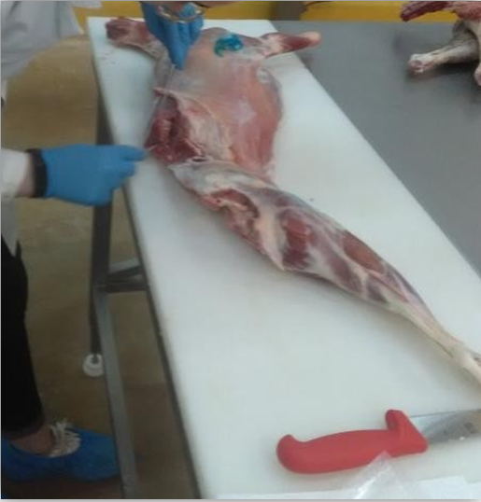
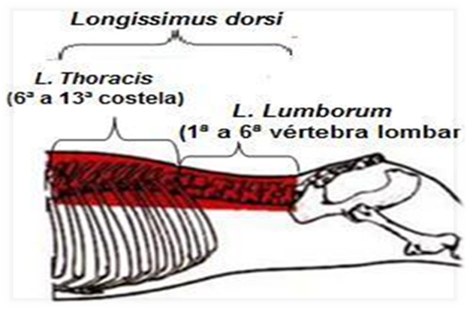
Materials and methods
After carcass splitting, the left side of the Longissimus dorsi muscle was removed from the 6th to the 13th vertebra under aseptic conditions, and was vacuum-packed for microbiological analysis
The right half of the muscle was kept for physicochemical analyses
Figure 5. Longissimus dorsi muscle
Figure 6. Scheme of the division of the L. thoracis and L. lumborum muscles for analysis

Slide 8
Materials and methods
Physicochemical analysis:
On Day 1
  pH
  Water activity (a_{w})
  Moisture content
  Fat content
  Protein content
  Ash content
Microbiological analysis:
On Days 3, 9 and 15
  Total viable counts
  Psychrotrophic bacteria
  Lactic acid bacteria
  Pseudomonas spp.

Slide 9
Materials and methods
Statistical analysis
Mixed effects models: Aimed to understand to what extent the intrinsic or physicochemical properties of meat (i.e., pH, aw and proximate composition) can affect the growth of mesophiles, lactic acid bacteria, psychrotrophic bacteria and Pseudomonas spp.
Dependent variables:
Independent variables:
As a function of
Each microbial group
Intrinsic property (Z)
Breed
Time
Time²
Z×Time (interaction)
Notes:
The statistical analysis was done by fitting a series of mixed-effects models with each of the microbial group as the dependent variable, and each intrinsic properties as independent variables.
Breed, Time, Time squared and the interaction of the property with time were also added as independent variables in all models.

Slide 10
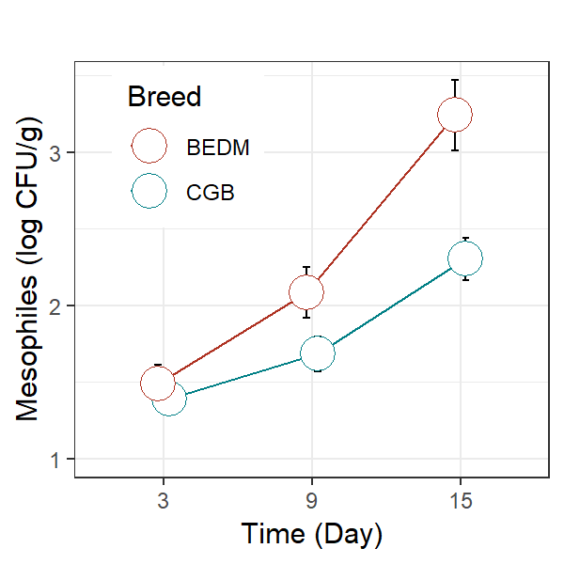
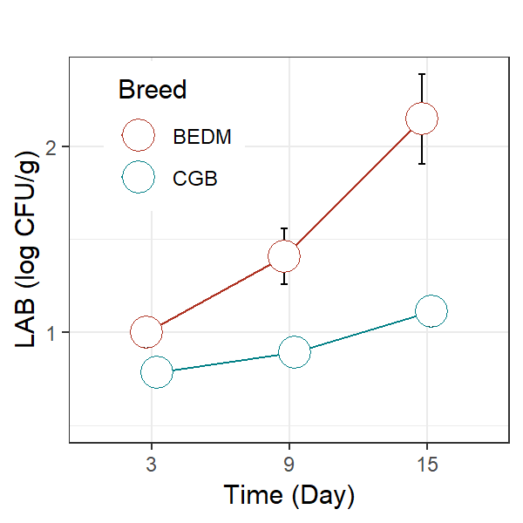
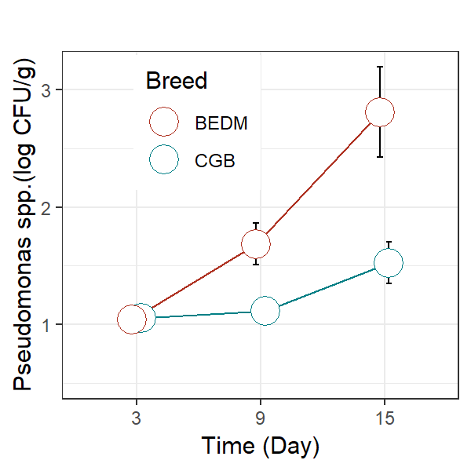
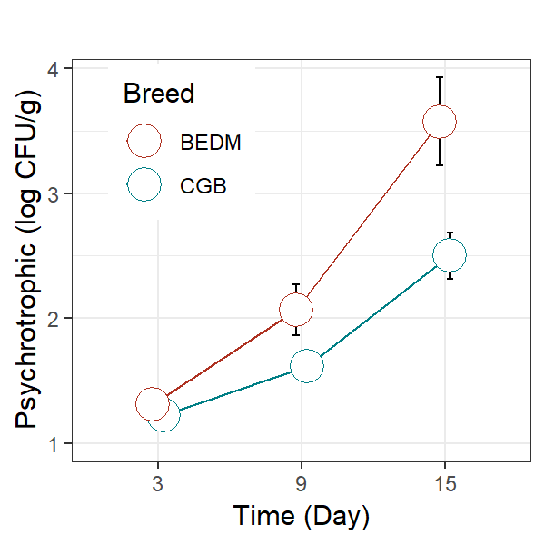
Results and discussion
The controlled hygiene process of the abattoir ensured relatively low bacterial counts in meat, even on day 3 post-slaughter
The lowest initial microbial populations were found for Pseudomonas and LAB
Microbial populations of CGB meat were significantly lower for all microbial groups than in BEDM meat
Figure 7. Increase in mesophiles and lactic acid bacteria
Figure 8. Increase in Pseudomonas spp. and psychrotrophic bacteria
Notes:
The controlled hygiene process of the abattoir enchure relatively low bacterial counts in meat, iven on day 3 post-sloterd
The lowest initial microbial populations our found for Pseudomonas and LAB
Microbial populations of CGB meat uor significantly lower for all microbial groups than in BEDM meat

Slide 11
Results and discussion
Significant effect of ‘Breed’ on mesophiles, LAB, Pseudomonas and psychrotrophic bacteria counts
The effect of pH on microbial growth was significant for all bacterial groups, as observed in the interaction term pH×Day (mesophiles, p=0.006; LAB, p=0.001; Pseudomonas, p=0.050; psychrotrophic bacteria, p=0.010)
Model | Variable | Mesophiles | LAB | Pseudomonas | Psychrotrophic
pH | Breed | 7.503 (0.008) | 17.70 (<.0001) | 8.147 (0.006) | 6.100 (0.017)
 | Day | 168.4 (<.0001) | 56.99 (<.0001) | 32.15 (<.0001) | 159.1 (<.0001)
 | pH×Day | 7.951 (0.006) | 12.24 (0.001) | 3.795 (0.050) | 6.893 (0.010)
a_{w} | Breed | 7.259 (0.009) | 18.32 (<.0001) | 8.520 (0.005) | 6.308 (0.015)
 | Day | 159.9 (<.0001) | 50.79 (<.0001) | 31.28 (<.0001) | 148.7 (<.0001)
 | a_{w}×Day | 0.050 (0.823) | 0.211 (0.646) | 3.082 (0.082) | 1.019 (0.315)
Moisture | Breed | 10.16 (0.002) | 20.02 (<.0001) | 8.854 (0.004) | 7.141 (0.009)
 | Day | 169.5 (<.0001) | 53.86 (<.0001) | 35.53 (<.0001) | 178.5 (<.0001)
 | Moisture×Day | 28.97 (<.0001) | 12.23 (<.0001) | 21.00 (<.0001) | 30.76 (<.0001)
Table 1. Effects of lamb breed and initial intrinsic factors of meat on the concentration of spoilage microorganisms in refrigerated vacuum-packed meat as quantified by mixed models (F-values and p-values from analysis of variance are shown.
Notes:
There is a significant effect of the variable ‘Breed’ on mesophiles, Lactic Acid Bacteria, Pseudomonas and psychrotrophic bacteria counts
The effect of pH on microbial growth was significant for all bacterial groups, as observed in the interaction pH times Day. This implies that a aiér ultimate pH of meat tend to accelerate microbial growth

Slide 12
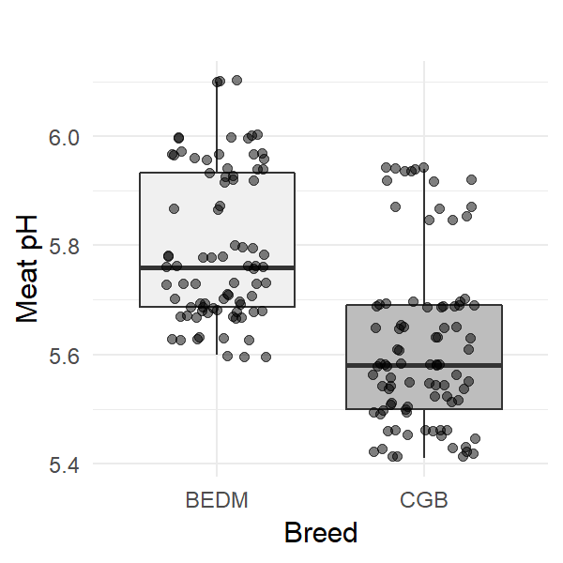
Results and Discussion
Lower microbial populations in CGB lamb meat is linked to lower ultimate pH (5.58 for CGB vs. 5.77 for BEDM)
The rapid depletion of glycogen levels, prompted by stress, prevents the normal drop in pH to optimal levels. As a result, meat of higher pH (>5.7) has better conditions for microbial growth, ultimately leading to a reduction of shelf-life in refrigerated conditions even when vacuum-packaging is applied
Figure 9. Box plots of lamb Longissimus dorsi pH measured 24 hourspost-slaughter, by breed, Churra-Galega-Bragançana (CGB) and Bordaleira-entre-Douro-e-Minho (BEDM)
Notes:
In this graph we can see that CGB breed definitely presents lower pH levels than BEDM.
These valius show that the BEDM breed, at sloterd, had lower glycogen levels, fruit of dieatary restrictions. This led to a lower production of lactic acid, and therefore a smaller pH drop.

Slide 13
Results and discussion
Water activity of meat had no effect on microbial growth, as seen by the non-significance of a_{w}×Day (p values from 0.082 to 0.823)
The development of deteriorating bacteria was found to be exacerbated by the moisture content of meat (p<.0001 for all interactions Moisture×Day)
Model | Variable | Mesophiles | LAB | Pseudomonas | Psychrotrophic
pH | Breed | 7.503 (0.008) | 17.70 (<.0001) | 8.147 (0.006) | 6.100 (0.017)
 | Day | 168.4 (<.0001) | 56.99 (<.0001) | 32.15 (<.0001) | 159.1 (<.0001)
 | pH×Day | 7.951 (0.006) | 12.24 (0.001) | 3.795 (0.050) | 6.893 (0.010)
a_{w} | Breed | 7.259 (0.009) | 18.32 (<.0001) | 8.520 (0.005) | 6.308 (0.015)
 | Day | 159.9 (<.0001) | 50.79 (<.0001) | 31.28 (<.0001) | 148.7 (<.0001)
 | a_{w}×Day | 0.050 (0.823) | 0.211 (0.646) | 3.082 (0.082) | 1.019 (0.315)
Moisture | Breed | 10.16 (0.002) | 20.02 (<.0001) | 8.854 (0.004) | 7.141 (0.009)
 | Day | 169.5 (<.0001) | 53.86 (<.0001) | 35.53 (<.0001) | 178.5 (<.0001)
 | Moisture×Day | 28.97 (<.0001) | 12.23 (<.0001) | 21.00 (<.0001) | 30.76 (<.0001)
Table 1. Effects of lamb breed and initial intrinsic factors of meat on the concentration of spoilage microorganisms in refrigerated vacuum-packed meat as quantified by mixed models (F-values and p-values from analysis of variance are shown.
Notes:
Water activity of meat had no effect on microbial growth, as seen by the non-significance of water activity times Day (marked in yellow)
On the other hand, The development of detioreiting bacteria was exacerbated by the moisture content of meat (p value under 0 point 0001 for Moisture times Day, marked in green)

Slide 14
Results and discussion
Lamb meat samples of higher intramuscular fat content underwent a slower microbial deterioration, as implied by the negative interaction Fat×Day (not shown) that was significant for all microbial groups (p<.0001)
Model | Variable | Mesophiles | LAB | Pseudomonas | Psychrotrophic
Fat | Breed | 9.314 (0.004) | 19.75 (<.0001) | 8.754 (0.005) | 6.973 (0.011)
 | Day | 184.67 (<.0001) | 56.73 (<.0001) | 36.00 (<.0001) | 185.5 (<.0001)
 | Fat×Day | 33.30 (<.0001) | 17.84 (<.0001) | 22.01 (<.0001) | 34.51 (<.0001)
Protein | Breed | 7.243 (0.009) | 18.32 (<.0001) | 8.196 (0.006) | 6.192 (0.016)
 | Day | 161.9 (<.0001) | 52.31 (<.0001) | 31.59 (<.0001) | 152.2 (<.0001)
 | Protein×Day | 1.392 (0.241) | 3.612 (0.060) | 2.085 (0.151) | 2.576 (0.111)
Ashes | Breed | 9.047 (0.004) | 18.74 (<.0001) | 8.591 (0.005) | 6.629 (0.013)
 | Day | 172.0 (<.0001) | 56.67 (<.0001) | 33.11 (<.0001) | 166.1 (<.0001)
 | Ash×Day | 22.25 (<.0001) | 14.67 (0.001) | 10.32 (0.002) | 16.87 (0.001)
Table 1 (cont). Effects of lamb breed and initial intrinsic factors of meat on the concentration of spoilage microorganisms in refrigerated vacuum-packed meat as quantified by mixed models (F-values and p-values from analysis of variance are shown.

Slide 15
Results and discussion
Although protein content of lamb meat presented a wide range of variation (80.97-91.34% (db)), protein content was not found to regulate the growth of spoilage bacteria in VP lamb meat (Protein×Day was non-significant in all bacterial groups)
On the contrary, lamb meat samples of higher content of metal salts and trace minerals (ashes) tended to have a faster microbial spoilage (p of at least 0.001)
Model | Variable | Mesophiles | LAB | Pseudomonas | Psychrotrophic
Fat | Breed | 9.314 (0.004) | 19.75 (<.0001) | 8.754 (0.005) | 6.973 (0.011)
 | Day | 184.67 (<.0001) | 56.73 (<.0001) | 36.00 (<.0001) | 185.5 (<.0001)
 | Fat×Day | 33.30 (<.0001) | 17.84 (<.0001) | 22.01 (<.0001) | 34.51 (<.0001)
Protein | Breed | 7.243 (0.009) | 18.32 (<.0001) | 8.196 (0.006) | 6.192 (0.016)
 | Day | 161.9 (<.0001) | 52.31 (<.0001) | 31.59 (<.0001) | 152.2 (<.0001)
 | Protein×Day | 1.392 (0.241) | 3.612 (0.060) | 2.085 (0.151) | 2.576 (0.111)
Ashes | Breed | 9.047 (0.004) | 18.74 (<.0001) | 8.591 (0.005) | 6.629 (0.013)
 | Day | 172.0 (<.0001) | 56.67 (<.0001) | 33.11 (<.0001) | 166.1 (<.0001)
 | Ash×Day | 22.25 (<.0001) | 14.67 (0.001) | 10.32 (0.002) | 16.87 (0.001)
Table 1 (cont). Effects of lamb breed and initial intrinsic factors of meat on the concentration of spoilage microorganisms in refrigerated vacuum-packed meat as quantified by mixed models (F-values and p-values from analysis of variance are shown.
Notes:
Although protein content of lamb meat presented a wide range of variation, protein content was not found to regulate the growth of spoilage bacteria in VP lamb meat (interaction Protein times Day was non-significant in all bacterial groups, as seen in yellow)
On the contrary, lamb meat samples of áiér ashes content tended to have a faster microbial spoilage (values marked in green)

Slide 16
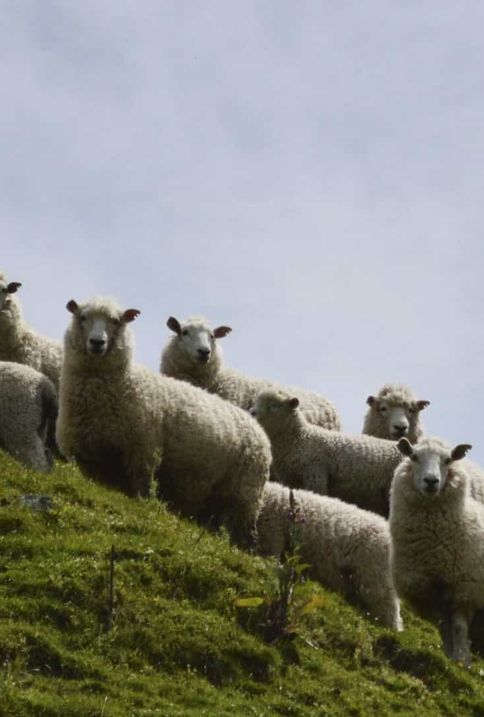
Conclusions
Populations of spoilage bacterial groups were higher in VP lamb meat from BEDM breed than in that of CGB breed
  Because pH was significantly higher in BEDM lamb meat.
A high ultimate pH was demonstrated to increase the rate of microbial deterioration
High moisture and ash content in meat also increased the rate of microbial spoilage
Notes:
Áier
aiiiiiiiiiiiii

Slide 17
Conclusions
A higher intramuscular fat content tended to delay microbial spoilage
In order to extend the shelf-life of Portuguese-origin lamb meat, animal handling and carcass classification can be improved towards the selection of fatter animals and chilled carcasses of optimal ultimate pH
Notes:
dilei

Slide 18

Acknowledgements
The authors are grateful to EU ERA-NET programme and the Portuguese Foundation for Science and Technology (FCT) for funding the project “EcoLamb–Holistic Production to Reduce the Ecological Footprint of Meat (SusAn/0002/2016). The authors are also grateful to FCT and FEDER under Programme PT2020 for financial support to CIMO (UIDB/00690/2020). Dr. Gonzales-Barron acknowledges the national funding by FCT, P.I., through the Institutional Scientific Employment Programme contract. José M. Lorenzo is member of the Healthy Meat network, funded by CYTED (ref. 119RT0568).

Slide 19
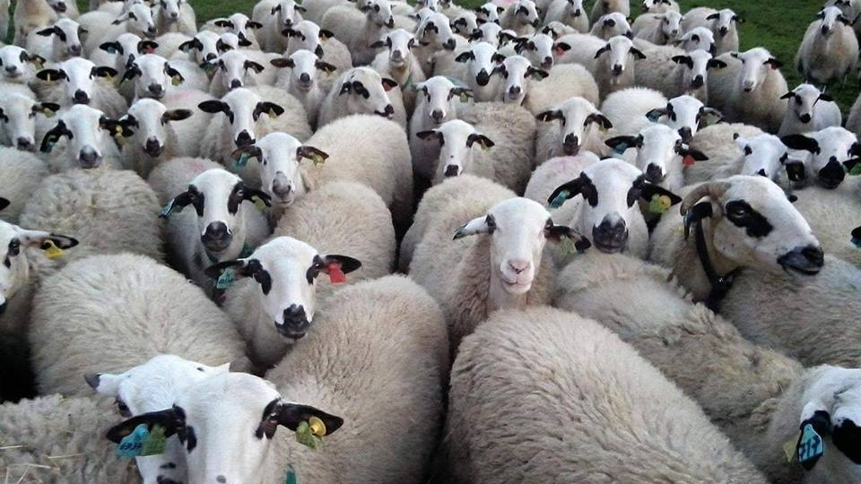
Thanks for your attention!
Notes:
Thank you so much for your attention, and please excuse my english! Hehe

