Slide 1
Multiple SERS detection of phenol derivatives in tap water
A. Carreira-Casais¹,V. Montes-García² , I. Pastoriza-Santos², M. Prieto¹, J. Simal-Gándara¹ J. Pérez-Juste²
¹Nutrition and Bromatology Group, Department of Analytical and Food Chemistry, Faculty of Science, University of Vigo, Vigo, Spain.
²Department of Physical Chemistry, Biomedic Research Center of Galicia (CINBIO) University of Vigo, Vigo, Spain.
jsimal@uvigo.es juste@uvigo.es

Slide 2
INDEX
Introduction
Why phenols are important?
Phenols detection
Why we had employed SERS?
Aim
Results
Conclusion

Slide 3
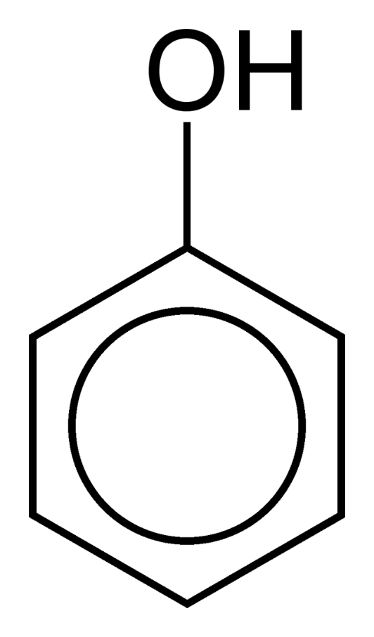
INTRODUCTION
WHY ARE PHENOL DERIVATIVES IMPORTANT FOR US?
a) Some phenol derivatives are employed as pesticides or are metabolites of pollutants.
b) They are produced by oil industry and are widely distributed in soils and water.
c) Many of them are really noxious for human health.

Slide 4
INTRODUCTION

Slide 5
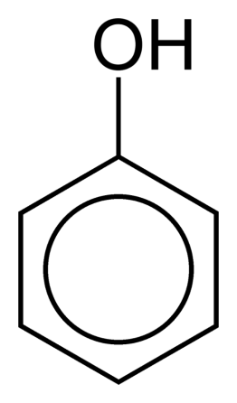
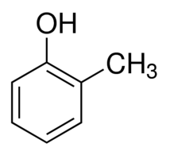
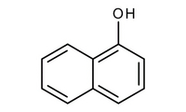
INTRODUCTION
PHENOLS DETECTION
We prove a method to demonstrate that we are able to detect PHENOL, O-CRESOL AND 1-NAPHTHOL in tap water using Surface-enhanced Raman spectroscopy (SERS).

Slide 6
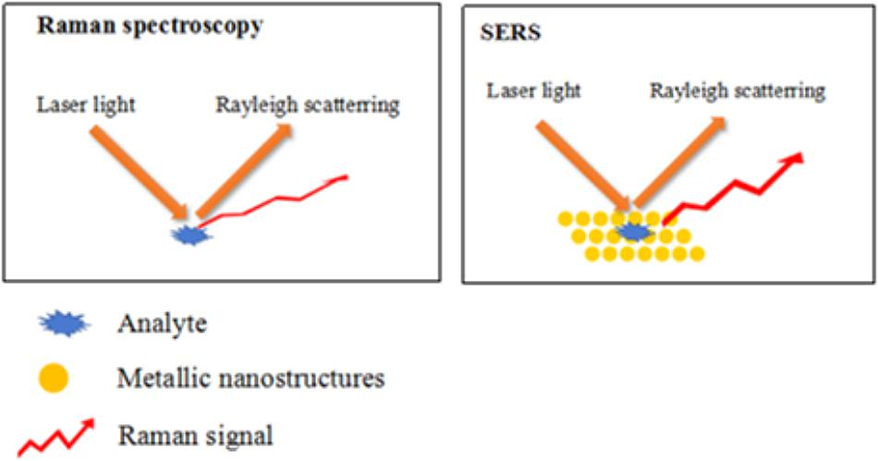
INTRODUCTION
WHY WE HAD EMPLOY SERS?
SERS is a really powerful method that allow us to detect pollutants without a great preparation of the sample.
Zhao et al., Front. Microbiol, 2018

Slide 7
INTRODUCTION
The method is based on the colorimetric reaction between a phenol and the indophenol (Gibbs reactive) to form and indophenolate. Our aim is to determitate phenols simultaneously
UV-VIS
Conditions: t: 2500 s ; Gibss Reagent Concentration (DBQC) 5X10⁻⁵ M
Colorless
Green-colored product

Slide 8
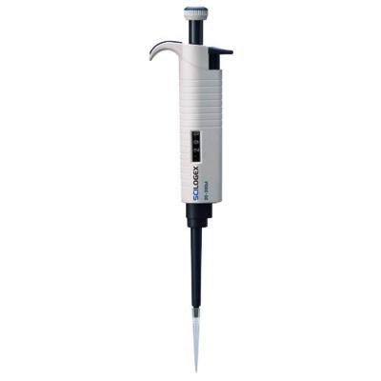
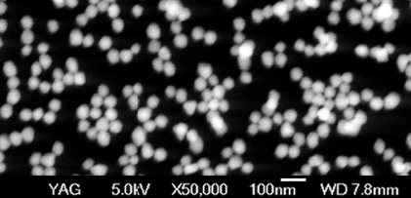
RESULTS Plasmonic Substrates
Plasmonic substrates were made with 60 nm Au@Nps

Slide 9
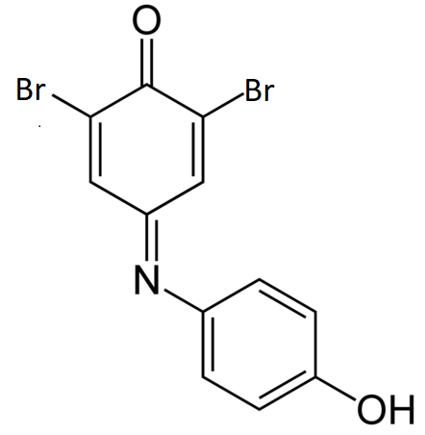
RESULTS Phenol calibration
phenol 5 µM
phenol 1 µM
phenol 0.25 µM
dbqc
Each spectra and point is the average of 16 single spectra
Fitted using a Hill-Langmuir equation y = A1 x (exp) (-x/t1) +y0

Slide 10
RESULTS First Step for Multiplex detection
1-naphthol 5 µM
phenol 5 µM
o-cresol 5 µM
WE COMPARE 3 SAMPLES AT THE SAME CONCENTRATION

Slide 11
RESULTS First Step for Multiplex detection
o-cresol 5 µM
1-naphthol 5 µM
phenol 5 µM
WE COMPARE 3 SAMPLES AT THE SAME CONCENTRATION

Slide 12
RESULTS Semiquantitative detection
1-naphthol/o-cresol Binary Mixture
and
Binary Mixture 1:1 5 µM
o-cresol 5 µM
1-naphthol 5 µM
Semi-quantitative detection performed as Zou, S. et al., Sci. Rep. 2017, 7.

Slide 13
RESULTS Semiquantitative detection
1-naphthol/o-cresol Binary Mixture
and
Semi-quantitative detection performed as Zou, S. et al., Sci. Rep. 2017, 7.

Slide 14
RESULTS Semiquantitative detection
phenol / 1-naphthol Binary Mixture
and
Binary mixture 1:1 5 µM
1-naphthol 5 µM
phenol 5 µM

Slide 15
RESULTS Semiquantitative detection
phenol / 1-naphthol Binary Mixture
and

Slide 16
RESULTS Semiquantitative detection
phenol/ o-cresol Binary Mixture
Binary mixture 1:1 5 µM
and
o-cresol 5 µm
phenol 5 µM

Slide 17
RESULTS Semiquantitative detection
phenol/ o-cresol Binary Mixture
and

Slide 18
CONCLUSIONS
1) This method allow to quantify the amount of this 3 phenol derivatives, and to differenciate between them.
2) This method allow to perform a semi-quantitative determination of binary mixtures.
3) We purpose that this experiment could be a new step in the rapid-screening of contamination in water.
On going work:
-Semiquantitative detection of ternary mixtures.

Slide 19
ACKNOWLEDGEMENTS
Anxo Carreira-Casais thanks the Ministerio de CIencia, Innovación y Universidades for his FPU 16/06135 fellowship.

