Slide 1
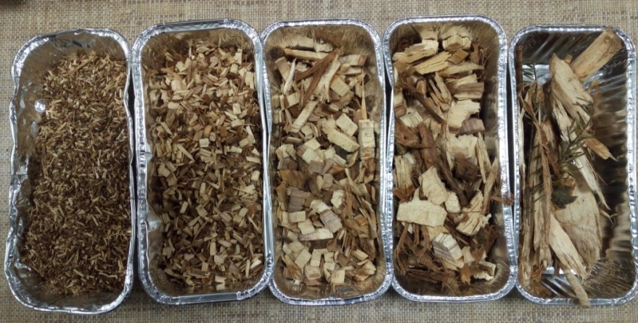
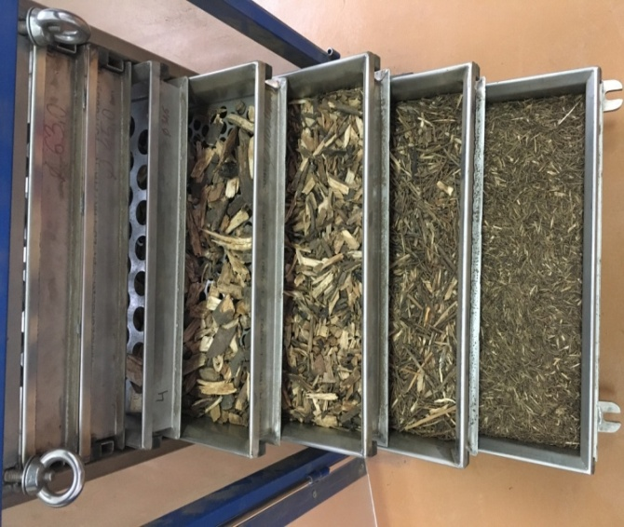
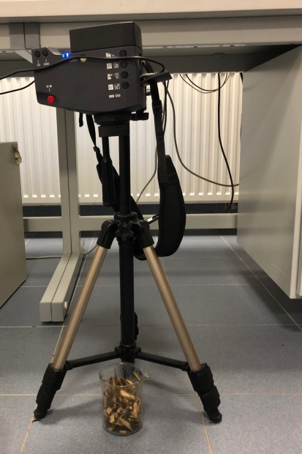
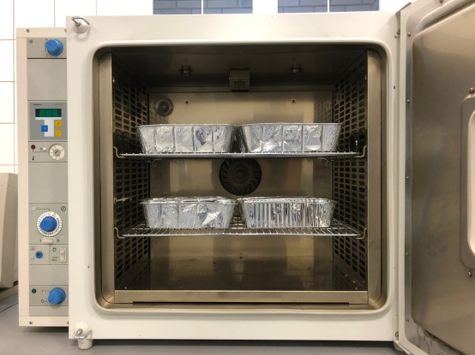
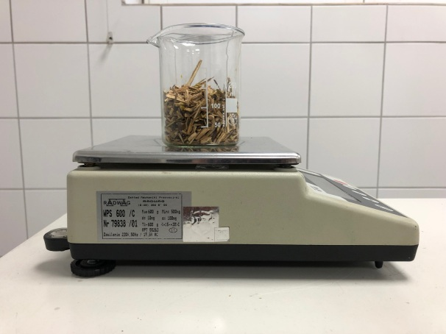
The 1st International Electronic Conference on Forests
Forests for a Better Future: Sustainability, Innovation, Interdisciplinarity
15-30 November 2020
Effects of microwave drying on moisture content depending on wood chip size distribution
Monika Aniszewska^{1,*}, Arkadiusz Gendek¹, Jan Malaťák², Barbora Tamelová², Sebastian Smyl¹
¹Department of Biosystems Engineering, Institute of Mechanical Engineering, Warsaw University of Life Sciences – SGGW, Nowoursynowska 164, 02-787 Warsaw, Poland
²Faculty of Engineering, Czech University of Life Sciences Prague, Kamycka 129, 165 21 Prague 6, Czech Republic
Introduction
In its guidelines on renewable energy sources, the European Union makes it obligatory to implement sustainable biomass management. Biomass is the only renewable energy resource that can be utilized in three ways: via combustion, pyrolysis, and gasification. Woody biomass can be converted into wood chips, which constitute an excellent fuel for furnaces and boilers. However, their utilization for energy purposes can be hindered by their moisture content, which mostly depends on the harvest period and storage conditions. The moisture content of fresh biomass may exceed 100% [1], practically preventing combustion. Currently, the most widespread biomass drying technologies include rotary, conveying, fluidized bed, and pneumatic dryers, while microwave drying has been less popular [2, 3].
The objective of the study was to determine the drying effects of microwave radiation on wood chips. Investigations encompassed the characterization of wood chips including size distribution, as well as the determination of their initial moisture content, surface temperature during microwave irradiation, and final moisture content.
Forest wood chips
Materials and Methods
The study involved wood chips produced from scots pine, silver birch, and shiny cotoneaster using a Vermeer BC150 chipper coupled to a farm tractor. The obtained chips were then separated into size fractions using a Łukomet separator (Łukomet, Całowno, Poland) [4].
The wood chips were separated into size fractions using screens with 3.15 mm, 8 mm, 16 mm, 31.5 mm, 45 mm, and 63 mm round openings consistent with the standards PN-ISO 565:2000 and PN-ISO 3310-2:2013 (the bottom fraction was also used). Five 10 L batches of wood chips were separated for each species over 120 s with an accuracy of 1 s. Individual fractions were weighed on a RADWAG WPS 600/C balance. The 16 mm, 8 mm, 3.15 mm, and bottom fractions were exposed to 800 W microwave radiation for 30 s, 60 s, and 90 s in a SHARP R-200 oven. After each irradiation, the wood chips were weighed, and at the end of the experiment they were placed in a Heraeus UT 6120 circulating air oven and dried at 105°C for 24 h to determine dry weight. The recorded weights of wood chips were used to calculate their moisture content. Selected samples were photographed using a VIGOcam v50 thermographic camera to determine their temperature (±0.1°C) during exposure to microwaves. The resulting images were processed with VIGO System Thermal software.
Łukomet separator
RADWAG WPS 600/C balance
VIGOcam v50 thermographic camera
Heraeus UT 6120 circulating air oven
Results
The percentage share of the >63 mm fraction was the lowest for all species (from 0.2% to 1.3%), while the fractions with the highest shares were 16–31.5 mm for pine chips (45.7%),
8–16 mm for birch chips (51.1%), and 3.15–8 mm for cotoneaster chips (52.4%). The mean initial moisture content of was 70.8% for pine chips, 37.3% for birch chips, and 39.7% for cotoneaster chips.
Following the microwave irradiation of 8–16 mm and 3.15–8 mm fractions for 30 s no significant differences in moisture content were found between pine and birch chips, while cotoneaster chips did differ significantly from the other two species. The 3.15 mm and bottom fractions revealed lower moisture content as compared to the 16 mm fraction. A 60 s exposure of 16 mm, 8 mm, and 3.15 mm fractions did not lead to any significant differences in moisture content between the studied species. The greatest loss of moisture was obtained for 90 s exposure of 3.15–8 mm and bottom fractions of pine chips. The >16 mm fractions were heated up to approx. 90°C after 30 s of exposure and to approx. 120°C after 60 s, with the corresponding average values for the finer fractions being 70°C and 80°C. Finally, the bottom fraction of pine chips (<3.15 mm) heated up to over 130°C
Conclusions
The overall percentage share of wood chip fractions from screens no. 1–4 ranged from 79% (pine) to 99% (cotoneaster) of total wood chips by weight. The study indicates that due to the selective nature of the process, the duration of microwave irradiation should be adjusted taking into account the size fraction of wood chips, with some fractions heating up to over 100°C. Importantly, the finer fractions lose moisture more slowly. A comparison of images recorded with a thermographic camera showed that temperature differences within individual samples decreased with increasing sample homogeneity.
References
1. Picchio R, Spina R, Sirna A, Monaco AL, Civitarese V, Giudice AD, Suardi A, Pari L (2012) Characterization of Woodchips for Energy from Forestry and Agroforestry Production. Energies 5:3803–3816 . https://doi.org/10.3390/en5103803 2. Li X, Zhang B, Li W, Li Y (2005) Research on the effect of microwave pretreatment on moisture diffusion coefficient of wood. Wood Sci Technol 39:521–528. https://doi.org/10.1007/s00226-005-0007-z 3. He X, Xiong X, Xie J, Li Y, Wei Y, Quan P, Mou Q, Li X (2017) Effect of Microwave Pretreatment on Permeability and Drying Properties of Wood. BioResources 12:3850-3863–3863 . https://doi.org/10.15376/biores.12.2.3850-3863
4. Lisowski A, Sar Ł, Świątek K, Kostyra K (2008) Sieve separator to analysis of chaff length distribution. Technika Rolnicza Ogrodnicza Leśna 2:17–19

