Slide 1
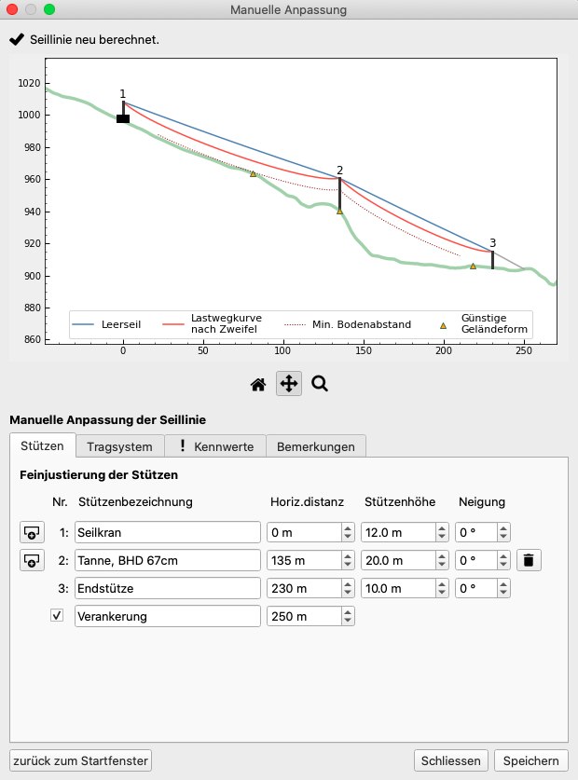
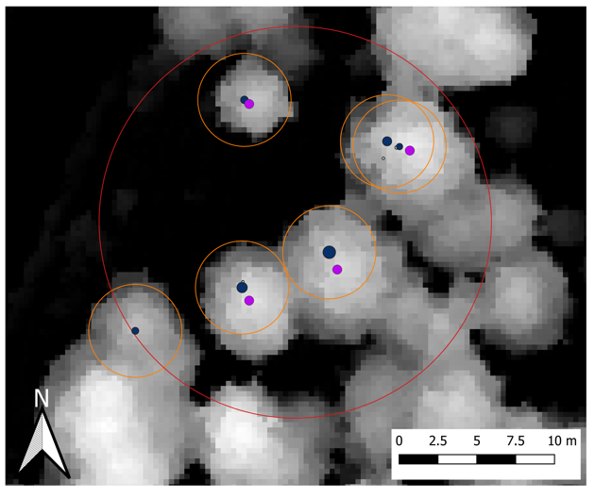
A QGIS based workflow for optimized cable road layout planning
L. Bont, L. Ramstein, F. Frutig, P. Moll, H. Heinimann and J. Schweier Swiss Federal Institute for Forest, Snow and Landscape Research / ETH Zurich Contact: leo.bont@wsl.ch 1st International Electronic Conference on Forests, 15–30 November 2020
WHFF-CH
Context: Cable logging is the principal wood extraction method in steep terrain.
Planning of a cable road is a complex task
Available planning tools do not fulfil the requirements of the practice (unprecise or unknown method to compute skyline properties / not integrated in a GIS / do not optimize the solution)
Solution may not be feasible as not matched with existing trees (for supports)
Aim: User friendly QGIS plugin, containing an optimization algorithm based on catenary and detecting support trees
Results: Workflow in QGIS
Geodata (DEM, Start & Endpoint)
#1 Layout Optimization
Optimized theoretical solution
?
Feasible solution
Mechanical Properties Cable Road
#2 Support trees
#3 Manual editing
Download available on github:
piMoll/SEILAPLAN
#1 Optimize cable road layout
#2 Identifying support and anchor trees from remote sensing data
Objective: Predicting Tree Height and DBH from available Remote Sensing data
72 method combinations were evaluated (3 Types of CHM x 8 Filter Methods x 3 Tree detection algorithms)
Best results were achieved based on ALS Data - resolution dependent Gauss Filter - local maxima tree detection algorithm
Tree position and tree height of the correctly detected trees show useful accuracies for cable line planning.
Objective: Minimize number and height of intermediate supports
[I]
Constraints:
[I] Stresses & strains within limits
[II] Min. clearance
[III] Min. gradient
Load Path
Standing Skyline [Catenary]
[II]
[III]
Decisions:
Locate Intermediate Supports
Location?
Height?
α
[Bont and Heinimann 2012]
#3 Manual
Editing
Fig.: Result of a single tree detection
Inventory
Canopy
Height Model
Detected
Conclusions & Outlook: Workflow simplifies Cable Road planning and calculates more efficient solutions
Master version available
Ability for manual editing remains necessary

